Slide 1
Preparing for QCIA verification
211039
Queensland Certificate of Individual Achievement

Slide 2
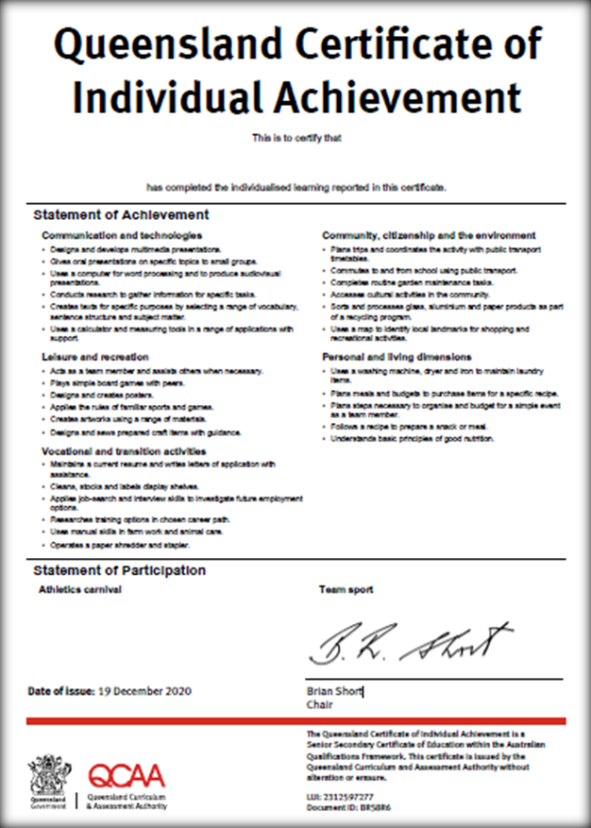
Sample of the Statements of Achievement
Maximum of 6 Statements of Achievement per Achievement Category
Schools record a student’s highest achievements when working towards their learning goals.

Slide 3
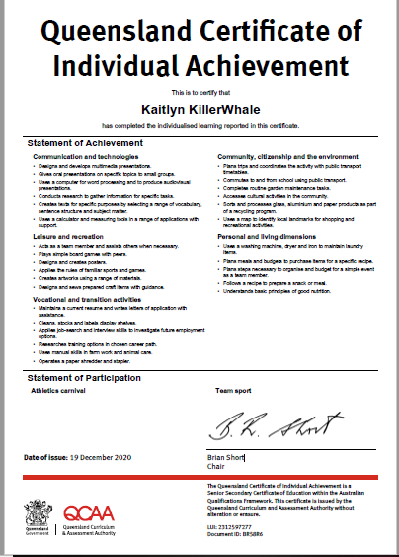
Sample of the Statements of Participation
Maximum of 8 may be recorded

Slide 4
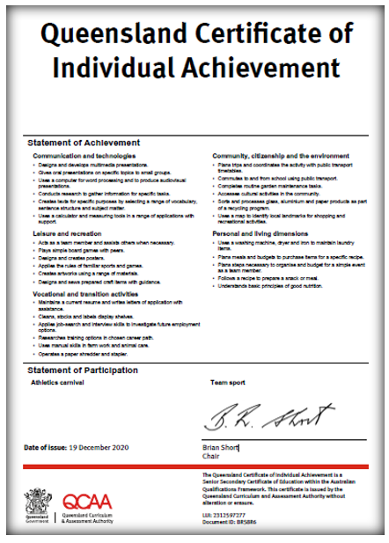
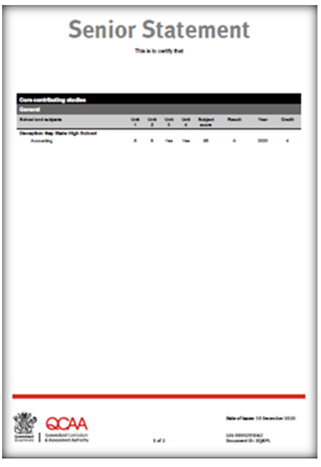
Senior Education Profile (SEP)
No duplication between the QCIA and the Senior Statement
(QCE-contributing studies)

Slide 5
Student Management application and the QCIA processes
Schools now use the Student Management application to record the QCIA draft certificates
(QCE and QCIA policy and procedure handbook, Section 3.3.2)

Slide 6
Accessing Student Management — QCIA roles
New role QCIA coordinator
See your Access Management Organisation Administrator (the person who allocates roles in the QCAA portal)

Slide 7
Statements in the Student Management application
To record Statements of Achievement:
select a pre-populated statement matched to student achievement or
add free-form statements matched to student achievement.
To enter Statements of Participation:
choose activities from the provided list only (free-form statements cannot be entered).

Slide 8
Statements of Achievement and Statements of Participation
QCAA-generated Statements of Achievement and Statements of Participation are incorporated in the Student Management application and are available on the QCAA website.
They are directly aligned to the GIL learning goals.
An autocomplete feature has been included in the Student Management application; this means that available statements will begin to appear in the statements field when you begin to record.

Slide 9
Free-form Statements of Achievement
In the Student Management application, ‘Add written statement’ is the free-form text field that can be used for specific statements that report the learning achievements of students on individualised learning programs.
Free-form statements must follow the guidelines and writing conventions for statements in the QCE and QCIA policy and procedures handbook.
(QCE and QCIA policy and procedure handbook, Section 3.3.4)

Slide 10
Accessing the Student Management application
New role QCIA coordinator

Slide 11
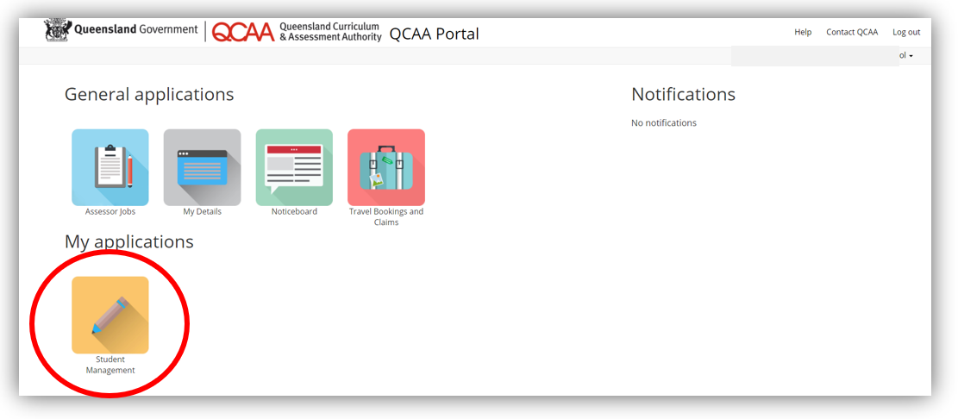
Demonstration — recording Statements of Achievement
1. To record the draft certificate, users log into the QCAA portal and access the Student Management tile.

Slide 12
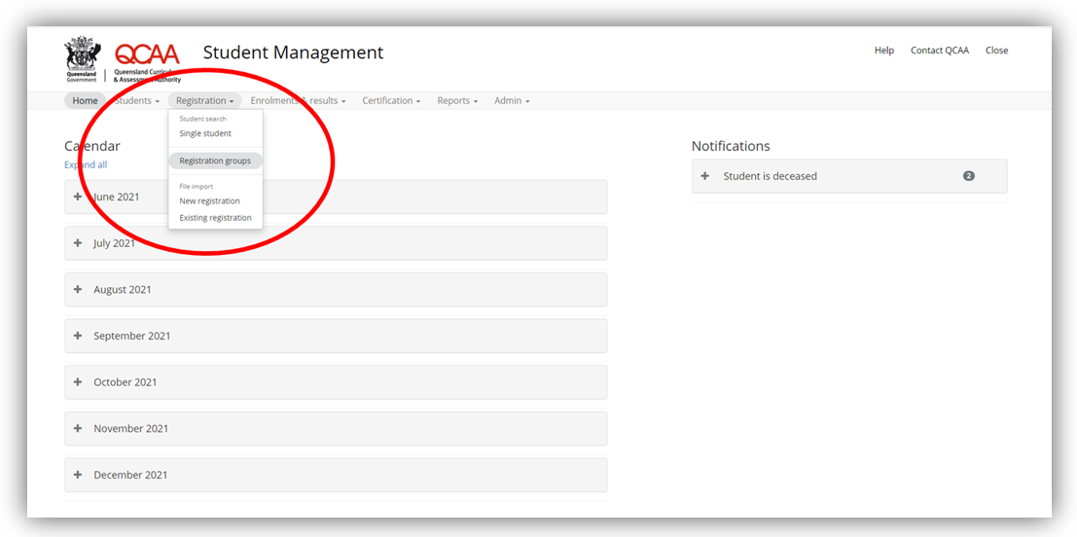
Demonstration — recording Statements of Achievement
2. Select the tab ‘Registration’ and then select ‘Registration groups’.

Slide 13
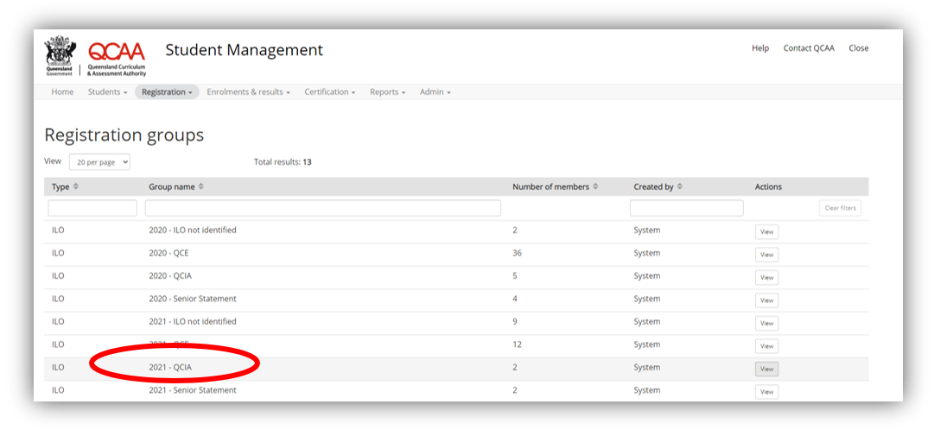
Demonstration — recording Statements of Achievement
3. Locate the correct registration group from your school’s list of registration groups e.g. ‘2021 – QCIA’.
Select the group by clicking on ‘view’ to view your school’s QCIA cohort.

Slide 14
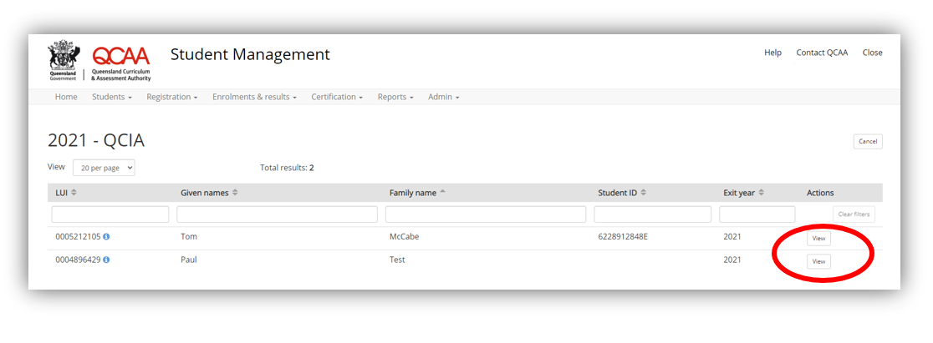
Demonstration — recording Statements of Achievement
4. To begin reporting, select a student and click ‘view’. This opens the school’s view of the student’s learning account.
Notes:
This list should match the list of students entered into the upload link.
Schools develop and upload one QCIA summary screen for each student in this list.
Sample
8912848622E

Slide 15
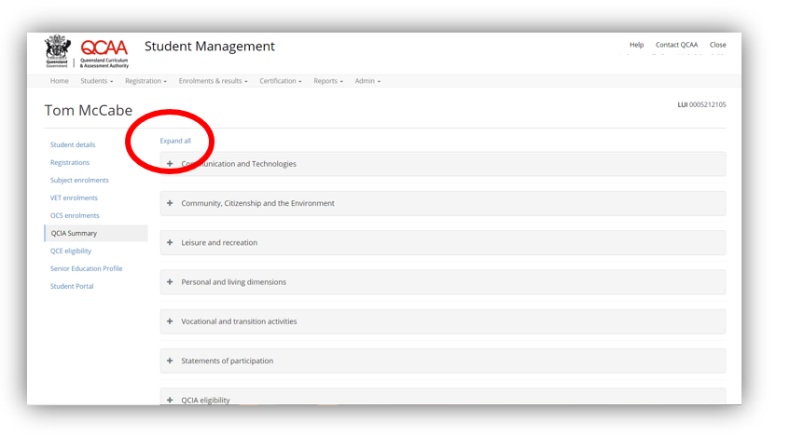
Demonstration — recording Statements of Achievement
Student name
5. Check the student’s details and registration — using the tabs in the menu on the left-hand side of the screen.

Slide 16
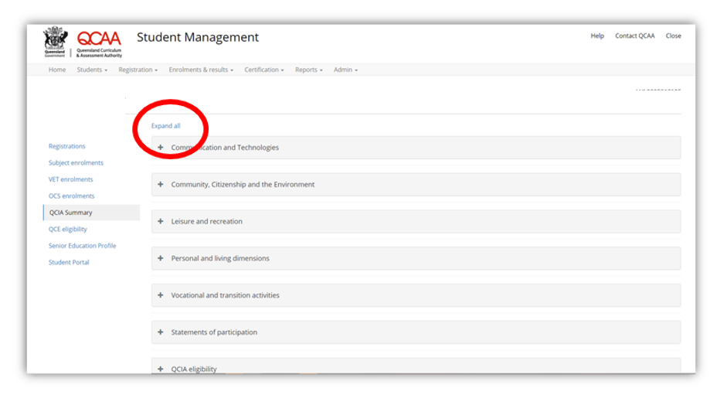
Demonstration — recording Statements of Achievement
6. Locate the ‘QCIA summary tab’ — this is where you will record the student’s draft certificate. Click on the tab to open and click on ‘expand all’ to open all of the achievement categories
7. Click ‘expand all’ to open all accordioned files.

Slide 17
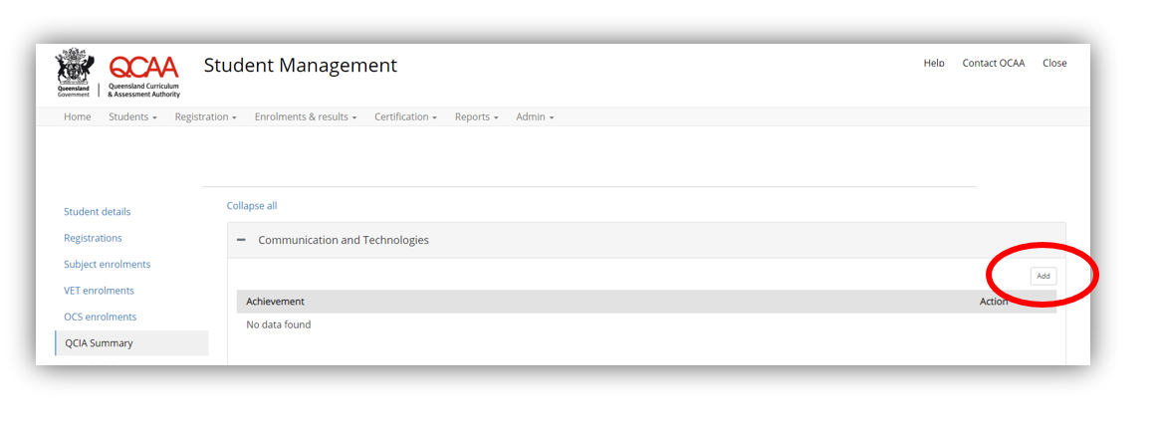
Demonstration — recording Statements of Achievement
8. To record using the preformulated Statements of Achievement:
Go to the first Achievement category – ‘Communication and technologies’. Click ‘add’, then begin by typing the verb.

Slide 18
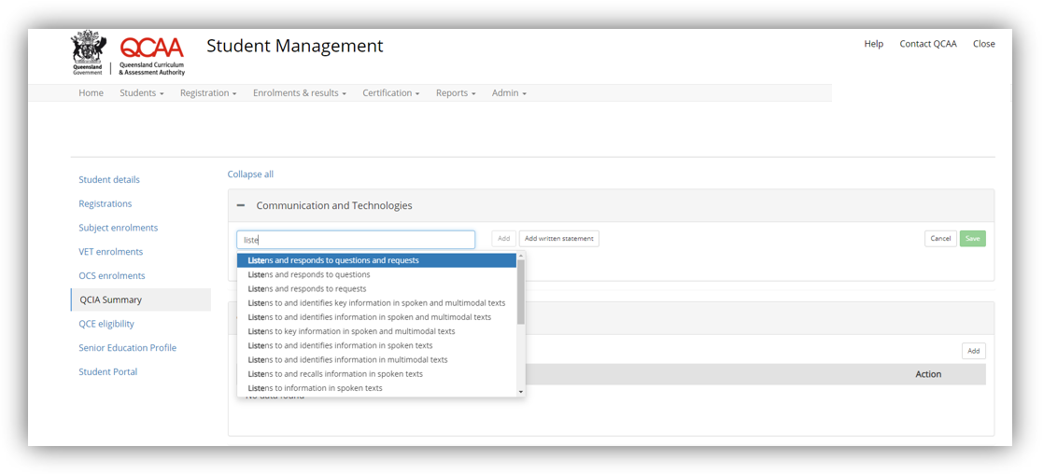
Demonstration — recording Statements of Achievement
9. A text box, equipped with an autocomplete feature, appears.
Choose the appropriate comment by clicking directly on it to populate the text box.

Slide 19
Demonstration — recording Statements of Achievement
10. Click the ‘Add’ button next to the text box to add the statement to the draft certificate.

Slide 20
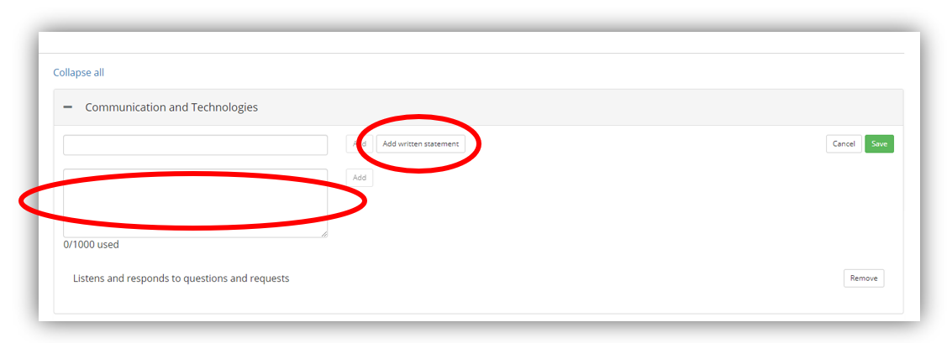
Demonstration — recording Statements of Achievement
Note: Do not add a full stop at the end of the statement.
11. If you choose to use school-developed Statements of Achievement, select ‘Add written statement’ (to the right of the textbox). A new text box appears: begin typing the school-developed statement.
Note: You must follow the QCIA writing conventions; see the QCE and QCIA policy and procedures handbook, section 3.3.4. ‘Writing statements of achievement and participation’.

Slide 21
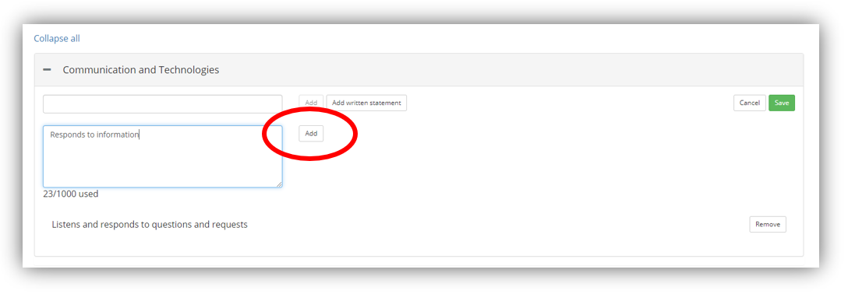
Demonstration — recording Statements of Achievement
Note: Do not add a full stop at the end of the statement.
12. Click the ‘Add’ button next to the text box to add the statement to the draft certificate.

Slide 22
Demonstration — recording Statements of Achievement
13. When you have finished recording the Statements of Achievement for the Achievement category, select ‘save’ to save the recorded statements.
Repeat these steps to record statements in the relevant Achievement categories.

Slide 23
Demonstration — recording Statements of Participation
To record a Statement of Participation
1. Scroll down the ‘QCIA summary’ screen to the ‘Statements of Participation’.
2. Open the accordioned file to record the statements.
3. Select ‘add’ and a text box appears.

Slide 24
Demonstration — recording Statements of Participation
4. Begin typing, and the autocomplete feature will provide a list of statements of participation that match your typed words.
5. Select the appropriate statement from the list and click ‘add’.

Slide 25
Demonstration — recording Statements of Participation
6. Select ‘save’ to ensure the added statements are saved.

Slide 26
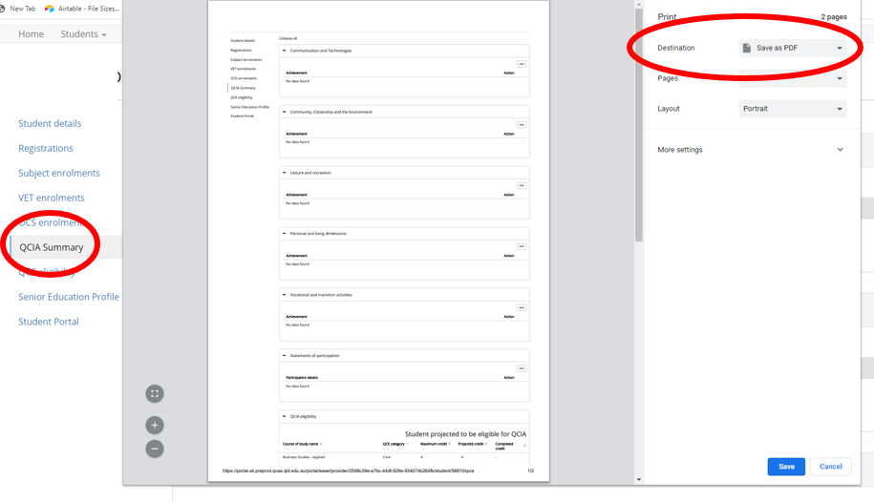
Saving the QCIA Summary screen ( the draft certificate)
Save a PDF copy of the QCIA Summary screen for each student.
1. Ensure all accordioned files are expanded.
2. Right-click on the screen and select ‘print’.
3. Opening the destination options and select ‘save as PDF’.
4. Save using the file-naming conventions outlined in the email.

Slide 27
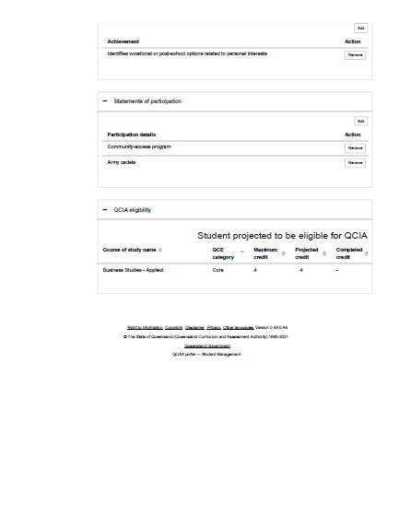
PDF of the QCIA summary screen
The PDF of the QCIA Summary screen will look like this.
Upload this PDF for verification.

Slide 28
How should the folio be organised?
Digital Folio
Folio: one PDF file
Evidence grouped in Achievement categories
Variety of direct and indirect evidence
Evidence of every statement
Video/audio files – MP4

Slide 29
Summary — Schools
To prepare for QCIA verification, schools:
allocate the role of QCIA Coordinator in the Student Management application
read the QCIA verification memo
complete required actions in the verification email
upload the QCIA Summary PDF files (the draft certificates) and folio/s

Slide 30
Summary — QCIA Coordinator
The QCIA coordinator:
records the draft statements in the Student Management application
saves the QCIA Summary screen as a PDF (for upload)
prepares the folio/s for upload.

Slide 31
Supporting QCIA verification resources
QCAA verification memo
QCIA verification email — sent to Principals’ delegates
Preparing for QCIA verification (this document).

Slide 32
QCAA social media

