Slide 1
Your Senior Education Profile

Slide 2
What is your Senior Education Profile?
Your Senior Education Profile (SEP) is a collection of documents sent to you on completion of Year 12.
The contents of your SEP depend on your learning achievements. They may include a:
Senior Statement
Queensland Certificate of Education (QCE)
Queensland Certificate of Individual Achievement (QCIA)
Tertiary Entrance Statement.

Slide 3
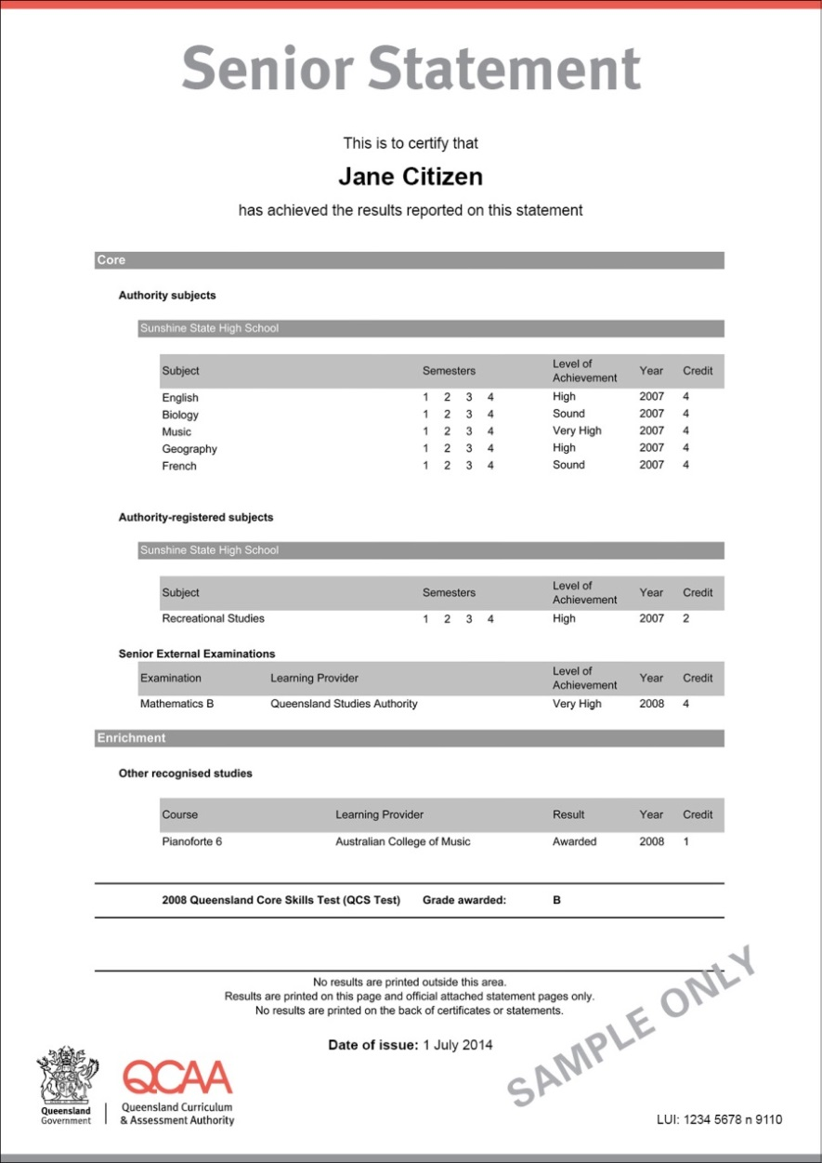
Senior Statement
A transcript of your learning account
Shows subjects/courses you studied and the results you achieved in Years 11 and 12

Slide 4
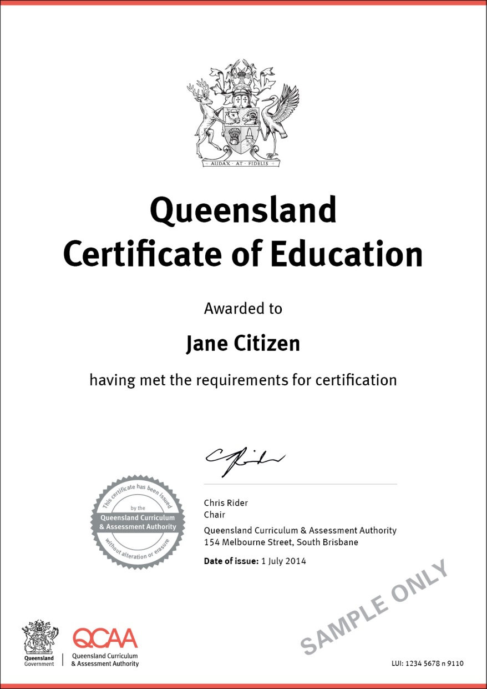
Queensland Certificate of Education (QCE)
Queensland’s senior schooling qualification
Internationally recognised
Awarded when you meet the set requirements
Shows employers and training providers that you have worked consistently and to a high standard over two years
May be required to enrol in further education and training

Slide 5
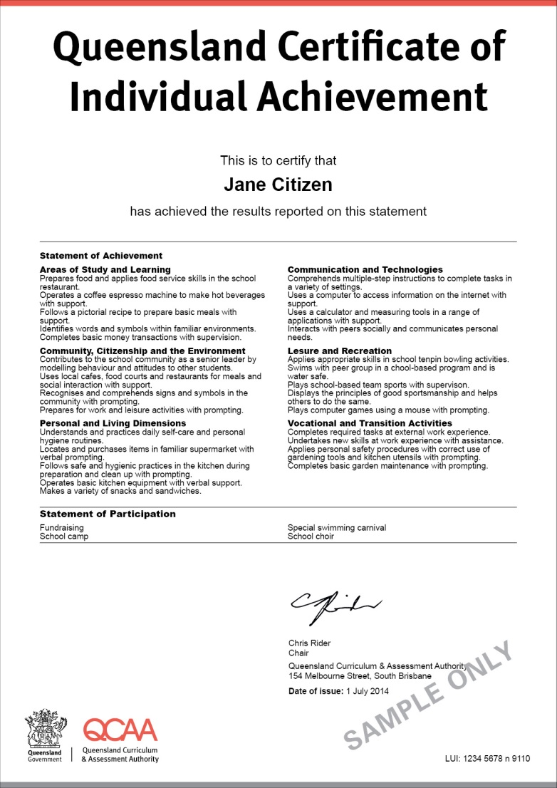
Queensland Certificate of Individual Achievement (QCIA)
Recognises the achievements of students who are on individualised learning programs

Slide 6
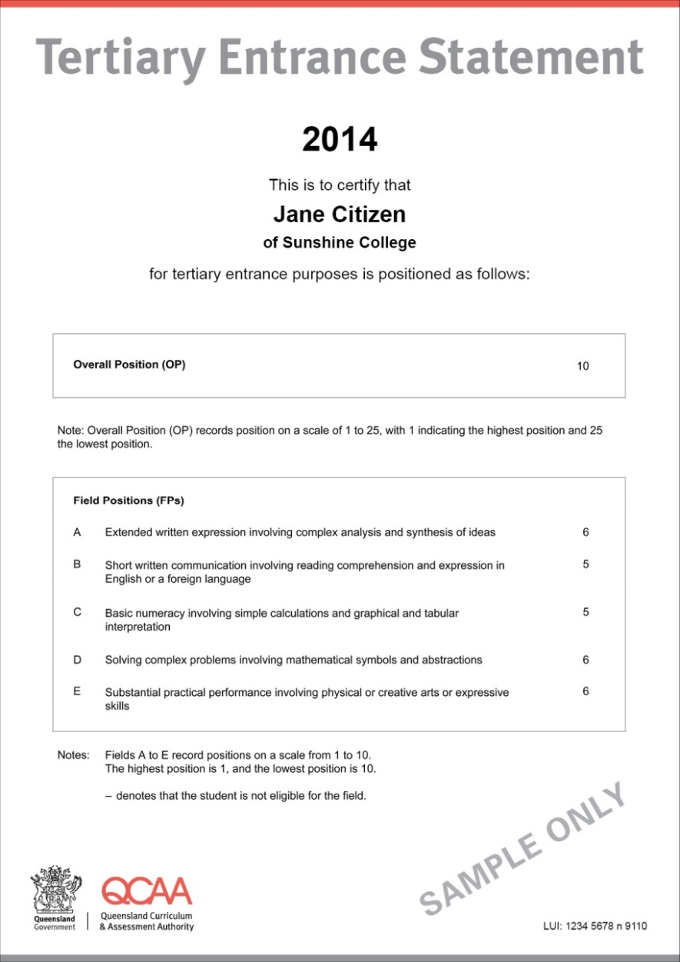
Tertiary Entrance Statement
Only given to students who are eligible for an Overall Position (OP)
Shows a student’s OP and Field Positions (FPs) — rankings used to determine eligibility for admission to tertiary courses
Provides information that is recognised by tertiary providers, e.g. in Queensland, interstate and overseas
May be required to enrol in study at institutions outside Queensland

Slide 7
When will I get a Senior Education Profile?
The Queensland Curriculum and Assessment Authority (QCAA) issues Senior Education Profiles to all eligible students at the end of Year 12 (in December each year).
If you continue to study towards a QCE after completing Year 12, you will receive a Statement of Results along with your QCE when you are eligible to receive a QCE.

Slide 8
Find out more
Student Connect
www.studentconnect.qcaa.qld.edu.au
Queensland Curriculum and Assessment Authority
www.qcaa.qld.edu.au
Talk to your teachers/career guidance officer at your school.

