Slide 1
Senior pathway planning
240258
For Year 10 students
Notes:
Note for schools:
This presentation has been developed by the QCAA for use at Year 10 parent information sessions. It includes speaking notes for all slides and is designed to help students and parents understand senior pathway planning and the requirements for the Queensland Certificate of Education (QCE).
An animated video about pathway planning has been developed to complement this presentation. Schools may wish to embed the video on slide 3 of this presentation, or pause the presentation to play the video separately.

Slide 2
What will be covered
  Planning for Years 11 and 12
  The Queensland Certificate of Education (QCE)
  Subjects and courses
  Tertiary entrance
  Results
  Information and support
Notes:
This presentation provides an overview of senior pathway planning for Year 10 students. It includes information about the Queensland Certificate of Education (QCE), eligible subjects and courses, tertiary entrance, and results.

Slide 3
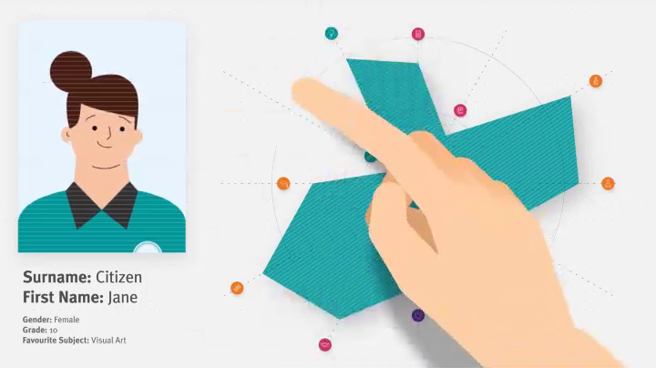
Setting the scene
Lets begin with a short animated video that suggests an approach to pathways planning.
Notes:
This short video animation from the QCAA gives students and parents an overview of senior pathway planning.

Slide 4
Preparing for senior school learning
  Planning for Years 11 and 12 is an important step for students.
  A wide range of learning options is available.
  Schools work with Year 10 students and their families to develop a plan.
Notes:
Deciding what to study in Years 11 and 12 is an important step for students.
Students can choose from a wide range of learning options to suit their interests, abilities and goals.
Planning for senior schooling starts in Year 10. The school will work with students and their families to develop a plan.

Slide 5
Planning a pathway
The plan helps students:
  think about their education, training and career goals
  structure their learning around their abilities, interests and ambitions
  map their pathway to a Queensland Certificate of Education (QCE).
Notes:
The plan will help students consider their goals, tailor their learning to their interests, abilities and ambitions, and map their pathway to a Queensland Certificate of Education.

Slide 6
Things for students to consider
  What are my career goals?
  Which subjects am I good at?
  Which subjects do I like?
  Do I want to continue studying after Year 12?
  Are there prerequisite subjects?
  Are there special entry requirements?
Notes:
There are a lot of things for students to consider. They should think about their career goals, which subjects they’re good at, whether they’d like to go to university, learn a trade, or go straight into the workforce. It also helps to know if there are any prerequisite subjects or courses, or special entry requirements students need to keep in mind.

Slide 7
Putting the plan into action
  The plan is documented.
  The student is registered with the QCAA and their learning account is opened.
  Schools review the plan regularly to monitor progress.
Notes:
Once the plan is documented, students are registered with the Queensland Curriculum and Assessment Authority and a learning account is opened. Students can access their learning account via the Student Portal on the myQCE website. It’s where they can check subject enrolments and results, monitor their progress towards a QCE, view final subject results and download their official statements and certificates once they’re eligible.
Schools monitor the plan throughout Years 11 and 12 and revise if needed.

Slide 8
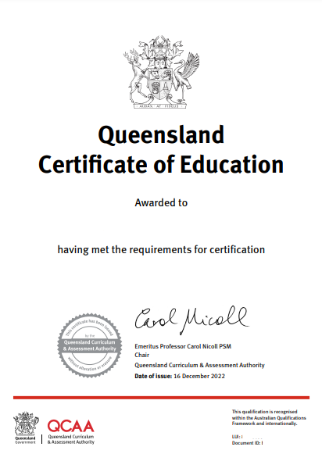
What is the QCE?
The QCE is Queensland’s senior schooling qualification.
  Internationally recognised
  Shows student achievement
  Flexible
  Wide range of learning options
Sample only
Jane Citizen
Notes:
The QCE is Queensland’s senior schooling qualification. It is internationally recognised and a sign of academic and personal success.
The flexibility of the QCE allows students to tailor their learning to suit their individual interests, abilities and ambitions.
A wide range of learning can contribute to a QCE, including QCAA-developed subjects and courses, vocational education and training, and other recognised courses.

Slide 9
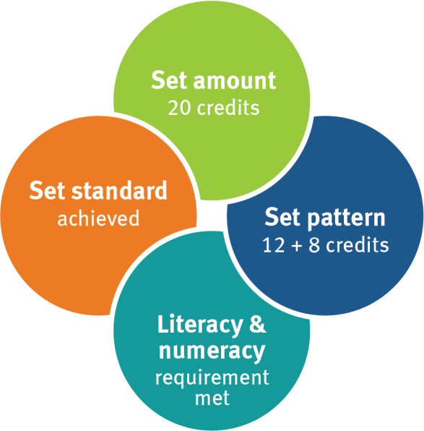
How does the QCE work?
  Set amount: 20 credits
  Set pattern:
  12 credits from completed
  Core courses
  8 credits from Core, Preparatory
  & Complementary courses
  Satisfactory completion
  Literacy & numeracy
Notes:
To be eligible for a QCE, students must achieve a set amount of learning at a set standard, in the set pattern, and meet literacy and numeracy requirements.
A total of 20 credits is required — 12 must come from completed Core courses and the other 8 can come from a mix of Core, Preparatory and Complementary courses. A maximum of 4 credits from Preparatory and 8 credits from Complementary courses can contribute to the QCE.
Most students will achieve their QCE when they complete Year 12, but students can continue to work towards it after they have left school.

Slide 10
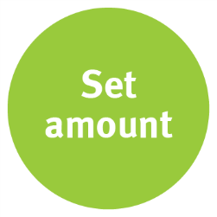
Set amount
20 credits from a range of learning options:
  QCAA courses
    General subjects
    Applied subjects
    Short Courses
    Senior External Examination syllabuses
  Vocational Education and Training (VET) certificates or qualifications
  Other recognised studies
Notes:
Students can choose from a range of learning options and need a total of 20 credits. Learning options include QCAA subjects and courses, vocational education and training, and other recognised studies, such as university subjects studied while at school. Some courses will contribute more credit than others.
The learning options are grouped into three categories — Core, Preparatory and Complementary courses.

Slide 11

Set pattern — Core courses
12 credits from completed Core courses:
Course | Credits per course
QCAA General subjects and Applied subjects | up to 4
QCAA General Extension subjects | up to 2
QCAA General Senior External Examination subjects | 4
Certificate II qualifications | up to 4
Certificate III and IV qualifications (includes traineeships) | up to 8
School-based apprenticeships | up to 6
Recognised studies categorised as Core | credit varies
Notes:
Core courses are the main courses that students do at school. They are quality assured by the QCAA or a recognised authority and are generally available for implementation statewide by schools or registered training organisations.
To be eligible for the QCE, students need 12 credits from completed Core courses.
Courses include QCAA General and Extension subjects, QCAA Applied subjects, vocational education and training (including traineeships and school-based apprenticeships) and selected recognised studies.
QCAA General and Applied subjects are the foundation of the QCE system.
General subjects prepare students for tertiary study, further education, training, and work, and contribute up to four credits to a QCE. Examples include English, General Mathematics, Ancient History, Biology, and Music Extension.
Applied subjects focus on practical skills and prepare students for further education, training and work. They also contribute up to four credits to a QCE. Examples include Essential English, Essential Mathematics, Business Studies, Industrial Technology Skills and Tourism.

Slide 12
Set pattern — Preparatory courses
  Maximum of 4 credits from:
Course | Credits per course
QCAA Short Courses QCAA Short Course in Literacy QCAA Short Course in Numeracy | 1
Certificate I qualifications | up to 3
Recognised studies categorised as Preparatory | credit varies
Notes:
Preparatory courses provide introductory or foundational learning that can be built on through further education and training. They include Certificate I qualifications, QCAA Short Courses and selected recognised studies.
A maximum of four credits from Preparatory courses can contribute to a QCE.

Slide 13
Set pattern — Complementary courses
  Maximum of 8 credits from:
Course | Credits per course
QCAA Short Courses QCAA Short Course in Aboriginal & Torres Strait Islander Languages QCAA Short Course in Career Education | 1
University subjects (while enrolled at a school) | up to 4
Diplomas and Advanced Diplomas (while enrolled at a school) | up to 8
Recognised studies categorised as Complementary | credit varies
Notes:
Complementary courses go beyond traditional senior schooling to enrich learning. Options include two QCAA Short Courses, a number of university subjects that can be completed while at school, Diplomas and Advanced Diplomas, and selected recognised studies.
A maximum of eight credits from Complementary courses can contribute to a QCE.

Slide 14
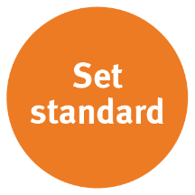
Set standard
QCE credits are accrued when the set
standard for each subject/course has been met.
Depending on the course, that may be:
satisfactory completion
grade of C or better
competency or qualification completion
pass or equivalent.
Notes:
Students earn credit towards their QCE when they complete their subjects or courses to a set standard. Depending on the type of course, the set standard may vary. In some courses it may be a grade, but for other courses, such as VET qualifications, the result may be a pass.

Slide 15

Literacy & numeracy options
QCAA General or Applied English/Mathematics subjects
QCAA Short Course in Literacy/Numeracy
Senior External Examination in a QCAA English/Mathematics subject
International Baccalaureate examination in approved English/Mathematics subjects
Recognised studies listed as meeting literacy/numeracy requirements
Notes:
As well as meeting the set amount and set pattern requirements for the QCE, students must also meet literacy and numeracy requirements. There are several options available to students.

Slide 16
QCE pathways
  The QCE is flexible.
  There is no single pathway — hundreds of course combinations can lead to a QCE.
  A student’s pathway will depend on the subjects and courses the school offers and their individual goals.
  Typically, students will study six subjects/courses across Years 11 and 12.
Notes:
It’s important to remember there are multiple pathways to a QCE. Most students will study six subjects or courses across Years 11 and 12, but what they choose to study will depend on their individual goals and what the school offers.
There are hundreds of possible course combinations that can lead to a QCE. Let’s look at some examples.

Slide 17
Example pathway
Example 1
A student enrols in six General subjects (Core category) over four semesters.
English
Mathematical Methods
Psychology
Geography
Philosophy & Reason
Dance
Notes:
In this example, a student chooses six QCAA General subjects. They are all from the Core category and completed over Years 11 and 12 to the set standard. The literacy requirement is met through the English subject and the numeracy requirement through Mathematical Methods. The student will receive four credits for each subject (a total of 24 credits) and will be eligible for a QCE at the end of Year 12.

Slide 18
Example pathway
Example 2
A student enrols in six Applied subjects (Core category) over four semesters and a Short Course (Preparatory category) for one semester.
Essential English
Business Studies
Religion & Ethics
Arts in Practice
Information & Communication Technology
Agricultural Practices
Short Course in Numeracy
Notes:
This student chooses six QCAA Applied subjects (from the Core category) and they are completed over Years 11 and 12 to a set standard. The student meets the literacy requirement through Essential English and also completes a Short Course in Numeracy (from the Preparatory category) for one semester. The student will receive four credits for each Applied subject and one for the Short Course (a total of 25 credits) and will be eligible for a QCE.

Slide 19
Example pathway
Example 3
A student enrols in a combination of General and Applied subjects (Core and Preparatory categories) and completes learning as part of a school-based apprenticeship in Carpentry.
Essential English
General Mathematics
Certificate I in Engineering
Science in Practice
Certificate III in Carpentry, 30% of certificate completed 50 days/year on-the-job (100 total)
Notes:
This student chooses a combination of QCAA General and Applied subjects (from the Core category). They also complete a Certificate I VET qualification (from the Preparatory category) and complete 30% of a Certificate III qualification as part of a school-based apprenticeship. They achieve the set standard in all completed courses, and met the literacy and numeracy requirements through Essential English and General Mathematics. They receive a total of 20 credits and are eligible for a QCE.

Slide 20
Tertiary entrance
  The ATAR is used nationally to measure a student’s position relative to other ATAR-eligible students.
  The Queensland Tertiary Admissions Centre (QTAC) calculates and issue ATARs.
Notes:
Tertiary entrance is a key consideration for many students.
The Australian Tertiary Admission Rank (ATAR) is used to measure a student’s position relative to others.
QTAC calculates and issues ATARs for Queensland students.

Slide 21
ATAR eligibility
To be eligible for an ATAR, students must successfully complete:
  5 General subjects, or
  4 General subjects + 1 Applied subject or completed VET qualification at Certificate III or above.
Students must also successfully complete an English subject.
Notes:
To be eligible for an ATAR, students need to successfully complete five QCAA General subjects, or four QCAA General subjects plus one QCAA Applied subject, or a VET qualification at Certificate III or higher.
Students must also complete an English subject, with a minimum C grade or higher, to be eligible for an ATAR. The result in English will only be included in the ATAR calculation if it’s one of the student’s best five scaled results.
Queensland ATARs are based on a student’s best five General subject results, or best results in four General subjects plus one Applied subject, or best results in four General subjects and their VET qualification.

Slide 22
Assessment — QCAA subjects/courses
QCAA General subjects:
  three internal assessments (set/marked by schools)
  one external assessment (set/marked by the QCAA and held at the same time in schools across Queensland)
Most external assessment will contribute 25% to the final subject result. In Mathematics and Science subjects, it will contribute 50%.
Notes:
The way students are assessed will depend on their subjects and courses.
In QCAA General subjects, a student’s final subject result is based on three internal assessments and one external assessment. Internal assessments are set by schools. Before these assessments are used in the classroom, the QCAA checks they meet syllabus requirements. Teachers then mark the internal assessments, and the QCAA collects samples of student responses to check for accuracy and consistency with the marking guides.
Students also sit an external assessment for General subjects. These external assessments are set and marked by the QCAA and will be held at the same time in schools across Queensland.
In most subjects, the external assessment will count for 25% of the results for each subject. For Mathematics and Science subjects, the external assessment will count for 50%.

Slide 23
Assessment — QCAA subjects/courses
QCAA Applied subjects:
  four internal assessments (set/marked by schools)
  Essential English and Essential Mathematics — one of the four is a common internal assessment (set by the QCAA and marked by schools)
QCAA Short Courses:
  two internal assessments (set/marked by schools)
Notes:
In QCAA Applied subjects, students will have four internal assessments that are set and marked by schools. They are not reviewed by the QCAA, but they do go through an annual process where student responses are checked against marking guides.
For Essential English and Essential Mathematics, one of the four internal assessments is set by the QCAA and marked by schools.

Slide 24
Assessment — VET and other courses
VET assessment may include
  observation
  written assessment
  work samples
  questioning.
Assessment for other courses will vary depending on the course.
Notes:
Assessment in VET and other courses will vary depending on the course. Some courses may require written assessment, while others will be in the form of practical work samples.

Slide 25
Results and reporting
Final results are released at the end of Year 12 via student learning accounts in the Student Portal on the myQCE website.
All students receive a senior statement.
Eligible students receive a QCE.
Students can keep working towards their QCE after Year 12.
Notes:
At the end of Year 12, students can access their final subject results via the learning account in the Student Portal on the myQCE website.
All students who complete Year 12 will receive a senior statement. It will show all the subjects and courses in a student’s learning account and the results achieved.
Eligible students will also receive a QCE. If a student isn’t eligible by the end of Year 12, they can keep working towards their QCE.

Slide 26
More information
myQCE website: myqce.qcaa.qld.edu.au
myQCE Instagram: www.instagram.com/myqce
QCAA website: www.qcaa.qld.edu.au
QTAC website: www.qtac.edu.au
Notes:
The myQCE website is a great starting point for further information about senior pathways. It has lots of information and resources about subjects and courses, further study, training and career options.
Students can also follow myQCE on Instagram to stay up to date with the latest news about senior studies, careers, key dates and more.
For parents, the QCAA website features a dedicated section with information about education in Queensland, including frequently asked questions.
The QTAC website is the best source of information about ATAR eligibility.

Slide 27
QCAA social media

