Slide 1
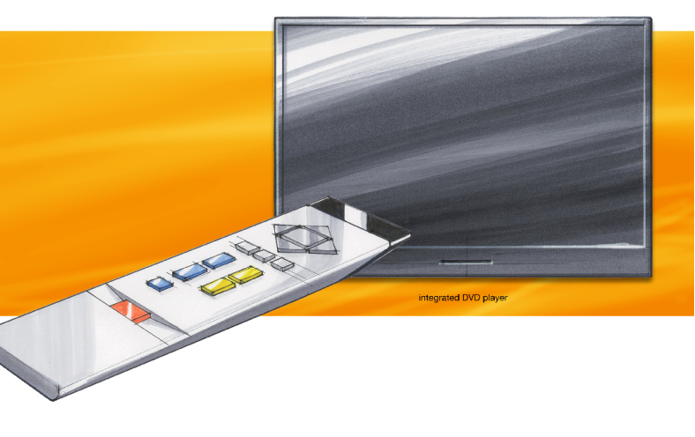
Design proposal
Easy TV
Integrated = Innovative
Timeless = Sustainable
Form = Aesthetic

Slide 2
Easy TV
Simplified controls = Accessible
Easy to use = Useful

Slide 3
Easy TV
Limitations
Implications
Suits older people
Elegant yet simple
Easy to use and
understand
Thank you

