Slide 1
Music Extension — Performance 2026 v1.3
IA1 high-level annotated sample response
January 2026
Performance 2 (20%)
This sample has been compiled by the QCAA to assist and support teachers to match evidence in student responses to the characteristics described in the instrument-specific marking guide (ISMG).
Assessment objectives
This assessment instrument is used to determine student achievement in the following objectives:
Analyse the choices made in the performance.
Apply literacy skills, using music terminology relevant to genre/style and language conventions to communicate ideas about the choices made in the performance.
Evaluate the choices made in the performance to communicate the intent.
Apply technical skills for the chosen instrument or sound source.
Interpret music elements and concepts of the chosen genre/style.
Realise music ideas to communicate meaning.
260167

Slide 2
Instrument-specific marking guide (ISMG)
Applying technique | Marks
The student response has the following characteristics:
application of technical skills is – refined and synthesised – sustained without interruption to create a polished performance | 6–7
application of technical skills – is specific to the chosen genre/style – displays control | 4–5
application of technical skills – for the chosen instrument or sound source – throughout the performance | 2–3
demonstration of some technical skills. | 1
The student response does not match any of the descriptors above. | 0

Slide 3
Interpreting music elements and concepts | Marks
The student response has the following characteristics:
interpretation of music elements and concepts shows – sensitivity towards the genre/style – sustained and perceptive use of stylistic nuances | 4–5
interpretation of music elements and concepts makes the genre/style explicit | 3
interpretation of music elements and concepts of the chosen genre/style | 2
interpretation of some music elements and concepts. | 1
The student response does not match any of the descriptors above. | 0

Slide 4
Realising music ideas | Marks
The student response has the following characteristics:
realisation of music ideas reveals subtleties of meaning through the perceptive synthesis of expressive devices | 5
realisation of music ideas consolidates meaning through the sustained use of expressive devices | 4
realisation of music ideas supports meaning through a selection of expressive devices | 3
realisation of music ideas to communicate meaning | 2
presentation of music ideas relevant to the performance of repertoire. | 1
The student response does not match any of the descriptors above. | 0

Slide 5
Statement of intent | Marks
The student response has the following characteristics:
analysis of the choices made in the performance is detailed and specific application of literacy skills through sequenced and connected ideas evaluation shows insightful judgments about the choices made in the performance | 3
analysis of the choices made in the performance application of literacy skills using music terminology relevant to genre/style and language conventions to communicate meaning about the choices made in the performance evaluation of the choices made in the performance to communicate the intent | 2
explains the choices made in the performance application of literacy skills that communicate ideas about choices made in the performance statements about the choices in the performance. | 1
The student response does not match any of the descriptors above. | 0

Slide 6
Task
Present a performance, using an instrument or sound source, in a style or genre of your choice. Complete a statement of intent that analyses and evaluates the choices made in the performance to communicate the intent. Your performance will be audiovisually recorded to substantiate teacher judgments.

Slide 7
Sample response
Criterion | Marks allocated | Provisional marks
Applying technique | 7 | 7
Interpreting music elements and concepts | 5 | 5
Realising music ideas | 5 | 5
Statement of intent | 3 | 3
Total | 20 | 20
The annotations show the match to the instrument-specific marking guide (ISMG) performance-level descriptors.

Slide 8
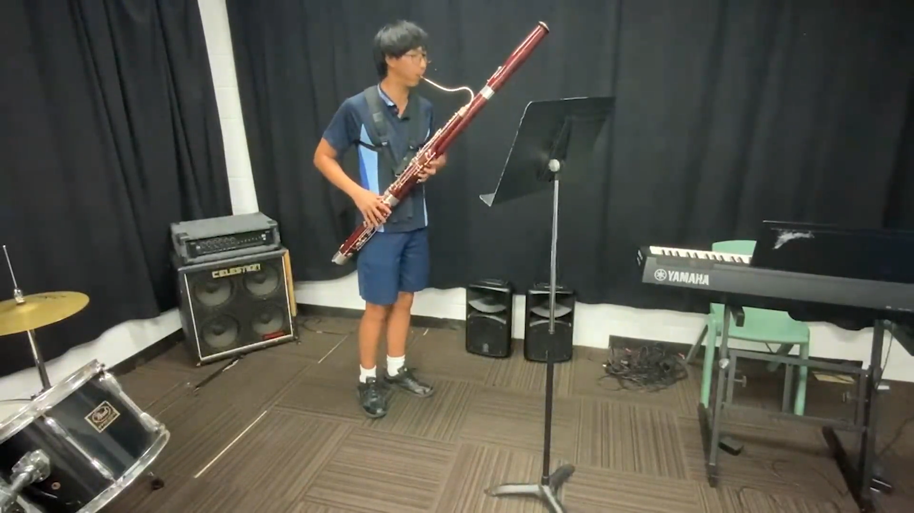
Applying technique [7]
application of technical skills is
– refined and synthesised
– sustained without interruption to create a polished performance
The performance demonstrates refined and synthesised technical skills throughout the work, including breath control, tone and intonation. Consistency and clarity are evident in both staccato and legato passages, creating a polished performance.
Interpreting music elements and concepts [5]
interpretation of music elements and concepts shows
– sensitivity towards the genre/style
– sustained and perceptive use of stylistic nuances
The performance demonstrates sensitivity towards the style through the nuanced use of phrasing, articulation and rubato to balance both the requirements of a study and the Romantic era style.
Resolving music ideas [5]
realisation of music ideas reveals subtleties of meaning through the perceptive synthesis of expressive devices
Subtleties of meaning are evident in the synthesised use of expressive devices, such as dynamics and articulation, which convey a ‘lively mood, emphasising the vibrant qualities of Romanticism’. This meaning is then analysed and evaluated in the statement of intent.
Click the image for video. This video is also available at www.qcaa.qld.edu.au/curriculum-assessment/portal/media/snr_music_ext_26_perf_ia1_asr_high.mp4.

Slide 9
Statement of intent
I performed the 1st study in C from 50 Concert Studies, Op.26 by Ludwig Milde (1849-1913), reflecting a Romantic German style that targets precise technical skills, phrasing, dynamic and articulation control, to develop virtuosic bassoon skills. Due to the nature of the piece being a study, its sole purpose is to enhance the player’s technicality, I employed expressive devices such as duration, dynamic, and articulation to convey a lively mood, emphasising the vibrant qualities of Romanticism.
The piece was performed at approximately 90 BPM, giving a lively mood which evident in the exposition through fast-moving semiquaver passages, providing a forward-moving energy, showing my technical fluency and control. To create contrast, I augmented parts of the passages (e.g. bar 19 & 23, see appendix) to introduce subtle recitativo feeling, adding hints of warmth by elongating the semiquaver-note at the beginning of the phrase. This successfully highlights the lyrical section of the piece, drawing attention to the melodic line while opposing the fast-moving passages.
I incorporated varied articulations throughout the performance to evoke a playful and Romantic mood. In bar 13, I employed sharp staccato at the end of each slur to drive the music, creating a lighter atmosphere, a buoyant, almost dance-like feel. Contrastingly, I used tenuto 2 bars later to sustain and propel the phrase (bar 15). However, in between bar 25 - 29, I applied slurred tonguing to connect notes fluidly, producing legato phrases with a warm, singing tone. The various articulation techniques successfully highlighted my phrasing abilities, and transitions between intended moods.
The bassoon demands precise embouchure and breath control to maintain accurate intonation and dynamics. I utilised dynamic contrast throughout the piece, opening with a vibrant forte to convey an energetic, lively mood. Then, transitioning to a softer, lyrical middle section at a piano dynamic (bars 19-27) to create a timid atmosphere. I used gradual crescendos and acceleration in bar 35 and 36 to build intensity, peaking at the phrase’s climax before fading down the chromatic runs, effectively capturing the dramatic feature of the Romantic era. I also incorporated subtle accents on specific downbeats, providing direction and rhythmic stability, guiding listeners through my phrase structure, reinforcing the momentum of my performance. With distinctive approach of duration, articulation, and dynamics, I have successfully, conveyed contrasting moods between liveliness and Romanticism throughout my performance.
Statement of intent [3]
analysis of the choices made in the performance is detailed and specific
application of literacy skills through sequenced and connected ideas
evaluation shows insightful judgments about the choices made in the performance
The statement of intent analyses and evaluates choices such as use of different articulations to create varied moods. Specificity about the articulation is provided, and insightful judgments are made about their effect on the mood communicated. This is also linked to the Romantic era style of the work.

Slide 10

Copyright notice
© State of Queensland (QCAA) 2026
Licence: https://creativecommons.org/licenses/by/4.0 | Copyright notice: www.qcaa.qld.edu.au/copyright — lists the full terms and conditions, which specify certain exceptions to the licence. | Attribution (include the link): © State of Queensland (QCAA) 2026 www.qcaa.qld.edu.au/copyright
Student work may have been modified for copyright reasons or formatting requirements.
Other copyright material in this publication is listed below.
1. Student work samples/assessment responses are licensed under the Creative Commons Attribution-NoDerivatives 4.0 Licence (CC BY-ND 4.0).

