Slide 1
Music Extension — Composition 2026 v1.3
IA1 high-level annotated sample response
June 2026
Composition 1 (20%)
This sample has been compiled by the QCAA to assist and support teachers to match evidence in student responses to the characteristics described in the instrument-specific marking guide (ISMG).
Assessment objectives
This assessment instrument is used to determine student achievement in the following objectives:
Analyse music elements, concepts and compositional devices in the composition.
Apply literacy skills, using music terminology relevant to genre/style and language conventions to communicate ideas in the composition.
Evaluate the use of music elements, concepts and compositional devices to communicate the intent in the composition.
Apply compositional devices in the creation of their work.
Manipulate music elements and concepts for the chosen genre/style.
Resolve music ideas to communicate meaning.

Slide 2
Instrument-specific marking guide (ISMG)
Applying compositional devices | Marks
The student response has the following characteristics:
application of compositional devices is synthesised to create a polished work | 5
application of compositional devices creates a unified and cohesive work | 4
application of idiomatic compositional devices to develop the work | 3
application of compositional devices in the creation of their work | 2
application of a selection of compositional devices. | 1
The student response does not match any of the descriptors above. | 0

Slide 3
Manipulating music elements and concepts | Marks
The student response has the following characteristics:
manipulation of music elements and concepts shows – perceptive understanding of genre/style – sensitivity towards the genre/style through sustained synthesis of stylistic nuances | 6–7
manipulation of music elements and concepts – is integrated – incorporates genre/style-specific characteristics – makes the genre/style explicit | 4–5
manipulation of music elements and concepts – for the chosen genre/style – throughout the composition | 2–3
some selection of music elements and concepts. | 1
The student response does not match any of the descriptors above. | 0

Slide 4
Resolving music ideas | Marks
The student response has the following characteristics:
resolution of music ideas is perceptively synthesised and reveals subtleties of meaning | 5
resolution of music ideas is sustained and consolidates meaning | 4
resolution of music ideas is integral to communicate meaning | 3
resolution of music ideas to communicate meaning | 2
demonstration of music idea/s. | 1
The student response does not match any of the descriptors above. | 0

Slide 5
Statement of intent | Marks
The student response has the following characteristics:
analysis of music elements and concepts, and compositional devices in the composition is detailed and specific application of literacy skills through sequenced and connected ideas evaluation shows insightful judgments about the use of music elements, concepts and compositional devices to communicate the intent in the composition | 3
analysis of music elements and concepts, and compositional devices in the composition application of literacy skills using music terminology relevant to genre/style and language conventions to communicate ideas in the composition evaluation of the use of music elements and concepts, and compositional devices to communicate the intent in the composition | 2
explanation of the choices made in the composition application of literacy skills that communicate ideas about the composition statements made about the use of music elements and concepts, and compositional devices in the composition. | 1
The student response does not match any of the descriptors above. | 0

Slide 6
Task
Compose one complete work or significant section/movement of a much larger work under the guidance of your mentor or another source. You may compose in any genre and/or style. You may compose for any sound source/s including instrument/s, voice/s and contemporary technologies.
Complete a statement of intent that analyses and evaluates the music elements, concepts and compositional devices to communicate the intent in the composition.

Slide 7
Sample response
Criterion | Marks allocated | Provisional marks
Applying compositional devices | 5 | 5
Manipulating music elements and concepts | 7 | 7
Resolving music ideas | 5 | 5
Statement of intent | 3 | 3
Total | 20 | 20
The annotations show the match to the instrument-specific marking guide (ISMG) performance-level descriptors.

Slide 8
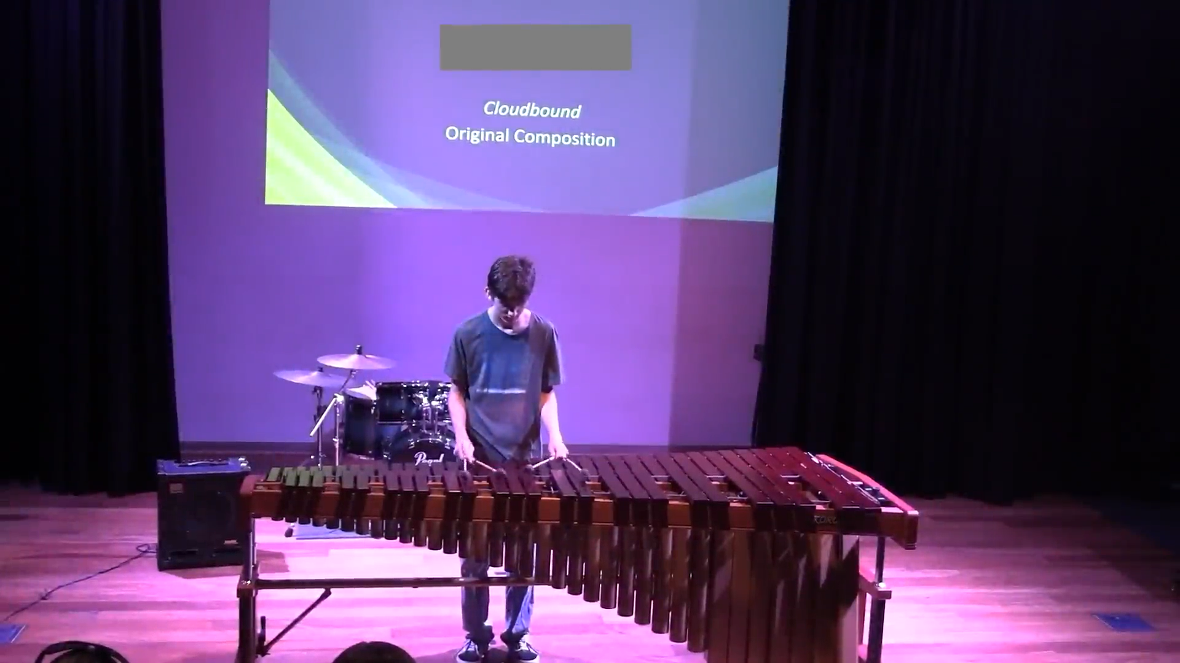

Cloudbound
Applying compositional devices [5]
application of compositional devices is synthesised to create a polished work
The composition synthesises a range of compositional devices, including unity, variation and contrast, to develop motivic ideas and create a cohesive, polished work.
Manipulating music elements and concepts [7]
manipulation of music elements and concepts shows
– perceptive understanding of genre/style
– sensitivity towards the genre/style through sustained synthesis of stylistic nuances
The manipulation of music elements and concepts such as harmony, rhythm and articulation demonstrates a perceptive understanding of composing for marimba, evident in both the notated score and live performance recording. Stylistic nuances are evident in the marimba-specific techniques included throughout the composition.
Resolving music ideas [5]
resolution of music ideas is perceptively synthesised and reveals subtleties of meaning
Music ideas are perceptively synthesised to communicate the intended idea of ‘floating within the clouds’. Subtleties of this meaning are revealed as the work progresses, depicting floating, light rain, wind, and a thunderstorm.
Click the image for video.
This live performance video of the composition can also be viewed at www.qcaa.qld.edu.au/curriculum-assessment/portal/media/snr_music_ext_26_comp_ia1_sr_cloudbound.mp4
The score can be downloaded from
www.qcaa.qld.edu.au/curriculum-assessment/portal/syllabus_resources/2026/snr_music_ext_26_comp_ia1_sr_cloudbound.pdf
Double click to open the score

Slide 9
  Statement of intent
  “Cloudbound” is a marimba solo that explores the idea of floating within the clouds. It embodies the serenity, as well as the danger contained within thunderclouds expressed through many different compositional devices and musical elements.
  A serene, weightless mood is conveyed through soft dynamics (pp, p, mp) and rolled chords creating a light timbre. Although the piece begins in Eb minor, major chords like D♭ and B appear in the floaty section. This adds to the emotional nature, as well as the light feeling using these musical elements.
  Following this, arpeggios of Eb minor, Db major, B major, and Bb minor repeat with quavers played with rubato, while a melody is played in octaves over the top. The quavers then speed to triplets, representing the movement of clouds and wind flowing through different speeds. By having rubato up until bar 96, a free and floaty mood is created using the musical element duration.
  A motif is then introduced based around a minor perfect cadence using Eb7 (V) and Ab minor (I). A melody is added over the top of the motifs playing offbeat semiquavers. Due to the high pitch and offbeat nature of the melody, as well as the timbre of marimba, the feeling of entering a rain cloud with light rain droplets is created. Steady time then follows, as a gradual crescendo to forte occurs. Using expressive devices depicts the clouds growing more dangerous. At bar 111, the use of subito pianissimo mixed with an Ab in the highest register possible creates a feeling of calm before the storm. This continues to build in dynamic, while the pitch lowers in octaves and adds Eb to create a powerful sound with a perfect 5th.
  After a cadenza, the use of semi-quavers and demi-semi quavers playing a descending Ab minor scale with an added G natural conveys the frantic nature of the storm clouds.
This leads into a section that utilises expressive devices, pitch, duration and timbre. Played at fortississimo (fff), an Eb3 and Eb2 are played in octaves using semi-quavers and demisemi-quavers, as well as perfect 5ths involving Eb as the root, and Ab as the root of the harmonies. This section also utilises the marimba’s low, woody, booming timbre to evoke thunder. All of this conveys the feeling of a rumbling storm cloud with thunder and lightning, and frantic panic.
Following a section that repeats a melody before with added harmonies for power representing the same setting but with added danger - the key modulates from Ab major to C major and goes from steady time and fortississimo to rubato and mezzo piano, representing finally leaving the thundercloud entering a bright blue sky, finally calm.
Statement of intent [3]
analysis of music elements and concepts, and compositional devices in the composition is detailed and specific
application of literacy skills through sequenced and connected ideas
evaluation shows insightful judgments about the use of music elements, concepts and compositional devices to communicate
the intent in the composition
The statement of intent analyses music elements and concepts, and compositional devices with detail, including specificity regarding notes, chords, cadences and rhythmic patterns. The response provides insightful judgments about these aspects of the composition, evaluating the ways they contribute to the stated imagery intended. The statement is sequenced chronologically through the work.

Slide 10

Copyright notice
© State of Queensland (QCAA) 2026
Licence: https://creativecommons.org/licenses/by/4.0 | Copyright notice: www.qcaa.qld.edu.au/copyright —
lists the full terms and conditions, which specify certain exceptions to the licence. |
Attribution: © State of Queensland (QCAA) 2026 www.qcaa.qld.edu.au/copyright
Student work may have been modified for copyright reasons or formatting requirements.
Other copyright material in this publication is listed below.
Student work samples/assessment responses are licensed under the Creative Commons Attribution-NoDerivatives 4.0 Licence (CC BY-ND 4.0).

