Slide 1

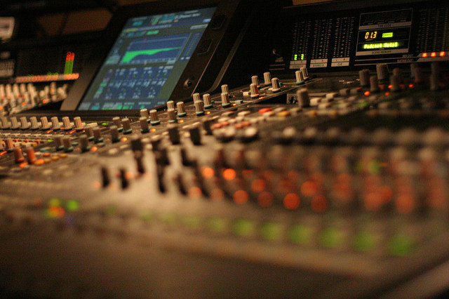
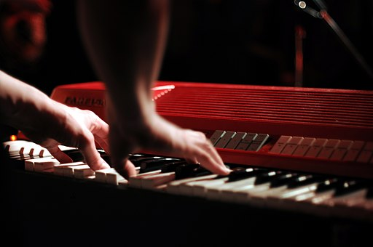
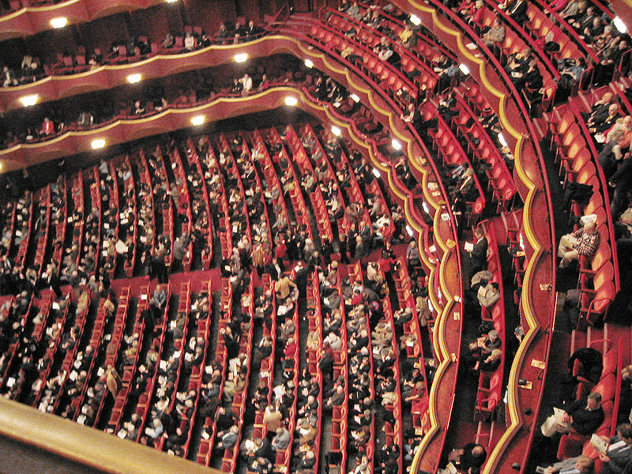
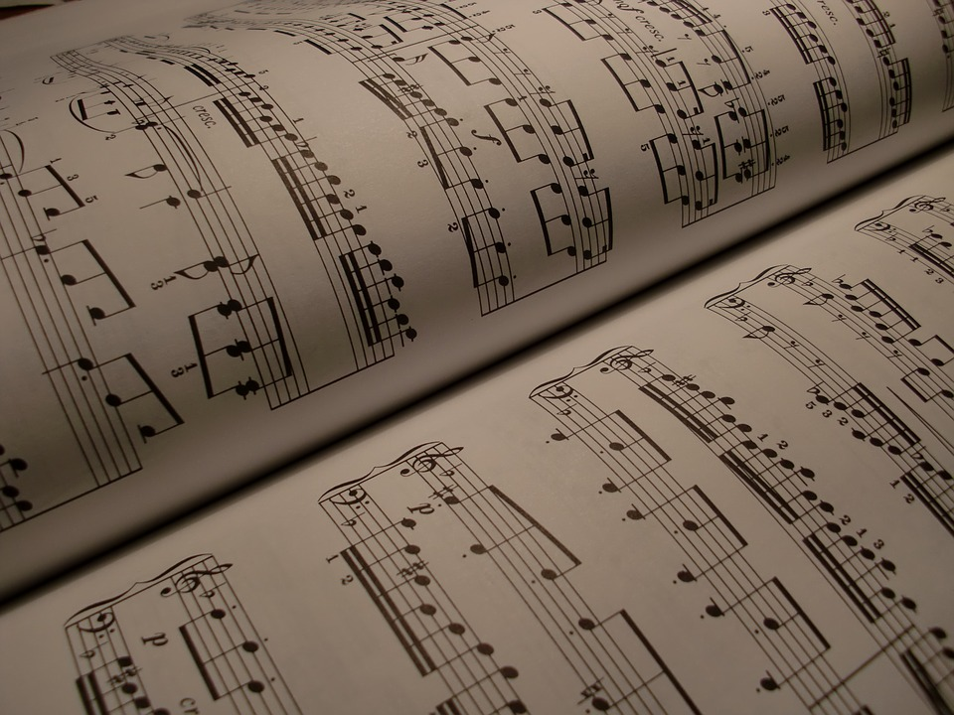
Music 2019 v1.2
Supporting resource: Syllabus objectives
1
2
apply compositional devices
realise
music ideas
use music elements and concepts
resolve
music ideas
interpret music elements and concepts
explain
the use of
music elements
and
concepts
evaluate music
to justify the use of music elements and concepts
3
4
demonstrate technical skills
analyse
music
apply
literacy skills
5

Slide 2
Images
Image 2599508, by StockSnap, Creative Commons 1.0 Universal (CC0 by 1.0),
https://pixabay.com/en/drums-set-people-man-concert-2599508/ Accessed 24 August 2018
Triple door mixing board is cool, by Roland Tanglao, Creative Commons 1.0 Universal (CC0 1.0)
www.flickr.com/photos/roland/104328963/in/photostream/ Accessed 24 August 2018
Erik Haegert (The Magnificent Brotherhood) live at NBI, by antifluor, Creative Comons Attribution
2.0 Generic (CC by 2.0), https://commons.wikimedia.org/wiki/File:Erik_Haegert_(The_Magnificent_Brotherhood)_live_at_NBI.jpg#filelinks, Accessed 24 August 2018
Metropolitan Opera auditorium from Family Circle, by Andreas Praefcke, Creative Commons
Attribution 3.0 Unported (CC by 3.0) https://commons.wikimedia.org/wiki/File%3AMetropolitan_Opera_auditorium_from_Familiy_Circle.jpg Accessed 24 August 2018
Image 1695041, Max Pixel (site), Creative Commons 1.0 Universal (CC0 by 1.0),
www.maxpixel.net/Music-Background-Treble-Clef-Scores-Composing-1695041
Accessed 24 August 2018

