Slide 1
NAPLAN Online
Test Administrator training — Part D

Slide 2
Part B
Part C
Part D
Introduction
Log into a test session
Run a test session
Practise
Part A
TA Training
Notes:
PART D
In this final part of training we are going to take turns to practise being a Test Administrator. We will also try out what to do for possible scenarios.
Before we start, can everyone please log out of the NAP Locked down browser. You do this by:
selecting finish test
selecting logout at the bottom of the page.
confirming you wish to log out
selecting X at the bottom right of the page.

Slide 3
Over to you …
Open your TA Pack and review the contents.
Test Administrator Session Slip
Student Session Slips
Test administration mini-handbook for teachers
Participating students list
Contact details for support
Your pack will also have a Test Administrator checklist.
Notes:
HAND OUT A TA PACK TO EACH PARTICIPANT.
Your TA Pack today includes only these items in bold.
Test Administrator Session Slip ― the Test Administrator uses the login details on this slip to login to the Assessment Platform and create a Test Session.
Student Session Slips ― the Test Administrator provides these login details to the students sitting the tests.
Test administration mini-handbook for teachers ― for test administration guidelines and scripts.
For NAPLAN, the following will also be included:
Participating student list ― a list of students in the test session, including information around students who require adjustments
Contact details for support ― for NAPLAN Coordinator and/or School Technical Support Officer.

Slide 4
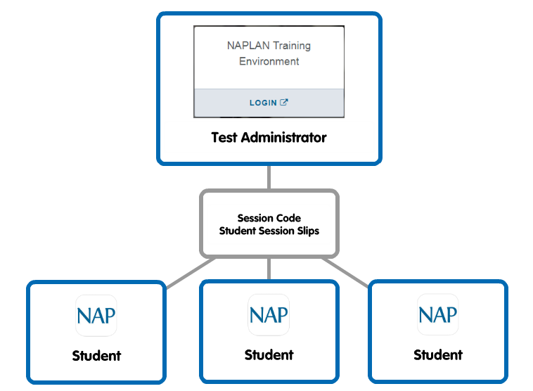
Over to you …
Notes:
Now we are going to take turns at practicing the roles of Test Administrator and Student.
To do this, please:
arrange yourselves into small groups of three or four people.
nominate one person to act as Test Administrator.
The remaining participants will be students.
Can the nominated Test Administrator:
Open www.assessform.edu.au and log into the NAPLAN Training environment using the Test Administrator Session Slip from their TA Pack.
Create a new session and write the Session Code on the board (piece of paper) for their ‘students’.
Distribute the Student Session Slips from their TA Pack to their ‘students’
Do this now.

Slide 5
Over to you …
Test Administrator
Students
www.assessform.edu.au
Select NAPLAN Training environment
Enter Username/Password
Create a new test session
Write the Session Code
Distribute Student Session Slips
Start and manage test session
Finalise test session
NAP Locked down browser
Select Training
Enter Session Code
Enter Student Code
Participate in a sample test
Finish test attempt
Log out
Notes:
[Columns animated to appear upon click.]
Students, can you now please:
open the NAP Locked down browser using the app on your desktop
select Training
enter Session Code provided by your Test Administrator
enter Student Code printed on your piece of paper
participate in a sample test
While you are in the test, and with the Test Administrator monitoring their dashboard, I would like you to try some possible scenarios that may occur in a testing classroom. On the next slide I have some suggestions.

Slide 6
Over to you …
Practise different scenarios. Swap roles.
Test Administrator (www.assessform.edu.au)
Start session
Pause student
Resume student
Monitor dashboard
Students (NAP Locked down browser)
Late entry
Finished test early
Reopen test
Disconnect (network)
Notes:
These are some scenarios you may like to try. You do not have to try them all at once.
After a few minutes, change roles and repeat until everyone has a turn.
Make sure to check the page 6 of your Test Administration mini-handbook for teachers for more details on test disruptions.

Slide 7
Let’s review
The Test Administrator has the following tasks when administering the NAPLAN tests online.
Before
During
After
Log in with TA Session Slip
Distribute Student Session Slips
Finalise session
Create new Test Session
Read aloud from the script
Collect Student Session Slips
Write Session Code on the board
Start and manage the test session
Return materials to NAPLAN Coordinator
Notes:
[Boxes are animated to appear upon clicks.]
Now that we have had a chance to practise, let’s review the tasks of the Test Administrator.
Before students enter the classroom:
login to the Assessment Platform using the username and password from the Test Administrator Session Slip.
create a new Test Session.
write the Session Code on the board.
When students enter the room:
distribute Student Session Slips
read aloud from the script
start and manage the test session by monitoring the TA dashboard.
When students have finished their test, the Test Administrator must:
finalise the test session
collect all materials
return the materials to the NAPLAN Coordinator.

Slide 8
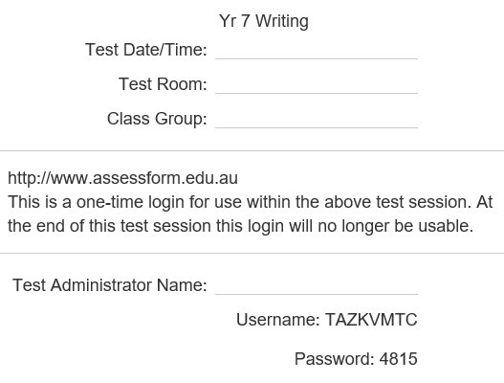
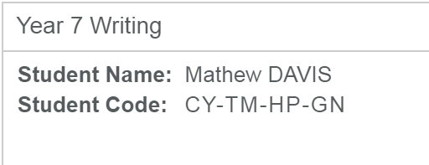
Let’s review: terminology
TA Session Login
Username/Password
Student Code
Unique 8-letter code
Printed on
Printed on
TA Session Slip
Student Session Slip
Session Code
Unique 8-letter code
Notes:
[Images are animated to appear upon clicks.]
Let’s also review the terminology that we will be using. It is really important that we use the right words for the right terms, as this can be confusing.
This is a graphic of how these things work together:
First, the Test Administrator logs in using their username and password on their Test Administrator Session Slip, they will then be asked to create a new Session Code which they will write on the board for students to use.
The students use the Session Code and the code on their Student Session Slip to login to the test.

Slide 9
Next steps for test administrators
Use your TA Packs to practise (let me know of any unfinalised test sessions)
Watch the videos www.assessform.edu.au
Check out the factsheets www.qcaa.qld.edu.au/p-10/naplan-online/factsheets
Familiarise yourself and students with the Public demonstration site www.nap.edu.au/online-assessment/public-demonstration-site
Notes:
So what do you do now?
Here’s some suggestions.

Slide 10
Supporting websites
QCAA
www.qcaa.qld.edu.au/p-10/naplan-online
Queensland Department of Education https://naplanonline.qld.edu.au
ACARA
www.assessform.edu.au
Public demonstration site
http://www.nap.edu.au/online-assessment/public-demonstration-site
Notes:
The following websites have a range of supporting resources available to schools.
These include:
QCAA ― factsheets and guides that summarise the steps for the main tasks that school staff need to carry out, in addition to the regular monthly NAPLAN newsletters that can be subscribed to (no password required).
Qld Department of Education ― information on school, staff and student readiness, in addition to parent information and other links (no password required).
ACARA ― detailed guides for the NAP Locked down browser, training guides, user guides and videos for Principals, NAPLAN Coordinators and School Technical Support Officers (password access required).
Public demonstration site ― provides a way to familiarise students with the style of test and questions that will be presented to them (no password required).

Slide 11
End of Part D
See www.qcaa.qld.edu.au/p-10/naplan-online/resources for other materials in this series.

