Slide 1
NAPLAN Online
Test Administrator training — Part C

Slide 2
Part B
Part C
Part D
Introduction
Log into a test session
Run a test session
Practise
Part A
TA Training
Notes:
PART C
You have now run through the process of logging in to a test session as the Test Administrator.
In Part C, you will all log in as students while I stay in the role of Test Administrator.
I am going to demonstrate how to run a test session.
Before we start, can everyone please Exit the assessment platform browser we have just been using. This way there will be no confusion when you log into NAP Locked down browser.
Do not log in at this stage.

Slide 3
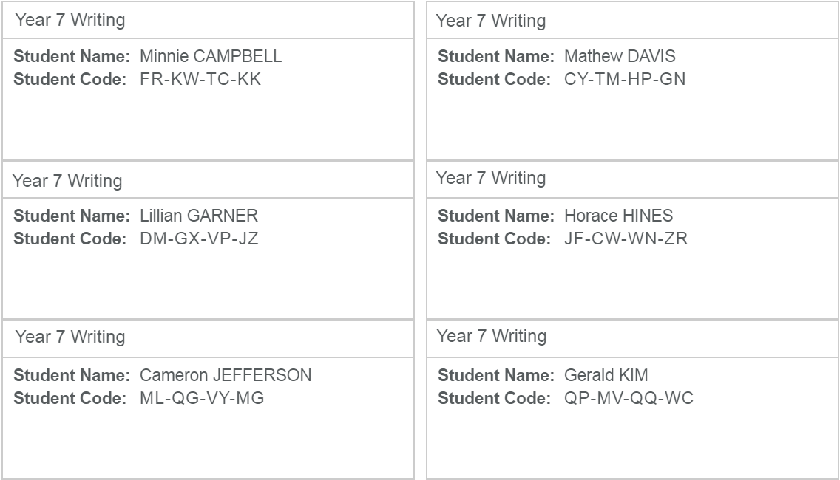
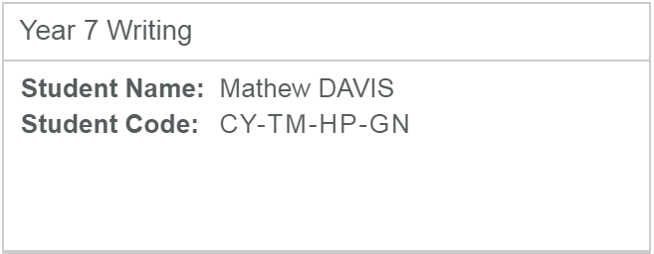
Test Administrator
Distribute a Student Session Slip to each participant.
Notes:
Firstly, I will hand out a Student Session Slip to each of you. This contains your Student Code.
The NAPLAN Coordinator has a choice of printing these in different ways:
14 to a page (default) ― this way requires each slip to be cut out individually.
one per page ― this way is useful as it can also be used as planning paper/working out paper (for all tests except the Reading test).
It is important to note that the Student Session Slip determines the test the student will do.

Slide 4
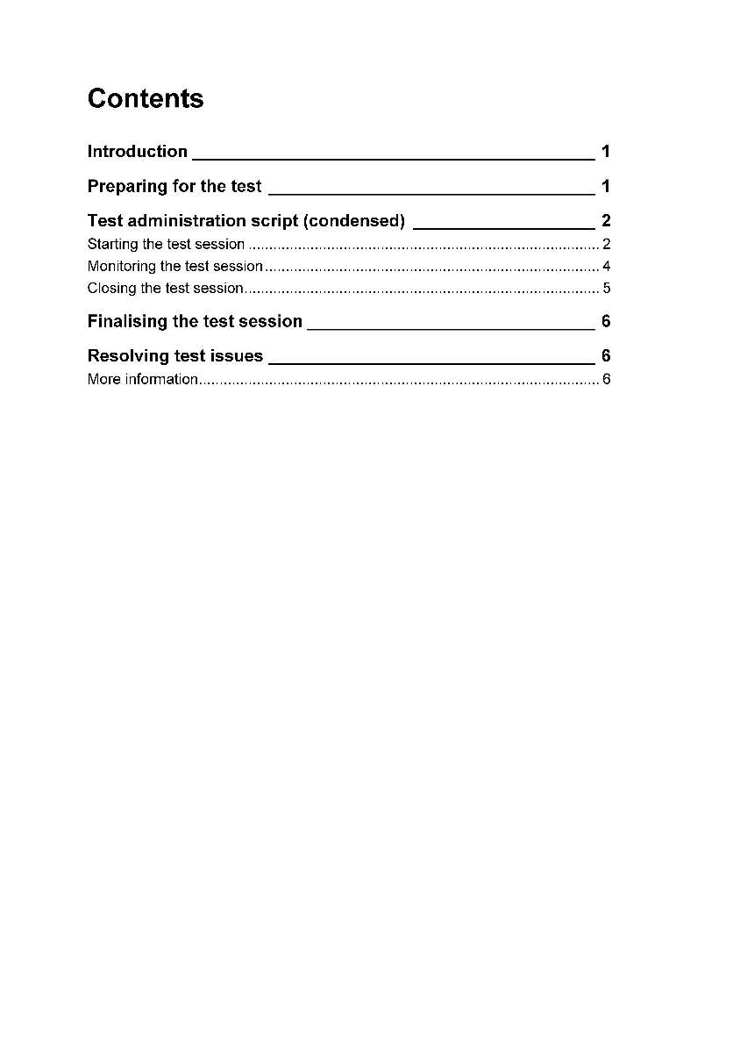
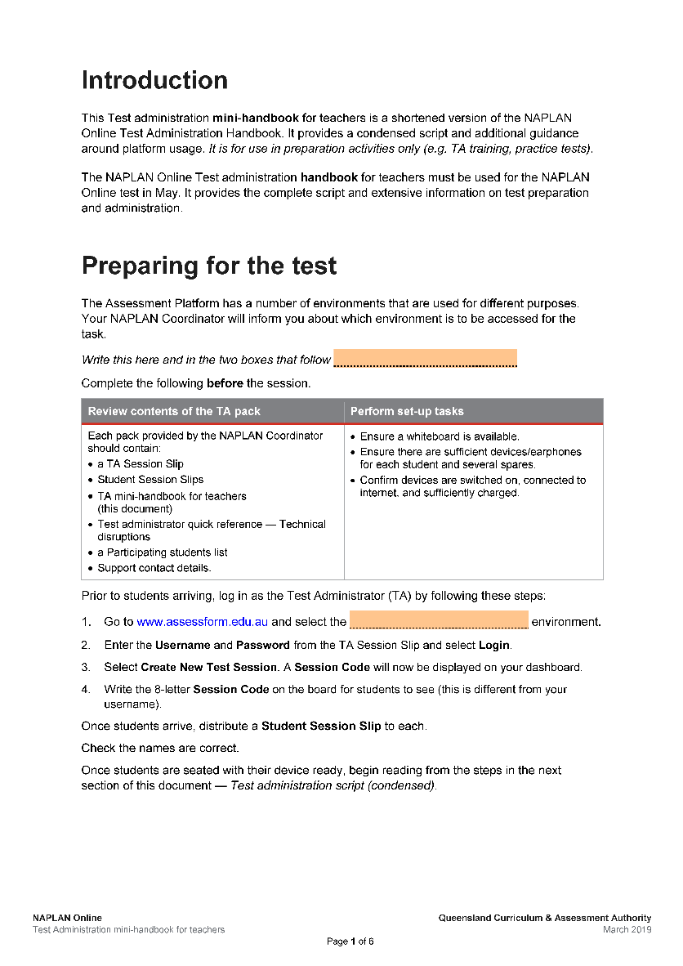
Test Administrator
Test administration mini-handbook for teachers
Notes:
Today we are using the Test administration mini-handbook for teachers. It is a shortened version of the TA Handbook you will use in May. It has a condensed script and additional guidance around how to prepare for and monitor the test session and information on how to manage test disruptions.
This is included in your TA Pack that you will receive in the next section. It is important to note that this is for preparation activities only, and should not be used in NAPLAN testing. Today we are using the Training environment. Can you please write Training everywhere the orange boxes appear.
I am going to read from the Test administration mini-handbook for teachers. I will stop from time to time to explain the screens you are looking at and what you need to be aware of.
[Read from the start of the Test Administration script.]
You should all have your Student Code for this test on a piece of paper. Check to see that you have this.
You should have your device turned on in front of you. The first thing we will do is check the sound using your earphones. Check that your earphones are plugged in. Set your device’s volume between halfway and full. You will not be able to adjust volume during the test.

Slide 5
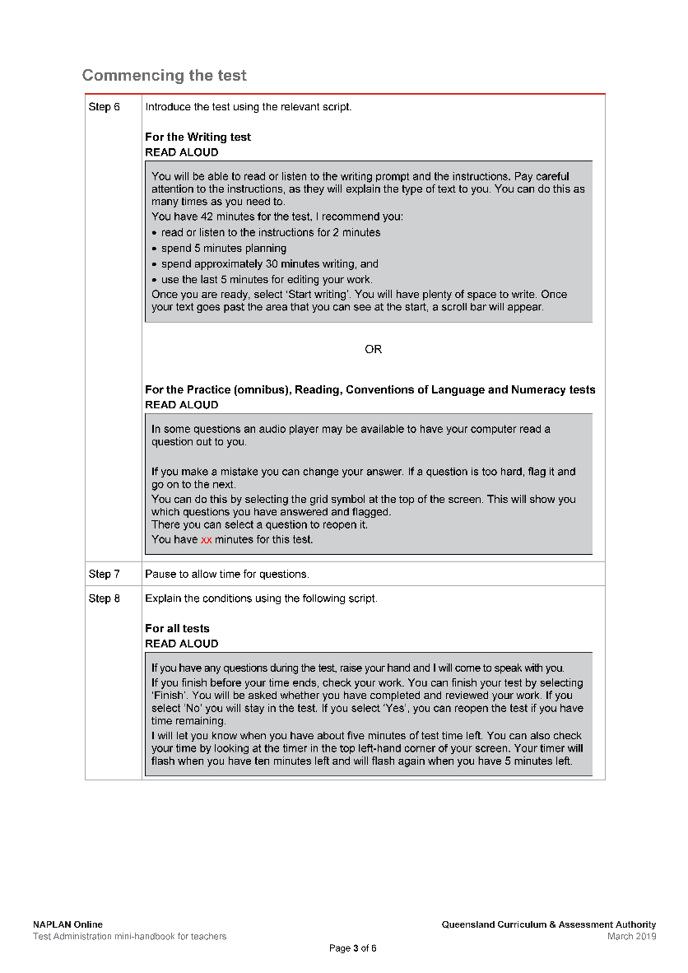
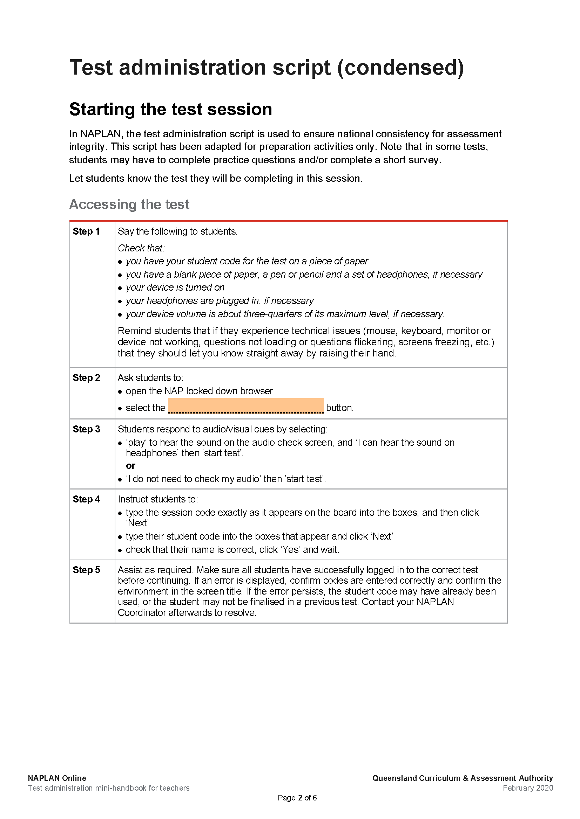
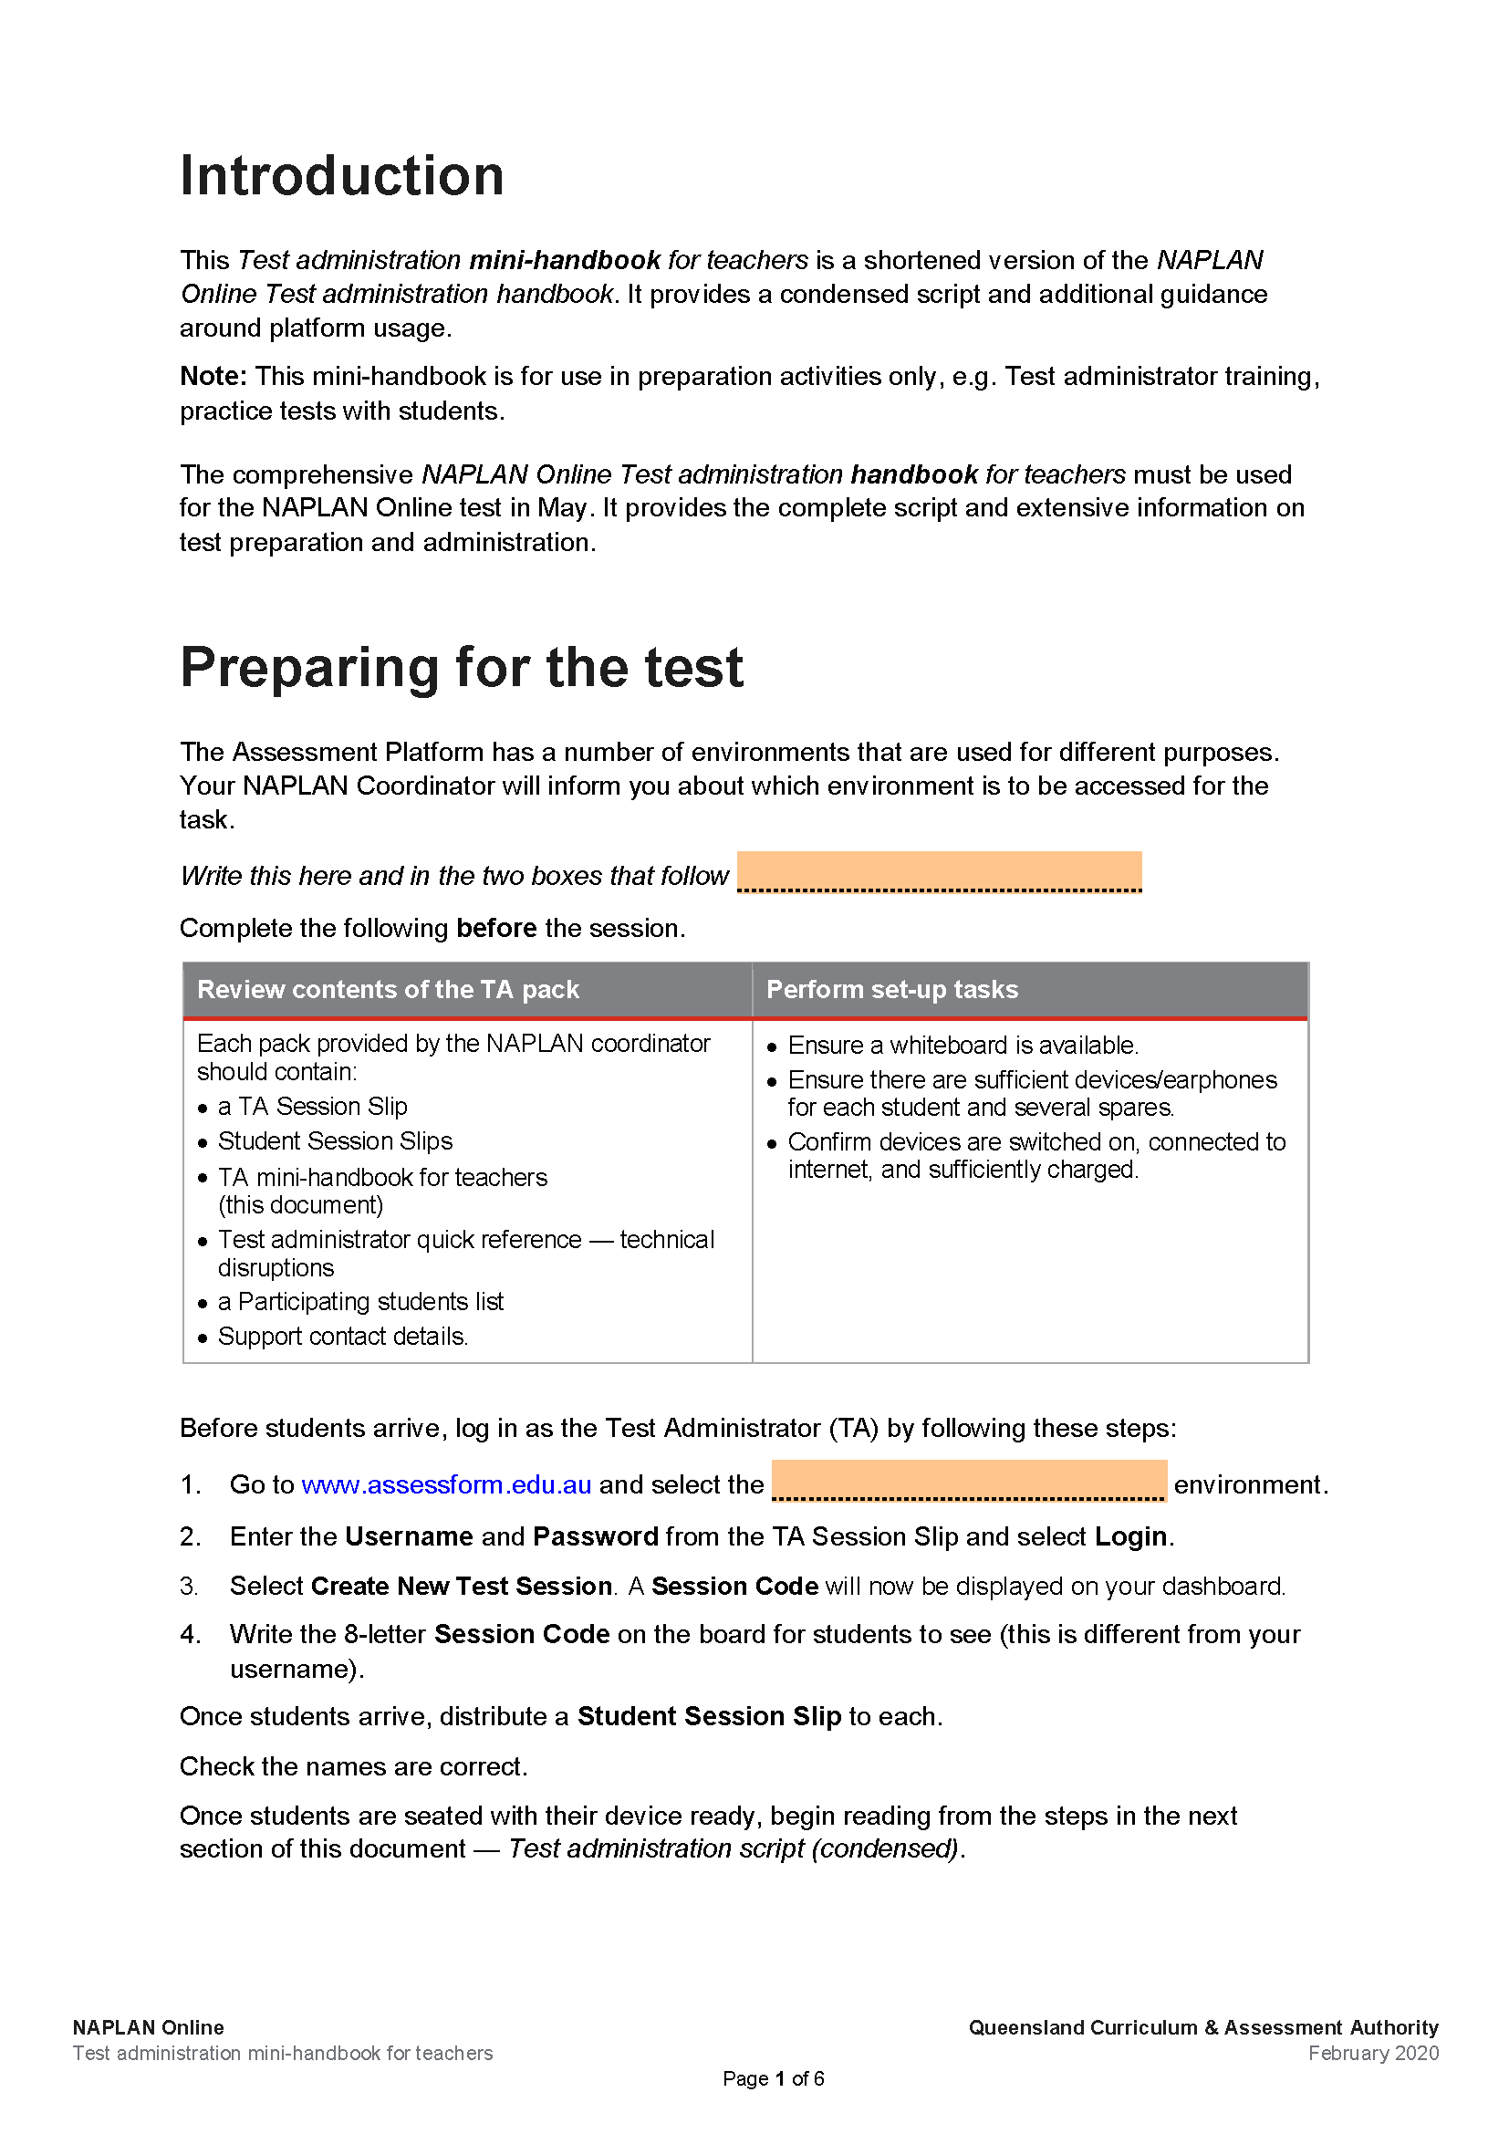
Test Administrator
Test administration mini-handbook for teachers
Notes:
Now we’ll start working through the instructions and reading the script in the TA mini-handbook to begin our practice test session.
[Start giving instructions from page 2 of the Test Administration mini-handbook for teachers.]
Today you’ll be completing the … test.
Let me know straight away if you experience any technical issues.
Check that:
you have your Student Code for the test on a piece of paper
you have a blank piece of paper, a pen or pencil and a set of headphones
your device is turned on
your headphones are plugged in
your device volume is about three-quarters of its maximum level.

Slide 6
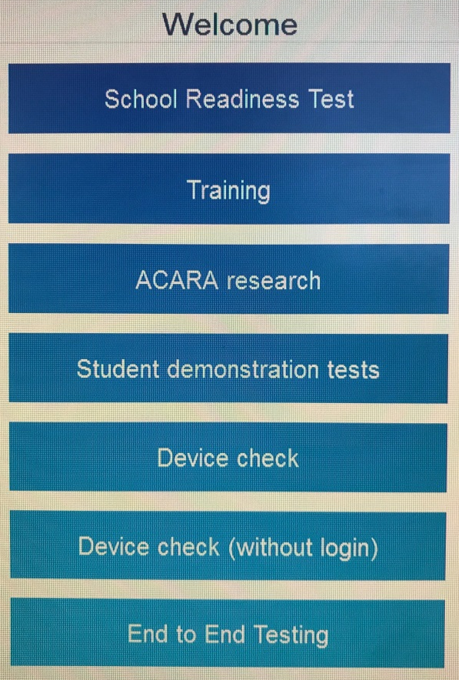
Student
Open the NAP Locked down browser
Select Training
Complete the audio check
Notes:
[Continue giving instructions from the Test Administration mini-handbook for teacherss.]
Please open the NAP Locked down browser on your device now and select the Training button.
Select Play to hear the sound on the audio check screen.
Select I can hear the sound on headphones and Start test if you can hear the sound.

Slide 7
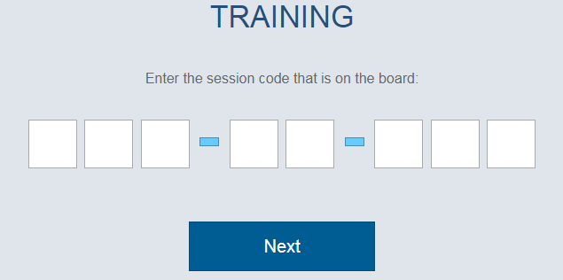
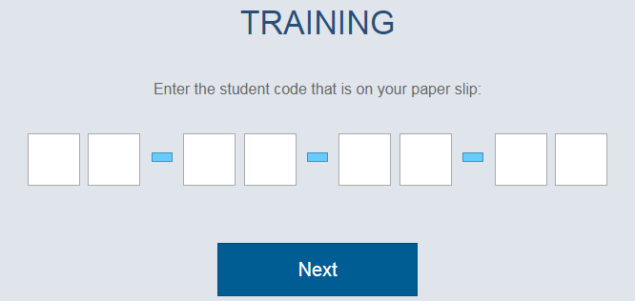
Student
4. Enter the Session Code
5. Enter the Student Code
Notes:
You will be presented with two successive screens that require unique 8-letter codes. There are several things to mention on these screens:
The title at the top confirms the environment the student has logged into.
The text underneath the title, indicates the code that needs to be entered and where it comes from.
It is important that students use the correct code in the correct place ― it is easy to confuse them.
First screen ― Session Code ― this is the code the Test Administrator has written on the board. By entering this, you connect to the session I created. This is the code I had you write down.
Second screen ― Student Code ― this is the code the students have on their piece of paper. By entering this, you join as a specific student sitting a specific test.
[Continue giving instructions from the Test Administration mini-handbook for teachers.]
You should now see the test session login screen with white boxes. If not, raise your hand.
Type the Session Code exactly as it appears on the board into the boxes, and then click on Next.
Type your Student Code into the boxes that appear and click on Next.
Check that your name is correct, click on Yes and wait.

Slide 8
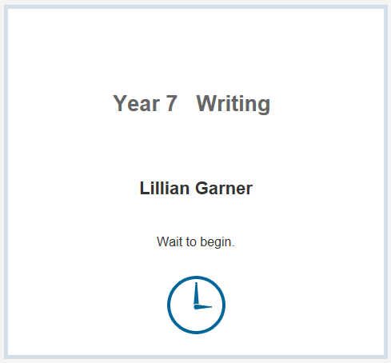
Student
Notes:
Next you will be presented with a screen to confirm your name and commence the test.
Check that your name is correct, click on Yes and wait.
Note that some tests may start with practice questions.
The screen will ask you to wait to begin.
The test will only start when I start the test session for the whole class.

Slide 9
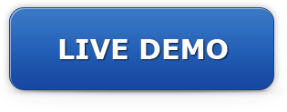
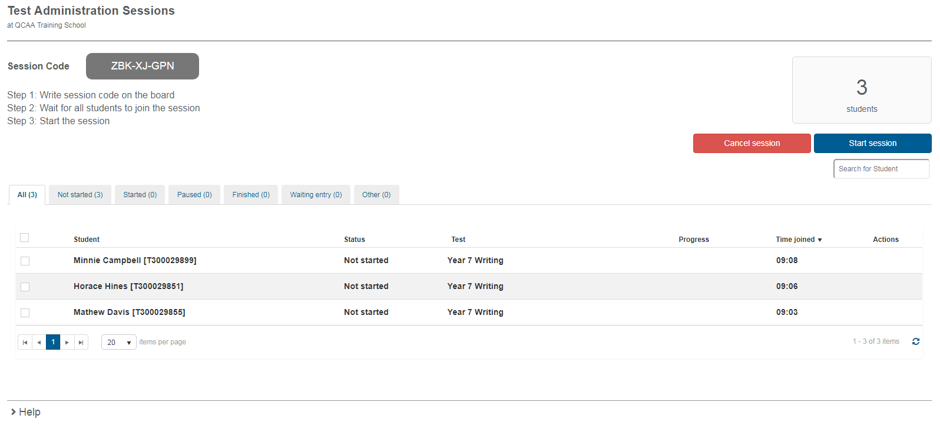
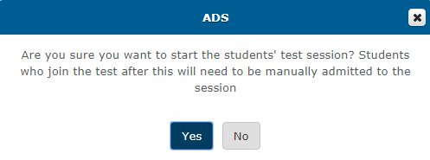
Test Administrator
Starting a test session.
Factsheet 16: Test Administrators (TA) login and start test session
Notes:
[Boxes are animated to appear upon clicks.]
Before I start the test, I want to show you what my screen looks like. This is the TA dashboard before students start the test.
At the top left of my screen is the Session Code ― I wrote this on the board for the students (you) to log in with.
As my students (you) log in to the session, your names will appear in a list in the middle.
And on the right side of the screen is my Start session button.
I select Start session when all students have logged in and completed any practice questions. A dialogue box will appear to confirm that I want to start.
I am going to start the session now and give you a few minutes to look at the test and attempt some questions.

Slide 10
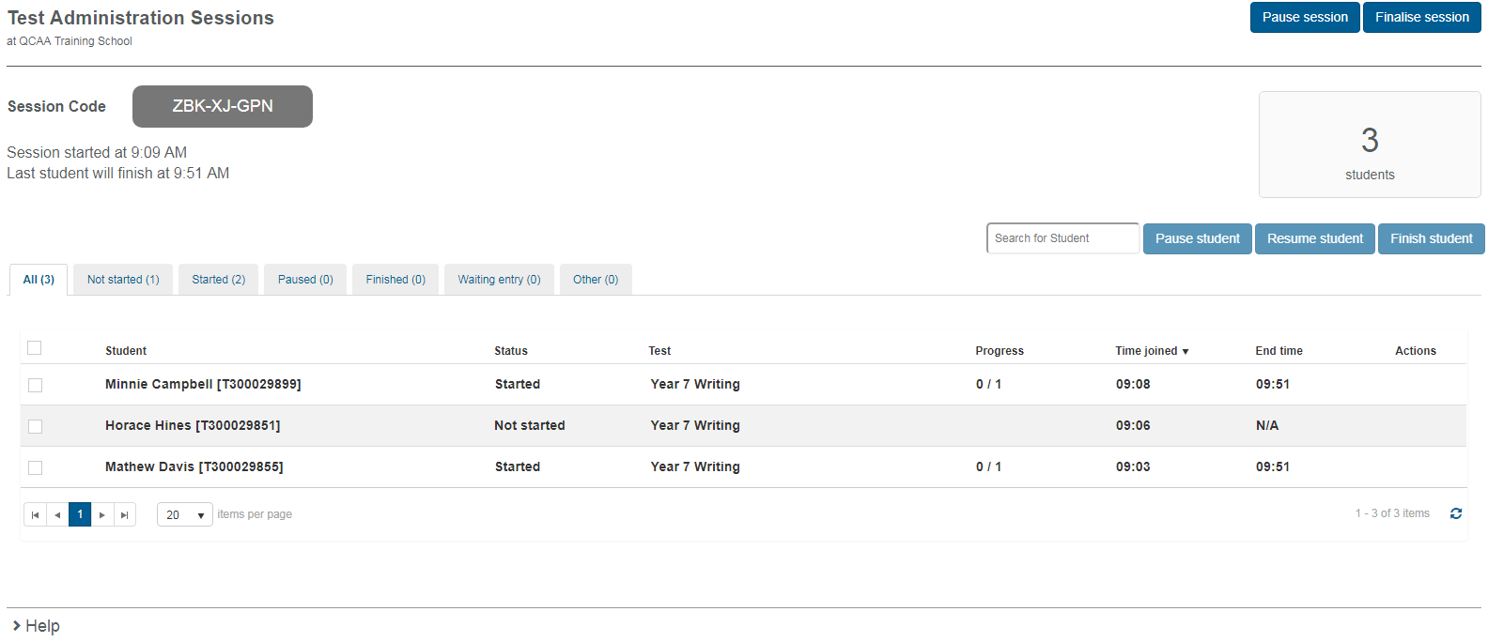
Test Administrator
Monitoring a test session.
Factsheet 17: Monitor a test session
Notes:
[Boxes in red are animated to appear upon clicks.]
Now that you have started the test, I want to show you what my dashboard looks like. It has changed slightly so that I can monitor the students in my session:
On the left of my screen is a selection of tabs that tell me the status of my students.
Below this is a list of students who have entered the test session. To perform actions for specific students, select the student by clicking to tick the checkbox next to their name. Then select the relevant button just above the student table.
At the top right are my buttons to Pause and Finalise a session (this will affect the whole class).
At the middle right are my buttons to Pause, Resume and Finish a student/s (selected using the box beside their name/s).
And beneath this, is information to tell me student progress.
Finally, the actions column alerts me to issues that I need to investigate further.
Note here that there is a difference between a whole test session (the whole class), and an individual student attempt.

Slide 11
Test Administrator
Monitor students’ activity on the dashboard:
Check the status of students.
Scan the Actions column:
lock icon indicates an attempt to re-enter the test
red warning icon indicates active test disruption — possible connectivity issues
grey warning icon indicates inactive test disruption no longer affecting student
plus sign indicates an adjustment.
Notes:
During the test session the test administrator should actively supervise students and monitor for disruptions. Let’s look a little more closely at parts of the screen displayed.
The status tabs tell me the number of students in the Not Started, Paused, Finished, and Waiting entry tabs is as expected. If not, I need to follow up as necessary by selecting the relevant tab, student and action.
Scan the Actions column for icons
A lock indicates an attempt to re-enter the test. This may be caused by a student exiting and re-entering, a device change or reboot.
A red warning icon indicates an active test disruption ― possibly due to connectivity issues. Monitor the student and resolve the issue if necessary.
A grey warning icon indicates an inactive test disruption that is no longer affecting the student.
A plus sign indicates an adjustment. Select the icon for details. Most adjustments are automatically applied to the test.

Slide 12
Technical disruptions
Notes:
If technical issues are experienced before or during a test session, the TA can refer to the Test administrator quick reference ― technical disruptions for possible rectification strategies to try.
This information is also available on page 6 of the Test administration mini-handbook for teachers.
One of the most important things to remember is that if a technical issue persists for more than 15 minutes, pause the test attempt for the student/s affected or if the whole class is affected, pause the session and contact the NAPLAN Coordinator for help.

Slide 13
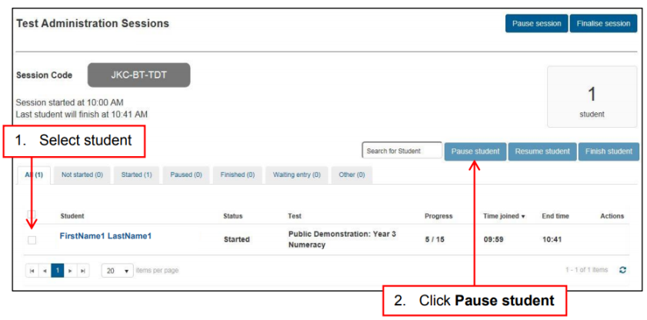
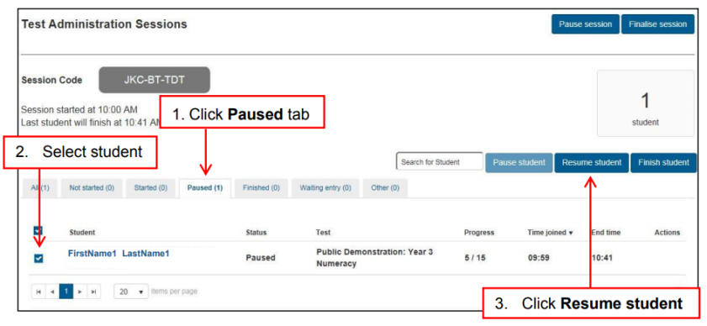
Test disruptions: Student test attempt
Select student
Select Pause student
Enter details, select Confirm
Rectify the problem (if possible)
1. Select Paused tab
2. Select student
3. Select Resume student
4. Enter details, select Confirm
Notes:
Where possible, tests should be completed in a single uninterrupted session.
In the event of a disruption to a student’s test attempt, the Test Administrator should:
Select Pause student
Rectify the problem (if possible)
Select Resume student
Any disruption must be notified to the NAPLAN Coordinator at the end of the session.
Refer to the back page of the Test administration mini-handbook for teachers or Test administrator quick reference ― technical disruptions for further information.
Remember ― ‘Don’t panic, pause’.

Slide 14
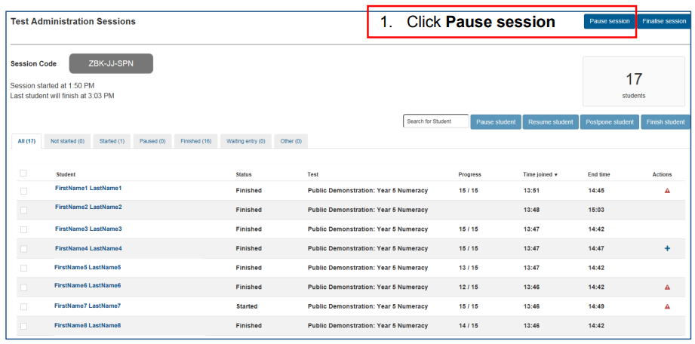
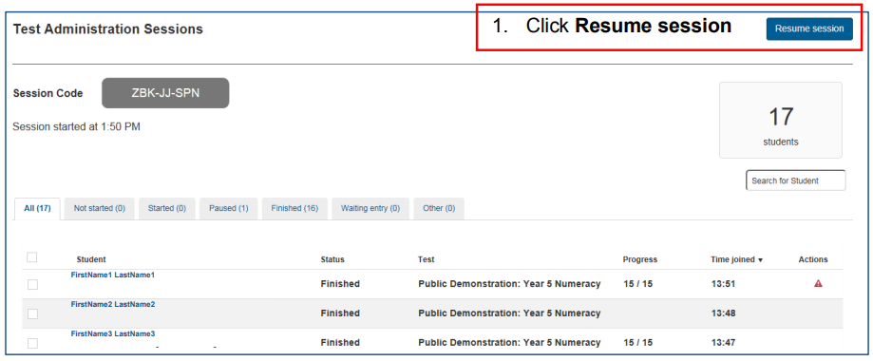
Test disruptions: Test session
Select Pause session
Enter details, select Confirm
Rectify the problem (if possible)
1. Select Resume session
2. Enter details, select Confirm
Notes:
Note that there is a difference between pausing/resuming individual student attempts, and a whole test session.
In the event of a disruption to a test session which affects all students, the Test Administrator should:
Select Pause session
Rectify the problem (if possible)
Select Resume session.
Any disruption must be notified to the NAPLAN Coordinator at the end of the session.
Refer to the back page of the Test administration mini-handbook for teachers or Test administrator quick reference ― Technical disruptions for further information.

Slide 15
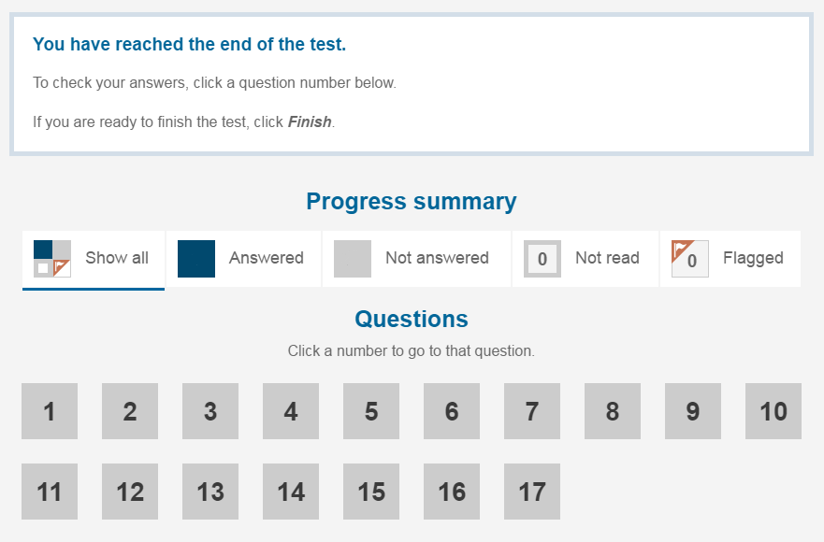
Test Administrator
Notes:
Students should finish their own test attempts once they have completed the test. However, you can finish a test attempt on their behalf (in the TA dashboard) if they have forgotten or walked off.
If a student did not complete the test during the session because they experienced a test disruption, or they left the session because they were unwell, you should not finish their test attempt. The test attempts should remain Paused and the NAPLAN Coordinator will need to be informed and follow up.

Slide 16
Test Administrator
Finalising a test session.
Check students have finished their test attempt.
Check students have closed the NAP Locked down browser.
Finalise Session (if possible). Do not finalise if any students are paused and advise the NAPLAN Coordinator.
Collect and return all test materials to the NAPLAN Coordinator.
Notes:
This is a list of things the Test Administrator needs to action at the end of a test session.
Check students have finished their test attempt.
Check students have closed the NAP locked down browser.
Finalise Session if possible , but do not finalise if any students remain paused. Instead advise the NAPLAN Coordinator.
Collect and return all test materials to the NAPLAN Coordinator.
It is extremely important that every test session is finalised whenever possible.
If not finalised, students cannot sit another test.
The Test Administrator needs to promptly advise the NAPLAN Coordinator if they are unable to finalise a test session (e.g. a student was absent or refused to attempt the test) so that the NAPLAN Coordinator can take further steps.

Slide 17
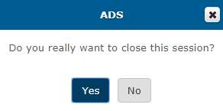
Test Administrator
Finalising a test session.
Notes:
[Dialogue box animated to appear upon click.]
This is what the TA dashboard will look like.

Slide 18
Supporting websites
QCAA
www.qcaa.qld.edu.au/p-10/naplan-online
Queensland Department of Education https://naplanonline.qld.edu.au
ACARA
www.assessform.edu.au
Public demonstration site
http://www.nap.edu.au/online-assessment/public-demonstration-site
Notes:
The following websites have a range of supporting resources available to schools.
These include:
QCAA ― factsheets and guides that summarise the steps for the main tasks that school staff need to carry out, in addition to the regular monthly NAPLAN newsletters that can be subscribed to (no password required).
Qld Department of Education ― information on school, staff and student readiness, in addition to parent information and other links (no password required).
ACARA ― detailed guides for the NAP Locked down browser, training guides, user guides and videos for Principals, NAPLAN Coordinators and School Technical Support Officers (password access required).
Public demonstration site ― provides a way to familiarise students with the style of test and questions that will be presented to them (no password required).

Slide 19
End of Part C
See www.qcaa.qld.edu.au/p-10/naplan-online/resources for other materials in this series.

