Slide 1
NAPLAN Online
Test Administrator training — Part B

Slide 2
Part B
Part C
Part D
Introduction
Log into a test session
Run a test session
Practise
Part A
TA Training
Notes:
PART B
In this part of the training, I will demonstrate how to log into a test session as a Test Administrator.
Before I start, let’s run through the steps that can be completed in the room before students arrive.

Slide 3
Test Administrator
Set up the room
Review the TA Pack
Check technical devices
TA device, charged and connected
Log into the environment
Username/password from TA Session Slip
Prepare the room
Access a whiteboard
Provide planning paper (if applicable)
Earphones for students (if applicable)
Spare devices and power boards
Write the Session Code on the board
Create New Test Session
Open www.assessform.edu.au and select environment
Student devices, charged and connected
Notes:
[Boxes are animated to appear upon clicks.]
Prior to administering a test, there are steps that the Test Administrator can perform before students enter the room.
These include:
Prepare the room ― review the TA Pack and any necessary adjustments that need to be implemented; arrange the room so that students cannot see each other’s work or posters. Make sure there is access to a whiteboard so that the Session Code can be written, and make sure that planning paper is available (for all tests with the exception of the Reading test).
Check technical devices ― ensure technical checks, including device checks and the installation of the NAP Locked down browser, have been done prior to the test window. On test days, it is the TA’s responsibility to check their device is charged and connected. It is also necessary to have spare earphones, devices and power boards in the event that a student is not prepared. If necessary, seek assistance from our NAPLAN Coordinator or School Technical Support Officer if you have questions on these, or other, technical aspects.
Log into the Training Environment ― use the details from the Test Administrator Session Slip in your TA pack. Once this has been done, you can then create a new test session and write this unique 8-letter code on the whiteboard for students to use.

Slide 4
Test Administrator
Log in
Open www.assessform.edu.au.
Select NAPLAN Training Environment.
Enter Username and Password.
Select Login.
Select Create New Test Session.
Write down the Session Code on the whiteboard.
Factsheet 16: Test Administrators (TA) login and start test session
Notes:
[Facilitator should show the following slides and then demonstrate live with the participants in a step-by-step approach.]
These are the steps that we need to follow to log in to the Assessment Platform as Test Administrator.
I am going to show you the steps in more detail, and then we will all log into the Assessment Platform and do them together. Please do not log in before then.

Slide 5
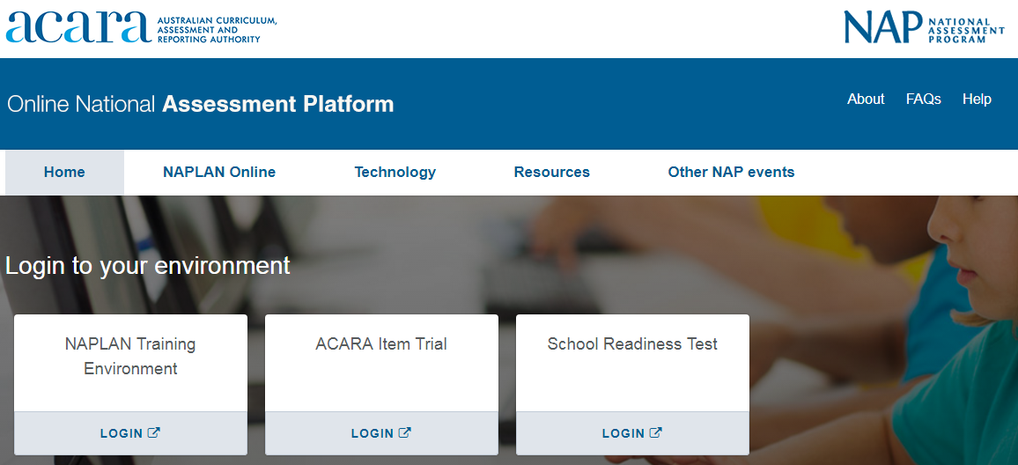
Test Administrator
Open www.assessform.edu.au.
Select the NAPLAN Training Environment.
Notes:
First, I log in to the Assessment Platform by opening the website www.assessform.edu.au.
I select the NAPLAN Training Environment for today’s demonstration.
It’s important that the correct environment is chosen as the login details will not work otherwise.

Slide 6
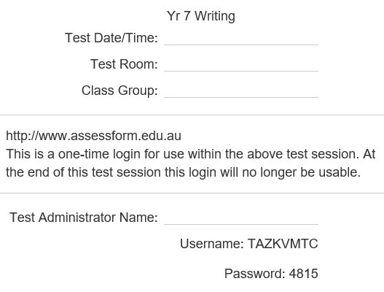
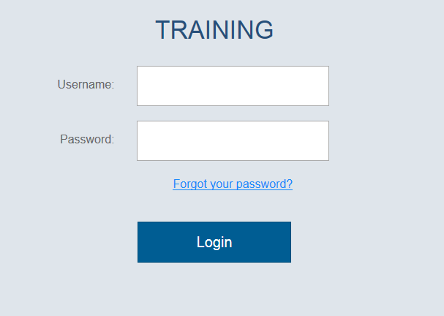
Test Administrator
Enter the Username and Password from the Test Administrator Session Slip.
Select Login.
Notes:
Next, I will use my Test Administrator Session Slip (from my TA Pack) to get my Username and Password.
I know that I have selected the correct environment because TRAINING is displayed at the top of my page.

Slide 7
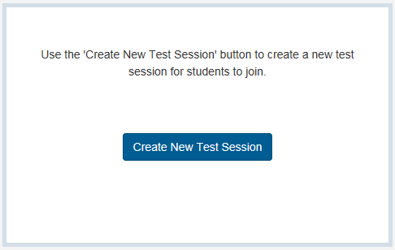
Test Administrator
Create a new test session.
Notes:
Once I have selected login, a dialogue box asks if I want to create a new test session.
I will confirm that I want to ‘Create New Test Session’.

Slide 8
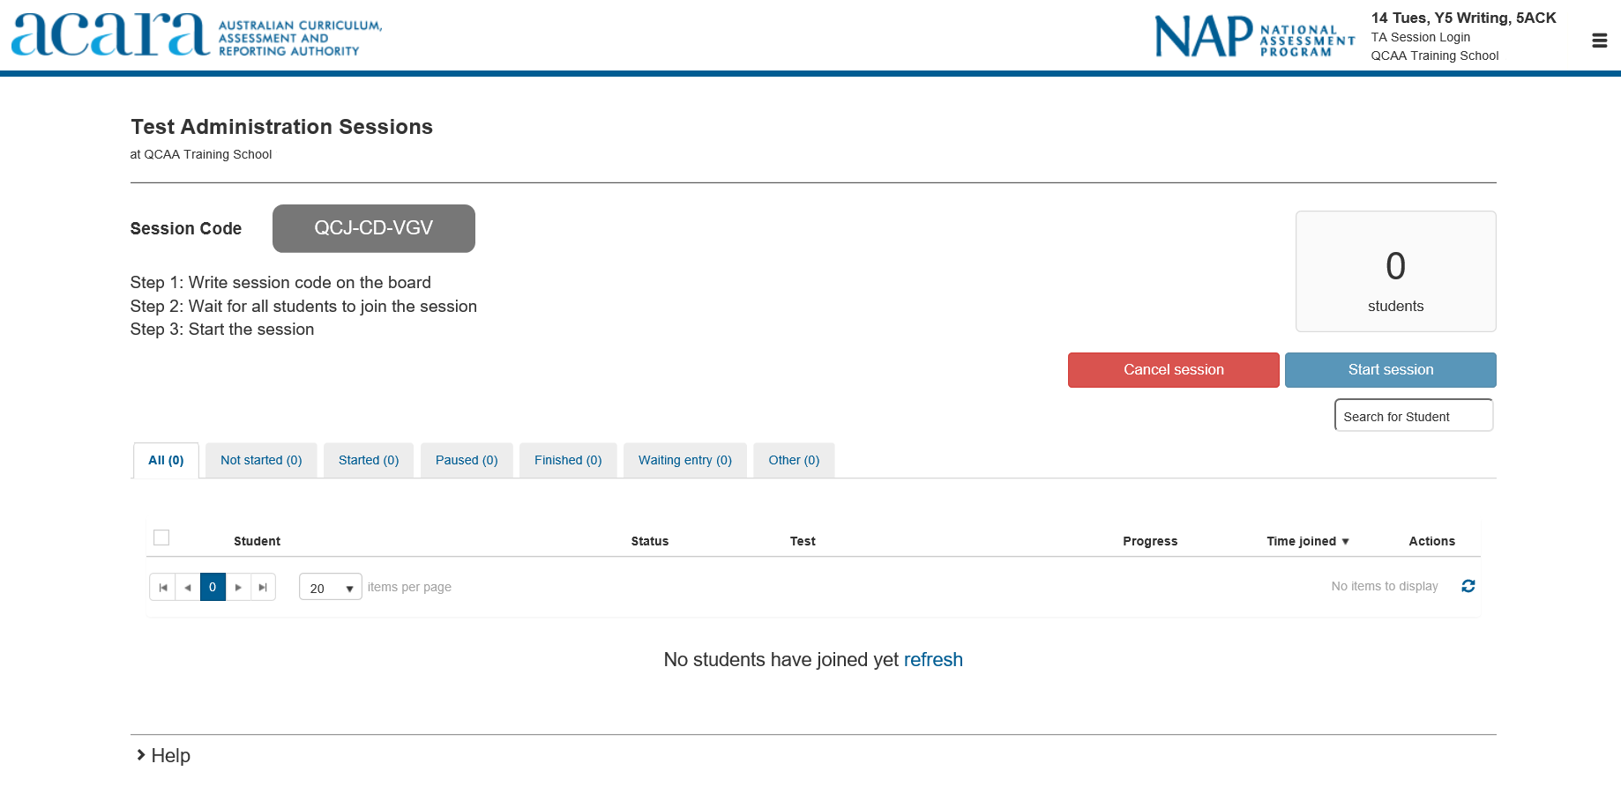
Test Administrator
TRAINING
QCJ CD VGV
6. Write the Session Code on the board.
Notes:
[Boxes in red are animated to appear upon clicks.]
This is my new Session Code. It can only be used for one test session.
I need to write this code on the board for the students to use.
I will also write the name of the environment so students can check they are logging into the correct place.
Now that you have seen the process of logging into the Assessment Platform, we are going to go through the steps together.
When we get to this stage, I would like you all to write down the Session Code on a piece of paper (instead of the board) so that we can use it later.
[Facilitator should demonstrate the steps live with the participants in a step by step approach ― repeat slides if necessary.]

Slide 9
Supporting websites
QCAA
www.qcaa.qld.edu.au/p-10/naplan-online
Queensland Department of Education https://naplanonline.qld.edu.au
ACARA
www.assessform.edu.au
Public demonstration site
http://www.nap.edu.au/online-assessment/public-demonstration-site
Notes:
The following websites have a range of supporting resources available to schools.
These include:
QCAA ― factsheets and guides that summarise the steps for the main tasks that school staff need to carry out, in addition to the regular monthly NAPLAN newsletters that can be subscribed to (no password required).
Qld Department of Education ― information on school, staff and student readiness, in addition to parent information and other links (no password required).
ACARA ― detailed guides for the NAP Locked down browser, training guides, user guides and videos for Principals, NAPLAN Coordinators and School Technical Support Officers (password access required).
Public demonstration site ― provides a way to familiarise students with the style of test and questions that will be presented to them (no password required).

Slide 10
End of Part B
See www.qcaa.qld.edu.au/p-10/naplan-online/resources for other materials in this series.

