Slide 1
NAPLAN Online
Test Administrator training — Part A

Slide 2
Part B
Part C
Part D
Introduction
Log into a test session
Run a test session
Practise
Part A
TA Training
Notes:
Training today can be divided into four parts.
Part A ― is a brief introduction and review of the key components of NAPLAN Online
Part B ― the Facilitator will demonstrate how to log into a test session as a Test Administrator (TA)
Part C ― the Facilitator will demonstrate how to run a test session using participants as students
Part D ― participants will have an opportunity to practise the role of Test Administrator

Slide 3
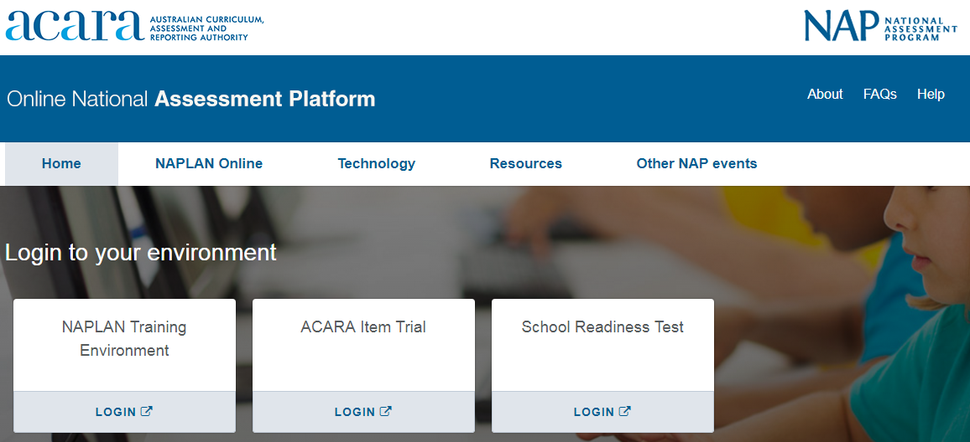
NAPLAN Online
Assessment Platform www.assessform.edu.au
Notes:
Moving to NAPLAN Online means that both students and school staff will use online systems.
Staff will always log in through the Assessment Platform ‘assessform’ website.
The Assessment Platform is the location of the Training and NAPLAN environments. This is where schools log in to administer the NAPLAN tests or conduct training.
It is important to note here that the environments on the Assessment Platform change from time to time; therefore, it is vital that you ensure you are accessing the correct environment for the task you are trying to perform.
Today we will be using the Training environment. You should bookmark this page now.

Slide 4
NAPLAN Online
Students
NAP Locked down browser | Unsecured access | Alternative formats
 | Assistive technology Colour overlay | Braille Black & White Large Print
Notes:
[Arrows are animated to appear upon clicks.]
Students use a different application to access the tests.
There are three ways students can do this:
through the NAP Locked down browser (primary access for most students) ― a shortcut on the desktop or an app on an iPad
using an unsecured URL (for students approved with the disability adjustment codes AST and COL)
using approved alternative formats such as braille, large print, and black and white.

Slide 5
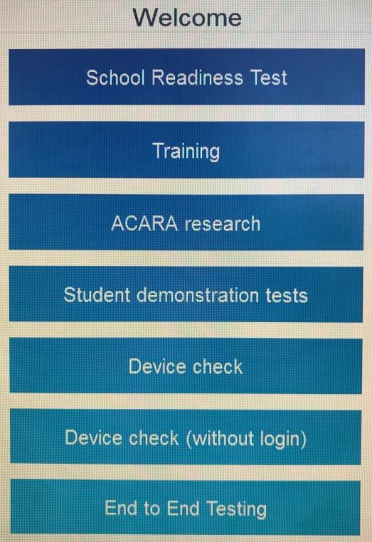
NAPLAN Online
Notes:
The NAP Locked down browser may appear as a shortcut on the desktop or an app on an iPad.
Just like the assessform website, it shows a number of available environments.
It is important that students log into the correct environment. To check this they will be able to see the name of the environment on the login screens.
When we use this today, we will access the Training environment.
Please note that the NAP Locked down browser is the one to install ― there is another locked down browser in the app store.

Slide 6
Roles
NAPLAN Coordinator
School Technical Support Officer
Test Administrator
Principal
P
NC
ST
TA
Accountable for the administration of the tests.
Can perform most tasks necessary for the preparation and delivery of the tests, as delegated by the principal.
Can perform specific tasks in the School Technical Readiness tile.
Administers the test sessions.
Notes:
[Roles are animated to appear upon clicks.]
There are four main roles associated with the administration of the NAPLAN Online tests. The size of the school will determine the number of people performing each of these roles (except Principal):
Principal ― accountable for NAPLAN administration
NAPLAN Coordinator ― can perform most of the tasks necessary for the preparation and delivery of NAPLAN tests, as delegated by the Principal
School Technical Support Officer ― can perform specific roles in the school technical support officer dashboard
Test Administrator ― is the only role that can start a test in the Assessment Platform.
Optional: Who are the people in our school who will fulfil these roles?

Slide 7
Not all TAs are the same …
TA
Test Administrator
$$≠$$
TA
Teacher Aide
Notes:
Note that NAPLAN Online uses the acronym TA to refer to the Test Administrator.
Test administrators can be teachers, school staff members and school support staff who are involved in delivering (administering) the NAPLAN tests to students.
It is sometimes confusing as the acronym ‘TA’ is commonly used to refer to a teacher aide or teacher assistant in schools.

Slide 8
NAPLAN Online
Tests are scheduled in the following order:
Writing
Reading
Conventions of language
Numeracy.
Year 3 students will sit the Writing test on paper.
Notes:
In the same way that paper based NAPLAN tests are conducted in a specific order, so is NAPLAN Online. The order of the tests is different for paper and online tests.
Tests are scheduled in the order as it appears on this screen.
A test schedule will be created by the Principal or NAPLAN Coordinator for our school that will outline when tests will occur over the testing window.
Please note that Year 3 students will sit the Writing test on paper.

Slide 9
Test Administrator (TA) Pack
The NAPLAN Coordinator will provide a TA Pack for each scheduled test session.
It is important to be familiar with the contents of the pack:
Test Administrator Session Slip
Student Session Slips
Test Administrator handbook for teachers
Test administrator quick reference — technical disruptions
Participating students list
Contact details for support.
Factsheet 12: Create Test Administrators (TA) packs
Notes:
To perform your role, each Test Administrator needs a TA Pack on the day of each test.
These are created by the Principal or NAPLAN Coordinator and given to you prior to the scheduled tests.
The following documents form the basis of the TA Pack.
Test Administrator Session Slip ― the Test Administrator uses the login details (the username and password) on this slip to log in to the Assessment Platform and create a Test Session code.
Student Session Slips ― the Test Administrator provides these to the students sitting the tests.
Test Administrator handbook for teachers ― for test administration guidelines, protocols and scripts.
Test administrator quick reference ― technical disruptions ― for troubleshooting technical issues during a test session
Participating students list ― contains information such as the class group and Disability Adjustment Codes (DACs). This list could be a class roll or a print out from the Assessment Platform.
Contact details for support ― to access support within the school if needed
The items in bold will be included in the TA Pack you will receive today.

Slide 10
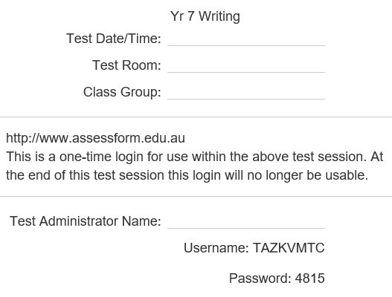
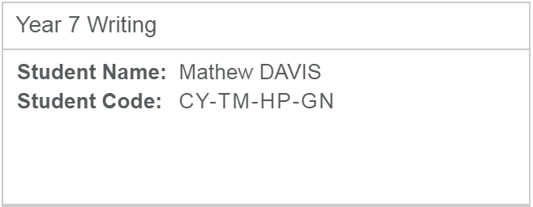
Test Administrator Session Slip (one for each test session)
Student Session Slip (for each student)
Notes:
[Boxes in red are animated to appear upon clicks.]
Let’s take a closer look at two essential parts of the TA Pack. These are created in the Assessment Platform by the Principal or NAPLAN Coordinator.
The Test Administrator Session Slip ― has the login details you will need to use to access the Assessment Platform. It is printed on an A4 piece of paper and has a description at the top. In this instance we have the date, year level and test type. Schools will include information here that helps them best organise their test sessions. Below this are the Username and Password details. Text in the middle of the slip provides the website address and reminder that this session slip is a one-time login.
Student Session slips ― has the login details for the student to access the test. At the top of the slip, we can see the name of the test. Below the title is the student name and the unique 8-letter Student Code. Once it has been used, and the test completed, it cannot be used again. Note that the test the student will sit is defined by the slip you give them.

Slide 11
Handbooks
Handbook for principals and NAPLAN coordinators ― NAPLAN Online
NAPLAN Online test administration handbook for teachers ― Year 3
NAPLAN Online test administration handbook for teachers ― Year 5
NAPLAN Online test administration handbook for teachers ― Years 7 & 9
+
Available electronically from the QCAA website www.qcaa.qld.edu.au/p-10/naplan-online.
Notes:
Our school will be accessing electronic versions of handbooks similar to those we have received in the past for paper based NAPLAN.
This will include the:
Handbook for principals and NAPLAN coordinators ― NAPLAN Online
NAPLAN Online test administration handbooks for teachers ― Years 3, 5, 7 and 9.

Slide 12
Test Administrator mini-handbook
QCAA has created the mini-handbook for preparation activities only.
Notes:
In addition, the QCAA have created a Test administration mini-handbook for teachers which is a condensed version of the original that we can use for training purposes.
It includes information on:
preparing for the test session
monitoring the test session
reading from the test administration script
finalising the test session
resolving test issues.
You will find this inside your TA Pack. Please note that this is for preparation activities only, and should not be used in NAPLAN testing.

Slide 13
Student readiness
The skills needed for online assessment include:
being familiar with devices (tablets, laptops, desktops)
using earphones
operating trackpad, mouse, touch screen, keyboard
navigating on screen
manipulating objects on screen
reading digital texts
composing digital texts.
Notes:
It is our school’s responsibility to help students develop the skills needed for all online assessment, including NAPLAN Online.
These are some general skills that students may need for online assessments.
While these skills will be helpful for NAPLAN Online, there are also some specific things that our students will need to be familiarised with through the NAPLAN Public Demonstration site.

Slide 14
Student readiness
The Public Demonstration site provides:
Familiarisation:
all year levels
all test domains
alternative items
accessibility options.
Explicit teaching required:
use audio
navigate the screen
manipulate objects
interact with tools
flag items
progress summary.
Notes:
It is highly recommended that students are taken through ACARA’s Public Demonstration Site to familiarise them with the style of test that will be presented to them in NAPLAN Online.
When students take a demonstration test, they will see a range of different question types. Some of these include: multiple choice/s, checkbox, text entry, dropdown list, drawing lines, and drag and drop. Students will need familiarisation with some of these question types.
This site allows teachers to familiarise students with:
all test domains in the appropriate NAPLAN year level
alternative items and accessibility options, if required.
Explicit teaching is also required before NAPLAN on how to complete the following tasks in the NAP Locked down browser:
using the audio player, when required
navigating using features on the screen
manipulating objects on the screen
interacting with the onscreen tools in the Numeracy test ― ruler, protractor & calculator (Years 7 & 9 only)
flagging items they are unsure of so they can come back to review them
using the Progress summary screen to move quickly between flagged items to review.

Slide 15
Student readiness
In addition, students should be aware of:
three audio check options (3rd option only for Reading)
listening to audio
time management
planning, writing and editing a text within a time frame
messaging between testlets
locked calculator testlet message (Years 7/9 Numeracy).
Notes:
Students also need to be familiar with completing the audio check in the locked down browser. For all tests other than Reading, students should click on the Play icon to check they can hear the sound. If they can’t hear it, they need to close the locked down browser, adjust the sound settings on their device, open the locked down browser and try playing the audio again.
For the Reading test only, students don’t need to click the Play icon and, instead, can select the 3rd option I do not need to check my audio.
Students should be made aware that listening to the audio is not compulsory. Even though audio is available for every question in Numeracy, they do not have to listen to every question if they don’t need to.
Time management using the timer on the screen is another thing that students should be familiar with as:
the Writing test requires them to plan, write and edit a text within a set timeframe
items in the last testlet for Reading, Conventions of language and Numeracy may be a little more challenging and may require a little more time.
There are also some messages at the end of testlets that students need to understand and pay attention to:
End of testlet message ― reminds students to check their answers before moving to the next section as their answers will be scored when they click Next. Student can still return to these previous testlets and change their answers later but their pathway through the test will not change.
End of non-calculator testlet message ― only presented at the end of the first testlet in Years 7 & 9 Numeracy (non-calculator questions). Once students move past this message they cannot return to the non-calculator testlet ― if they try to do so they will see a locked testlet message.

Slide 16
Public demonstration site
www.nap.edu.au
Notes:
This Public Demonstration site is provided by ACARA for schools to familiarise students with the NAPLAN Online tests.
Note, that this is also a website that parents can access to see what their children will experience in the online test.
There are several ways to access this site:
NAP website – as on the screen. Select NAPLAN Online > Public demonstration site
NAP Locked down browser – this is how students at school should be accessing it on student devices: select Demonstration tests
You should bookmark this now if you haven’t already.
You may wish to use slides 17-25 in this presentation with your class while familiarising students with the Demonstration tests.

Slide 17
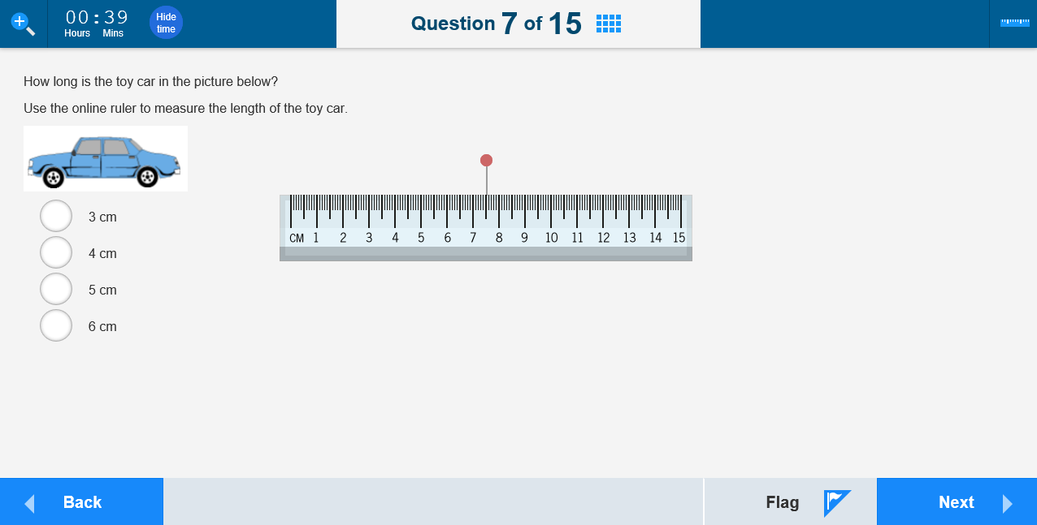
Public demonstration site
Year 5 Numeracy example
Notes:
[Boxes in red are animated to appear upon clicks.]
In addition to the familiarisation of the different question types, students should be shown the different features on the page they are viewing. In this Year 5 Numeracy example:
Top left corner ― magnifier tool and timer. The magnifier tool allows students to enlarge the screen they are using. Note that this may require scrolling to view the whole question. The timer counts down the test time remaining for the student. Students can select the Hide time button to hide the timer if they prefer. The timer flashes to alert students when there is 5 minutes left on the test.
Top centre ― indicates a student’s current test question and the number of items.
Also, top centre ― the grid icon opens a progress summary screen.
Top right ― tool symbol which is available for some items only. This item is a numeracy question that requires a ruler. When selected, it appears in the middle of the screen. The calculator may also been seen in Years 7 & 9 numeracy tests.
Bottom left ― Back button. To move back to previous questions if needed. In the opposite bottom right corner is the Next button to progress through the questions.
Bottom right ― Beside the Next button is the Flag button, which allows students to flag a question they might want to go back to later.

Slide 18
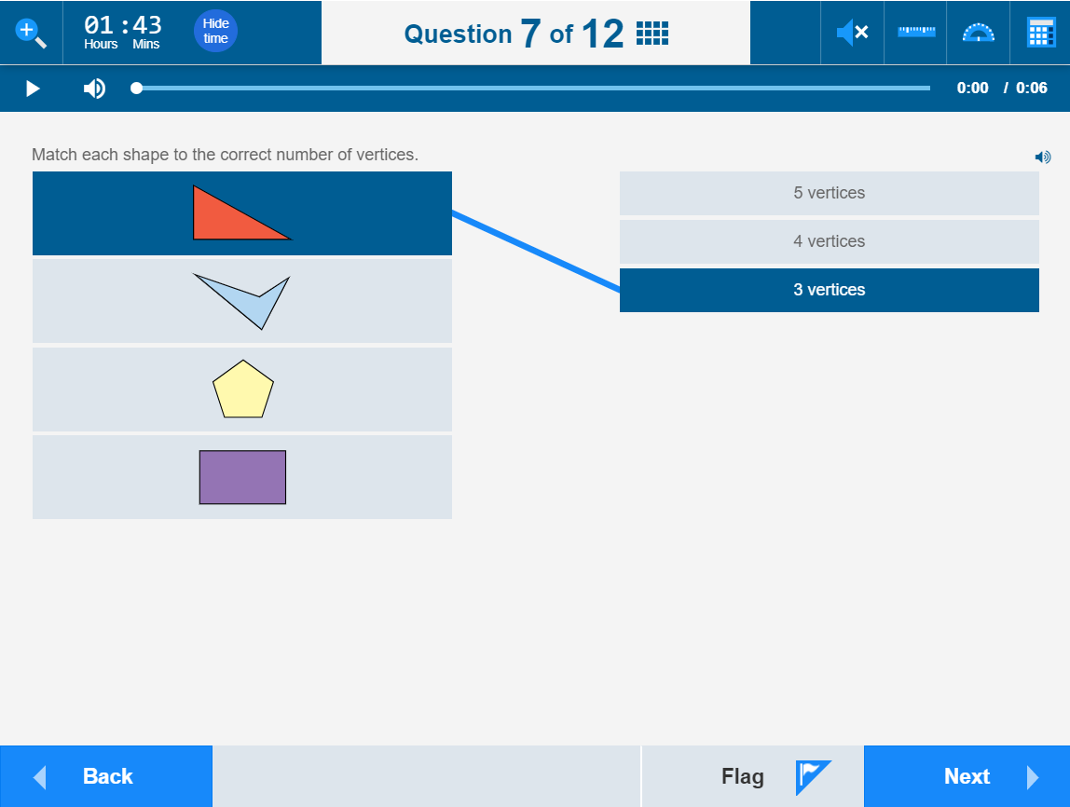
Public demonstration site
Year 7 Numeracy example
Notes:
[Boxes in red are animated to appear upon clicks.]
This question type is important for students to be familiarised with as it can be confusing. This question requires matching to more than one option ― there are four shapes on the left and only three options on the right, so some students will only draw lines to match three of the shapes instead of all four as required. In addition to the familiarisation of the different question types, students should be shown the different features on the page they are viewing.
In this Year 7 Numeracy example:
Top left corner ― magnifier tool and timer. The magnifier tool allows students to enlarge the screen they are using. Note that this may require scrolling to view the whole question. The timer counts down the test time remaining for the student. Students can select the Hide time button to hide the timer if they prefer. The timer flashes to alert students when there is 5 minutes left on the test.
Top centre ― indicates a student’s current test question and the number of items.
Also, top centre ― the grid icon opens a progress summary screen.
Top right ― tool symbol which is available for some items only. The tools available here are the ruler, the protractor and the calculator. The calculator is only available in the calculator allowed sections of the Year 7 & 9 numeracy tests. When selected, each tool appears in the middle of the screen.
Bottom left ― Back button. To move back to previous questions if needed. In the opposite bottom right corner is the Next button to progress through the questions.
Bottom right ― Beside the Next button is the Flag button, which allows students to flag a question they might want to go back to later.

Slide 19
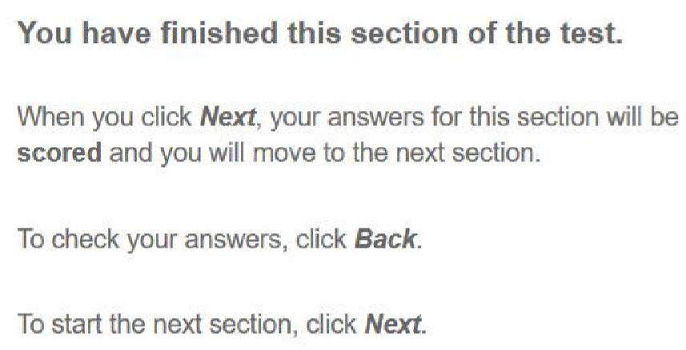
Public demonstration site
Notes:
This is an example of the automated message students will see at the end of each section of the tests for Reading, Conventions of language and Numeracy. It is highly recommended that students check over their answers in each section before clicking Next to progress to the next section of the test. At the end of each test section, the student’s answers in that section are marked and the next section of questions presented to the student is based on these marks.

Slide 20
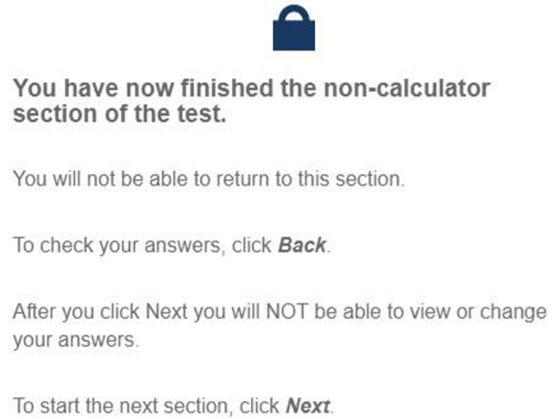
Public demonstration site
Notes:
Years 7 and 9 Numeracy tests have separate sections for non-calculator and calculator allowed questions. In these tests, the student will see a warning message on their test player that advises that the non-calculator section is complete and that they must check their answers before progressing.
Once Next is selected after this message, the non-calculator questions will be locked, and will not be editable. Selecting Back from this point will display a Question locked message. These questions will also display with a lock icon on the Progress summary screen, which is opened by clicking on the blue grid symbol in the top centre of the screen.

Slide 21
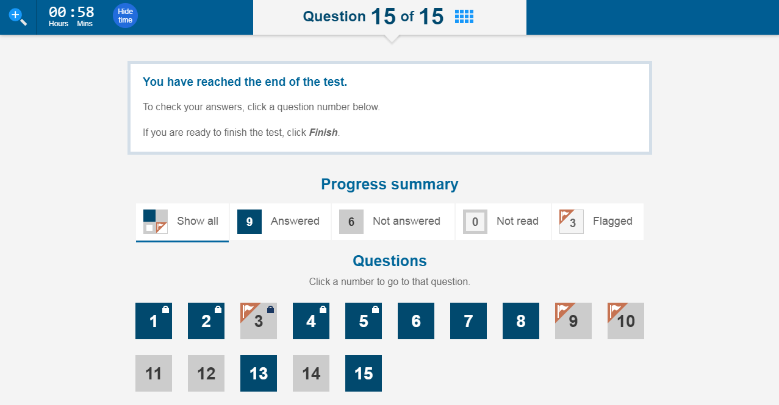
Public demonstration site
Notes:
This page shows the progress summary of the student test. It appears at the end of each test or when the grid is selected at the top of the page.
Students can see at a glance which questions they have answered, not answered, not read yet and flagged. You can also see here that Questions 1−5 are locked as they are non-calculator questions.
They can select any of the unlocked question boxes to go directly to that question so it’s a great tool for them to review and check their answers. After reviewing a question, students can select the grid again to be able to quickly go to another flagged question.

Slide 22
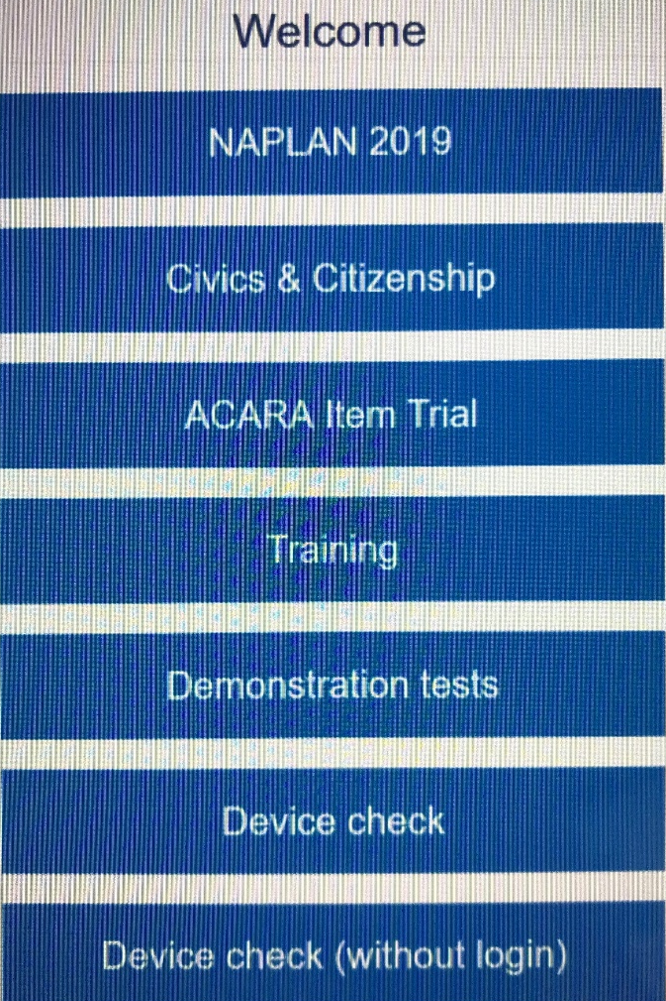
The student experience
Locate the icon on your desktop.
Open the NAP Locked down browser.
Select Demonstration tests.
Notes:
Now we will take a few minutes to explore how you can use the Public demonstration site through the NAP locked down browser to familiarise your students with the NAPLAN Online tests.
In the same way the Assessment Platform has a number of available environments, so does the Locked Down Browser. It is important that students choose the correct environment ― in this case, select Demonstration tests.

Slide 23
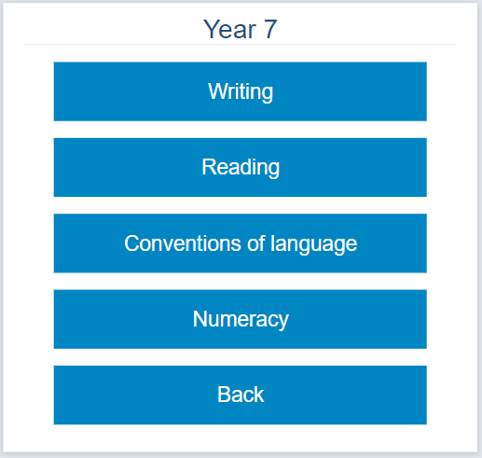
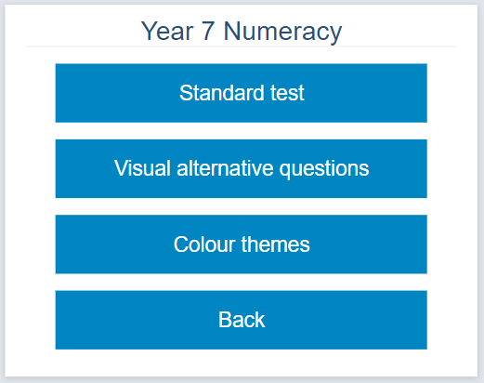
Select Year level, then test type:
Notes:
Select a year level appropriate to your students’ year level, then select a test, then either a standard test or one with alternative items or colour themes.

Slide 24
Session code
Student code
Notes:
Students will be presented with two successive screens that require unique 8-letter codes. There are several things to point out on these screens:
The title at the top confirms the environment the student has logged into.
The text underneath the title, indicates the code that needs to be entered and where it comes from.
It is important that students use the correct code in the correct place ― it is easy to confuse them.
First screen ― Session code ― this is the code the Test Administrator will write on the board. By entering this code, the student connects to the correct test session.
Second screen ― Student code ― this is the code the students have on their piece of paper. By entering this code, the student joins the test session as a specific student sitting a specific test. In the demonstration tests, these codes are prefilled to simulate the student login experience.

Slide 25
Confirm name
Confirm test
Notes:
Once a correct Session Code and Student Code are entered, the student is asked to confirm that the test name and their name is correct. In the Demonstration tests, a generic student name is used.
If the test and name are correct, the student selects Yes and will see a Wait to begin screen until the Test Administrator starts the test after all students are logged in. However, in the demonstration tests students may click on Test to start immediately.

Slide 26
Take some time to
explore the demonstration test.
Notes:
Take a little time to explore the demonstration test you have chosen now.
[At end of exploration time.]
You should now close down the NAP Locked down browser.
To do this:
Select Logout at the bottom of the screen, you will then be asked if you are sure you want to log out.
Click Yes.
Select the X at the bottom right of the screen.
You will then see an extra message asking you if you are sure you want to logout? Select Yes.

Slide 27
Supporting websites
QCAA
www.qcaa.qld.edu.au/p-10/naplan-online
Queensland Department of Education https://naplanonline.qld.edu.au
ACARA
www.assessform.edu.au
Public demonstration site
http://www.nap.edu.au/online-assessment/public-demonstration-site
Notes:
The following websites have a range of supporting resources available to schools.
These include:
QCAA ― factsheets and guides that summarise the steps for the main tasks that school staff need to carry out, in addition to the regular monthly NAPLAN newsletters that can be subscribed to (no password required).
Qld Department of Education ― information on school, staff and student readiness, in addition to parent information and other links (no password required).
ACARA ― detailed guides for the NAP Locked down browser, training guides, user guides and videos for Principals, NAPLAN Coordinators and School Technical Support Officers (password access required).
Public demonstration site ― provides a way to familiarise students with the style of test and questions that will be presented to them (no password required).

Slide 28
End of Part A
See www.qcaa.qld.edu.au/p-10/naplan-online/resources
for other materials in this series.

