Slide 1
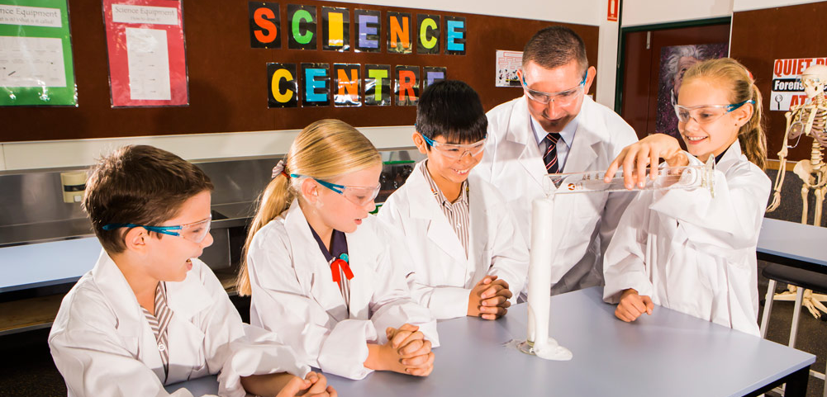
Learning area overview
Prep–Year 10 Australian Curriculum: Science
Notes:
This presentation supports understanding of the Australian Curriculum: Science Prep*–Year 10. It gives insight into the position of Science within the Australian Curriculum and the structure of the Science learning area.
You can use this presentation in your organisation as the basis for professional learning about the Science curriculum. It includes information about the key aspects of the curriculum, as well as activities for becoming familiar with the curriculum. An icon in the top-right corner of a slide identifies opportunities for activities. Presenters are encouraged to tailor this presentation to suit the needs of their audience.
The Australian Curriculum content referred to in this presentation is available from:
Australian Curriculum, Assessment and Reporting Authority (ACARA) 2017, Australian Curriculum Version 8 Foundation to Year 10, www.australiancurriculum.edu.au.
*Prep (P) in Queensland is the Foundation Year (F) of the Australian Curriculum and refers to the year before Year 1. Children beginning Prep in January are required to be five years of age by 30 June.

Slide 2
Learning goals
This presentation aims to:
build understanding of the Australian Curriculum: Science
provide an overview of the structure of the Science learning area.
Notes:
This presentation aims to:
build understanding of the Australian Curriculum, with particular reference to the Science curriculum
provide an overview of the structure of the Science learning area, including the curriculum content and achievement standards.

Slide 3
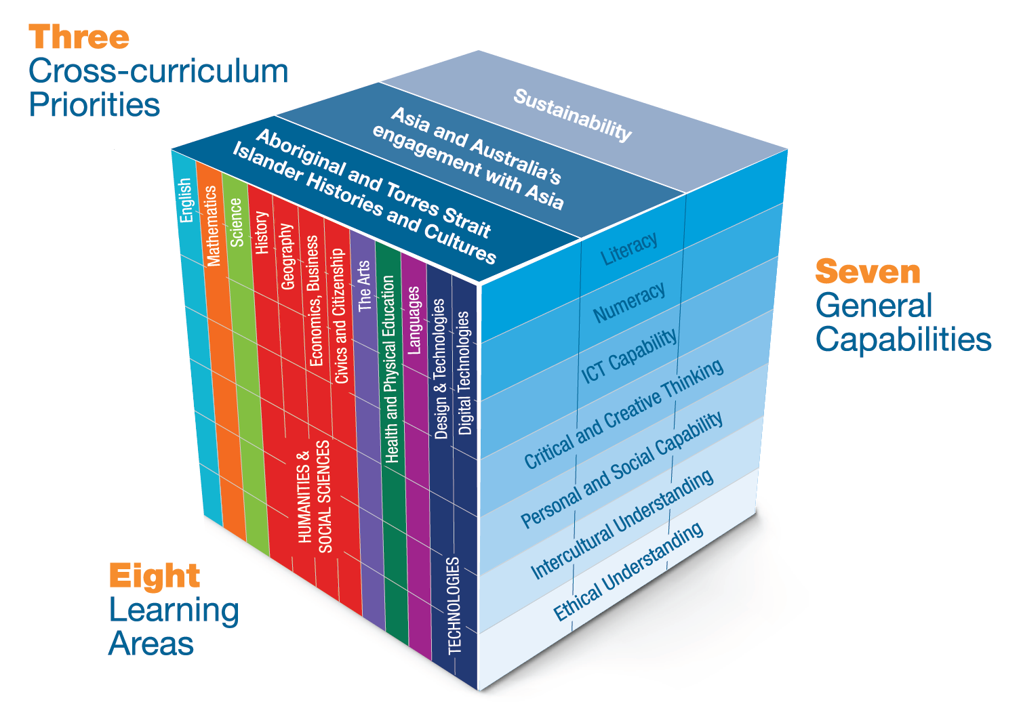
Three-dimensional curriculum
The Australian Curriculum is a three-dimensional curriculum made up of:
learning areas
general capabilities
cross-curriculum priorities.
English
Notes:
The Australian Curriculum sets the expectations for what all Australian students should be taught and have the opportunity to learn as they progress through their school life. In Prep to Year 10, the Australian Curriculum provides teachers, students, and parents with access to the same content, and consistent national standards for determining the progress of student learning.
All Australian students across all education settings and contexts can be supported in their diverse learning needs through the three dimensions of the Australian Curriculum: the learning area content, the general capabilities and the cross-curriculum priorities.
This diagram shows the relationship between these dimensions of the Australian Curriculum. Teachers emphasise one or more dimensions to develop learning programs suited to the strengths, interests and diverse needs of all students.
This presentation provides a brief overview of the general capabilities and cross-curriculum priorities. However, the focus will be on the Science learning area.

Slide 4
Structure of the Science learning area
Rationale
Aims
Key ideas
Year-by-year and banded curriculum
Year-level descriptions
Curriculum content
Strands and sub-strands
Intent of interrelated strands
Content descriptions
Content elaborations
Achievement standards
Notes:
The Australian Curriculum sets out what all young people should be taught by specifying the curriculum content, and identifies the learning expected at points in their schooling by specifying the achievement standards. The content and achievement standards are supported by additional information that describes the curriculum intent (rationale), aims of learning (aims), key ideas, and focus for the learning at specific year levels (year-level descriptions).
The following sections of the presentation will provide an overview of each of these key aspects of the curriculum.

Slide 5
Rationale
Learning area summary
In the Science learning area, students develop scientific knowledge, understandings and skills that will enable them to make informed decisions about local, national and global issues while nurturing their natural curiosity about the world around them.
Video
Introduction to Science
www.australiancurriculum.edu.au/f-10-curriculum/science/rationale
Notes:
The rationale defines the learning area and describes the importance of the learning area within the curriculum:
Why is it important?
How is it shaped in the curriculum?
The Science rationale promotes:
developing an understanding of important science concepts and processes, the practices used to develop scientific knowledge, science’s contribution to our culture and society, and applications in our lives
developing the scientific knowledge, understandings and skills to make informed decisions about local, national and global issues
experiencing the joy of scientific discovery and nurturing students’ natural curiosity about the world around them
developing critical and creative thinking skills, and identifying questions and drawing evidence-based conclusions using scientific methods
gaining the capability to investigate the natural world and changes made to it through human activity
thinking and acting in scientific ways to build the broader suite of capabilities as confident, self-motivated and active members of our society.
The rationale is available from: www.australiancurriculum.edu.au/f-10-curriculum/science/rationale.
Suggested activities
Read the learning area rationale or watch the introductory video. Partner with a colleague to discuss the following questions:
What were the key aspects of the rationale?
Why is the learning area important? What important contribution does the learning make to a student’s education?
Which aspects of this rationale matched your current understanding of the learning area? Which aspects were new understandings?
Watch and listen to the video.
What were the guiding principles that informed the development of the Science curriculum?
Are there any messages that you will need to consider when planning your teaching, learning and assessment programs?

Slide 6
Aims
Learning area summary
Learning through Science enables students to:
explore, explain and predict phenomena
use a range of scientific inquiry methods
make informed, evidence-based decisions
evaluate and debate scientific decisions.
Notes:
The aims flow logically from the rationale and define the big-picture objectives for the learning area.
The Science learning area aims to develop the knowledge, understanding and skills to enable students to:
expand their curiosity and willingness to explore, ask questions about and speculate on the changing world in which they live
use a range of scientific inquiry methods to make informed, evidence-based decisions
evaluate and debate scientific arguments and claims
solve problems and make informed, evidence-based decisions while taking into account ethical and social implications of decisions
apply understanding of phenomena to new situations and events, and appreciate the dynamic nature of science knowledge.
The aims are available from: www.australiancurriculum.edu.au/f-10-curriculum/science/aims.
Suggested activities
Prepare a brief statement/overview that would help you describe the aims of the learning area to a parent group.
Identify two or three big ideas in the aims. How do they inform:
your understanding of the learning area?
what is valued in the Australian Curriculum for the learning area?
your teaching and learning approaches?

Slide 7
Key ideas
Patterns, order and organisation
Form and function
Stability and change
Scale and measurement
Matter and energy
Systems
Notes:
The key ideas represent key aspects of the learning area content, and frame the development of knowledge and skills in the learning area.
The key ideas represent significant aspects of a scientific world view, and bridge knowledge and understanding across the disciplines of science. They are embedded within each year-level description and guide the teaching/learning emphasis for the year.
In the Science learning area, there are six key ideas:
patterns, order and organisation
form and function
stability and change
scale and measurement
matter and energy
systems.
The key ideas are available from: www.australiancurriculum.edu.au/f-10-curriculum/science/key-ideas.
Patterns, order and organisation: An important aspect of science is recognising patterns in the world around us, and ordering and organising phenomena at different scales.
Form and function: Many areas of science are concerned with the relationships between form (the nature or make-up of an aspect of an object or organism) and function (the use of that aspect).
Stability and change: Many areas of science involve the recognition, description and prediction of stability and change.
Scale and measurement: Quantifying time and spatial scale is critical to developing science understanding because it allows observations to be compared.
Matter and energy: Many aspects of science involve identifying, describing and measuring transfers of energy and/or matter.
Systems: Science frequently involves thinking, modelling and analysing in terms of systems in order to understand, explain and predict events and phenomena.
Suggested activities
What are the key ideas? How do they affect your reading of the content?
How are the key ideas reflected in your Science program?

Slide 8
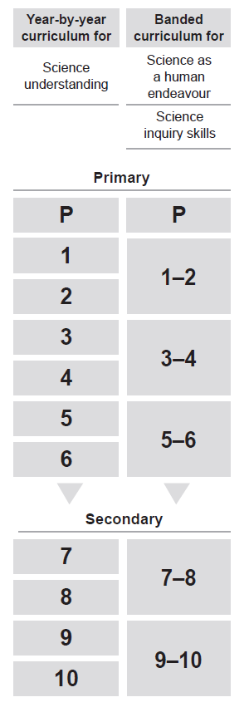
Year-by-year and banded curriculum
Each year level of the Australian Curriculum: Science includes the following structural components:
year-level description
year-by-year content for the Science understanding strand
banded content for the Science as a human endeavour strand
banded content for the Science inquiry skills strand
year-by-year achievement standards.
The curriculum is developmentally sequenced across the year levels.
Notes:
The Science curriculum is structured into both year-by-year and banded curriculum content. The banded curriculum content enables flexible delivery of Science across Prep–Year 10.
Suggested activity
What are the implications for planning your teaching, learning and assessment program using banded content (Science as a human endeavor strand and Science inquiry skills strand) and year-by-year content (Science understanding strand)?

Slide 9
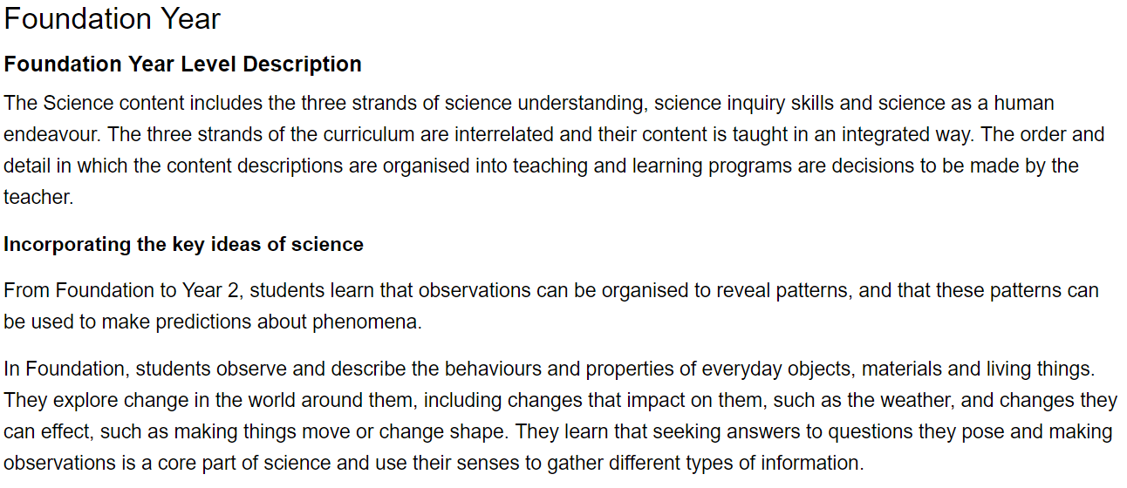
Year-level descriptions
Content
Key ideas
Notes:
Each Science year-level description identifies the:
focus of knowledge, understanding and skills for student learning in that year level
interrelated nature of the three strands to emphasise the importance of teaching the content of the three strands in an interrelated way
broad focus of the key ideas for the particular phase of learning
specific key ideas to be addressed in the year level.

Slide 10
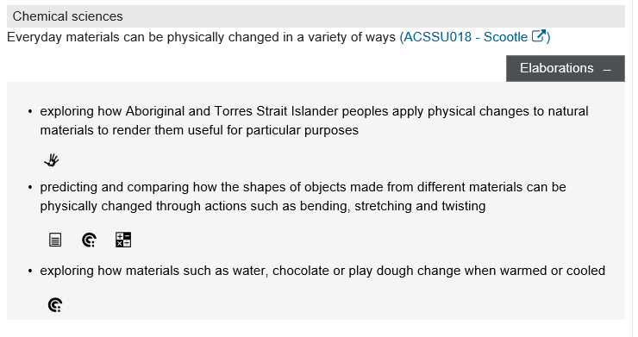
Curriculum content
Content description
Content elaborations
Notes:
The curriculum content is presented as content descriptions that specify the knowledge, understanding and skills young people are expected to learn and teachers are expected to teach across the years of schooling.
The content descriptions are accompanied by content elaborations. Content elaborations provide illustrations and/or examples that teachers may choose to use in the classroom or as inspiration for their own activities. The content elaborations are not a mandatory aspect of the curriculum and as such are not required to be taught.
Suggested activity
Use the Science: Sequence of content to build an understanding of the sequence of content of the curriculum across year levels: www.australiancurriculum.edu.au/f-10-curriculum/science/science-scope-and-sequence-pdf.
Consider the content descriptions for the year level/band prior to and following the selected year level/band.
In a small group, discuss how the curriculum develops in increasing complexity of cognition and skills across the year levels/bands.

Slide 11
Strands and sub-strands Intent of the interrelated strands
 | Strands
 | discipline-specific content | taught in |  | context | informed by |  | inquiry model
 | Science understanding |  | Science as a human endeavour |  |  | Science inquiry skills
Sub-strands | Biological sciences |  | Nature and development of science |  |  | Questioning and predicting
 | Chemical sciences |  | Use and influence of science (1–10) |  |  | Planning and conducting
 | Earth and space sciences |  |  |  |  | Processing and analysing data and information
 | Physical sciences |  |  |  |  | Evaluating (1–10)
 |  |  |  |  |  | Communicating
Notes:
In Science, the curriculum content is organised through strands and sub-strands. The three strands are:
Science understanding
Science as a human endeavour
Science inquiry skills.
These strands are interrelated to inform and support each other.
Some of the examples of knowledge and skills are relevant to specific year levels.
Each strand is organised into sub-strands:
Science understanding
Biological sciences
Chemical sciences
Earth and space sciences
Physical sciences
Science as a human endeavour
Nature and development of science
Use and influence of science (1–10)
Science inquiry skills
Questioning and predicting
Planning and conducting
Processing and analysing data and information
Evaluating (1–10)
Communicating
The discipline-specific content in Science understanding is taught using contexts from Science as a human endeavour, using an inquiry model informed by Science inquiry skills.
Information on strands and sub-strands is available from: www.australiancurriculum.edu.au/f-10-curriculum/science/structure.
Suggested activity
What is the relationship between the content strands of Science?

Slide 12
Achievement standards
Year 2 Achievement Standard
By the end of Year 2, students describe changes to objects, materials and living things. They identify that certain materials and resources have different uses and describe examples of where science is used in people’s daily lives.
Students pose and respond to questions about their experiences and predict outcomes of investigations. They use informal measurements to make and compare observations. They record and represent observations and communicate ideas in a variety of ways.
Understanding
Skills
Notes:
The achievement standard is a statement of what students should know and be able to do at the end of the year level. In Science, the first paragraph of the achievement standard relates to understanding and the second paragraph relates to skills. The concepts that underpin and connect understanding are related to a student’s ability to appropriately select and apply knowledge to solve problems. The skills provide the specific techniques, strategies and processes in Science.
Work sample portfolios provide examples of student work that are reflective of achievement levels at, above and below the achievement standard.
Suggested activities
Using the Science: Sequence of achievement, discuss how the evidence that students need to provide of what they know and can do increases in complexity across year levels: www.australiancurriculum.edu.au/f-10-curriculum/science/science-scope-and-sequence-pdf.
For a given year level, map the achievement standard to the content descriptions.

Slide 13
Three-dimensional curriculum: General capabilities
Support students to be successful learners
Literacy
Numeracy
Information and communication technology (ICT) capability
Critical and creative thinking
Develop ways of being, behaving and learning to live with others
Personal and social capability
Ethical understanding
Intercultural understanding
Notes:
The seven capabilities are divided into two groups:
capabilities that support students to be successful learners ― literacy, numeracy, information and communication technology (ICT) capability, and critical and creative thinking
capabilities that develop ways of being, behaving and learning to live with others ― personal and social capability, ethical understanding and intercultural understanding.
Continua of learning have been developed for each capability to describe the relevant knowledge, understanding and skills at particular points of schooling.
The content outlined in the general capabilities continua is embedded in the content descriptions for each learning area, where appropriate. The icons shown on this slide are used to identify where the general capabilities are embedded in content descriptions.
A summary of the focus of each of the general capabilities in the Science learning area is available from: www.australiancurriculum.edu.au/f-10-curriculum/general-capabilities. On the general capabilities overview webpage, scroll down to ‘Learning area specific advice’.

Slide 14
Three-dimensional curriculum: Cross-curriculum priorities
Aboriginal and Torres Strait Islander histories and cultures Asia and Australia’s engagement with Asia Sustainability
Notes:
The Australian Curriculum promotes three cross-curriculum priorities that young Australians should learn about. Each of the priorities is represented in learning areas in ways appropriate to that area.
The three priorities are:
Aboriginal and Torres Strait Islander histories and cultures ― to ensure that all young Australians are given the opportunity to gain a deeper understanding and appreciation of Aboriginal and Torres Strait Islander histories and cultures, their significance for Australia, and the impact that these have had, and continue to have, on our world
Asia and Australia’s engagement with Asia ― to reflect the importance of knowing about Asia and Australia’s engagement with Asia, and to encourage better understanding of the countries and cultures of the Asia region so that young people appreciate the economic, political and cultural interconnections that Australia has with the region
Sustainability ― to allow young people to develop an appreciation of the need for more sustainable patterns of living, and to build capacities for thinking, valuing and acting that are necessary to create a more sustainable future.
Each of the cross-curriculum priorities contains a set of organising ideas. These are consistent across the curriculum and are reinforced in learning areas. Each of the cross-curriculum priorities can be relevant to teaching and learning in Science, and explicit teaching of the priorities should be incorporated in teaching and learning activities where appropriate.

Slide 15
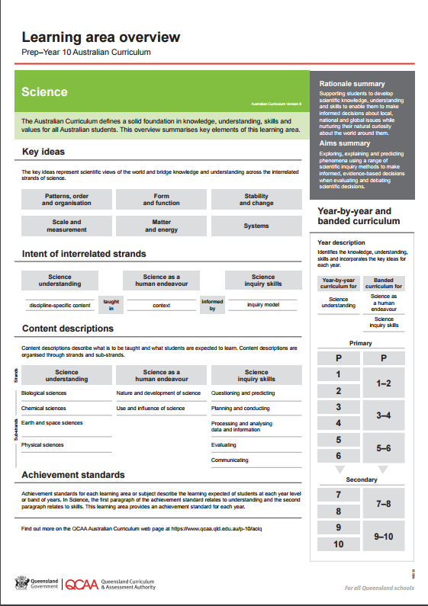
Find out more
Find out more on the QCAA Australian Curriculum webpage at www.qcaa.qld.edu.au/p-10/aciq.
Notes:
More information about the implementation of Australian Curriculum in Queensland is available on the QCAA website. In the Australian Curriculum section of the QCAA website, you will find the Learning area overview: Prep‒Year 10 Australian Curriculum — Science: www.qcaa.qld.edu.au/aciq.
Send any further questions to: australiancurriculum@qcaa.qld.edu.au.
Information about requests for further professional learning is available from: www.qcaa.qld.edu.au/pd-events/request-pd.
Suggested activity
What did I learn?
What was confirmed?
What was new?
What challenged my thinking?
What else do I need to do?
What is our plan as a teaching team?

Slide 16
Copyright information
Slides 3 and 8–14: Images and text © Australian Curriculum, Assessment and Reporting Authority (ACARA) 2009 to present, unless otherwise indicated. This material was downloaded from the ACARA website (www.acara.edu.au) (Website) (accessed Mar 25, 2019) and was not modified. The material is licensed under CC BY 4.0 (https://creativecommons.org/licenses/by/4.0/). ACARA does not endorse any product that uses ACARA material or make any representations as to the quality of such products. Any product that uses material published on this website should not be taken to be affiliated with ACARA or have the sponsorship or approval of ACARA. It is up to each person to make their own assessment of the product.

