Slide 1
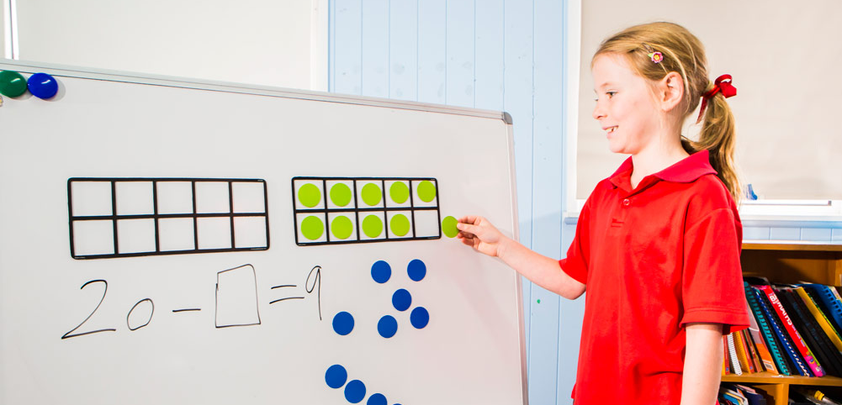
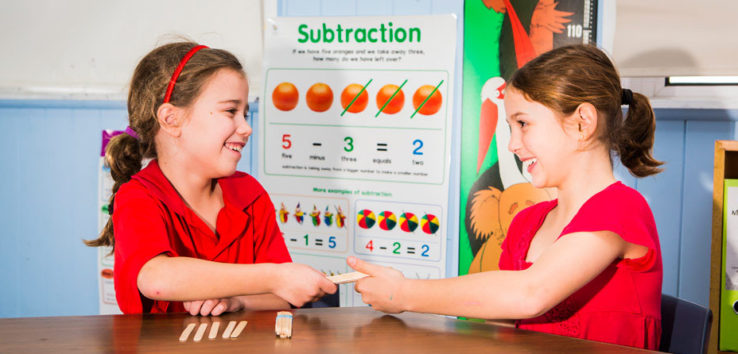
Learning area overview
Prep–Year 10 Australian Curriculum: Mathematics
Notes:
This presentation supports understanding of the Australian Curriculum: Mathematics Prep*–Year 10. It gives insight into the position of Mathematics within the Australian Curriculum and the structure of the Mathematics learning area.
You can use this presentation in your organisation as the basis for professional learning about the Mathematics curriculum. It includes information about the key aspects of the curriculum, as well as activities for becoming familiar with the curriculum. An icon in the top-right corner of a slide identifies opportunities for activities. Presenters are encouraged to tailor this presentation to suit the needs of their audience.
The Australian Curriculum content referred to in this presentation is available from:
Australian Curriculum, Assessment and Reporting Authority (ACARA) 2017, Australian Curriculum Version 8 Foundation to Year 10, www.australiancurriculum.edu.au.
*Prep (P) in Queensland is the Foundation Year (F) of the Australian Curriculum and refers to the year before Year 1. Children beginning Prep in January are required to be five years of age by 30 June.

Slide 2
Learning goals
This presentation aims to:
build understanding of the Australian Curriculum: Mathematics
provide an overview of the structure of the Mathematics learning area.
Notes:
This presentation aims to:
build understanding of the Australian Curriculum, with particular reference to the Mathematics curriculum
provide an overview of the structure of the Mathematics learning area, including the curriculum content and achievement standards.

Slide 3
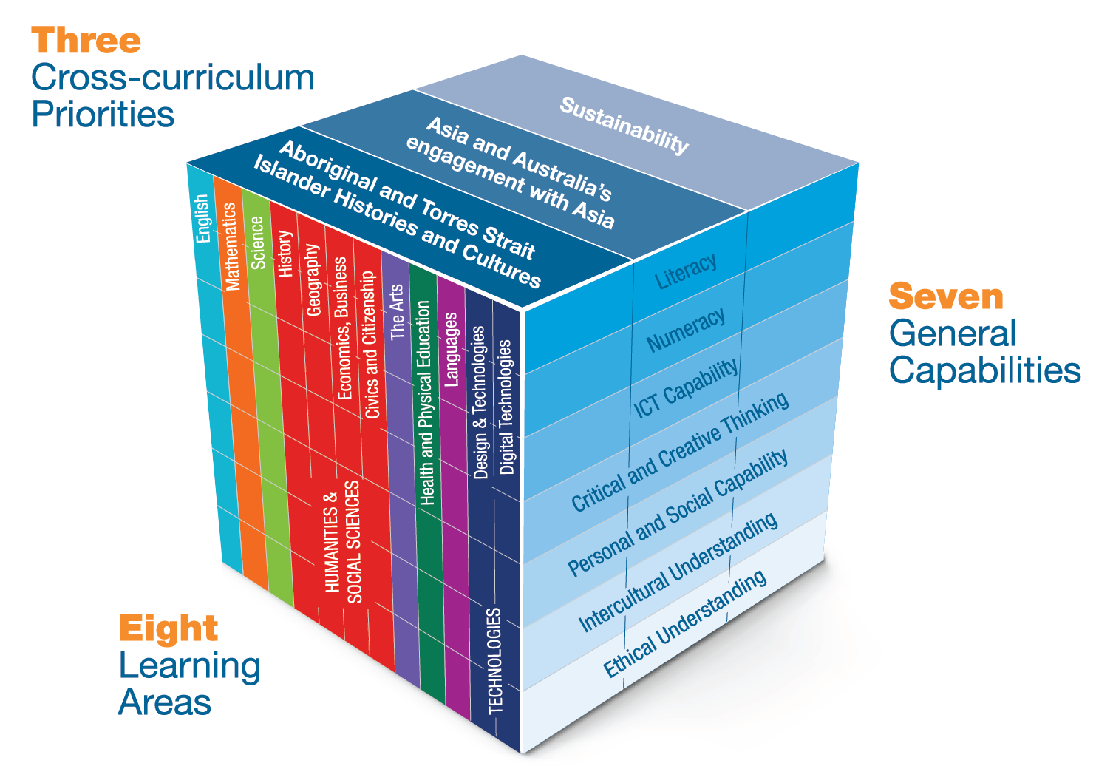
Three-dimensional curriculum
The Australian Curriculum is a three-dimensional curriculum made up of:
learning areas
general capabilities
cross-curriculum
priorities.
English
Notes:
The Australian Curriculum sets the expectations for what all Australian students should be taught and have the opportunity to learn as they progress through their school life. In Prep to Year 10, the Australian Curriculum provides teachers, students, and parents with access to the same content, and consistent national standards for determining the progress of student learning.
All Australian students across all education settings and contexts can be supported in their diverse learning needs through the three dimensions of the Australian Curriculum: the learning area content, the general capabilities and the cross-curriculum priorities.
This diagram shows the relationship between these dimensions of the Australian Curriculum. Teachers emphasise one or more dimensions to develop learning programs suited to the strengths, interests and diverse needs of all students.
This presentation provides a brief overview of the general capabilities and cross-curriculum priorities. However, the focus will be on the Mathematics learning area.

Slide 4
Structure of the Mathematics learning area
Rationale
Aims
Key ideas
Year-by-year curriculum
  Year-level descriptions
Curriculum content
  Strands and sub-strands
  Content descriptions
  Content elaborations
Achievement standards
Notes:
The Australian Curriculum sets out what all young people should be taught by specifying the curriculum content, and identifies the learning expected at points in their schooling by specifying the achievement standards. The content and achievement standards are supported by additional information that describes the curriculum intent (rationale), aims of learning (aims), key ideas, and focus for the learning at specific year levels (year-level descriptions).
The following sections of the presentation will provide an overview of each of these key aspects of the curriculum.

Slide 5

Rationale
Learning area summary
In the Mathematics learning area, students develop the numeracy capabilities needed to make informed, efficient decisions in the real world and learn the fundamentals on which further mathematics are built.
Video
Introduction to Mathematics
www.australiancurriculum.edu.au/f-10-curriculum/mathematics/rationale
Notes:
The rationale defines the learning area and describes the importance of the learning area within the curriculum:
Why is it important?
How is it shaped in the curriculum?
The Mathematics rationale promotes:
an appreciation of the elegance and power of mathematical reasoning
increasingly sophisticated and refined mathematical understanding, fluency, reasoning and problem-solving skills
links between the various components of mathematics, as well as the relationship between mathematics and other disciplines
self-motivated, confident learning through enquiry and active participation in challenging and engaging experiences.
The rationale is available from: www.australiancurriculum.edu.au/f-10-curriculum/mathematics/rationale.
Suggested activities
Read the learning area rationale or watch the introductory video. Partner with a colleague to discuss the following questions:
What were the key aspects of the rationale?
Why is the learning area important? What important contribution does the learning make to a student’s education?
Which aspects of this rationale matched your current understanding of the learning area? Which aspects were new understandings?
Watch and listen to the video.
What were the guiding principles that informed the development of the Mathematics curriculum?
Are there any messages that you will need to consider when planning your teaching, learning and assessment programs?

Slide 6
Aims
Learning area summary
Learning through Mathematics aims to
ensure students:
become confident, creative users of mathematics
develop the ability to pose and solve problems
recognise the connections between the areas of mathematics and other disciplines.
Notes:
The aims flow logically from the rationale and define the big-picture objectives for the learning area.
The Mathematics learning area aims to develop students’ knowledge, understanding and skills so that they:
become confident, creative users and communicators of mathematics, able to investigate, represent and interpret situations in their personal and work lives, and as active citizens
develop an increasingly sophisticated understanding of mathematical concepts and fluency with processes, able to pose and solve problems as well as reason in Number and algebra, Measurement and geometry, and Statistics and probability
recognise connections between the areas of mathematics and other disciplines, and appreciate mathematics as an accessible and enjoyable discipline to study.
The aims are available from: www.australiancurriculum.edu.au/f-10-curriculum/mathematics/aims.
Suggested activities
Prepare a brief statement/overview that would help you describe the aims of the learning area to a parent group.
Identify two or three big ideas in the aims. How do they inform:
your understanding of the learning area?
what is valued in the Australian Curriculum for the learning area?
your teaching and learning approaches?

Slide 7
Key ideas
Proficiency strands
Understanding
Fluency
Problem-solving
Reasoning
The proficiency strands describe the actions that students can engage in when learning and using the content.
Video
Introduction with Peter Sullivan
www.australiancurriculum.edu.au/resources/
mathematics-proficiencies/
Notes:
The key ideas represent key aspects of the learning area content, and frame the development of knowledge and skills in the learning area. In Mathematics, the key ideas are the proficiency strands ― understanding, fluency, problem-solving and reasoning. They describe how content is explored or developed; that is, the thinking and doing of Mathematics.
The key ideas are available from: www.australiancurriculum.edu.au/f-10-curriculum/mathematics/key-ideas.
Further information to explain how Mathematics can incorporate the proficiency strands is available from: www.australiancurriculum.edu.au/resources/mathematics-proficiencies.
The proficiency strands describe the actions of students when learning and using the content of the Mathematics learning area. These strands are integrated within the content descriptions and the achievement standards, with further support provided in the year-level descriptions. The four proficiency strands are:
Understanding: Students make connections between related concepts and apply the familiar to develop new ideas, understand relationships between the ‘why’ and the ‘how’, represent concepts in different ways and describe their thinking mathematically.
Fluency: Students develop skills in choosing appropriate procedures; carry out these procedures flexibly, accurately, efficiently and appropriately; recall factual knowledge; become fluent when calculating; recognise robust ways of answering questions; and choose appropriate methods and approximations to find solutions.
Problem-solving: Students develop the ability to make choices; interpret, formulate, model and investigate problem situations; and communicate solutions effectively.
Reasoning: Students develop an increasingly sophisticated capacity for logical thought and actions, such as analysing, proving, evaluating, explaining, inferring, justifying and generalising.
The proficiencies ensure that student learning and independence form the centre of the curriculum. The curriculum focuses on developing increasingly sophisticated and refined mathematical understanding, fluency, reasoning, and problem-solving skills. These proficiencies enable students to respond to familiar and unfamiliar situations by employing mathematical strategies to make informed decisions and solve problems efficiently.
Suggested activities
What are the key ideas? How do they affect your reading of the content?
How are the key ideas reflected in your Mathematics program?
Watch and listen to the video.
Why are proficiencies included in the Mathematics learning area?
Are there any messages that you will need to consider when planning your teaching, learning and assessment programs?

Slide 8
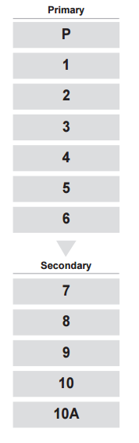
Year-by-year curriculum
Each year includes the following structural components:
year-level description
curriculum content
achievement standards.
The curriculum is developmentally sequenced across the year levels.
Notes:
The Mathematics curriculum is structured into year levels.
Suggested activity
What are the implications of the year-by-year curriculum for the planning of your teaching, learning and assessment program?

Slide 9
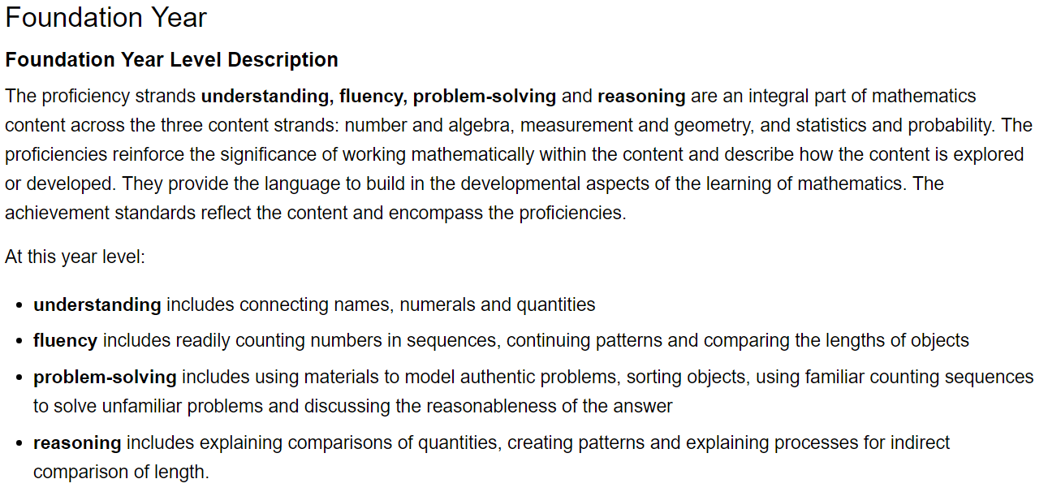
Year-level description
Relationship between proficiency and content
Proficiency strands
Notes:
Each Mathematics year-level description:
highlights the interrelatedness of the content descriptions and the proficiency strands for each year
provides specific examples of what each proficiency strand includes at that year level.

Slide 10
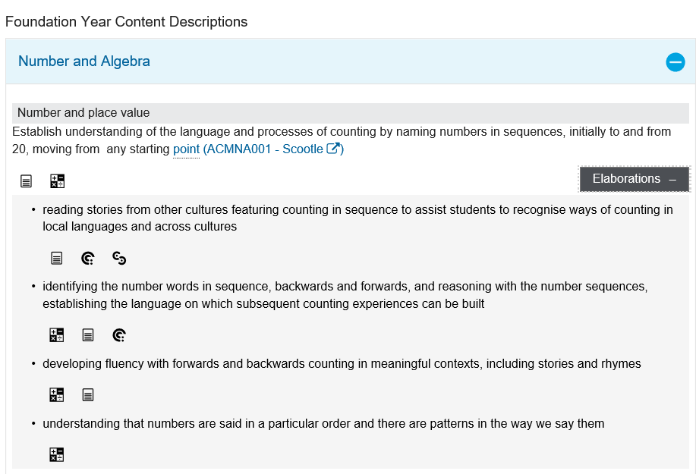
Curriculum content
Content description
Content elaborations
Notes:
The curriculum content is presented as content descriptions that specify the knowledge, understanding and skills young people are expected to learn and teachers are expected to teach across the years of schooling.
The content descriptions are accompanied by content elaborations. Content elaborations provide illustrations and/or examples that teachers may choose to use in the classroom or as inspiration for their own activities. The content elaborations are not a mandatory aspect of the curriculum and as such are not required to be taught.
Suggested activity
Use the Mathematics: Sequence of content to build an understanding of the sequence of content of the curriculum across year levels: www.australiancurriculum.edu.au/f-10-curriculum/mathematics/pdf-documents.
Select a year level and read the content descriptions.
Consider the content descriptions for the year level prior to and following the selected year level.
In a small group, discuss how the curriculum develops in increasing complexity of cognition and skills across the bands.

Slide 11
Strands and sub-strands
 | Strands
 | Number and algebra | Measurement and geometry | Statistics and probability
Sub-strands | Number and place value (P–8) | Using units of measurement (P–10) | Chance (1–10)
 | Fractions and decimals (1–6) | Shape (P–7) | Data representation and interpretation (P–10)
 | Real numbers (7–10) | Geometric reasoning (3–10)
 | Money and financial mathematics (1–10) | Location and transformation (P–7)
 | Patterns and algebra (P–10) | Pythagoras and trigonometry (9–10)
 | Linear and non-linear relationships (7–10)
Notes:
In Mathematics, the curriculum content is organised through strands and sub-strands, as well as proficiency strands.
The three content strands describe what to teach and learn. They are:
Number and algebra
Measurement and geometry
Statistics and probability.
Each content strand is organised into sub-strands to illustrate the clarity and sequence of development of concepts through and across the year levels. They reveal the connections across strands and the sequential development of concepts from Prep to Year 10.
Some of the examples of knowledge and skills are relevant to specific year levels. These are indicated in brackets.
Number and algebra
Number and place value (P–8)
Fractions and decimals (1–6)
Real numbers (7–10)
Money and financial mathematics (1–10)
Patterns and algebra (P–10)
Linear and non-linear relationships (7–10)
Measurement and geometry
Using units of measurement (P–10)
Shape (P–7)
Geometric reasoning (3–10)
Location and transformation (P–10)
Pythagoras and trigonometry (9–10)
Statistics and probability
Chance (1–10)
Data representation and interpretation (P–10)
Note: 10A has been added to the Year 10 curriculum. This content is optional. It is intended for students who require more content to enrich their study of Mathematics.
Information on strands and sub-strands is available from: www.australiancurriculum.edu.au/f-10-curriculum/mathematics/structure.
Suggested activity
What is the relationship between the content strands of Mathematics?

Slide 12
Achievement standards
Foundation Year Achievement Standard
By the end of the Foundation year, students make connections between number names, numerals and quantities up to 10. They compare objects using mass, length and capacity. Students connect events and the days of the week. They explain the order and duration of events. They use appropriate language to describe location.
Students count to and from 20 and order small collections. They group objects based on common characteristics and sort shapes and objects. Students answer simple questions to collect information and make simple inferences.
Understanding
Skills
Notes:
The achievement standard is a statement of what students should know and be able to do at the end of the year level. The first paragraph of the achievement standard relates to understanding and the second paragraph relates to skills.
In Mathematics, a learning area achievement standard is provided for each year.
Work sample portfolios provide examples of student work, which are reflective of achievement levels at, above, and below the achievement standard.
Suggested activities
Using the Mathematics: Sequence of achievement, discuss how the evidence that students need to provide of what they know and can do increases in complexity across year levels: www.australiancurriculum.edu.au/f-10-curriculum/mathematics/pdf-documents.
For a given year level, map the achievement standard to the content descriptions.

Slide 13




Three-dimensional curriculum:
General capabilities
  Support students to be successful learners
Literacy
Numeracy
Information and communication technology (ICT) capability
Critical and creative thinking
  Develop ways of being, behaving and learning to live
  with others
Personal and social capability
Ethical understanding
Intercultural understanding
Notes:
The seven capabilities are divided into two groups:
capabilities that support students to be successful learners ― literacy, numeracy, information and communication technology (ICT) capability, and critical and creative thinking
capabilities that develop ways of being, behaving and learning to live with others ― personal and social capability, ethical behaviour and intercultural understanding.
Continua of learning have been developed for each capability to describe the relevant knowledge, understanding and skills at particular points of schooling.
The content outlined in the general capabilities continua is embedded in the content descriptions for each learning area, where appropriate. The icons shown on this slide are used to identify where the general capabilities are embedded in content descriptions.
A summary of the focus of each of the general capabilities in the Mathematics learning area is available from: www.australiancurriculum.edu.au/f-10-curriculum/general-capabilities. On the general capabilities overview web page, scroll down to ‘Learning area specific advice’.

Slide 14
Three-dimensional curriculum:
Cross-curriculum priorities
Aboriginal and Torres Strait Islander histories and culture
Asia and Australia’s engagement with Asia
Sustainability
Notes:
The Australian Curriculum promotes three cross-curriculum priorities that young Australians should learn about. Each of the priorities is represented in learning areas in ways appropriate to that area.
The three priorities are:
Aboriginal and Torres Strait Islander histories and cultures ― to ensure that all young Australians are given the opportunity to gain a deeper understanding and appreciation of Aboriginal and Torres Strait Islander histories and cultures, their significance for Australia, and the impact that these have had, and continue to have, on our world
Asia and Australia’s engagement with Asia ― to reflect the importance of knowing about Asia and Australia’s engagement with Asia, and to encourage better understanding of the countries and cultures of the Asia region so that young people appreciate the economic, political and cultural interconnections that Australia has with the region
Sustainability ― to allow young people to develop an appreciation of the need for more sustainable patterns of living, and to build capacities for thinking, valuing and acting that are necessary to create a more sustainable future.
Each of the cross-curriculum priorities contains a set of organising ideas. These are consistent across the curriculum and are reinforced in learning areas. Each of the cross-curriculum priorities can be relevant to teaching and learning in Mathematics, and explicit teaching of the priorities should be incorporated in teaching and learning activities where appropriate.

Slide 15
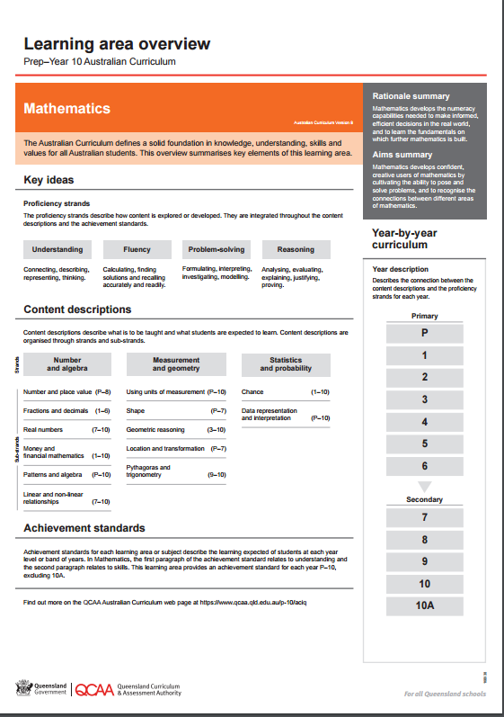
Find out more
Find out more on the QCAA Australian Curriculum
webpage at www.qcaa.qld.edu.au/p-10/aciq.
Notes:
More information about the implementation of Australian Curriculum in Queensland is available on the QCAA website. In the Australian Curriculum section of the QCAA website, you will find the Learning area overview: Prep‒Year 10 Australian Curriculum — Mathematics: www.qcaa.qld.edu.au/aciq.
Send any further questions to: australiancurriculum@qcaa.qld.edu.au.
Information about requests for further professional learning is available from: www.qcaa.qld.edu.au/pd-events/request-pd.
Suggested activity
What did I learn?
What was confirmed?
What was new?
What challenged my thinking?
What else do I need to do?
What is our plan as a teaching team?

Slide 16
Copyright information
Slides 3 and 8–14: Images and text © Australian Curriculum, Assessment and Reporting Authority (ACARA) 2009 to present, unless otherwise indicated. This material was downloaded from the ACARA website (www.acara.edu.au) (Website) (accessed Mar 25, 2019) and was not modified. The material is licensed under CC BY 4.0 (https://creativecommons.org/licenses/by/4.0/). ACARA does not endorse any product that uses ACARA material or make any representations as to the quality of such products. Any product that uses material published on this website should not be taken to be affiliated with ACARA or have the sponsorship or approval of ACARA. It is up to each person to make their own assessment of the product.

