Slide 1

Learning area overview
Prep–Year 10 Australian Curriculum: P–6 Humanities and Social Sciences (HASS)
Notes:
This presentation supports understanding of the Australian Curriculum: Humanities and Social Sciences (HASS) Prep*–Year 6. It gives insight into the position of Prep–Year 6 HASS within the Australian Curriculum and the structure of Prep–Year 6 HASS. A separate presentation is available for Years 7–10 HASS.
You can use this presentation in your organisation as the basis for professional learning about the HASS curriculum. It includes information about the key aspects of the curriculum, as well as activities for becoming familiar with the curriculum. An icon in the top-right corner of a slide identifies opportunities for activities. Presenters are encouraged to tailor this presentation to suit the needs of their audience.
The Australian Curriculum content referred to in this presentation is available from:
Australian Curriculum, Assessment and Reporting Authority (ACARA) 2017, Australian Curriculum Version 8 Foundation to Year 10, www.australiancurriculum.edu.au.
*Prep (P) in Queensland is the Foundation Year (F) of the Australian Curriculum and refers to the year before Year 1. Children beginning Prep in January are required to be five years of age by 30 June.

Slide 2
Learning goals
This presentation aims to:
build understanding of the Australian Curriculum: Humanities and Social Sciences in Prep–Year 6
provide an overview of the structure of
Prep–Year 6 HASS.
Notes:
This presentation aims to:
build understanding of the Australian Curriculum, with particular reference to the Humanities and Social Sciences curriculum in Prep–Year 6
provide an overview of the structure of the Prep–Year 6 HASS subject, including the curriculum content and achievement standards.

Slide 3
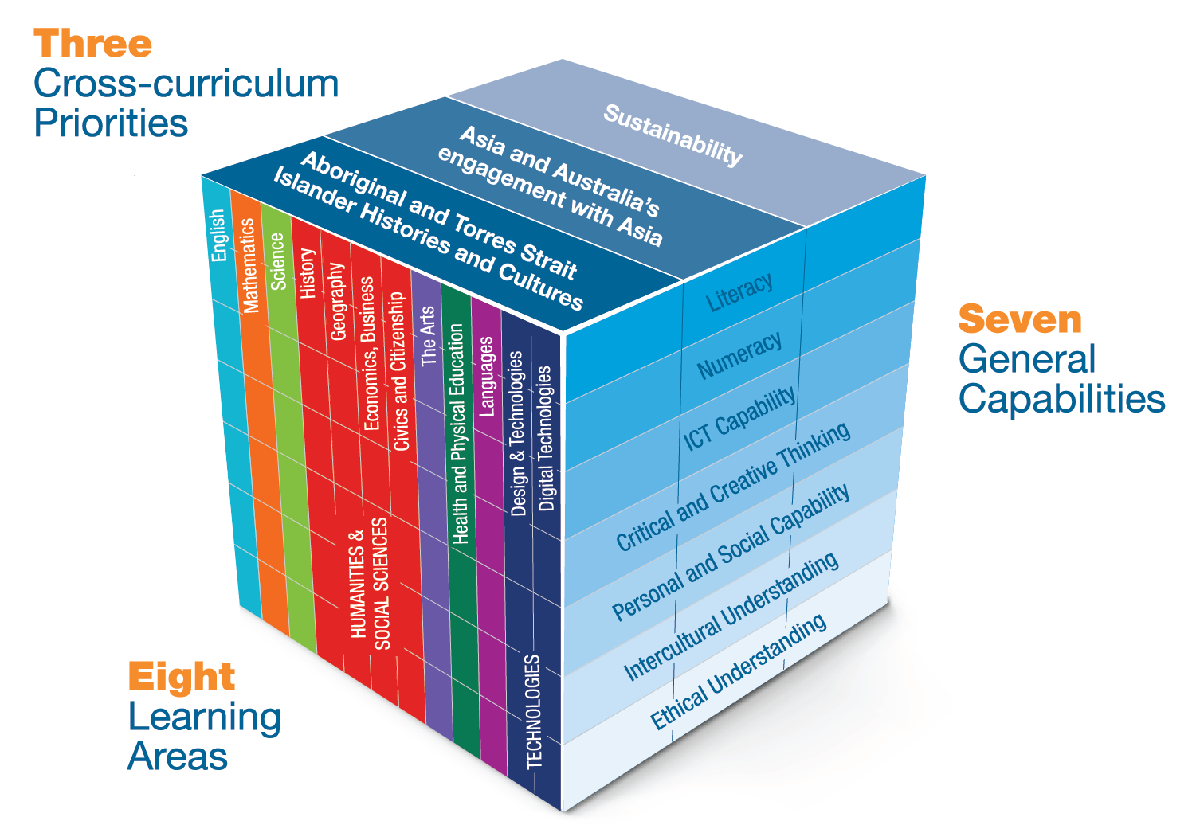
Three-dimensional curriculum
The Australian Curriculum is a three-dimensional curriculum made up of:
learning areas
general capabilities
cross-curriculum
priorities.
English
Notes:
The Australian Curriculum sets the expectations for what all Australian students should be taught and have the opportunity to learn as they progress through their school life. In Prep to Year 10, the Australian Curriculum provides teachers, students, and parents with access to the same content, and consistent national standards for determining the progress of student learning.
All Australian students across all education settings and contexts can be supported in their diverse learning needs through the three dimensions of the Australian Curriculum: the learning area content, the general capabilities and the cross-curriculum priorities.
This diagram shows the relationship between these dimensions of the Australian Curriculum. Teachers emphasise one or more dimensions to develop learning programs suited to the strengths, interests and diverse needs of all students.
This presentation provides a brief overview of the general capabilities and cross-curriculum priorities. However, the focus will be on Prep–Year 6 HASS.

Slide 4
Structure of the HASS learning area
The HASS learning area consists of five subjects:
Prep–Year 6 HASS
Years 7–10
  History
  Geography
  Civics and Citizenship
  Economics and Business.
Notes:
In the Australian Curriculum, the HASS learning area consists of five subjects: Prep–Year 6 Humanities and Social Sciences, as well as Years 7–10 History, Geography, Civics and Citizenship, and Economics and Business.
This presentation focuses on information specific to Prep–Year 6 HASS. A separate presentation is available for the Years 7–10 subjects.

Slide 5
Structure of the HASS learning area
Learning area
Introduction
Key ideas
Subject-specific: P–6 HASS
Rationale
Aims
Year-by-year and banded curriculum
  Year-level descriptions
Curriculum content
  Strands, sub-strands and threads
  Content descriptions
  Content elaborations
Achievement standards
Notes:
The Australian Curriculum sets out what all young people should be taught by specifying the curriculum content, and identifies the learning expected at points in their schooling by specifying the achievement standards. The content and achievement standards are supported by additional information that describes the curriculum intent (rationale), aims of learning (aims), key ideas, and focus for the learning at specific year levels (year-level descriptions).
The following sections of the presentation will provide an overview of each of these key aspects of the curriculum.

Slide 6

Key ideas
Who we are, who came before us, and traditions and values that have shaped societies
How societies and economies operate and how they are changing over time
The ways people, places, ideas and events are perceived and connected
How people exercise their responsibilities, participate in society and make informed decisions
Notes:
The key ideas represent key aspects of the learning area content, and frame the development of knowledge and skills in the learning area. In HASS, there are four key ideas:
Who we are, who came before us, and traditions and values that have shaped societies: Students explore their own identity, Australia’s heritage and cultural diversity, and Australia’s identity as a nation in the world. They examine the significance of traditions and shared values within society.
How societies and economies operate and how they are changing over time: Students learn about Australian society and other societies in the world, both past and present; and how they function socially, culturally, economically and politically. Students examine developments that have resulted in or are bringing about change.
The ways people, places, ideas and events are perceived and connected: Students are provided with opportunities to explore different perceptions of people, places, ideas and events. They develop an understanding of the interdependent nature of the world and the interrelationships within and between the natural environment, human communities and economies. They explore how people, ideas and events are connected over time and increasingly interconnected across local, national, regional and global contexts.
How people exercise their responsibilities, participate in society and make informed decisions: Students examine how individuals and groups have participated in and contributed to society past and present. They examine the rights and responsibilities of individuals and groups over time and in different contexts. They develop an understanding of the need to make decisions, the importance of ethical considerations and being informed when making decisions, the processes for decision-making and the implications of decisions that are made for individuals, society, the economy and the environment.
The key ideas are available from: www.australiancurriculum.edu.au/f-10-curriculum/humanities-and-social-sciences/key-ideas.
The key ideas are represented in varying ways across the five HASS subjects. Specific illustrations of the key ideas across the HASS curriculum are provided in F–10 Humanities and Social Sciences: Key ideas — Subject/sub-strand illustrations, available from: www.australiancurriculum.edu.au/f-10-curriculum/humanities-and-social-sciences/pdf-documents.
Suggested activities
What are the key ideas? How do they affect your reading of the content?
How are the key ideas reflected in your HASS program?

Slide 7
Structure of Prep–Year 6 HASS
Rationale
Aims
Year-level description
  Concepts of disciplinary thinking
  Concepts of interdisciplinary thinking
  Inquiry questions
Curriculum content
  Strands and sub-strands
  Content descriptions
  Content elaborations
Achievement standards
Notes:
The Australian Curriculum sets out what all young people should be taught by specifying the curriculum content, and identifies the learning expected at points in their schooling by specifying the achievement standards. These two key aspects of the curriculum are supported by additional information that describes the curriculum intent (rationale), aims of learning (aims), and focus for the learning at specific year levels (year-level descriptions).
The following sections of the presentation will provide an overview of each of these key aspects of the curriculum.

Slide 8
Rationale
Subject-specific summary
Prep–Year 6 HASS empowers students to shape change, make informed decisions, solve problems and contribute to a cohesive society, sustainable environment, productive economy and stable democracy.
Rationale for Prep–Year 6 HASS
http://www.australiancurriculum.edu.au/f-10-curriculum/humanities-and-social-sciences/hass/rationale
Notes:
The rationale defines the learning area and describes the importance of the learning area within the curriculum:
Why is it important?
How is it shaped in the curriculum?
The Prep–Year 6 HASS rationale promotes:
the development of empowered individuals who make reflective, informed decisions; value their belonging in a diverse and dynamic society; and positively contribute locally, nationally, regionally and globally
a deep understanding of the world we live in from a range of perspectives, past and present, and an appreciation and respect for social, cultural and religious diversity
the ability to question, think critically, solve problems, communicate effectively, make decisions and adapt to change.
The rationale is available from: www.australiancurriculum.edu.au/f-10-curriculum/humanities-and-social-sciences/hass/rationale.
Suggested activity
Read the rationale for Prep–Year 6 HASS. Partner with a colleague to discuss the following questions:
What were the key aspects of the rationale?
Why is Prep–Year 6 HASS important? What important contribution does the learning make to a student’s education?
Which aspects of this rationale matched your current understanding of the subject? Which aspects were new understandings?

Slide 9
Aims
Subject-specific summary
In Prep–Year 6 HASS, students develop:
knowledge about, and understanding of people, places, values and systems
the capacity to use inquiry skills to effectively participate in everyday life, now and in the future.
Notes:
The aims flow logically from the rationale and define the big-picture objectives for the learning area.
The Prep–Year 6 HASS subject aims to ensure students develop:
a sense of wonder, curiosity and respect about places, people, cultures and systems throughout the world
key historical, geographical, civic and economic knowledge of people, places, values and systems in local to global contexts
an understanding and appreciation of historical developments, geographic phenomena, civic values and economic factors that shape society, influence sustainability and create a sense of belonging
the capacity to use inquiry methods and skills
dispositions required for effective participation in everyday life, now and in the future.
The aims are available from: www.australiancurriculum.edu.au/f-10-curriculum/humanities-and-social-sciences/hass/aims.
Suggested activities
Prepare a brief statement/overview that would help you describe the aims of the subject to a parent group.
Identify two or three big ideas in the aims. How do they inform:
your understanding of the subject?
what is valued in the Australian Curriculum for the learning area?
your teaching and learning approaches?

Slide 10
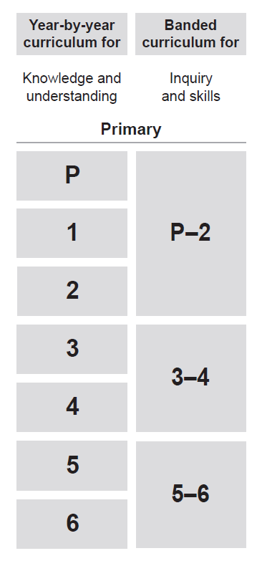
Year-by-year and banded curriculum
Each year of Prep–Year 6 HASS includes the following structural components:
year-level description
year-by-year content for the Knowledge and understanding strand
banded content for the Inquiry and skills strand
year-by-year achievement standards.
The curriculum is developmentally sequenced across the year levels.
Notes:
The Prep–Year 6 HASS curriculum is structured into both year-by-year and banded curriculum content. The banded curriculum content enables flexible delivery of HASS across Prep–Year 6.
Suggested activity
What are the implications of the year-by-year curriculum for the planning of your teaching, learning and assessment program?

Slide 11
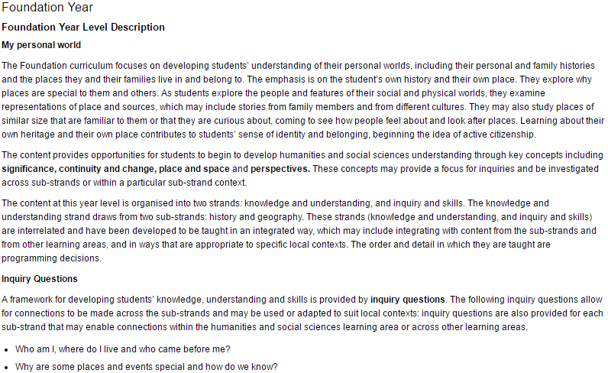
Year-level description
Context
Key concepts
Strands and sub-strands
Inquiry questions
Notes:
Each Prep–Year 6 HASS year-level description identifies the:
focus of knowledge, understanding and skills for student learning in that year level
context for each year
opportunities to develop students’ interdisciplinary thinking through key concepts across Prep–Year 6
interrelated nature of the two strands and sub-strands in each year
inquiry questions that may be addressed in each year.

Slide 12
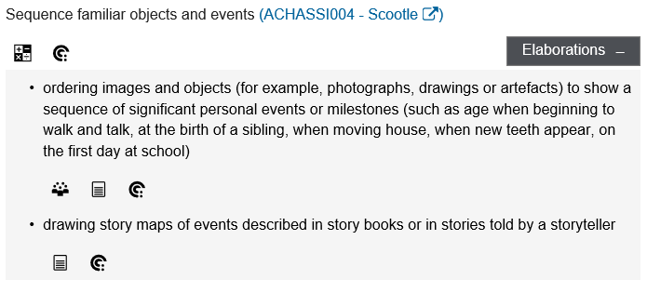
Curriculum content
Content description
Content elaborations
Notes:
The curriculum content is presented as content descriptions that specify the knowledge, understanding and skills young people are expected to learn and teachers are expected to teach across the years of schooling.
The content descriptions are accompanied by content elaborations. Content elaborations provide illustrations and/or examples that teachers may choose to use in the classroom or as inspiration for their own activities. The content elaborations are not a mandatory aspect of the curriculum and as such are not required to be taught.
Suggested activity
Use the Year F–6/7 Humanities and Social Sciences: Sequence of content to build an understanding of the sequence of content of the curriculum across year levels: www.australiancurriculum.edu.au/f-10-curriculum/humanities-and-social-sciences/hass/pdf-documents.
Select a year level and read the content descriptions.
Consider the content descriptions for the year level before and following the selected year level.
In a small group, discuss how the curriculum develops in increasing complexity of cognition and skills across the bands.

Slide 13
Strands and sub-strands
 | Strands
 | Knowledge and understanding | Inquiry and skills
Sub-strands | History (P–6) | Questioning
 | Geography (P–6) | Researching
 | Civics and Citizenship (3–6) | Analysing
 | Economics and Business (5–6) | Evaluating and reflecting
 |  | Communicating
Notes:
In Prep–Year 6 HASS, the curriculum content is organised according to strands and sub-strands. These strands are interrelated to inform and support each other. The curriculum content is arranged under two strands:
Knowledge and understanding
Inquiry and skills.
The Knowledge and understanding strand is organised into four sub-strands:
Knowledge and understanding
History (P–6)
Geography (P–6)
Civics and Citizenship (3–6)
Economics and Business (5–6)
In Prep–Year 6 HASS, the sub-strands of History and Geography are included from Prep–Year 6. The sub-strand of Civics and Citizenship is introduced in Year 3 and the sub-strand of Economics and Business is introduced in Year 5.
The Inquiry and skills strand is organised into five sub-strands:
Inquiry and skills
Questioning
Researching
Analysing
Evaluating and reflecting
Communicating
Suggested activity
What is the relationship between the strands?

Slide 14
Strand: Knowledge and understanding
Concepts of disciplinary thinking
Sub-strand: History
Sources, continuity and change, cause and effect, significance, perspectives, and empathy.
Sub-strand: Geography
Place, space, environment, interconnection, sustainability, scale and change.
Sub-strand: Civics and Citizenship
Government and democracy, laws and citizens, and citizenship, diversity and identity.
Sub-strand: Economics and Business
Resource allocation and making choices, the business environment, and consumer and financial literacy.
Notes:
The HASS learning area focuses on developing students’ ability to develop and apply concepts of disciplinary thinking that are distinct for each sub-strand:
History
Geography
Civics and Citizenship
Economics and Business.
The concepts of disciplinary thinking for each sub-strand are available from: www.australiancurriculum.edu.au/f-10-curriculum/humanities-and-social-sciences/hass/structure.
Concepts for developing historical thinking and Concepts for developing geographical thinking are available from: www.australiancurriculum.edu.au/f-10-curriculum/humanities-and-social-sciences/hass/pdf-documents.

Slide 15
Strand: Knowledge and understanding
Concepts of interdisciplinary thinking
Concepts of interdisciplinary thinking are
introduced at varying year levels:
significance (P–6)
continuity and change (P–6)
cause and effect (2–6)
place and space (P–6)
interconnections (2–6)
roles, rights and responsibilities (1–6)
perspectives and actions (P–6).
Notes:
In addition to the concepts of disciplinary thinking, Prep–Year 6 HASS identifies seven concepts of interdisciplinary thinking. These concepts provide opportunities for students to explore connections between the four sub-strands.
Concepts of interdisciplinary thinking are introduced at varying year levels (identified on the slide in brackets):
significance (P–6)
continuity and change (P–6)
cause and effect (2–6)
place and space (P–6)
interconnections (2–6)
roles, rights and responsibilities (1–6)
perspectives and actions (P–6).
The concepts of interdisciplinary thinking are available from: www.australiancurriculum.edu.au/f-10-curriculum/humanities-and-social-sciences/hass/structure.
Concepts of interdisciplinary thinking — Sub-strand illustrations for Prep–Year 6 HASS is available from: www.australiancurriculum.edu.au/f-10-curriculum/humanities-and-social-sciences/hass/pdf-documents.

Slide 16
Strand: Inquiry and skills
Inquiry questions
Two sets of inquiry questions are provided for
each year level:
subject inquiry questions
sub-strand inquiry questions.
Notes:
Inquiry questions provide a framework for developing students’ inquiry skills, which are applied through the Knowledge and understanding strand content.
Prep–Year 6 HASS provides two sets of inquiry questions for each year level:
Subject inquiry questions provide guidance on how learning in two or more sub-strands might be connected.
Sub-strand inquiry questions are specific to either History, Geography, Civics and Citizenship, or Economics and Business.
Both sets of inquiry questions are intended as suggestions for teachers. Teachers can use the inquiry questions appropriate for their students, adapt them, or develop their own to suit their school context.
Suggested activity
For Prep–Year 6 HASS, identify connections between the two strands.

Slide 17
Achievement standards
Foundation Year Achievement Standard
By the end of Foundation Year, students identify important events in their own lives and recognise why some places are special to people. They describe the features of familiar places and recognise that places can be represented on maps and models. They identify how they, their families and friends know about their past and commemorate events that are important to them.
Students respond to questions about their own past and places they belong to. They sequence familiar events in order. They observe the familiar features of places and represent these features and their location on pictorial maps and models. They reflect on their learning to suggest ways they can care for a familiar place. Students relate stories about their past and share and compare observations about familiar places.
Understanding
Skills
Notes:
The achievement standard is a statement of what students should know and be able to do at the end of the year level. In HASS, the first paragraph of the achievement standard relates to understanding and the second paragraph relates to skills.
In Prep–Year 6, this subject provides a choice between two achievement standards for each year:
subject achievement standard
sub-strand-specific achievement standard.
The first paragraph in the subject achievement standard (understanding) is organised by the sub-strands:
History
Geography
Civics and Citizenship
Economics and Business.
Within the Knowledge and understanding strand, the concepts of disciplinary thinking are identified in both the subject and sub-strand-specific achievement standards. The concepts of disciplinary thinking are introduced to the achievement standards at different year levels, reflecting increasing breadth and depth of expected learning. Although the achievement standards articulate the concepts of disciplinary thinking, the concepts of interdisciplinary thinking are also evident and can be used by teachers when they plan.
The Prep–Year 6 HASS achievement standards are available from: www.australiancurriculum.edu.au/f-10-curriculum/humanities-and-social-sciences/hass/pdf-documents.
The subject achievement standards are provided in Humanities and Social Sciences — Sequence of achievement F–6/7. (Select the link ‘F–6/7 HASS — Combined sequence of achievement’.)
The sub-strand-specific achievement standards are provided in the following documents at the above link:
History: Sequence of achievement F–6/7
Geography: Sequence of achievement F–6/7
Civics and Citizenship: Sequence of achievement F–6/7
Economics and Business: Sequence of achievement F–6/7.
Suggested activities
Using one of the Sequence of achievement documents, discuss how the evidence that students need to provide of what they know and can do increases in complexity across year levels.
For a given year level, map the subject-specific and/or sub-strand-specific achievement standard to the content descriptions.

Slide 18




Three-dimensional curriculum:
General capabilities
  Support students to be successful learners
Literacy
Numeracy
Information and communication technology (ICT) capability
Critical and creative thinking
  Develop ways of being, behaving and learning to live
  with others
Personal and social capability
Ethical understanding
Intercultural understanding
Notes:
The seven capabilities are divided into two groups:
capabilities that support students to be successful learners ― literacy, numeracy, information and communication technology (ICT) capability, and critical and creative thinking
capabilities that develop ways of being, behaving and learning to live with others ― personal and social capability, ethical understanding and intercultural understanding.
Continua of learning have been developed for each capability to describe the relevant knowledge, understanding and skills at particular points of schooling.
The content outlined in the general capabilities continua is embedded in the content descriptions for each learning area, where appropriate. The icons shown on this slide are used to identify where the general capabilities are embedded in content descriptions.
A summary of the focus of each of the general capabilities in the HASS learning area is available from: www.australiancurriculum.edu.au/f-10-curriculum/general-capabilities. On the general capabilities overview webpage, scroll down to ‘Learning area specific advice’.

Slide 19
Three-dimensional curriculum:
Cross-curriculum priorities
Aboriginal and Torres Strait Islander histories and cultures
Asia and Australia’s engagement with Asia
Sustainability
Notes:
The Australian Curriculum promotes three cross-curriculum priorities that young Australians should learn about. Each of the priorities is represented in learning areas in ways appropriate to that area.
The three priorities are:
Aboriginal and Torres Strait Islander histories and cultures ― to ensure that all young Australians are given the opportunity to gain a deeper understanding and appreciation of Aboriginal and Torres Strait Islander histories and cultures, their significance for Australia, and the impact that these have had, and continue to have, on our world
Asia and Australia’s engagement with Asia ― to reflect the importance of knowing about Asia and Australia’s engagement with Asia, and to encourage better understanding of the countries and cultures of the Asia region so that young people appreciate the economic, political and cultural interconnections that Australia has with the region
Sustainability ― to allow young people to develop an appreciation of the need for more sustainable patterns of living, and to build capacities for thinking, valuing and acting that are necessary to create a more sustainable future.
Each of the cross-curriculum priorities contains a set of organising ideas. These are consistent across the curriculum and are reinforced in learning areas. Each of the cross-curriculum priorities can be relevant to teaching and learning in HASS, and explicit teaching of the priorities should be incorporated in teaching and learning activities where appropriate.

Slide 20
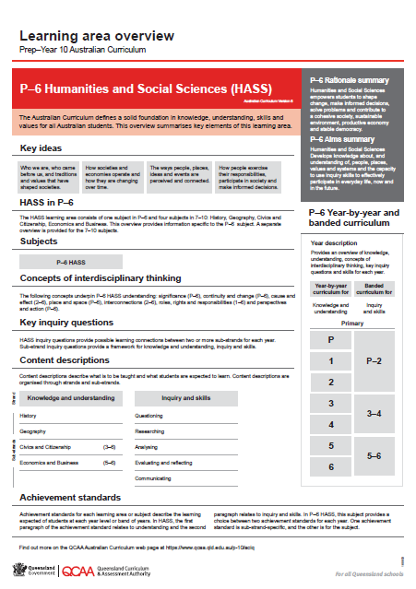
Find out more
Find out more on the QCAA Australian Curriculum
webpage at www.qcaa.qld.edu.au/p-10/aciq.
Notes:
More information about the implementation of Australian Curriculum in Queensland is available on the QCAA website. In the Australian Curriculum section of the QCAA website, you will find the Learning area overview: Prep‒Year 10 Australian Curriculum — P–6 Humanities and Social Sciences (HASS): www.qcaa.qld.edu.au/aciq.
Send any further questions to: australiancurriculum@qcaa.qld.edu.au.
Information about requests for further professional learning is available from: www.qcaa.qld.edu.au/pd-events/request-pd.
Suggested activity
What did I learn?
What was confirmed?
What was new?
What challenged my thinking?
What else do I need to do?
What is our plan as a teaching team?

Slide 21
Copyright information
Slides 3 and 11–19: Images and text © Australian Curriculum, Assessment and Reporting Authority (ACARA) 2009 to present, unless otherwise indicated. This material was downloaded from the ACARA website (www.acara.edu.au) (Website) (accessed Mar 25, 2019) and was not modified. The material is licensed under CC BY 4.0 (https://creativecommons.org/licenses/by/4.0/). ACARA does not endorse any product that uses ACARA material or make any representations as to the quality of such products. Any product that uses material published on this website should not be taken to be affiliated with ACARA or have the sponsorship or approval of ACARA. It is up to each person to make their own assessment of the product.

