Slide 1

Learning area overview
Prep–Year 10 Australian Curriculum: English
Notes:
This presentation supports understanding of the Australian Curriculum: English Prep*–Year 10. It gives insight into the position of English within the Australian Curriculum and the structure of the English learning area.
You can use this presentation in your organisation as the basis for professional learning about the English curriculum. It includes information about the key aspects of the curriculum, as well as activities for becoming familiar with the curriculum. An icon in the top-right corner of a slide identifies opportunities for activities. Presenters are encouraged to tailor this presentation to suit the needs of their audience.
The Australian Curriculum content referred to in this presentation is available from:
Australian Curriculum, Assessment and Reporting Authority (ACARA) 2017, Australian Curriculum Version 8 Foundation to Year 10, www.australiancurriculum.edu.au.
*Prep (P) in Queensland is the Foundation Year (F) of the Australian Curriculum and refers to the year before Year 1. Children beginning Prep in January are required to be five years of age by 30 June.

Slide 2
Learning goals
This presentation aims to:
build understanding of the Australian Curriculum: English
provide an overview of the structure of the English learning area.
Notes:
This presentation aims to:
build understanding of the Australian Curriculum, with particular reference to the English curriculum
provide an overview of the structure of the English learning area, including the curriculum content and achievement standards.

Slide 3
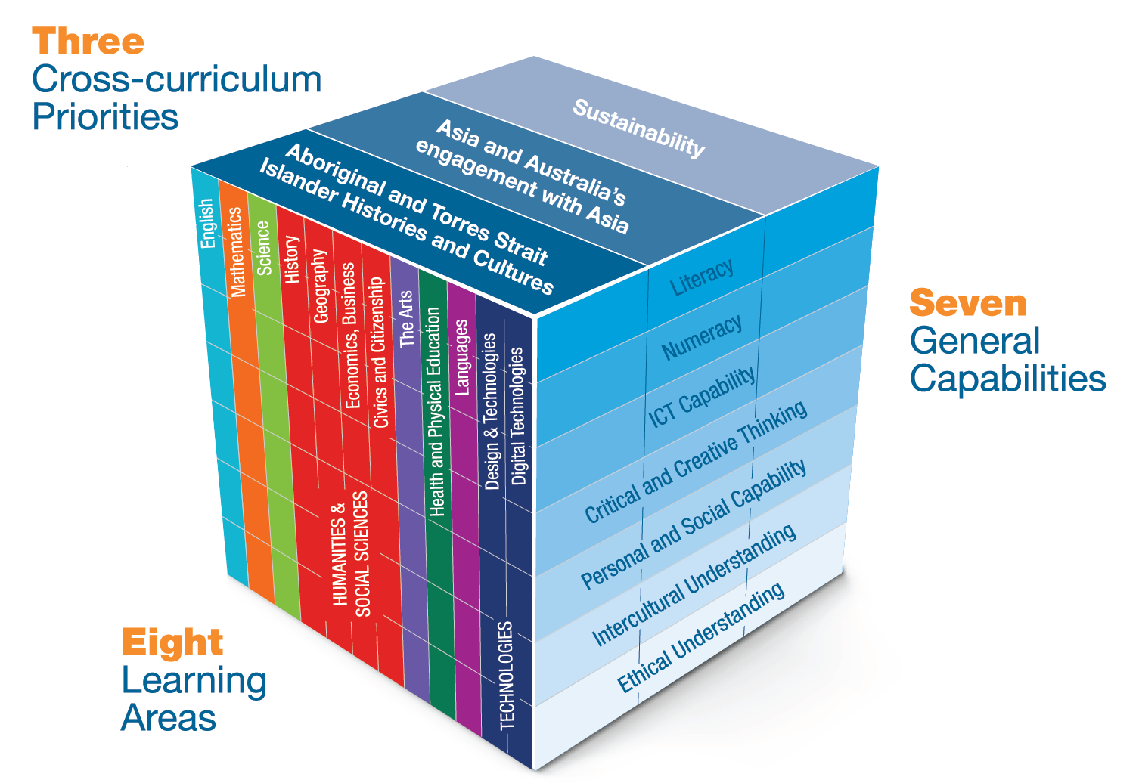
Three-dimensional curriculum
The Australian Curriculum is a three-dimensional curriculum made up of:
learning areas
general capabilities
cross-curriculum
priorities.
English
Notes:
The Australian Curriculum sets the expectations for what all Australian students should be taught and have the opportunity to learn as they progress through their school life. In Prep to Year 10, the Australian Curriculum provides teachers, students, and parents with access to the same content, and consistent national standards for determining the progress of student learning.
All Australian students across all education settings and contexts can be supported in their diverse learning needs through the three dimensions of the Australian Curriculum: the learning area content, the general capabilities and the cross-curriculum priorities.
This diagram shows the relationship between these dimensions of the Australian Curriculum. Teachers emphasise one or more dimensions to develop learning programs suited to the strengths, interests and diverse needs of all students.
This presentation provides a brief overview of the general capabilities and cross-curriculum priorities. However, the focus will be on the English learning area.

Slide 4
Structure of the English learning area
Rationale
Aims
Key ideas
Year-by-year curriculum
  Year-level descriptions
Curriculum content
  Strands, sub-strands and threads
  Content descriptions
  Content elaborations
Achievement standards
Notes:
The Australian Curriculum sets out what all young people should be taught by specifying the curriculum content, and identifies the learning expected at points in their schooling by specifying the achievement standards. The content and achievement standards are supported by additional information that describes the curriculum intent (rationale), aims of learning (aims), key ideas, and focus for the learning at specific year levels (year-level descriptions).
The following sections of the presentation will provide an overview of each of these key aspects of the curriculum.

Slide 5

Rationale
Learning area summary
The study of English is central to the learning and development of all young Australians.
In the English learning area, students have opportunities to become confident communicators, imaginative thinkers and informed citizens who analyse, understand, communicate and build relationships with others and the world around them.
Video
Introduction to English
http://www.australiancurriculum.edu.au/f-10-curriculum/english/rationale
Notes:
The rationale defines the learning area and describes the importance of the learning area within the curriculum:
Why is it important?
How is it shaped in the curriculum?
The English rationale promotes:
confident communicators, imaginative thinkers and informed citizens
individuals who learn to analyse, understand, communicate and build relationships with others and with the world around them
reading and literacy skills which help young people develop the knowledge and skills needed for education, training and the workplace
ethical, thoughtful, informed and active members of society
understanding, attitudes and capabilities of those who will take responsibility for Australia’s future
effective communication in Standard Australian English
imaginative and critical engagement with literature to expand the scope of students’ experience
value, respect and exploration of the contribution of Aboriginal peoples and Torres Strait Islander peoples to Australian society, its contemporary literature and its literary heritage
Australia’s links to Asia.
The rationale is available from: www.australiancurriculum.edu.au/f-10-curriculum/english/rationale.
Suggested activities
Read the learning area rationale or watch the introductory video. Partner with a colleague to discuss the following questions:
What were the key aspects of the rationale?
Why is the learning area important? What important contribution does the learning make to a student’s education?
Which aspects of this rationale matched your current understanding of the learning area? Which aspects were new understandings?
Watch and listen to the video.
What were the guiding principles that informed the development of the English curriculum?
Are there any messages that you will need to consider when planning your teaching, learning and assessment programs?

Slide 6
Aims
Learning area summary
Learning through English aims to:
ensure that students interact with texts in a variety of ways
develop capabilities to use, appreciate and enjoy English
develop an understanding of how the various forms of text work in combination to create meaning.
Notes:
The aims flow logically from the rationale and define the big-picture objectives for the learning area.
The English learning area aims to develop the knowledge, understanding and skills to enable students to:
learn to listen to, read, view, speak, write, create and reflect on increasingly complex and sophisticated spoken, written and multimodal texts across a growing range of contexts with accuracy, fluency and purpose
appreciate, enjoy and use the English language in all its variations and develop a sense of its richness and power to evoke feelings, convey information, form ideas, facilitate interaction with others, entertain, persuade and argue
understand how Standard Australian English works in its spoken and written forms and in combination with non-linguistic forms of communication to create meaning
develop interest and skills in inquiring into the aesthetic aspects of texts, and develop an informed appreciation of literature.
The aims are available from: www.australiancurriculum.edu.au/f-10-curriculum/English/aims.
Suggested activities
Prepare a brief statement/overview that would help you describe the aims of the learning area to a parent group.
Identify two or three big ideas in the aims. How do they inform:
your understanding of the learning area?
what is valued in the Australian Curriculum for the learning area?
your teaching and learning approaches?

Slide 7
Key ideas
Texts
Communication processes
The English language
Literacy is language in use
Language features, visual features and text structures
The appreciation of literature
Notes:
The key ideas represent key aspects of the learning area content, and frame the development of knowledge and skills in the learning area. In English, there are six key ideas:
texts
communication processes
the English language
literacy is language in use
language features, visual features and text structures
the appreciation of literature.
The key ideas are available from: www.australiancurriculum.edu.au/f-10-curriculum/English/key-ideas.
Texts provide the means for communication and occur in a variety of forms.
Communication processes can be divided into receptive modes where students read, listen to and respond to texts, and productive modes where students plan, draft and publish texts.
The English language provides students with a broad conceptual understanding of what a language is, how languages change, and the distinction between language in use and language as a system.
Literacy is language in use where individuals interpret and use language features, forms, conventions and text structures in imaginative, informative and persuasive texts.
Language features, visual features and text structures are used by authors to shape the way texts are interpreted, analysed and evaluated.
The appreciation of literature is developed through engaging with literature in many different ways. Individuals examine, evaluate and discuss a variety of classic and contemporary literary texts from a range of historical and cultural contexts.
Suggested activities
What are the key ideas? How do they affect your reading of the content?
How are the key ideas reflected in your English program?

Slide 8
Year-by-year curriculum
Primary
Each year includes the following structural components:
year-level description
curriculum content
achievement standards.
The curriculum is developmentally sequenced across the year levels.
1
2
3
4
5
6
Secondary
7
8
9
10
Notes:
The English curriculum is structured into year levels.
Suggested activity
What are the implications of the year-by-year curriculum for the planning of your teaching, learning and assessment program?

Slide 9
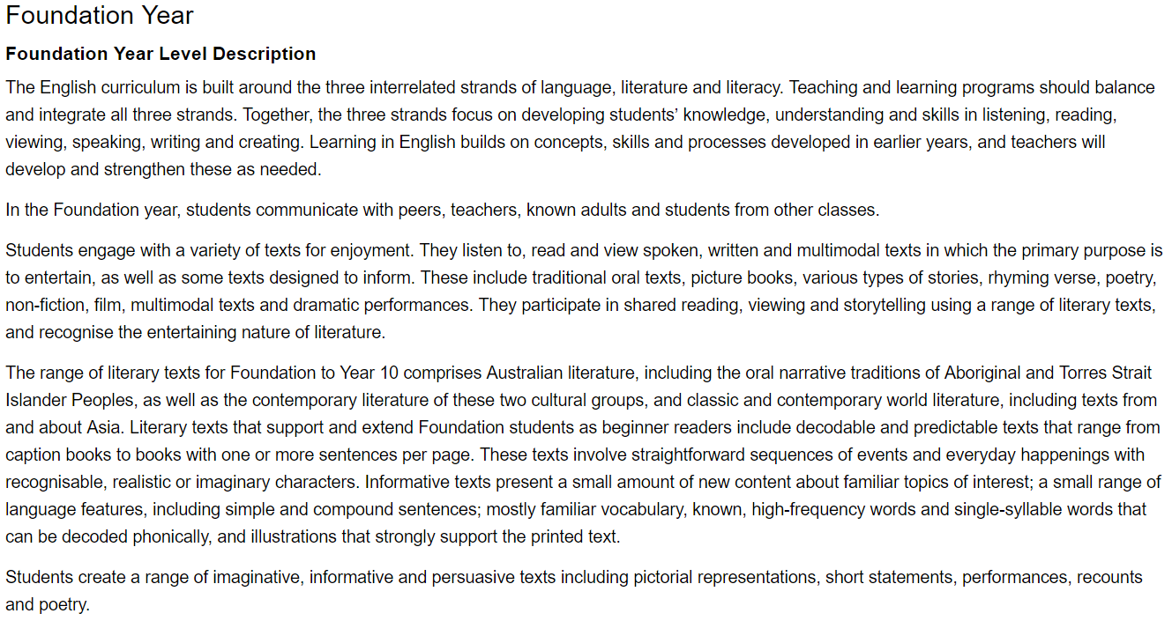
Year level descriptions
P–10 English
Year-level specific
Text types
Notes:
English year-level descriptions typically have a common structure that includes:
the knowledge, understanding and skills; the intended audience; and suggestions about a variety of texts for students to enjoy and create
learning from each new year that builds on concepts, skills and processes from earlier years to further develop and strengthen these as needed
an introduction about the English learning area and its structure
specific information about typical interactions and communication
suggested text types for that year level in the final paragraphs.

Slide 10
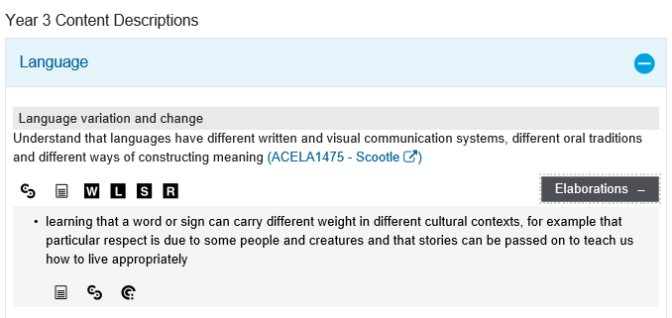
Curriculum content
Content description
Content elaborations
Notes:
The curriculum content is presented as content descriptions that specify the knowledge, understanding and skills young people are expected to learn and teachers are expected to teach across the years of schooling.
The content descriptions are accompanied by content elaborations. Content elaborations provide illustrations and/or examples that teachers may choose to use in the classroom or as inspiration for their own activities. The content elaborations are not a mandatory aspect of the curriculum and as such are not required to be taught.
Suggested activity
Use the English: Sequence of content to build an understanding of the sequence of content of the curriculum across year levels: www.australiancurriculum.edu.au/f-10-curriculum/english/pdf-documents.
Select a year level and read the content descriptions.
Consider the content descriptions for the year level prior to and following the selected year level.
In a small group, discuss how the curriculum develops in increasing complexity of cognition and skills across the bands.

Slide 11
Strands and sub-strands
 | Strands
 | Language | Literature | Literacy
Sub-strands | Language variation and change Language for interaction Text structure and organisation Expressing and developing ideas Phonics and word knowledge | Literature and context Responding to literature Examining literature Creating literature | Texts in context Interacting with others Interpreting, analysing and evaluating Creating texts
Notes:
In English, the curriculum content is organised through strands, sub-strands and threads. The three strands are:
Language
Literature
Literacy.
These strands are interrelated to inform and support each other. All strands must be taught each year from Prep to Year 10.
Each strand is organised into sub-strands. Within each sub-strand there are threads [listed below].
Language
Language variation and change
- Thread: Language variation and change
Language for interaction
- Thread: Language for social interactions and evaluative language
Text structure and organisation
- Thread: Purpose, audience and structures of different types of texts, text cohesion, punctuation and concepts of print and screen
Expressing and developing ideas
- Thread: Sentence and clause level grammar, word level grammar, visual language, vocabulary and spelling
Phonics and word knowledge
- Threads: Phonological and phonemic awareness, alphabet and phonic knowledge and spelling
Literature
Literature and context
- Threads: How texts reflect the context of culture and situation in which they are created
Responding to literature
- Threads: Personal responses to the ideas, characters and viewpoints in texts, and expressing preferences and evaluating texts
Examining literature
- Threads: Features of literary texts and language devices in literary texts
Creating literature
- Threads: Creating literary texts, and experimentation and adaptation
Literacy
Texts in context
- Threads: Texts and the contexts in which they are used
Interacting with others
- Threads: Listening and speaking interactions (purposes and contexts), listening and speaking interactions (skills) and oral presentations
Interpreting, analysing and evaluating
- Threads: Purpose and audience, reading processes, comprehension strategies, and analysing and evaluating texts
Creating texts
- Threads: Creating texts, editing, handwriting and use of software
The threads provide further organisation of the English content, emphasising opportunities for practical application across English. Students should be provided with the opportunity to participate in English on a daily basis, as a minimum, as part of the English curriculum.
Information on strands, sub-strands and threads is available from: www.australiancurriculum.edu.au/f-10-curriculum/english/structure.
Suggested activity
What is the relationship between the content strands of English?

Slide 12
Achievement standards
Foundation Year Achievement Standard
Receptive modes (listening, reading and viewing)
By the end of the Foundation year, students use predicting and questioning strategies to make meaning from texts. They recall one or two events from texts with familiar topics. They understand that there are different types of texts and that these can have similar characteristics. They identify connections between texts and their personal experience.
They read short, decodable and predictable texts with familiar vocabulary and supportive images, drawing on their developing knowledge of concepts of print, sounds and letters and decoding and self-monitoring strategies. They recognise the letters of the English alphabet, in upper and lower case and know and use the most common sounds represented by most letters. They read high-frequency words and blend sounds orally to read consonant-vowel-consonant words. They use appropriate interaction skills to listen and respond to others in a familiar environment. They listen for rhyme, letter patterns and sounds in words.
Productive modes (speaking, writing and creating)
Students understand that their texts can reflect their own experiences. They identify and describe likes and dislikes about familiar texts, objects, characters and events.
In informal group and whole class settings, students communicate clearly. They retell events
and experiences with peers and known adults. They identify and use rhyme, and orally blend
and segment sounds in words. When writing, students use familiar words and phrases and
images to convey ideas. Their writing shows evidence of letter and sound knowledge, beginning
writing behaviours and experimentation with capital letters and full stops. They correctly form
known upper- and lower-case letters.
Understanding
Skills
Understanding
Skills
Notes:
The achievement standard is a statement of what students should know and be able to do at the end of the year level. In English, achievement standards are written in two modes: receptive and productive. The first paragraph of these modes relates to understanding and the second paragraph relates to skills.
In English, a learning area achievement standard is provided for each year.
Work sample portfolios provide examples of student work that are reflective of achievement levels at, above and below the achievement standard.
Suggested activities
Using the English: Sequence of achievement, discuss how the evidence that students need to provide of what they know and can do increases in complexity across year levels:
www.australiancurriculum.edu.au/f-10-curriculum/english/pdf-documents.
For a given year level, map the achievement standard to the content descriptions.

Slide 13




Three-dimensional curriculum:
General capabilities
  Support students to be successful learners
Literacy
Numeracy
Information and communication technology (ICT) capability
Critical and creative thinking
  Develop ways of being, behaving and learning to live
  with others
Personal and social capability
Ethical understanding
Intercultural understanding
Notes:
The seven capabilities are divided into two groups:
capabilities that support students to be successful learners ― literacy, numeracy, information and communication technology (ICT) capability, and critical and creative thinking
capabilities that develop ways of being, behaving and learning to live with others ― personal and social capability, ethical understanding and intercultural understanding.
Continua of learning have been developed for each capability to describe the relevant knowledge, understanding and skills at particular points of schooling.
The content outlined in the general capabilities continua is embedded in the content descriptions for each learning area, where appropriate. The icons shown on this slide are used to identify where the general capabilities are embedded in content descriptions.
A summary of the focus of each of the general capabilities in the English learning area is available from: www.australiancurriculum.edu.au/f-10-curriculum/general-capabilities. On the general capabilities overview webpage, scroll down to ‘Learning area specific advice’.

Slide 14
Three-dimensional curriculum:
Cross-curriculum priorities
Aboriginal and Torres Strait Islander histories and cultures
Asia and Australia’s engagement with Asia
Sustainability
Notes:
The Australian Curriculum promotes three cross-curriculum priorities that young Australians should learn about. Each of the priorities is represented in learning areas in ways appropriate to that area.
The three priorities are:
Aboriginal and Torres Strait Islander histories and cultures ― to ensure that all young Australians are given the opportunity to gain a deeper understanding and appreciation of Aboriginal and Torres Strait Islander histories and cultures, their significance for Australia, and the impact that these have had, and continue to have, on our world
Asia and Australia’s engagement with Asia ― to reflect the importance of knowing about Asia and Australia’s engagement with Asia, and to encourage better understanding of the countries and cultures of the Asia region so that young people appreciate the economic, political and cultural interconnections that Australia has with the region
Sustainability ― to allow young people to develop an appreciation of the need for more sustainable patterns of living, and to build capacities for thinking, valuing and acting that are necessary to create a more sustainable future.
Each of the cross-curriculum priorities contains a set of organising ideas. These are consistent across the curriculum and are reinforced in learning areas. Each of the cross-curriculum priorities can be relevant to teaching and learning in English, and explicit teaching of the priorities should be incorporated in teaching and learning activities where appropriate.

Slide 15
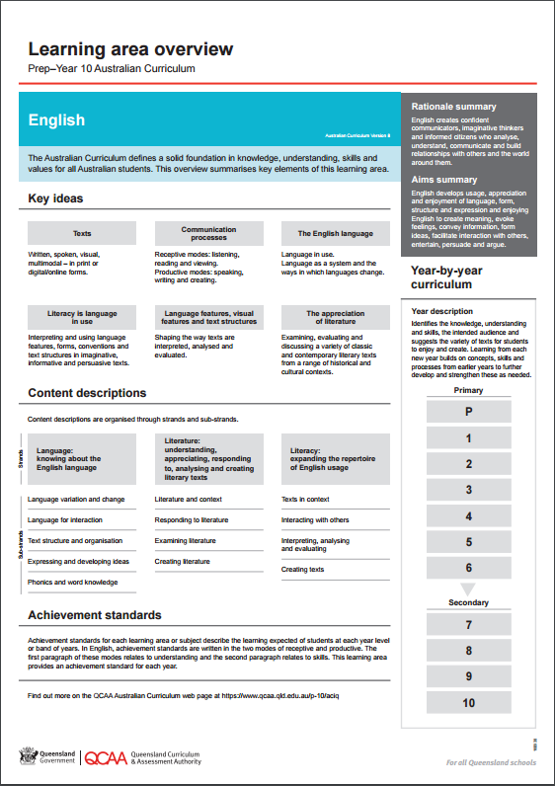
Find out more
Find out more on the QCAA Australian Curriculum
webpage at www.qcaa.qld.edu.au/p-10/aciq.
Notes:
More information about the implementation of Australian Curriculum in Queensland is available on the QCAA website. In the Australian Curriculum section of the QCAA website, you will find the Learning area overview: Prep‒Year 10 Australian Curriculum — English: www.qcaa.qld.edu.au/aciq.
Send any further questions to: australiancurriculum@qcaa.qld.edu.au.
Information about requests for further professional learning is available from: www.qcaa.qld.edu.au/pd-events/request-pd.
Suggested activity
What did I learn?
What was confirmed?
What was new?
What challenged my thinking?
What else do I need to do?
What is our plan as a teaching team?

Slide 16
Copyright information
Slides 3 and 8–14: Images and text © Australian Curriculum, Assessment and Reporting Authority (ACARA) 2009 to present, unless otherwise indicated. This material was downloaded from the ACARA website (www.acara.edu.au) (Website) (accessed Mar 25, 2019) and was not modified. The material is licensed under CC BY 4.0 (https://creativecommons.org/licenses/by/4.0/). ACARA does not endorse any product that uses ACARA material or make any representations as to the quality of such products. Any product that uses material published on this website should not be taken to be affiliated with ACARA or have the sponsorship or approval of ACARA. It is up to each person to make their own assessment of the product.

