Slide 1
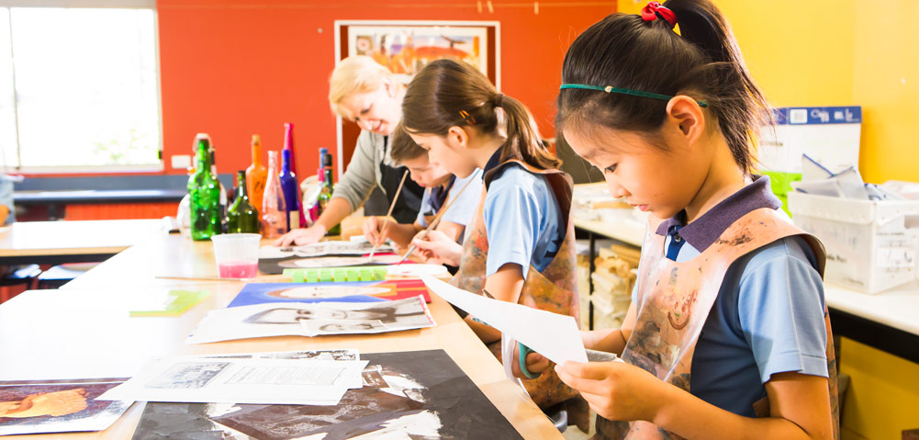
Learning area overview
Prep–Year 10 Australian Curriculum: The Arts
Notes:
This presentation supports understanding of the Australian Curriculum: The Arts Prep*–Year 10. It gives insight into the position of The Arts within the Australian Curriculum and the structure of the Arts learning area.
You can use this presentation in your organisation as the basis for professional learning about the Arts curriculum. It includes information about the key aspects of the curriculum, as well as activities for becoming familiar with the curriculum. An icon in the top-right corner of a slide identifies opportunities for activities. Presenters are encouraged to tailor this presentation to suit the needs of their audience.
The Australian Curriculum content referred to in this presentation is available from:
Australian Curriculum, Assessment and Reporting Authority (ACARA) 2017, Australian Curriculum Version 8 Foundation to Year 10, www.australiancurriculum.edu.au.
*Prep (P) in Queensland is the Foundation Year (F) of the Australian Curriculum and refers to the year before Year 1. Children beginning Prep in January are required to be five years of age by 30 June.

Slide 2
Learning goals
This presentation aims to:
build understanding of the Australian Curriculum: The Arts
provide an overview of the structure of the Arts learning area.
Notes:
This presentation aims to:
build understanding of the Australian Curriculum, with particular reference to the Arts curriculum
provide an overview of the structure of the Arts learning area, including the curriculum content and achievement standards.

Slide 3
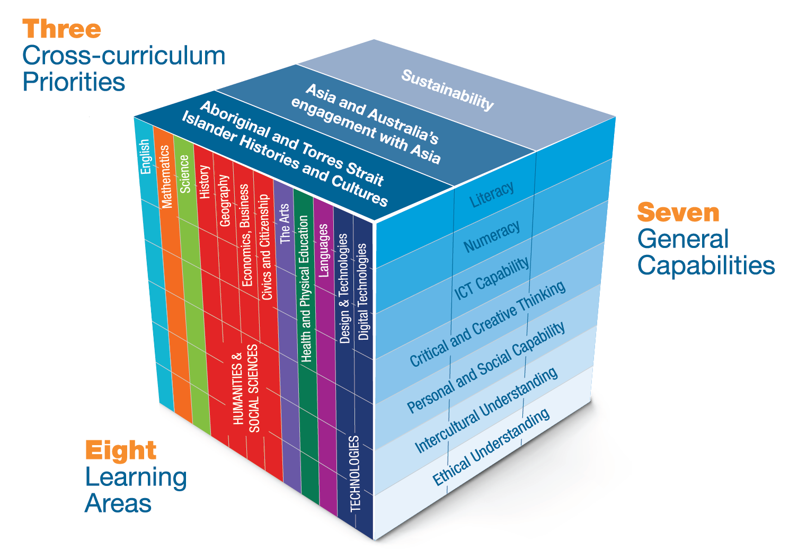
Three-dimensional curriculum
The Australian Curriculum is a three-dimensional curriculum made up of:
learning areas
general capabilities
cross-curriculum priorities.
English
Notes:
The Australian Curriculum sets the expectations for what all Australian students should be taught and have the opportunity to learn as they progress through their school life. In Prep to Year 10, the Australian Curriculum provides teachers, students, and parents with access to the same content, and consistent national standards for determining the progress of student learning.
All Australian students across all education settings and contexts can be supported in their diverse learning needs through the three dimensions of the Australian Curriculum: the learning area content, the general capabilities and the cross-curriculum priorities.
This diagram shows the relationship between these dimensions of the Australian Curriculum. Teachers emphasise one or more dimensions to develop learning programs suited to the strengths, interests and diverse needs of all students.
This presentation provides a brief overview of the general capabilities and cross-curriculum priorities. However, the focus will be on the Arts learning area.

Slide 4
Structure of the Arts learning area
Introduction
Rationale
Aims
Key ideas
Banded curriculum
Subjects: Dance, Drama, Music, Media Arts, Visual Arts
Band descriptions
Curriculum content
Strands and sub-strands
Content descriptions
Examples of knowledge and skills
Arts processes
Content elaborations
Achievement standards
Notes:
The Australian Curriculum sets out what all young people should be taught by specifying the curriculum content, and identifies the learning expected at points in their schooling by specifying the achievement standards. The content and achievement standards are supported by additional information that describes the curriculum intent (rationale), aims of learning (aims), key ideas, and focus for the learning at specific bands (band descriptions).
The following sections of the presentation will provide an overview of each of these key aspects of the curriculum.

Slide 5
Rationale
Learning area summary
In The Arts, students will learn how to communicate and share their ideas, emotions, observations and experiences through making as artists and responding to artworks as artists and audience.
This learning area rationale is complemented by subject-specific rationales.
Video
Introduction to The Arts
www.australiancurriculum.edu.au/f-10-curriculum/the-arts/introduction
Notes:
The rationale defines the learning area and describes the importance of the learning area within the curriculum:
Why is it important?
How is it shaped in the curriculum?
The Arts comprises five subjects:
Dance
Drama
Media Arts
Music
Visual Arts.
The Arts rationale promotes:
opportunities for students to learn how to create, design, represent, communicate and share their imagined and conceptual ideas, emotions, observations and experiences
understanding of the development and expression of cultures and communities, locally, nationally and globally
students’ ability to communicate ideas in current, traditional and emerging forms, and use arts knowledge and understanding to make sense of their world
value, respect and exploration of the significant contributions of Aboriginal and Torres Strait Islander Peoples to Australia’s arts heritage and contemporary arts practices through their distinctive ways of representing and communicating knowledge, traditions and experience
students learning
as artists and audience through the intellectual, emotional and sensory experiences of the arts
to express their ideas, thoughts and opinions as they discover and interpret the world
that designing, producing and resolving their work is as essential to learning in the arts as creating a finished artwork
comprehension of the distinct and related languages, symbols, techniques, processes and skills of the arts subjects
knowledge of self, communities, world cultures and histories.
The rationale is available from: www.australiancurriculum.edu.au/f-10-curriculum/the-arts/introduction.
Suggested activities
Read the learning area rationale or watch the introductory video. Partner with a colleague to discuss the following questions:
What were the key aspects of the rationale?
Why is the learning area important? What important contribution does the learning make to a student’s education?
Which aspects of this rationale matched your current understanding of the learning area? Which aspects were new understandings?
Watch and listen to the video.
What were the guiding principles that informed the development of the Arts curriculum?
Are there any messages that you will need to consider when planning your teaching, learning and assessment programs?

Slide 6
Aims
Learning area summary
Students develop knowledge, understanding and skills for creativity, exploration, experimentation and critical thinking across a range of cultures and contexts.
These learning area aims are complemented by subject-specific aims.
Notes:
The aims flow logically from the rationale and define the big-picture objectives for the learning area.
The Arts learning area aims to develop students’:
creativity, critical thinking, aesthetic knowledge and understanding about arts practices, through making and responding to artworks with increasing self-confidence
arts knowledge and skills to communicate ideas; they value and share their arts and life experiences by representing, expressing and communicating ideas, imagination and observations about their individual and collective worlds to others in meaningful ways
use of innovative arts practices with available and emerging technologies, to express and represent ideas, while displaying empathy for multiple viewpoints
understanding of Australia’s histories and traditions through the arts, engaging with the artworks and practices, both traditional and contemporary, of Aboriginal and Torres Strait Islander peoples
understanding of local, regional and global cultures, and their arts histories and traditions, through engaging with the worlds of artists, artworks, audiences and arts professions.
The aims are available from: www.australiancurriculum.edu.au/f-10-curriculum/the-arts/introduction.
Suggested activities
Prepare a brief statement/overview that would help you describe the aims of the learning area to a parent group.
Identify two or three big ideas in the aims. How do they inform:
your understanding of the learning area?
what is valued in the Australian Curriculum for the learning area?
your teaching and learning approaches?

Slide 7
Key ideas
Interrelated strands
Making: Exploring, developing and sharing artworks as artists
Responding: Interpreting meaning in artworks as artists and audience to influence making
Viewpoints
Contexts
Knowledge
Evaluations (judgments)
Evaluations
Notes:
The key ideas represent key aspects of the learning area content, and frame the development of knowledge and skills in the learning area. In The Arts, there are two key ideas:
interrelated strands
viewpoints.
The key ideas are available from: www.australiancurriculum.edu.au/f-10-curriculum/the-arts/key-ideas.
Interrelated strands: Strands are interrelated so that students may experience making and responding simultaneously through Arts processes. Content descriptions and achievement standards reflect the interrelationship between making and responding. The two strands are:
Making — includes learning about and using knowledge, skills, techniques, processes, materials and technologies to explore arts practices and make artworks that communicate ideas and intentions
Responding — includes exploring, responding to, analysing and interpreting artworks.
Viewpoints promote student engagement with artworks as artists and audience through different perspectives. The four viewpoints are:
contexts
societal
cultural
historical
knowledge
elements
materials
skills, techniques and processes
forms and styles
content
evaluations (judgments)
evaluations
philosophical and ideological
theoretical
institutional
psychological
scientific.
Viewpoint questions for Prep–Year 10 across Arts subjects are available from: www.australiancurriculum.edu.au/f-10-curriculum/the-arts/key-ideas.
Suggested activities
What are the key ideas? How do they affect your reading of the content?
How are the key ideas reflected in your Arts program?

Slide 8
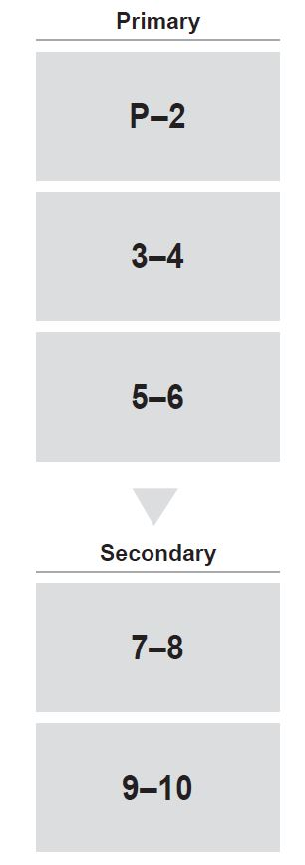
Banded curriculum
Each band includes the following structural components:
band description
curriculum content
achievement standards.
The curriculum is developmentally sequenced across the bands.
Notes:
The Arts curriculum is structured into bands of year levels. This banded curriculum enables flexible delivery of The Arts across P–10.
Suggested activity
What are the implications of the banded curriculum for the planning of your teaching, learning and assessment program?

Slide 9
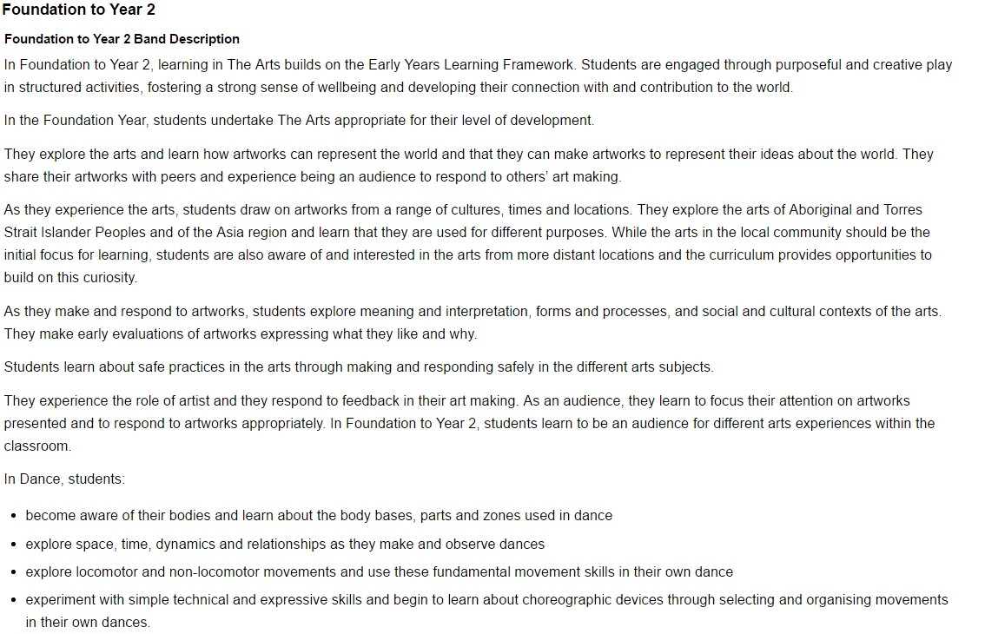
Band description
Each Arts subject has its own band description.
P–6 learning area
P–6 strands
P–10 subject-specific
Notes:
In Prep–Year 6, each Arts subject band description first identifies the learning area focus, then the subject-specific focus. However, in Years 7–10, each band description only has a subject-specific focus.
Each band description identifies the:
focus of knowledge, understanding and skills for student learning in that band
interrelatedness of the two strands
viewpoints and contexts through which students can explore and interpret artworks.

Slide 10
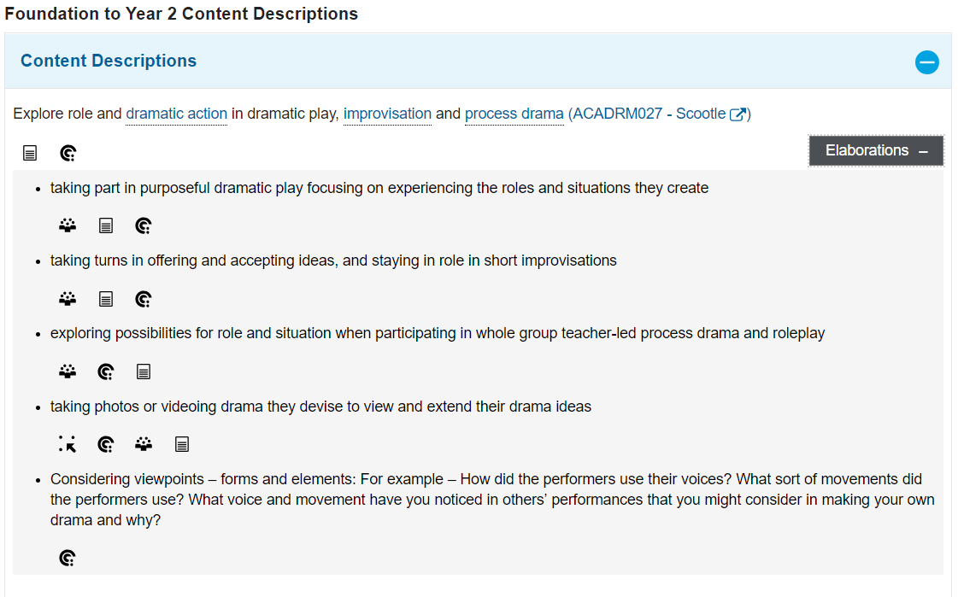
Curriculum content
Content description
Content elaborations
Notes:
The curriculum content is presented as content descriptions that specify the knowledge, understanding and skills young people are expected to learn and teachers are expected to teach across the years of schooling.
The content descriptions are accompanied by content elaborations. Content elaborations provide illustrations and/or examples that teachers may choose to use in the classroom or as inspiration for their own activities. The content elaborations are not a mandatory aspect of the curriculum and as such are not required to be taught.
Suggested activity
Use The Arts: Sequence of content to build an understanding of the sequence of content of the curriculum across bands: www.australiancurriculum.edu.au/f-10-curriculum/the-arts/pdf-documents.
Consider the content descriptions for the band before and following the selected band.
In a small group, discuss how the curriculum develops in increasing complexity of cognition and skills across the bands.

Slide 11
Strands and sub-strands
 | Prep–Year 6 | Years 7–10
 | Strand: Making
Sub-strands | Exploring ideas and improvising with ways to represent ideas | Exploring ideas and improvising with ways to represent ideas
 |  | Manipulating and applying the elements/concepts with intent
 | Developing understanding of practices | Developing and refining understanding of skills and techniques
 |  | Structuring and organising ideas into form
 | Sharing artworks through performance, presentation or display | Sharing artworks through performance, presentation or display
 | Strand: Responding
 | Responding to and interpreting artworks | Analysing and reflecting upon intentions
 |  | Responding to and interpreting artworks
Notes:
In The Arts, the curriculum content is organised through strands and sub-strands. The two strands are:
Making
Responding.
These strands are interrelated to inform and support each other.
Each strand is organised into sub-strands that increase in number from Prep–Year 6 to Years 7–10:
Making (Prep–Year 6)
Exploring ideas and improvising with ways to represent ideas
Developing understanding of practices
Sharing artworks through performance, presentation or display
Making (Years 7–10)
Exploring ideas and improvising with ways to represent ideas
Manipulating and applying the elements/concepts with intent
Developing and refining understanding of skills and techniques
Structuring and organising ideas into form
Sharing artworks through performance, presentation or display
Responding (Prep–Year 6)
Responding to and interpreting artworks
Responding (Years 7–10)
Analysing and reflecting upon intentions
Responding to and interpreting artworks
Suggested activity
What is the relationship between the content strands of The Arts?

Slide 12
Examples of knowledge and skills
Dance | Drama | Media Arts | Music | Visual Arts
Body | Elements of drama: Role, character and relationships Voice and movement Language, ideas and dramatic action (3–10) Audience | Representation and story principles Structure Intent Character Settings Points of view (5–10) Genre conventions (5–10) Media conventions (7–10) | Elements of music: Rhythm Pitch Dynamics and expression Form (and structure in 7–10) Timbre Texture | Representation: Subject matter Forms Techniques Visual conventions Materials Technologies
Elements of dance Space Time Dynamics Relationships
Fundamental movement skills
 |  | Languages: elements of media arts (technical and symbolic) Composition - Time (3–10) - Space (3–10) Sound Movement Lighting | Skills (including aural skills) | Practices Spaces Skills Processes
Technical skills |  | Languages: elements of media arts (technical and symbolic) Composition - Time (3–10) - Space (3–10) Sound Movement Lighting |  | Practices Spaces Skills Processes
Expressive skills |  | Languages: elements of media arts (technical and symbolic) Composition - Time (3–10) - Space (3–10) Sound Movement Lighting
Safe dance practices |  | Languages: elements of media arts (technical and symbolic) Composition - Time (3–10) - Space (3–10) Sound Movement Lighting
Choreographic devices
 |  |  |  | Viewpoints
Choreographic forms (7–10) |  |  |  | Practices Spaces Skills Processes
 |  | Technologies
Fundamental movement skills |  | Audience
 |  | Institutions: individuals, communities and organisations (3–10)
Notes:
The examples of knowledge and skills identify subject-specific examples for each band, including devices, elements, key concepts, practices, representations, skills and viewpoints. Subject-specific knowledge and skills are evident in the content descriptions and achievement standards.
Some of the examples of knowledge and skills are relevant to specific year levels (identified on the slide in brackets).
Suggested activities
1. Use examples of knowledge and skills to build an understanding of how they may be used across bands of year levels:
Dance — www.australiancurriculum.edu.au/f-10-curriculum/the-arts/dance/example-of-knowledge-and-skills
Drama — www.australiancurriculum.edu.au/f-10-curriculum/the-arts/drama/example-of-knowledge-and-skills
Media Arts — www.australiancurriculum.edu.au/f-10-curriculum/the-arts/media-arts/example-of-knowledge-and-skills
Music — www.australiancurriculum.edu.au/f-10-curriculum/the-arts/music/example-of-knowledge-and-skills
Visual Arts — www.australiancurriculum.edu.au/f-10-curriculum/the-arts/visual-arts/example-of-knowledge-and-skills
2. Using the examples of knowledge and skills, select a subject and band.
Consider the bands before and following the selected band.
In a small group, discuss how the knowledge and skills develop in increasing complexity across the bands.

Slide 13
Arts processes
The Arts curriculum, students engage with processes common across Arts subjects. These processes may be experienced simultaneously, as Making and Responding are interrelated.
Common Arts processes include:
exploring
developing
sharing
responding.
Notes:
Exploring processes include the use of arts materials, techniques, processes, technologies and viewpoints in artworks made by students and other artists to represent ideas. Students’ exploration of other artists’ artwork will influence their own art making.
Developing processes include the use of art-making knowledge, understanding and skills of how to apply materials, techniques, processes, technologies and viewpoints to communicate the intended meaning.
Sharing processes include the use of artworks with audiences through display, performance or presentation.
Responding processes include the use of artworks to interpret artists’ intended meanings.
Suggested activity
Consider the Arts processes common across Arts subjects. In a small group, discuss how Arts processes can be used to plan a unit of work for a specific year within a band. You could plan for one Arts subject, or for more than one Arts subject within a unit.

Slide 14
Arts processes: Subject-specific
Each Arts subject includes subject-specific processes for Making and Responding.
The Arts performing subjects of Dance, Drama and Music have two processes within the Making strand. The common Making process in these subjects is performing. In Prep–Year 10, the subject-specific Making processes are:
Dance — choreographing
Drama — forming
Music — composing.
Notes:
In Dance, students use the body to communicate and express meaning through purposeful movement. Dance practice integrates choreography, performance, and appreciation of and responses to dance and dance making.
In Drama, students explore and depict real and fictional worlds through use of body language, gesture and space to make meaning as performers and audience. They create, rehearse, perform and respond to drama.
In Music, students listen to, compose and perform music from a diverse range of styles, traditions and contexts. They create, shape and share sounds in time and space, and critically analyse music. Music practice is aurally based and focuses on acquiring and using knowledge, understanding and skills about music and musicians.
In Media Arts, students use communications technologies to creatively explore, make and interpret stories about people, ideas and the world around them. They engage their senses, imagination and intellect through media artworks that respond to diverse cultural, social and organisational influences on communications practices today.
In Visual Arts, students experience and explore the concepts of artists, artworks, world and audience. Students learn in, through and about visual arts practices, including the fields of art, craft and design. Students develop practical skills and critical thinking which inform their work as artists and audience.
Suggested activity
Consider the subject-specific processes within a performing subject (Dance, Drama, Music) and a visual subject (Media Arts, Visual Arts). In a small group, compare how these processes are similar and different. For example, the following comparison is between Dance processes and Visual Arts processes:
similarities — in Dance and Visual Arts, students respond to artworks as audience and as artists to inform their artwork making
differences — in Dance, students communicate meaning using their body through movement and performance, whereas in Visual Arts, students use Visual Arts materials to communicate meaning, which may or may not include using their body through movement and performance.

Slide 15
Achievement standards
Years 3 and 4 Achievement Standard
By the end of Year 4, students describe and discuss similarities and differences between dances they make, perform and view. They discuss how they and others organise the elements of dance in dances depending on the purpose.
Students structure movements into dance sequences and use the elements of dance and choreographic devices to represent a story or mood. They collaborate to make dances and perform with control, accuracy, projection and focus.
Responding
Making
Notes:
The achievement standard is a statement of what students should know and be able to do at the end of the band. In The Arts, the first paragraph of the achievement standard relates to Responding and the second paragraph relates to Making.
The Arts provides a subject-specific achievement standard for each band.
In Prep–Year 6, a choice between two achievement standards for each band is provided:
subject-specific achievement standard
learning area achievement standard.
Work sample portfolios provide examples of student work that are reflective of achievement levels at, above and below the achievement standard.
Suggested activities
Using The Arts: Sequence of achievement, how the evidence that students need to provide of what they know and can do increases in complexity across bands: www.australiancurriculum.edu.au/f-10-curriculum/the-arts/pdf-documents
For a given band, map the achievement standard to the content descriptions.

Slide 16
Three-dimensional curriculum: General capabilities
Support students to be successful learners
Literacy
Numeracy
Information and communication technology (ICT) capability
Critical and creative thinking
Develop ways of being, behaving and learning to live with others
Personal and social capability
Ethical understanding
Intercultural understanding
Notes:
The seven capabilities are divided into two groups:
capabilities that support students to be successful learners ― literacy, numeracy, information and communication technology (ICT) capability, and critical and creative thinking
capabilities that develop ways of being, behaving and learning to live with others ― personal and social capability, ethical understanding and intercultural understanding.
Continua of learning have been developed for each capability to describe the relevant knowledge, understanding and skills at particular points of schooling.
The content outlined in the general capabilities continua is embedded in the content descriptions for each learning area, where appropriate. The icons shown on this slide are used to identify where the general capabilities are embedded in content descriptions.
A summary of the focus of each of the general capabilities in the Arts learning area is available from: www.australiancurriculum.edu.au/f-10-curriculum/general-capabilities. On the general capabilities overview webpage, scroll down to ‘Learning area specific advice’.

Slide 17
Three-dimensional curriculum: Cross-curriculum priorities
Aboriginal and Torres Strait Islander histories and cultures Asia and Australia’s engagement with Asia Sustainability
Notes:
The Australian Curriculum promotes three cross-curriculum priorities that young Australians should learn about. Each of the priorities is represented in learning areas in ways appropriate to that area.
The three priorities are:
Aboriginal and Torres Strait Islander histories and cultures ― to ensure that all young Australians are given the opportunity to gain a deeper understanding and appreciation of Aboriginal and Torres Strait Islander histories and cultures, their significance for Australia, and the impact that these have had, and continue to have, on our world
Asia and Australia’s engagement with Asia ― to reflect the importance of knowing about Asia and Australia’s engagement with Asia, and to encourage better understanding of the countries and cultures of the Asia region so that young people appreciate the economic, political and cultural interconnections that Australia has with the region
Sustainability ― to allow young people to develop an appreciation of the need for more sustainable patterns of living, and to build capacities for thinking, valuing and acting that are necessary to create a more sustainable future.
Each of the cross-curriculum priorities contains a set of organising ideas. These are consistent across the curriculum and are reinforced in learning areas. Each of the cross-curriculum priorities can be relevant to teaching and learning in The Arts, and explicit teaching of the priorities should be incorporated in teaching and learning activities where appropriate.

Slide 18
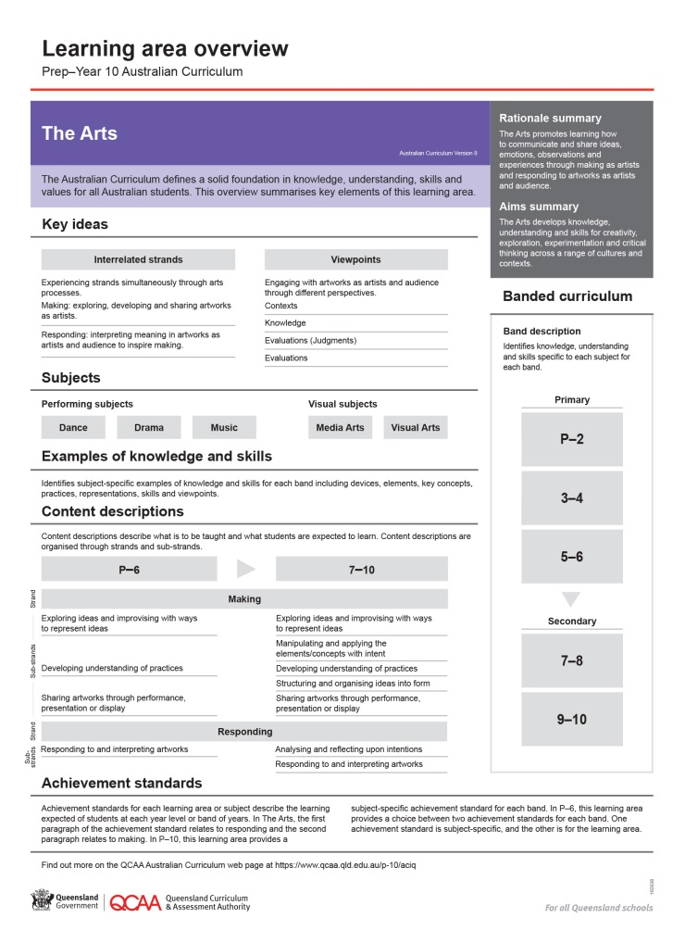
Find out more
Find out more on the QCAA Australian Curriculum webpage at www.qcaa.qld.edu.au/p-10/aciq.
Notes:
More information about the implementation of Australian Curriculum in Queensland is available on the QCAA website. In the Australian Curriculum section of the QCAA website, you will find the Learning area overview: Prep‒Year 10 Australian Curriculum — The Arts: www.qcaa.qld.edu.au/aciq.
Send any further questions to: australiancurriculum@qcaa.qld.edu.au.
Information about requests for further professional learning is available from: www.qcaa.qld.edu.au/pd-events/request-pd.
Suggested activity
What did I learn?
What was confirmed?
What was new?
What challenged my thinking?
What else do I need to do?
What is our plan as a teaching team?

Slide 19
Copyright information
Slides 3 and 8–17: Images and text © Australian Curriculum, Assessment and Reporting Authority (ACARA) 2009 to present, unless otherwise indicated. This material was downloaded from the ACARA website (www.acara.edu.au) (Website) (accessed Mar 25, 2019) and was not modified. The material is licensed under CC BY 4.0 (https://creativecommons.org/licenses/by/4.0/). ACARA does not endorse any product that uses ACARA material or make any representations as to the quality of such products. Any product that uses material published on this website should not be taken to be affiliated with ACARA or have the sponsorship or approval of ACARA. It is up to each person to make their own assessment of the product.

