Slide 1
Exploring respectful approaches to creating, performing and responding
241048
Australian Curriculum v9.0: The Arts — Years 7–8
Notes:
This resource reproduces key slides from the webinar delivered in Semester 2, 2024.
For more resources, see the Australian Curriculum Version 9.0 in Queensland (ACiQ) The Arts page: www.qcaa.qld.edu.au/p-10/aciq/version-9/learning-areas/p-10-the-arts

Slide 2
Acknowledgment of Country

Slide 3
Learning goal
Success criteria
  To understand respectful approaches to creating, performing and responding in the Australian Curriculum v9.0: The Arts — Years 7–8 and opportunities for embedding these into your planning and assessment.
You will know you are successful if you:
  understand respectful approaches in the Australian Curriculum v9.0: The Arts — Years 7–8
  identify ways to incorporate respectful approaches in your planning and assessment.

Slide 4
Outline
Respectful approaches in The Arts: Years 7–8
Assessing respectful approaches in The Arts: Years 7–8
Resources to support respectful approaches in The Arts: Years 7–8

Slide 5
Outline
Respectful approaches in The Arts: Years 7–8
Assessing respectful approaches in The Arts: Years 7–8
Resources to support respectful approaches in The Arts: Years 7–8
Notes:
One aspect of the Years 7–8 achievement standards in The Arts is describing respectful approaches to creating, performing and/or responding to artworks.

Slide 6
Australian Curriculum v9.0: The Arts — rationale
The rationale addresses how studying The Arts can:
strengthen understanding of Australia’s cultural diversity
develop critical intercultural understandings to inform decision-making and aesthetic choices
develop creative, confident, compassionate and resilient individuals who can:
    think and reflect critically
    work towards making a difference in sustaining and reimagining their own and their communities’ futures.
Source: Adapted from ACARA, 2024, Understand this learning area: The Arts, v9.australiancurriculum.edu.au/teacher-resources/understand-this-learning-area/the-arts.
Notes:
In The Arts, the learning area rationale explains that students develop critical intercultural understandings so they can make respectful choices when making artworks and when responding to culturally diverse artworks.
The rationale states: ‘Rich in tradition, the arts play a major role in the development and expressions of diverse cultures and communities, locally, nationally and globally. The exploration of cultures and histories through Arts learning strengthens understanding of Australia’s cultural diversity and develops critical intercultural understandings to inform decision-making and aesthetic choices’ (Rationale, paragraph 3).
Source: ACARA 2024, Understand this learning area: The Arts, v9.australiancurriculum.edu.au/curriculum-information/understand-this-learning-area/the-arts

Slide 7
Australian Curriculum v9.0: The Arts — aims
Three of The Arts’ aims are to develop students’:
empathy for multiple perspectives ...
understanding of personal, local, regional, national and global histories and traditions through [The Arts]
engagement with the diverse and continuing cultures, arts works and practices of First Nations Australians.
Source: Adapted from ACARA 2024, Understand this learning area: The Arts, v9.australiancurriculum.edu.au/teacher-resources/understand-this-learning-area/the-arts.
Notes:
This focus on respectful approaches extends to the aims of The Arts learning area.
Source: ACARA 2024, Understand this learning area: The Arts, v9.australiancurriculum.edu.au/curriculum-information/understand-this-learning-area/the-arts

Slide 8
Achievement standard aspect: Years 7–8
Dance
Drama
They describe respectful approaches to creating, performing and/or responding to drama.
Media Arts
They describe respectful approaches to creating and/or responding to media arts works.
Visual Arts
Music
They describe respectful approaches to composing, performing and/or responding to music.
They describe respectful approaches to creating and/or responding to artworks.
They describe respectful approaches to creating and/or responding to dance.
Source: ACARA 2024, Learning areas, v9.australiancurriculum.edu.au/f-10-curriculum/f-10-curriculum-overview/learning-areas.
Notes:
Each Arts subject has a sentence in the Years 7–8 achievement standards about describing respectful approaches to creating, performing and/or responding to artworks. It is the last sentence of the first paragraph of each of these achievement standards.
It is worth considering how to assess this in different ways to keep the content interesting and engaging for students across The Arts subjects.
Source: ACARA 2024, Learning areas, v9.australiancurriculum.edu.au/f-10-curriculum/f-10-curriculum-overview/learning-areas

Slide 9
Alignment of content description to achievement standard
Content description (teaching and learning)
investigate the diversity of First Nations Australians’ [Arts subject] arts works and practices, considering culturally responsive approaches to Indigenous Intellectual and Cultural Property
describe respectful approaches to creating, performing or responding to [Arts subject]
Achievement standard (assessment)
Source: Adapted from ACARA 2024, Learning areas, v9.australiancurriculum.edu.au/f-10-curriculum/f-10-curriculum-overview/learning-areas.
Notes:
This image shows the content description aligned to this aspect of the Years 7 and 8 achievement standard.
The content descriptions describe what students should have the opportunity to learn in the year or band.
The focus for assessment of this aspect of the achievement standard, on the right, can have broader application. Through the design of quality assessment tasks, teachers provide opportunities for students to demonstrate their learning and describe respectful approaches to creating and/or responding.

Slide 10
Content descriptions: Years 7–8
Dance
Drama
They investigate the diversity of drama created and/or performed by First Nations Australians, considering culturally responsive approaches to Indigenous Intellectual and Cultural Property Rights AC9ADR8E02
Media Arts
They investigate the diversity of First Nations Australians’ media arts works and practices, considering culturally responsive approaches to Indigenous Intellectual and Cultural Property Rights AC9AMA8E02
Visual Arts
Music
They investigate the diversity of music composed and/or performed by First Nations Australians, considering culturally responsive approaches to Indigenous Intellectual and Cultural Property Rights AC9AMU8E02
They investigate the diversity of First Nations Australians artworks and arts practices, considering culturally responsive approaches to Indigenous Intellectual and Cultural Property Rights AC9AVA8E02
They investigate the diversity of dance choreographed and/or performed by First Nations Australians considering culturally responsive approaches to Indigenous Intellectual and Cultural Property Rights AC9ADA8E02
Source: ACARA 2024, Learning areas, v9.australiancurriculum.edu.au/f-10-curriculum/f-10-curriculum-overview/learning-areas.
Notes:
This content description, in each Arts subject, guides teachers to include opportunities for students to learn about:
the diversity of First Nations’ Australians arts works and practices
how to be culturally responsive when responding, creating and performing arts works
the importance of Indigenous Cultural and Intellectual Property rights.
The following slides unpack this content description.
Source: ACARA 2024, Learning areas, v9.australiancurriculum.edu.au/f-10-curriculum/f-10-curriculum-overview/learning-areas

Slide 11
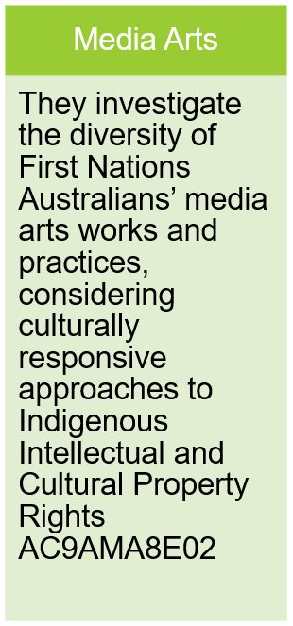
Unpacking the content description
Aboriginal and Torres Strait Islander Histories and Cultures cross-curriculum priority
A_TSIP1: Australia has 2 distinct First Nations Peoples; each encompasses a diversity of nations across Australia. Aboriginal Peoples are the first peoples of Australia and have occupied the Australian continent for more than 60,000 years. Torres Strait Islander Peoples are the First Nations Peoples of the Torres Strait and have occupied the region for over 4,000 years.
Source: ACARA 2024, Aboriginal and Torres Strait Islander Histories and Cultures’, v9.australiancurriculum.edu.au/f-10-curriculum/cross-curriculum-priorities/aboriginal-and-torres-strait-islander-histories-and-cultures?organising-idea=A_TSICP%2CA_TSIC%2CA_TSIP
Notes:
The Australian Curriculum Aboriginal and Torres Strait Islander Histories and Cultures Cross Curriculum Priority is a useful starting point when unpacking this content description.
The concept diversity is referred to in the content descriptions and so it is important to recognise and consider the diversity of nations across Australia when exploring First Nations Australians’ arts works.
Source: ACARA 2024, Aboriginal and Torres Strait Islander Histories and Cultures, v9.australiancurriculum.edu.au/f-10-curriculum/cross-curriculum-priorities/aboriginal-and-torres-strait-islander-histories-and-cultures?organising-idea=A_TSICP%2CA_TSIC%2CA_TSIP

Slide 12
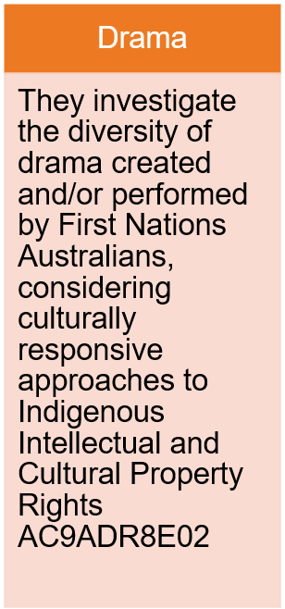
Unpacking the content description
Definition:
Indigenous Cultural and Intellectual Property (ICIP)
‘The rights of First Peoples of Australia to own and control their cultural heritage. It refers to all aspects of cultural heritage, including the tangible (e.g. cultural objects) and intangible (e.g. knowledge).’
Source: ACARA 2024, Aboriginal and Torres Strait Islander Histories and Cultures: Glossary, https://v9.australiancurriculum.edu.au/downloads/cross-curriculum-priorities#accordion-00dfddc453-item-c84c8658c0
Notes:
The cross-curriculum priority glossary includes a definition of Indigenous Cultural and Intellectual Property (ICIP) Rights, which is an important consideration when teaching this content description.
The cross-curriculum priority glossary also defines cultural expressions, as ‘cultural content resulting from the creativity of societies, groups and individuals. They include cultural stories, body, cave and sand paintings, symbols, song, dance, artworks and material culture’.
Source: ACARA 2024, Aboriginal and Torres Strait Islander Histories and Cultures: Glossary, https://v9.australiancurriculum.edu.au/downloads/cross-curriculum-priorities#accordion-00dfddc453-item-c84c8658c0

Slide 13
Indigenous Cultural and Intellectual Property (ICIP) Rights
Indigenous Cultural and Intellectual Property (ICIP) includes:
traditional knowledge (scientific, agricultural, technical and ecological, ritual knowledge)
traditional cultural expression (stories, designs and symbols, literature and language)
performances (ceremonies, dance and song)
cultural objects (including but not limited to arts, crafts, ceramics, jewellery, weapons, tools, visual arts, photographs, textiles, contemporary art practices).
Excerpted from Australia Council for the Arts 2019, Protocols for using First Nations Cultural and Intellectual Property in the Arts, p. 5. creative.gov.au/wp-content/uploads/2021/07/protocols-for-using-first-nati-5f72716d09f01.pdf.
Notes:
The Arts curriculum provides opportunities to develop understanding and appreciation of respectful approaches to responding, creating and performing artwork through engagement with Indigenous Cultural and Intellectual Property (ICIP).
The Australian Council for the Arts publication ‘Protocols for using First Nations Cultural and Intellectual Property in the Arts’ provides more advice on ICIP.
This slide includes some of the tangible and intangible forms that ICIP can take.
Source: Australia Council for the Arts 2019, Protocols for using First Nations Cultural and Intellectual Property in the Arts, p. 5, creative.gov.au/wp-content/uploads/2021/07/protocols-for-using-first-nati-5f72716d09f01.pdf

Slide 14
Outline
Respectful approaches in The Arts: Years 7–8
Assessing respectful approaches in The Arts: Years 7–8
Resources to support respectful approaches in The Arts: Years 7–8

Slide 15
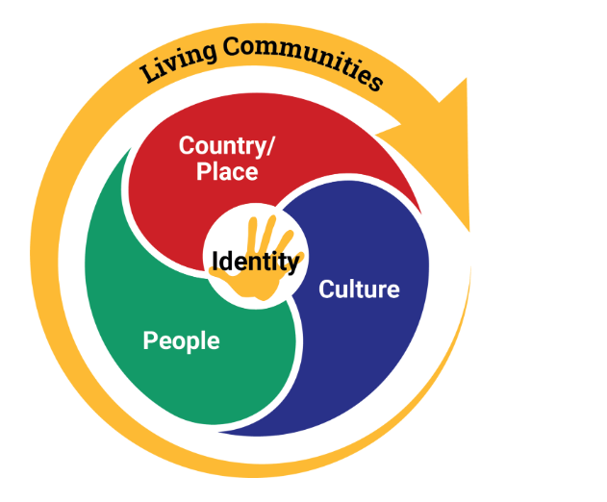
Aboriginal and Torres Strait Islander Histories and Cultures cross-curriculum priority
Source: ACARA 2024, Aboriginal and Torres Strait Islander Histories and Cultures, v9.australiancurriculum.edu.au/f-10-curriculum/cross-curriculum-priorities/aboriginal-and-torres-strait-islander-histories-and-cultures?organising-idea=0.
Notes:
The conceptual framework of the Australian Curriculum Aboriginal and Torres Strait Islander Histories and Cultures cross-curriculum priority may be useful to support planning.
The cross-curriculum priorities provide opportunities to enrich the content of learning areas and subjects, allowing students to engage with and better understand their world and everyone who they share it with.
The three sets of organising ideas within this cross-curriculum priority are interconnected, and the conceptual framework illustrates this: Country/Place, Culture and People. These organising ideas are relevant in various ways to the content description and achievement standard under discussion, and teachers can draw from this content to enrich teaching and learning in The Arts.
Source: ACARA 2024, Aboriginal and Torres Strait Islander Histories and Cultures, v9.australiancurriculum.edu.au/curriculum-information/understand-this-cross-curriculum-priority/aboriginal-and-torres-strait-islander-histories-and-cultures

Slide 16
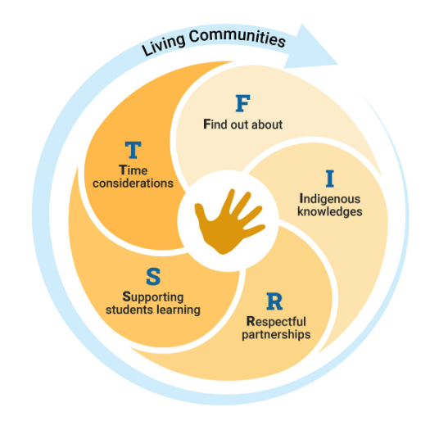
Australian Curriculum v9.0 FIRST framework
Source: ACARA 2024, FIRST framework, v9.australiancurriculum.edu.au/resources/aboriginal-and-torres-strait-islander-histories-and-cultures/first-framework.
Notes:
The Australian Curriculum FIRST framework is a guide to assist teachers and schools to engage with their local First Nations communities to support the implementation of the Australian Curriculum.
Teachers may be planning to include the Aboriginal and Torres Strait Islander Histories and Cultures cross-curriculum priority and/or learning area specific content.
This FIRST framework aims to provide some very simple and practical considerations when developing a teaching and learning program suitable for the local context.
Source: ACARA 2024, FIRST framework, v9.australiancurriculum.edu.au/resources/aboriginal-and-torres-strait-islander-histories-and-cultures/first-framework

Slide 17
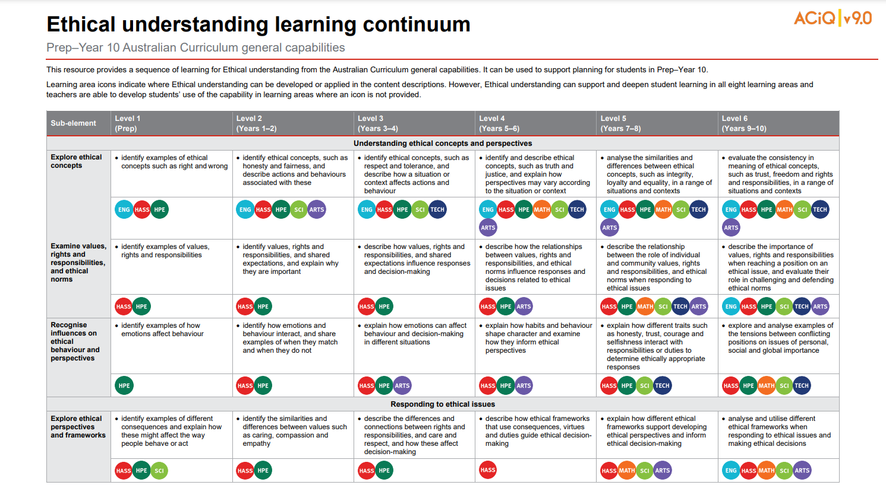

General capability: Ethical understanding
Notes:
The Australian Curriculum Ethical understanding general capability also supports teachers to embed respectful approaches, as ethical decision-making is involved in how to approach First Nations arts practices, protocols and ICIP.
The resource shown — ‘Ethical understanding learning continuum: Prep–Year 10 Australian Curriculum general capabilities’ — was developed by the QCAA to assist teachers with their planning.
It identifies where the Australian Curriculum has identified opportunities to engage with this general capability in The Arts, indicated by the purple icon.
Source: State of Queensland (QCAA) 2022, Ethical understanding learning continuum, www.qcaa.qld.edu.au/downloads/aciqv9/general-resources/ac9_gc_ethical_understanding_learning_continuum.pdf

Slide 18
Outline
Respectful approaches in The Arts: Years 7–8
Assessing respectful approaches in The Arts: Years 7–8
Resources to support respectful approaches in The Arts: Years 7–8

Slide 19
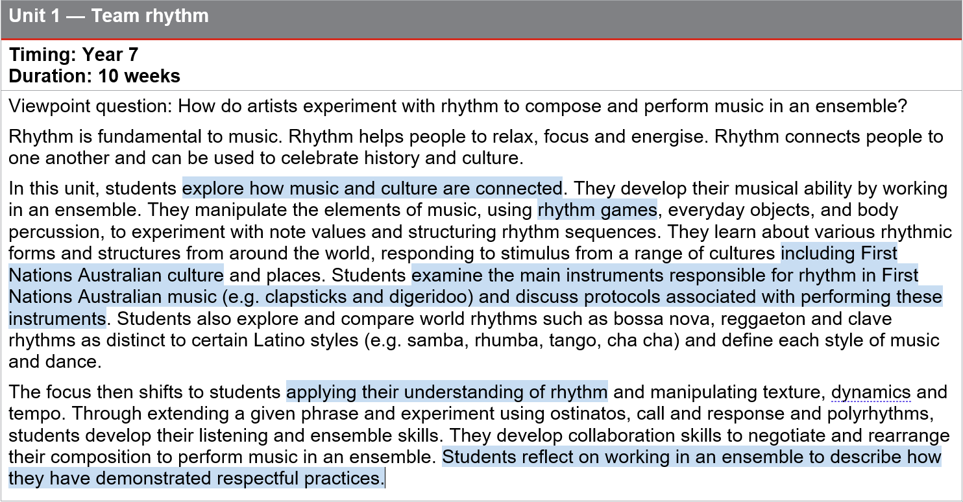
Unit description: Years 7–8 Music
Notes:
This unit, ‘Team rhythm’, is from a sample Curriculum and assessment plan available on the planning tab of the Music page on the QCAA website.
Some possible ways to incorporate respectful approaches to are shown in this example.
The unit explores the relationship between music and culture. Students learn about rhythm in First Nations’ cultures and the instruments that are used to create rhythm.
Students could learn about cultural protocols of playing these instruments, so they are learning about and discussing respectful approaches in an authentic context.
The students use this understanding to develop ensemble work in which First Nations’ cultural rhythms are not copied but listened to, analysed and recontextualised using Western compositional devices, such as ostinato.
Source: State of Queensland (QCAA) 2023, Year 7–8 Music Curriculum and assessment plan: Example A, www.qcaa.qld.edu.au/downloads/aciqv9/the-arts/planning/ac9_music_yr7-8_cap_example_a.pdf

Slide 20
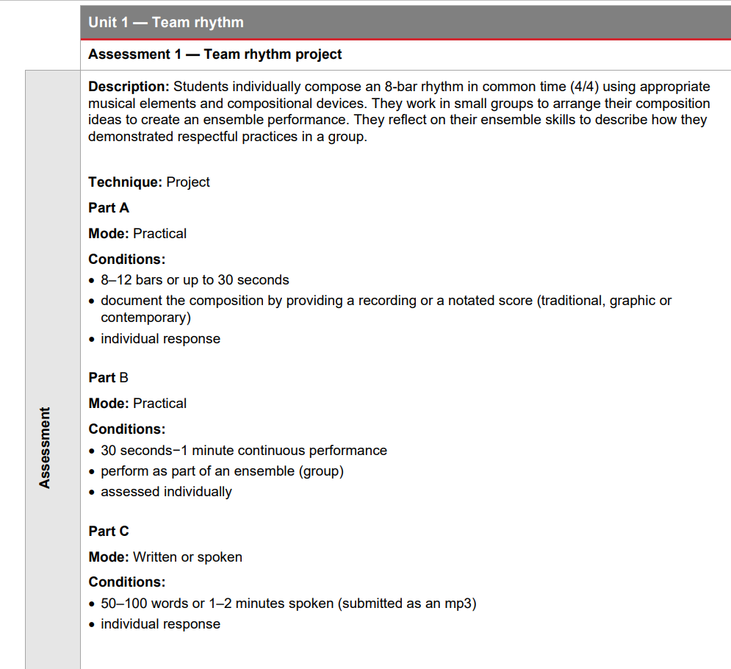
Assessment: Years 7–8 Music
Description: Students individually compose an 8-bar rhythm in common time (4/4) using appropriate musical elements and compositional devices. They work in small groups to arrange their composition ideas to create an ensemble performance. They reflect on their ensemble to describe how they demonstrated respectful practices in a group.
Notes:
Here is the assessment outline for this Music sample curriculum and assessment plan.
The assessment task example described is a project with three parts: a composition, a performance and a written or spoken reflection that provides students with the opportunity to describe how they have demonstrated respectful practices in a group.
Source: State of Queensland (QCAA) 2023, Year 7–8 Music curriculum and assessment plan: Example A, www.qcaa.qld.edu.au/downloads/aciqv9/the-arts/planning/ac9_music_yr7-8_cap_example_a.pdf

Slide 21
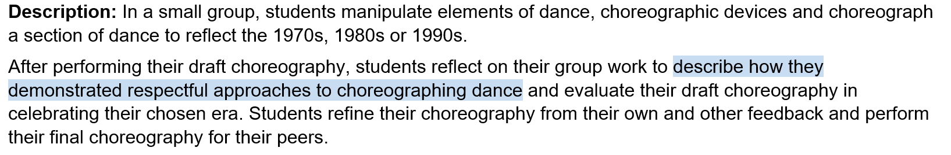
Assessment: Years 7–8 Dance
Technique: Project
Part A
Mode: Practical
Conditions:
individually responsible for up to 1 minute
assessed individually
individually responsible for a continuous section of a larger work.
Part B
Mode: Written or spoken
Conditions:
50–150 words or 1–2 minute spoken (submitted as an mp3) per response
individual response.
Notes:
This assessment task example is from a sample Years 7‒8 Dance Curriculum and assessment plan.
The assessment is a group choreographic task reflective of an era where students are asked to reflect on how they have demonstrated respect in working as part of the ensemble.
Students’ responses might describe respectful approaches such as
listening respectfully to each other
taking it in turns to talk
encouraging each other
watching each other’s choreography with purpose
giving helpful feedback.
Source: State of Queensland (QCAA) 2023, Year 7–8 Dance curriculum and assessment plan: Example A, www.qcaa.qld.edu.au/downloads/aciqv9/the-arts/planning/ac9_arts_dance_yr7-8_cap_a.pdf

Slide 22
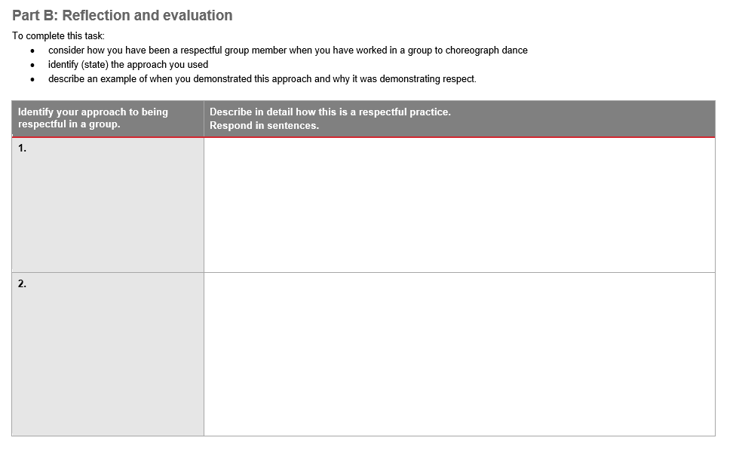
Assessment: Years 7–8 Dance
Notes:
Assessing respectful approaches in Performing Arts might involve students reflecting on their tasks to describe how they have been a respectful group or ensemble member.
For example, this is a possible scaffold that could support students to describe the respectful approaches they have used as part of the Dance assessment task.
Alternatively, when working with text, students might describe how they have been respectful to the copyright owner or to the original cultural context. For example, students might describe the way a work needs to be adapted for privacy reasons.

Slide 23
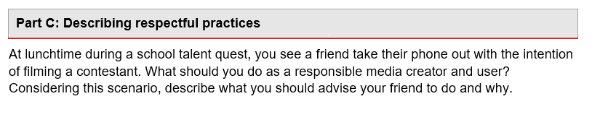
Assessment: Years 7–8 Media Arts
Notes:
This is another example of a possible way to capture evidence of respectful approaches in Media Arts as part of a supervised assessment.

Slide 24
References
Australia Council for the Arts 2019, ‘Protocols for using First Nations Cultural and Intellectual Property in the Arts’, https://creative.gov.au/wp-content/uploads/2021/07/protocols-for-using-first-nati-5f72716d09f01.pdf.

Slide 25
Acknowledgments
Third-party copyright material, and QCAA material not covered by the CC BY licence is listed below:
Queensland Government coat of arms, and the QCAA and QSA trademarks may not be reproduced without permission.
Acknowledgment of Country artwork (2023) ‘Growth through Learning’ by Chern’ee, Brooke and Jesse Sutton, Kalkadoon. www.cherneesutton.com.au.
Unless otherwise indicated, material from Australian Curriculum is © ACARA 2010–present, licensed CC BY 4.0. For the latest information and additional terms of use, see the Australian Curriculum website and its copyright notice.
Student and staff images have been used with permission.
ACARA framework diagrams and glossary terms are ‘Excluded Material’ used under the terms of the Australian Curriculum and its copyright notice and is not modified. © Australian Curriculum, Assessment and Reporting Authority (ACARA) 2009 to present, unless otherwise indicated. You may view, download, display, print, reproduce (such as by making photocopies) and distribute these Excluded Materials in unaltered form only for your personal, non-commercial educational purposes or for the non-commercial educational purposes of your organisation, provided that you make others aware it can only be used for these purposes and attribute ACARA as the source of the Excluded Material. For the avoidance of doubt, this means that you cannot edit, modify or adapt any of these materials, and you cannot sub-license any of these materials to others. Apart from any uses permitted under the Copyright Act 1968 (Cth), and those explicitly granted above, all other rights are reserved by ACARA. If you want to use such material in a manner that is outside this restrictive licence, you must request permission from ACARA by submitting a request through the online enquiry form.

Slide 26
Copyright notice
© State of Queensland (QCAA) 2024
Licence: https://creativecommons.org/licenses/by/4.0 | Copyright notice: www.qcaa.qld.edu.au/copyright — lists the full terms and conditions, which specify certain exceptions to the licence. |
Attribution (include the link): © State of Queensland (QCAA) 2024 www.qcaa.qld.edu.au/copyright.
Other copyright material in this presentation is listed on the previous slide/s.

Slide 27
QCAA social media

