Slide 1
Technologies
Prep–Year 10 Australian Curriculum Version 9.0
Learning area overview
220098
Notes:
This presentation supports understanding of the Australian Curriculum Version 9.0: Technologies Prep* –Year10. It gives an insight into the position of Technologies within the Australian Curriculum and the structure of the Technologies learning area.
You can use this presentation in your organisation as the basis for professional learning about the Technologies curriculum. It includes information about the key aspects of the curriculum as well as activities that can be used to build familiarity with the curriculum. Opportunities for activities are identified through the use of the icon in the bottom-right corner of the slide. Presenters are encouraged to tailor this presentation to suit the needs of their audience.
The Australian Curriculum content referred to in this presentation is available from:
Australian Curriculum, Assessment and Reporting Authority (ACARA) 2022, Australian Curriculum Version 9 Foundation to Year 10, https://v9.australiancurriculum.edu.au/.
*Prep (P) in Queensland is the Foundation Year (F) of the Australian Curriculum and refers to the year before Year 1. Children beginning Prep in January are required to be five years of age by 30 June.

Slide 2
Learning goals
This presentation aims to:
build understanding of the Australian Curriculum Version 9.0: Technologies
provide an overview of the structure of the Technologies learning area.
Notes:
This presentation aims to:
build understanding of the Australian Curriculum Version 9.0, with particular reference to the Technologies curriculum
provide an overview of the structure of the Technologies learning area, including the curriculum content and achievement standards.

Slide 3
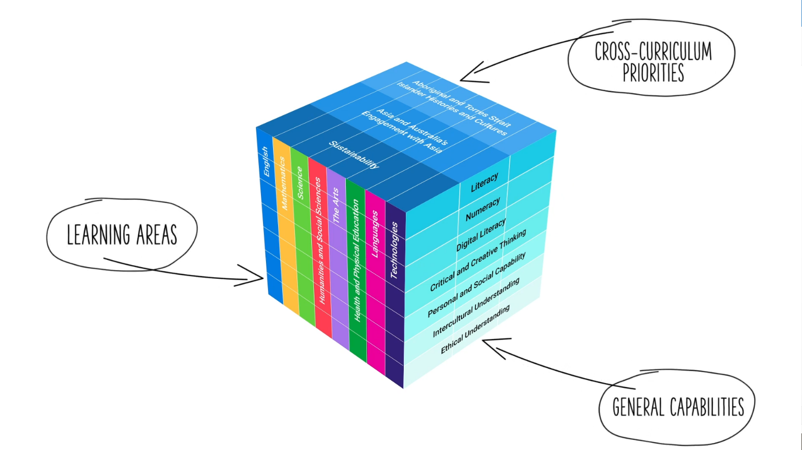
Three-dimensional curriculum
The Australian Curriculum is a three-dimensional curriculum made up of:
learning areas
general capabilities
cross-curriculum priorities.
ACARA image from Summary overview (video): https://v9.australiancurriculum.edu.au/help/website-tour.
Notes:
The Australian Curriculum sets the expectations for what all Australian students should be taught and have opportunity to learn as they progress through their school life. In Prep–Year 10, the Australian Curriculum provides teachers, students and parents with access to the same content and consistent national standards for determining the progress of student learning.
All Australian students across all education settings and contexts can be supported in their diverse learning needs through the three dimensions of the Australian Curriculum: the learning area content, the general capabilities and the cross-curriculum priorities.
This diagram shows the relationship between these dimensions of the Australian Curriculum. Teachers emphasise one or more dimensions to develop learning programs suited to the strengths, interests and diverse needs of all students.
This presentation provides a brief overview of the general capabilities and cross-curriculum priorities. However, the focus will be on the Technologies learning area.

Slide 4
Structure of the Technologies learning area
Introduction
Rationale
Aims
Core concepts
Key considerations
Key connections
Subject by subject curriculum including
Year/Banded curriculum*
Achievement standards
Curriculum content
* The Australian Curriculum: Technologies is presented in two-year band levels from Year 1 to Year 10, with Prep presented as a single year level.
Notes:
The Australian Curriculum sets out what all young people should be taught by specifying the curriculum content and identifies the learning expected at points in their schooling by specifying the achievement standards. The curriculum content and achievement standards are supported by additional information that describes the:
curriculum intent (rationale)
aims of learning (aims)
key considerations when planning learning experiences that are unique to the learning area of Technologies
key connections with the other dimensions for the Australian Curriculum including the general capabilities, cross curriculum priorities and other learning areas
the organising structure and focus for the learning at specific year/band levels including the level descriptions, achievement standards and the curriculum content.
The Australian Curriculum: Technologies is presented in two-year band levels from Year 1 to Year 10, with Prep presented as a single year level.
The following sections of the presentation will provide an overview of each of these key aspects of the curriculum.

Slide 5
Rationale
‘Technologies enrich and impact on the lives of people and societies globally. They can play an important role in transforming, restoring and sustaining societies and natural, managed and constructed environments.
Australia needs enterprising individuals who can make discerning decisions about the development and use of technologies, develop solutions to complex challenges and contribute to sustainable patterns of living. Therefore, all young Australians should develop capacity for action and a critical appreciation of how technologies are developed and can contribute to societies.’
Source: Extract quoted verbatim and unaltered from ACARA, https://v9.australiancurriculum.edu.au/teacher-resources/understand-this-learning-area/technologies.
This learning area rationale is complemented with subject-specific rationales.
Notes:
The rationale defines the learning area and describes the importance of the learning area within the curriculum:
The Technologies rationale promotes:
using technologies to solve problems independently and collaboratively and applying knowledge, processes and skills to create solutions that contribute to preferred futures for themselves and others
an ability to learn about and work with traditional, contemporary and emerging technologies and to consider how technologies can contribute to societies
critical and creative thinking, including understanding interrelationships in systems
a systematic approach to experimentation, problem-solving, prototyping and evaluation and project management
an ability to consider the use and impact of technological solutions on equity, ethics, sustainability and personal and social values.
The full rationale is available under the introduction tab from: https://v9.australiancurriculum.edu.au/teacher-resources/understand-this-learning-area/technologies/.
Suggested activity:
Read the full rationale. Partner with a colleague to discuss:
What were the key aspects of the rationale?
Why is the learning area important? What important contribution does the learning make to a student’s education?
Which aspects of this rationale matched your current understanding of the learning area? Which aspects were new understandings?

Slide 6
Aims
‘Technologies aims to develop the knowledge, understanding and skills to ensure that, individually and collaboratively, students:
investigate, design, plan, manage, create and evaluate solutions
are creative, innovative and enterprising when using traditional, contemporary and emerging technologies, and understand how technologies have developed over time
make informed and ethical decisions about the role, impact and use of technologies in their own lives, the economy, environment and society for a sustainable future
engage confidently with and responsibly select and manipulate appropriate technologies – tools, equipment, processes, materials, data, systems and components − when designing and creating solutions
analyse and evaluate needs, opportunities or problems to identify and create solutions.’
Source: Quoted verbatim and unaltered from ACARA, https://v9.australiancurriculum.edu.au/teacher-resources/understand-this-learning-area/technologies.
These learning area aims are complemented with subject-specific aims.
Technologies
Notes:
The aims flow logically from the rationale and identify the major learning that students will be able to demonstrate as a result of being taught the curriculum.
The Technologies learning area aims to develop the knowledge, understanding and skills to enable students to:
investigate, design, plan, manage, create and evaluate solutions
create, innovate and be enterprising when using technologies
make informed and ethical decisions about the role, impact and use of technologies
engage confidently with and responsibly select and manipulate appropriate technologies
critique, analyse and evaluate problems, needs or opportunities.
The full aims are available under the introduction tab from: https://v9.australiancurriculum.edu.au/teacher-resources/understand-this-learning-area/technologies/.
Suggested activities:
Prepare a brief statement/overview that would help you describe the aims of the learning area to a parent group.
Identify two or three big ideas in the aims. How do they inform:
your understanding of the learning area?
what is valued in the Australian Curriculum for the learning area?
your teaching and learning approaches?

Slide 7
Technologies core concepts
Technologies
Notes:
The Technologies core concepts represent key aspects of the learning area content and frame the development of knowledge and skills in the learning area. In Technologies, the main overarching core concept is Creating solutions for preferred futures.
The core concepts that underpin the overarching idea include:
systems
data
project management skills
systems thinking
computational thinking
design thinking
interactions and impact
enterprise skills and innovation
technologies processes and production skills.
The Technologies learning area concepts are referred to in the Structure section of the Technologies curriculum: https://v9.australiancurriculum.edu.au/teacher-resources/understand-this-learning-area/technologies/
The Design and Technologies subject-specific core concepts: https://v9.australiancurriculum.edu.au/teacher-resources/understand-this-learning-area/technologies#design-and-technologies/
The Digital Technologies subject-specific core concepts: https://v9.australiancurriculum.edu.au/teacher-resources/understand-this-learning-area/technologies#digital-technologies/
Suggested activities:
What are the core concepts, and how do they impact on your reading of the content?
How could the core concepts be reflected in your teaching and learning approaches?

Slide 8
Key considerations
Protocols for engaging First Nations Australians
Meeting the needs of diverse learners
Safety
Privacy and security
Copyright
Intellectual property
Designing for safety and equity
Notes:
The key considerations provide a brief overview of how the Australian Curriculum can accommodate particular approaches to teaching and assessment in Technologies.
When planning teaching and learning activities teachers need to consider:
safety
privacy and security
copyright
intellectual property
This section also supports teachers to consider:
protocols for engaging in First Nation Australians
inclusive practices that are relevant to the students needs.
Suggested activity
How are the key considerations reflected in your Technologies program?

Slide 9
Year/Banded curriculum
Each year/band includes the following structural components:
level description
curriculum content
achievement standard.
The curriculum is developmentally sequenced across the bands.
Notes:
The Technologies curriculum is structured into two-year band levels from Year 1 to Year 10, with Prep presented as a single year level.
This banded curriculum enables flexible delivery of the Technologies across P-10.
Suggested activity:
What are the implications of the banded curriculum for the planning of your teaching, learning and assessment program?

Slide 10
Level description — Design and Technologies
Years 1 and 2
By the end of Year 2 students should have had the opportunity to create 3 types of designed solutions, and addressed each of these 2 technologies contexts:
Engineering principles and systems; Materials and technologies specialisations
Food and fibre production; Food specialisations.
Students should have opportunities to experience designing and producing products, services and environments. There are rich connections to Digital Technologies, and other learning areas, including Science and Humanities and Social Sciences.
Students explore and investigate technologies – tools, equipment, processes, materials, systems and components – including their purposes and how they meet personal and social needs within local settings. Students learn about how society and environmental sustainability factors influence design and technologies decisions. They begin to consider the impact of their decisions and of technologies on others and the environment.
They evaluate designed solutions using questions such as: How does it work? What purpose does it meet? Who will use it? What do I like about it? How can it be improved? They reflect on their participation in a design process. This involves students developing new perspectives and engaging in different forms of evaluating products, services and environments based on their personal preferences.
Students use a range of technologies to communicate and explain design ideas, including drawings and models. They label drawings and draw objects as 2-dimensional images from different views.
They plan steps, follow directions and manage their own role to complete their own or group design projects. Students are aware of the need to work safely and cooperatively when making designed solutions.
Contexts
Notes:
The Design and Technologies subject has a unique year/band description for each level.
Each Design and Technologies level description identifies the:
focus of knowledge, understanding and skills for student learning in that year/band
Design and Technologies contexts relevant to the year/band.

Slide 11
Level description — Digital Technologies
Years 1 and 2
By the end of Year 2 students should have had the opportunity to apply computational thinking by describing algorithms that include sequences of instructions and decisions, and by using digital systems to produce simple solutions. Through practice and investigation, they become more familiar with and confident in representing data in different ways.
Through Digital Technologies and Mathematics (Statistics), students begin to recognise patterns in the data they have acquired, such as identifying common and distinctive features after sorting it, and these generalisations help them make predictions, such as how a pattern might continue.
Students develop systems thinking by exploring a range of purposes for using digital systems and their components. They have opportunities to experience and develop their skills in using different hardware components, such as a touchpad and keyboard. They use different software to create content such as writing a message that includes an image and sharing it with classmates. Students become aware of design thinking by discussing and observing how the needs of different people are met through using digital systems. They protect the security of their own data on their school account by using their own username and password and, through discussion, develop an awareness that some websites and apps store their personal data online.
In Digital Technologies, students should have frequent opportunities for authentic learning by making key connections with other learning areas.
Notes:
The Digital Technologies subject has a unique year/band description for each level.
Each Digital Technologies level description identifies the focus of knowledge, understanding and skills for student learning in that year/band.

Slide 12
Curriculum content
Years 7 and 8
Design and Technologies
Knowledge and understanding
Technologies and society
Content description | Content elaborations
analyse how people in design and technologies occupations consider ethical and sustainability factors to design and produce products, services and environments AC9TDE8K01 | researching current information on animal welfare when designing an animal shelter or researching intellectual property or the significance of offshore manufacturing in a country in Asia when designing a 3D printed product investigating traditional and contemporary design and technologies, including from a country in Asia, and predicting how they might change or be sustained in the future in response to technological, environmental or economic change, for example the production of contemporary textile designs using traditional batik techniques and modern dyes in Indonesia comparing the design and production of products, services and environments in Australia and a country in Asia by identifying needs and opportunities for design and enterprise, for example design, promotion and marketing of a Western Australian wheat variety especially bred and grown for the making of udon noodles in Japan researching the rights and responsibilities of those working in design and technologies occupations, for example taking into account First Nations Australian protocols and Indigenous cultural and intellectual property rights
Notes:
The curriculum content is presented as content descriptions that specify the knowledge, understanding and skills young people are expected to learn and teachers are expected to teach across the years of schooling.
The content descriptions are accompanied by content elaborations. Content elaborations provide illustrations and/or examples that teachers may choose to use in the classroom or as inspiration for their own activities. The content elaborations are not a mandatory aspect of the curriculum and as such are not required to be taught.
Suggested activity
Use the Australian Curriculum: Technologies to build an understanding of the sequence of content of the curriculum across year/band levels: https://v9.australiancurriculum.edu.au/teacher-resources/understand-this-learning-area/technologies/.
Within the Australian Curriculum: Technologies, select a level and read the content descriptions.
Consider the content descriptions for the level prior to and following the selected level.
In a small group, discuss how the curriculum develops in increasing complexity of cognition and skills across the levels.

Slide 13
Strands and sub-strands
 | Technologies subjects
Strands | Design and Technologies | Digital Technologies
Knowledge and understanding | Technologies and society the use, development and impact of technologies in people’s lives Technologies contexts technologies and design across a range of technologies contexts | Digital systems the components of digital systems: hardware, software and networks and their use Data representation how data are represented and structured symbolically
Processes and production skills | Creating designed solutions by: investigating and defining generating and designing producing and implementing evaluating collaborating and managing | Acquiring, managing and analysing data Creating digital solutions by: investigating and defining generating and designing producing and implementing evaluating collaborating and managing Privacy and security
Notes:
In Technologies, the curriculum content is organised through strands. The two strands are:
Knowledge and understanding
Processes and production skills.
The related nature of the strands means that:
there are opportunities to facilitate an integrated approach so that students may discover the use and design of technologies within society and as part of various contexts
teaching programs should find a balance between the strands as students require the ability to draw upon their understanding of concepts in knowledge and understanding via their application of the processes and production skills.
Information on strands and sub-strands if available from: https://v9.australiancurriculum.edu.au/teacher-resources/understand-this-learning-area/technologies/.
Suggested activity:
What is the relationship between the strands of Technologies?
Prepare a brief statement/overview that would help to describe the strands to a parent group.

Slide 14
Strands and sub-strands: Design and Technologies
Design and Technologies strands
Knowledge and understanding | Processes and production skills
Technologies and society the use, development and impact of technologies in people’s lives Technologies contexts technologies and design across a range of technologies contexts including: engineering principles and systems food and fibre production food specialisations materials and technologies specialisations. Types of designed solutions include a product, service and environment | Creating designed solutions by: investigating and defining generating and designing producing and implementing evaluating collaborating and managing
Notes:
Within the Technologies contexts there are four contexts in which students create designed solutions, they include:
engineering principles and systems — students will progressively develop knowledge and understanding of how forces and the properties of materials affect the behaviour and performance of designed engineering solutions
food and fibre production — students will progressively develop knowledge and understanding about the managed systems that produce food and fibre through creating designed solutions
food specialisations — an understanding of nutrition principles and the nature of food, safety and preparation, with relation to technology-related food issues that are sustainable in nature
materials and technologies specialisations — the development of confidence to make ethical and sustainable choices about solutions and the steps required to produce them, as well as understanding the properties of a range of materials that are used in production processes, e.g., architecture, electronics, graphics technologies or fashion.
Within the four guiding perspectives of the Technologies contexts students have the opportunity to address such contexts by creating different types of designed solutions. The three types of designed solutions within the various Technologies contexts include the creation of:
a product
a service
an environment.
Suggested activities:
Describe the Technologies contexts and how they might be developed in relation to technologies and society?
What connections are you able to make between the strands within Design and Technologies knowledge and understanding, and the processes and production skills?

Slide 15
Strands and sub-strands: Digital Technologies
Digital Technologies strands
Knowledge and understanding | Processes and production skills
Digital systems the components of digital systems — hardware, software and networks and their use Data representation how data are represented and structured symbolically | Acquiring, managing and analysing data Creating digital solutions by investigating and defining generating and designing producing and implementing evaluating collaborating and managing Privacy and security
Notes:
In Digital Technologies, the curriculum content is organised through strands. The two strands are:
Knowledge and understanding
Processes and production skills.
Suggested activities:
What connections are you able to make between the strands within Digital Technologies knowledge and understanding, and the processes and production skills?
Identify some similarities and differences between the Design and Technologies and the Digital Technologies subjects? Are there any connections between the two?

Slide 16
Technologies learning area achievement standard
Years 7 and 8
By the end of Year 8 students explain how people design, innovate and produce products, services and environments for preferred futures. For each of the 4 prescribed technologies contexts students explain how the features of technologies impact on design decisions, and create designed solutions based on analysis of needs or opportunities. They acquire, interpret and model with spreadsheets and represent data with integers and binary. Students design and trace algorithms; and implement them in a general-purpose programming language. Students create and adapt design ideas, processes and solutions, and justify their decisions against developed design criteria that include sustainability. They communicate design ideas and solutions to audiences using technical terms and graphical representation techniques, including using digital tools. They select appropriate hardware for particular tasks, explain how data is transmitted and secured in networks, and identify cyber security threats. They use a range of digital tools to individually and collaboratively document and manage production processes to safely and responsibly produce designed or digital solutions for the intended purpose. Students manage their digital footprint.
Notes:
The achievement standard is a statement of what students should know and be able to do at the end of the year/band.
In Prep–Year 10, this learning area provides a subject-specific achievement standard for each year/band.
In Prep–Year 8, this learning area provides a choice between two achievement standards for each year/band:
subject achievement standard
learning area achievement standard.
The achievement standards reflect that the teaching and learning programs should balance and integrate both strands. Students learn knowledge and understanding of Technologies as they create designed solutions while gaining processes and production skills.
Suggested activities:
Using the Australian curriculum: Technologies, discuss how the evidence that students need to provide of what they know and can do increases in complexity across year/band levels: https://v9.australiancurriculum.edu.au/teacher-resources/understand-this-learning-area/technologies/.
For a given year/band level, map the achievement standard to the content descriptions.

Slide 17
Subject-specific achievement standard
Years 9 and 10
By the end of Year 10 students develop and modify innovative digital solutions, decompose real-world problems, and critically evaluate alternative solutions against stakeholder elicited user stories. Students acquire, interpret and model complex data with databases and represent documents as content, structure and presentation. They design and validate algorithms and implement them, including in an object-oriented programming language. Students explain how digital systems manage, control and secure access to data; and model cyber security threats and explore a vulnerability. They use advanced features of digital tools to create interactive content, and to plan, collaborate on and manage agile projects. Students apply privacy principles to manage digital footprints.
Technologies
Notes:
In Prep–Year 10, there are subject-specific achievement standards.

Slide 18
Key connections
Identify the connections with the other dimensions for the Australian curriculum including:
the general capabilities
the cross-curriculum priorities
other learning areas with in the Australian Curriculum.
Notes:
The key connections help teachers identify the links to the other dimensions for the Australian Curriculum including the general capabilities, cross-curriculum priorities and other learning areas to assist teachers to make connections in their planning for student learning.
The key connections are available from: https://v9.australiancurriculum.edu.au/teacher-resources/understand-this-learning-area/technologies/.
Suggested activities
Read the key connections section relating to other learning areas. Partner with a colleague to discuss the following questions:
Which learning areas does the Technologies curriculum have key connections to?
Create a concept map showing the connections between other learning areas.

Slide 19
Three-dimensional curriculum: General capabilities
Critical and creative thinking
Digital literacy
Ethical understanding
Intercultural understanding
Literacy
Numeracy
Personal and social capability
Notes:
The seven capabilities are divided into two groups:
capabilities that support students to be successful learners ― literacy, numeracy, digital literacy and critical and creative thinking
capabilities that develop ways of being, behaving and learning to live with others ― personal and social capability, ethical understanding and intercultural understanding.
Continua of learning have been developed for each capability to describe the relevant knowledge, understanding and skills at particular points of schooling, while the literacy and numeracy general capabilities have national learning progressions that describe the skills, understandings and capabilities that students typically acquire as their proficiency increases in a particular aspect of the curriculum over time.
The content outlined in the general capabilities' continua/progressions is embedded in the content descriptions for each learning area, where appropriate. The icons shown on this slide are used to identify where the general capabilities are embedded in content descriptions.
A summary of the focus of each of the general capabilities in the Technologies learning area is available from: https://v9.australiancurriculum.edu.au/teacher-resources/understand-this-learning-area/technologies/.
Suggested activities
Read the key connection section relating to the general capabilities. Partner with a colleague to discuss the following questions:
To which general capabilities are there key connections?
Why are these connections important?
How could you embed the general capabilities authentically into your teaching and learning programs?

Slide 20
Three-dimensional curriculum: Cross-curriculum priorities
Aboriginal and Torres Strait Islander histories and cultures Asia and Australia’s engagement with Asia Sustainability
Notes:
The Australian Curriculum promotes three cross-curriculum priorities that young Australians should learn about. Each of the priorities is represented in learning areas in ways appropriate to that area.
The three priorities are:
Aboriginal and Torres Strait Islander histories and cultures ― to ensure that all young Australians are given the opportunity to gain a deeper understanding and appreciation of Aboriginal and Torres Strait Islander histories and cultures, their significance for Australia and the impact that these have had, and continue to have, on our world
Asia and Australia’s Engagement with Asia ― to reflect the importance of knowing about Asia and Australia’s engagement with Asia and to encourage better understanding of the countries and cultures of the Asia region so that young people appreciate the economic, political and cultural interconnections that Australia has with the region
Sustainability ― to allow young people to develop an appreciation of the need for more sustainable patterns of living and to build capacities for thinking, valuing and acting that are necessary to create a more sustainable future.
Each of the cross-curriculum priorities contains a set of organising ideas. These are consistent across the curriculum and are reinforced in learning areas. Explicit teaching of the priorities should be incorporated in teaching and learning activities where appropriate.
Suggested activity
Read the key connection section relating to the cross-curriculum priorities. Partner with a colleague to discuss the following questions:
To which cross-curriculum priorities are there key connections?
How are the cross-curriculum priorities reflected in your teaching and learning programs?

Slide 21
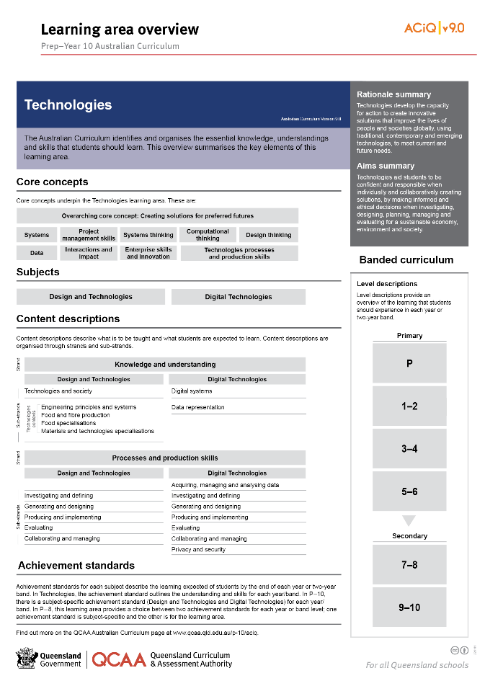
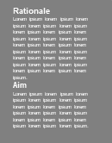
Find out more
Find out more on the QCAA Australian Curriculum webpage.
Notes:
More information about the implementation of Australian Curriculum in Queensland is available on the QCAA website. A one-page overview of the Australian Curriculum: Technologies can be accessed through https://www.qcaa.qld.edu.au/p-10/aciq/version-9/learning-areas/p-10-technologies/.
Send any further questions to: australiancurriculum@qcaa.qld.edu.au
Information about requests for further professional learning is available from: www.qcaa.qld.edu.au/pd-events/request-pd
Suggested activity:
Partner with a colleague to discuss the following questions:
What did I learn?
What was confirmed?
What was new?
What challenged my thinking?
What else do I need to do?
What is our plan as a teaching team?

Slide 22
Acknowledgments
© State of Queensland (QCAA) 2022
Licence: https://creativecommons.org/licenses/by/4.0 | Copyright notice: www.qcaa.qld.edu.au/copyright — lists the full terms and conditions, which specify certain exceptions to the licence. | Attribution: ‘© State of Queensland (QCAA) 2022’ — please include the link to our copyright notice.
Other copyright material in this publication is listed below:
Photograph/s of staff and students used with permission.
Unless otherwise indicated, material from Australian Curriculum is © ACARA 2010–present, licensed CC BY 4.0. For the latest information and additional terms of use, see the Australian Curriculum website and its copyright notice.
The three-dimensional curriculum diagram is 'Excluded Material' used under the terms of the Australian Curriculum and its copyright notice and is not modified. © Australian Curriculum, Assessment and Reporting Authority (ACARA) 2009 to present, unless otherwise indicated.
You may view, download, display, print, reproduce (such as by making photocopies) and distribute these Excluded Materials in unaltered form only for your personal, non-commercial educational purposes or for the non-commercial educational purposes of your organisation, provided that you make others aware it can only be used for these purposes and attribute ACARA as the source of the Excluded Material. For the avoidance of doubt, this means that you cannot edit, modify or adapt any of these materials, and you cannot sub-licence any of these materials to others. Apart from any uses permitted under the Copyright Act 1968 (Cth), and those explicitly granted above, all other rights are reserved by ACARA. If you want to use such material in a manner that is outside this restrictive licence, you must request permission from ACARA by emailing (copyright@acara.edu.au).

Slide 23
QCAA social media

