Slide 1
Science
Prep–Year 10 Australian Curriculum Version 9.0
Learning area overview
220097
Notes:
This presentation supports understanding of the Australian Curriculum Version 9.0: Science Prep*–Year 10. It gives insight into the position of Science within the Australian Curriculum and the structure of the Science learning area.
You can use this presentation in your organisation as the basis for professional learning about the Science curriculum. It includes information about the key aspects of the curriculum, as well as activities for becoming familiar with the curriculum. An icon in the bottom-right corner of a slide identifies opportunities for activities. Presenters are encouraged to tailor this presentation to suit the needs of their audience.
The Australian Curriculum content referred to in this presentation is available from:
Australian Curriculum, Assessment and Reporting Authority (ACARA) 2022, Australian Curriculum Version 9 Foundation to Year 10, https://v9.australiancurriculum.edu.au/.
*Prep (P) in Queensland is the Foundation Year (F) of the Australian Curriculum and refers to the year before Year 1. Children beginning Prep in January are required to be five years of age by 30 June.

Slide 2
Learning goals
This presentation aims to:
build understanding of the Australian Curriculum Version 9.0: Science
provide an overview of the structure of the Science learning area.
Notes:
This presentation aims to:
build understanding of the Australian Curriculum, with particular reference to the Science curriculum
provide an overview of the structure of the Science learning area, including the curriculum content and achievement standards.

Slide 3
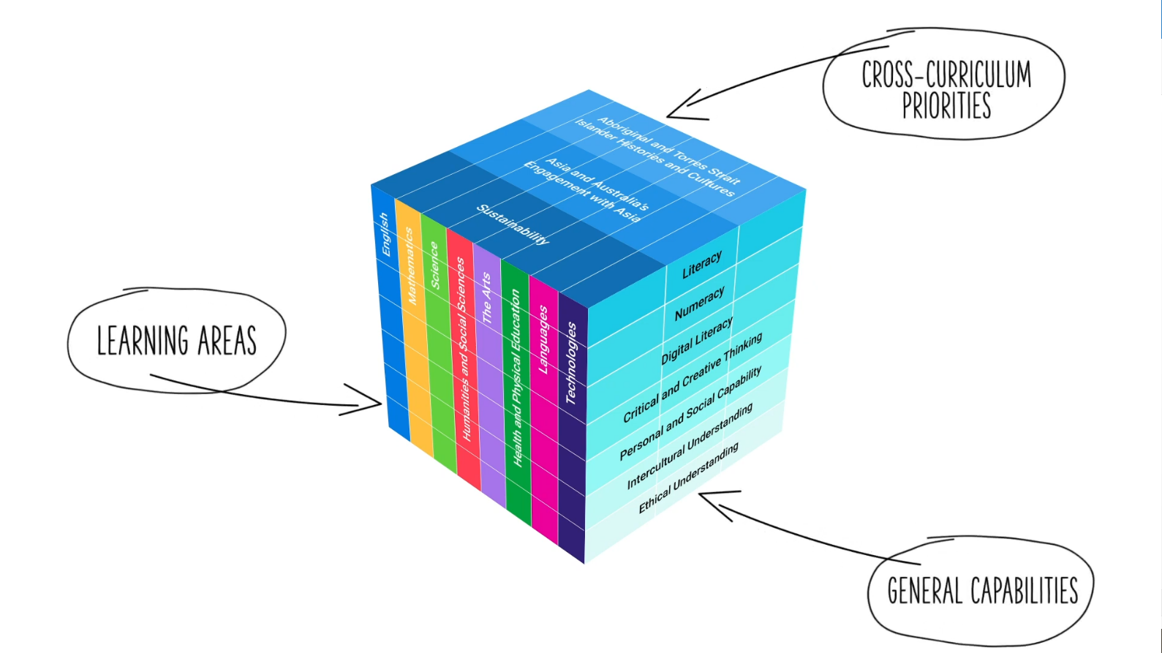
Three-dimensional curriculum
The Australian Curriculum is a three-dimensional curriculum made up of:
learning areas
general capabilities
cross-curriculum priorities.
ACARA image from Summary overview (video): https://v9.australiancurriculum.edu.au/help/website-tour.
Notes:
The Australian Curriculum sets the expectations for what all Australian students should be taught and have the opportunity to learn as they progress through their school life. In Prep to Year 10, the Australian Curriculum provides teachers, students and parents with access to the same content and consistent national standards for determining the progress of student learning.
All Australian students across all education settings and contexts can be supported in their diverse learning needs through the three dimensions of the Australian Curriculum: the learning area content, the general capabilities and the cross-curriculum priorities.
This diagram shows the relationship between these dimensions of the Australian Curriculum. Teachers emphasise one or more dimensions to develop learning programs suited to the strengths, interests and diverse needs of all students.
This presentation provides a brief overview of the general capabilities and cross-curriculum priorities. However, the focus will be on the Science learning area.

Slide 4
Structure of the Science learning area
Rationale
Aims
Key ideas
Key considerations
Key connections
Structure
Year-by-year and banded curriculum
Achievement standards
Curriculum content
Source: https://v9.australiancurriculum.edu.au/teacher-resources/understand-this-learning-area/science.
Notes:
The Australian Curriculum sets out what all young people should be taught by specifying the curriculum content and identifies the learning expected at points in their schooling by specifying the achievement standards. The content and achievement standards are supported by additional information that describes the:
curriculum intent (rationale)
aims of learning (aims)
overarching key ideas
key considerations when planning learning experiences that are unique to the learning area of Science
key connections with the other dimensions for the Australian Curriculum including the general capabilities, cross-curriculum priorities and other learning areas
organising structure and focus for the learning at specific year levels including the level descriptions, achievement standards and the curriculum content.
The following sections of the presentation will provide an overview of each of these key aspects of the curriculum.

Slide 5
Rationale
‘Science is a dynamic, collaborative and creative human endeavour arising from our desire to make sense of our world. Through science, we explore the unknown, investigate universal phenomena, make predictions and solve problems. Science gives us an empirical way of answering curious and important questions about the changing world we live in. Science knowledge is revised, refined and extended as new evidence arises and has proven to be a reliable basis for action in our personal, social and economic lives.’
Source: Quoted verbatim and unaltered from ACARA, https://v9.australiancurriculum.edu.au/teacher-resources/understand-this-learning-area/science.
Notes:
The rationale defines the learning area and describes the importance of the learning area within the curriculum.
The Science rationale promotes:
exploration of the unknown
understanding of important scientific concepts and processes
natural curiosity
critical and creative thinking
development of STEM competencies.
The rationale is available from: https://v9.australiancurriculum.edu.au/teacher-resources/understand-this-learning-area/science/.
Suggested activity
Read the full rationale. Partner with a colleague to discuss the following questions:
What were the key aspects of the rationale?
Why is the learning area important? What important contribution does the learning make to a student’s education?
Which aspects of this rationale matched your current understanding of the learning area? Which aspects were new understandings?

Slide 6
Aims
The Australian Curriculum: Science aims to ensure that students develop:
an interest in science as a way of expanding their curiosity and willingness to explore, ask questions about and speculate on the changing world they live in
a solid foundation of knowledge of the biological, Earth and space, physical and chemical sciences, including being able to select and integrate scientific knowledge and practices to explain and predict phenomena and to apply understanding to new situations and events
an understanding of scientific inquiry and the ability to use a range of scientific inquiry practices, including questioning; planning and conducting experiments and investigations based on ethical and interculturally aware principles; generating and analysing data; evaluating results; and drawing critical, evidence-based conclusions
an ability to communicate scientific understanding and findings to a range of audiences, to justify claims with evidence, and to evaluate and debate scientific explanations and arguments
an ability to solve problems and make informed decisions about current and future uses of science while taking into account ethical, environmental, social and economic implications of decisions
an understanding of the dynamic nature of science knowledge including historical and global contributions, and an understanding of the relationship between science and society including the diversity of science careers.
Source: Quoted verbatim and unaltered from ACARA, https://v9.australiancurriculum.edu.au/teacher-resources/understand-this-learning-area/science.
Notes:
The aims flow logically from the rationale and identify the major learning that students will be able to demonstrate as a result of being taught the curriculum.
The Australian Curriculum: Science aims to ensure that students develop:
• an interest in science as a means of expanding their curiosity
• a solid foundation of knowledge
• an understanding of the nature of scientific inquiry
• an ability to communicate scientific understanding and findings
• an ability to solve problems and make informed decisions
• an understanding of the dynamic nature of science knowledge.
The aims are available from: https://v9.australiancurriculum.edu.au/teacher-resources/understand-this-learning-area/science/.
Suggested activities
Prepare a brief statement/overview that would help you describe the aims of the learning area to a parent group.
Identify two or three big ideas in the aims. How do they inform:
your understanding of the learning area?
what is valued in the Australian Curriculum for the learning area?
your teaching and learning approaches?

Slide 7
Key ideas
Patterns, order and organisation
Form and function
Stability and change
Scale and measurement
Matter and energy
Systems
Notes:
The key ideas represent views of the world and bridge knowledge and understanding across the interrelated strands of Science.
In the Science learning area, there are six key ideas:
patterns, order and organisation
form and function
stability and change
scale and measurement
matter and energy
systems.
The key ideas are available from: https://v9.australiancurriculum.edu.au/teacher-resources/understand-this-learning-area/science/.
Patterns, order and organisation: An important aspect of science is recognising patterns in the world around us and ordering and organising phenomena at different scales.
Form and function: Many aspects of science are concerned with the relationships between form (the nature or make-up of an aspect of an object or organism) and function (the use of that aspect).
Stability and change: Many areas of science involve the recognition, description and prediction of stability and change.
Scale and measurement: Quantification of time and spatial scale is critical to the development as it enables the comparison of observations.
Matter and energy: Many aspects of science involve identifying, describing and measuring transfers of energy and matter.
Systems: Science often involves thinking, modelling and analysing in terms of systems to understand, explain and predict events and phenomena.
Suggested activities
How do the key ideas affect your reading of the content?
How are the key ideas reflected in your Science program?

Slide 8
Key considerations
Safety
Animal ethics and biosecurity
Protocols for engaging with First Nations Australians
Meeting the needs of diverse learners
Notes:
The key considerations provide a brief overview of how the Australian Curriculum can accommodate particular approaches to teaching and assessment in Science.
When planning teaching and learning activities teachers need to consider:
safety
animal ethics and biosecurity.
This section also supports teachers to consider:
protocols for engaging with First Nations Australians
inclusive practices that are relevant to the needs of diverse learners.
Suggested activity
How are the key considerations reflected in your Science program?

Slide 9
Year-by-year and banded curriculum
Each year level of the Australian Curriculum: Science includes the following structural components:
level description
year-by-year content for the Science understanding strand
banded content for the Science as a human endeavour and Science inquiry strands
year-by-year achievement standards.
The curriculum is developmentally sequenced across the year levels.
Notes:
The Science curriculum is structured into both year-by-year and banded curriculum content. The banded curriculum content enables flexible delivery of Science across Prep–Year 10.
Suggested activity
What are the implications for planning your teaching, learning and assessment program using banded content (Science as a human endeavor strand and Science inquiry strand) and year-by-year content (Science understanding strand)?

Slide 10
Level description
Year 1
In Year 1 students extend their understanding of patterns by exploring patterns in daily and seasonal events, recognising that all living things share the same basic needs, and that objects can behave in predictable ways. They infer relationships from their observations and experiences and begin to link function with observable properties.
They observe that changes to objects and events can be large or small and happen quickly or slowly. Students pose questions and make predictions based on their observations and are introduced to ways of organising their observations to identify patterns. They appreciate that science involves observing, asking questions about and describing changes in objects and events.
Inquiry questions can help excite students’ curiosity and challenge their thinking. Following are examples of inquiry questions that could be used to prompt discussion and exploration:
Does a fish have a home?
How do we know what season it is?
What makes playgrounds fun? How do playground designers come up with ideas?
How can we tell if something has changed?
How does science help us care for ourselves and other living things?
Key ideas
Inquiry questions
Notes:
Each Science year level description identifies the:
focus of knowledge, understanding and skills for student learning in that year level
broad focus of the key ideas for the particular phase of learning
specific inquiry questions to help excite student’s curiosity and challenge their thinking.

Slide 11
Curriculum content
Year 7
Science understanding
Biological sciences
Content description | Content elaborations
investigate the role of classification in ordering and organising the diversity of life on Earth and use and develop classification tools including dichotomous keys AC9S701 | observing and identifying the similarities and differences of particular features within and between groups of organisms creating and modifying a dichotomous key to classify organisms into groups and groups within groups naming and classifying species using scientific conventions from the Linnaean hierarchical classification system, such as kingdom, phylum, class, order, family, genus, species considering the reasons for classifying living things, such as identification and communication examining how biological classification has changed over time through improvements in microscopy using provided dichotomous keys to identify organisms surveyed on a field trip investigating First Nations Australians’ systems of classifying living things and how these systems differ from those used by contemporary science
Notes:
The curriculum content is presented as content descriptions that specify the knowledge, understanding and skills young people are expected to learn and teachers are expected to teach across the years of schooling.
The content descriptions are accompanied by content elaborations. Content elaborations provide illustrations and/or examples that teachers may choose to use in the classroom or as inspiration for their own activities. The content elaborations are not a mandatory aspect of the curriculum and as such are not required to be taught.
Suggested activity
Use the Australian Curriculum: Science to build an understanding of the sequence of content of the curriculum across year levels: https://v9.australiancurriculum.edu.au/teacher-resources/understand-this-learning-area/science/.
Within the Australian Curriculum: Science, select a year level and read the content descriptions.
Consider the content descriptions for the year level/band prior to and following the selected year level/band.
In a small group, discuss how the curriculum develops in increasing complexity of cognition and skills across the year levels/bands.

Slide 12
Strands and sub-strands Intent of the interrelated strands
 | Strands
 | discipline-specific content | taught in |  | context | informed by |  | inquiry model
 | Science understanding |  | Science as a human endeavour |  |  | Science inquiry
Sub-strands | Biological sciences (F, 1, 3–10) |  | Nature and development of science (3–10) |  |  | Questioning and predicting
 | Chemical sciences (F, 2–10) |  | Use and influence of science |  |  | Planning and conducting
 | Earth and space sciences (1–10) |  |  |  |  | Processing, modelling and analysing
 | Physical sciences |  |  |  |  | Evaluating
 |  |  |  |  |  | Communicating
Notes:
In Science, the curriculum content is organised through strands and sub-strands. The three strands are:
Science understanding
Science as a human endeavour
Science inquiry.
These strands are interrelated to inform and support each other.
Some of the examples of knowledge and skills are relevant to specific year levels.
Each strand is organised into sub-strands:
Science understanding
Biological sciences (F, 1, 3–10)
Chemical sciences (F, 2–10)
Earth and space sciences (1–10)
Physical sciences.
Science as a human endeavour
Nature and development of science (3–10)
Use and influence of science.
Science inquiry skills
Questioning and predicting
Planning and conducting
Processing, modelling and analysing
Evaluating
Communicating.
The discipline-specific content in Science understanding is taught using contexts from Science as a human endeavour, using an inquiry model informed by Science inquiry.
Information on strands and sub-strands is available from: https://v9.australiancurriculum.edu.au/teacher-resources/understand-this-learning-area/science/.
Suggested activities
What is the relationship between the strands of Science?
2. Prepare a brief statement/overview that would help you describe the strands to a parent group.

Slide 13
Achievement standards
Year 10
By the end of Year 10 students explain the processes that underpin heredity and genetic diversity and describe the evidence supporting the theory of evolution by natural selection. They sequence key events in the origin and evolution of the universe and describe the supporting evidence for the big bang theory. They describe trends in patterns of global climate change and identify causal factors. They explain how Newton’s laws describe motion and apply them to predict motion of objects in a system. They explain patterns and trends in the periodic table and predict the products of reactions and the effect of changing reactant and reaction conditions. Students analyse the importance of publication and peer review in the development of scientific knowledge and analyse the relationship between science, technologies and engineering. They analyse the key factors that influence interactions between science and society.
Students plan and conduct safe, valid and reproducible investigations to test relationships or develop explanatory models. They explain how they have addressed any ethical and intercultural considerations when generating or using primary and secondary data. They select equipment and use it efficiently to generate and record appropriate sample sizes and replicable data with precision. They select and construct effective representations to organise, process and summarise data and information. They analyse and connect a variety of data and information to identify and explain patterns, trends, relationships and anomalies. They evaluate the validity and reproducibility of methods, and the validity of conclusions and claims. They construct logical arguments based on analysis of a variety of evidence to support conclusions and evaluate claims. They select and use content, language and text features effectively to achieve their purpose when communicating their ideas, findings and arguments to diverse audiences.
Understanding
Skills
Notes:
The achievement standard is a statement of what students should know and be able to do at the end of the year level. In Science, the first paragraph of the achievement standard relates to understanding and the second paragraph relates to skills.
The Science achievement standards are available from: https://v9.australiancurriculum.edu.au/.
Suggested activities
Partner with a colleague and complete the following activities:
Using the Australian curriculum: Science, discuss how the evidence that students need to provide of what they know and can do, increases in complexity across year levels.
For a given year level, map the achievement standard to the content descriptions.

Slide 14
Key connections
Identify the connections with the other dimensions for the Australian Curriculum including:
the general capabilities
the cross-curriculum priorities
other learning areas within the Australian Curriculum.
Notes:
The key connections help teachers identify the links to the other dimensions of the Australian Curriculum including the general capabilities, cross-curriculum priorities and other learning areas to assist teachers to make connections in their planning for student learning.
The key connections are available from: https://v9.australiancurriculum.edu.au/teacher-resources/understand-this-learning-area/science/.
Suggested activities
Read the key connections section relating to other learning areas. Partner with a colleague to discuss the following questions:
Which learning areas does the Science curriculum have key connections to?
Why are these connections important?
2. Create a concept map showing the connections between other learning areas.

Slide 15
Three-dimensional curriculum: General capabilities
Critical and creative thinking
Digital literacy
Ethical understanding
Intercultural understanding
Literacy
Numeracy
Personal and social capability
Notes:
The seven capabilities are divided into two groups:
capabilities that support students to be successful learners ― literacy, numeracy, digital literacy and critical and creative thinking
capabilities that develop ways of being, behaving and learning to live with others ― personal and social capability, ethical understanding and intercultural understanding.
Continua of learning have been developed for each capability to describe the relevant knowledge, understanding and skills at particular points of schooling, while the literacy and numeracy general capabilities have national learning progressions that describe the skills, understandings and capabilities that students typically acquire as their proficiency increases in a particular aspect of the curriculum over time.
The content outlined in the general capabilities' continua/progressions is embedded in the content descriptions for each learning area, where appropriate. The icons shown on this slide are used to identify where the general capabilities are embedded in content descriptions.
A summary of the focus of each of the general capabilities in the Science learning area is available from: https://v9.australiancurriculum.edu.au/teacher-resources/understand-this-learning-area/science/.
Suggested activities
Read the key connection section relating to the general capabilities. Partner with a colleague to discuss the following questions:
To which general capabilities are there key connections?
Why are these connections important?
How could you embed the general capabilities authentically into your teaching and learning programs?

Slide 16
Three-dimensional curriculum: Cross-curriculum priorities
Aboriginal and Torres Strait Islander histories and cultures Asia and Australia’s engagement with Asia Sustainability
Notes:
The Australian Curriculum promotes three cross-curriculum priorities that young Australians should learn about. Each of the priorities is represented in learning areas in ways appropriate to that area.
The three priorities are:
Aboriginal and Torres Strait Islander histories and cultures ― to ensure that all young Australians are given the opportunity to gain a deeper understanding and appreciation of Aboriginal and Torres Strait Islander histories and cultures, their significance for Australia and the impact that these have had, and continue to have, on our world
Asia and Australia’s Engagement with Asia ― to reflect the importance of knowing about Asia and Australia’s engagement with Asia and to encourage better understanding of the countries and cultures of the Asia region so that young people appreciate the economic, political and cultural interconnections that Australia has with the region
Sustainability ― to allow young people to develop an appreciation of the need for more sustainable patterns of living and to build capacities for thinking, valuing and acting that are necessary to create a more sustainable future.
Each of the cross-curriculum priorities contains a set of organising ideas. These are consistent across the curriculum and are reinforced in learning areas. Explicit teaching of the priorities maybe incorporated in teaching and learning activities where appropriate.
Suggested activity
Read the key connection section relating to the cross-curriculum priorities. Partner with a colleague to discuss the following questions:
To which cross-curriculum priorities are there key connections?
How are the cross-curriculum priorities reflected in your teaching and learning programs?

Slide 17
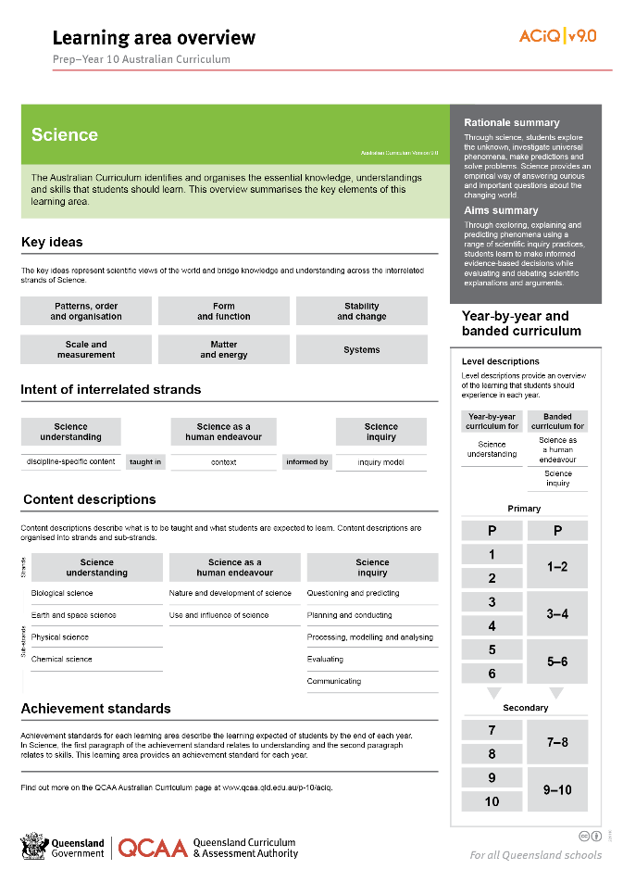
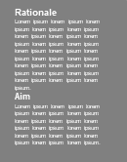
Find out more
Find out more on the QCAA Australian Curriculum webpage.
Notes:
More information about the implementation of Australian Curriculum in Queensland is available on the QCAA website. A one-page overview of the Australian Curriculum: Science can be accessed through https://www.qcaa.qld.edu.au/p-10/aciq/version-9/learning-areas/p-10-science/.
Send any further questions to: australiancurriculum@qcaa.qld.edu.au.
Information about requests for further professional learning is available from: www.qcaa.qld.edu.au/pd-events/request-pd.
Suggested activity
Partner with a colleague to discuss the following questions.
What did I learn?
What was confirmed?
What was new?
What challenged my thinking?
What else do I need to do?
What is our plan as a teaching team?

Slide 18
Acknowledgments
© State of Queensland (QCAA) 2022
Licence: https://creativecommons.org/licenses/by/4.0 | Copyright notice: www.qcaa.qld.edu.au/copyright — lists the full terms and conditions, which specify certain exceptions to the licence. | Attribution: ‘© State of Queensland (QCAA) 2022’ — please include the link to our copyright notice.
Other copyright material in this publication is listed below:
Photograph/s of staff and students used with permission.
Unless otherwise indicated, material from Australian Curriculum is © ACARA 2010–present, licensed CC BY 4.0. For the latest information and additional terms of use, see the Australian Curriculum website and its copyright notice.
The three-dimensional curriculum diagram is 'Excluded Material' used under the terms of the Australian Curriculum and its copyright notice and is not modified. © Australian Curriculum, Assessment and Reporting Authority (ACARA) 2009 to present, unless otherwise indicated.
You may view, download, display, print, reproduce (such as by making photocopies) and distribute these Excluded Materials in unaltered form only for your personal, non-commercial educational purposes or for the non-commercial educational purposes of your organisation, provided that you make others aware it can only be used for these purposes and attribute ACARA as the source of the Excluded Material. For the avoidance of doubt, this means that you cannot edit, modify or adapt any of these materials, and you cannot sub-licence any of these materials to others. Apart from any uses permitted under the Copyright Act 1968 (Cth), and those explicitly granted above, all other rights are reserved by ACARA. If you want to use such material in a manner that is outside this restrictive licence, you must request permission from ACARA by emailing (copyright@acara.edu.au).

Slide 19
QCAA social media

