Slide 1
Mathematics
Prep–Year 10 Australian Curriculum Version 9.0
Learning area overview
220096
Notes:
This presentation supports understanding of the Australian Curriculum Version 9.0: Mathematics Prep*–Year 10. It gives insight into the position of Mathematics within the Australian Curriculum and the structure of the Mathematics learning area.
You can use this presentation in your organisation as the basis for professional learning about the Mathematics curriculum. It includes information about the key aspects of the curriculum, as well as activities for becoming familiar with the curriculum. An icon in the bottom-right corner of a slide identifies opportunities for activities. Presenters are encouraged to tailor this presentation to suit the needs of their audience.
The Australian Curriculum content referred to in this presentation is available from:
Australian Curriculum, Assessment and Reporting Authority (ACARA) 2022, Australian Curriculum Version 9 Foundation to Year 10, https://v9.australiancurriculum.edu.au/.
*Prep (P) in Queensland is the Foundation Year (F) of the Australian Curriculum and refers to the year before Year 1. Children beginning Prep in January are required to be five years of age by 30 June.

Slide 2
Learning goals
This presentation aims to:
build understanding of the Australian Curriculum Version 9.0: Mathematics
provide an overview of the structure of the Mathematics learning area.
Notes:
This presentation aims to:
build understanding of the Australian Curriculum Version 9.0: Mathematics
provide an overview of the structure of the Mathematics learning area.

Slide 3
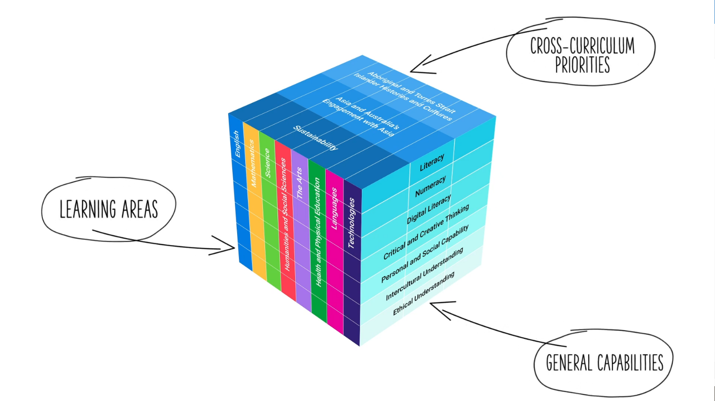
Three-dimensional curriculum
The Australian Curriculum is a three-dimensional curriculum made up of:
learning areas
general capabilities
cross-curriculum priorities.
ACARA image from Summary overview (video): https://v9.australiancurriculum.edu.au/help/website-tour.
Notes:
The Australian Curriculum sets the expectations for what all Australian students should be taught and have the opportunity to learn as they progress through their school life. In Prep to Year 10, the Australian Curriculum provides teachers, students and parents with access to the same content and consistent national standards for determining the progress of student learning.
All Australian students across all education settings and contexts can be supported in their diverse learning needs through the three dimensions of the Australian Curriculum: the learning area content, the general capabilities and the cross-curriculum priorities.
This diagram shows the relationship between these dimensions of the Australian Curriculum. Teachers emphasise one or more dimensions to develop learning programs suited to the strengths, interests and diverse needs of all students.
This presentation provides a brief overview of the general capabilities and cross-curriculum priorities. However, the focus will be on the Mathematics learning area.

Slide 4
Structure of the Mathematics learning area
Rationale
Aims
Key considerations
Key connections
Structure
Year-by-year curriculum
Achievement standards
Curriculum content
Source: https://v9.australiancurriculum.edu.au/teacher-resources/understand-this-learning-area/mathematics
Notes:
The Australian Curriculum sets out what all young people should be taught by specifying the curriculum content and identifies the learning expected at points in their schooling by specifying the achievement standards. The curriculum content and achievement standards are supported by additional information that describes the:
curriculum intent (rationale)
aims of learning (aims)
key considerations when planning learning experiences that are unique to the learning area of Mathematics
key connections with the other dimensions for the Australian curriculum including the general capabilities, cross curriculum priorities and other learning areas,
organising structure and focus for the learning at specific year levels including the level descriptions, achievement standards and the curriculum content.
The following sections of the presentation will provide an overview of each of these key aspects of the curriculum.

Slide 5
Rationale
‘The study of mathematics is central to the learning, development and prospects of all young Australians. Mathematics provides students with essential mathematical knowledge, skills, procedures and processes in number, algebra, measurement, space, statistics and probability. It develops the numeracy capabilities that all students need in their personal, work and civic lives, and provides the fundamentals on which mathematical specialties and professional applications of mathematics are built.’
Source: Quoted verbatim and unaltered from ACARA, https://v9.australiancurriculum.edu.au/teacher-resources/understand-this-learning-area/mathematics.
Notes:
The rationale defines the learning area and describes the importance of the learning area within the curriculum.
The Mathematics rationale promotes:
an appreciation of the power of mathematical reasoning
increasingly sophisticated and refined mathematical knowledge, skills, procedures and processes
links between the various components of mathematics, as well as the relationship between mathematics and other disciplines including STEM
self-motivated, confident learning through practice, inquiry and participation in challenging experiences.
The full rationale is available from: https://v9.australiancurriculum.edu.au/teacher-resources/understand-this-learning-area/mathematics/.
Suggested activities
Read the full learning area rationale. Partner with a colleague to discuss the following questions:
What were the key aspects of the rationale?
Why is the learning area important? What important contribution does the learning make to a student’s education?
Which aspects of this rationale matched your current understanding of the learning area? Which aspects were new understandings?

Slide 6
Aims
Mathematics aims to ensure that students:
become confident, proficient and effective users and communicators of mathematics, who can investigate, represent and interpret situations in their personal and work lives, think critically, and make choices as active, engaged, numerate citizens
develop proficiency with mathematical concepts, skills, procedures and processes, and use them to demonstrate mastery in mathematics as they pose and solve problems, and reason with number, algebra, measurement, space, statistics and probability
make connections between areas of mathematics and apply mathematics to model situations in various fields and disciplines
foster a positive disposition towards mathematics, recognising it as an accessible and useful discipline to study
acquire specialist mathematical knowledge and skills that underpin numeracy development and lead to further study in mathematics and other disciplines.
Source: Quoted verbatim and unaltered from ACARA, https://v9.australiancurriculum.edu.au/teacher-resources/understand-this-learning-area/mathematics.
Notes:
The aims flow logically from the rationale and identify the major learning that students will be able to demonstrate as a result of being taught the curriculum.
Mathematics develops confident, proficient and effective users of mathematics by cultivating the ability to pose and solve problems and to recognise the connections between different areas of mathematics.
The full aims are available from: https://v9.australiancurriculum.edu.au/teacher-resources/understand-this-learning-area/mathematics/.
Suggested activities
Prepare a brief statement/overview that would help you describe the aims of the learning area to a parent group.
Identify two or three big ideas in the aims. How do they inform:
your understanding of the learning area?
what is valued in the Australian Curriculum for the learning area?
your teaching and learning approaches?

Slide 7
Key considerations
Proficiency in mathematics
Mathematical processes
Computation, algorithms and the use of digital tools in mathematics
Protocols for engaging First Nations Australians
Meeting the needs of diverse learners
Notes:
The key considerations provide a brief overview of how the Australian Curriculum can accommodate particular approaches to teaching and assessment in Mathematics
The Australian Curriculum: Mathematics emphasises the importance of providing learning opportunities for students to:
develop proficiency in mathematics, focusing on the development of increasingly sophisticated knowledge and understanding of mathematical concepts, fluency in representations and procedures and sound mathematical reasoning and problem-solving skills
purposefully select and effectively use the functionality of a digital tool or platform to develop computational and algorithmic thinking that is explicitly developed and used to learn and apply mathematics, and addresses the managing and operating element of the digital literacy capability.
This section also supports teachers to consider:
protocols for engaging in First Nations Australians
inclusive practices that are relevant to the students needs.
Suggested activity
How are the key considerations reflected in your Mathematics program?

Slide 8
Year-by-year curriculum
Each year includes the following structural components:
level description
curriculum content
achievement standard.
The curriculum is developmentally sequenced across the year levels.
Notes:
The Mathematics curriculum is structured into year levels.
Suggested activity
What are the implications of the year-by-year curriculum for the planning of your teaching, learning and assessment program?

Slide 9
Level description
Year 1
In Year 1, learning in Mathematics builds on each student’s prior learning and experiences. Students engage in a range of approaches to learning and doing mathematics that develop their understanding of and fluency with concepts, procedures and processes by making connections, reasoning, problem-solving and practice. Proficiency in mathematics enables students to respond to familiar and unfamiliar situations by employing mathematical strategies to make informed decisions and solve problems efficiently.
Students further develop proficiency and positive dispositions towards mathematics and its use as they:
use their curiosity and imagination to explore situations, recognise patterns in their environment and choose ways of representing their thinking when communicating with others
demonstrate that numbers can be represented, partitioned and composed in various ways, recognise patterns in numbers and extend their knowledge of numbers beyond 2 digits
use physical or virtual materials and diagrams when modelling practical problems through active learning experiences, recognise existing patterns, employ different strategies and discuss the reasonableness of answers
explain ways of making direct and indirect comparisons and begin to use uniform, informal units to measure some attributes
reason spatially and use spatial features to classify shapes and objects; they recognise these shapes and objects in their environment and use simple transformations, directions and pathways to move the positions of shapes and objects within a space
use simple surveys to collect and sort data, based on a question of interest, recognise that data can be represented in different ways, and explain patterns that they see in the results
develop a sense of equivalence, fairness, repetition and variability when they engage in play-based and practical activities
Notes:
Each Mathematics level description:
highlights the interrelatedness of the strands and content descriptions for each year
provides general examples of what the mathematical learning and experiences may include at that year level.

Slide 10
Curriculum content
Year 7
Number
Content description | Content elaborations
represent natural numbers as products of powers of prime numbers using exponent notation AC9M7N02 | applying knowledge of factors to strategies for expressing natural numbers as products of powers of prime factors, such as repeated division by prime factors or creating factor trees; for example, 48=6×8=2×3×2×2×2=3^1×2^4=3×2^4 developing familiarity with the sequence 1, 2, 4, 8, 16, 32, 64, 128, 256, 512 and powers of 2; the sequence 1, 3, 9, 27, 81, 243, 729 and powers of 3; and the sequence 1, 5, 25, 125, 625 and powers of 5 solving problems involving lowest common multiples and greatest common divisors (highest common factors) for pairs of natural numbers by comparing their prime factorisation
Notes:
The curriculum content is presented as content descriptions that specify the knowledge, understanding and skills young people are expected to learn and teachers are expected to teach across the years of schooling.
The content descriptions are accompanied by content elaborations. Content elaborations provide illustrations and/or examples that teachers may choose to use in the classroom or as inspiration for their own activities. The content elaborations are not a mandatory aspect of the curriculum and as such are not required to be taught.
Suggested activity
Use the Australian curriculum: Mathematics to build an understanding of the sequence of content of the curriculum across year levels: https://v9.australiancurriculum.edu.au/.
Within the Australian Curriculum: Mathematics, select a year level and read the content descriptions.
Consider the content descriptions for the year level prior to and following the selected year level.
In a small group, discuss how the curriculum develops in increasing complexity of cognition and skills across the years.

Slide 11
Strands
Number |  | Algebra
Measurement |  | Space
Statistics |  | Probability
Notes:
In Mathematics, the curriculum content is organised through strands.
The six content strands describe what to teach and learn. They are:
Number
Algebra
Measurement
Space
Statistics
Probability.
Information on the strands are available from: https://v9.australiancurriculum.edu.au/teacher-resources/understand-this-learning-area/mathematics/.
Suggested activities
What is the relationship between the strands of Mathematics?
Prepare a brief statement/overview that would help you describe the strands to a parent group.

Slide 12
Achievement standards
Year 10
By the end of Year 10, students recognise the effect of approximations of real numbers in repeated calculations. They use mathematical modelling to solve problems involving growth and decay in financial and other applied situations, applying linear, quadratic and exponential functions as appropriate, and solve related equations, numerically and graphically. Students make and test conjectures involving functions and relations using digital tools. They solve problems involving simultaneous linear equations and linear inequalities in 2 variables graphically and justify solutions.
Students interpret and use logarithmic scales representing small or large quantities or change in applied contexts. They solve measurement problems involving surface area and volume of composite objects. Students apply Pythagoras’ theorem and trigonometry to solve practical problems involving right-angled triangles. They identify the impact of measurement errors on the accuracy of results. Students use mathematical modelling to solve practical problems involving proportion and scaling, evaluating and modifying models, and reporting assumptions, methods and findings. They use deductive reasoning, theorems and algorithms to solve spatial problems. Students interpret networks used to represent practical situations and describe connectedness.
They plan and conduct statistical investigations involving bivariate data. Students represent the distribution of data involving 2 variables, using tables and scatter plots, and comment on possible association. They analyse inferences and conclusions in the media, noting potential sources of bias. Students compare the distribution of continuous numerical data, using various displays, and discuss distributions in terms of centre, spread, shape and outliers. They apply conditional probability to solve problems involving compound events. Students design and conduct simulations involving conditional probability, using digital tools.
Number and Algebra
Measurement and Space
Statistics and Probability
Notes:
The achievement standard is a statement of what students should know and be able to do at the end of the year level. The first paragraph of the achievement standard relates to the content from the Number and Algebra strands, the second paragraph relates to the Measurement and Space strands, and the third paragraph relates to the Statistic and Probability strands.
In Mathematics, a learning area achievement standard is provided for each year.
Suggested activities
Partner with a colleague and complete the following activities:
Using the Australian Curriculum: Mathematics, discuss how the evidence that students need to provide of what they know and can do increases in complexity across year levels: https://v9.australiancurriculum.edu.au/.
For a given year level, map the achievement standard to the content descriptions.

Slide 13
Key connections
Identify the connections with the other dimensions for the Australian Curriculum including:
the general capabilities
the cross-curriculum priorities
other learning areas within the Australian Curriculum.
Notes:
The key connections are to help teachers identify the links to the other dimensions for the Australian Curriculum including the general capabilities, cross-curriculum priorities and other learning areas to assist teachers to make connections in their planning for student learning.
The key connects are available from: https://v9.australiancurriculum.edu.au/teacher-resources/understand-this-learning-area/mathematics/.
Suggested activities
Read the key connections section relating to other learning areas. Partner with a colleague to discuss the following questions:
Which learning areas does the Mathematics curriculum have key connections to?
Why are these connections important?
Create a concept map showing the connections between other learning areas.

Slide 14
Three-dimensional curriculum: General capabilities
Critical and creative thinking
Digital literacy
Ethical understanding
Intercultural understanding
Literacy
Numeracy
Personal and social capability
Notes:
The seven capabilities are divided into two groups:
capabilities that support students to be successful learners ― literacy, numeracy, digital literacy and critical and creative thinking
capabilities that develop ways of being, behaving and learning to live with others ― personal and social capability, ethical understanding and intercultural understanding.
Continua of learning have been developed for each capability to describe the relevant knowledge, understanding and skills at particular points of schooling, while the literacy and numeracy general capabilities have national learning progressions that describe the skills, understandings and capabilities that students typically acquire as their proficiency increases in a particular aspect of the curriculum over time.
The content outlined in the general capabilities' continua/progressions is embedded in the content descriptions for each learning area, where appropriate. The icons shown on this slide are used to identify where the general capabilities are embedded in content descriptions.
A summary of the focus of each of the general capabilities in the Mathematics learning area is available from: https://v9.australiancurriculum.edu.au/teacher-resources/understand-this-learning-area/mathematics/.
Suggested activities
Read the key connection section relating to the general capabilities. Partner with a colleague to discuss the following questions:
To which general capabilities are there key connections?
Why are these connections important?
How could you embed the general capabilities authentically into your teaching and learning programs?

Slide 15
Three-dimensional curriculum: Cross-curriculum priorities
Aboriginal and Torres Strait Islander Histories and Cultures Asia and Australia’s Engagement with Asia Sustainability
Notes:
The Australian Curriculum promotes three cross-curriculum priorities that young Australians should learn about. Each of the priorities is represented in learning areas in ways appropriate to that area.
The three priorities are:
Aboriginal and Torres Strait Islander Histories and Cultures ― to ensure that all young Australians are given the opportunity to gain a deeper understanding and appreciation of Aboriginal and Torres Strait Islander histories and cultures, their significance for Australia and the impact that these have had, and continue to have, on our world
Asia and Australia’s Engagement with Asia ― to reflect the importance of knowing about Asia and Australia’s engagement with Asia and to encourage better understanding of the countries and cultures of the Asia region so that young people appreciate the economic, political and cultural interconnections that Australia has with the region
Sustainability ― to allow young people to develop an appreciation of the need for more sustainable patterns of living and to build capacities for thinking, valuing and acting that are necessary to create a more sustainable future.
Each of the cross-curriculum priorities contains a set of organising ideas. These are consistent across the curriculum and are reinforced in learning areas. Explicit teaching of the priorities may be incorporated in teaching and learning activities where appropriate.
Suggested activity
Read the key connection section relating to the cross-curriculum priorities. Partner with a colleague to discuss the following questions:
To which cross-curriculum priorities are there key connections?
How are the cross-curriculum priorities reflected in your teaching and learning programs?

Slide 16
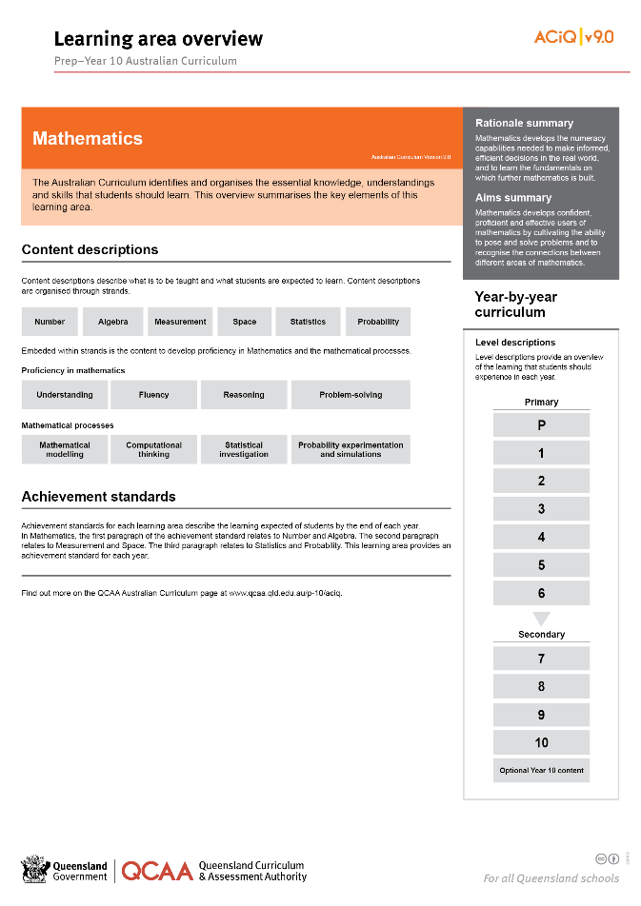
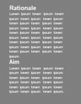
Find out more
Find out more on the QCAA Australian Curriculum webpage.
Notes:
More information about the implementation of Australian Curriculum in Queensland is available on the QCAA website. A one-page overview of the Australian curriculum: Mathematics can be accessed through https://www.qcaa.qld.edu.au/p-10/aciq/version-9/learning-areas/p-10-mathematics/.
Send any further questions to: australiancurriculum@qcaa.qld.edu.au.
Information about requests for further professional learning is available from: www.qcaa.qld.edu.au/pd-events/request-pd.
Suggested activity
1. Partner with a colleague to discuss the following questions:
What did I learn?
What was confirmed?
What was new?
What challenged my thinking?
What else do I need to do?
What is our plan as a teaching team?

Slide 17
Acknowledgments
© State of Queensland (QCAA) 2022
Licence: https://creativecommons.org/licenses/by/4.0 | Copyright notice: www.qcaa.qld.edu.au/copyright — lists the full terms and conditions, which specify certain exceptions to the licence. | Attribution: ‘© State of Queensland (QCAA) 2022’ — please include the link to our copyright notice.
Other copyright material in this publication is listed below:
Photograph/s of staff and students used with permission.
Unless otherwise indicated, material from Australian Curriculum is © ACARA 2010–present, licensed CC BY 4.0. For the latest information and additional terms of use, see the Australian Curriculum website and its copyright notice.
The three-dimensional curriculum diagram is 'Excluded Material' used under the terms of the Australian Curriculum and its copyright notice and is not modified. © Australian Curriculum, Assessment and Reporting Authority (ACARA) 2009 to present, unless otherwise indicated.
You may view, download, display, print, reproduce (such as by making photocopies) and distribute these Excluded Materials in unaltered form only for your personal, non-commercial educational purposes or for the non-commercial educational purposes of your organisation, provided that you make others aware it can only be used for these purposes and attribute ACARA as the source of the Excluded Material. For the avoidance of doubt, this means that you cannot edit, modify or adapt any of these materials, and you cannot sub-licence any of these materials to others. Apart from any uses permitted under the Copyright Act 1968 (Cth), and those explicitly granted above, all other rights are reserved by ACARA. If you want to use such material in a manner that is outside this restrictive licence, you must request permission from ACARA by emailing (copyright@acara.edu.au).

Slide 18
QCAA social media

