Slide 1
This presentation is part of the Creating questions for quality Mathematics assessment — Australian Curriculum v9.0 toolkit. The toolkit contains guidance and additional resources.
Read Creating questions for quality Mathematics assessment — Australian Curriculum v9.0: Guide, which provides the context and purpose of the toolkit.
Check the Session 1 information in Creating questions for quality Mathematics assessment — Australian Curriculum v9.0: Guide and the notes section of this slide deck. Each slide may include additional information in the notes section to support understanding and scripting for facilitators (use Normal view).
Document reflections and strategies using Creating questions for quality Mathematics assessment — Australian Curriculum v9.0: Reflection sheet.
Before you start
Notes:
** Hide this slide before presenting. **

Slide 2



Look for activity icons. Throughout this presentation, icons are used to indicate different activities, groupings and available resources.
Before you start
Reflection document
Pause and reflect
Group discussion
Notes:
** Hide this slide before presenting. **

Slide 3
Using complexity and familiarity to create questions in Mathematics
251562
Examinations for Years 7–10
Notes:
This presentation helps teachers design and construct quality examinations for the Australian Curriculum v9.0: Mathematics by using complexity and familiarity to create questions.

Slide 4
Acknowledgment of Country
Notes:
Acknowledgment of Country
Schools should use protocols and acknowledgment used in their own context.

Slide 5
Success criteria
Learning goal
To develop skills required to create questions in quality examinations for the Years 7−10 Australian Curriculum v9.0: Mathematics.
You will know you are successful when you can:
identify how the attributes of quality assessment are incorporated in question design
use the QCAA Mathematics standards elaborations to review questions that vary in complexity and familiarity
document reflections to contribute to a shared approach.
Notes:
Read the learning goal and success criteria to frame the learning within this presentation.

Slide 6
Guiding question
How are complexity and familiarity used to create questions in quality Mathematics examinations?
Notes:
The session is guided by the question on the screen.
Throughout this session, use the reflection sheet to capture key messages or insights that resonate with you and strategies to support your growing understanding and guide your next steps.

Slide 7

Attributes of quality assessment
Validity: the extent to which an assessment accurately measures what it is intended to measure
Reliability: the extent to which an assessment will produce the same consistent result
Accessibility: the extent to which the assessment provides all students with a clear understanding of how to demonstrate their learning
Notes:
Assessment is an essential component of effective teaching and learning.
Quality assessment is characterised by the attributes of validity, accessibility and reliability.
On the screen is a description for each attribute from the QCAA’s Understanding K–12 assessment policy and resources document.
Read and consider the attributes of quality assessment.
Source: QCAA, Understanding K–12 assessment: K–12 policies and resources

Slide 8


Incorporating the attributes in assessment design
In a moment …
Consider which attribute of quality assessment you find most challenging to incorporate in question design, in your current practice.
Notes:
Whether working independently or in groups, consider how the attributes of quality assessment (validity, accessibility, or reliability) are incorporated in question design, in your current practice.
Document your reflections using the reflection sheet.

Slide 9
Considerations — validity
Validity: the extent to which an assessment accurately measures what it is intended to measure
Reliability: the extent to which an assessment will produce the same consistent result
Accessibility: the extent to which the assessment provides all students with a clear understanding of how to demonstrate their learning
Notes:
We will now explore how teachers consider the attributes of quality assessment to design and construct quality supervised assessments for the Australian Curriculum v9.0: Mathematics.
To ensure examinations are valid, teachers identify the knowledge, understanding or skills to be assessed from the curriculum and create questions using complexity and familiarity.

Slide 10
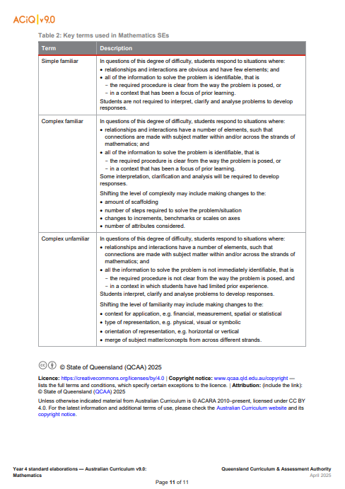
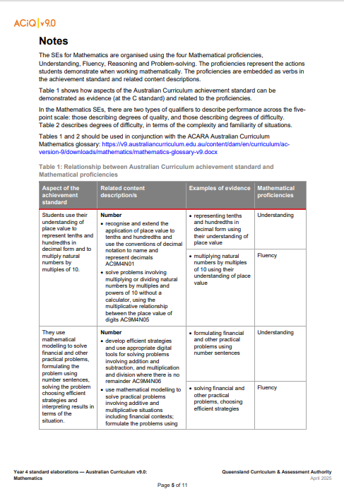
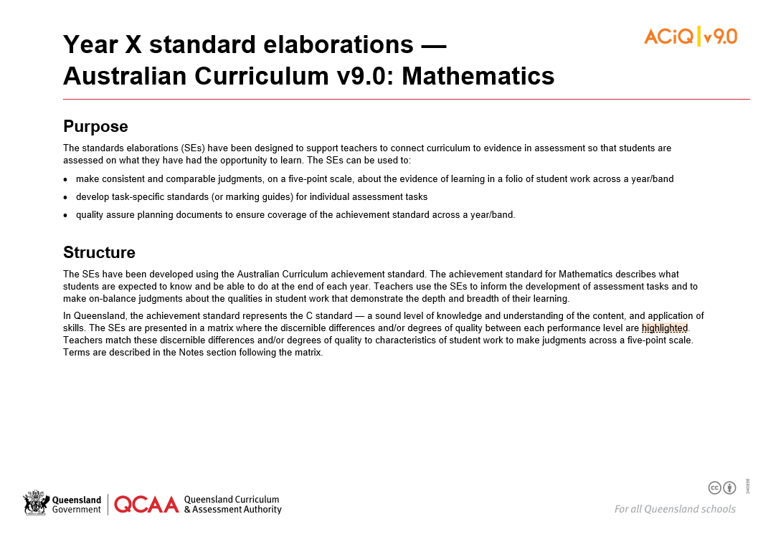
Mathematics standards elaborations
Notes:
The QCAA standards elaborations support teachers to create and review questions that vary in complexity and familiarity.
Located in the Mathematics standards elaborations Notes section, Tables 1 and 2 support teachers to create questions for quality supervised assessment.
If you are new to the standards elaborations, consider using the slideshow presentation: Understanding the Mathematics standards elaborations: Quality assessment design for Prep–Year 10 to gain a deeper understanding of its purpose and features.
This next section will explore considerations when creating questions using the QCAA standards elaborations.

Slide 11
Creating questions for an examination
When creating questions using the QCAA standards elaborations, it is important to consider:
aspects of the achievement standard and related content descriptions
mathematical proficiencies
learning experiences and assumed knowledge
complexity
familiarity
Notes:
When creating questions:
Consider the aspect/s of the achievement standard and related content description/s that are the focus of the assessment item. These will be the aspect/s of the achievement standard and related content description/s addressed in the teaching and learning for the unit being assessed.

Slide 12
Creating questions for an examination
When creating questions using the QCAA standards elaborations, it is important to consider:
aspects of the achievement standard and related content descriptions
mathematical proficiencies
learning experiences and assumed knowledge
complexity
familiarity
Notes:
Consider the mathematical proficiencies, which are embedded in the curriculum content. They are the cognitions described in the aspects of the achievement standard and related content descriptions. When creating questions, the proficiencies and curriculum content help determine the level of complexity. Table 1 of the relevant standard elaborations resource can help teachers identify the proficiencies associated with each aspect of the achievement standard.

Slide 13
Creating questions for an examination
When creating questions using the QCAA standards elaborations, it is important to consider:
aspects of the achievement standard and related content descriptions
mathematical proficiencies
learning experiences and assumed knowledge
complexity
familiarity
Notes:
Consider the learning experiences and students’ assumed knowledge, including concepts taught in earlier units of work and previous years. This helps establish the level of familiarity of questions. It also helps ensure the question does not exceed what is age- and stage-appropriate, or address aspects of the achievement standard that are beyond the year level expectations.
The following section of this presentation will use the terminology of ‘complex/simple’ and ‘familiar/unfamiliar', and describe the characteristics of the different types of question using examples from the Australian Curriculum v9.0: Mathematics — Year 8.

Slide 14
Simple familiar questions
Notes:
Starting with simple familiar questions …

Slide 15
Characteristics of simple familiar questions
In questions of this degree of difficulty, students respond to situations where:
relationships and interactions are obvious and have few elements; and
all of the information to solve the problem is identifiable, that is
the required procedure is clear from the way the problem is posed, or
in a context that has been a focus of prior learning.
Students are not required to interpret, clarify and analyse problems to develop responses.
Notes:
On the screen is the description of simple familiar questions from Table 2 of the Mathematics standards elaborations.
The description has two bullet points — the first refers to complexity. It is highlighted in orange. The second bullet point refers to familiarity. It is highlighted in green.
Simple familiar questions require students to respond to situations where:
relationships and interactions are obvious and have few elements (i.e. they are simple); and
all the information to solve the problem is identifiable (i.e. it is familiar), where:
the required procedure is clear from the way the problem is posed, or
in a context that has been a focus of prior learning.
Table 2 further states that students are not required to interpret, clarify and analyse problems to develop responses.
Typically, a simple familiar question focuses on the proficiency/proficiencies described in a single aspect of the achievement standard.

Slide 16
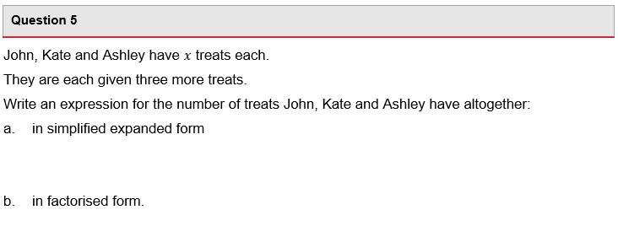
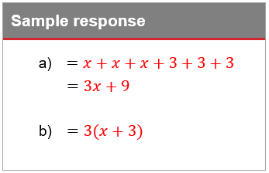
Example of a simple familiar question
Notes:
Here is an example question from a Year 8 examination.
The sample response is also on the screen.
Pause for a moment to read the question and consider the sample response.

Slide 17
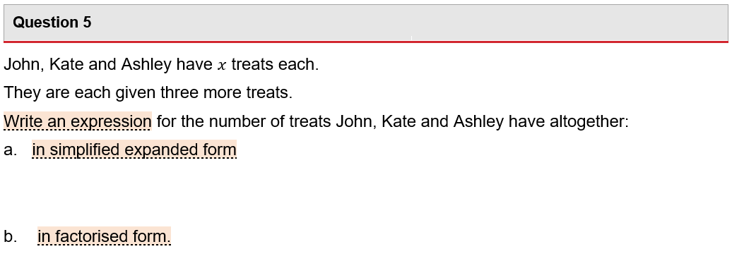
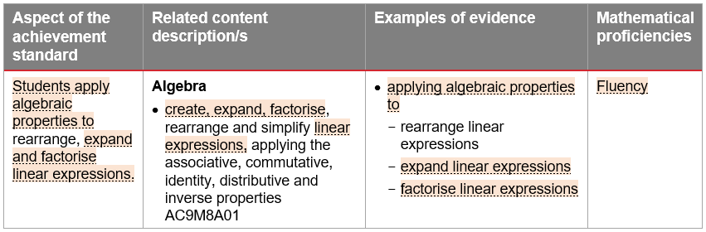
Example of a simple familiar question
Notes:
Use Table 1 in the standards elaborations Notes to check alignment with the identified aspects of the achievement standard, related content description and mathematical proficiency.
When creating questions, the proficiencies and curriculum content help determine the level of complexity.
The complexity of this question is simple, as there are few elements — students write expressions in simplified expanded form and factorised form.

Slide 18
Example of a simple familiar question
The procedure is clear, and this type of question has been a focus in teaching and learning.
Notes:
The level of familiarity of questions is determined by identifying learning experiences and assumed knowledge that students may have, considering previous concepts taught in earlier units of work and previous years.
This question is familiar. The procedure is clear, and this type of question would have been a focus in teaching and learning. In Year 7 students used variables to represent everyday formulas algebraically and substituted values into formulas to determine an unknown. They also solved one-variable linear equations. In Year 8 students have learnt to apply algebraic properties to rearrange, expand and factorise linear expressions.
In this example, students are not required to interpret, clarify and analyse the problem to develop their response.

Slide 19
Complex familiar questions
Notes:
Now complex familiar questions.

Slide 20
Characteristics of complex familiar questions
In questions of this degree of difficulty, students respond to situations where:
relationships and interactions have a number of elements, such that connections are made with subject matter within and/or across the strands of mathematics; and
all of the information to solve the problem is identifiable, that is ­
the required procedure is clear from the way the problem is posed, or ­
in a context that has been a focus of prior learning.
Some interpretation, clarification and analysis will be required to develop responses.
Notes:
On the screen is the description of complex familiar questions from Table 2 of the standards elaborations.
The first bullet point referring to complexity has changed. The second bullet point referring to familiarity is the same as in simple familiar.
Complex familiar questions require students to respond to situations where:
relationships and interactions have a number of elements, such that connections are made with subject matter within and/or across the strands of mathematics (i.e. they are complex), and
all the information to solve the problem is identifiable (i.e. it remains familiar), where: ­
the required procedure is clear from the way the problem is posed, or ­
in a context that has been a focus of prior learning.
Table 2 further states that in complex familiar questions, students are required to do some interpretation, clarification and analysis to develop responses.
Typically, a complex familiar question draws on more than one proficiency and/or makes connections with content within and/or across strands.

Slide 21
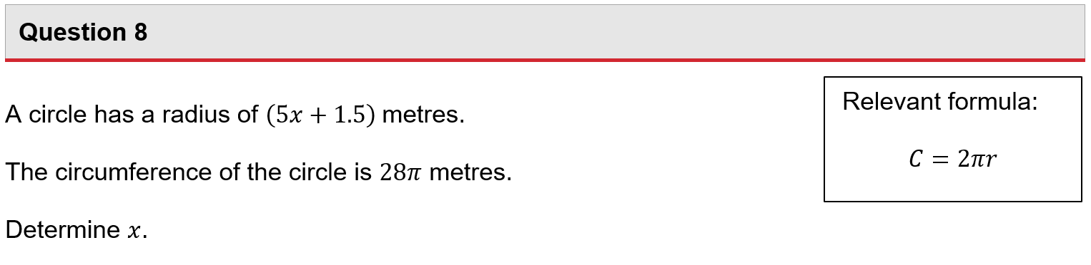
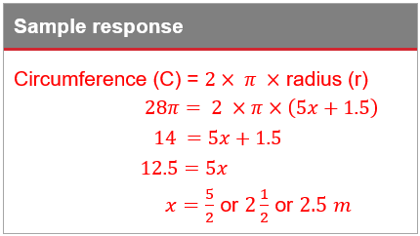
Example of a complex familiar question
Notes:
Here is another example question from a Year 8 examination.
The sample response is also on the screen.
Pause for a moment to read the question and consider the sample response.

Slide 22
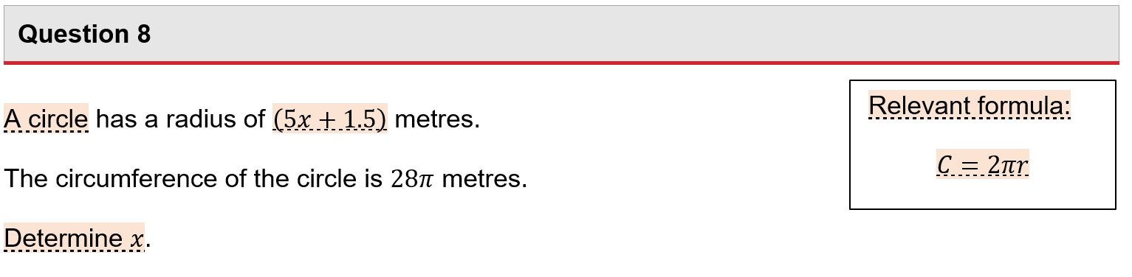
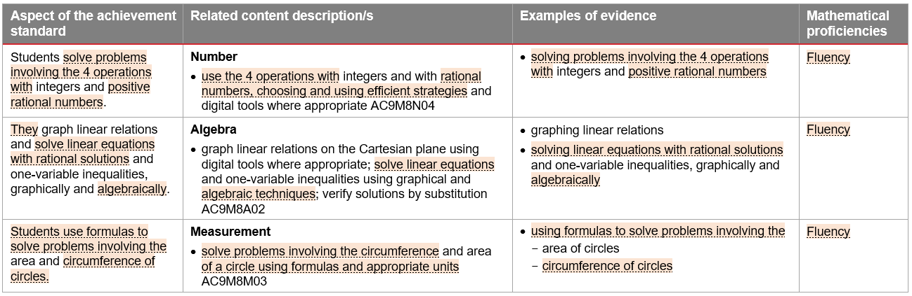
Example of a complex familiar question
Notes:
Use Table 1 in the standards elaborations Notes to identify the aspects of the achievement standard, mathematical proficiency and related content descriptions. This helps to identify complexity.
In a complex familiar question, the level of complexity has shifted in comparison to the simple familiar question.
This question is more complex than the simple familiar question, as relationships and interactions have a number of elements. In this question, students use the 4 operations with rational numbers and solve problems involving the circumference of circles. The simple familiar question only required students to consider one element. In this complex familiar question, students are required to work across the strands of Number, Algebra and Measurement.
Some interpretation and analysis is required as students substitute values into the formula for the circumference of a circle and solve a linear equation.

Slide 23
Example of a complex familiar question
The information to solve the problem is identifiable and the procedure is clear. This type of question has been a focus in teaching and learning.
Notes:
Now consider the learning experiences and assumed knowledge of students.
In a complex familiar question, familiarity has not shifted from the simple familiar description.
The question is familiar as the required procedure is clear, and the context would have been a focus in teaching and learning. In Year 7 students explored the relationships between the radius, diameter and circumference of a circle and learnt to substitute values into formulas to determine unknown values. In Year 8, the pi symbol is a focus of learning as an irrational number and the solution of linear equations is a focus of learning. Connections would have been made between pi, the solution of linear equations and substitution into formulas in the teaching and learning program.

Slide 24
Complex unfamiliar questions
Notes:
And thirdly, complex unfamiliar questions.

Slide 25
Characteristics of complex unfamiliar questions
In questions of this degree of difficulty, students respond to situations where:
relationships and interactions have a number of elements, such that connections are made with subject matter within and/or across the strands of mathematics; and
all of the information to solve the problem is not immediately identifiable, that is
the required procedure is not clear from the way the problem is posed, and
in a context in which students have had limited prior experience.
Students interpret, clarify and analyse problems to develop responses.
Notes:
On the screen is the description of complex unfamiliar questions from Table 2 of the standards elaborations.
The first bullet point on complexity has not changed from complex familiar. The second bullet point on familiarity has changed.
Complex unfamiliar questions require students to respond to situations where:
relationships and interactions have a number of elements, such that connections are made with subject matter within and/or across the strands of mathematics (i.e. they are complex), and
all the information to solve the problem is not immediately identifiable, that is
the required procedure is not clear from the way the problem is posed, and
in a context in which students have had limited prior experience (i.e. it is unfamiliar).
Table 2 further states that in these types of questions, students are required to interpret, clarify and analyse problems to develop responses.
Typically, a complex unfamiliar question incorporates problem-solving because the situation is one for which students do not immediately have a solution. Problem-solving draws the proficiencies together in an interconnected way as students ‘apply their mathematical understanding, fluency and reasoning skills to obtain mathematical solutions’ (ACARA, 2010–present).

Slide 26
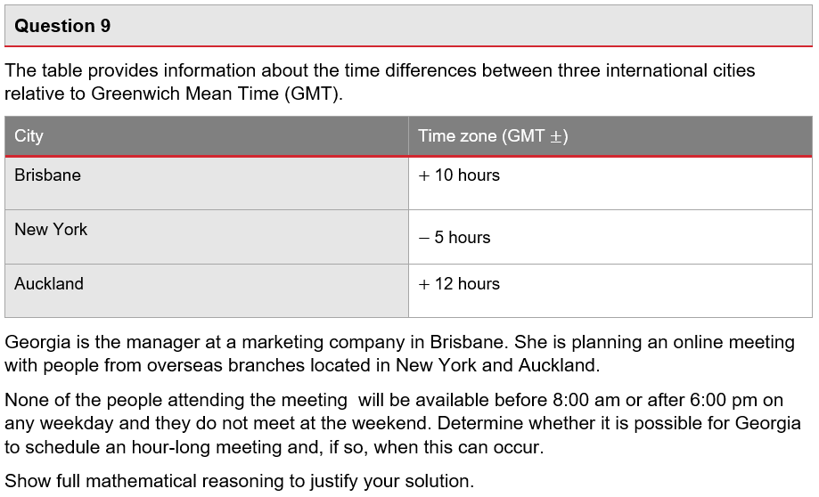
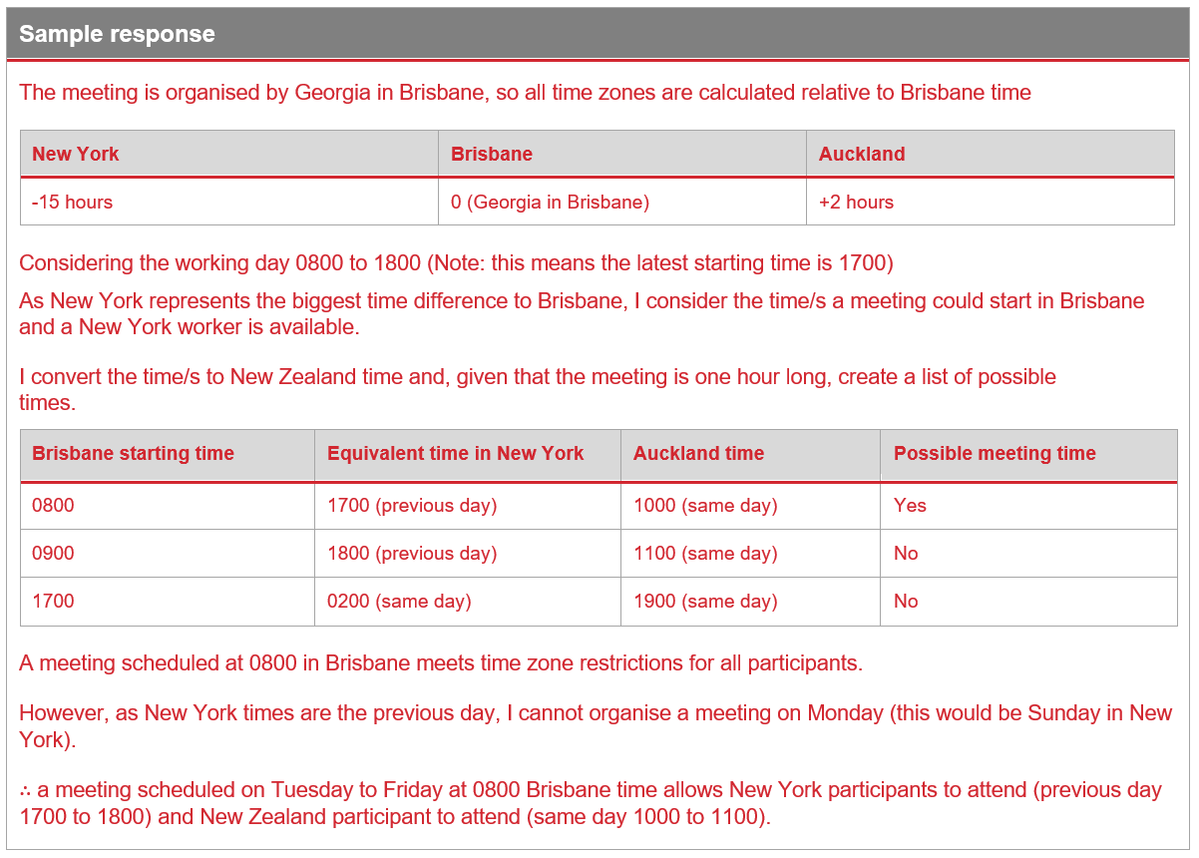
Example of a complex unfamiliar question
Notes:
Here is an example question from a Year 8 examination.
The sample response is also on the screen.
Pause for a moment to read the question and consider the sample response.

Slide 27
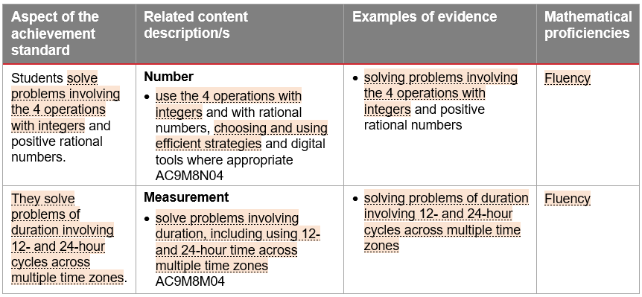
Example of a complex unfamiliar question
Notes:
Again, relevant sections from Table 1 in the standards elaborations Notes appears on the screen.
This table provides examples of how content can be related to the mathematical proficiencies at a C standard.
In a complex unfamiliar question, the level of complexity has not shifted from complex familiar questions. However, complex unfamiliar questions typically incorporate problem-solving as a situation is posed for which students do not immediately know the answer. This is the unfamiliarity aspect which we will explore in a moment.
This question is complex, as the question has a number of elements, and connections are made with subject matter across the strands of mathematics. In this problem-solving scenario, connections are made between the strands of Number and Measurement. Students use operations with integers as they solve problems of durations involving 12- and 24-hour cycles across three time zones.

Slide 28
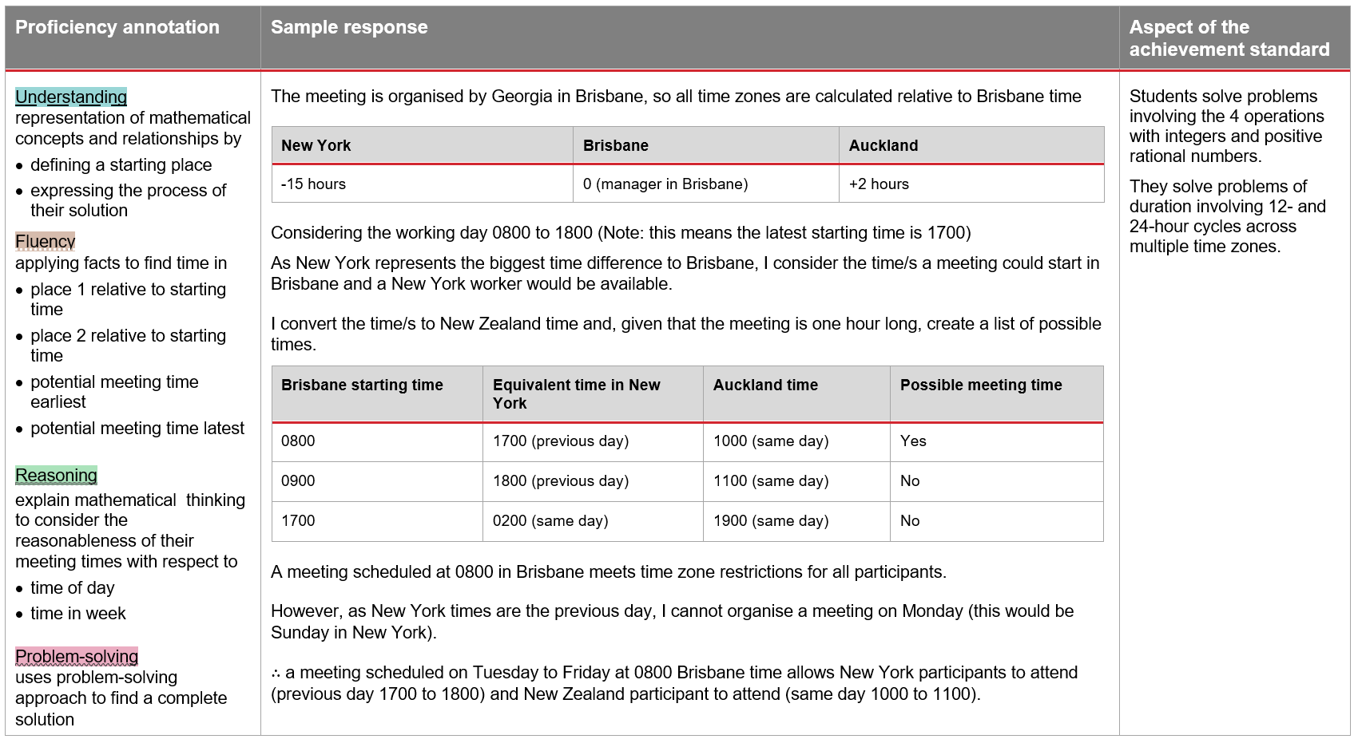
Example of a complex unfamiliar question
Notes:
In a complex unfamiliar question, the level of familiarity has shifted from complex familiar questions.
In this question, all the information to solve the problem is not immediately identifiable because the question is posed in a problem-solving situation.
The proficiency of problem-solving draws together the other proficiencies in an interconnected way as students work through a process to seek solutions.
On the screen is the sample response, again with proficiency annotations added to illustrate how multiple proficiencies are drawn upon as students respond to the question.
Pause for a moment to read the proficiency annotations and consider the sample response.

Slide 29
Example of a complex unfamiliar question
All the information to solve the problem is not immediately identifiable, and students have had limited prior experience with the question’s context in the teaching and learning program.
Notes:
To determine the level of familiarity, consider the learning experiences and assumed knowledge of students.
The question is unfamiliar as all the information to solve the problem is not immediately identifiable. In this problem-solving scenario, students interpret the given information to set parameters on their solution. They need to understand the question and create a representation of the problem. Students then apply facts and procedures and reason to reach a solution.
Students would have had limited prior experience with the context of the question.
In this question students are required to interpret, clarify and analyse the problem, applying their understanding to seek solutions and develop a response.

Slide 30
Considerations — accessibility
Validity: the extent to which an assessment accurately measures what it is intended to measure
Reliability: the extent to which an assessment will produce the same consistent result
Accessibility: the extent to which the assessment provides all students with a clear understanding of how to demonstrate their learning
Notes:
Once questions have been created using complexity and familiarity, the next step is to review the questions to enhance accessibility.
To ensure assessment is accessible, questions should use language and terminology that is familiar to students and has been used in the teaching and learning program.
The context of each question should be relevant to the students, reflect their background and experience, and avoid stereotypes and bias.
Finally, the layout of the questions should be appropriate, with sufficient space to develop a response.
A question may be scaffolded by breaking it into separate elements or steps (e.g. parts a, b, c). However, this will usually shift its complexity from complex to simple.

Slide 31
Considerations — reliability
Validity: the extent to which an assessment accurately measures what it is intended to measure
Reliability: the extent to which an assessment will produce the same consistent result
Accessibility: the extent to which the assessment provides all students with a clear understanding of how to demonstrate their learning
Notes:
Teachers also need to review the questions to enhance reliability.
To ensure assessment is reliable, engage in professional conversations to interrogate the questions.
Develop a sample response to clarify assessment expectations and create a marking guide.

Slide 32
Consider the attributes in question design
In a moment …
How do the QCAA standards elaborations support effective question design in Mathematics?
How can the QCAA standards elaborations be used to enhance the validity of Mathematics assessment?
How can questions be adjusted to improve accessibility for students in our context?
How might engaging in professional conversations enhance the reliability of quality Mathematics assessment?
Notes:
Whether working independently or in groups, consider the attributes of quality assessment and how they are incorporated in question design.
Use the question prompts on the screen to guide your reflections and/or conversations.
Document your reflections and strategies using the reflection sheet.

Slide 33
Guiding question
How are complexity and familiarity used to create questions in quality Mathematics assessment?
Notes:
This presentation has been guided by the question on the screen.
Take a moment to reflect on your learning.

Slide 34
Success criteria
Learning goal
To develop skills required to create questions in quality examinations for the Years 7−10 Australian Curriculum v9.0: Mathematics.
You will know you are successful when you can:
identify how the attributes of quality assessment are incorporated in question design
use the QCAA standards elaborations to review questions that vary in complexity and familiarity
document reflections to contribute to a shared approach.
Notes:
Also reflect on the purpose of this presentation, which is to support the development of skills required to design questions in quality examinations for the Australian Curriculum v9.0: Mathematics.
Review the success criteria.

Slide 35
Reflect on your learning
In a moment …
Document your final reflections and strategies for future reference using the reflection sheet.
Notes:
Now, record a final note using the reflection sheet.
If you have any queries about the design of quality examinations, please email australiancurriculum@qcaa.qld.edu.au.

Slide 36
Acknowledgments
Third-party copyright material, and QCAA material not covered by the CC BY licence is listed below:
Queensland Government coat of arms, and the QCAA and QSA trademarks may not be reproduced without permission.
Acknowledgment of Country artwork (2023) ‘Growth through Learning’ by Chern’ee, Brooke and Jesse Sutton, Kalkadoon. www.cherneesutton.com.au
Unless otherwise indicated, material from Australian Curriculum is © ACARA 2010–present, licensed CC BY 4.0. For the latest information and additional terms of use, see the Australian Curriculum website and its copyright notice.
Student and staff images have been used with permission.

Slide 37
Copyright notice
© State of Queensland (QCAA) 2026
Licence: https://creativecommons.org/licenses/by/4.0 | Copyright notice: www.qcaa.qld.edu.au/copyright — lists the full terms and conditions, which specify certain exceptions to the licence. | Attribution (include the link): © State of Queensland (QCAA) 2026 www.qcaa.qld.edu.au/copyright.
Other copyright material in this presentation is listed on the previous slide/s.

