Slide 1
This presentation is part of the Creating questions for quality Mathematics assessment — Australian Curriculum v9.0 toolkit. The toolkit contains guidance and additional resources.
Read Creating questions for quality Mathematics assessment — Australian Curriculum v9.0: Guide, which provides the context and purpose of the toolkit.
Check the Session 2 information in Creating questions for quality Mathematics assessment — Australian Curriculum v9.0: Guide and the notes section of this slide deck. Each slide may include additional information in the notes section to support understanding and scripting for facilitators (use Normal view).
Document reflections and strategies using Creating questions for quality Mathematics assessment — Australian Curriculum v9.0: Reflection sheet.
Before you start
Notes:
** Hide this slide before presenting. **

Slide 2




Look for activity icons. Throughout this presentation, icons are used to indicate different activities, groupings and available resources.
Before you start
Reflection document
Pause and reflect
Group discussion
Hands-on
activity
Notes:
** Hide this slide before presenting. **

Slide 3
Applying practical strategies to analyse and create questions in Mathematics
251561
Using complexity and familiarity in assessment for Prep–Year 6
Notes:
This presentation helps teachers analyse and create questions in quality supervised assessments that are aligned with the Australian Curriculum v9.0: Mathematics.

Slide 4
Acknowledgment of Country
Notes:
Acknowledgment of Country
Schools should use protocols and acknowledgment used in their own context.

Slide 5
Success criteria
Learning goal
To apply practical strategies
for analysing and creating questions in quality supervised assessments that are aligned with the Australian Curriculum v9.0: Mathematics.
You will know you are successful when you can:
use QCAA resources
to guide question design
apply understanding of complexity and familiarity descriptors to analyse and create questions
review and refine questions
for validity, accessibility,
and reliability.
Notes:
Read the learning goal and success criteria to frame the learning within this presentation.

Slide 6
Guiding question
How can we apply our understanding of complexity and familiarity
to analyse and create questions in Mathematics?
Notes:
The session is guided by the question on the screen.
Throughout this session, use the reflection sheet to capture key messages or insights that resonate with you and strategies to support your growing understanding and guide your next steps.

Slide 7
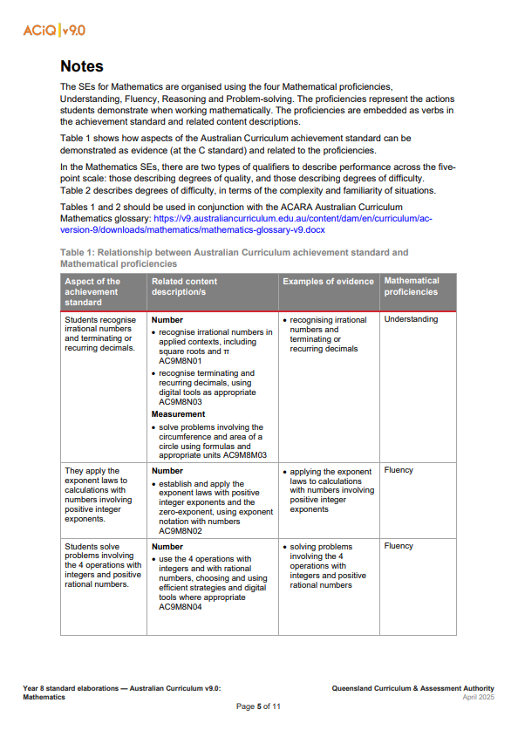
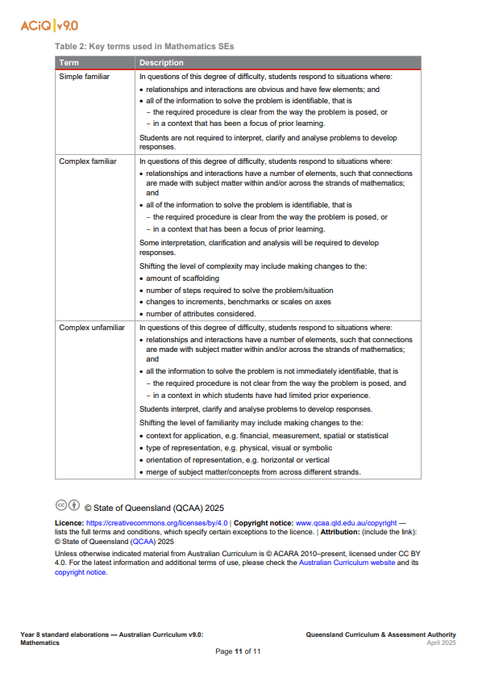
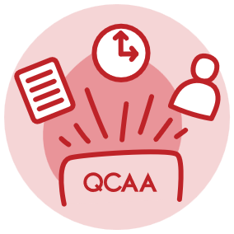
Review our previous learning
Table 1
Table 2
Notes:
Last session we learnt the QCAA standards elaborations can been used to create questions with different levels of complexity and familiarity for a quality supervised assessment.
Table 1 links achievement standards, content descriptions, and mathematical proficiencies.
Table 2 defines the degree of difficulty qualifiers.

Slide 8
Review our previous learning
Validity: the extent to which an assessment accurately measures what it is intended to measure
Reliability: the extent to which an assessment will produce the same consistent result
Accessibility: the extent to which the assessment provides all students with a clear understanding of how to demonstrate their learning
Notes:
We considered the attributes of quality assessment in question design, to ensure the questions are valid, accessible and reliable.

Slide 9
Review our previous learning
When creating questions using the QCAA standards elaborations,
it is important to consider:
aspects of the achievement standard and related content descriptions
mathematical proficiencies
learning experiences and assumed knowledge
complexity
familiarity
Notes:
We also learnt that when creating questions, there are three key factors to consider:
achievement standard and content descriptions — we need to identify the aspects that are the focus of the assessment item, as outlined in the school’s curriculum and assessment plan
mathematical proficiencies — these are embedded in the curriculum content. The proficiencies and curriculum content help determine the level of complexity when designing questions
learning experiences and assumed knowledge — it is important to reflect on prior learning experiences and assumed knowledge from earlier units and years. This reflection helps establish the level of familiarity of questions. It also helps ensure questions are age-appropriate and aligned with year-level expectations.

Slide 10
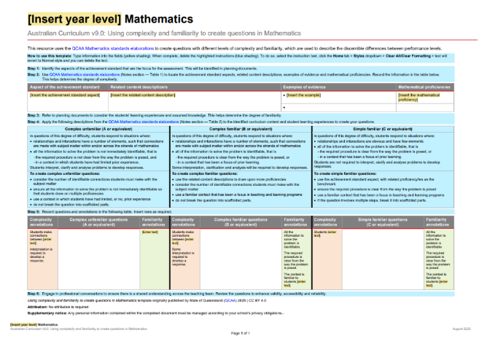
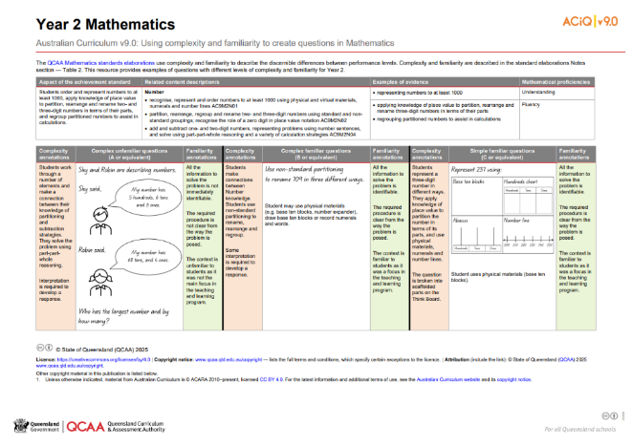
Resources to support complexity and familiarity
Downloadable template
Year 2 example
Notes:
We will now deepen our growing understandings by applying practical strategies for analysing and creating questions.
The QCAA has developed resources that support teachers to use complexity and familiarity to create questions in Mathematics.
These resources are aligned with the Australian Curriculum v9.0.
On screen is a downloadable template schools can use to create questions. A Year 2 example, which uses the steps outlined in the template, is also on screen.

Slide 11
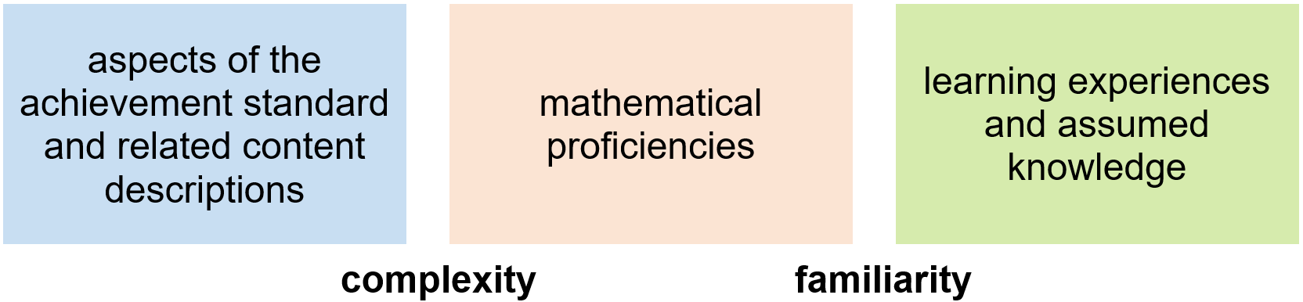
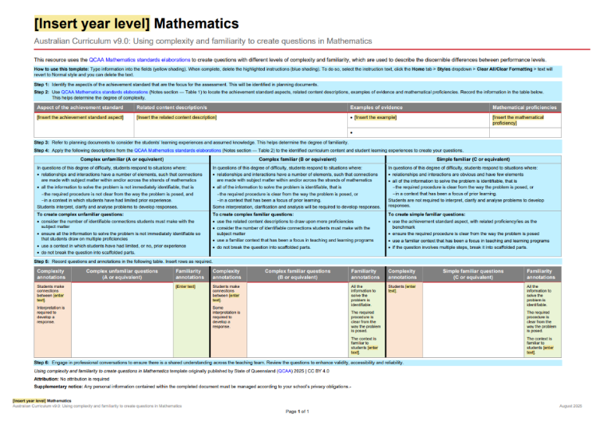
Downloadable template
1
2
3
4
5
6
Notes:
The template steps users through the process for creating questions with different levels of complexity and familiarity.
Teachers can use this template to create their own questions.
The standards elaborations, attributes of quality assessment and key factors have been incorporated in the design of the template.
Yellow-shaded fields prompt teachers to add information, and blue shading indicates instructional text.
Steps 1–6 in the instructional text guide question design as teachers apply their understandings.
The instructional text can be deleted once the step is completed.

Slide 12
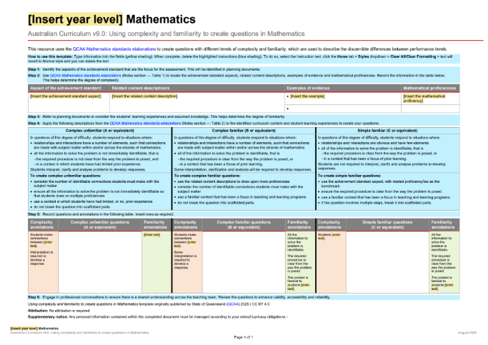
Steps for creating questions
Step 1: Identify the aspect/s of the achievement standard that are
the focus of the assessment.
This will be identified in planning documents.
Notes:
The template begins with identifying the aspect or aspects of the achievement standard that are the focus of the assessment.
The relevant aspect/s of the achievement standard and related content description/s have been identified in the school’s planning documents.

Slide 13

Steps for creating questions
Step 2: Use QCAA Mathematics standards elaborations (Notes section — Table 1) to locate the achievement standard aspects, related content descriptions, examples of evidence and mathematical proficiencies.
Record the information in the table provided. This helps determine the degree of complexity.
Notes:
Next, teachers use QCAA Mathematics standards elaborations (Notes section — Table 1) to locate the achievement standard aspect/s, related content description/s, examples of evidence and mathematical proficiency/proficiencies.
This is a good starting point when designing simple familiar questions.
In question design, the proficiencies and curriculum content help determine the level of complexity.
Teachers record the information in the table provided.

Slide 14
Steps for creating questions
Step 3: Refer to planning documents to consider the students’ learning experiences and assumed knowledge. This helps determine the degree of familiarity.
Notes:
Thirdly, teachers refer to planning documents to consider the students’ learning experiences and assumed knowledge.
This helps with establishing the familiarity of questions.

Slide 15
Steps for creating questions
Step 4: Apply the descriptions from the QCAA Mathematics standards elaborations (Notes section — Table 2) to the identified curriculum content and student learning experiences to create
your questions.
Step 5: Record questions and annotations in the table provided.
Notes:
Teachers then apply the descriptions from Table 2 in the QCAA standards elaborations to the identified curriculum content and student learning experiences to create questions.
A table is provided to record questions and annotations.

Slide 16
Steps for creating questions
Step 6: Engage in professional conversations to ensure there is
a shared understanding across
the teaching team. Review the questions to enhance validity, accessibility and reliability.
Notes:
Finally, teachers engage in professional conversations to ensure there is a shared understanding across the teaching team.
They review the questions to enhance validity, accessibility and reliability.

Slide 17
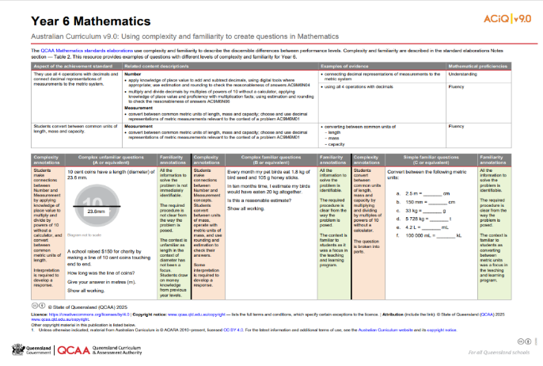
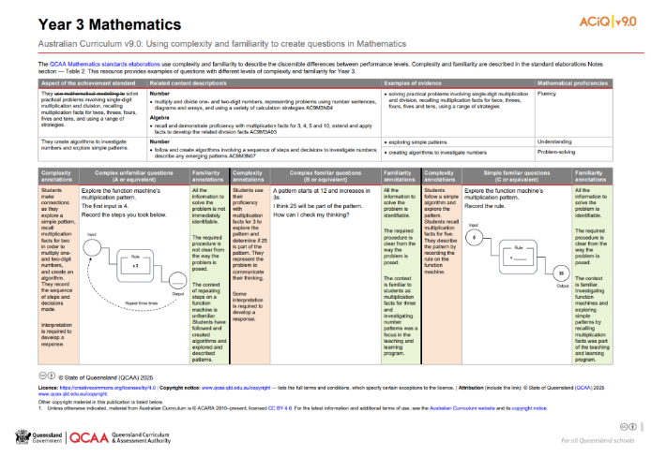
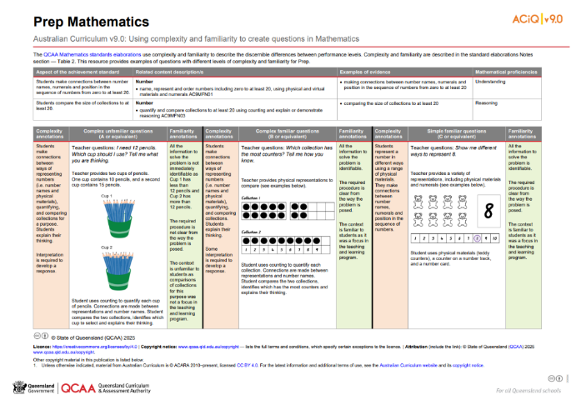
Year level example resources
Notes:
Year level example resources are provided on the QCAA website.
Teachers refer to the example resources as they create their own questions or use the example resources to analyse the questions provided.

Slide 18
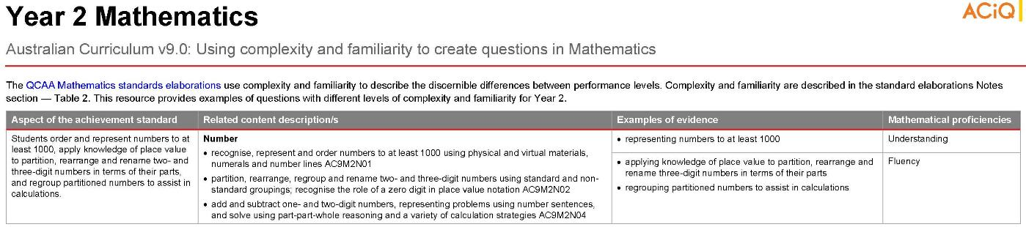
Year 2 example using the steps for creating questions
Notes:
Year level example resources illustrate the process outlined in the template (Steps 1–6).
On the screen is the Year 2 example.
It begins by identifying the aspect or aspects of the achievement standard that are the focus of the assessment.
At the top of the resource, these aspects have been recorded, along with related content descriptions, examples of evidence, and mathematical proficiencies, using information from the QCAA Mathematics standards elaborations (Notes section — Table 1).

Slide 19
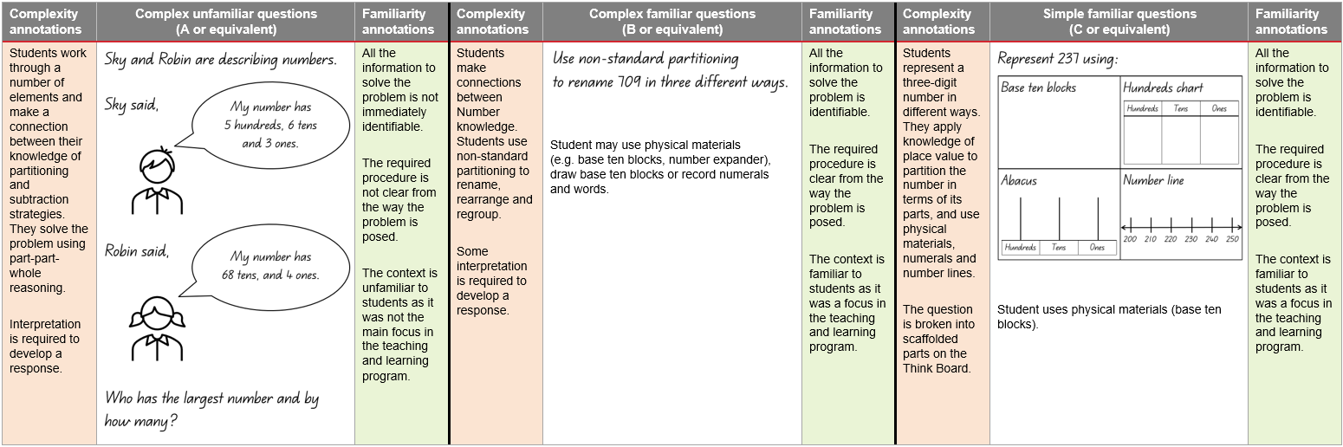
Year 2 example using the steps for creating questions
Notes:
Descriptions from Table 2 in the QCAA standards elaborations have been applied to the identified curriculum content and student learning experiences.
Each resource gives an example of a simple familiar, complex familiar and complex unfamiliar question.
These questions are recorded in the table alongside complexity and familiarity annotations.

Slide 20
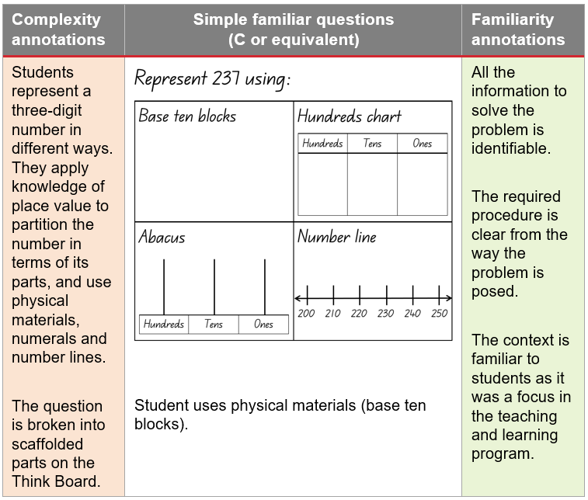
Year 2 example using the steps for creating questions
Notes:
Teachers can review the example questions and familiarity and complexity annotations and discuss them while identifying ways to enhance validity, accessibility and reliability in their context.

Slide 21

Year level examples
In a moment …
Use relevant year level example resources to:
examine the steps for creating questions
reflect on the example questions and annotations
identify adjustments you would make for students in your context.
Then, if working in a group, discuss your findings.
Notes:
In a moment, use QCAA resources to implement practical strategies for analysing and creating questions.
Year level example resources are available on the QCAA website https://www.qcaa.qld.edu.au/p-10/aciq/version-9/learning-areas/p-10-mathematics/p-10-mathematics-assessment-resources in the Designing quality assessment accordion.
Use relevant year level example resources to:
examine the steps for creating questions
reflect on the example questions and annotations. Check them against the attributes of quality assessment
identify adjustments that you would make for students in your context.
Whether working independently or in groups, document your reflections and adjustments using the reflection sheet.
If working in a group, engage in professional conversations to share your strategies.
If working independently, consider opportunities to share and discuss your findings with a colleague.

Slide 22
Creating your own questions
In a moment …
Open the Using complexity and familiarity to create questions
template, and:
follow the steps outlined
create questions for your year level.
Then, engage in professional conversations.
Notes:
Finally, open the Using complexity and familiarity to create questions in Mathematics template, and:
follow the steps outlined
create questions for your year level.
Once you have reviewed your questions and considered the attributes of quality assessment, engage in professional conversations to ensure there is shared understanding across the teaching team.
Note: If working independently, consider sharing your questions later with a colleague or during a team meeting. This helps build shared understanding and supports consistency across your school.

Slide 23
Guiding question
How can we apply understanding of complexity and familiarity
to analyse and create questions in Mathematics?
Notes:
This presentation has been guided by the question on the screen.
Take a moment to reflect on your learning.

Slide 24
Success criteria
Learning goal
To apply practical strategies
for analysing and creating questions in quality supervised assessments that are aligned with the Australian Curriculum v9.0: Mathematics.
You will know you are successful when you can:
use QCAA resources
to guide question design
apply understanding of complexity and familiarity descriptors to analyse and create questions
review and refine questions
for validity, accessibility,
and reliability.
Notes:
Also reflect on the purpose of this presentation, which is to support teachers as they analyse and create questions for quality supervised assessments that are aligned with the Australian Curriculum v9.0: Mathematics.
Review the success criteria.

Slide 25

Reflect on your learning
In a moment …
Document your final reflections and strategies for future reference using the reflection sheet.
Notes:
Now, record a final note using the reflection sheet.
If you have any queries about the design of quality supervised assessments, please email australiancurriculum@qcaa.qld.edu.au.

Slide 26
Acknowledgments
Third-party copyright material, and QCAA material not covered by the CC BY licence is listed below:
Queensland Government coat of arms, and the QCAA and QSA trademarks may not be reproduced without permission.
Acknowledgment of Country artwork (2023) ‘Growth through Learning’ by Chern’ee, Brooke and Jesse Sutton, Kalkadoon. www.cherneesutton.com.au
Unless otherwise indicated, material from Australian Curriculum is © ACARA 2010–present, licensed
CC BY 4.0. For the latest information and additional terms of use, see the Australian Curriculum website and its copyright notice.
Student and staff images have been used with permission.

Slide 27
Copyright notice
© State of Queensland (QCAA) 2026
Licence: https://creativecommons.org/licenses/by/4.0 | Copyright notice: www.qcaa.qld.edu.au/copyright — lists the full terms and conditions, which specify certain exceptions to the licence. |
Attribution (include the link): © State of Queensland (QCAA) 2026 www.qcaa.qld.edu.au/copyright.
Other copyright material in this presentation is listed on the previous slide/s.

