Slide 1
Understanding the Mathematics standards elaborations
251559
Quality assessment design for Prep–Year 10
Notes:
This presentation can be used by teachers to build understanding of the QCAA standards elaborations resources for the Australian Curriculum v9.0: Mathematics.

Slide 2
Notes:
Acknowledgment of Country
Schools should use protocols and acknowledgment used in their own context.

Slide 3
Success criteria
Learning goal
To understand how the QCAA Mathematics standards elaborations support the design and construction of quality assessment that is aligned with the Australian Curriculum v9.0.
You will know you are successful when you can:
describe the purpose and features of the standards elaborations
explain how the elaborations support alignment between curriculum and assessment
apply the features of the elaborations to design or evaluate quality assessment tasks or marking guides.
Notes:
Read the learning goal and success criteria to frame the learning within this presentation.

Slide 4
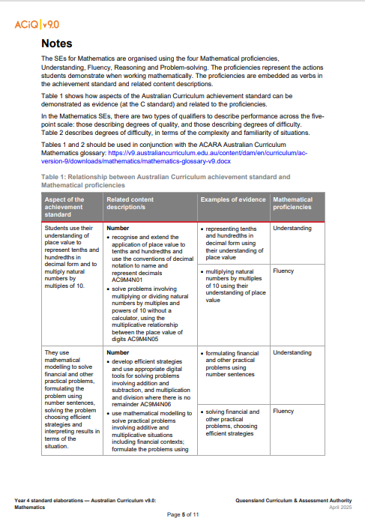
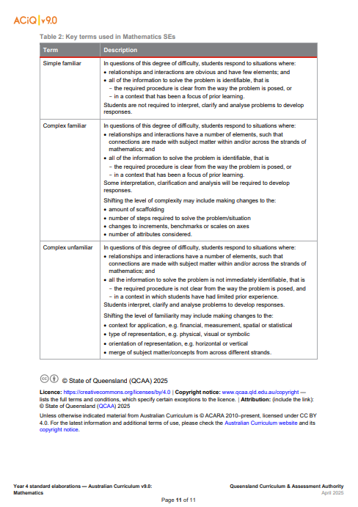
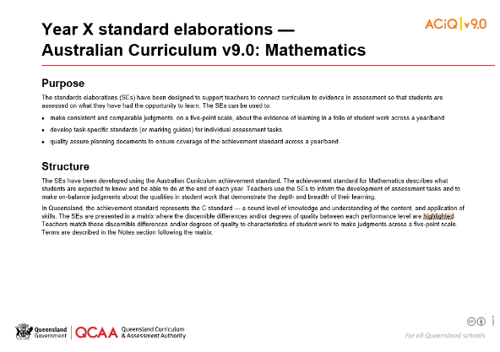
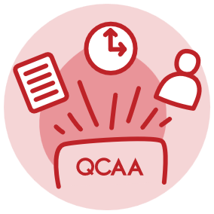
Mathematics standards elaborations
Notes:
To support teachers in designing quality assessment, the QCAA created standards elaborations (SEs). These resources connect curriculum to evidence in assessment.
The SEs can be used to:
make consistent and comparable judgments, on a five-point scale, about the evidence of learning in a folio of student work across a year/band
develop task-specific standards (or marking guides) for individual assessment tasks
quality assure planning documents to ensure coverage of the achievement standard across a year/band.
They can be found under the Standards elaborations accordion on the QCAA’s P–10 Mathematics assessment resources page: https://www.qcaa.qld.edu.au/p-10/aciq/version-9/learning-areas/p-10-mathematics/p-10-mathematics-assessment-resources.
The Mathematics standards elaborations contains a Notes section which provides additional information that can be used by teachers to design and construct quality assessment tasks and marking guides.

Slide 5
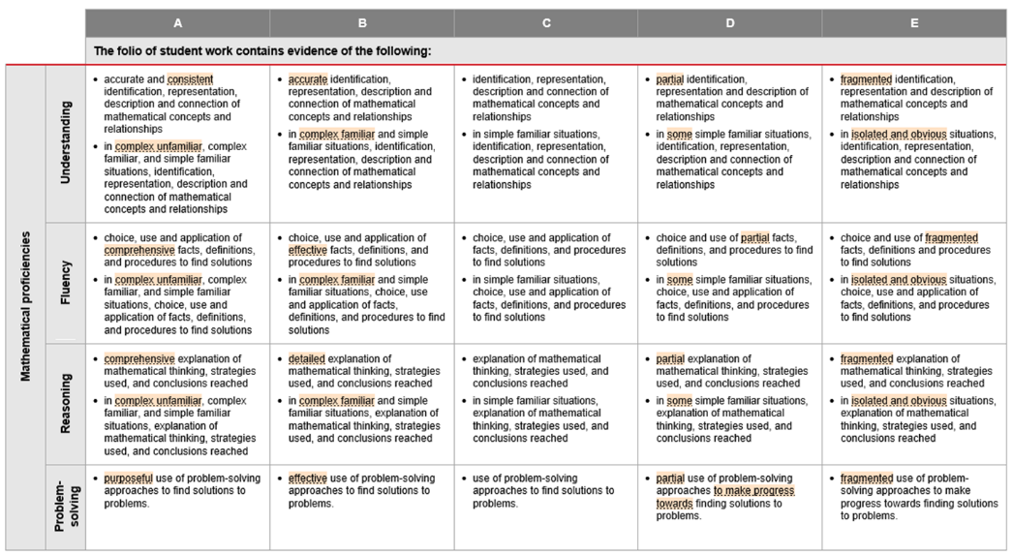
Mathematical proficiencies
Notes:
The Mathematics standards elaborations have been organised using the mathematical proficiencies: understanding, fluency, reasoning and problem-solving.
This is because the curriculum emphasises the importance of proficiency in mathematics.

Slide 6
Proficiencies in the Mathematics curriculum
Proficiency in mathematics
Mathematics provides students with learning opportunities to develop mathematical proficiency, including a sound understanding of and fluency with the concepts, skills, procedures and processes needed to interpret contexts, choose ways to approach situations using mathematics, and to reason and solve problems arising from these situations.
Source: Quoted verbatim from ACARA, 2010 to present, https://v9.australiancurriculum.edu.au/teacher-resources/understand-this-learning-area/mathematics
Notes:
On the screen is a statement from the Australian Curriculum v9.0: Mathematics rationale.
The rationale ‘describes the importance of the learning area, and how students will benefit from its study’ (ACARA, 2010–present).
The Mathematics curriculum emphasises that Mathematics ‘provides students with learning opportunities to develop mathematical proficiency, including a sound understanding of and fluency with the concepts, skills, procedures and processes needed to interpret contexts, choose ways to approach situations using Mathematics, and to reason and solve problems arising from these situations’ (ACARA, 2010–present).
The proficiencies of understanding, fluency, reasoning and problem-solving describe how content is explored or developed; that is, the thinking and doing of mathematics.
Source: https://v9.australiancurriculum.edu.au/help/learning-areas/understanding-the-learning-area
https://v9.australiancurriculum.edu.au/teacher-resources/understand-this-learning-area/mathematics

Slide 7
Table 1 — understanding proficiencies
Table 1 links achievement standards, content descriptions and mathematical proficiencies.
Notes:
Table 1 in the Notes section shows how aspects of the Australian Curriculum achievement standard can be demonstrated as evidence and related to the mathematical proficiencies.
This is an important consideration when designing quality assessment tasks and marking guides.
Teachers can use Table 1 to identify which proficiency aligns with an identified aspect of the achievement standard.

Slide 8
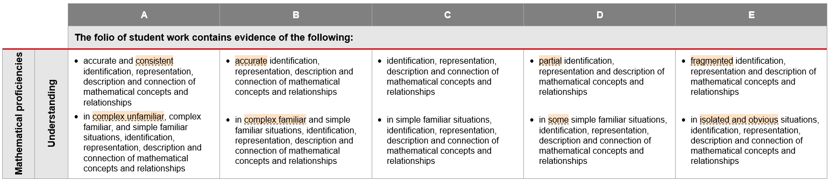
Describing work across a 5-point scale
qualifier
degree of difficulty
Notes:
The standards elaborations describe student work across a 5-point scale (e.g. A–E) using language that supports teachers in making consistent and comparable judgments about how well students have demonstrated what they know, understand and can do.
In Mathematics, the standards elaborations describe:
discernable differences in quality using qualifiers such as accurate and consistent
differences in the degree of difficulty using the terms simple/complex and familiar/unfamiliar.

Slide 9
Degree of quality
Notes:
The degree of quality qualifiers are used when the evidence comes from open-ended, extended response items, typically found in projects.
Source: https://v9.australiancurriculum.edu.au/teacher-resources/understand-this-learning-area/mathematics
www.qcaa.qld.edu.au/p-10/aciq/version-9/learning-areas/p-10-mathematics/p-10-mathematics-assessment-resources

Slide 10
Degree of difficulty
Notes:
The terms describing the degree of difficulty are used when the evidence comes from multiple closed, short response items, typically found in supervised assessments and examinations. The degree of difficulty is described in terms of complexity and familiarity.
Source: https://v9.australiancurriculum.edu.au/teacher-resources/understand-this-learning-area/mathematics
www.qcaa.qld.edu.au/p-10/aciq/version-9/learning-areas/p-10-mathematics/p-10-mathematics-assessment-resources

Slide 11
Familiar and unfamiliar situations in the curriculum
Level description
In Year __, learning in Mathematics builds on each student’s prior learning and experiences. Students engage in a range of approaches to learning and doing mathematics that develop their understanding of and fluency with concepts, procedures and processes by making connections, reasoning, problem-solving and practice. Proficiency in mathematics enables students to respond to familiar and unfamiliar situations by employing mathematical strategies to make informed decisions and solve problems efficiently.
Source: Quoted verbatim from ACARA, 2010 to present, https://v9.australiancurriculum.edu.au/f-10-curriculum/learning-areas/mathematics/foundation-year_year-1_year-2_year-3_year-4_year-5_year-6_year-7_year-8_year-9_year-10?view=quick&detailed-content-descriptions=0&hide-ccp=0&hide-gc=0&side-by-side=1&strands-start-index=0
Notes:
The P-10 Mathematics level descriptions ‘provide an overview of the learning that students should experience in each year’ (ACARA, 2010–present) and echo the rationale of the Mathematics curriculum.
ACARA has identified the importance of proficiency in mathematics as it ‘enables students to respond to familiar and unfamiliar situations by employing mathematical strategies to make informed decisions and solve problems efficiently’ (ACARA, 2010–present).
Source: https://v9.australiancurriculum.edu.au/help/learning-areas/understanding-the-learning-area
ACARA, 2010–present, https://v9.australiancurriculum.edu.au/f-10-curriculum/learning-areas/mathematics/foundation-year_year-1_year-2_year-3_year-4_year-5_year-6_year-7_year-8_year-9_year-10?view=quick&detailed-content-descriptions=0&hide-ccp=0&hide-gc=0&side-by-side=1&strands-start-index=0

Slide 12
Table 2 — understanding complexity and familiarity
Table 2 in the Notes section defines terms for degree of difficulty (simple familiar, complex familiar, complex unfamiliar).
Notes:
Table 2 in the Notes section of the standard elaborations defines the degree of difficulty terms — simple familiar, complex familiar and complex unfamiliar.
These terms are usually used for supervised assessments and examinations.
The descriptions of complexity and familiarity used in the Prep–Year 10 standards elaborations align with the way these terms are defined in the QCAA’s senior Mathematics syllabuses.

Slide 13
Key messages
Standards elaborations can be used to:
    make consistent and comparable judgments about a folio of student work
    develop task-specific standards for individual assessment tasks
    quality assure planning documents to ensure coverage of the achievement standard across a year/band.
Notes:
A key message from this presentation is that using the QCAA standards elaborations ensures valid, reliable, and comparable assessment decisions.

Slide 14
Key messages
The Mathematics standards elaborations:
    are organised according to the mathematical proficiencies
    use terms that describe degree of quality and degree of difficulty.
Table 1 links achievement standards, content descriptions,
and mathematical proficiencies.
Table 2 defines the terms used to describe degree of difficulty.
Notes:
Another key message is that the Mathematics standards elaborations contain particular features that support the design and implementation of assessment in Mathematics.

Slide 15

Reflect and apply
Consider:
How will you use the standards elaborations in your next assessment task?
Which feature will most influence your design decisions?
Notes:
Now consider an action or next step to apply your learning.
How will you use the standards elaborations in your next assessment task?
Which feature will most influence your design decisions?
You may choose to further explore the QCAA standards elaborations by downloading relevant year level resources from the P–10 Mathematics assessment resources page: https://www.qcaa.qld.edu.au/p-10/aciq/version-9/learning-areas/p-10-mathematics/p-10-mathematics-assessment-resources.

Slide 16
Success criteria
Learning goal
To understand how the QCAA Mathematics standards elaborations support the design and construction of quality assessment that is aligned with the Australian Curriculum v9.0.
You will know you are successful when you can:
describe the purpose and features of the standards elaborations
explain how the elaborations support alignment between curriculum and assessment
apply the features of the elaborations to design or evaluate quality assessment tasks or marking guides.
Notes:
Review the learning goal and success criteria.

Slide 17
Acknowledgments
Third-party copyright material, and QCAA material not covered by the CC BY licence is listed below:
Queensland Government coat of arms, and the QCAA and QSA trademarks may not be reproduced without permission.
Acknowledgment of Country artwork (2023) ‘Growth through Learning’ by Chern’ee, Brooke and Jesse Sutton, Kalkadoon. www.cherneesutton.com.au
Unless otherwise indicated, material from Australian Curriculum is © ACARA 2010–present, licensed
CC BY 4.0. For the latest information and additional terms of use, see the Australian Curriculum website and its copyright notice.
Student and staff images have been used with permission.

Slide 18
Copyright notice
© State of Queensland (QCAA) 2026
Licence: https://creativecommons.org/licenses/by/4.0 | Copyright notice: www.qcaa.qld.edu.au/copyright — lists the full terms and conditions, which specify certain exceptions to the licence. |
Attribution (include the link): © State of Queensland (QCAA) 2026 www.qcaa.qld.edu.au/copyright.
Other copyright material in this presentation is listed on the previous slide/s.

