Slide 1
Languages
Prep–Year 10 Australian Curriculum Version 9.0
Learning area overview
240915
Notes:
This presentation supports understanding of the Australian Curriculum Version 9.0: Languages Prep*–Year 10. It gives insight into the position of Languages within the Australian Curriculum and the structure of the Languages learning area.
You can use this presentation in your organisation as the basis for professional learning about the Languages curriculum. It includes information about the key aspects of the curriculum, as well as activities for becoming familiar with the curriculum. An icon in the bottom-right corner of a slide identifies opportunities for activities. Presenters are encouraged to tailor this presentation to suit the needs of their audience.
Presenters are encouraged to view the first section (Languages learning area information) along with their language-specific curricula. The other sections can be deleted if necessary.
The Australian Curriculum content referred to in this presentation is available from:
Australian Curriculum, Assessment and Reporting Authority (ACARA) 2022, Australian Curriculum Version 9 Foundation to Year 10, https://v9.australiancurriculum.edu.au/.
*Prep (P) in Queensland is the Foundation Year (F) of the Australian Curriculum and refers to the year before Year 1. Children beginning Prep in January are required to be five years of age by 30 June.

Slide 2
Learning goals
This presentation aims to:
build understanding of the Australian Curriculum Version 9.0: Languages
provide an overview of the structure of the Languages learning area.
Languages learning area
Notes:
This presentation aims to:
build understanding of the Australian Curriculum, with particular reference to the Languages curriculum
provide an overview of the structure of the Languages learning area, including the curriculum content and achievement standards.

Slide 3
Languages
Auslan
Chinese
Framework for Aboriginal Languages and Torres Strait Islander Languages
French
German
Indonesian
Italian
Japanese
Spanish
Languages
Notes:
This presentation is only focusing on the nine languages that QCAA offers language-specific resources for.
Auslan https://v9.australiancurriculum.edu.au/teacher-resources/understand-this-learning-area/languages#auslan
Chinese https://v9.australiancurriculum.edu.au/teacher-resources/understand-this-learning-area/languages#chinese/
Framework for Aboriginal Languages and Torres Strait Islander Languages
https://v9.australiancurriculum.edu.au/teacher-resources/understand-this-learning-area/languages#framework-for-aboriginal-languages-and-torres-strait-islander-languages
French https://v9.australiancurriculum.edu.au/teacher-resources/understand-this-learning-area/languages#french/
German https://v9.australiancurriculum.edu.au/teacher-resources/understand-this-learning-area/languages#german/
Indonesian https://v9.australiancurriculum.edu.au/teacher-resources/understand-this-learning-area/languages#indonesian/
Italian https://v9.australiancurriculum.edu.au/teacher-resources/understand-this-learning-area/languages#italian/
Japanese https://v9.australiancurriculum.edu.au/teacher-resources/understand-this-learning-area/languages#japanese/
Spanish https://v9.australiancurriculum.edu.au/teacher-resources/understand-this-learning-area/languages#spanish/
Other languages are available on the Australian Curriculum website.
Currently, this is only for second language learners.

Slide 4
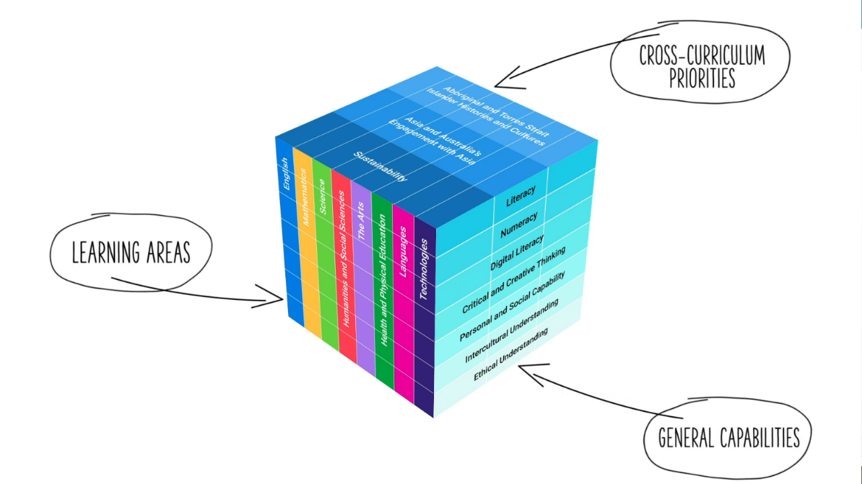
Three-dimensional curriculum
The Australian Curriculum is a three-dimensional curriculum made up of:
learning areas
general capabilities
cross-curriculum
priorities.
ACARA image from Summary overview (video): https://v9.australiancurriculum.edu.au/help/website-tour.
Languages learning area
Notes:
The Australian Curriculum sets the expectations for what all Australian students should be taught and have the opportunity to learn as they progress through their school life. In Prep to Year 10, the Australian Curriculum provides teachers, students and parents with access to the same content and consistent national standards for determining the progress of student learning.
All Australian students across all education settings and contexts can be supported in their diverse learning needs through the three dimensions of the Australian Curriculum: the learning area content, the general capabilities and the cross-curriculum priorities.
This diagram shows the relationship between these dimensions of the Australian Curriculum. Teachers emphasise one or more dimensions to develop learning programs suited to the strengths, interests and diverse needs of all students.
This presentation provides a brief overview of the general capabilities and cross-curriculum priorities. However, the focus will be on the Languages learning area.

Slide 5
Structure of the Languages learning area
Introduction
Rationale
Aims
Structure
  Year/banded curriculum*
  Achievement standards
  Curriculum content
Key considerations
Key connections
  *The Australian Curriculum: Languages is presented in two-year band levels from Year 1 to Year 10, with Prep presented in a single year level
Source: https://v9.australiancurriculum.edu.au/teacher-resources/understand-this-learning-area/languages.
Languages learning area
Notes:
The Australian Curriculum sets out what all young people should be taught by specifying the curriculum content and identifies the learning expected at points in their schooling by specifying the achievement standards. The content and achievement standards are supported by additional information that describes the:
curriculum intent (rationale)
aims of learning (aims)
key considerations when planning learning experiences that are unique to the learning area of Languages
key connections with the other dimensions for the Australian Curriculum including the general capabilities, cross-curriculum priorities and other learning areas
organising structure and focus for the learning at specific year levels including the level descriptions, achievement standards and the curriculum content.
The Australian Curriculum: Languages is presented in two-year band levels from Year 1 to Year 10, with Prep presented as a single year level.
The following sections of the presentation will provide an overview of each of these key aspects of the curriculum.

Slide 6

Rationale
‘Communication is a human imperative. Irrespective of which language, communication involves interaction to convey meaning as well as imagination, creativity and a broad understanding of ourselves and others. Language learning provides the opportunity for students to engage with the linguistic and cultural diversity of the world and its peoples, and reflect on their experience in various aspects of social life, including their own participation and ways of being in the world.’
Extract from languages rationale quoted verbatim and unaltered from ACARA, https://v9.australiancurriculum.edu.au/teacher-resources/understand-this-learning-area/languages.
This learning area rationale is complemented by language-specific rationales.
Notes:
The rationale defines the learning area and describes the importance of the learning area within the curriculum.
The Languages rationale promotes:
communication skills
literacy skills in their first and additional languages
intercultural capabilities
understanding of, and respect for, diversity and difference and an openness to different experiences and perspectives
understanding and appreciation of how culture shapes world views and extends their understanding of themselves, their own heritage, values, culture and identity
critical and creative thinking.
The full rationale is available from: https://v9.australiancurriculum.edu.au/teacher-resources/understand-this-learning-area/languages/.
Suggested activity
Read the full rationale. Partner with a colleague to discuss the following questions:
What were the key aspects of the rationale?
Why is the learning area important? What important contribution does the learning make to a student’s education?
Which aspects of this rationale matched your current understanding of the learning area? Which aspects were new understandings?

Slide 7
Aims
‘The 3 interrelated aims of Languages are to develop knowledge, understanding and skills to ensure students:
develop linguistic competence
understand language and culture, and their relationship, and thereby develop an intercultural capability in communication
understand themselves as communicators.’
Languages aims quoted verbatim and unaltered from ACARA, https://v9.australiancurriculum.edu.au/teacher-resources/understand-this-learning-area/languages.
These learning area aims are complemented with language-specific aims.
Languages learning area
Notes:
The aims flow logically from the rationale and identify the major learning that students will be able to demonstrate as a result of being taught the curriculum.
The Languages learning area aims to develop the knowledge, understanding and skills to enable students to:
understand themselves as communicators
communicate in the target language
understand language, culture and learning and their relationship, and thereby develop an intercultural capability in communication.
These three aims are interrelated and provide the basis for the two organising strands: communicating and understanding. The three aims are common to all languages.
The full aims are available from: https://v9.australiancurriculum.edu.au/teacher-resources/understand-this-learning-area/languages/.
Suggested activities
Prepare a brief statement/overview that would help you describe the aims of the learning area to a parent group.
Identify two or three big ideas in the aims. How do they inform:
your understanding of the learning area?
what is valued in the Australian Curriculum for the learning area?
your teaching and learning approaches?

Slide 8
Key considerations
Flexible entry points
Use of English
Macro skills
Texts
Protocols for engaging First Nations Australians
Meeting the needs of diverse learners
Notes:
The key considerations provide a brief overview of how the Australian Curriculum can accommodate particular approaches to teaching and assessment in Languages.
The Australian Curriculum: Languages emphasises the importance of providing learning opportunities for students to:
have flexible entry points to P–10 and Years 7–10 sequences
reflect on, explore and discuss ideas in English
develop skills in listening, speaking, reading, viewing and writing
be exposed to different types of texts.
This section also supports teachers to consider:
protocols for engaging in First Nations Australians
inclusive practices that are relevant to the students’ needs.
Suggested activity
How are the key considerations reflected in your Languages program?

Slide 9
Sequences of learning
The Australian Curriculum identifies two sequences of learning for most languages:
Prep–Year 10
Years 7–10 (Year 7 entry).
Curriculum content and achievement standards are provided through each sequence of learning.
Languages
Notes:
Most subjects have two sequences of learning:
Prep–Year 10
Years 7–10 (Year 7 entry).
The Framework for Aboriginal Languages and Torres Strait Islander Languages only has a P–10 sequence.
Suggested activity
Select a language and identify the sequences of learning within it.

Slide 10
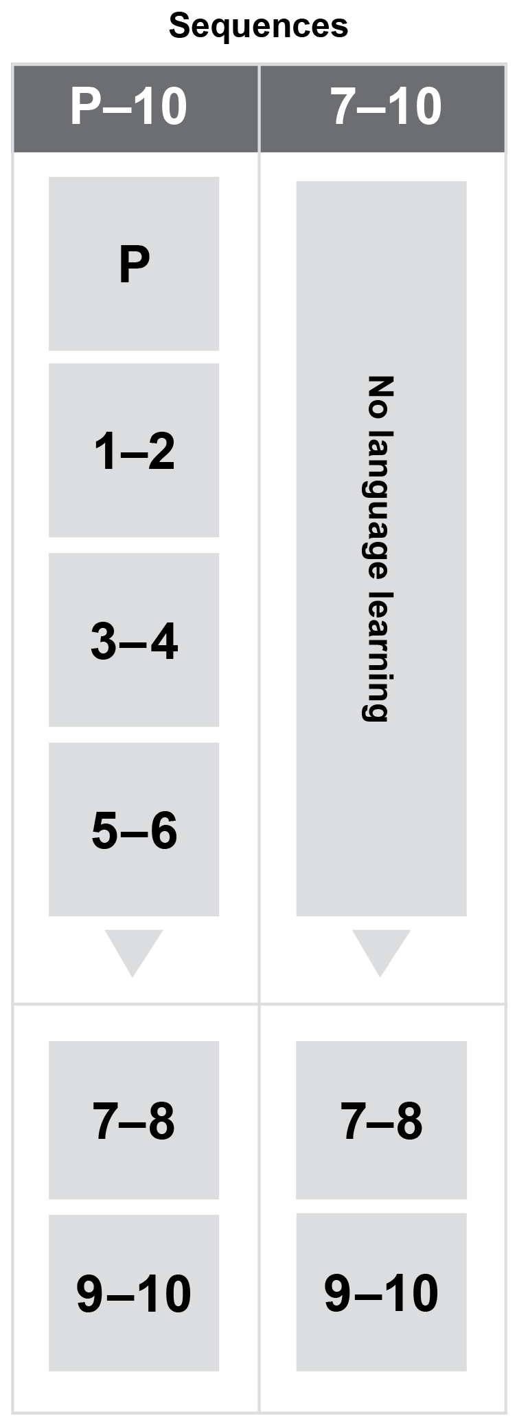
Year/banded curriculum
Each year/band includes the
following structural components:
level description
curriculum content
achievement standard.
The curriculum is developmentally sequenced across bands.
Languages
Notes:
Each sequence of learning provides the curriculum content and achievement standards.
It is important to note that the sequences of learning begin at different entry points — either Prep or Year 7.
Sequence of learning: Prep–Year 10
Year: Prep
Bands: Years 1– 2, Years 3–4, Years 5–6, Years 7–8, Years 9–10
Sequence of learning: Years 7–10 (Year 7 entry)
Bands: Years 7–8, Years 9–10.
Suggested activities
What are the implications of the banded curriculum for the planning of your teaching, learning and assessment program?
What are the implications for teaching and learning programs when you have students starting a new language in Year 7 when you have students who have prior learning of that language?

Slide 11
Level description
Chinese
Years 1 and 2
In Years 1 and 2, Chinese language learning builds on each student’s prior learning and experiences with language. Students continue to communicate and work in collaboration with peers and teachers through purposeful and structured activities involving listening, speaking and viewing. They interact in Chinese to share information about themselves and their immediate environments using play-based and action-related learning. In informal settings, they use local and digital resources to explore Chinese-speaking communities in Australia, China and diverse locations. They continue to receive extensive support through modelling, scaffolding, repetition and reinforcement.
Students recognise key words and phrases, imitate language gestures and pronunciation, and use modelled language to communicate with others. They transition from spoken to written language using common characters, and understand that Pinyin uses the Roman alphabet to represent the sounds of characters. They create simple imaginative and informative texts that may include pictorial representations, words and short statements. They collaborate and respond to spoken, written and multimodal texts that may include conversations, songs and rhymes, picture and story books, animated cartoons, films and performances. They notice that languages contain words which have been borrowed from another language, and that there are similarities and differences between Chinese language and culture(s) and their own.
Notes:
Each level description:​
​
highlights the interrelatedness of the strands for each year or band of years
provides information about skills, contexts of interaction and texts students may engage with.

Slide 12
Context statement
For each language, a context statement describes:
the place of the language and culture in Australia and in the world
the place of the language in Australian education
the nature of language learning
the diversity of learners of the language.
Languages
Notes:
Context statements identify the contextual focus for a language in relation to its place in Australia and in the world, as well as the nature of language learning and diversity of student learners.
Context statements for languages are available from:
Auslan https://v9.australiancurriculum.edu.au/teacher-resources/understand-this-learning-area/languages#auslan
Chinese https://v9.australiancurriculum.edu.au/teacher-resources/understand-this-learning-area/languages#chinese/
Framework for Aboriginal Languages and Torres Strait Islander Languages
https://v9.australiancurriculum.edu.au/teacher-resources/understand-this-learning-area/languages#framework-for-aboriginal-languages-and-torres-strait-islander-languages
French https://v9.australiancurriculum.edu.au/teacher-resources/understand-this-learning-area/languages#french/
German https://v9.australiancurriculum.edu.au/teacher-resources/understand-this-learning-area/languages#german/
Indonesian https://v9.australiancurriculum.edu.au/teacher-resources/understand-this-learning-area/languages#indonesian/
Italian https://v9.australiancurriculum.edu.au/teacher-resources/understand-this-learning-area/languages#italian/
Japanese https://v9.australiancurriculum.edu.au/teacher-resources/understand-this-learning-area/languages#japanese/
Spanish https://v9.australiancurriculum.edu.au/teacher-resources/understand-this-learning-area/languages#spanish/
Suggested activity
Select a language and read the context statement. How does it inform teaching, learning and assessment?

Slide 13

Curriculum content
Years 7 and 8
French
Communicating meaning in French
Interacting in French
Content description | Content elaborations
interact with others using modelled language to exchange information in familiar contexts about self and personal world AC9LF8EC01 | exchanging greetings, wishes and thanks, adjusting language to suit the situation such as Bonjour, la classe! Salut, Marianne, ça va? Bonsoir, Madame Legrand, comment allez-vous? Bonne fête, Solange! Merci bien, Maman ... introducing and describing self and others, for example, Je m’appelle Marc; Je te présente mon oncle; Voici ma petite sœur, Eliane; Je m’appelle Sophie, j’ai les yeux bleus, j’aime le sport ... stating likes, dislikes and preferences, for example, J’aime bien le fromage mais je n’aime pas le yaourt; Je déteste les prunes mais j’adore les pruneaux ... comparing routines, interests and leisure activities, using language associated with time, frequency and location such as Lundi après-midi, je fais du foot; Le weekend, je joue aux jeux vidéos; L’hiver, je fais du ski; L’été, on va souvent à la plage ... describing aspects of their own lifestyles such as surf lifesaving, school camps, excursions and music events that may interest young learners of their own age in French-speaking environments
Languages
Notes:
The content descriptions specify the knowledge, understanding and skills young people are expected to learn and teachers are expected to teach across the years of schooling.
The content descriptions are accompanied by content elaborations. Content elaborations provide illustrations and/or examples that teachers may choose to use in the classroom or as inspiration for their own activities. The content elaborations are not a mandatory aspect of the curriculum and as such are not required to be taught.
Suggested activity
Use the Australian Curriculum: Languages to build an understanding of the sequence of content of the curriculum across year levels: https://v9.australiancurriculum.edu.au/teacher-resources/understand-this-learning-area/languages/.
Within the Australian Curriculum: Languages, select a year-level/band for one of the languages and read the content descriptions.
Consider the content descriptions for the year level/band before and following the selected band.
In a small group, discuss how the curriculum develops in increasing complexity of cognition and skills across the bands.

Slide 14
Strands and sub-strands
 | Strands
 | Communicating meaning in [Language] | Understanding language and culture
Sub-strands | Interacting in [Language] | Understanding systems of language
 | Mediating meaning in and between languages | Understanding the interrelationship of language and culture*
 | Creating text in [Language]
Languages
Notes:
The curriculum is organised under two interrelated strands:
Communicating meaning in the language
Understanding language and culture.
Under each strand, curriculum is organised into sub-strands.
The sub-strands for Communicating meaning in the language are:
Interacting in the language
Mediating meaning in and between languages
Creating text in the language.
The sub-strands for Understanding language and culture are:
Understanding systems of language.
Understanding the interrelationship of language and culture.
*Note that for Auslan and the Framework for Aboriginal Languages and Torres Strait Islander Languages, this sub-strand is named ‘Understanding the interrelationship of language, culture and identity’.
Information on strands and sub-strands is available from: https://v9.australiancurriculum.edu.au/teacher-resources/understand-this-learning-area/languages/.
Suggested activities
What is the relationship between the strands of Languages?
Prepare a brief statement/overview that would help you describe the strands to a parent group.

Slide 15
Achievement standards
By the end of Year 8, students use Japanese language to interact and collaborate with others, and to share information and plan activities in familiar contexts. They respond to others’ contributions, and recognise familiar gestures, questions and instructions in exchanges. They locate and respond to information in texts and use non-verbal, visual and contextual cues to help make meaning. They respond in Japanese or English, and demonstrate understanding of context, purpose and audience in texts. They use familiar language, and modelled sentence and grammatical structures to create texts, and demonstrate understanding of how some language reflects cultural practices. They use some familiar katakana and kanji, and hiragana, with support.
Students approximate Japanese sound patterns, intonation and rhythms, and recognise the relationship between spoken and written forms. They demonstrate understanding that Japanese has conventions and rules for scripts, non-verbal, spoken and written communication. They comment on aspects of Japanese and English language structures and features, using metalanguage. They demonstrate awareness that the Japanese language is connected with culture and identity, and how this is reflected in their own language(s), culture(s) and identity.
Communicating meaning in Japanese
Understanding language and culture
Languages
Notes:
The achievement standard is a statement of what students should know and be able to do at the end of the band. In Languages, the first paragraph of the achievement standard relates to Communicating meaning in the language and the second paragraph relates to Understanding language and culture.

Slide 16
Achievement standards
By the end of Year 10, students initiate and sustain Italian language to exchange and compare ideas and experiences about their own and others’ personal world. They communicate using non-verbal, spoken and written language to collaborate, plan and reflect on activities and events. They interpret and analyse information and ideas in texts and demonstrate understanding of different perspectives. They synthesise information and respond in Italian or English, adjusting language to convey meaning and to suit context, purpose and audience. They use structures and features of spoken and written Italian to create texts.
Students apply features of the Italian sound system to enhance fluency and demonstrate understanding of the sound system in spoken exchanges. They select and apply knowledge of language conventions, structures and features to interact, make meaning and create texts. They support discussion of structures and features of texts, using metalanguage. They reflect on their own language use and cultural identity, and draw on their experience of learning Italian, to discuss how this learning influences their ideas and ways of communicating.
Communicating meaning in Italian
Understanding language and culture
Languages
Notes:
Suggested activities
Partner with a colleague and complete the following activities:
Using the Australian Curriculum: Languages, discuss how the evidence that students need to provide of what they know and can do increases in complexity across year levels. https://v9.australiancurriculum.edu.au/teacher-resources/understand-this-learning-area/languages/.
For a given year level, map the achievement standard to the content descriptions.

Slide 17
Key connections
Identify the connections with the other dimensions for the Australian Curriculum including:
the general capabilities
the cross-curriculum priorities
other learning areas within the Australian Curriculum.
Notes:
The key connections help teachers identify the links to the other dimensions for the Australian Curriculum, including the general capabilities, cross-curriculum priorities and other learning areas to assist teachers to make connections in their planning for student learning.
The key connections are available from: https://v9.australiancurriculum.edu.au/teacher-resources/understand-this-learning-area/languages/.
Suggested activities
Read the key connections section relating to other learning areas. Partner with a colleague to discuss the following questions:
Which learning areas does the Languages curriculum have key connections to?
Why are these connections important? What important contribution do they make to a student’s education?
2. Create a concept map showing the connections between other learning areas.

Slide 18







Three-dimensional curriculum:
General capabilities
Critical and creative thinking
Digital literacy
Ethical understanding
Intercultural understanding
Literacy
Numeracy
Personal and social capability
Notes:
The seven capabilities are divided into two groups:
capabilities that support students to be successful learners ― literacy, numeracy, digital literacy and critical and creative thinking
capabilities that develop ways of being, behaving and learning to live with others ― personal and social capability, ethical understanding and intercultural understanding.
Continua of learning have been developed for each capability to describe the relevant knowledge, understanding and skills at particular points of schooling, while the literacy and numeracy general capabilities have national learning progressions that describe the skills, understandings and capabilities that students typically acquire as their proficiency increases in a particular aspect of the curriculum over time.
The content outlined in the general capabilities' continua/progressions is embedded in the content descriptions for each learning area, where appropriate. The icons shown on this slide are used to identify where the general capabilities are embedded in content descriptions.
A summary of the focus of each of the general capabilities in the Languages learning area is available from: https://v9.australiancurriculum.edu.au/teacher-resources/understand-this-learning-area/languages/.
Suggested activities
Read the key connection section relating to the general capabilities. Partner with a colleague to discuss the following questions:
To which general capabilities are there key connections?
Why are these connections important?
How could you embed the general capabilities authentically into your teaching and learning programs?

Slide 19



Three-dimensional curriculum:
Cross-curriculum priorities
Aboriginal and Torres Strait Islander histories and cultures
Asia and Australia’s engagement with Asia
Sustainability
Notes:
The Australian Curriculum promotes three cross-curriculum priorities that young Australians should learn about. Each of the priorities is represented in learning areas in ways appropriate to that area.
The three priorities are:
Aboriginal and Torres Strait Islander histories and cultures ― to ensure that all young Australians are given the opportunity to gain a deeper understanding and appreciation of Aboriginal and Torres Strait Islander histories and cultures, their significance for Australia and the impact that these have had, and continue to have, on our world
Asia and Australia’s engagement with Asia ― to reflect the importance of knowing about Asia and Australia’s engagement with Asia and to encourage better understanding of the countries and cultures of the Asia region so that young people appreciate the economic, political and cultural interconnections that Australia has with the region
Sustainability ― to allow young people to develop an appreciation of the need for more sustainable patterns of living and to build capacities for thinking, valuing and acting that are necessary to create a more sustainable future.
Each of the cross-curriculum priorities contains a set of organising ideas. These are consistent across the curriculum and are reinforced in learning areas. Explicit teaching of the priorities may be incorporated in teaching and learning activities where appropriate.
Suggested activity
Read the key connections’ section relating to the cross-curriculum priorities. Partner with a colleague to discuss the following questions:
To which cross-curriculum priorities are there key connections?
How are the cross-curriculum priorities reflected in your teaching and learning programs?

Slide 20
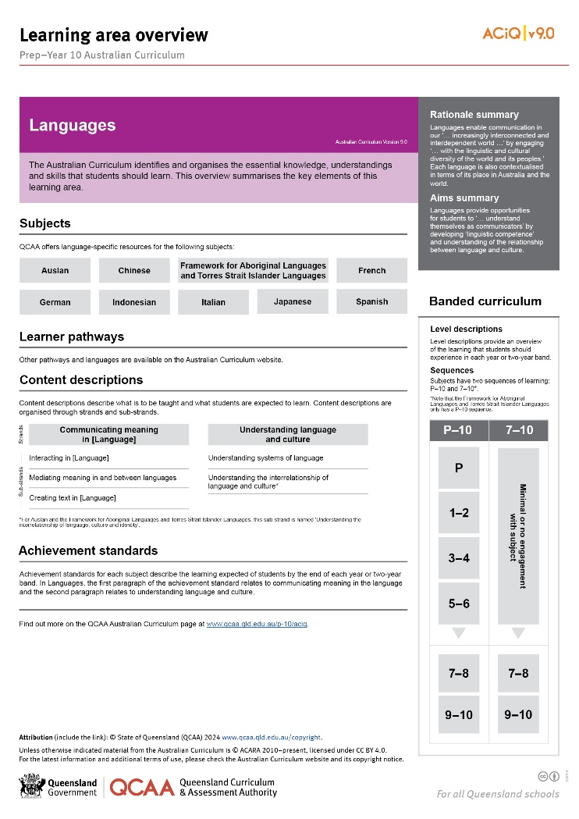
Find out more
Find out more on the QCAA Australian Curriculum
webpage.
Languages
Notes:
More information about the implementation of the Australian Curriculum in Queensland is available on the QCAA website. A one-page overview of the Australian Curriculum: Languages can be accessed through https://www.qcaa.qld.edu.au/p-10/aciq/version-9/learning-areas/p-10-languages/.
Send any further questions to: australiancurriculum@qcaa.qld.edu.au.
Information about requests for further professional learning is available from: www.qcaa.qld.edu.au/pd-events/request-pd.
Suggested activity
Partner with a colleague to discuss the following questions:
What did I learn?
What was confirmed?
What was new?
What challenged my thinking?
What else do I need to do?
What is our plan as a teaching team?

Slide 21
Acknowledgments
© State of Queensland (QCAA) 2022
Licence: https://creativecommons.org/licenses/by/4.0 | Copyright notice: www.qcaa.qld.edu.au/copyright — lists the full terms and conditions, which specify certain exceptions to the licence. |
Attribution: ‘© State of Queensland (QCAA) 2022’ — please include the link to our copyright notice.
Other copyright material in this publication is listed below:
Photograph/s of staff and students used with permission.
Unless otherwise indicated, material from Australian Curriculum is © ACARA 2010–present, licensed CC BY 4.0. For the latest information and additional terms of use, see the Australian Curriculum website and its copyright notice.
The three-dimensional curriculum diagram is 'Excluded Material' used under the terms of the Australian Curriculum and its copyright notice and is not modified. © Australian Curriculum, Assessment and Reporting Authority (ACARA) 2009 to present, unless otherwise indicated.
You may view, download, display, print, reproduce (such as by making photocopies) and distribute these Excluded Materials in unaltered form only for your personal, non-commercial educational purposes or for the non-commercial educational purposes of your organisation, provided that you make others aware it can only be used for these purposes and attribute ACARA as the source of the Excluded Material. For the avoidance of doubt, this means that you cannot edit, modify or adapt any of these materials, and you cannot sub-licence any of these materials to others. Apart from any uses permitted under the Copyright Act 1968 (Cth), and those explicitly granted above, all other rights are reserved by ACARA. If you want to use such material in a manner that is outside this restrictive licence, you must request permission from ACARA by emailing (copyright@acara.edu.au).

Slide 22
QCAA social media

