Slide 1
Familiarisation and planning
240889
Australian Curriculum v9.0: History — Years 7–10
Notes:
This presentation is designed to introduce curriculum leaders and teachers to the Australian Curriculum Version 9.0: History — Years 7‒10.

Slide 2
Acknowledgment of Country
Notes:
Acknowledgment of Country
The QCAA acknowledges the Traditional Owners and Traditional Custodians of the lands on which we meet today.
We pay our respects to their Elders and their descendants, who continue cultural and spiritual connections to Country, and we extend that respect to Aboriginal people and Torres Strait Islander people here today.
We thank them for sharing their cultures and spiritualities and recognise the important contribution of this knowledge to our understanding of this place we call home.

Slide 3
Learning goal
Understand the implications of changes in the Years 7–10 Australian Curriculum from v8.4 to v9.0: History for planning.
Success criteria
You will know you are successful if you:
have more knowledge about the intent and structure of the Years 7–10 Australian Curriculum v9.0: History
can identify actions for planning in your school.

Slide 4
Outline
Introduction to the Australian Curriculum v9.0: History
Understand this learning area and subject
Formulating next steps
Curriculum elements

Slide 5
Outline
Introduction to the Australian Curriculum v9.0: History
Understand this learning area and subject
Formulating next steps
Curriculum elements

Slide 6
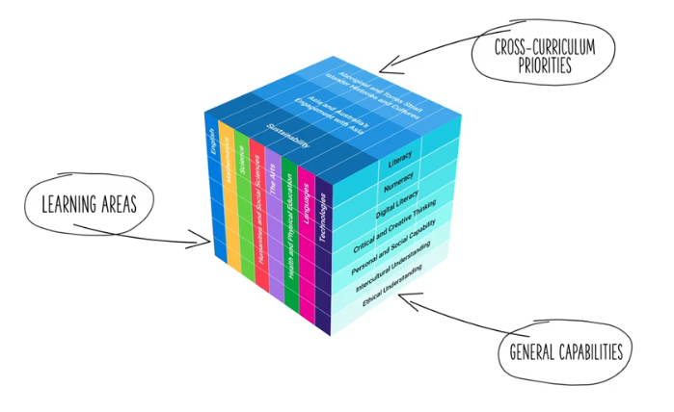
HASS in the three-dimensional Australian Curriculum
Source: ACARA, www.v9.australiancurriculum.edu.au/help/website-tour
Notes:
In the Australian Curriculum Version 9.0, the three-dimensional interrelated structure has not changed as part of the review. The diagram visually represents these three dimensions.
Source: Script and picture adapted (addition of labels) from video at www.v9.australiancurriculum.edu.au/help/website-tour (time stamp 50 seconds).

Slide 7
HASS in the three-dimensional Australian Curriculum
Source: ACARA, www.v9.australiancurriculum.edu.au/help/website-tour
Notes:
The Australian Curriculum consists of eight learning areas. History which is part of the Humanities and Social Sciences (HASS) learning area is indicated in red.
Source: Script and picture adapted (addition of labels) from video at www.v9.australiancurriculum.edu.au/help/website-tour (time stamp 50 seconds).

Slide 8
HASS in the three-dimensional Australian Curriculum
Source: ACARA, www.v9.australiancurriculum.edu.au/help/website-tour
Notes:
There are seven general capabilities:
Literacy
Numeracy
Digital literacy
Critical and creative thinking
Personal and social capability
Intercultural understanding, and
Ethical understanding.
As part of the review, the general capabilities have been refined.
The Information, Communications and Technologies (ICT) general capability in v8.4 has been renamed Digital literacy in v9.0 to reflect current understandings in the field.
The Literacy and Numeracy general capabilities are no longer continua. In v9.0 they are progressions representing the fine-grained indicators of the typical trajectory of literacy and numeracy development.
The remaining general capabilities have had refinements to elements, sub-elements and continua.
Source: Script and picture adapted (addition of labels) from video at www.v9.australiancurriculum.edu.au/help/website-tour (time stamp 50 seconds).

Slide 9
HASS in the three-dimensional Australian Curriculum
Source: ACARA, www.v9.australiancurriculum.edu.au/help/website-tour
Notes:
There are three cross-curriculum priorities:
Aboriginal and Torres Strait Islander Histories and Cultures
Asia and Australia’s engagement with Asia, and
Sustainability.
Source: Script and picture adapted (addition of labels) from video at www.v9.australiancurriculum.edu.au/help/website-tour (time stamp 50 seconds).

Slide 10
Organisation of Learning areas and changes
Version 8.4
Version 9.0
Understand how the learning area works
Rationale
Aims
Key ideas
Structure
Resources (learning area specific)
Understand this learning area
Introduction
Rationale
Aims
Structure
Key considerations
Key connections
Resources
Learning area curriculum
Year level description
Achievement standard
Strands and sub-strands
Content descriptions
Threads (learning area specific)
Content elaborations
Curriculum elements
Level description
Achievement standard
Strands and sub-strands
Content descriptions
Content elaborations
Notes:
This is an overview of the organisation of all Learning areas in the Australian Curriculum Version 8.4 compared with Version 9.0, with the main changes noted.
The following slides show the organisation as it applies specifically to the HASS learning area, and the the subject, History.
Source: Image created in house using SmartArt. Adapted from https://v9.australiancurriculum.edu.au/teacher-resources/understand-this-learning-area/humanities-and-social-sciences

Slide 11
Organisation of HASS learning area and changes
Humanities and Social Sciences (HASS)
Version 9.0
History
Version 9.0
Understand this subject
Rationale
Aims
Structure
Key considerations
Understand this learning area
Introduction
Rationale
Aims
Structure
Key considerations
Key connections
Resources
Curriculum elements
Level description
Achievement standard
Strands and sub-strands
Content descriptions
Content elaborations
Notes:
In the HASS learning area, there is a two-tier structure.
Source: Image created in house using SmartArt. Adapted from https://v9.australiancurriculum.edu.au/teacher-resources/understand-this-learning-area/humanities-and-social-sciences.

Slide 12
Organisation of HASS learning area and changes
HASS
Version 9.0
History
Version 9.0
Understand this learning area
Introduction
Rationale
Aims
Structure
Key considerations
Key connections
Resources
Understand this subject
Rationale
Aims
Structure
Key considerations
Curriculum elements
Level description
Achievement standard
Strands and sub-strands
Content descriptions
Content elaborations
Notes:
The first tier for the HASS learning area is called Understand this learning area. It outlines guiding principles of the HASS learning area and provides context for each of the subjects that sit within HASS.
In red, Key considerations and Key connections are new additions in the Australian Curriculum Version 9.0 for HASS.
Source: Image created in house using SmartArt. Adapted https://v9.australiancurriculum.edu.au/teacher-resources/understand-this-learning-area/humanities-and-social-sciences.

Slide 13
Organisation of History and changes
HASS
Version 9.0
History
Version 9.0
Understand this learning area
Introduction
Rationale
Aims
Structure
Key considerations
Key connections
Resources
Understand this subject
Rationale
Aims
Structure
Key considerations
Curriculum elements
Level description
Achievement standard
Strands and sub-strands
Content descriptions
Content elaborations
Notes:
In the second tier is information about the subject, in this case History.
Understand this subject provides detail of the intent of the subject History and a snapshot of the structure. In red is a new section, Key considerations, which includes those considerations specific to the subject, History.
Curriculum elements provides the content required in History, including the achievement standards and content descriptions.
Source: Image created in house using SmartArt. Adapted from https://v9.australiancurriculum.edu.au/teacher-resources/understand-this-learning-area/humanities-and-social-sciences.

Slide 14
Outline
Introduction to Australian Curriculum v9.0: History
Understand this learning area and subject
Formulating next steps
Curriculum elements

Slide 15
Organisation of HASS learning area
HASS
Version 9.0
History
Version 9.0
Understand this learning area
Introduction
Rationale
Aims
Structure
Key considerations
Key connections
Resources
Understand this subject
Rationale
Aims
Structure
Key considerations
Introduction
Rationale
Aims
Curriculum elements
Level description
Achievement standard
Strands and sub-strands
Content descriptions
Content elaborations
Notes:
In Version 9 the introduction includes information about the 5 subjects that comprise the HASS learning area:
P–6 HASS
Civics and Citizenship
Economics and Business
Geography
History.
The rationale and aims capture the intent of teaching HASS and inform teachers’ planning in a school context.
Source: Image created in house using SmartArt. Adapted from https://v9.australiancurriculum.edu.au/teacher-resources/understand-this-learning-area/humanities-and-social-sciences.

Slide 16
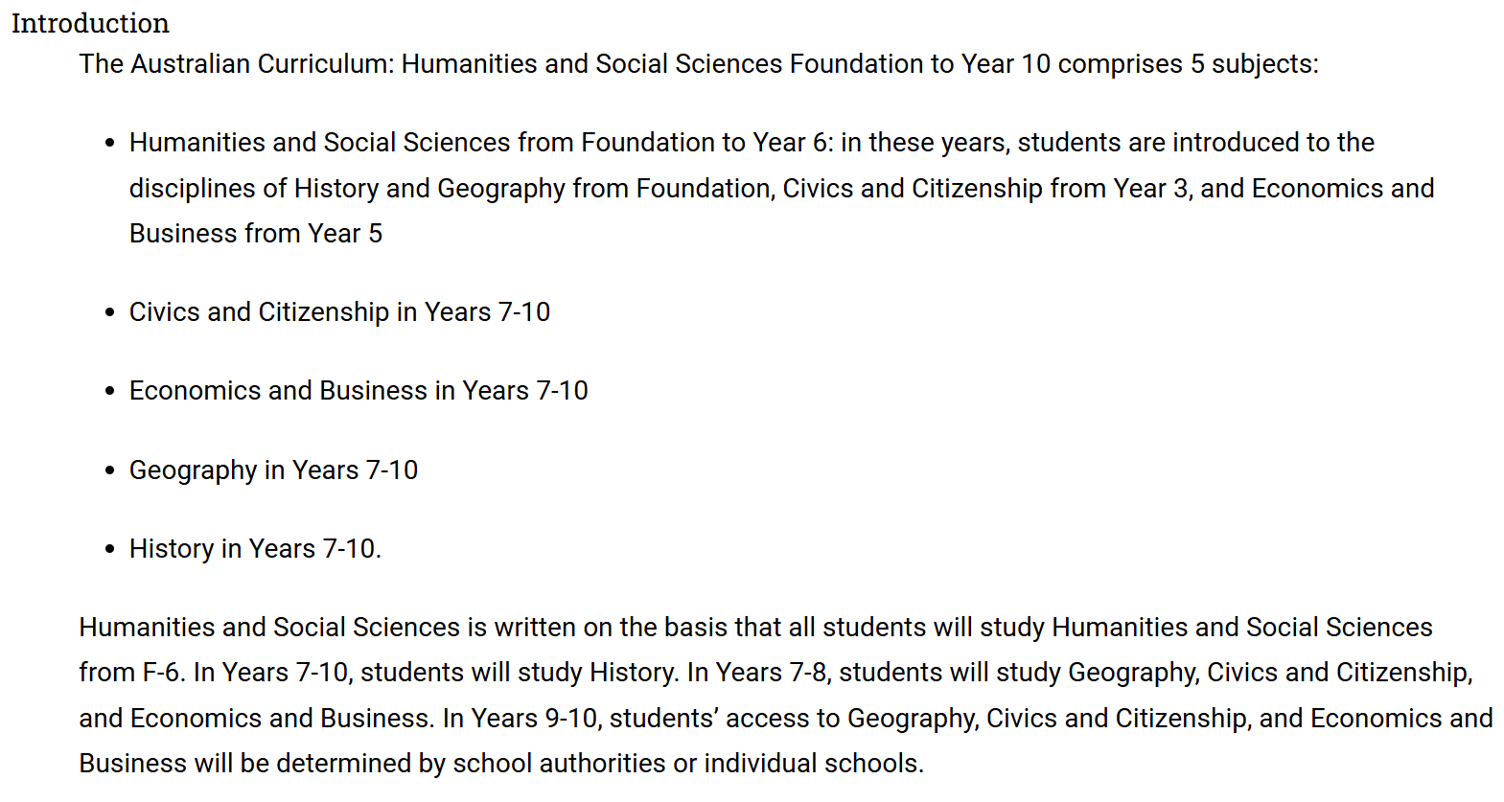
Organisation of HASS learning area
Source: Quoted verbatim and unaltered from AC https://v9.australiancurriculum.edu.au/teacher-resources/understand-this-learning-area/humanities-and-social-sciences
Notes:
The introduction in Understand this learning area also describes the learning entitlement in HASS.

Slide 17
Organisation of HASS learning area
HASS
Version 9.0
History
Version 9.0
Understand this learning area
Introduction
Rationale
Aims
Structure
Key considerations
Key connections
Resources
Understand this subject
Rationale
Aims
Structure
Key considerations
Structure
Curriculum elements
Level description
Achievement standard
Strands and sub-strands
Content descriptions
Content elaborations
Notes:
The section on structure includes information about the strands and sub-strands in the HASS learning area.
Source: Image created in house using SmartArt. Adapted https://v9.australiancurriculum.edu.au/teacher-resources/understand-this-learning-area/humanities-and-social-sciences.

Slide 18
Structure of HASS learning area: strands
Version 8.4 | Version 9.0
Knowledge and understanding | Knowledge and understanding
Inquiry and skills | Skills
Notes:
In HASS in Version 9.0, all subjects continue to be organised through strands and sub-strands. The two, interrelated strands in Version 9.0 are:
Knowledge and understanding and
Skills.
This is a small change from Version 8.4. Inquiry is now incorporated into the sub-strands as a skill.

Slide 19
Structure of Knowledge and understanding strand across the HASS learning area
History |  | Geography |  | Civics and Citizenship |  | Economics and Business
Two to four sub-strands per year level |  | Two sub-strands per year level |  | Three sub-strands per year level |  | No sub-strands
Some sub-strands are required |  | All sub-strands are required |  | All sub-strands are required |  | All content descriptions in the strand are required
Selection of topics within each sub-strand
Economics and Business v9.0
Economics and Business v9.0
Notes:
The Knowledge and understanding strand in the v9.0 HASS learning area contains varying numbers of sub-strands depending on the subject.
For example, there are different requirements across the subjects regarding what sub-strands are expected to be studied in a school’s program.
It is important to note that in History the number of sub-strands varies across the year levels, and only some of these sub-strands are expected to be studied.
Source: Adapted from https://v9.australiancurriculum.edu.au/teacher-resources/understand-this-learning-area/humanities-and-social-sciences. Image created in house using SmartArt

Slide 20
Structure of Skills strand across the HASS learning area
— Sub-strands — | History |  | Geography |  | Civics and Citizenship |  | Economics and Business
 | Questioning and researching |  | Questioning and researching using geographical methods |  | Questioning and researching |  | Questioning and researching
 | Using historical sources |  | Interpreting and analysing geographical data and information |  | Analysis, evaluation and interpretation |  | Interpreting and analysing
 | Historical perspectives and interpretations |  | Concluding and decision-making |  | Civic participation and decision-making |  | Evaluating, concluding and decision-making
 | Communicating |  | Communicating |  | Communicating |  | Communicating
Notes:
Strands are organised into sub-strands depending on the subject.
For example, there is now a consistent number of sub-strands in the Skills strand across the suite of Years 7‒10 HASS subjects.
In each HASS subject, there are four Skills sub-strands. These vary depending on the nature of the subject; however, there are certain skills, Questioning and researching and Communicating, that are common to all subjects.
In addition, there are some similarities in the grouping of cognitions in the second and third skills sub-strands.

Slide 21
Organisation of HASS learning area
HASS
Version 9.0
History
Version 9.0
Understand this learning area
Introduction
Rationale
Aims
Structure
Key considerations
Key connections
Resources
Understand this subject
Rationale
Aims
Structure
Key considerations
Key considerations
Key connections
Resources
Curriculum elements
Level description
Achievement standard
Strands and sub-strands
Content descriptions
Content elaborations
Notes:
The final section of Understand this learning area includes the key considerations, key connections and resources that provide further support and advice for teachers when planning for Version 9.0 in HASS.
Source: Image created in house using SmartArt. Adapted https://v9.australiancurriculum.edu.au/teacher-resources/understand-this-learning-area/humanities-and-social-sciences.

Slide 22
Key considerations for the HASS learning area
Protocols for
engaging
First Nations Australians
Meeting the
needs of diverse learners
Notes:
The key considerations is a new section in v9.0 consistent across all learning areas.
There are two new considerations in all learning areas which are Protocols for engaging First Nations Australians and Meeting the needs of diverse learners.
Subject-specific key considerations for History will be discussed later.
Source: Image created in house using SmartArt based on https://v9.australiancurriculum.edu.au/teacher-resources/understand-this-learning-area/humanities-and-social-sciences.

Slide 23
Key connections
Learning
areas
General capabilities
Cross-curriculum priorities
Source: ACARA, www.v9.australiancurriculum.edu.au/help/website-tour
Notes:
The key connections in the curriculum support teachers to integrate HASS with other learning areas, embed relevant general capabilities and provide possible contexts for learning through the cross-curriculum priorities.
This integration can enrich and deepen student engagement with learning area content.
These connections should only be considered when they provide appropriate and authentic opportunities to strengthen learning area content.

Slide 24
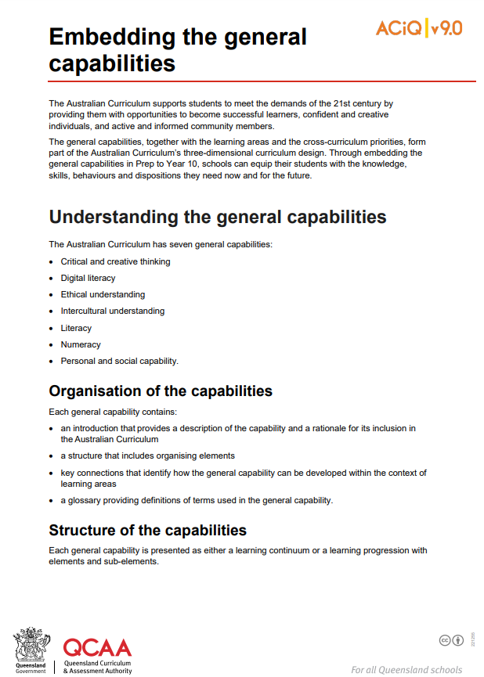
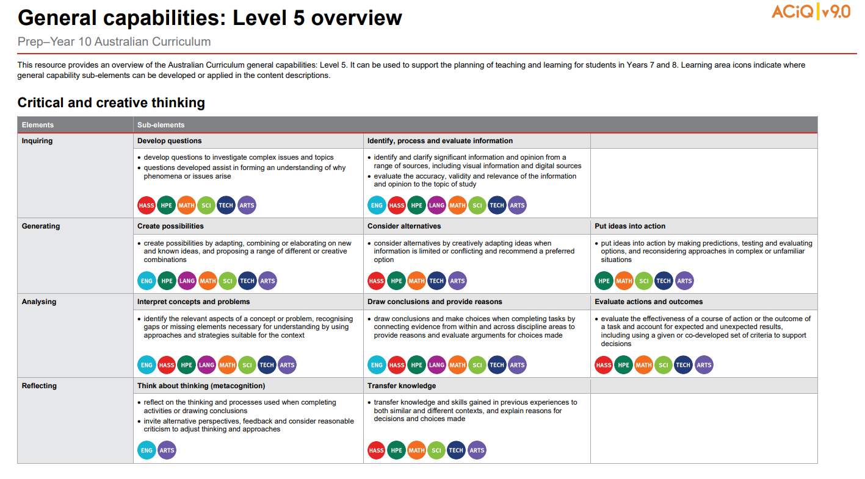
General capabilities advice and resources
https://www.qcaa.qld.edu.au/p-10/aciq/version-9/general-capabilities
Notes:
The QCAA has resources that identify the connections the Australian Curriculum has made between learning areas and the general capabilities.
The general capability level overviews provide an overview of where each general capability can be developed or applied in the content descriptions of the learning areas. For example, the general capability Level 5 and Level 6 align with Years 7–10 learning areas.
The continua resources are available for the general capabilities:
critical and creative thinking
digital literacy
ethical understanding
intercultural understanding and,
personal and social capability.
There are resources available that provide a sequence of learning for the capability from Level 1 to Level 6. This can be helpful for teachers when catering for students with diverse needs.
The QCAA has advice documents to support teachers to use the Literacy and Numeracy progressions. These progressions provide observable indicators of increasing complexity in literacy and numeracy which can help teachers to develop targeted teaching and learning programs for students who are working at, above and below year-level expectations.
These resources can support teaching teams to interrogate connections between the general capabilities and the learning area content in more detail.

Slide 25
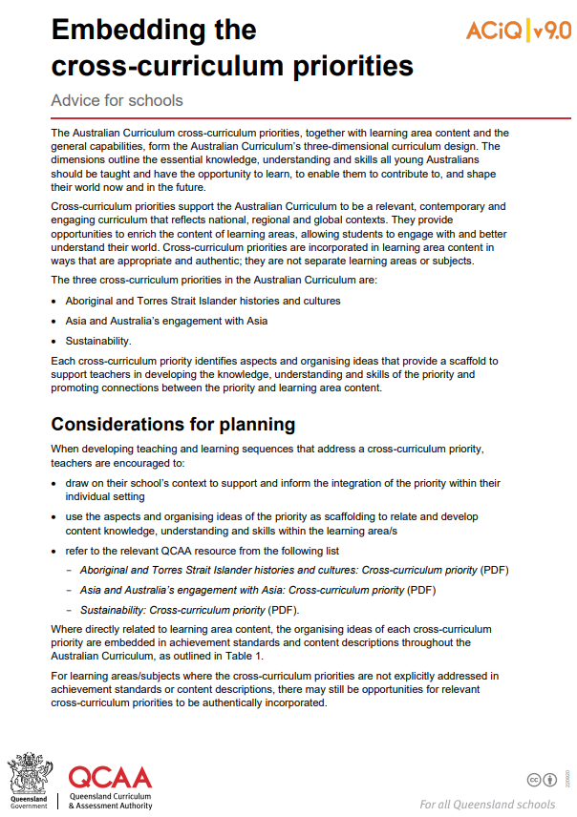
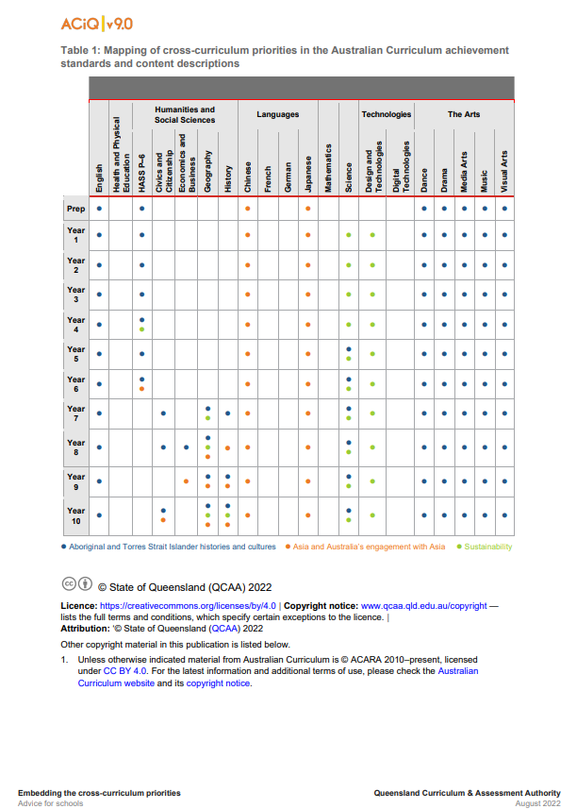
Cross-curriculum priorities advice and resources
www.qcaa.qld.edu.au/p-10/aciq/version-9/cross-curriculum-priorities
Notes:
The QCAA has resources to support schools with understanding how to connect the curriculum with cross-curriculum priorities.
Cross-curriculum priorities are incorporated through learning area content, in ways that are appropriate and authentic. The resources provide an overview of, as well as mapping across learning area and/or subject content descriptions and achievement standards to identify connections to each of the cross-curriculum priorities. ​

Slide 26
Organisation of History
HASS
Version 9.0
History
Version 9.0
Understand this learning area
Introduction
Rationale
Aims
Structure
Key considerations
Key connections
Resources
Understand this subject
Rationale
Aims
Structure
Key considerations
Rationale
Aims
Curriculum elements
Level description
Achievement standard
Strands and sub-strands
Content descriptions
Content elaborations
Notes:
The subject organisation varies slightly from the Understand this learning area section of the curriculum.
The subject-specific rationale and aims capture the intent of teaching History and inform teachers’ planning in a school context. For example, History is a disciplined process of inquiry into the past that develops students’ knowledge, curiosity and imagination about the past. It helps students appreciate how the world and its people and environments have changed, as well as the significant continuities that exist to the present day.
Source: Image created in house using SmartArt. Adapted https://v9.australiancurriculum.edu.au/teacher-resources/understand-this-learning-area/humanities-and-social-sciences.

Slide 27
Organisation of History
HASS
Version 9.0
History
Version 9.0
Understand this learning area
Introduction
Rationale
Aims
Structure
Key considerations
Key connections
Resources
Understand this subject
Rationale
Aims
Structure
Key considerations
Structure
Curriculum elements
Level description
Achievement standard
Strands and sub-strands
Content descriptions
Content elaborations
Notes:
While there are some consistent structural elements across the learning area (e.g. strands for Knowledge and understanding, and Skills) schools also need to consider the structure of the sub-strands for each subject.
Source: Image created in house using SmartArt. Adapted https://v9.australiancurriculum.edu.au/teacher-resources/understand-this-learning-area/humanities-and-social-sciences.

Slide 28
Knowledge and understanding sub-strands: History
Year 7 |  | Year 8 |  | Year 9 |  | Year 10
Deep time history of Australia |  | Medieval Europe and the early modern world |  | Making and transforming the Australian nation (1750–1914) |  | Second World War
The ancient world |  | Empires and expansions |  | First World War (1914–1918) |  | Building modern Australia
 |  | Asia-Pacific world |  | The Industrial Revolution and the movement of peoples (1750–1900) |  | The globalising world
 |  |  |  | Asia and the world (1750–1914)
History v9.0
*Bold titles indicate those sub-strands that are expected to be taught in the year level.
Notes:
The Knowledge and understanding sub-strands for History have undergone significant revision.
Firstly, there has been a change in the nomenclature for History, from ‘depth studies’ in Version 8.4 to ‘sub-strands’ in Version 9.0 of the curriculum.
In History, some sub-strands are expected to be studied, and these are indicated in bold, while others are optional.
In Version 9.0 of the History curriculum, at least two sub-strands are taught in each year level. This represents a significant reduction from Version 8.4 of the curriculum that required teaching an overview and three depth studies each year.
Source: Adapted from https://v9.australiancurriculum.edu.au/teacher-resources/understand-this-learning-area/humanities-and-social-sciences. Image created in house using SmartArt.

Slide 29
Knowledge and Understanding sub-strands: History
Year 7 |  | Year 8 |  | Year 9 |  | Year 10
Deep time history of Australia |  | Medieval Europe and the early modern world |  | Making and transforming the Australian nation (1750–1914) |  | Second World War
The ancient world |  | Empires and expansions |  | First World War (1914–1918) |  | Building modern Australia
 |  | Asia-Pacific world |  | The Industrial Revolution and the movement of peoples (1750–1900) |  | The globalising world
 |  |  |  | Asia and the world (1750–1914)
History v9.0
*Bold titles indicate those sub-strands that are expected to be taught in the year level.
Notes:
In Year 7, both sub-strands are expected to be studied. Schools may choose the order in which the sub-strands are taught.
Deep time history of Australia is a new sub-strand in Version 9.0 of the History curriculum.
The ancient world sub-strand includes some topic choices.
Source: Adapted from https://v9.australiancurriculum.edu.au/teacher-resources/understand-this-learning-area/humanities-and-social-sciences. Image created in house using SmartArt.

Slide 30
Knowledge and understanding sub-strands: History
Year 7 |  | Year 8 |  | Year 9 |  | Year 10
Deep time history of Australia |  | Medieval Europe and the early modern world |  | Making and transforming the Australian nation (1750–1914) |  | Second World War
The ancient world |  | Empires and expansions |  | First World War (1914–1918) |  | Building modern Australia
 |  | Asia-Pacific world |  | The Industrial Revolution and the movement of peoples (1750–1900) |  | The globalising world
 |  |  |  | Asia and the world (1750–1914)
  Select one from the following:
  Greece
  Rome
  Egypt
  India
  China.
History v9.0
*Bold titles indicate those sub-strands that are expected to be taught in the year level.
Notes:
One topic is selected as the focus for learning in The ancient world sub-strand. The topic choices are:
Greece
Rome
Egypt
India
China.
The 6 Knowledge and understanding content descriptions for The ancient world sub-strand are applied to the chosen ancient society.
In Version 8.4 of the curriculum, two of these ancient world topics were taught as depth studies. The transition to Version 9.0 of the curriculum is an opportunity to select the most suitable topic for your students to build their historical skills and gain an appreciation and understanding of the ancient world. When making these topic decisions, schools should consider the balance and range of topics across Years 7‒10 History.
Source: Adapted from https://v9.australiancurriculum.edu.au/teacher-resources/understand-this-learning-area/humanities-and-social-sciences. Image created in house using SmartArt.

Slide 31
Knowledge and understanding sub-strands: History
Year 7 |  | Year 8 |  | Year 9 |  | Year 10
Deep time history of Australia |  | Medieval Europe and the early modern world |  | Making and transforming the Australian nation (1750–1914) |  | Second World War
The ancient world |  | Empires and expansions |  | First World War (1914–1918) |  | Building modern Australia
 |  | Asia-Pacific world |  | The Industrial Revolution and the movement of peoples (1750–1900) |  | The globalising world
 |  |  |  | Asia and the world (1750–1914)
History v9.0
*Bold titles indicate those sub-strands that are expected to be taught in the year level.
Notes:
In Year 8, three sub-strands are available for study, and students are expected to study at least two sub-strands.
One of these is Medieval Europe and the early modern world.
Schools then choose one of the other two sub-strands, Empires and expansions or Asia-Pacific world.
Source: Adapted from https://v9.australiancurriculum.edu.au/teacher-resources/understand-this-learning-area/humanities-and-social-sciences. Image created in house using SmartArt.

Slide 32
Knowledge and understanding sub-strands: History
Year 7 |  | Year 8 |  | Year 9 |  | Year 10
Deep time history of Australia |  | Medieval Europe and the early modern world |  | Making and transforming the Australian nation (1750–1914) |  | Second World War
The ancient world |  | Empires and expansions |  | First World War (1914–1918) |  | Building modern Australia
 |  | Asia-Pacific world |  | The Industrial Revolution and the movement of peoples (1750–1900) |  | The globalising world
 |  |  |  | Asia and the world (1750–1914)
Select one from the following:
Medieval Europe (c.590‒c.1500)
The Renaissance (c.1400‒c.1600)
The emergence of the modern world (c.1500‒1650)
History v9.0
*Bold titles indicate those sub-strands that are expected to be taught in the year level.
Notes:
For the Medieval Europe and the early modern world sub-strand, schools select at least one topic from:
Medieval Europe
The Renaissance
The emergence of the modern world.
Schools may already be teaching aspects of ‘Medieval Europe’ or ‘The Renaissance’ in their Version 8.4 programs. ‘The emergence of the modern world’ is a new topic.
Source: Adapted from https://v9.australiancurriculum.edu.au/teacher-resources/understand-this-learning-area/humanities-and-social-sciences. Image created in house using SmartArt.

Slide 33
Knowledge and understanding sub-strands: History
Year 7 |  | Year 8 |  | Year 9 |  | Year 10
Deep time history of Australia |  | Medieval Europe and the early modern world |  | Making and transforming the Australian nation (1750–1914) |  | Second World War
The ancient world |  | Empires and expansions |  | First World War (1914–1918) |  | Building modern Australia
 |  | Asia-Pacific world |  | The Industrial Revolution and the movement of peoples (1750–1900) |  | The globalising world
 |  |  |  | Asia and the world (1750–1914)
Select one topic from the following:
Mongol Empire (c.1206–c.1368)
Ottoman Empire (c.1299–c.1683)
Vikings (c.790–c.1066)
The Spanish conquest of the Americas (c.1492–c.1572)
History v9.0
Select one topic from the following:
Angkor/Khmer Empire (c.802–c.1431)
Japan under the Shoguns (c.794–1867)
Polynesian expansion across the Pacific (c.700–1756)
*Bold titles indicate those sub-strands that are expected to be taught in the year level.
Notes:
Students are then expected to study at least one topic from either of the other 2 sub-strands. The topic choices available are shown on the slide.
Source: Adapted from https://v9.australiancurriculum.edu.au/teacher-resources/understand-this-learning-area/humanities-and-social-sciences. Image created in house using SmartArt.

Slide 34
Knowledge and understanding sub-strands: History
Year 7 |  | Year 8 |  | Year 9 |  | Year 10
Deep time history of Australia |  | Medieval Europe and the early modern world |  | Making and transforming the Australian nation (1750–1914) |  | Second World War
The ancient world |  | Empires and expansions |  | First World War (1914–1918) |  | Building modern Australia
 |  | Asia-Pacific world |  | The Industrial Revolution and the movement of peoples (1750–1900) |  | The globalising world
 |  |  |  | Asia and the world (1750–1914)
History v9.0
*Bold titles indicate those sub-strands that are expected to be taught in the year level.
Notes:
In Year 9, four sub-strands are available for study.
Students are expected to study the two sub-strands in bold:
Making and transforming the Australian nation (1750–1914) and
First World War (1914–1918).
The Industrial Revolution and movement of peoples (1750–1900) and the Asia and the World (1750–1914) sub-strands may be studied as additional options.
There are no topics within the Knowledge and understanding sub-strands for Year 9. Each sub-strand has its own set of specific content descriptions associated with that sub-strand.
Aspects of the Version 8.4 depth studies ‘Movements of people’ and ‘Industrial Revolution’ have been incorporated into one optional sub-strand. The Version 8.4 depth study ‘Progressive ideas and movements’ is not a Version 9.0 sub-strand.
Source: Adapted from https://v9.australiancurriculum.edu.au/teacher-resources/understand-this-learning-area/humanities-and-social-sciences. Image created in house using SmartArt.

Slide 35
Knowledge and understanding sub-strands: History
Year 7 |  | Year 8 |  | Year 9 |  | Year 10
Deep time history of Australia |  | Medieval Europe and the early modern world |  | Making and transforming the Australian nation (1750–1914) |  | Second World War
The ancient world |  | Empires and expansions |  | First World War (1914–1918) |  | Building modern Australia
 |  | Asia-Pacific world |  | The Industrial Revolution and the movement of peoples (1750–1900) |  | The globalising world
 |  |  |  | Asia and the world (1750–1914)
History v9.0
*Bold titles indicate those sub-strands that are expected to be taught in the year level.
Notes:
In Year 10, three sub-strands are available for study.
Students are expected to study two sub-strands in bold:
Second World War and
Building Modern Australia.
The globalising world is a sub-strand that may be studied as an additional option.
As for Year 9, in Year 10, there are no topics to select within the sub-strands.
The Version 8.4 depth studies ‘Rights and freedoms’ ‘Popular culture’, ‘Migration experiences’ and ‘The environment ‘ are not in Version 9.0 of the History curriculum, but aspects of the content has been included in the sub-strands Building modern Australia and The globalising world.
Source: Adapted from https://v9.australiancurriculum.edu.au/teacher-resources/understand-this-learning-area/humanities-and-social-sciences. Image created in house using SmartArt.

Slide 36
Structure of Skills strand: v8.4 to v9.0
— Sub-strands — | History v8.4
 | Chronology, terms and concepts
 | Historical questions and research |  | Questioning and researching
 | Analysis and use of sources |  | Using historical sources
 | Perspectives and interpretations |  | Historical perspectives and interpretations
 | Explanation and communication |  | Communicating
History v9.0
Notes:
The structure of the History Skills strand has changed from five sub-strands to four. Highlighted in red are the revised Skills sub-strands for History.
Although Chronology, terms and concepts is no longer a stand-alone skill in Version 9.0, this has been incorporated into the sub-strand of Historical perspectives and interpretations when students describe causes and effects and explain changes and continuities.
The Questioning and researching sub-strand is a refinement of the related skill in Version 8.4. Students still develop historical questions to inform historical inquiries and locate sources to use in inquiries.
Using historical sources is again a refinement of the related skill in Version 8.4 with some expansion of the skills to be developed.
There is a greater degree of change in the Historical perspectives and interpretations, which is discussed later in the presentation.
There are small refinements to the Communicating skill in Version 9.0.

Slide 37
Organisation of History
HASS
Version 9.0
History
Version 9.0
Understand this learning area
Introduction
Rationale
Aims
Structure
Key considerations
Key connections
Resources
Understand this subject
Rationale
Aims
Structure
Key considerations
Key considerations
Curriculum elements
Level description
Achievement standard
Strands and sub-strands
Content descriptions
Content elaborations
Notes:
The final section of Understand this subject provides further support and advice for teachers when planning for version 9 in History.
Source: Image created in house using SmartArt. Adapted https://v9.australiancurriculum.edu.au/teacher-resources/understand-this-learning-area/humanities-and-social-sciences.

Slide 38
Key considerations in History
Inquiry questions
Historical sources
Australian history within a world history approach
Protocols for
engaging
First Nations Australians
Meeting the
needs of diverse learners
Notes:
On screen are the key considerations that inform teaching and learning in History.
Inquiry as a pedagogical approach is valued across the HASS subjects. Inquiry questions provide a framework for developing students’ knowledge and understanding and skills. Teachers may develop inquiry questions to guide units of work, and several inquiry questions are provided in the curriculum for each year level. These are examples only, but schools may find them useful for planning. In History, students also learn how to use and develop their own questions to guide historical inquiries.
The use of historical sources is fundamental to the study of history. This key consideration includes a useful discussion of the importance of incorporating a range of primary and secondary sources when planning teaching and learning experiences for history. Students need to be explicitly taught the skills of using historical sources.
The study of Australia’s national history is taught within the context of global developments. When planning units of work, students should have the opportunity to consider how global developments have shaped and influenced national events. In addition to building their historical skills, students develop a breadth of historical knowledge and understanding across their studies of history in the middle years.
As explained previously, the two key considerations in grey are common to all HASS subjects and all learning areas.
Source: Image created in house using SmartArt based on https://v9.australiancurriculum.edu.au/teacher-resources/understand-this-learning-area/humanities-and-social-sciences.

Slide 39
Outline
Introduction to Australian Curriculum v9.0: History
Understand this learning area and subject
Formulating next steps
Curriculum elements

Slide 40
Organisation of History
HASS
Version 9.0
History
Version 9.0
Understand this learning area
Introduction
Rationale
Aims
Structure
Key considerations
Key connections
Resources
Understand this subject
Rationale
Aims
Structure
Key considerations
Curriculum elements
Level description
Achievement standard
Strands and sub-strands
Content descriptions
Content elaborations
Level description
Achievement standard
Notes:
The History level description in the Curriculum elements section provides a high-level overview of the learning students should experience each year. The level description also provides some possible inquiry questions that teachers can use to structure their units of work. These are examples only.
In Queensland, the achievement standard represents the C standard (or equivalent).
Source: Image created in house using SmartArt. Adapted https://v9.australiancurriculum.edu.au/teacher-resources/understand-this-learning-area/humanities-and-social-sciences.

Slide 41
Achievement standard structure
 | Version 8.4 | Version 9.0
Knowledge & understanding | By the end of Year 7, students suggest reasons for change and continuity over time. They describe the effects of change on societies, individuals and groups. They describe events and developments from the perspective of different people who lived at the time. Students explain the role of groups and the significance of particular individuals in society. They identify past events and developments that have been interpreted in different ways. | By the end of Year 7, students describe the historical significance of the ancient past and the histories of early First Nations Peoples of Australia. They identify the causes and effects of events, developments and achievements connected to groups and individuals in Australia and other societies from the ancient past. Students describe the social, religious, cultural, economic, environmental and/or political aspects related to changes and continuities in these societies. They identify the roles and achievements of significant individuals and groups, and the influences on the development of ancient societies. Students explain the importance of heritage sites connected to Australia and other societies from the ancient past.
Skills | Students sequence events and developments within a chronological framework, using dating conventions to represent and measure time. When researching, students develop questions to frame a historical inquiry. They identify and select a range of sources and locate, compare and use information to answer inquiry questions. They examine sources to explain points of view. When interpreting sources, they identify their origin and purpose. Students develop texts, particularly descriptions and explanations. In developing these texts and organising and presenting their findings, they use historical terms and concepts, incorporate relevant sources, and acknowledge their sources of information. | Students develop questions about the past. They locate and identify primary and secondary sources as evidence in historical inquiry. They describe the origin, content, context and purpose of primary and secondary sources. Students identify the accuracy and usefulness of sources as evidence. They sequence events and developments to describe causes and effects, and continuities and changes across societies and periods of time. They describe the perspectives, attitudes and values of the past in sources. They identify and describe historical interpretations about significant events and people. Students use historical knowledge, concepts, terms and evidence from sources to create descriptions, explanations and historical arguments.
Notes:
The organisation of the achievement standards remains the same in Version 9.0 of the History curriculum.
The achievement standard for Year 7 History on the slide illustrates the same two-paragraph structure: Knowledge and understanding first, followed by a Skills paragraph. The wording within each paragraph has changed to align with revised content descriptions in Version 9.0 of the History curriculum.
The Knowledge and understanding paragraph in the achievement standards in History is structured according to the subject matter in the Knowledge and understanding content descriptions for each year level.
Across the Humanities and Social Sciences subjects the achievement standards have been revised for all year levels.
Source: https://v9.australiancurriculum.edu.au/f-10-curriculum/learning-areas/history-7-10/year-7?view=quick&detailed-content-descriptions=0&hide-ccp=0&hide-gc=0&side-by-side=1&strands-start-index=0

Slide 42
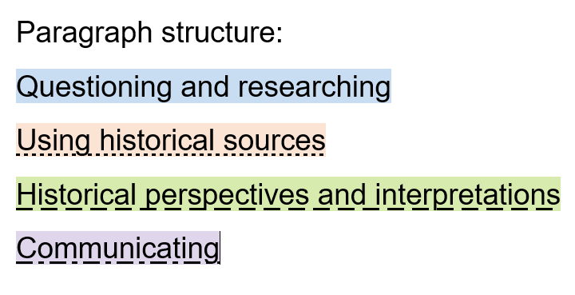
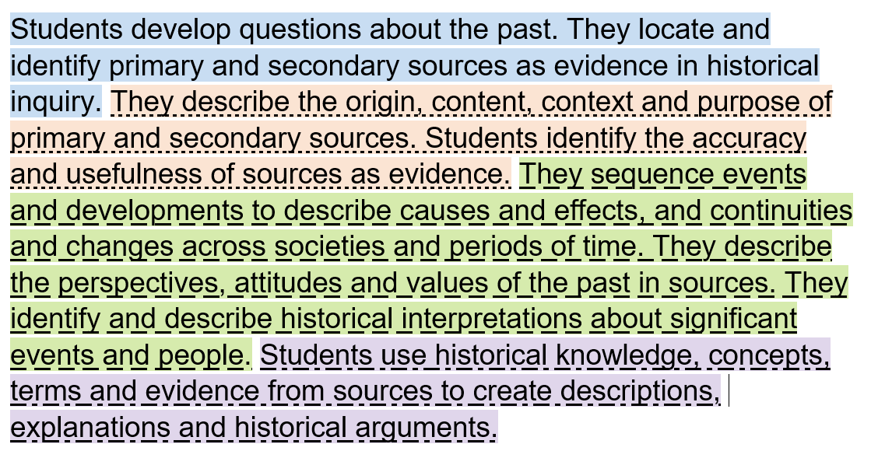
Achievement standard structure: Skills
Year 7 History example:
Notes:
The Skills paragraph does have a consistent structure across all year levels.
This example from Year 7 History illustrates how the four Skills sub-strands are used to organise this paragraph in the achievement standard. This model is replicated across the suite of HASS subjects.
Source: https://v9.australiancurriculum.edu.au/f-10-curriculum/learning-areas/history-7-10/year-7?view=quick&detailed-content-descriptions=0&hide-ccp=0&hide-gc=0&side-by-side=1&strands-start-index=0

Slide 43
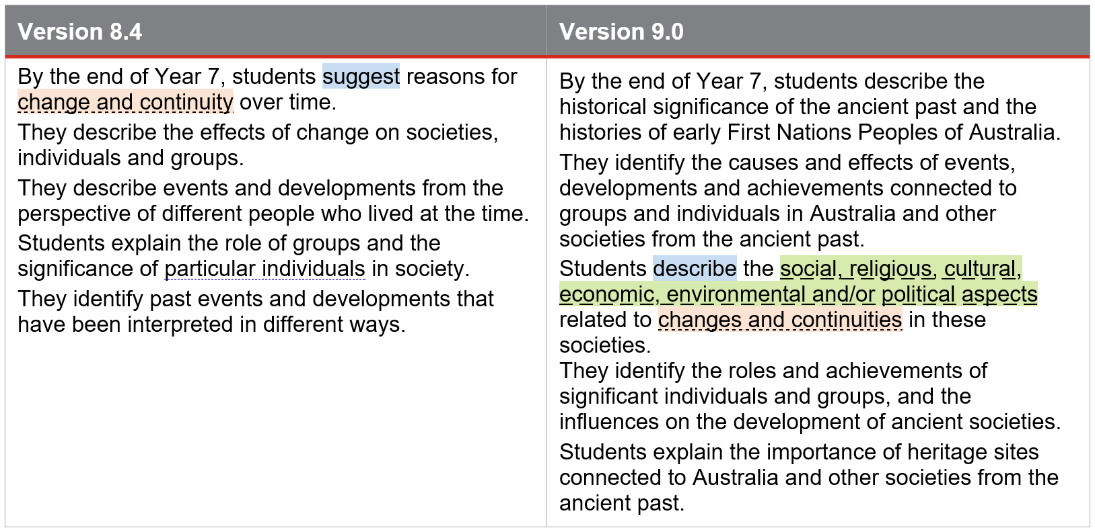
Achievement standard structure: Language
Notes:
A close read of the language in the achievement standard in Versions 8.4 and 9.0 can help schools to identify things they need to think about when aligning programs to Version 9.0 of the History curriculum.
For example, on screen is the Year 7 History Knowledge and understanding paragraph that has been split up into separate sentences to enable examination of the alignment, sentence by sentence. The following example shows how one sentence may be unpacked.
Start by identifying the cognitions used (in blue). In Version 8.4 students are required to ‘suggest’ reasons for change and continuity over time. In Version 9.0 students are required to ‘describe’, which is a different cognitive process.
Next, both sentences still focus on the concept of changes and continuities (highlighted in orange).
However, the specificity differs from Version 8.4 to Version 9.0 with some additions to the Version 9.0 sentence. Highlighted in green, students describe aspects related to changes and continuities that could be categorised as ‘social, religious, cultural, economic, environmental and/or political aspects’.
Identifying where there are differences in the cognitions or the specific focus in versions 8.4 and 9.0 of the achievement standards can be a useful way to identify new elements that need to be considered in planning for Version 9.0.
Source: https://v9.australiancurriculum.edu.au/f-10-curriculum/learning-areas/history-7-10/year-7?view=quick&detailed-content-descriptions=0&hide-ccp=0&hide-gc=0&side-by-side=1&strands-start-index=0

Slide 44
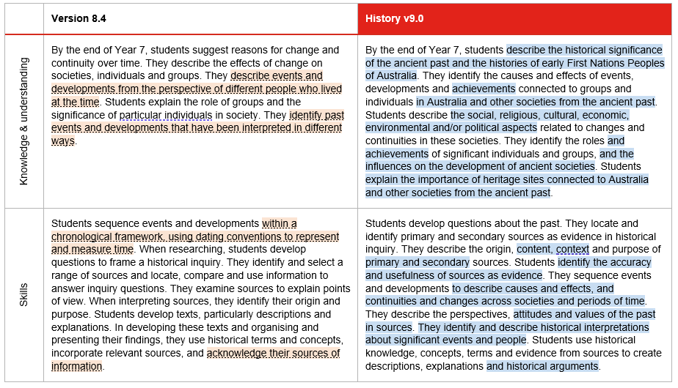
Achievement standard: changes
Notes:
Another way schools can work through the changes to the History achievement standard is to use two different highlight colours to identify what has been added to the achievement standard.
Continuing with the Year 7 example, on the left, in orange shading, are those aspects from Version 8.4 that no longer appear in the Version 9.0 achievement standard. By examining content shaded in orange, schools can consider the implications for teaching and learning, and assessment.
On the right, shaded in blue, are those aspects that have been added in Version 9.0.
When reviewing teaching and learning programs, and assessment, these new aspects will need to be addressed.
Source: https://v9.australiancurriculum.edu.au/f-10-curriculum/learning-areas/history-7-10/year-7?view=quick&detailed-content-descriptions=0&hide-ccp=0&hide-gc=0&side-by-side=1&strands-start-index=0

Slide 45
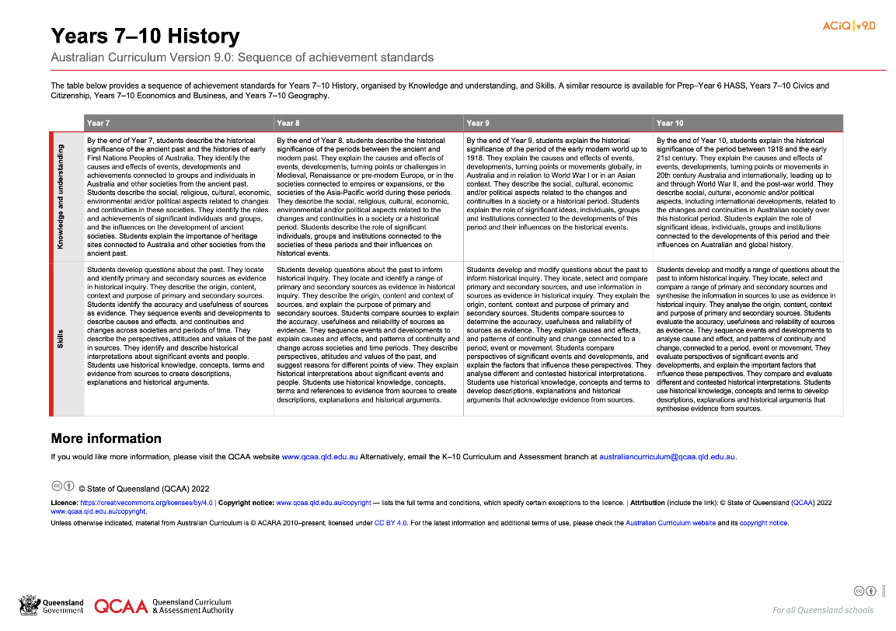
HASS: Achievement standard structure
www.qcaa.qld.edu.au/downloads/aciqv9/humanities-and-social-sciences/curriculum/ac9_hass_geog_yr7-10_as_sequence.pdf
Notes:
On the QCAA website, there is a resource illustrating the sequence of achievement standards from Years 7‒10. There is a similar resource for HASS in Prep–Year 6.

Slide 46
Organisation of History
HASS
Version 9.0
History
Version 9.0
Understand this learning area
Introduction
Rationale
Aims
Structure
Key considerations
Key connections
Resources
Understand this subject
Rationale
Aims
Structure
Key considerations
Curriculum elements
Level description
Achievement standard
Strands and sub-strands
Content descriptions
Content elaborations
Strands and sub-strands
Content descriptions
Content elaborations
Notes:
The final section of Curriculum elements provides further information regarding the content descriptions in the strands and sub-strands which inform teaching and learning and assessment.
Content descriptions specify the knowledge, understanding and skills that students learn and that teachers are expected to teach. The content elaborations provide optional examples of how to teach the content descriptions.
Source: Image created in house using SmartArt. Adapted https://v9.australiancurriculum.edu.au/teacher-resources/understand-this-learning-area/humanities-and-social-sciences.

Slide 47
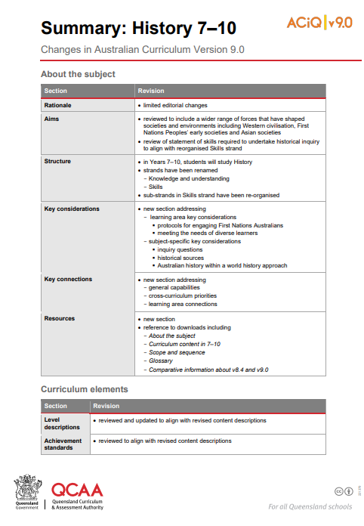
Summary: History 7–10
Summary of changes resource for History is available on the QCAA website.
Notes:
A summary of the changes to the content descriptions in Version 9.0 that is specific to History is available on the QCAA website.

Slide 48
Changes to content descriptions
significantly reduced the number of content descriptions
many content descriptions from v8.4 have been refined or combined in v9.0
common set of content descriptions for the selection of topics within a sub-strand
  The ancient world (Year 7)
  Medieval Europe and the early modern world (Year 8)
  Empires and expansions (Year 8)
  Asia-Pacific world (Year 8).
Notes:
As detailed earlier in the presentation, in History the most significant change is at the sub-strand level.
Because two Knowledge and understanding sub-strands are taught each year in Version 9.0 (as compared to three depth studies and an overview each year in Version 8.4), the number of Knowledge and understanding content descriptions to be taught has reduced significantly.
For History, many of the Version 8.4 content descriptions have been refined or combined in Version 9.0.
Where there is a topic choice within a sub-strand in Years 7 and 8, there is a set of common content descriptions that are applied to whichever topic is chosen for study.

Slide 49
Outline
Introduction to Australian Curriculum v9.0: History
Understand this learning area and subject
Formulating next steps
Curriculum elements

Slide 50

Australian Curriculum in Queensland (ACiQ) v9.0 webpages
QCAA website www.qcaa.qld.edu.au/p-10/aciq
Notes:
Resources to support the Australian Curriculum Version 9.0 can be found within the Australian Curriculum in Queensland Version 9.0 webpages.
These webpages only include resources that have been created or updated to align with Version 9.0.
Source: Screenshot from QCAA website https://www.qcaa.qld.edu.au/p-10/aciq.

Slide 51
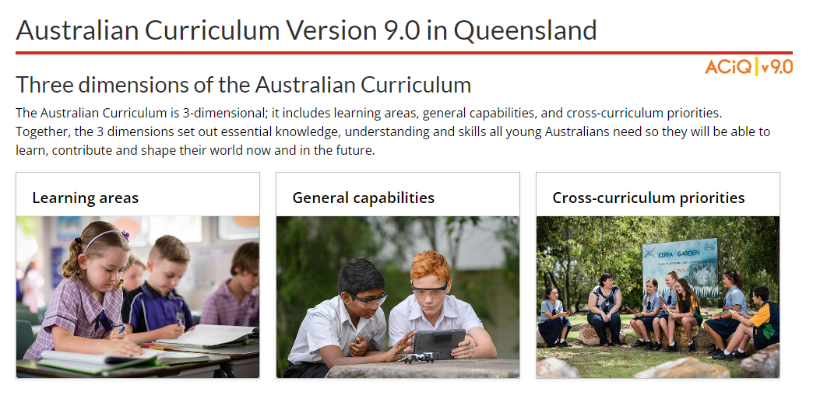
The ACiQ v9.0 webpages
These webpages house advice and resources to support the three dimensions of the Australian Curriculum:
Learning areas
General capabilities
Cross-curriculum priorities.
Notes:
The Version 9.0 webpages support familiarisation with all three dimensions of the curriculum.
Teachers can access advice and resources for their learning area and/or subject, or the general capabilities, and the cross-curriculum priorities.
Source: Screenshot from QCAA website www.qcaa.qld.edu.au/p-10/aciq/version-9.

Slide 52
Examples of QCAA resources for History
Summary of changes in AC v9.0: 7–10 History
Sequence of achievement standards
Sequence of content descriptions
Achievement standard aligned to content descriptions (P–10)
Prepopulated curriculum and assessment plans
Assessment techniques and conditions (P–10)
Standards elaborations
QCAA P–10 Planning app
Notes:
On screen is a snapshot of some of the History resources. These resources have been hyperlinked in the slide.

Slide 53
Learning goal
Understand the implications of changes in the Years 7–10 Australian Curriculum from v8.4 to v9.0: History for planning.
Success criteria
You will know you are successful if you:
have more knowledge about the intent and structure of the Years 7–10 Australian Curriculum v9.0: History
can identify actions for planning in your school.

Slide 54
Contact
K–10 Curriculum and Assessment Branch​
​
T +61 7 3120 6102
E australiancurriculum@qcaa.qld.edu.au
W www.qcaa.qld.edu.au
Notes:
If you have any queries regarding Australian Curriculum v9.0: History, please contact the K‒10 Curriculum and Assessment Branch.
​

Slide 55
References
Australian Curriculum, Assessment and reporting Authority 2013, The Shape of the Australian Curriculum Version 4.0, https://docs.acara.edu.au/resources/The_Shape_of_the_Australian_Curriculum_v4.pdf

Slide 56
Acknowledgments
Third-party copyright material, and QCAA material not covered by the CC BY licence is listed below:
Queensland Government coat of arms, and the QCAA and QSA trademarks may not be reproduced without permission.
Unless otherwise indicated, material from Australian Curriculum is © ACARA 2010–present, licensed CC BY 4.0. For the latest information and additional terms of use, see the Australian Curriculum website and its copyright notice.
Acknowledgment of Country artwork (2023) ‘Growth through Learning’ by Chern’ee, Brooke and Jesse Sutton, Kalkadoon. www.cherneesutton.com.au
Student and staff images have been used with permission.
The three-dimensional curriculum diagram and glossary are 'Excluded Material' used under the terms of the Australian Curriculum and its copyright notice and not modified. © Australian Curriculum, Assessment and Reporting Authority (ACARA) 2009 to present, unless otherwise indicated. You may view, download, display, print, reproduce (such as by making photocopies) and distribute these Excluded Materials in unaltered form only for your personal, non-commercial educational purposes or for the non-commercial educational purposes of your organisation, provided that you make others aware it can only be used for these purposes and attribute ACARA as the source of the Excluded Material. For the avoidance of doubt, this means that you cannot edit, modify or adapt any of these materials, and you cannot sub-licence any of these materials to others. Apart from any uses permitted under the Copyright Act 1968 (Cth), and those explicitly granted above, all other rights are reserved by ACARA.

Slide 57
Copyright notice
© State of Queensland (QCAA) 2024
Licence: https://creativecommons.org/licenses/by/4.0 | Copyright notice: www.qcaa.qld.edu.au/copyright — lists the full terms and conditions, which specify certain exceptions to the licence. |
Attribution: © State of Queensland (QCAA) 2024 www.qcaa.qld.edu.au/copyright.
Other copyright material in this presentation is listed on the previous slide/s.

Slide 58
QCAA social media
Notes:
If you don’t do so already, we recommend you follow QCAA on one or more social media platforms to stay in touch with us, and to find out about upcoming resources and professional learning.

