Slide 1
Familiarisation and planning
240887
Australian Curriculum v9.0: Economics and Business — Years 7–10
Notes:
This presentation is designed to introduce curriculum leaders and teachers to the Australian Curriculum Version 9.0: Economics and Business — Years 7‒10.

Slide 2
Acknowledgment of Country
Notes:
Acknowledgment of Country
The QCAA acknowledges the Traditional Owners and Traditional Custodians of the lands on which we meet today.
We pay our respects to their Elders and their descendants, who continue cultural and spiritual connections to Country, and we extend that respect to Aboriginal people and Torres Strait Islander people here today.
We thank them for sharing their cultures and spiritualities and recognise the important contribution of this knowledge to our understanding of this place we call home.

Slide 3
Learning goal
Understand the implications of changes in the Years 7–10 Australian Curriculum from v8.4 to v9.0: Economics and Business for planning.
Success criteria
You will know you are successful if you:
have more knowledge about the intent and structure of the Years 7–10 Australian Curriculum v9.0: Economics and Business
can identify actions for planning in your school.

Slide 4
Outline
Introduction to the Australian Curriculum v9.0: Economics and Business
Understand this learning area and subject
Formulating next steps
Curriculum elements

Slide 5
Outline
Introduction to the Australian Curriculum v9.0: Economics and Business
Understand this learning area and subject
Formulating next steps
Curriculum elements

Slide 6
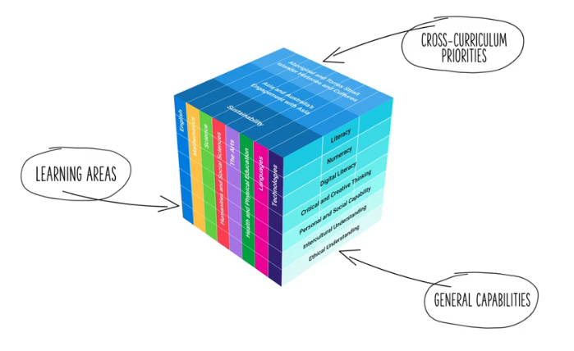
HASS in the three-dimensional Australian Curriculum
Source: ACARA, www.australiancurriculum.edu.au/help/website-tour
Notes:
In the Australian Curriculum Version 9.0, the three-dimensional interrelated structure has not changed as part of the review. The diagram visually represents these three dimensions.
Source: Script and picture adapted (addition of labels) from video at www.v9.australiancurriculum.edu.au/help/website-tour (time stamp 50 seconds).

Slide 7
HASS in the three-dimensional Australian Curriculum
Source: ACARA, www.v9.australiancurriculum.edu.au/help/website-tour
Notes:
The Australian Curriculum consists of eight learning areas. Economics and Business which is part of the Humanities and Social Sciences (HASS) learning area is indicated in red.
Source: Script and picture adapted (addition of labels) from video at www.v9.australiancurriculum.edu.au/help/website-tour (time stamp 50 seconds).

Slide 8
HASS in the three-dimensional Australian Curriculum
Source: ACARA, www.v9.australiancurriculum.edu.au/help/website-tour
Notes:
There are seven general capabilities:
Literacy
Numeracy
Digital literacy
Critical and creative thinking
Personal and social capability
Intercultural understanding, and
Ethical understanding.
As part of the review, the general capabilities have been refined.
The Information, Communications and Technologies (ICT) general capability in v8.4 has been renamed Digital literacy in v9.0 to reflect current understandings in the field.
The Literacy and Numeracy general capabilities are no longer continua. In v9.0 they are progressions representing the fine-grained indicators of the typical trajectory of literacy and numeracy development.
The remaining general capabilities have had refinements to elements, sub-elements and continua.
Source: Script and picture adapted (addition of labels) from video at www.v9.australiancurriculum.edu.au/help/website-tour (time stamp 50 seconds).

Slide 9
HASS in the three-dimensional Australian Curriculum
Source: ACARA, https://v9.australiancurriculum.edu.au/help/website-tour
Notes:
There are three cross-curriculum priorities:
Aboriginal and Torres Strait Islander Histories and Cultures
Asia and Australia’s engagement with Asia, and
Sustainability.
Source: Script and picture adapted (addition of labels) from video at www.v9.australiancurriculum.edu.au/help/website-tour (time stamp 50 seconds).

Slide 10
Organisation of Learning areas and changes
Version 8.4
Version 9.0
Understand how the learning area works
Rationale
Aims
Key ideas
Structure
Resources (learning area specific)
Understand this learning area
Introduction
Rationale
Aims
Structure
Key considerations
Key connections
Resources
Learning area curriculum
Year level description
Achievement standard
Strands and sub-strands
Content descriptions
Threads (learning area specific)
Content elaborations
Curriculum elements
Level description
Achievement standard
Strands and sub-strands
Content descriptions
Content elaborations
Notes:
This is an overview of the organisation of all Learning areas in the Australian Curriculum Version 8.4 compared to Version 9.0, with the main changes noted.
The following slides show the organisation as it applies specifically to the HASS learning area, and the the subject, Economics and Business.
Source: Image created in house using SmartArt. Adapted from https://v9.australiancurriculum.edu.au/teacher-resources/understand-this-learning-area/humanities-and-social-sciences.

Slide 11
Organisation of HASS learning area and changes
Humanities and Social Sciences (HASS)
Version 9.0
Economics and Business
Version 9.0
Understand this learning area
Introduction
Rationale
Aims
Structure
Key considerations
Key connections
Resources
Understand this subject
Rationale
Aims
Structure
Key considerations
Curriculum elements
Level description
Achievement standard
Strands and sub-strands
Content descriptions
Content elaborations
Notes:
In the HASS learning area, there is a two-tier structure.
Source: Image created in house using SmartArt. Adapted from https://v9.australiancurriculum.edu.au/teacher-resources/understand-this-learning-area/humanities-and-social-sciences.

Slide 12
Organisation of HASS learning area and changes
HASS
Version 9.0
Economics and Business
Version 9.0
Understand this learning area
Introduction
Rationale
Aims
Structure
Key considerations
Key connections
Resources
Understand this subject
Rationale
Aims
Structure
Key considerations
Curriculum elements
Level description
Achievement standard
Strands and sub-strands
Content descriptions
Content elaborations
Notes:
First is the tier for HASS as a learning area called Understand this learning area. It outlines guiding principles of the HASS learning area and provides context for each of the subjects that sit within HASS.
In red, Key considerations and Key connections are new additions in the Australian Curriculum Version 9.0 for HASS.
Source: Image created in house using SmartArt. Adapted https://v9.australiancurriculum.edu.au/teacher-resources/understand-this-learning-area/humanities-and-social-sciences.

Slide 13
Organisation of Economics and Business and changes
HASS
Version 9.0
Economics and Business
Version 9.0
Understand this learning area
Introduction
Rationale
Aims
Structure
Key considerations
Key connections
Resources
Understand this subject
Rationale
Aims
Structure
Key considerations
Curriculum elements
Level description
Achievement standard
Strands and sub-strands
Content descriptions
Content elaborations
Notes:
In the second tier is information about the subject, in this case Economics and Business.
Understand this subject provides detail of the intent of the subject Economics and Business and a snapshot of the structure. In red is a new section, Key considerations, which includes those considerations specific to the subject, Economics and Business.
Curriculum elements provides the content required in Economics and Business, including the achievement standards and content descriptions.
Source: Image created in house using SmartArt. Adapted from https://v9.australiancurriculum.edu.au/teacher-resources/understand-this-learning-area/humanities-and-social-sciences.

Slide 14
Outline
Introduction to Australian Curriculum v9.0: Economics and Business
Understand this learning area and subject
Formulating next steps
Curriculum elements

Slide 15
Organisation of HASS learning area
HASS
Version 9.0
Economics and Business
Version 9.0
Understand this learning area
Introduction
Rationale
Aims
Structure
Key considerations
Key connections
Resources
Introduction
Rationale
Aims
Understand this subject
Rationale
Aims
Structure
Key considerations
Curriculum elements
Level description
Achievement standard
Strands and sub-strands
Content descriptions
Content elaborations
Notes:
In Version 9 the introduction includes information about the 5 subjects that comprise the HASS learning area:
P–6 HASS
Civics and Citizenship
Economics and Business
Geography
History.
The rationale and aims capture the intent of teaching HASS and inform teachers’ planning in a school context.
Source: Image created in house using SmartArt. Adapted from https://v9.australiancurriculum.edu.au/teacher-resources/understand-this-learning-area/humanities-and-social-sciences.

Slide 16
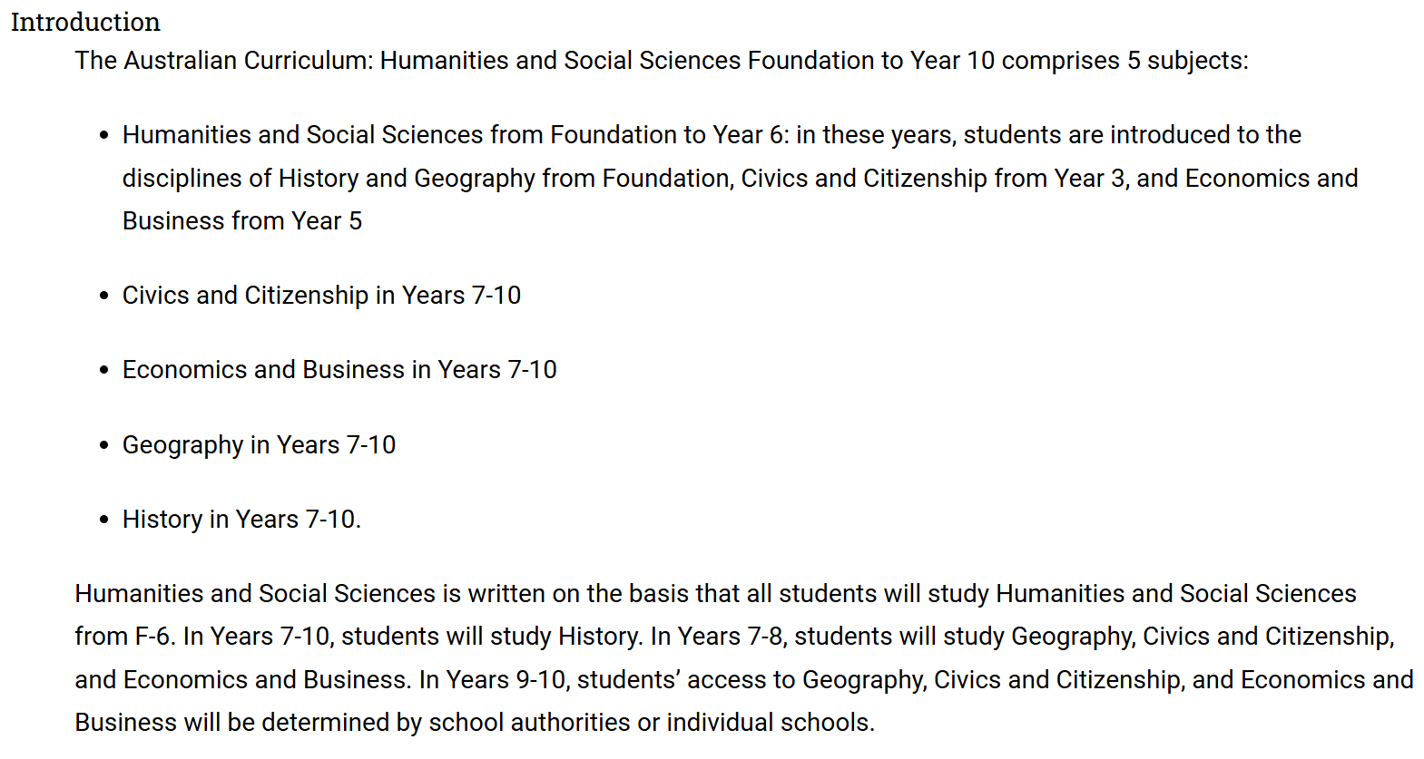
Organisation of HASS learning area
Source: Quoted verbatim and unaltered from AC https://v9.australiancurriculum.edu.au/teacher-resources/understand-this-learning-area/humanities-and-social-sciences
Notes:
The introduction in Understand this learning area also describes the learning entitlement in HASS.

Slide 17
Organisation of HASS learning area
HASS
Version 9.0
Economics and Business
Version 9.0
Understand this learning area
Introduction
Rationale
Aims
Structure
Key considerations
Key connections
Resources
Understand this subject
Rationale
Aims
Structure
Key considerations
Structure
Curriculum elements
Level description
Achievement standard
Strands and sub-strands
Content descriptions
Content elaborations
Notes:
The section on structure includes information about the strands and sub-strands in the HASS learning area.
Source: Image created in house using SmartArt. Adapted https://v9.australiancurriculum.edu.au/teacher-resources/understand-this-learning-area/humanities-and-social-sciences.

Slide 18
Structure of HASS learning area: strands
Version 8.4 | Version 9.0
Knowledge and understanding | Knowledge and understanding
Inquiry and skills | Skills
Notes:
In HASS in Version 9.0, all subjects continue to be organised through strands and sub-strands. The two, interrelated strands in Version 9.0 are:
Knowledge and understanding and
Skills.
This is a small change from Version 8.4. Inquiry is now incorporated into the sub-strands as a skill.

Slide 19
Structure of Knowledge and understanding strand across the HASS learning area
History |  | Geography |  | Civics and Citizenship |  | Economics and Business
Two to four sub-strands per year level |  | Two sub-strands per year level |  | Three sub-strands per year level |  | No sub-strands
Some sub-strands are required |  | All sub-strands are required |  | All sub-strands are required |  | All content descriptions in the strand are required
Selection of topics within each sub-strand
Economics and Business v9.0
Economics and Business v9.0
Notes:
The Knowledge and understanding strand in the v9.0 HASS learning area contains varying numbers of sub-strands depending on the subject.
For example, there are different requirements across the subjects regarding what sub-strands are expected to be studied in a school’s program.
It is important to note that in Economics and Business there are no Knowledge and understanding sub-strands, only content descriptions — and all of the content descriptions are taught. This is a change from version 8.4 where the Knowledge and understanding strand comprised four key organising ideas: resource allocation and making choices; the business environment; consumer and financial literacy; and work and work futures. While they no longer appear as part of the strand structure, the concepts are embedded across the Years 7–10 curriculum.
Source: Adapted from https://v9.australiancurriculum.edu.au/teacher-resources/understand-this-learning-area/humanities-and-social-sciences. Image created in house using SmartArt.

Slide 20
Structure of Skills strand across the HASS learning area
— Sub-strands — | History |  | Geography |  | Civics and Citizenship |  | Economics and Business
 | Questioning and researching |  | Questioning and researching using geographical methods |  | Questioning and researching |  | Questioning and researching
 | Using historical sources |  | Interpreting and analysing geographical data and information |  | Analysis, evaluation and interpretation |  | Interpreting and analysing
 | Historical perspectives and interpretations |  | Concluding and decision-making |  | Civic participation and decision-making |  | Evaluating, concluding and decision-making
 | Communicating |  | Communicating |  | Communicating |  | Communicating
Notes:
Strands are organised into sub-strands depending on the subject.
For example, on this slide you can see that there is now a consistent number of sub-strands in the Skills strand across the suite of Years 7‒10 HASS subjects.
In each HASS subject, there are four Skills sub-strands. These vary depending on the nature of the subject; however, there are certain skills, Questioning and researching and Communicating, that are common to all subjects.
In addition, there are some similarities in the grouping of cognitions in the second and third skills sub-strands.

Slide 21
Organisation of HASS learning area
HASS
Version 9.0
Economics and Business
Version 9.0
Understand this learning area
Introduction
Rationale
Aims
Structure
Key considerations
Key connections
Resources
Understand this subject
Rationale
Aims
Structure
Key considerations
Key considerations
Key connections
Resources
Curriculum elements
Level description
Achievement standard
Strands and sub-strands
Content descriptions
Content elaborations
Notes:
The final section of Understand this learning area includes the key considerations, key connections and resources that provide further support and advice for teachers when planning for Version 9.0 in HASS.
Source: Image created in house using SmartArt. Adapted https://v9.australiancurriculum.edu.au/teacher-resources/understand-this-learning-area/humanities-and-social-sciences.

Slide 22
Key considerations for the HASS learning area
Protocols for
engaging
First Nations Australians
Meeting the
needs of diverse learners
Notes:
The key considerations is a new section in v9.0 consistent across all learning areas.
There are two new considerations in all learning areas which are Protocols for engaging First Nations Australians and Meeting the needs of diverse learners.
Subject-specific key considerations for Economics and Business will be discussed later.
Source: Image created in house using SmartArt based on https://v9.australiancurriculum.edu.au/teacher-resources/understand-this-learning-area/humanities-and-social-sciences.

Slide 23
Key connections
Learning
areas
General capabilities
Cross-curriculum priorities
Source: ACARA, www.v9.australiancurriculum.edu.au/help/website-tour
Notes:
The key connections in the curriculum support teachers to integrate HASS with other learning areas, embed relevant general capabilities and provide possible contexts for learning through the cross-curriculum priorities.
This integration can enrich and deepen student engagement with learning area content.
These connections should only be considered when they provide appropriate and authentic opportunities to strengthen learning area content.

Slide 24
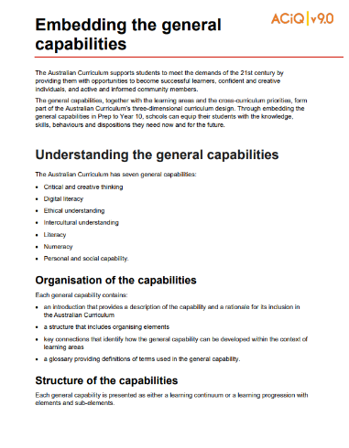
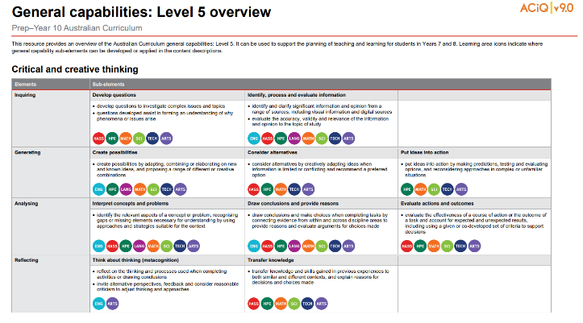
General capabilities advice and resources
https://www.qcaa.qld.edu.au/p-10/aciq/version-9/general-capabilities
Notes:
The QCAA has resources that identify the connections the Australian Curriculum has made between learning areas and the general capabilities.
The general capability level overviews provide an overview of where each general capability can be developed or applied in the content descriptions of the learning areas. For example, the general capability Level 5 and Level 6 align with Years 7–10 learning areas.
The continua resources are available for the general capabilities:
critical and creative thinking
digital literacy
ethical understanding
intercultural understanding, and
personal and social capability.
There are resources available that provide a sequence of learning for the capability from Level 1 to Level 6. This can be helpful for teachers when catering for students with diverse needs.
The QCAA has advice documents to support teachers to use the Literacy and Numeracy progressions. These progressions provide observable indicators of increasing complexity in literacy and numeracy which can help teachers to develop targeted teaching and learning programs for students who are working at, above and below year-level expectations.
These resources can support teaching teams to interrogate connections between the general capabilities and the learning area content in more detail.

Slide 25

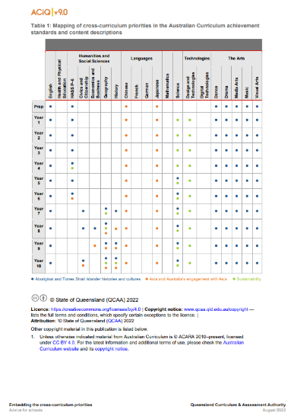
Cross-curriculum priorities advice and resources
www.qcaa.qld.edu.au/p-10/aciq/version-9/cross-curriculum-priorities
Notes:
The QCAA has resources to support schools with understanding how to connect the curriculum with cross-curriculum priorities.
Cross-curriculum priorities are incorporated through learning area content, in ways that are appropriate and authentic. The resources provide an overview of, as well as mapping across learning area and/or subject content descriptions and achievement standards to identify connections to each of the cross-curriculum priorities. ​

Slide 26
Organisation of Economics and Business
HASS
Version 9.0
Economics and Business
Version 9.0
Understand this learning area
Introduction
Rationale
Aims
Structure
Key considerations
Key connections
Resources
Understand this subject
Rationale
Aims
Structure
Key considerations
Rationale
Aims
Curriculum elements
Level description
Achievement standard
Strands and sub-strands
Content descriptions
Content elaborations
Notes:
The subject organisation varies slightly from the Understand this learning area section of the curriculum.
The subject-specific rationale and aims capture the intent of teaching Economics and Business and inform teachers’ planning in a school context. For example, Economics and Business develops the knowledge, understanding and skills that will equip students to shape their social and economic futures through fostering enterprising individuals who can effectively embrace change; seek innovation; work with others; show initiative, flexibility and leadership; plan, organise and manage risk; and use resources efficiently.
Source: Image created in house using SmartArt. Adapted https://v9.australiancurriculum.edu.au/teacher-resources/understand-this-learning-area/humanities-and-social-sciences.

Slide 27
Organisation of Economics and Business
HASS
Version 9.0
Economics and Business
Version 9.0
Understand this learning area
Introduction
Rationale
Aims
Structure
Key considerations
Key connections
Resources
Understand this subject
Rationale
Aims
Structure
Key considerations
Structure
Curriculum elements
Level description
Achievement standard
Strands and sub-strands
Content descriptions
Content elaborations
Notes:
While there are some consistent structural elements across the learning area (e.g. strands for Knowledge and understanding, and Skills), schools also need to consider the structure of the sub-strands for each subject.
Source: Image created in house using SmartArt. Adapted https://v9.australiancurriculum.edu.au/teacher-resources/understand-this-learning-area/humanities-and-social-sciences.

Slide 28
Structure of Skills strand: v8.4 to v9.0
— Sub-strands — | Economics and Business v8.4
 | Questioning and research |  | Questioning and researching
 | Interpretation and analysis |  | Interpreting and analysing
 | Economic reasoning, decision-making and application |  | Evaluating, concluding and decision-making
 | Communication and reflection |  | Communicating
Economics and Business v9.0
Notes:
The structure of the Skills strand still maintains four sub-strands; however, there have been some revisions.
Highlighted in red are the revised Skills sub-strands for Version 9.0 of Economics and Business compared to Version 8.4.
While there are some refinements at the content description level to the Questioning and researching sub-strand and the Interpreting and analysing sub-strand, the substance of these two sub-strands remains similar to Version 8.4.
The third sub-strand has the most changes. While students are still developing responses to economics and business issues in this sub-strand, the change in cognitions signals a revision in Version 9.0. The changes at the content description level are discussed later in the presentation, but as an example, students are no longer required to generate alternatives or options in response to issues in this sub-strand in Version 9.
Finally, the reflection component of the final sub-strand has been removed.

Slide 29
Organisation of Economics and Business
HASS
Version 9.0
Economics and Business
Version 9.0
Understand this learning area
Introduction
Rationale
Aims
Structure
Key considerations
Key connections
Resources
Understand this subject
Rationale
Aims
Structure
Key considerations
Key considerations
Curriculum elements
Level description
Achievement standard
Strands and sub-strands
Content descriptions
Content elaborations
Notes:
The final section of Understand this subject provides further support and advice for teachers when planning for Version 9.0 in Economics and Business.
Source: Image created in house using SmartArt. Adapted https://v9.australiancurriculum.edu.au/teacher-resources/understand-this-learning-area/humanities-and-social-sciences.

Slide 30
Key considerations for Economics and Business
Inquiry questions
Selecting contexts for study
Developing consumer and financial literacy capability
Protocols for
engaging
First Nations Australians
Meeting the
needs of diverse learners
An integrated approach to planning a teaching and learning program
Notes:
On screen are the key considerations that inform teaching and learning in Economics and Business.
Inquiry as a pedagogical approach is valued across the HASS subjects. Inquiry questions provides a framework for developing students’ knowledge and understanding and skills. Teachers may develop inquiry questions to guide units of work and several inquiry questions are provided in the curriculum for each year level. These are examples only, but schools may find them useful for planning. In Economics and Business, students also learn how to develop questions to guide investigations into economics and business issues.
The next consideration is Selecting contexts for study. Here, the Economics and Business curriculum encourages contexts for study that offer students opportunities to make connections between the context focuses in the level descriptions and the economic and business issues that are occurring in the students’ local area, Australia, the significant nations of Asia, and the world.
The next consideration is about providing opportunities to develop students’ consumer and financial literacy, suggesting that learning experiences and resources can offer real-world consumer and financial situations to support this.
With the fourth consideration in red, advice is offered around the need to develop Economics and Business knowledge, understandings and skills in an integrated way. At each year level, some content descriptions develop economics concepts and principles, while other content descriptions apply these concepts to work and business environments as well as consumer and financial contexts.
As explained previously, the two key considerations in grey are common to all HASS subjects and all learning areas.
Source: Image created in house using SmartArt based on https://v9.australiancurriculum.edu.au/teacher-resources/understand-this-learning-area/humanities-and-social-sciences#economics-and-business-7-10.

Slide 31
Outline
Introduction to Australian Curriculum v9.0: Economics and Business
Understand this learning area and subject
Formulating next steps
Curriculum elements

Slide 32
Organisation of Economics and Business
HASS
Version 9.0
Economics and Business
Version 9.0
Understand this learning area
Introduction
Rationale
Aims
Structure
Key considerations
Key connections
Resources
Understand this subject
Rationale
Aims
Structure
Key considerations
Curriculum elements
Level description
Achievement standard
Strands and sub-strands
Content descriptions
Content elaborations
Level description
Achievement standard
Notes:
The Economics and Business level description in the Curriculum elements section provides a high-level overview of the learning students should experience each year. The level descriptions also provide some possible inquiry questions that teachers can use to structure their units of work. These are examples only.
In Queensland, the achievement standard represents the C standard (or equivalent).
Source: Image created in house using SmartArt. Adapted https://v9.australiancurriculum.edu.au/teacher-resources/understand-this-learning-area/humanities-and-social-sciences.

Slide 33
Achievement standard structure
 | Version 8.4 | Version 9.0
Knowledge & understanding | By the end of Year 9, students explain the role of the Australian economy in allocating and distributing resources, and analyse the interdependence of participants in the global economy. They explain the importance of managing financial risks and rewards and analyse the different strategies that may be used. They explain why businesses seek to create a competitive advantage, including through innovation, and evaluate the strategies that may be used. Students analyse the roles and responsibilities of participants in the workplace. | By the end of Year 9, students explain the role of Australia’s financial sector and its effect on economic decision-making by individuals and businesses. They explain the interdependence of participants in the global market and the effect on economic decision-making. They explain the reasons for trade and Australia’s pattern of trade with Asia. They explain why businesses seek to create and maintain a competitive advantage. Students explain how individuals and businesses manage consumer and financial risks and rewards.
Skills | When researching, students develop questions and simple hypotheses to frame an investigation of an economic or business issue. They gather and analyse relevant data and information from different sources to answer questions, identify trends and explain relationships. Students generate alternative responses to an issue and use cost-benefit analysis and appropriate criteria to propose a course of action. They apply economics and business knowledge, skills and concepts to familiar, unfamiliar and hypothetical problems. Students develop and present evidence-based conclusions and reasoned arguments using appropriate texts, subject-specific language and concepts. They analyse the effects of economic and business decisions and the potential consequences of alternative actions. | Students develop and modify questions to investigate an economic and business issue. They locate, select and analyse information and data from a range of sources. They interpret and analyse information and data to explain economic trends and cause-and-effect relationships, and identify consumer and financial impacts. They develop a response to an economic and business issue, taking account of economic, business or financial factors. They evaluate a response using criteria and make decisions about how it is to be implemented. Students use economic and business knowledge, concepts and terms to develop descriptions, explanations and arguments that acknowledge research findings.
Notes:
The organisation of the achievement standards remains the same in Version 9.0 of the Economics and Business curriculum.
The achievement standard for Year 9 Economics and Business illustrates the same two-paragraph structure: Knowledge and understanding first, following by a Skills paragraph.
However, the wording within each paragraph has changed to align with revised content descriptions in Version 9.0 of the Economics and Business curriculum.
Across the Humanities and Social Sciences subjects the achievement standards have been revised for all year levels.
Source: https://v9.australiancurriculum.edu.au/f-10-curriculum/learning-areas/economics-and-business-7-10/year-9?view=quick&detailed-content-descriptions=0&hide-ccp=0&hide-gc=0&side-by-side=1&strands-start-index=0

Slide 34
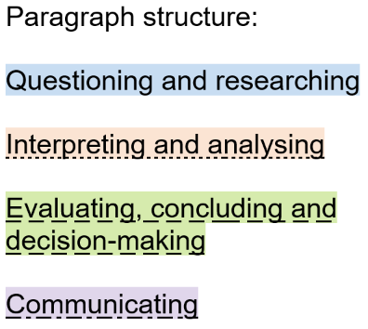
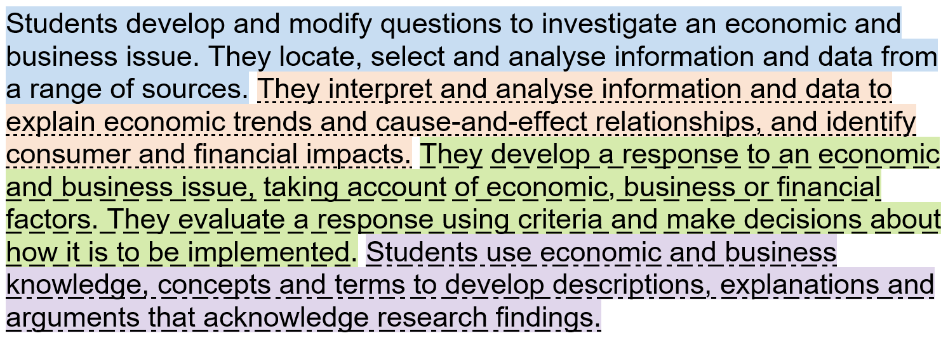
Achievement standard structure: Skills
Year 9 Economics and Business example:
Notes:
While the Knowledge and understanding paragraph in the achievement standards in Economics and Business is structured according to the subject matter in the Knowledge and understanding content descriptions for each year level, the Skills paragraph does have a consistent structure across all year levels.
This example from Year 9 Economics and Business and illustrates how the four Skills sub-strands are used to organise this paragraph in the achievement standard. This model is replicated across the suite of HASS subjects.
Source: https://v9.australiancurriculum.edu.au/f-10-curriculum/learning-areas/economics-and-business-7-10/year-9?view=quick&detailed-content-descriptions=0&hide-ccp=0&hide-gc=0&side-by-side=1&strands-start-index=0

Slide 35
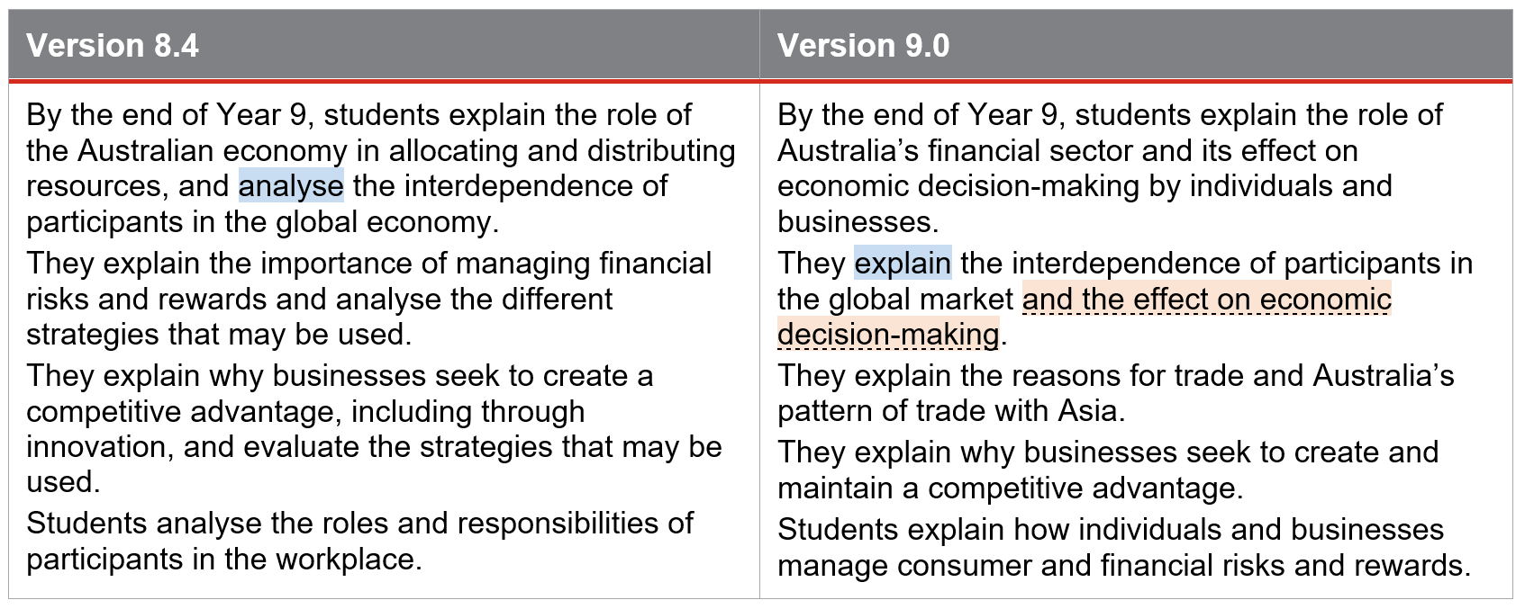
Achievement standard structure: Language
Notes:
A close read of the language in the achievement standard in Versions 8.4 and 9.0 can help schools to identify things they need to think about when aligning programs to Version 9.0 of the Economics and Business curriculum.
For example, on screen is the Year 9 Economics and Business Knowledge and understanding paragraph that has been split up into separate sentences to enable examination of the alignment, sentence by sentence. The following example shows how one sentence may be unpacked.
Start by identifying the cognitions used (in blue). In Version 8.4, students are required to ‘analyse’ the interdependence of participants, whereas in Version 9.0 students are required to ‘explain’.
While we’ve established both of these sentences refer to the interdependence of participants in the global economy or market, in Version 9.0 there is a new inclusion (in orange) where students also explain the effect of this interdependence on economic decision-making.
Identifying where there are differences in the cognitions or the specific focus in versions 8.4 and 9.0 of the achievement standards can be a useful way to identify new elements that need to be considered in planning for Version 9.0.
Source: https://v9.australiancurriculum.edu.au/f-10-curriculum/learning-areas/economics-and-business-7-10/year-9?view=quick&detailed-content-descriptions=0&hide-ccp=0&hide-gc=0&side-by-side=1&strands-start-index=0

Slide 36
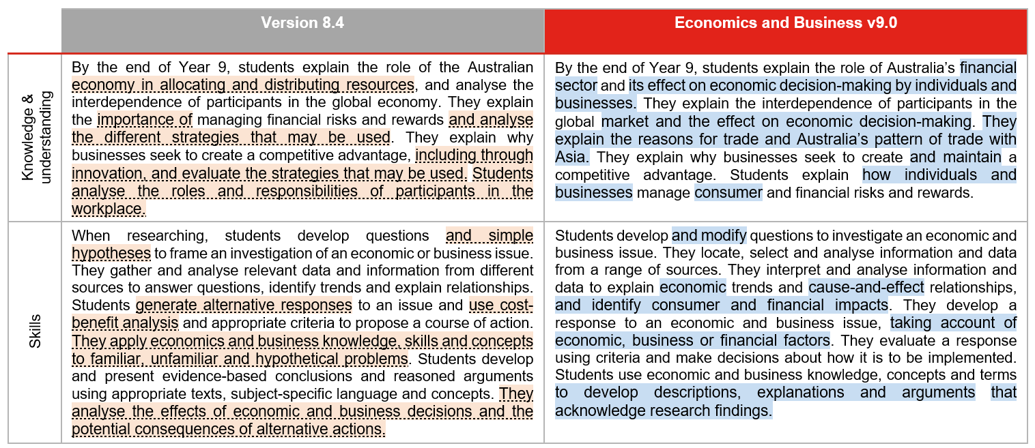
Achievement standard: changes
Notes:
Another way to work through the changes to the Economics and Business achievement standard is to use two different highlight colours to identify what has been removed and what has been added to the achievement standard. On screen is the Year 9 achievement standard.
On the left, in orange shading, are those aspects from Version 8.4 that no longer appear in the Version 9.0 achievement standard. By examining content shaded in orange, schools can consider the implications for teaching and learning, and assessment.
On the right, shaded in blue, are those aspects that have been added in Version 9.0.
When reviewing teaching and learning programs, and assessment, these new aspects will need to be addressed.
Source: https://v9.australiancurriculum.edu.au/f-10-curriculum/learning-areas/economics-and-business-7-10/year-9?view=quick&detailed-content-descriptions=0&hide-ccp=0&hide-gc=0&side-by-side=1&strands-start-index=0

Slide 37
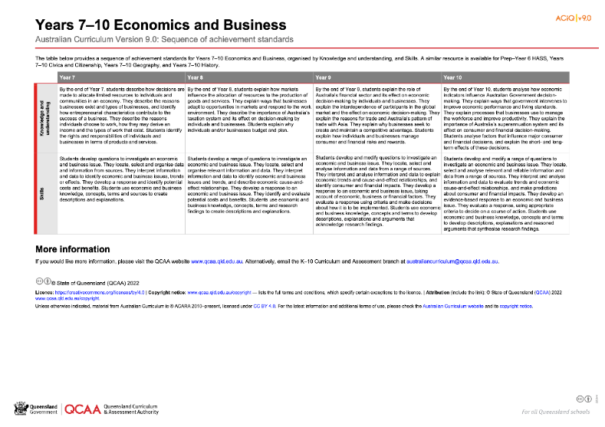
HASS: Achievement standard structure
www.qcaa.qld.edu.au/downloads/aciqv9/humanities-and-social-sciences/curriculum/ac9_hass_econ_bus_yr7-10_as_sequence.pdf
Notes:
On the QCAA website, there is a resource illustrating the sequence of achievement standards from Years 7‒10. There is a similar resource for HASS in Prep–Year 6.

Slide 38
Organisation of Economics and Business
HASS
Version 9.0
Economics and Business
Version 9.0
Understand this learning area
Introduction
Rationale
Aims
Structure
Key considerations
Key connections
Resources
Understand this subject
Rationale
Aims
Structure
Key considerations
Curriculum elements
Level description
Achievement standard
Strands and sub-strands
Content descriptions
Content elaborations
Strands and sub-strands
Content descriptions
Content elaborations
Notes:
The final section of Curriculum elements provides further information regarding the content descriptions in the strands and sub-strands which inform teaching and learning and assessment.
Content descriptions specify the knowledge, understanding and skills that students learn and that teachers are expected to teach. The content elaborations provide optional examples of how to teach the content descriptions.
Source: Image created in house using SmartArt. Adapted https://v9.australiancurriculum.edu.au/teacher-resources/understand-this-learning-area/humanities-and-social-sciences.

Slide 39
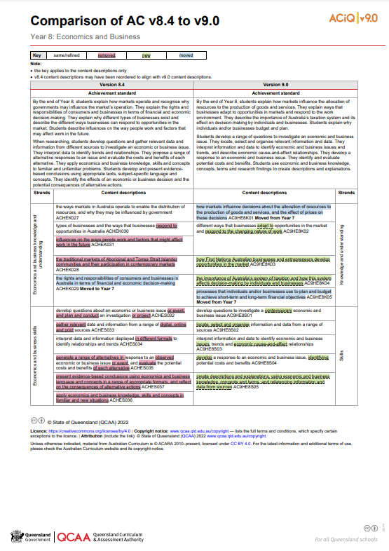
Comparison of AC v8.4 with v9.0 documents
One document for each year level is available on the QCAA website.
Notes:
The comparison documents show the changes to the content descriptions for Economics and Business.

Slide 40
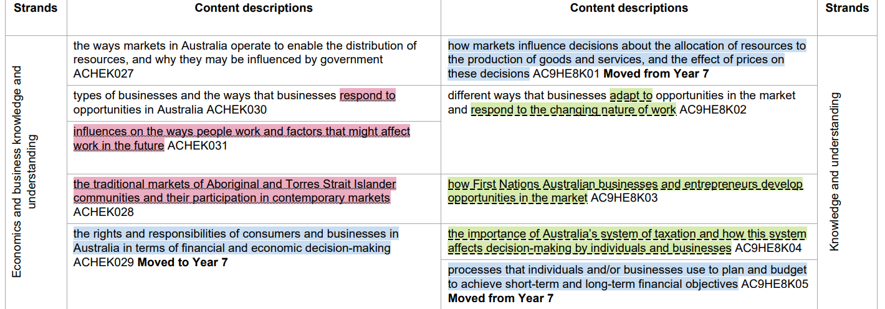
Comparison of AC v8.4 with v9.0 documents
Notes:
A key is used to show the changes from Version 8.4 to Version 9.0.
If something has been refined from Version 8.4, it does not appear in colour.

Slide 41
Removed content
Notes:
If a content description or part of a content description has been removed from Version 8.4 and no longer appears in Version 9.0, it has been highlighted in red.
For example, the content description in Version 8.4 about the ways people work and factors that might affect work in the future has been removed.

Slide 42
Removed content
Knowledge and Understanding | Year 9 | Changing roles and responsibilities of participants in Australian or global workplaces
Skills | Years 7/8 | Apply economics and business knowledge, skills and concepts in familiar and new situations
 | Years 9/10 | Apply economics and business knowledge, skills and concepts in familiar, new and hypothetical situations
 |  | Reflection on the intended and unintended consequences of economic and business decisions
Notes:
On this slide are some further examples of content that has been removed to reduce the amount or type of content to be studied.
The first row shows the content removed from the Knowledge and understanding strand in Year 9.
The remaining points are content descriptions removed from the Skills strand.

Slide 43
New content
Notes:
If a new content description has been added to Version 9.0, it has been highlighted in green.
For example, the new content description ‘how First Nations Australian businesses and entrepreneurs develop opportunities in the market’ has been added in Year 8.

Slide 44
New content descriptions
Year 8 | Australia’s system of taxation and how it can affect decision-making processes of individuals and businesses
Year 9 | The role of Australia’s financial sector and its effect on economic decision-making by individuals, businesses and global markets
Year 10 | The importance of Australia’s superannuation system and how this system affects consumer and financial decision-making
Notes:
On this slide are three new areas of content across Years 8–10 around Australia’s system of taxation, the role of Australia’s financial sector and Australia’s superannuation system.
Schools might consider whether there is an opportunity here for professional learning for the relevant teaching team.

Slide 45
Moved content
Notes:
If a content description has moved year levels from Version 8.4 to Version 9.0, it has been highlighted in blue. There is also a bold note to indicate the year level from or to which it has moved.
For example, subject matter from Year 7 in Version 8.4 has been moved to Year 8 in Version 9.0, including a content description about how markets influence decisions about the allocation of resources to the production of goods and services.

Slide 46
Moved content
Year 6 to Year 7 | Why opportunity cost exists as decisions are made to allocate limited resources to meet unlimited needs and wants
Year 6 to Year 7 | The reasons businesses exist and how different types of businesses provide goods and services
Year 8 to Year 7 | Rights and responsibilities of individuals and businesses in relation to consumer and financial products and services
Year 7 to Year 8 | Processes individuals and/or businesses use to plan and budget to achieve short-term and long-term financial objectives
Year 7 to Year 8 | How markets influence decisions about the allocation of resources to the production of goods and services, and the effect of prices on these decisions.
Notes:
On this slide are further examples of movement of content across year levels. These movements may require some refinement of existing teaching and learning resources for the age and stage of the learners to whom this content will now be delivered.

Slide 47
Outline
Introduction to Australian Curriculum v9.0: Economics and Business
Understand this learning area and subject
Formulating next steps
Curriculum elements

Slide 48

Australian Curriculum in Queensland (ACiQ) v9.0 webpages
QCAA website www.qcaa.qld.edu.au/p-10/aciq
Notes:
Resources to support the Australian Curriculum Version 9.0 can be found within the Australian Curriculum in Queensland Version 9.0 webpages.
These webpages only include resources that have been created or updated to align with Version 9.0.
Source: Screenshot from QCAA website www.qcaa.qld.edu.au/p-10/aciq.

Slide 49

The ACiQ v9.0 webpages
These webpages house advice and resources to support the three dimensions of the Australian Curriculum:
Learning areas
General capabilities
Cross-curriculum priorities.
Notes:
The Version 9.0 webpages support familiarisation with all three dimensions of the curriculum.
Teachers can access advice and resources for their learning area and/or subject, or the general capabilities, and the cross-curriculum priorities.
Source: Screenshot from QCAA website www.qcaa.qld.edu.au/p-10/aciq/version-9.

Slide 50
Examples of QCAA resources for Economics and Business
Comparison of AC v8.4 to v9.0 (P–10)
Sequence of achievement standards
Sequence of content descriptions
Achievement standard aligned to content descriptions (P–10)
Prepopulated curriculum and assessment plans
Assessment techniques and conditions (P–10)
Standards elaborations
QCAA P–10 Planning app
Notes:
On screen is a snapshot of some of the Economics and Business resources. These resources have been hyperlinked in the slide.

Slide 51
Learning goal
Understand the implications of changes in the Years 7–10 Australian Curriculum from v8.4 to v9.0: Economics and Business for planning.
Success criteria
You will know you are successful if you:
have more knowledge about the intent and structure of the Years 7–10 Australian Curriculum v9.0: Economics and Business
can identify actions for planning in your school.

Slide 52
Contact
K–10 Curriculum and Assessment Branch​
​
T +61 7 3120 6102
E australiancurriculum@qcaa.qld.edu.au
W www.qcaa.qld.edu.au
Notes:
If you have any queries regarding Australian Curriculum v9.0: Economics and Business, please contact the K‒10 Curriculum and Assessment Branch.
​

Slide 53
References
Australian Curriculum, Assessment and reporting Authority 2013, The Shape of the Australian Curriculum Version 4.0, https://docs.acara.edu.au/resources/The_Shape_of_the_Australian_Curriculum_v4.pdf

Slide 54
Acknowledgments
Third-party copyright material, and QCAA material not covered by the CC BY licence is listed below:
Queensland Government coat of arms, and the QCAA and QSA trademarks may not be reproduced without permission.
Unless otherwise indicated, material from Australian Curriculum is © ACARA 2010–present, licensed CC BY 4.0. For the latest information and additional terms of use, see the Australian Curriculum website and its copyright notice.
Acknowledgment of Country artwork (2023) ‘Growth through Learning’ by Chern’ee, Brooke and Jesse Sutton, Kalkadoon. www.cherneesutton.com.au
Student and staff images have been used with permission.
The three-dimensional curriculum diagram and glossary are 'Excluded Material' used under the terms of the Australian Curriculum and its copyright notice and not modified. © Australian Curriculum, Assessment and Reporting Authority (ACARA) 2009 to present, unless otherwise indicated. You may view, download, display, print, reproduce (such as by making photocopies) and distribute these Excluded Materials in unaltered form only for your personal, non-commercial educational purposes or for the non-commercial educational purposes of your organisation, provided that you make others aware it can only be used for these purposes and attribute ACARA as the source of the Excluded Material. For the avoidance of doubt, this means that you cannot edit, modify or adapt any of these materials, and you cannot sub-licence any of these materials to others. Apart from any uses permitted under the Copyright Act 1968 (Cth), and those explicitly granted above, all other rights are reserved by ACARA.

Slide 55
Copyright notice
© State of Queensland (QCAA) 2024
Licence: https://creativecommons.org/licenses/by/4.0 | Copyright notice: www.qcaa.qld.edu.au/copyright — lists the full terms and conditions, which specify certain exceptions to the licence. |
Attribution: © State of Queensland (QCAA) 2024 www.qcaa.qld.edu.au/copyright.
Other copyright material in this presentation is listed on the previous slide/s.

Slide 56
QCAA social media
Notes:
If you don’t do so already, we recommend you follow QCAA on one or more social media platforms to stay in touch with us, and to find out about upcoming resources and professional learning.

