Slide 1
Humanities and Social Sciences (HASS)
Prep–Year 6 Australian Curriculum Version 9.0
Subject overview
220093
Notes:
This presentation supports understanding of the Australian Curriculum Version 9.0: Humanities and Social Sciences Prep*–Year 6. It gives insight into the position of HASS within the Australian Curriculum and the structure of the HASS learning area.
You can use this presentation in your organisation as the basis for professional learning about the HASS curriculum. It includes information about the key aspects of the curriculum, as well as activities for becoming familiar with the curriculum. An icon in the bottom-right corner of a slide identifies opportunities for activities. Presenters are encouraged to tailor this presentation to suit the needs of their audience.
The Australian Curriculum content referred to in this presentation is available from:
Australian Curriculum, Assessment and Reporting Authority (ACARA) 2022, Australian Curriculum Version 9 Foundation to Year 10, https://v9.australiancurriculum.edu.au/.
*Prep (P) in Queensland is the Foundation Year (F) of the Australian Curriculum and refers to the year before Year 1. Children beginning Prep in January are required to be five years of age by 30 June.

Slide 2
Learning goals
This presentation aims to:
build understanding of the Australian Curriculum Version 9.0: Humanities and Social Sciences in Prep–Year 6
provide an overview of the structure of Prep–Year 6 HASS.
Notes:
This presentation aims to:
build understanding of the Australian Curriculum Version 9.0, with particular reference to the Humanities and Social Sciences curriculum in Prep–Year 6
provide an overview of the structure of the Prep–Year 6 HASS subjects, including the curriculum content and achievement standards.

Slide 3
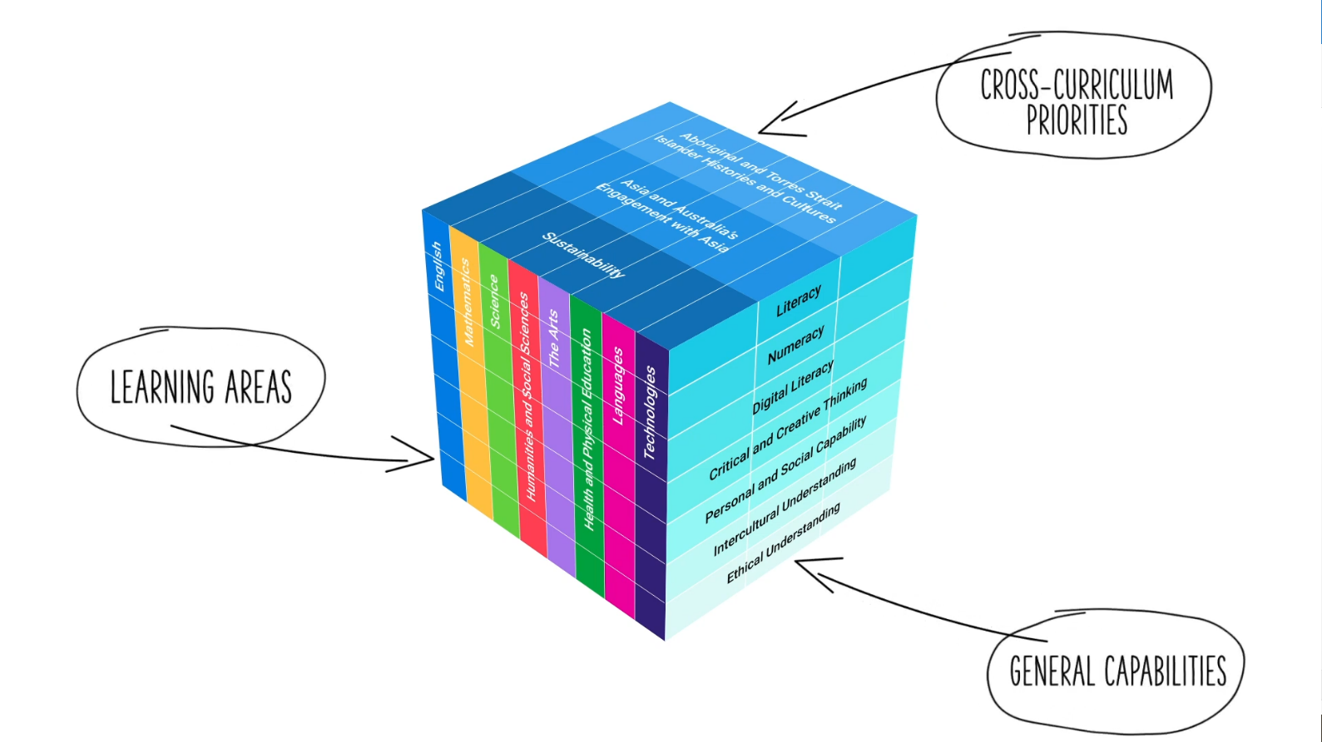
Three-dimensional curriculum
The Australian Curriculum is a three-dimensional curriculum made up of:
learning areas
general capabilities
cross-curriculum priorities.
ACARA image from Summary overview (video): https://v9.australiancurriculum.edu.au/help/website-tour.
Notes:
The Australian Curriculum sets the expectations for what all Australian students should be taught and have the opportunity to learn as they progress through their school life. In Prep to Year 10, the Australian Curriculum provides teachers, students and parents with access to the same content and consistent national standards for determining the progress of student learning.
All Australian students across all education settings and contexts can be supported in their diverse learning needs through the three dimensions of the Australian Curriculum: the learning area content, the general capabilities and the cross-curriculum priorities.
This diagram shows the relationship between these dimensions of the Australian Curriculum. Teachers emphasise one or more dimensions to develop learning programs suited to the strengths, interests and diverse needs of all students.
This presentation provides a brief overview of the general capabilities and cross-curriculum priorities. However, the focus will be on Prep – Year 6 HASS.

Slide 4
Structure of the HASS learning area
The HASS learning area consists of five subjects:
Prep–Year 6 HASS
Years 7–10
History
Geography
Civics and Citizenship
Economics and Business.
Source: https://v9.australiancurriculum.edu.au/teacher-resources/understand-this-learning-area/humanities-and-social-sciences.
Notes:
In the Australian Curriculum, the HASS learning area consists of five subjects: Prep–Year 6 Humanities and Social Sciences, as well as Years 7–10 History, Geography, Civics and Citizenship, and Economics and Business.
This presentation focuses on information specific to Prep–Year 6 HASS. A separate presentation is available for the Years 7–10 subjects.

Slide 5
Structure of P–6 HASS
Rationale
Aims
Key considerations
Key connections
Core concepts
Structure
Year-by-year curriculum
Achievement standards
Curriculum content
Source: https://v9.australiancurriculum.edu.au/teacher-resources/understand-this-learning-area/humanities-and-social-sciences#hass-f%E2%80%936.
Notes:
The Australian Curriculum sets out what all young people should be taught by specifying the curriculum content and identifies the learning expected at points in their schooling by specifying the achievement standards. The content and achievement standards are supported by additional information that describes the:
curriculum intent (rationale)
aims of learning (aims)
key considerations when planning learning experiences that are unique to the learning area of Humanities and Social Sciences
key connections with the other dimensions of the Australian Curriculum including general capabilities, cross-curriculum priorities and other learning areas
organising structure and focus for the learning at specific year levels including the level descriptions, the curriculum content and the achievement standards.
The following sections of the presentation will provide an overview of each of these key aspects of the curriculum.

Slide 6
Rationale
In a world that is increasingly culturally diverse and dynamically interconnected, it is important that students in Foundation to Year 6 develop a deep understanding of their world, past and present. They will continue to strengthen a range of learning dispositions to respond personally and collectively to current and future challenges in innovative and informed ways.
Humanities and Social Sciences (HASS) F–6 plays an important role in harnessing students’ curiosity and imagination about the world they live in. It empowers them to value their belonging and contribution to their community and beyond. HASS F–6 encompasses the knowledge and understandings of History, Geography, Civics and Citizenship, and Economics and Business. It gives students a deep understanding of the world they live in, past and present, and encourages them to appreciate and respect social, cultural and religious diversity.
HASS F–6 supports the development of a range of skills that enable students to question, think critically, consider perspectives, solve problems, make decisions and communicate effectively. Students are given opportunities to develop an understanding of the concepts that underpin the disciplines of HASS. They then apply these concepts when investigating historical, geographical, civic, and economic and business contexts relevant to their lives. These skills are developed holistically through connection to key knowledge and understandings outlined in the curriculum.
Source: Quoted verbatim and unaltered from ACARA, https://v9.australiancurriculum.edu.au/teacher-resources/understand-this-learning-area/humanities-and-social-sciences#hass-f%E2%80%936.
Notes:
The rationale defines the learning area and describes the importance of the learning area within the curriculum.
The Prep–Year 6 HASS rationale promotes:
the development of empowered individuals who demonstrate deep understanding of their world, value their belonging in a diverse and dynamic society and positively contribute locally, nationally, regionally and globally
the ability to question, think critically, consider perspectives, solve problems, make decisions and communicate effectively.
The full rationale is available from: https://v9.australiancurriculum.edu.au/teacher-resources/understand-this-learning-area/humanities-and-social-sciences#hass-f%E2%80%936/.
Suggested activity
Read the full rationale for Prep–Year 6 HASS. Partner with a colleague to discuss the following questions:
What are the key aspects of the rationale?
Why is Prep–Year 6 HASS important? What important contribution does the learning make to a student’s education?
Which aspects of this rationale match your current understanding of the subject? Which aspects are new understandings?

Slide 7
Aims
HASS F–6 aims to ensure that students develop:
foundational knowledge and skills for History, Geography, Civics and Citizenship, and Economics and Business to support their learning in discipline-specific HASS subjects from Years 7–10
an understanding of the concepts applied to disciplinary and/or cross-disciplinary inquiries
a sense of their personal world, wider community, country, region and the world in terms of key historical, geographical, civic, and economic and business contexts
an appreciation of the nature of both past and contemporary Australian society that values the contributions of the histories and cultures of First Nations Australians, Australia’s Western and Christian heritage, and the diversity of other migrant cultures and groups to our prosperous, democratic nation
skills to engage in inquiries, including questioning, researching, interpreting, analysing, evaluating, decision-making and communicating
capabilities to engage in everyday life, including critical and creative thinking, ethical understanding and intercultural understanding.
Source: Quoted verbatim and unaltered from ACARA, https://v9.australiancurriculum.edu.au/teacher-resources/understand-this-learning-area/humanities-and-social-sciences#hass-f%E2%80%936.
Notes:
The aims flow logically from the rationale and identify the major learning that students will be able to demonstrate as a result of being taught the curriculum.
The Prep–Year 6 HASS subject aims to ensure students develop:
foundational knowledge and skills for history, geography, civics and citizenship and economics and business to support their learning in discipline-specific HASS subjects from Years 7–10
an understanding of the core concepts applied to disciplinary and/or cross-disciplinary inquiries
a sense of their personal world, wider community, region, country and the world in terms of key historical, geographical, civic and economic contexts
an appreciation of the nature of both past and contemporary Australian society that values the contributions of the histories and cultures of First Nations Australians, our Western and Christian heritage and the diversity of other migrant cultures and groups to our prosperous, democratic nation
skills to engage in inquiries including questioning, researching, analysing, evaluating and communicating
capabilities to engage in everyday life including critical and creative problem-solving and informed decision-making.
The full aims are available from: https://v9.australiancurriculum.edu.au/teacher-resources/understand-this-learning-area/humanities-and-social-sciences/.
Suggested activities
Prepare a brief statement/overview that would help you describe the aims of the subject to a parent group.
Identify two or three big ideas in the aims. How do they inform:
your understanding of the subject?
what is valued in the Australian Curriculum for the learning area?
your teaching and learning approaches?

Slide 8
Key considerations
HASS P–6
Inquiry questions
Connecting HASS concepts across the primary curriculum
Other HASS considerations
Protocols for engaging First Nations Australians
Meeting the needs of diverse learners
Notes:
The key considerations provide a brief overview of how the Australian Curriculum can accommodate particular approaches to teaching and assessment in HASS.
The Australian Curriculum: HASS emphasises the importance of providing learning opportunities for students to:
engage in questioning to develop students’ knowledge, understanding and skills. As such, exemplar inquiry questions have been incorporated into each year-level description
make connections that support the development of conceptual understanding within HASS sub-strands, across sub-strands and with other learning areas.
This section also supports teachers to consider:
protocols for engaging First Nations Australians
inclusive practices that are relevant to students’ needs.
Suggested activity
How are the key considerations reflected in your HASS program?

Slide 9
Core concepts
The core concepts have been used to identify and develop the essential content in P–6 HASS.
The core concepts are grouped according to the four subjects.
History | Significance Continuity and change Cause and effect
Geography | Place and space Interconnections
Civics and Citizenship | Identity and diversity Democracy and citizenship
Economics and Business | Resource allocation and making choices
Notes:
The core concepts have been used to identify and develop the essential content in P–6 HASS.
The core concepts are grouped according to the four subjects.
Suggested activities
Prepare a brief statement/overview that would help you describe the core concepts of the learning area to a parent group.
Identify two or three big ideas of the core concepts. How do they inform:
your understanding of the learning area?
your teaching and learning approaches?

Slide 10
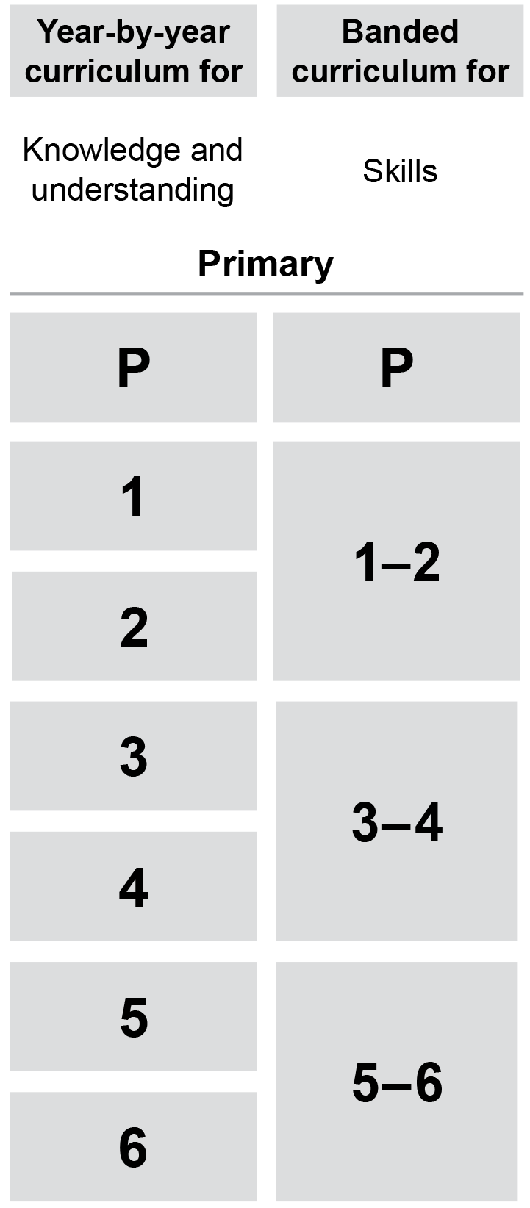
Year-by-year and banded curriculum
Each year of Prep–Year 6 HASS includes the following structural components:
level description
year-by-year content for the Knowledge and understanding strand
banded content for the Skills strand
year-by-year achievement standards.
The curriculum is developmentally sequenced across the year levels.
Notes:
The Prep–Year 6 HASS curriculum is structured into both year-by-year and banded curriculum content. The banded curriculum content enables flexible delivery of HASS across Prep–Year 6. ​
​
Suggested activity​​
What are the implications of the year-by-year curriculum for the planning of your teaching, learning and assessment program?​

Slide 11
Level description
Year 1
In Year 1, the focus is on "how my world is different from the past and can change in the future".
The Year 1 curriculum builds on each student’s prior learning and experiences investigating the past and places. Students’ exploration of the history of their family contributes to their sense of identity, connection and belonging. They consider how they can contribute to their world by sharing a perspective on family roles and responsibilities, and ways people care for places. Students continue to develop skills and processes to investigate the past and places, and dispositions for learning, such as curiosity, imagination and problem-solving. They resource their own learning through connecting with people, places, and the natural, managed and constructed world.
The Year 1 curriculum focuses on developing students’ understanding of the recent past of families and the features of local places. Students are given opportunities to explore similarities and differences in family structures and roles over recent time. They consider how aspects of family life such as education and play have undergone continuities and changes. Students learn about the location and nature of natural, managed and constructed features of local places. They consider how places change over time and the ways different groups of people can care for places, including how First Nations Australians care for Country/Place.
Inquiry questions provide a framework for developing students’ knowledge, understanding and skills. They allow for connections to be made within and across the HASS sub-strands or with other learning areas. The following inquiry questions are examples only and may be used or adapted to suit local contexts.
How has family life and the place we live in changed and stayed the same over time?
What events, activities and places do I care about? Why?
Early Years Learning Framework
Context
Inquiry questions
Notes:
Each Prep–Year 6 HASS level description identifies the:​
​
context for each year​
inquiry questions that may be addressed in each year.
In Prep–Year 2, the level description also identifies how learning in HASS builds on the Early Years Learning Framework.

Slide 12
Curriculum content
Year 3
Knowledge and Understanding
Geography
Content description | Content elaborations
the representation of contemporary Australia as states and territories, and as the Countries/Places of First Nations Australians prior to colonisation, and the locations of Australia’s neighbouring regions and countries AC9HS3K03 | using geographical tools to locate and name the states and territories in Australia, along with their capital cities; for example, a globe, wall map or digital source such as an online satellite image using a globe or digital source to locate the Pacific Island nations, New Zealand, Papua New Guinea, Timor-Leste, Indonesia and countries relevant to students, labelling them on a map and identifying the direction of each country from Australia using the Australian Institute of Aboriginal and Torres Strait Islander Studies Map of Indigenous Australia and a states and territories map of Australia to compare the boundaries of Aboriginal Countries and Torres Strait Islander Places with the surveyed boundaries between Australian states and territories, to gain an appreciation of the different ways Australia can be represented
Notes:
The curriculum content is presented as content descriptions that specify the knowledge, understanding and skills young people are expected to learn and teachers are expected to teach across the years of schooling.​
​
The content descriptions are accompanied by content elaborations. Content elaborations provide illustrations and/or examples that teachers may choose to use in the classroom or as inspiration for their own activities. The content elaborations are not a mandatory aspect of the curriculum and as such are not required to be taught. ​
​
Suggested activity​
​
Use the Australian Curriculum: Year F–6 Humanities and Social Sciences to build an understanding of the sequence of content of the curriculum across year levels: https://v9.australiancurriculum.edu.au/.​
Within the Australian Curriculum: HASS, select a year level and read the content descriptions.​
Consider the content descriptions for the year level prior to and following the selected year level.​
In a small group, discuss how the curriculum develops in increasing complexity of cognition and skills across the years.​

Slide 13
Strands and sub-strands
 | Strands
 | Knowledge and understanding | Skills
Sub-strands | History (P–6) | Questioning and researching
 | Geography (P–6) | Interpreting, analysing and evaluating
 | Civics and Citizenship (3–6) | Concluding and decision-making
 | Economics and Business (5–6) | Communicating
Notes:
Content is organised under two interrelated strands:
Knowledge and understanding
Skills.
Under each strand, curriculum content is further organised into sub-strands. The two strands are interrelated and should be programmed and taught in an integrated way. The content descriptions of the two strands have been written so that at each year this integration is possible. The knowledge and understanding strand provides the contexts through which skills and understandings of the core concepts are developed in increasing complexity across Foundation to Year 6.
Suggested activity
What is the relationship between strands of HASS?
Prepare a brief statement/overview that would help you describe the strands to a parent group.

Slide 14
Achievement standards
Foundation
By the end of Foundation, students identify significant people and events in their own lives, and how significant events are celebrated or commemorated. Students recognise the features of familiar places, why some places are special to people and the ways they can care for them.
Students pose questions, and sort and record information from observations and provided sources. They share a perspective and draw conclusions. Students use sources and terms to share observations about places and the past.
Knowledge and understanding
Skills
Notes:
The achievement standard is a statement of what students should know and be able to do at the end of the year level. In HASS, the first paragraph of the achievement standard relates to Knowledge and understanding and the second paragraph relates to Skills. ​
​
The first paragraph in the subject achievement standard (Knowledge and understanding) is organised by the sub-strands: ​
History​
Geography​
Civics and Citizenship​
Economics and Business.​
​
Suggested activities​
​Using the Australian Curriculum: P–6 HASS, discuss how the evidence that students need to provide of what they know and can do increases in complexity across year levels: https://v9.australiancurriculum.edu.au/.
​For a given year level, map the achievement standard to the content descriptions.

Slide 15
Key connections
Identify the connections with the other dimensions of the Australian Curriculum including:
the general capabilities
the cross-curriculum priorities
other learning areas within the Australian Curriculum.
Notes:
The key connections help teachers identify the links to the other dimensions for the Australian Curriculum including the general capabilities, cross-curriculum priorities and other learning areas to assist teachers to make connections in their planning for student learning.
The key connections are available from: https://v9.australiancurriculum.edu.au/teacher-resources/understand-this-learning-area/humanities-and-social-sciences.
Suggested activities
Read the key connections section relating to the other learning areas. Partner with a colleague to discuss the following questions:
Which learning areas does the F–6 HASS curriculum have key connections to?
Create a concept map showing the connections between other learning areas

Slide 16
Three-dimensional curriculum: General capabilities
Critical and creative thinking
Digital literacy
Ethical understanding
Intercultural understanding
Literacy
Numeracy
Personal and social capability
Notes:
The seven capabilities are divided into two groups:
capabilities that support students to be successful learners ― literacy, numeracy, digital literacy and critical and creative thinking
capabilities that develop ways of being, behaving and learning to live with others ― personal and social capability, ethical understanding and intercultural understanding.
Continua of learning have been developed for each capability to describe the relevant knowledge, understanding and skills at particular points of schooling, while the literacy and numeracy general capabilities have national learning progressions that describe the skills, understandings and capabilities that students typically acquire as their proficiency increases in a particular aspect of the curriculum over time.
The content outlined in the general capabilities' continua/progressions is embedded in the content descriptions for each learning area, where appropriate. The icons shown on this slide are used to identify where the general capabilities are embedded in content descriptions.
A summary of the focus of each of the general capabilities in the Humanities and social sciences learning area is available from: https://v9.australiancurriculum.edu.au/teacher-resources/understand-this-learning-area/humanities-and-social-sciences/.
Suggested activities
Read the key connection section relating to the general capabilities. Partner with a colleague to discuss the following questions:
To which general capabilities are there key connections?
Why are these connections important?
How could you embed the general capabilities authentically into your teaching and learning programs?

Slide 17
Three-dimensional curriculum: Cross-curriculum priorities
Aboriginal and Torres Strait Islander histories and cultures Asia and Australia’s engagement with Asia Sustainability
Notes:
The Australian Curriculum promotes three cross-curriculum priorities that young Australians should learn about. Each of the priorities is represented in learning areas in ways appropriate to that area.
The three priorities are:
Aboriginal and Torres Strait Islander histories and cultures ― to ensure that all young Australians are given the opportunity to gain a deeper understanding and appreciation of Aboriginal and Torres Strait Islander histories and cultures, their significance for Australia and the impact that these have had, and continue to have, on our world
Asia and Australia’s engagement with Asia ― to reflect the importance of knowing about Asia and Australia’s engagement with Asia and to encourage better understanding of the countries and cultures of the Asia region so that young people appreciate the economic, political and cultural interconnections that Australia has with the region
Sustainability ― to allow young people to develop an appreciation of the need for more sustainable patterns of living and to build capacities for thinking, valuing and acting that are necessary to create a more sustainable future.
Each of the cross-curriculum priorities contains a set of organising ideas. These are consistent across the curriculum and are reinforced in learning areas. Explicit teaching of the priorities maybe incorporated in teaching and learning activities where appropriate.
Suggested activity
Read the key connections section relating to the cross-curriculum priorities. Partner with a colleague to discuss the following questions:
To which cross-curriculum priorities are there key connections?
How are the cross-curriculum priorities reflected in your teaching and learning programs?

Slide 18
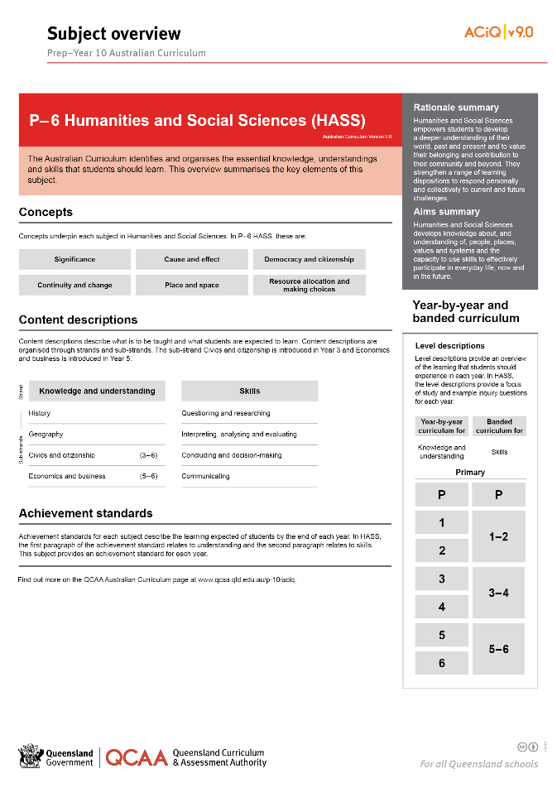
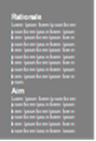
Find out more
Find out more on the QCAA Australian Curriculum webpage.
Notes:
More information about the implementation of Australian Curriculum in Queensland is available on the QCAA website. A one-page overview of the Australian Curriculum: HASS can be accessed through https://www.qcaa.qld.edu.au/p-10/aciq/version-9/learning-areas/p-10-humanities-and-social-sciences/.
Send any further questions to: australiancurriculum@qcaa.qld.edu.au.
Information about requests for further professional learning is available from: www.qcaa.qld.edu.au/pd-events/request-pd.
Suggested activity
Partner with a colleague to discuss the following questions:
What did I learn?
What was confirmed?
What was new?
What challenged my thinking?
What else do I need to do?
What is our plan as a teaching team?

Slide 19
Acknowledgments
© State of Queensland (QCAA) 2022
Licence: https://creativecommons.org/licenses/by/4.0 | Copyright notice: www.qcaa.qld.edu.au/copyright — lists the full terms and conditions, which specify certain exceptions to the licence. | Attribution: ‘© State of Queensland (QCAA) 2022’ — please include the link to our copyright notice.
Other copyright material in this publication is listed below:
Photograph/s of staff and students used with permission.
Unless otherwise indicated, material from Australian Curriculum is © ACARA 2010–present, licensed CC BY 4.0. For the latest information and additional terms of use, see the Australian Curriculum website and its copyright notice.
The three-dimensional curriculum diagram is 'Excluded Material' used under the terms of the Australian Curriculum and its copyright notice and is not modified. © Australian Curriculum, Assessment and Reporting Authority (ACARA) 2009 to present, unless otherwise indicated.
You may view, download, display, print, reproduce (such as by making photocopies) and distribute these Excluded Materials in unaltered form only for your personal, non-commercial educational purposes or for the non-commercial educational purposes of your organisation, provided that you make others aware it can only be used for these purposes and attribute ACARA as the source of the Excluded Material. For the avoidance of doubt, this means that you cannot edit, modify or adapt any of these materials, and you cannot sub-licence any of these materials to others. Apart from any uses permitted under the Copyright Act 1968 (Cth), and those explicitly granted above, all other rights are reserved by ACARA. If you want to use such material in a manner that is outside this restrictive licence, you must request permission from ACARA by emailing (copyright@acara.edu.au).

Slide 20
QCAA social media

