Slide 1
Humanities and Social Sciences (HASS)
Years 7–10 Australian Curriculum Version 9.0
Learning area overview
220092
Notes:
This presentation supports understanding of the Australian Curriculum Version 9.0: Humanities and Social Sciences Years 7–Year 10. It gives insight into the position of HASS within the Australian Curriculum and the structure of the HASS learning area.
You can use this presentation in your organisation as the basis for professional learning about the HASS curriculum. It includes information about the key aspects of the curriculum, as well as activities for becoming familiar with the curriculum. An icon in the bottom-right corner of a slide identifies opportunities for activities. Presenters are encouraged to tailor this presentation to suit the needs of their audience.
The Australian Curriculum content referred to in this presentation is available from:
Australian Curriculum, Assessment and Reporting Authority (ACARA) 2022, Australian Curriculum Version 9 Foundation to Year 10, https://v9.australiancurriculum.edu.au/.

Slide 2
Learning goals
This presentation aims to:
build understanding of the Australian Curriculum Version 9.0: Humanities and Social Sciences in Years 7–10
provide an overview of the structure of Years 7–10 HASS.
Notes:
This presentation aims to:
build understanding of the Australian Curriculum Version 9.0, with particular reference to the Humanities and Social Sciences curriculum in Years 7–10
provide an overview of the structure of the Years 7–10 HASS subjects, including the curriculum content and achievement standards.
Note: Subject-specific information can be found in the corresponding Subject overview presentations. These are available for:
Years 7–10 History
Years 7–10 Geography
Years 7–10 Civics and Citizenship
Years 7–10 Economics and Business

Slide 3
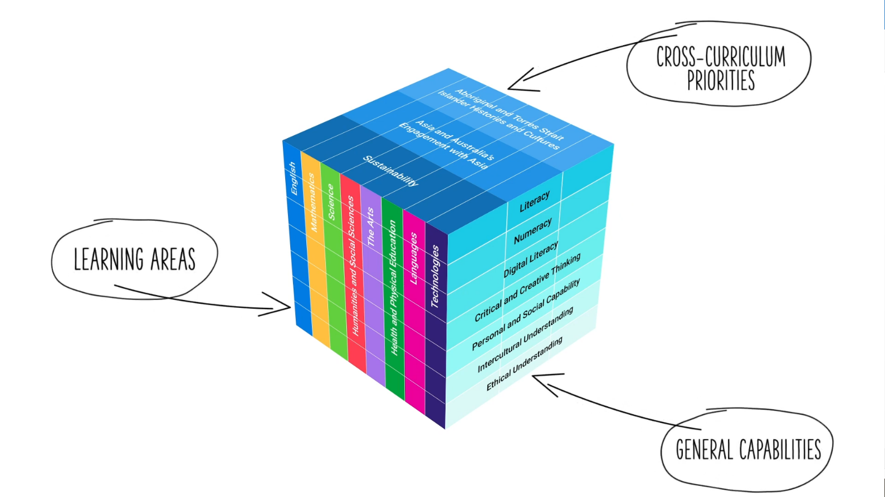
Three-dimensional curriculum
The Australian Curriculum is a three-dimensional curriculum made up of:
learning areas
general capabilities
cross-curriculum priorities.
ACARA image from Summary overview (video): https://v9.australiancurriculum.edu.au/help/website-tour.
Notes:
The Australian Curriculum sets the expectations for what all Australian students should be taught and have the opportunity to learn as they progress through their school life. In Prep to Year 10, the Australian Curriculum provides teachers, students and parents with access to the same content and consistent national standards for determining the progress of student learning.
All Australian students across all education settings and contexts can be supported in their diverse learning needs through the three dimensions of the Australian Curriculum: the learning area content, the general capabilities and the cross-curriculum priorities.
This diagram shows the relationship between these dimensions of the Australian Curriculum. Teachers emphasise one or more dimensions to develop learning programs suited to the strengths, interests and diverse needs of all students.
This presentation provides a brief overview of the general capabilities and cross-curriculum priorities. However, the focus will be on Years 7–10 HASS subjects.

Slide 4
Structure of the HASS learning area
The HASS learning area consists of five subjects:
Prep–Year 6 HASS
Years 7–10
History
Geography
Civics and Citizenship
Economics and Business.
Source: https://v9.australiancurriculum.edu.au/teacher-resources/understand-this-learning-area/humanities-and-social-sciences.
Notes:
In the Australian Curriculum, the HASS learning area consists of five subjects: Prep–Year 6 Humanities and Social Sciences, as well as Years 7–10 History, Geography, Civics and Citizenship, and Economics and Business.
This presentation focuses on information specific to Years 7–10 HASS subjects. A separate presentation is available for the Prep–Year 6 HASS.

Slide 5
Structure of the HASS learning area
Rationale
Aims
Key considerations
Key connections
Core concepts
Structure
Year-by-year curriculum
Achievement standards
Curriculum content
Source: https://v9.australiancurriculum.edu.au/teacher-resources/understand-this-learning-area/humanities-and-social-sciences.
Notes:
The Australian Curriculum sets out what all young people should be taught by specifying the curriculum content and identifies the learning expected at points in their schooling by specifying the achievement standards. The content and achievement standards are supported by additional information that describes the:
curriculum intent (rationale)
aims of learning (aims)
key considerations when planning learning experiences that are unique to the learning area of Humanities and Social Sciences
key connections with the other dimensions for the Australian Curriculum including the general capabilities, cross-curriculum priorities and other learning areas
core concepts that underpin the essential content across the learning area
organising structure and focus for the learning at specific year levels including the level descriptions, the curriculum content and the achievement standards.
The following sections of the presentation will provide an overview of each of these key aspects of the curriculum.

Slide 6
Rationale
The Humanities and Social Sciences are the study of human behaviour and interaction in social, cultural, environmental, economic, business, legal and political contexts. This learning area has a historical and contemporary focus, from personal to global contexts, and considers the challenges that may occur in the future. It plays an important role in assisting students to understand global issues, and building their capacity to be active and informed citizens who understand and participate in the world.
The Humanities and Social Sciences subjects in the Australian Curriculum provide a broad understanding of the world we live in, and how people can participate as active and informed citizens with high-level skills needed now and in the future. They provide opportunities for students to develop their own personal and social learning, and to explore their perspectives as well as those of others.
Through studying Humanities and Social Sciences, students will develop the ability to question, think critically, solve problems, communicate effectively, make decisions and adapt to change. This requires an understanding of the key historical, geographical, legal, political, economic, business and societal factors involved, and how these different factors interrelate.
Source: Quoted verbatim and unaltered from ACARA, https://v9.australiancurriculum.edu.au/teacher-resources/understand-this-learning-area/humanities-and-social-sciences.
Notes:
The rationale defines the learning area and describes the importance of the learning area within the curriculum.
The Years 7–10 HASS rationale promotes:
a broad understanding of the world in which students live and how people can participate as active and informed citizens
development of personal and social learning and the ability to explore their perspectives as well as those of others
the ability to question, think critically, solve problems, communicate effectively, make decisions and adapt to change.
The full rationale is available from: https://v9.australiancurriculum.edu.au/teacher-resources/understand-this-learning-area/humanities-and-social-sciences/.
Suggested activity
Read the full rationale for Years 7–10 HASS. Partner with a colleague to discuss the following questions:
What are the key aspects of the rationale?
Why is Years 7–10 HASS important? What important contribution does the learning make to a student’s education?
Which aspects of this rationale match your current understanding of the subject? Which aspects are new understandings?

Slide 7
Aims
Humanities and Social Sciences aims to ensure that students develop:
a sense of wonder, curiosity and respect about places, people, cultures and systems throughout the world, past and present, and an interest in and enjoyment of the study of these phenomena
key historical, geographical, civic, business and economic knowledge of people, places, values and systems, past and present, in local to global contexts
an understanding and appreciation of historical developments, geographic phenomena, civic values and economic factors that shape society, influence sustainability and create a sense of belonging
an understanding of the key concepts applied to disciplinary and/or cross-disciplinary inquiries
the capacity to use disciplinary skills, including disciplinary-appropriate questioning, researching using reliable sources, analysing, evaluating and communicating
dispositions required for effective participation in everyday life, now and in the future, including the ability to problem-solve critically and creatively, make informed decisions, be a responsible and active citizen, make informed economic and financial choices, and reflect on ethics.
Source: Quoted verbatim and unaltered from ACARA, https://v9.australiancurriculum.edu.au/teacher-resources/understand-this-learning-area/humanities-and-social-sciences.
Notes:
The aims flow logically from the rationale and identify the major learning that students will be able to demonstrate as a result of being taught the curriculum.
The Years 7–10 HASS subjects aims to ensure students develop:
a sense of wonder, curiosity and respect about places, people, cultures and systems throughout the world, past and present and an interest in, and enjoyment of, the study of these phenomena
key historical, geographical, civic and economic knowledge of people, places, values and systems, past and present, in local to global contexts
an understanding and appreciation of historical developments, geographic phenomena, civic values and economic factors that shape society, influence sustainability and create a sense of belonging
an understanding of the key concepts applied to disciplinary and/or cross-disciplinary inquiries
the capacity to use disciplinary methods and skills, including disciplinary-appropriate questioning, researching using reliable sources, analysing, evaluating and communicating
dispositions required for effective participation in everyday life, now and in the future, including the ability to problem-solve critically and creatively, make informed decisions, be a responsible and active citizen, make informed economic and financial choices and ethically reflect.
The full aims are available from: https://v9.australiancurriculum.edu.au/teacher-resources/understand-this-learning-area/humanities-and-social-sciences/.
Suggested activities
Prepare a brief statement/overview that would help you describe the aims of the subject to a parent group.
Identify two or three big ideas in the aims. How do they inform:
your understanding of the subject?
what is valued in the Australian Curriculum for the learning area?
your teaching and learning approaches?

Slide 8
Key considerations
In Years 7–10 HASS subjects, there are:
inquiry questions
considerations specific to each HASS subject.
History | Historical sources Australian history within a world history approach
Geography | Primary research methods, including fieldwork Use of geospatial technologies and digital tools Selecting contexts for study
Civics and Citizenship | Contemporary issues Active citizenship
Economics and Business | Selecting contexts for study Developing consumer and financial literacy capability
Notes:
The key considerations provide a brief overview of how the Australian Curriculum can accommodate particular approaches to teaching and assessment in HASS.
The Australian Curriculum: HASS emphasises the importance of providing learning opportunities for students to:
engage in questioning to develop students’ knowledge, understanding and skills. As such, exemplar inquiry questions have been incorporated into each year-level description for each subject in Years 7–10
subject-specific key considerations exist for each 7–10 subject.
This section also supports teachers to consider:
protocols for engaging First Nations Australians
inclusive practices that are relevant to students’ needs.
Suggested activity
How are the key considerations reflected in your HASS program?

Slide 9
Core concepts
The core concepts have been used to identify and develop the essential content in Humanities and Social Sciences.
In Years 7–10, the core concepts are discipline-specific within each of the subjects.
Notes:
Core concepts are identified for each subject. The core concepts are available from:
History: https://v9.australiancurriculum.edu.au/teacher-resources/understand-this-learning-area/humanities-and-social-sciences#history-7-10/
Geography: https://v9.australiancurriculum.edu.au/teacher-resources/understand-this-learning-area/humanities-and-social-sciences#geography-7-10/
Civics and Citizenship: https://v9.australiancurriculum.edu.au/teacher-resources/understand-this-learning-area/humanities-and-social-sciences#civics-and-citizenship-7-10/
Economics and Business: https://v9.australiancurriculum.edu.au/teacher-resources/understand-this-learning-area/humanities-and-social-sciences#economics-and-business-7-10/
Suggested activities
Prepare a brief statement/overview that would help you describe the core concepts of the learning area to a parent group.
Identify two or three big ideas of the core concepts. How do they inform:
your understanding of the learning area?
what is valued in the Australian Curriculum for the learning area?
your teaching and learning approaches?

Slide 10
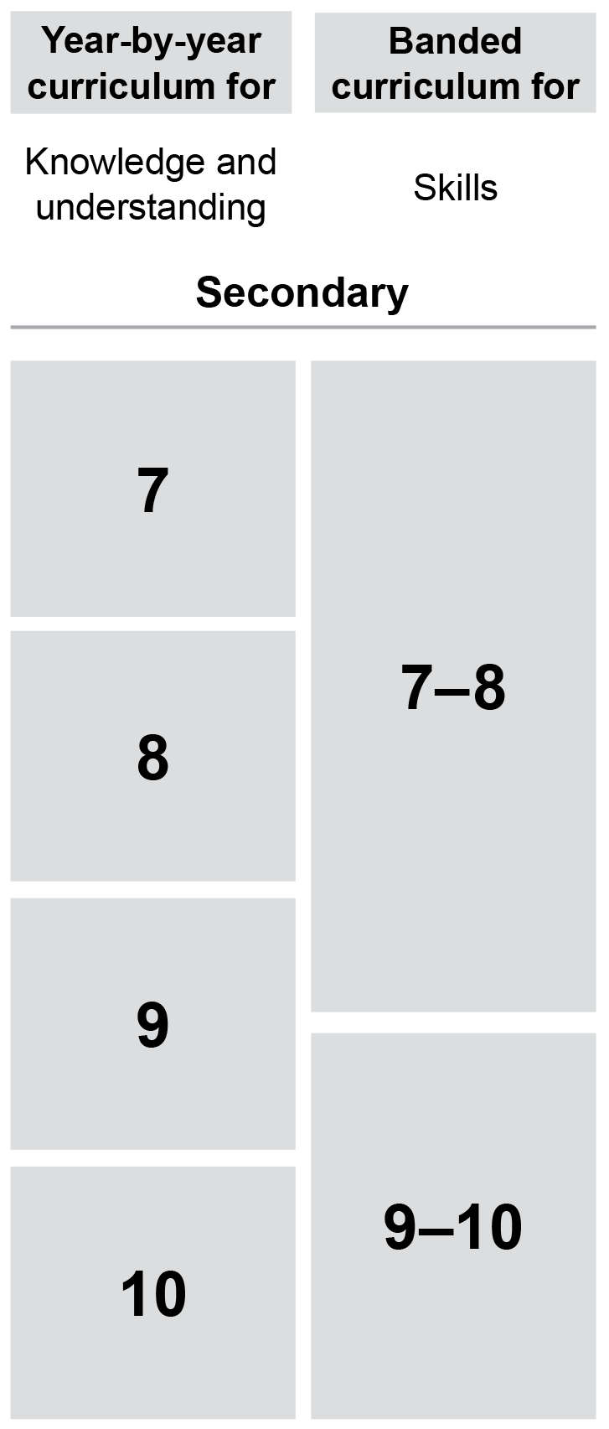
Year-by-year and banded curriculum
Each year of Years 7–10 HASS includes the following structural components:
level description
year-by-year content for the Knowledge and understanding strand
banded content for the Skills strand
year-by-year achievement standards.
The curriculum is developmentally sequenced across the year levels.
Notes:
The Years 7–10 HASS curriculum is structured into both year-by-year and banded curriculum content. The banded curriculum content enables flexible delivery of HASS across Years 7–10 . ​
​
Suggested activity​
What are the implications of the year-by-year curriculum for the planning of your teaching, learning and assessment program?​

Slide 11
Level description
Year 7 History
The Year 7 curriculum provides a study of history from the time of the earliest human communities to the end of the ancient period, approximately 60,000 years ago – c.650 (CE), and a study of early First Nations Peoples of Australia. It was a period defined by the development of cultural practices and organised societies. The study of the ancient world includes the discoveries (the remains of the past and what we know) and the mysteries (what we do not know) about this period of history, in a range of societies from places including Egypt, Greece, Rome, India and China.
An overview of the study of the ancient world's earliest societies requires students to develop a broad understanding of the context and chronology of the period, the patterns of historical continuity and change over time, and related historical themes. This includes understanding the archaeological and historical terms used to describe different periods of time, and the ways different cultures, including First Nations Australians, identify and represent time.
In Year 7, students are expected to study the sub-strand Deep time history of Australia and at least one of the topics from The ancient world sub-strand. The ancient world sub-strand topics are:
Greece
Rome
Egypt
India
China.
Inquiry questions provide a framework for developing students’ knowledge, understanding and skills. The following inquiry questions are examples only and may be used or adapted to suit local contexts.
How do we know about the ancient past?
Why, where and when did the earliest societies develop?
What emerged as the distinctive features of societies of early First Nations Peoples of Australia?
What emerged as the defining features and achievements of ancient societies?
What have been the significant legacies of ancient societies?
Context
Inquiry questions
Notes:
Each Years 7–10 HASS level description identifies the:​
​
context for each year​
inquiry questions that may be addressed in each year.

Slide 12
Curriculum content
For each of the four subjects, content is organised under two interrelated strands:
Knowledge and understanding
Skills
Notes:
The two strands are interrelated and should be programmed and taught in an integrated way. The content descriptions of the two strands have been written so that at each year this integration is possible. The knowledge and understanding strand provides the contexts through which skills and understandings of the core concepts are developed in increasing complexity across Years 7–10 .

Slide 13
Curriculum content
Year 8 Civics and Citizenship
Knowledge and Understanding
Citizenship, diversity and identity
Content description | Content elaborations
how culture and religion may influence individuals' and groups' perceptions and expressions of citizenship and their actions as citizens AC9HC8K05 | exploring how people express different aspects of their personal identity through membership of multiple communities, such as cultural groups, faith groups, professional associations, trade unions, and sporting and social clubs, and how this is reflected in expressions of citizenship; for example, fund-raising for community services or supporting people experiencing health concerns exploring the collective identities of several different groups in Australia’s multicultural society, and how these identities might be represented and perceived discussing the differences between legal citizenship, active citizenship and global citizenship
Notes:
The curriculum content is presented as content descriptions that specify the knowledge, understanding and skills young people are expected to learn and teachers are expected to teach across the years of schooling.
The content descriptions are accompanied by content elaborations. Content elaborations provide illustrations and/or examples that teachers may choose to use in the classroom or as inspiration for their own activities. The content elaborations are not a mandatory aspect of the curriculum and as such are not required to be taught.
Suggested activity
Use the Australian Curriculum for one subject in the Years 7–10 HASS learning area to build an understanding of the sequence of content of the curriculum across year levels: https://v9.australiancurriculum.edu.au/.
Within the Australian Curriculum: HASS, select a year level and read the content descriptions.
Consider the content descriptions for the year level prior to and following the selected year level.
In a small group, discuss how the curriculum develops in increasing complexity of cognition and skills across the years.

Slide 14
Knowledge and understanding strand
History |  | Geography |  | Civics and Citizenship |  | Economics and Business
Two to four sub-strands per year level |  | Two sub-strands per year level |  | Three sub-strands per year level |  | No sub-strands
Some sub-strands are mandatory |  | All sub-strands are mandatory |  | All sub-strands are mandatory |  | All content descriptions within the strand are mandatory
Selection of topics within each sub-strand
Notes:
Under each strand, curriculum content is further organised into sub-strands. In the Knowledge and understanding strand, there are varying numbers of sub-strands depending on the subject.
Sub-strands are provided for:
History — an overview and a selection of two (Year 7), three (Years 8 and 10) or four (Year 9) sub-strands
Geography — two sub-strands
Civics and Citizenship — three sub-strands
It is important to note that there are no sub-strands provided for Economics and Business in the Knowledge and understanding strand.
Suggested activities:
What is the relationship between the strands of HASS?
Prepare a brief statement/overview that would help you describe the strands to a parent group.

Slide 15
Skills strand
— Sub-strands — | History |  | Geography |  | Civics and Citizenship |  | Economics and Business
 | Questioning and researching |  | Questioning and researching using geographical methods |  | Questioning and researching |  | Questioning and researching
 | Using historical sources |  | Interpreting and analysing geographical data and information |  | Analysis, evaluation and interpretation |  | Interpreting and analysing
 | Historical perspectives and interpretations |  | Concluding and decision-making |  | Civic participation and decision-making |  | Evaluating, concluding and decision-making
 | Communicating |  | Communicating |  | Communicating |  | Communicating
Notes:
In each HASS subject, there are four sub-strands. These vary depending on the nature of the subject. There are certain skills that are common to all subjects, namely:
questioning and researching
Communicating.

Slide 16
Achievement standards
Year 10 Economics and Business
By the end of Year 10, students analyse how economic indicators influence Australian Government decision-making. They explain ways that government intervenes to improve economic performance and living standards. They explain processes that businesses use to manage the workforce and improve productivity. They explain the importance of Australia’s superannuation system and its effect on consumer and financial decision-making. Students analyse factors that influence major consumer and financial decisions, and explain the short- and long-term effects of these decisions.
Students develop and modify a range of questions to investigate an economic and business issue. They locate, select and analyse relevant and reliable information and data from a range of sources. They interpret and analyse information and data to evaluate trends and economic cause-and-effect relationships, and make predictions about consumer and financial impacts. They develop an evidence-based response to an economic and business issue. They evaluate a response, using appropriate criteria to decide on a course of action. Students use economic and business knowledge, concepts and terms to develop descriptions, explanations and reasoned arguments that synthesise research findings.
Knowledge and understanding
Skills
Notes:
The achievement standard is a statement of what students should know and should be able to do at the end of the year level. In HASS, the first paragraph of the achievement standard relates to Knowledge and understanding, and the second paragraph relates to Skills. ​
​
The Years 7–10 HASS achievement standards are available from: https://v9.australiancurriculum.edu.au/.
​​
Suggested activities
Using the Australian Curriculum for one subject within the Years 7–10 HASS learning area, discuss how the evidence that students need to provide of what they know and can do increases in complexity across year levels.
For a given year level, map the achievement standard to the content descriptions.

Slide 17
Key connections
Identify the connections with the other dimensions of the Australian Curriculum including:
the general capabilities
the cross-curriculum priorities
other learning areas within the Australian Curriculum.
Notes:
The key connections help teachers identify the links to the other dimensions for the Australian Curriculum including the general capabilities, cross-curriculum priorities and other learning areas to assist teachers to make connections in their planning for student learning.
The key connections are available from: https://v9.australiancurriculum.edu.au/teacher-resources/understand-this-learning-area/humanities-and-social-sciences/.
Suggested activities
Read the key connections section relating to the other learning areas. Partner with a colleague to discuss the following questions:
Which learning areas does the 7–10 HASS curriculum have key connections to?
Why are these connections important?
Create a concept map showing the connections between other learning areas.

Slide 18
Three-dimensional curriculum: General capabilities
Critical and creative thinking
Digital literacy
Ethical understanding
Intercultural understanding
Literacy
Numeracy
Personal and social capability
Notes:
The seven capabilities are divided into two groups:
capabilities that support students to be successful learners ― literacy, numeracy, digital literacy and critical and creative thinking
capabilities that develop ways of being, behaving and learning to live with others ― personal and social capability, ethical understanding and intercultural understanding.
Continua of learning have been developed for each capability to describe the relevant knowledge, understanding and skills at particular points of schooling, while the literacy and numeracy general capabilities have national learning progressions that describe the skills, understandings and capabilities that students typically acquire as their proficiency increases in a particular aspect of the curriculum over time.
The content outlined in the general capabilities' continua/progressions is embedded in the content descriptions for each learning area, where appropriate. The icons shown on this slide are used to identify where the general capabilities are embedded in content descriptions.
A summary of the focus of each of the general capabilities in the Humanities and social sciences learning area is available from: https://v9.australiancurriculum.edu.au/teacher-resources/understand-this-learning-area/humanities-and-social-sciences/.
Suggested activities
Read the key connection section relating to the general capabilities. Partner with a colleague to discuss the following questions:
To which general capabilities are there key connections?
Why are these connections important?
How could you embed the general capabilities authentically into your teaching and learning programs?

Slide 19
Three-dimensional curriculum: Cross-curriculum priorities
Aboriginal and Torres Strait Islander histories and cultures Asia and Australia’s engagement with Asia Sustainability
Notes:
The Australian Curriculum promotes three cross-curriculum priorities that young Australians should learn about. Each of the priorities is represented in learning areas in ways appropriate to that area.
The three priorities are:
Aboriginal and Torres Strait Islander histories and cultures ― to ensure that all young Australians are given the opportunity to gain a deeper understanding and appreciation of Aboriginal and Torres Strait Islander histories and cultures, their significance for Australia and the impact that these have had, and continue to have, on our world
Asia and Australia’s engagement with Asia ― to reflect the importance of knowing about Asia and Australia’s engagement with Asia and to encourage better understanding of the countries and cultures of the Asia region so that young people appreciate the economic, political and cultural interconnections that Australia has with the region
Sustainability ― to allow young people to develop an appreciation of the need for more sustainable patterns of living and to build capacities for thinking, valuing and acting that are necessary to create a more sustainable future.
Each of the cross-curriculum priorities contains a set of organising ideas. These are consistent across the curriculum and are reinforced in learning areas. Explicit teaching of the priorities maybe incorporated in teaching and learning activities where appropriate.
Suggested activity
Read the key connections section relating to the cross-curriculum priorities. Partner with a colleague to discuss the following questions:
To which cross-curriculum priorities are there key connections?
How are the cross-curriculum priorities reflected in your teaching and learning programs?

Slide 20
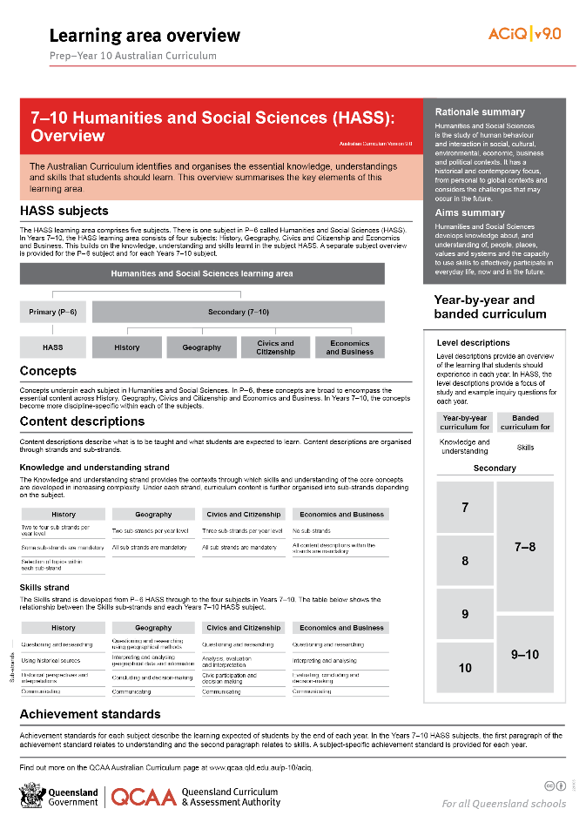
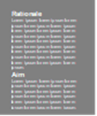
Find out more
Find out more on the QCAA Australian Curriculum webpage.
Notes:
More information about the implementation of Australian Curriculum in Queensland is available on the QCAA website. A one-page overview of the Australian Curriculum: HASS can be accessed through https://www.qcaa.qld.edu.au/p-10/aciq/version-9/learning-areas/p-10-humanities-and-social-sciences/.
Send any further questions to: australiancurriculum@qcaa.qld.edu.au.
Information about requests for further professional learning is available from: www.qcaa.qld.edu.au/pd-events/request-pd.
Suggested activity
Partner with a colleague to discuss the following questions:
What did I learn?
What was confirmed?
What was new?
What challenged my thinking?
What else do I need to do?
What is our plan as a teaching team?

Slide 21
Acknowledgments
© State of Queensland (QCAA) 2022
Licence: https://creativecommons.org/licenses/by/4.0 | Copyright notice: www.qcaa.qld.edu.au/copyright — lists the full terms and conditions, which specify certain exceptions to the licence. | Attribution: ‘© State of Queensland (QCAA) 2022’ — please include the link to our copyright notice.
Other copyright material in this publication is listed below:
Photograph/s of staff and students used with permission.
Unless otherwise indicated, material from Australian Curriculum is © ACARA 2010–present, licensed CC BY 4.0. For the latest information and additional terms of use, see the Australian Curriculum website and its copyright notice.
The three-dimensional curriculum diagram is 'Excluded Material' used under the terms of the Australian Curriculum and its copyright notice and is not modified. © Australian Curriculum, Assessment and Reporting Authority (ACARA) 2009 to present, unless otherwise indicated.
You may view, download, display, print, reproduce (such as by making photocopies) and distribute these Excluded Materials in unaltered form only for your personal, non-commercial educational purposes or for the non-commercial educational purposes of your organisation, provided that you make others aware it can only be used for these purposes and attribute ACARA as the source of the Excluded Material. For the avoidance of doubt, this means that you cannot edit, modify or adapt any of these materials, and you cannot sub-licence any of these materials to others. Apart from any uses permitted under the Copyright Act 1968 (Cth), and those explicitly granted above, all other rights are reserved by ACARA. If you want to use such material in a manner that is outside this restrictive licence, you must request permission from ACARA by emailing (copyright@acara.edu.au).

Slide 22
QCAA social media

