Slide 1
Geography
Years 7–10 Australian Curriculum: Humanities and Social Sciences Version 9.0
Subject overview
220090
Notes:
This presentation supports understanding of the Australian Curriculum Version 9.0: Humanities and Social Sciences Year 7–Year 10. It gives insight into the position of Geography within the Australian Curriculum: HASS and the structure of the HASS learning area.
You can use this presentation in your organisation as the basis for professional learning about the HASS curriculum. It includes information about the key aspects of the curriculum, as well as activities for becoming familiar with the curriculum. An icon in the bottom-right corner of a slide identifies opportunities for activities. Presenters are encouraged to tailor this presentation to suit the needs of their audience.
The Australian Curriculum content referred to in this presentation is available from:
Australian Curriculum, Assessment and Reporting Authority (ACARA) 2022, Australian Curriculum Version 9 Foundation to Year 10, https://v9.australiancurriculum.edu.au/.

Slide 2
Learning goals
This presentation aims to:
build understanding of the Australian Curriculum Version 9.0: Humanities and Social Sciences in Years 7–10 Geography
provide an overview of the structure of Years 7–10 Geography.
Notes:
This presentation aims to:
build understanding of the Australian Curriculum Version 9.0, with particular reference to the Humanities and Social Sciences curriculum in Years 7–10 Geography
provide an overview of the structure of Years 7–10 Geography, including the curriculum content and achievement standards.
Note: Learning area information for Years 7–10 Humanities and Social Sciences is available in the Learning area overview presentation.
Note: Subject-specific presentations are also available for other HASS subjects. These are:
Years 7–10 History
Years 7–10 Civics and Citizenship
Years 7–10 Economics and Business.

Slide 3
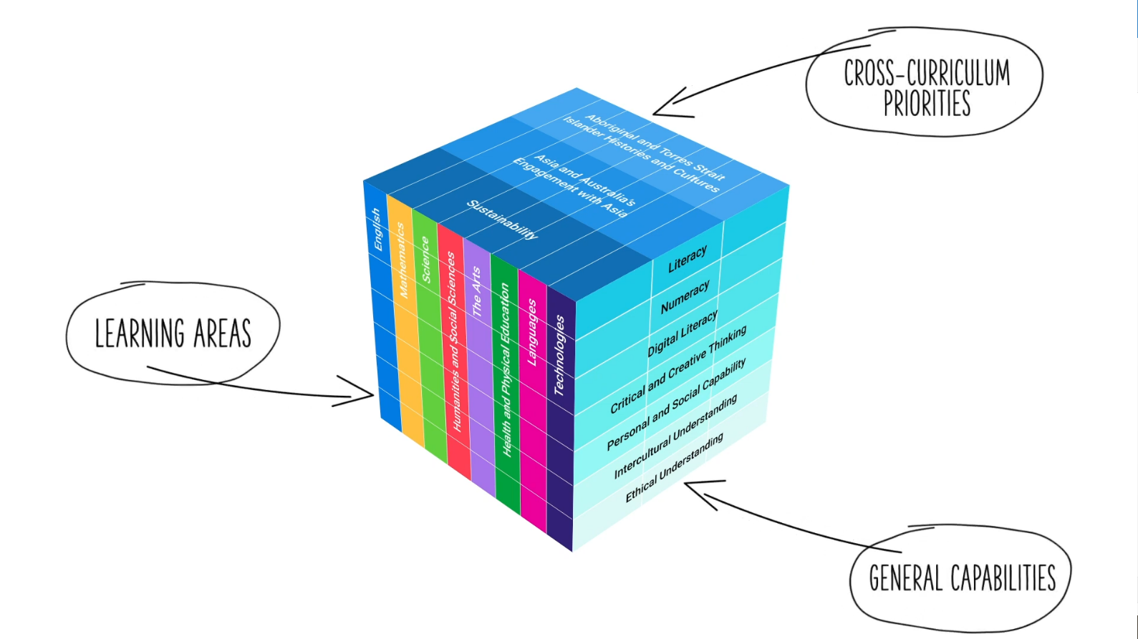
Three-dimensional curriculum
The Australian Curriculum is a three-dimensional curriculum made up of:
learning areas
general capabilities
cross-curriculum priorities.
ACARA image from Summary overview (video): https://v9.australiancurriculum.edu.au/help/website-tour.
Notes:
The Australian Curriculum sets the expectations for what all Australian students should be taught and have the opportunity to learn as they progress through their school life. In Prep to Year 10, the Australian Curriculum provides teachers, students and parents with access to the same content and consistent national standards for determining the progress of student learning.
All Australian students across all education settings and contexts can be supported in their diverse learning needs through the three dimensions of the Australian Curriculum: the learning area content, the general capabilities and the cross-curriculum priorities.
This diagram shows the relationship between these dimensions of the Australian Curriculum. Teachers emphasise one or more dimensions to develop learning programs suited to the strengths, interests and diverse needs of all students.
This presentation provides a brief overview of the general capabilities and cross-curriculum priorities. However, the focus will be on Years 7–10 Geography.

Slide 4
Structure of Years 7–10 Geography
Rationale
Aims
Key considerations
Core concepts
Structure
Year-by-year curriculum
Achievement standards
Curriculum content
Source: https://v9.australiancurriculum.edu.au/teacher-resources/understand-this-learning-area/humanities-and-social-sciences#geography-7%E2%80%9310.
Notes:
The Australian Curriculum sets out what all young people should be taught by specifying the curriculum content and identifies the learning expected at points in their schooling by specifying the achievement standards. The content and achievement standards are supported by additional information that describes the:
curriculum intent (rationale)
aims of learning (aims)
key considerations when planning learning experiences that are unique to Geography
core concepts that underpin the essential content of Geography
organising structure and focus for the learning at specific year levels including the level descriptions, the curriculum content and the achievement standards.
The following sections of the presentation will provide an overview of each of these key aspects of the curriculum.

Slide 5
Rationale
In a world of increasing global integration and international mobility, it is critical to sustainability and human wellbeing that young Australians develop a holistic understanding of the world. This requires deep knowledge and understanding of why the world is the way it is and the interconnections between people, places and environments over time.
Geography inspires curiosity and wonder about the diversity of the world’s people, places and environments. Geography features a structured way of exploring, analysing and understanding the characteristics of the places that make up our world. This enables students to question why the world is the way it is and reflect on their relationships with and responsibilities for the world.
Geography provides students with opportunities to develop a wide range of general skills, capabilities and dispositions that can be applied in everyday life and at work. The subject helps students to develop geospatial technologies and digital tools; an appreciation and respect for social and cultural diversity; a capacity for teamwork; and an ability to solve problems, and to think critically and creatively.
Through the study of Geography, students become informed and responsible members of their local and global communities. They learn to act ethically to sustain and improve natural and social environments, and engage in the global community.
Source: Quoted verbatim and unaltered from ACARA, https://v9.australiancurriculum.edu.au/teacher-resources/understand-this-learning-area/humanities-and-social-sciences#geography-7%E2%80%9310.
Notes:
The rationale defines the subject and describes its importance within the curriculum:
Why is it important?
How is it shaped in the curriculum?
The Years 7–10 Geography rationale promotes:
the development of students’ holistic understanding of the world, sustainability and human wellbeing
curiosity and wonder about the diversity of the world’s places, peoples, cultures and environments
questioning about why the world is the way it is and reflection on their relationships with and responsibilities for that world.
The full rationale is available from: https://v9.australiancurriculum.edu.au/teacher-resources/understand-this-learning-area/humanities-and-social-sciences#geography-7%E2%80%9310/.
Suggested activity
Read the full rationale for Years 7–10 Geography. Partner with a colleague to discuss the following questions:
What are the key aspects of the rationale?
Why is Years 7–10 Geography important? What important contribution does the learning make to a student’s education?
Which aspects of this rationale match your current understanding of the subject? Which aspects are new understandings?

Slide 6
Aims
Geography aims to ensure that students develop:
a sense of wonder and curiosity about, and respect for, places, people, cultures and environments throughout the world
a deep geographical knowledge of their own locality, Australia, the countries of Asia and the world
the ability to inquire and think geographically, using the geographical concepts of place, space, environment, scale, change, interconnections and sustainability
the capacity to be competent, critical and creative users of geographical methods and skills, including questioning and researching, interpreting and analysing, concluding and decision-making, and communicating effectively
an appreciation for the nature of geographical phenomena and challenges, and their impact on people's lives, places and environments
capabilities to engage in everyday life, including critical and creative thinking, ethical understanding and intercultural understanding.
Source: Quoted verbatim and unaltered from ACARA, https://v9.australiancurriculum.edu.au/teacher-resources/understand-this-learning-area/humanities-and-social-sciences#geography-7%E2%80%9310.
Notes:
The aims flow logically from the rationale and identify the major learning that students will be able to demonstrate as a result of being taught the curriculum.
The Years 7–10 Geography subject aims to ensure students develop:
a sense of wonder, curiosity and respect about places, people, cultures and environments throughout the world
a deep geographical knowledge of their own locality, Australia, the countries of Asia and the world
the ability to inquire and think geographically, using the geographical concepts of place, space, environment, scale, change, interconnection and sustainability
the capacity to be competent, critical and creative users of geographical methods and skills, including questioning and researching, interpreting and analysing, decision-making and communicating
an appreciation for the nature of geographical phenomena and challenges and their impact on peoples’ lives, place and environment
capabilities to engage in everyday life, including critical and creative thinking, ethical understanding and intercultural understanding.
The full aims are available from: https://v9.australiancurriculum.edu.au/teacher-resources/understand-this-learning-area/humanities-and-social-sciences/.
Suggested activities
Prepare a brief statement/overview that would help you describe the aims of the subject to a parent group.
Identify two or three big ideas in the aims. How do they inform:
your understanding of the subject?
what is valued in the Australian Curriculum for the learning area?
your teaching and learning approaches?

Slide 7
Key considerations
Geography
Inquiry questions
Primary research methods, including fieldwork
Use of geospatial technologies and digital tools
Selecting contexts for study
Other HASS considerations
Protocols for engaging First Nations Australians
Meeting the needs of diverse learners
Notes:
The key considerations provide a brief overview of how the Australian Curriculum can accommodate particular approaches to teaching and assessment in Years 7-10 Geography.
The Australian Curriculum: Geography emphasises the importance of providing learning opportunities for students to:
engage in questioning to develop students’ knowledge, understanding and skills. As such, exemplar inquiry questions have been incorporated into each year-level description for each subject in Years 7–10
conduct active and first-hand collection, examination, interpretation and analysis of materials in relation to geographical questions through primary research methods and fieldwork
enable the collection, storage, mapping, representation and visualisation of the occurrence of geographical phenomena and challenges for interpretation and analysis of causes, effects and responses
explore a range of local, regional, national and global scales
This section also supports teachers to consider:
protocols for engaging First Nations Australians
meeting the need of diverse learners.
The key considerations are available from: https://v9.australiancurriculum.edu.au/teacher-resources/understand-this-learning-area/humanities-and-social-sciences/.
Suggested activity
How are the key considerations reflected in your Geography program?

Slide 8
Core concepts
Place
Space
Environment
Scale
Change
Interconnection
Sustainability
Notes:
In Geography for Years 7–10, students build on their understanding through core concepts and apply this understanding to the study of history. These concepts are the key ideas involved in teaching students to think historically.
Place —The understanding of how places are defined and conceptualised, how their characteristics can be explained and the influence they have on our lives and on the outcomes of environmental processes and human activities.
Space — The influence of location and distance on people and places, using patterns and trends in distributions to identify causes and consequences and understanding how people organise space.
Environment — The significance of the environment to people and other living things, understanding how it works and the influence of the environment on people and of people on the environment.
Scale — The level at which an investigation occurs — personal, local, regional, national or global.
Change — The understanding of causes of phenomena, by finding out how they have changed over time, and using this knowledge to think about how they might change in the future.
Interconnection — The interconnections between people, places and environments; and the way processes and phenomena are influenced by their relationships, interactions and interdependencies within and between places across a variety of scales.
Sustainability — The maintenance of the capacity of environments to continue to support human life and wellbeing into the future, including environmental, economic, demographic and social sustainability of places.
The core concepts are available from: https://v9.australiancurriculum.edu.au/teacher-resources/understand-this-learning-area/humanities-and-social-sciences#geography-7%E2%80%9310/.
Suggested activity:
With a colleague, look at one of the core concepts and aim to identify where this concept is evident in the content descriptions and/or content elaborations for a particular year level.

Slide 9
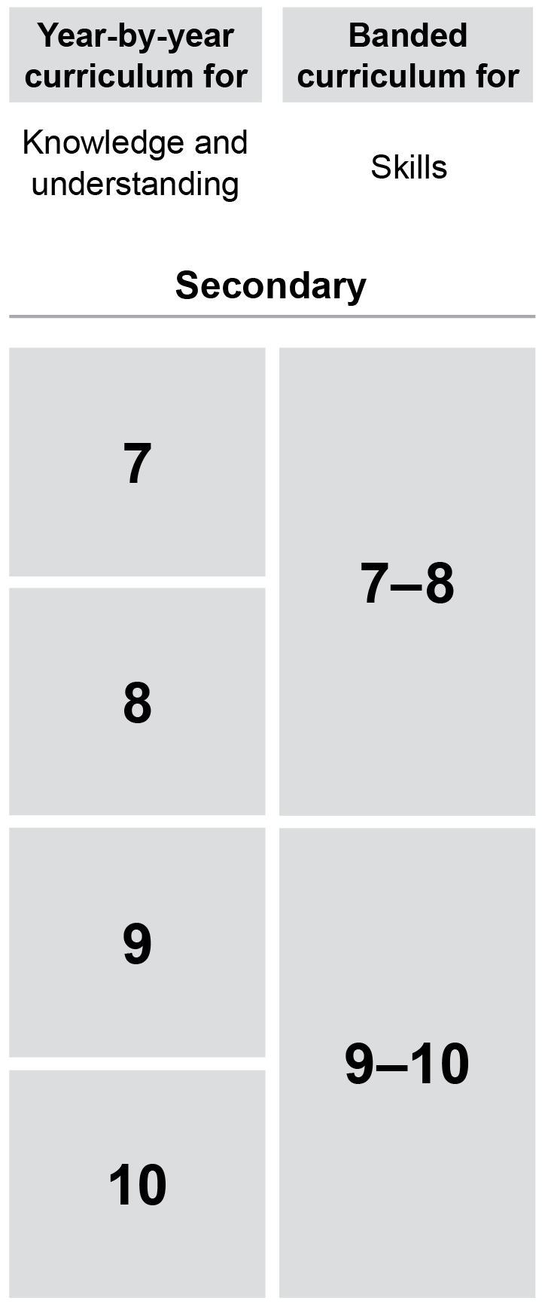
Year-by-year and banded curriculum
Each year of Years 7–10 Geography includes the following structural components:
level description
year-by-year content for the Knowledge and understanding strand
banded content for the Skills strand
year-by-year achievement standards.
The curriculum is developmentally sequenced across the year levels.
Notes:
The Years 7–10 Geography curriculum is structured into both year-by-year and banded curriculum content. The banded curriculum content enables flexible delivery of Geography across Years 7–10 . ​
​
Suggested activity​
What are the implications of the year-by-year curriculum for the planning of your teaching, learning and assessment program?​

Slide 10
Level description
Year 7
The Year 7 curriculum involves the study of 2 topics.
Water in the world – focuses on the many uses of water, the ways it is perceived and valued, and the hazards associated with environmental processes. Students examine the distribution of its different forms as a resource, its varying availability in time and across space, and its scarcity. They also explore the ways water connects and changes places as it moves through the environment, and the impact of water-related hazards on human-environment relationships.
It is suggested that the study of this topic draws on studies from Australia and countries in Asia.
Place and liveability – focuses on the factors that influence liveability, how it is perceived, and the idea that places provide us with the services and facilities needed to support and enhance our lives. Students examine the distribution of these spaces, and how they are planned and managed by people. They also consider the ways that the liveability of a place is enhanced and how sustainability is managed.
It is suggested that study of this topic draws on studies from Australia and countries in Europe.
Inquiry questions provide a framework for developing students’ knowledge, understanding and skills. The following inquiry questions are examples only and may be used or adapted to suit local contexts.
What approaches can be used to improve the availability of resources and access to services?
How does people’s reliance on places and environments influence their perception of them?
What effect does the uneven distribution of resources and services have on the lives of people?
Topics
Context
Inquiry questions
Notes:
Each Years 7–10 Geography level description identifies the:​
​
topics for each year​
context for each year
inquiry questions that may be addressed in each year.

Slide 11
Curriculum content
Year 9
Knowledge and understanding
Biomes and food security
Content description | Content elaborations
the effects on environments of human alteration of biomes to produce food, industrial materials and fibres AC9HG9K02 | identifying the biomes in Australia and a country in Asia that produce some of the foods and plant material people consume explaining the differences between natural and agricultural ecosystems in flows of nutrients and water, and in biodiversity; for example, the tropical rainforest biome in Indonesia produces food such as fruit, grains, nuts, vegetables and spices, and non-food products such as wood, rubber, coffee, chocolate and palm oil explaining how human alteration of biomes (for example, drip irrigation, fertilisers, pesticides, genetically modified seeds, agrobiotics, terracing, and controlling erosion and overgrazing) has increased agricultural productivity in Australia and a country in Asia
Notes:
The curriculum content is presented as content descriptions that specify the knowledge, understanding and skills young people are expected to learn and teachers are expected to teach across the years of schooling.
The content descriptions are accompanied by content elaborations. Content elaborations provide illustrations and/or examples that teachers may choose to use in the classroom or as inspiration for their own activities. The content elaborations are not a mandatory aspect of the curriculum and as such are not required to be taught.
Suggested activity
Use the Australian Curriculum: Geography to build an understanding of the sequence of content of the curriculum across year levels: https://v9.australiancurriculum.edu.au/.
Within the Australian Curriculum: Geography, select a year level and read the content descriptions.
Consider the content descriptions for the year level prior to and following the selected year level.
In a small group, discuss how the curriculum develops in increasing complexity of cognition and skills across the years/bands.

Slide 12
Curriculum content
Geography content is organised under two interrelated strands:
Knowledge and understanding
Skills.
Notes:
The two strands are interrelated and should be programmed and taught in an integrated way. The content descriptions of the two strands have been written so that at each year this integration is possible. The Knowledge and understanding strand provides the contexts through which skills and understandings of the core concepts are developed in increasing complexity across Years 7–10 .

Slide 13
Knowledge and understanding strand
Year 7 |  | Year 8 |  | Year 9 |  | Year 10
Water in the world |  | Landscapes and landforms |  | Biomes and food security |  | Environmental change and management
Place and liveability |  | Changing nations |  | Geographies of interconnections |  | Geographies of human wellbeing
Notes:
In each strand, curriculum content is further organised into sub-strands. In Geography, there are two sub-strands per year level.
Suggested activities
What is the relationship between the Knowledge and understanding strands of Geography?
Prepare a brief statement/overview that would help you describe the strands to a parent group.

Slide 14
Skills strand
— Sub-strands — | Questioning and researching using geographical methods |  | Concluding and decision-making
 | Interpreting and analysing geographical data and information |  | Communicating
Notes:
The skills strand is comprised of four sub-strands:
Questioning and researching using geographical methods
Interpreting and analysing geographical data and information
Concluding and decision-making
Communicating
Suggested activities
How do these sub-strands support skills development in other HASS subjects, e.g. Economics and Business?
How might you explain the difference between the sub-strands to your students? What does learning look like in each sub-strand?

Slide 15
Achievement standard
Year 8
By the end of Year 8, students explain how the interactions of people and environmental processes impact on the characteristics of places. They explain how the characteristics of places are perceived and valued differently by people. They describe the effects of human activity or hazards on environments. They explain the features of a distribution and identify implications. They explain the interconnections between people and places and environments. They explain how these interconnections change places or environments. Students explain responses or strategies to address a geographical phenomenon or challenge, referring to environmental, economic or social factors.
Students develop relevant questions about a geographical phenomenon or challenge. They collect, organise and represent relevant and reliable data and information using primary research methods and secondary research materials. They interpret and analyse data and information to explain patterns and trends and infer relationships. They draw reasoned conclusions about the impact of the geographical phenomenon or challenge. They decide on appropriate strategies for action and explain potential impacts. Students use geographical knowledge, methods, concepts, terms and reference findings from sources to create descriptions, explanations and responses.
Knowledge and understanding
Skills
Notes:
The achievement standard is a statement of what students should know and should be able to do at the end of the year level. In Geography, the first paragraph of the achievement standard relates to Knowledge and understanding and the second paragraph relates to Skills. ​
​
The Years 7–10 Geography achievement standards are available from: https://v9.australiancurriculum.edu.au/​​.
Suggested activities​
​Using the Australian Curriculum: Geography, discuss how the evidence that students need to provide of what they know and can do increases in complexity across year levels.​
​For a given year level, map the achievement standard to the content descriptions.

Slide 16
Key connections
Identify the connections with the other dimensions of the Australian Curriculum including:
the general capabilities
the cross-curriculum priorities
other learning areas within the Australian Curriculum.
Notes:
The key connections help teachers identify the links to the other dimensions for the Australian Curriculum including the general capabilities, cross-curriculum priorities and other learning areas to assist teachers to make connections in their planning for student learning.
The key connections are available from: https://v9.australiancurriculum.edu.au/teacher-resources/understand-this-learning-area/humanities-and-social-sciences/.
Suggested activities
Read the key connections section relating to the other learning areas. Partner with a colleague to discuss the following questions:
Which learning areas does the History curriculum have key connections to?
Why are these connections important? What important contribution do they make to a student’s education?
Create a concept map showing the connections between other learning areas.

Slide 17
Three-dimensional curriculum: General capabilities
Critical and creative thinking
Digital literacy
Ethical understanding
Intercultural understanding
Literacy
Numeracy
Personal and social capability
Notes:
The seven capabilities are divided into two groups:
capabilities that support students to be successful learners ― literacy, numeracy, digital literacy and critical and creative thinking
capabilities that develop ways of being, behaving and learning to live with others ― personal and social capability, ethical understanding and intercultural understanding.
Continua of learning have been developed for each capability to describe the relevant knowledge, understanding and skills at particular points of schooling, while the literacy and numeracy general capabilities have national learning progressions that describe the skills, understandings and capabilities that students typically acquire as their proficiency increases in a particular aspect of the curriculum over time.
The content outlined in the general capabilities' continua/progressions is embedded in the content descriptions for each learning area, where appropriate. The icons shown on this slide are used to identify where the general capabilities are embedded in content descriptions.
A summary of the focus of each of the general capabilities in the Humanities and social sciences learning area is available from: https://v9.australiancurriculum.edu.au/teacher-resources/understand-this-learning-area/humanities-and-social-sciences/.
Suggested activities
Read the key connection section relating to the general capabilities. Partner with a colleague to discuss the following questions:
To which general capabilities are there key connections?
Why are these connections important?
How could you embed the general capabilities authentically into your teaching and learning programs?

Slide 18
Three-dimensional curriculum: Cross-curriculum priorities
Aboriginal and Torres Strait Islander histories and cultures Asia and Australia’s Engagement with Asia Sustainability
Notes:
The Australian Curriculum promotes three cross-curriculum priorities that young Australians should learn about. Each of the priorities is represented in learning areas in ways appropriate to that area.
The three priorities are:
Aboriginal and Torres Strait Islander histories and cultures ― to ensure that all young Australians are given the opportunity to gain a deeper understanding and appreciation of Aboriginal and Torres Strait Islander histories and cultures, their significance for Australia and the impact that these have had, and continue to have, on our world
Asia and Australia’s engagement with Asia ― to reflect the importance of knowing about Asia and Australia’s engagement with Asia and to encourage better understanding of the countries and cultures of the Asia region so that young people appreciate the economic, political and cultural interconnections that Australia has with the region
Sustainability ― to allow young people to develop an appreciation of the need for more sustainable patterns of living and to build capacities for thinking, valuing and acting that are necessary to create a more sustainable future.
Each of the cross-curriculum priorities contains a set of organising ideas. These are consistent across the curriculum and are reinforced in learning areas. Explicit teaching of the priorities may be be incorporated in teaching and learning activities where appropriate.
Suggested activity
Read the key connections section relating to the cross-curriculum priorities. Partner with a colleague to discuss the following questions:
To which cross-curriculum priorities are there key connections?
How are the cross-curriculum priorities reflected in your teaching and learning programs?

Slide 19
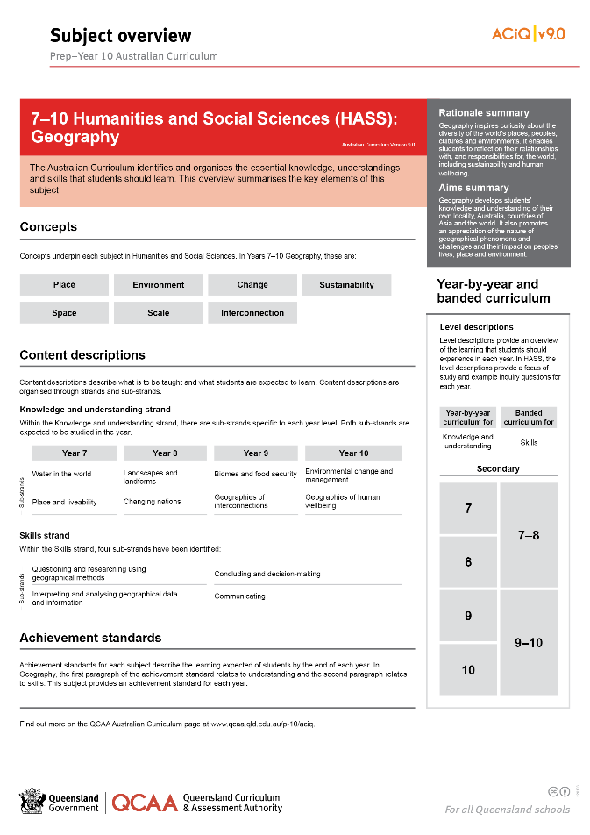
Find out more
Find out more on the QCAA Australian Curriculum webpage.
Notes:
More information about the implementation of Australian Curriculum in Queensland is available on the QCAA website. A one-page overview of the Australian Curriculum: Geography can be accessed through https://www.qcaa.qld.edu.au/p-10/aciq/version-9/learning-areas/p-10-humanities-and-social-sciences/.
Send any further questions to: australiancurriculum@qcaa.qld.edu.au.
Information about requests for further professional learning is available from: www.qcaa.qld.edu.au/pd-events/request-pd.
Suggested activity
Partner with a colleague to discuss the following questions:
What did I learn?
What was confirmed?
What was new?
What challenged my thinking?
What else do I need to do?
What is our plan as a teaching team?

Slide 20
Acknowledgments
© State of Queensland (QCAA) 2022
Licence: https://creativecommons.org/licenses/by/4.0 | Copyright notice: www.qcaa.qld.edu.au/copyright — lists the full terms and conditions, which specify certain exceptions to the licence. | Attribution: ‘© State of Queensland (QCAA) 2022’ — please include the link to our copyright notice.
Other copyright material in this publication is listed below:
Photograph/s of staff and students used with permission.
Unless otherwise indicated, material from Australian Curriculum is © ACARA 2010–present, licensed CC BY 4.0. For the latest information and additional terms of use, see the Australian Curriculum website and its copyright notice.
The three-dimensional curriculum diagram is 'Excluded Material' used under the terms of the Australian Curriculum and its copyright notice and is not modified. © Australian Curriculum, Assessment and Reporting Authority (ACARA) 2009 to present, unless otherwise indicated.
You may view, download, display, print, reproduce (such as by making photocopies) and distribute these Excluded Materials in unaltered form only for your personal, non-commercial educational purposes or for the non-commercial educational purposes of your organisation, provided that you make others aware it can only be used for these purposes and attribute ACARA as the source of the Excluded Material. For the avoidance of doubt, this means that you cannot edit, modify or adapt any of these materials, and you cannot sub-licence any of these materials to others. Apart from any uses permitted under the Copyright Act 1968 (Cth), and those explicitly granted above, all other rights are reserved by ACARA. If you want to use such material in a manner that is outside this restrictive licence, you must request permission from ACARA by emailing (copyright@acara.edu.au).

Slide 21
QCAA social media

