Slide 1
Economics and Business
Years 7–10 Australian Curriculum: Humanities and Social Sciences Version 9.0
Subject overview
220089
Notes:
This presentation supports understanding of Australian Curriculum Version 9.0: Humanities and Social Sciences Year 7–Year 10. It gives insight into the position of Economics and Business within the Australian Curriculum: HASS and the structure of the HASS learning area.
You can use this presentation in your organisation as the basis for professional learning about the HASS curriculum. It includes information about the key aspects of the curriculum, as well as activities for becoming familiar with the curriculum. An icon in the bottom-right corner of a slide identifies opportunities for activities. Presenters are encouraged to tailor this presentation to suit the needs of their audience.
The Australian Curriculum content referred to in this presentation is available from:
Australian Curriculum, Assessment and Reporting Authority (ACARA) 2022, Australian Curriculum Version 9 Foundation to Year 10, https://v9.australiancurriculum.edu.au/

Slide 2
Learning goals
This presentation aims to:
build understanding of the Australian Curriculum Version 9.0: Humanities and Social Sciences in Years 7–10 Economics and Business
provide an overview of the structure of Years 7–10 Economics and Business.
Notes:
This presentation aims to:
build understanding of the Australian Curriculum Version 9.0, with particular reference to the Humanities and Social Sciences curriculum in Years 7–10 Economics and Business
provide an overview of the structure of Years 7–10 Economics and Business, including the curriculum content and achievement standards.
Note: Learning area information for Years 7–10 Humanities and Social Sciences is available in the Learning area overview presentation.
Note: Subject-specific presentations are also available for other HASS subjects. These are:
Years 7–10 History
Years 7–10 Geography
Years 7–10 Civics and Citizenship.

Slide 3
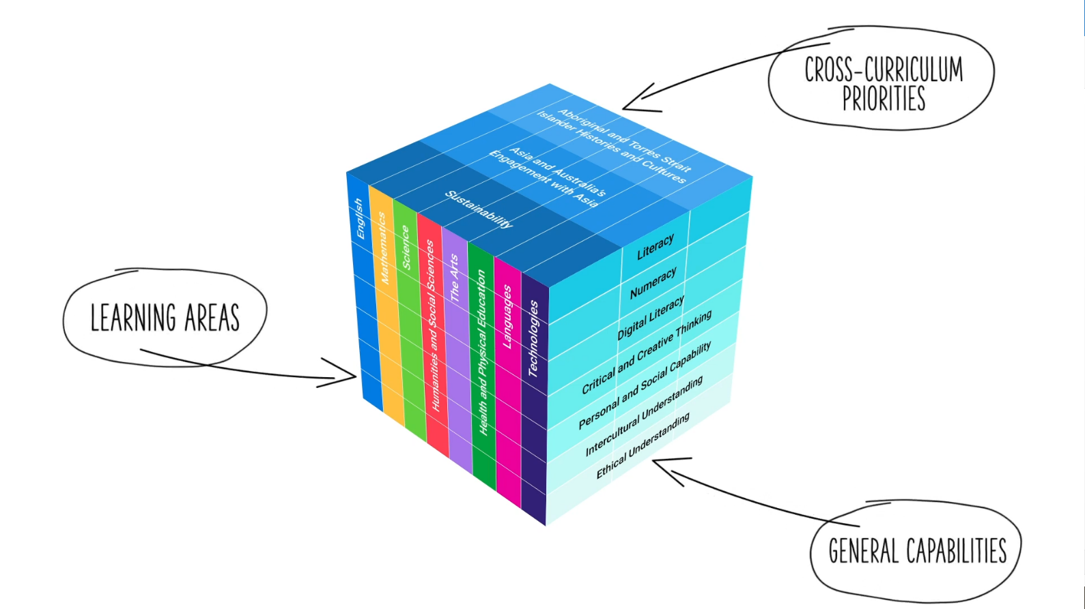
Three-dimensional curriculum
The Australian Curriculum is a three-dimensional curriculum made up of:
learning areas
general capabilities
cross-curriculum priorities.
ACARA image from Summary overview (video): https://v9.australiancurriculum.edu.au/help/website-tour.
Notes:
The Australian Curriculum sets the expectations for what all Australian students should be taught and have the opportunity to learn as they progress through their school life. In Prep to Year 10, the Australian Curriculum provides teachers, students, and parents with access to the same content and consistent national standards for determining the progress of student learning.
All Australian students across all education settings and contexts can be supported in their diverse learning needs through the three dimensions of the Australian Curriculum: the learning area content, the general capabilities and the cross-curriculum priorities.
This diagram shows the relationship between these dimensions of the Australian Curriculum. Teachers emphasise one or more dimensions to develop learning programs suited to the strengths, interests and diverse needs of all students.
This presentation provides a brief overview of the general capabilities and cross-curriculum priorities. However, the focus will be on Years 7–10 Economics and Business.

Slide 4
Structure of Years 7–10 Economics and Business
Rationale
Aims
Key considerations
Core concepts
Structure
Year-by-year curriculum
Achievement standards
Curriculum content
Source: https://v9.australiancurriculum.edu.au/teacher-resources/understand-this-learning-area/humanities-and-social-sciences#economics-and-business-7%E2%80%9310.
Notes:
The Australian Curriculum sets out what all young people should be taught by specifying the curriculum content, and identifies the learning expected at points in their schooling by specifying the achievement standards. The content and achievement standards are supported by additional information that describes the:
curriculum intent (rationale)
aims of learning (aims)
key considerations when planning learning experiences that are unique to Economics and Business
core concepts that underpin the essential content of Economics and Business
organising structure and focus for the learning at specific year levels including the level descriptions, the curriculum content and the achievement standards.
The following sections of the presentation will provide an overview of each of these key aspects of the curriculum.

Slide 5
Rationale
Global flows of people, resources, finances and information produce social, economic, political and environmental complexities and challenges. Consequently, Australia needs enterprising individuals and businesses who embrace opportunities, make informed decisions and contribute to the common good. Young Australians will also face several social, economic, environmental and ethical challenges in their lifetimes, which will impact on their lives and choices. It is critical that students are equipped with the knowledge, understanding and skills to respond to such challenges.
Economics and Business develops the knowledge, understanding and skills that will equip students to shape their social and economic futures. It also aids in the development of prosperous, sustainable and equitable Australian and global economies. Through studying economics and business, students learn to make informed decisions and to appreciate the effects of these decisions on individuals, businesses, and environmental and social systems.
Thinking about and responding to contemporary economic and business issues requires an understanding of resource allocation and economic decision-making, the operation of the business environment, the ways entrepreneurs create solutions, the nature and future of work, and the factors influencing decision-making in consumer and financial contexts.
Economics and Business develops a range of skills that foster enterprising individuals who can effectively embrace change; seek innovation; work with others; show initiative, flexibility and leadership; plan, organise and manage risk; and use resources efficiently.
Source: Quoted verbatim and unaltered from ACARA, https://v9.australiancurriculum.edu.au/teacher-resources/understand-this-learning-area/humanities-and-social-sciences#economics-and-business-7%E2%80%9310.
Notes:
The rationale defines the subject and describes its importance within the curriculum:
Why is it important?
How is it shaped in the curriculum?
The Years 7–10 Economics and Business rationale promotes:
understanding of the global flows of people, resources, finances and information and how these may produce social, economic, political and environmental complexities and challenges
making informed decisions in response to challenges
appreciation of the effects of decisions on individuals, businesses and environmental and social systems
The full rationale is available from: https://v9.australiancurriculum.edu.au/teacher-resources/understand-this-learning-area/humanities-and-social-sciences#economics-and-business-7%E2%80%9310/.
Suggested activity
Read the full rationale for Years 7–10 Economics and Business. Partner with a colleague to discuss the following questions:
What are the key aspects of the rationale?
What important contribution does the learning area make to a student’s education?
Which aspects of this rationale match your current understanding of the subject? Which aspects are new understandings?

Slide 6
Aims
Economics and Business aims to ensure students develop:
knowledge and understanding of the nature and operation of the work and business environments within the Australian economy, and factors influencing decision-making, their impacts and appropriate responses
an understanding of the concepts of resource allocation and economic decision-making, the business environment, entrepreneurship, work and work futures, and consumer and financial literacy
a sense of what it is to participate in the economy, contribute to work and business environments, and make informed decisions in relation to contemporary issues drawn from local, national, Asian and global contexts
an appreciation of economic and business issues affecting contemporary Australian society, an understanding of how Australia and Asia are interdependent through economic and business connections, and consideration of sustainable patterns of living
skills to engage in inquiries, including questioning and researching, interpreting and analysing, decision-making, and communicating
capabilities to engage in everyday life, including critical and creative thinking, ethical understanding, and personal and social competence.
Source: Quoted verbatim and unaltered from ACARA, https://v9.australiancurriculum.edu.au/teacher-resources/understand-this-learning-area/humanities-and-social-sciences#economics-and-business-7%E2%80%9310.
Notes:
The aims flow logically from the rationale and identify the major learning that students will be able to demonstrate as a result of being taught the curriculum.
The Years 7–10 Economics and Business subject aims to ensure students develop:
knowledge and understanding of the nature and operation of the business and economic environment and factors influencing decision-making, their impacts and appropriate responses
an understanding of the concepts — resource allocation and economic decision-making, the business environment, entrepreneurship, work and work futures and consumer and financial literacy
a sense of what it is to participate in and contribute to the economic and business environment and make informed decisions in relation to contemporary issues drawn from local, national, Asian and global contexts
an appreciation of economic and business issues affecting contemporary Australian society, awareness of the economic and business environment within Asia and consideration of sustainable patterns of living
skills to engage in inquiries, including questioning and researching, interpreting and analysing, decision-making and communicating
capabilities to engage in everyday life including critical and creative thinking, ethical understanding and personal and social competence.
The aims are available from: https://v9.australiancurriculum.edu.au/teacher-resources/understand-this-learning-area/humanities-and-social-sciences/.
Suggested activities
Prepare a brief statement/overview that would help you describe the aims of the subject to a parent group.
Identify two or three big ideas in the aims. How do they inform:
your understanding of the subject?
what is valued in the Australian Curriculum for the subject?
your teaching and learning approaches?

Slide 7
Key considerations
Economics and business
Inquiry questions
Selecting contexts for study
Developing consumer and financial literacy capability
Other HASS considerations
Protocols for engaging First Nations Australians
Meeting the needs of diverse learners
Notes:
The key considerations provide a brief overview of how the Australian Curriculum can accommodate particular approaches to teaching and assessment in Economics and Business.
The Australian Curriculum: Economics and Business emphasises the importance of providing learning opportunities for students to:
engage in questioning to develop students’ knowledge, understanding and skills. As such, exemplar inquiry questions have been incorporated into each year-level description for each subject in Years 7–10
make connections between the curriculum and events or issues that are occurring in the students’ local area, Australia, the significant nations of Asia and the world
develop capability in consumer and financial literacy.
This section also supports teachers to consider:
protocols for engaging in First Nations Australians
inclusive practices that are relevant to the students’ needs.
The key considerations are available from: https://v9.australiancurriculum.edu.au/teacher-resources/understand-this-learning-area/humanities-and-social-sciences/.
Suggested activity
How are the key considerations reflected in your Economics and Business program?

Slide 8
Core concepts
Resource allocation and decision-making
The business environment
Entrepreneurship
Work and work futures
Consumer and financial literacy
Notes:
In Years 7–10, students build on their understanding through core concepts and apply this understanding to the study of history. These concepts are the key ideas involved in teaching students to think historically.
Resource allocation and decision-making — The process of choosing between competing alternatives to satisfy needs and wants with limited resources, recognising that decisions impact on individuals, communities and the environment.
The business environment — The ways businesses operate at many levels, and respond to opportunities and changing circumstances and conditions. As businesses operate in markets, the decisions they make have social, economic and environmental consequences.
Entrepreneurship — The innovative thinking and calculated risk-taking of individuals and groups to find and implement creative business solutions to problems, while considering the social, economic and environmental impact for the local community and Australian society.
Work and work futures — An exploration of the contribution of work to human wellbeing and a prosperous society, the factors that influence the work environment now and into the future and the rights and responsibilities of participants in the work environment.
Consumer and financial literacy — The capacity to make responsible and informed decisions about managing money and assets and identifying how these decisions affect human wellbeing, our society and sense of security for the future.
The core concepts are available from https://v9.australiancurriculum.edu.au/teacher-resources/understand-this-learning-area/humanities-and-social-sciences#economics-and-business-7%E2%80%9310/.
Suggested activity:
With a colleague, look at one of the core concepts and aim to identify where this concept is evident in the content descriptions and/or content elaborations for a particular year level.

Slide 9
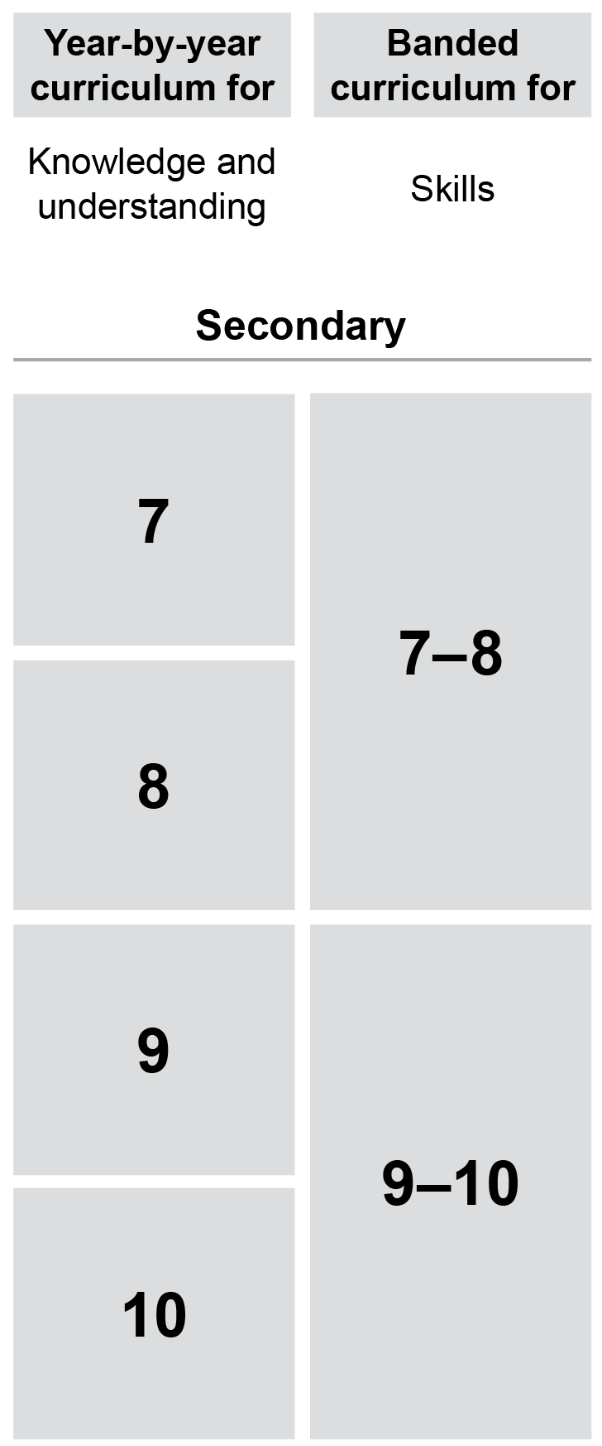
Year-by-year and banded curriculum
Each year includes the following structural components:
level description
year-by-year content for the Knowledge and understanding strand
banded content for the Skills strand
year-by-year achievement standards.
The curriculum is developmentally sequenced across the year levels.
Notes:
The Years 7–10 Economics and Business curriculum is structured into both year-by-year and banded curriculum content. The banded curriculum content enables flexible delivery of Economics and Business across Years 7–10 . ​
​
Suggested activity​
What are the implications of the year-by-year curriculum for the planning of your teaching, learning and assessment program?​

Slide 10
Level description
Year 7
The focus of learning in Year 7 is the topic "individuals, businesses and entrepreneurs" within a personal, community and national context.
In Year 7, students investigate the nature and purpose of informed and responsible decision-making by individuals and businesses, with attention to the allocation of limited resources to meet unlimited needs and wants, types of businesses, how entrepreneurial characteristics contribute to business success, and the ways work is undertaken. They also examine the rights and responsibilities that individuals and businesses have within consumer and financial contexts.
Inquiry questions provide a framework for developing students’ knowledge, understanding and skills. The following inquiry questions are examples only and may be used or adapted to suit local contexts:
How and why are economic decisions made to allocate limited resources to meet unlimited needs and wants in the Australian economy?
What are the different types of businesses that provide goods and/or services?
What is entrepreneurship and how do entrepreneurial characteristics contribute to the success of a business?
Why do individuals contribute to their community and how do they derive an income?
Why do consumers and businesses have both rights and responsibilities?
Topic
Inquiry questions
Notes:
Each Years 7–10 Economics and Business level description identifies the:​
​
topic for each year​
inquiry questions that may be addressed in each year.

Slide 11
Curriculum content
Year 8
Knowledge and Understanding
Content description | Content elaborations
processes that individuals and/or businesses use to plan and budget to achieve short-term and long-term financial objectives AC9HE8K05 | identifying ways short- and long-term personal financial objectives can be achieved; for example, through developing a budget and having a savings plan explaining how financial records, such as income statements, balance sheets, budgets and cash flow statements, inform business decision-making identifying and explaining business processes that are used to manage finances and plan in the short- and long-term; for example, devising a business plan, borrowing from a financial institution, building savings by earning interest
Notes:
The curriculum content is presented as content descriptions that specify the knowledge, understanding and skills young people are expected to learn and teachers are expected to teach across the years of schooling.
The content descriptions are accompanied by content elaborations. Content elaborations provide illustrations and/or examples that teachers may choose to use in the classroom or as inspiration for their own activities. The content elaborations are not a mandatory aspect of the curriculum and as such are not required to be taught.
Suggested activity
Use the Australian Curriculum: Economics and Business to build an understanding of the sequence of content of the curriculum across year levels: https://v9.australiancurriculum.edu.au/.
Within the Australian Curriculum: Economics and Business, select a year level and read the content descriptions.
Consider the content descriptions for the year level prior to and following the selected year level.
In a small group, discuss how the curriculum develops in increasing complexity of cognition and skills across the years/bands.

Slide 12
Curriculum content
Economics and Business content is organised under two interrelated strands:
Knowledge and understanding
Skills.
Notes:
The two strands are interrelated and should be programmed and taught in an integrated way. The content descriptions of the two strands have been written so that at each year this integration is possible. The Knowledge and understanding strand provides the contexts through which skills and understandings of the core concepts are developed in increasing complexity across Years 7–10 .

Slide 13
Strands and sub-strands
Strand | Knowledge and understanding |  | Skills
Sub-strands | Sub-strands are not included in this subject |  | Questioning and researching
 |  |  | Interpreting and analysing
 |  |  | Economic and business decision-making
 |  |  | Communicating
Notes:
In each strand, curriculum content is further organised into sub-strands. In Economics and Business, the Knowledge and understanding strand does not include sub-strands, but there are four sub-strands in the Skills strand.
Suggested activities
What is the relationship between the strands of Economics and Business?
Prepare a brief statement/overview that would help you describe the strands to a parent group.

Slide 14
Achievement standards
Year 10
By the end of Year 10, students compare the key features and values of Australia’s system of government to those of another system of government. They describe the Australian Government’s role and responsibilities at a regional and global level. They explain the role of the High Court of Australia. They explain how Australia’s international legal obligations influence the law and government policy. They identify and explain challenges to a resilient democracy and a cohesive society in Australia.
Students develop and refine a range of questions and locate, select and compare relevant and reliable information from a range of sources to investigate political and legal systems, and contemporary civic issues. They analyse information to evaluate perspectives and challenges related to political, legal or civic issues. They evaluate and compare the methods or strategies related to civic participation or action. Students use civics and citizenship knowledge, concepts and terms to develop descriptions, explanations and arguments that synthesise evidence from sources.
Knowledge and understanding
Skills
Notes:
The achievement standard is a statement of what students should know and should be able to do at the end of the year level. In Economics and Business, the first paragraph of the achievement standard relates to Knowledge and understanding and the second paragraph relates to Skills. ​
​
The Years 7–10 Economics and Business achievement standards are available from: https://v9.australiancurriculum.edu.au/.
​​
Suggested activities​
​Using the Australian Curriculum: Economics and Business, discuss how the evidence that students need to provide of what they know and can do increases in complexity across year levels.​
​For a given year level, map the achievement standard to the content descriptions.

Slide 15
Key connections
Identify the connections with the other dimensions of the Australian Curriculum including:
the general capabilities
the cross-curriculum priorities
other learning areas within the Australian Curriculum.
Notes:
The key connections are to help teachers identify the links to the other dimensions for the Australian Curriculum including the general capabilities, cross-curriculum priorities and other learning areas to assist teachers to make connections in their planning for student learning.
The key connections are available from: https://v9.australiancurriculum.edu.au/teacher-resources/understand-this-learning-area/humanities-and-social-sciences/.
Suggested activities
Read the key connections section relating to the other learning areas. Partner with a colleague to discuss the following questions:
Which learning areas does the Economics and Business curriculum have key connections to?
Why are these connections important?
Create a concept map showing the connections between other learning areas.

Slide 16
Three-dimensional curriculum: General capabilities
Critical and creative thinking
Digital literacy
Ethical understanding
Intercultural understanding
Literacy
Numeracy
Personal and social capability
Notes:
The seven capabilities are divided into two groups:
capabilities that support students to be successful learners ― literacy, numeracy, digital literacy and critical and creative thinking
capabilities that develop ways of being, behaving and learning to live with others ― personal and social capability, ethical understanding and intercultural understanding.
Continua of learning have been developed for each capability to describe the relevant knowledge, understanding and skills at particular points of schooling, while the literacy and numeracy general capabilities have national learning progressions that describe the skills, understandings and capabilities that students typically acquire as their proficiency increases in a particular aspect of the curriculum over time.
The content outlined in the general capabilities' continua/progressions is embedded in the content descriptions for each learning area, where appropriate. The icons shown on this slide are used to identify where the general capabilities are embedded in content descriptions.
A summary of the focus of each of the general capabilities in the Humanities and social sciences learning area is available from: https://v9.australiancurriculum.edu.au/teacher-resources/understand-this-learning-area/humanities-and-social-sciences/.
Suggested activities
Read the key connection section relating to the general capabilities. Partner with a colleague to discuss the following questions:
To which general capabilities are there key connections?
Why are these connections important?
How could you embed the general capabilities authentically into your teaching and learning programs?

Slide 17
Three-dimensional curriculum: Cross-curriculum priorities
Aboriginal and Torres Strait Islander histories and cultures Asia and Australia’s engagement with Asia Sustainability
Notes:
The Australian Curriculum promotes three cross-curriculum priorities that young Australians should learn about. Each of the priorities is represented in learning areas in ways appropriate to that area.
The three priorities are:
Aboriginal and Torres Strait Islander histories and cultures ― to ensure that all young Australians are given the opportunity to gain a deeper understanding and appreciation of Aboriginal and Torres Strait Islander histories and cultures, their significance for Australia and the impact that these have had, and continue to have, on our world
Asia and Australia’s engagement with Asia ― to reflect the importance of knowing about Asia and Australia’s engagement with Asia and to encourage better understanding of the countries and cultures of the Asia region so that young people appreciate the economic, political and cultural interconnections that Australia has with the region
Sustainability ― to allow young people to develop an appreciation of the need for more sustainable patterns of living and to build capacities for thinking, valuing and acting that are necessary to create a more sustainable future.
Each of the cross-curriculum priorities contains a set of organising ideas. These are consistent across the curriculum and are reinforced in learning areas. Each of the cross-curriculum priorities can be relevant to teaching and learning in Economic and Business and explicit teaching of the priorities may be incorporated in teaching and learning activities where appropriate.
Suggested activity
Read the key connections section relating to the cross-curriculum priorities. Partner with a colleague to discuss the following questions:
To which cross-curriculum priorities are there key connections?
How are the cross-curriculum priorities reflected in your teaching and learning programs?

Slide 18
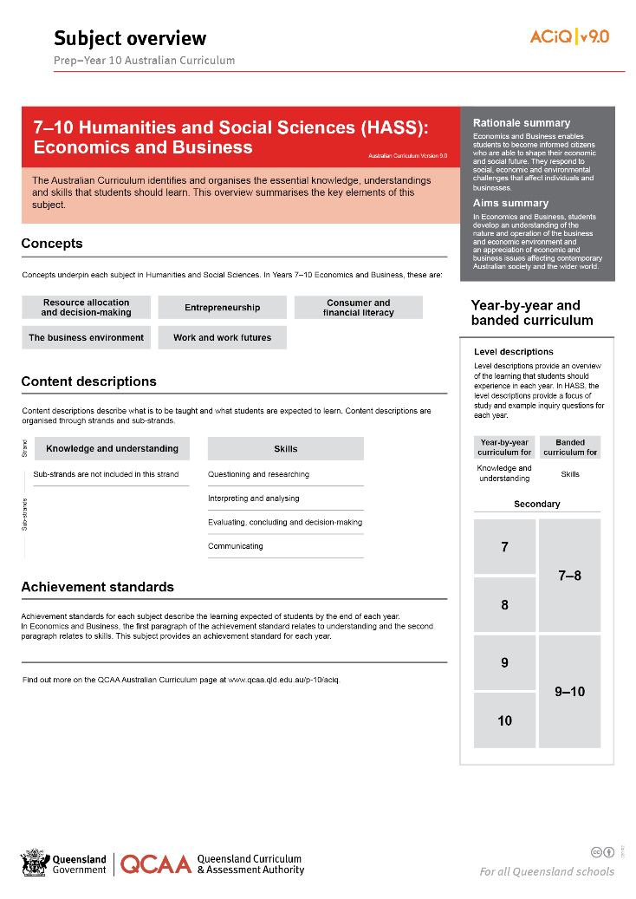
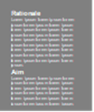
Find out more
Find out more on the QCAA Australian Curriculum webpage.
Notes:
More information about the implementation of Australian Curriculum in Queensland is available on the QCAA website. A one-page overview of the Australian Curriculum: HASS in Years 7–10 Economics and Business can be accessed through https://www.qcaa.qld.edu.au/p-10/aciq/version-9/learning-areas/p-10-humanities-and-social-sciences/.
Send any further questions to: australiancurriculum@qcaa.qld.edu.au.
Information about requests for further professional learning is available from: www.qcaa.qld.edu.au/pd-events/request-pd.
Suggested activity
Partner with a colleague to discuss the following questions:
What did I learn?
What was confirmed?
What was new?
What challenged my thinking?
What else do I need to do?
What is our plan as a teaching team?

Slide 19
Acknowledgments
© State of Queensland (QCAA) 2022
Licence: https://creativecommons.org/licenses/by/4.0 | Copyright notice: www.qcaa.qld.edu.au/copyright — lists the full terms and conditions, which specify certain exceptions to the licence. | Attribution: ‘© State of Queensland (QCAA) 2022’ — please include the link to our copyright notice.
Other copyright material in this publication is listed below:
Photograph/s of staff and students used with permission.
Unless otherwise indicated, material from Australian Curriculum is © ACARA 2010–present, licensed CC BY 4.0. For the latest information and additional terms of use, see the Australian Curriculum website and its copyright notice.
The three-dimensional curriculum diagram is 'Excluded Material' used under the terms of the Australian Curriculum and its copyright notice and is not modified. © Australian Curriculum, Assessment and Reporting Authority (ACARA) 2009 to present, unless otherwise indicated.
You may view, download, display, print, reproduce (such as by making photocopies) and distribute these Excluded Materials in unaltered form only for your personal, non-commercial educational purposes or for the non-commercial educational purposes of your organisation, provided that you make others aware it can only be used for these purposes and attribute ACARA as the source of the Excluded Material. For the avoidance of doubt, this means that you cannot edit, modify or adapt any of these materials, and you cannot sub-licence any of these materials to others. Apart from any uses permitted under the Copyright Act 1968 (Cth), and those explicitly granted above, all other rights are reserved by ACARA. If you want to use such material in a manner that is outside this restrictive licence, you must request permission from ACARA by emailing (copyright@acara.edu.au).

Slide 20
QCAA social media

