Slide 1
Civics and Citizenship
Years 7–10 Australian Curriculum: Humanities and Social Sciences Version 9.0
Subject overview
220088
Notes:
This presentation supports understanding of the Australian Curriculum Version 9.0: Humanities and Social Sciences Year 7–Year 10. It gives insight into the position of Civics and Citizenship within the Australian Curriculum: HASS and the structure of the HASS learning area.
You can use this presentation in your organisation as the basis for professional learning about the HASS curriculum. It includes information about the key aspects of the curriculum, as well as activities for becoming familiar with the curriculum. An icon in the bottom-right corner of a slide identifies opportunities for activities. Presenters are encouraged to tailor this presentation to suit the needs of their audience.
The Australian Curriculum content referred to in this presentation is available from:
Australian Curriculum, Assessment and Reporting Authority (ACARA) 2022, Australian Curriculum Version 9 Foundation to Year 10, https://v9.australiancurriculum.edu.au/

Slide 2
Learning goals
This presentation aims to:
build understanding of the Australian Curriculum Version 9.0: Humanities and Social Sciences in Years 7–10 Civics and Citizenship
provide an overview of the structure of Years 7–10 Civics and Citizenship.
Notes:
This presentation aims to:
build understanding of the Australian Curriculum Version 9.0, with particular reference to the Humanities and Social Sciences curriculum in Years 7–10 Civics and Citizenship
provide an overview of the structure of Years 7–10 Civics and Citizenship, including the curriculum content and achievement standards.
Note: Learning area information for Years 7–10 Humanities and Social Sciences is available in the Learning area overview presentation.
Note: Subject-specific presentations are also available for other HASS subjects. These are:
Years 7–10 History
Years 7–10 Geography
Years 7–10 Economics and Business.

Slide 3
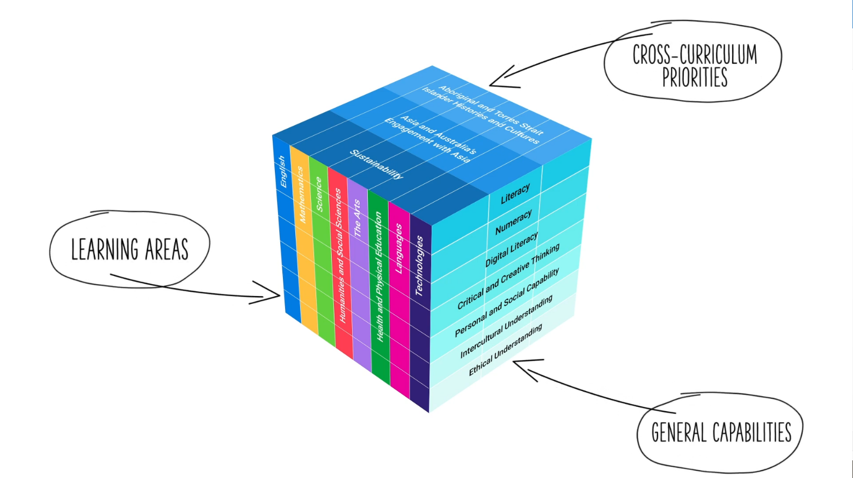
Three-dimensional curriculum
The Australian Curriculum is a three-dimensional curriculum made up of:
learning areas
general capabilities
cross-curriculum priorities.
ACARA image from Summary overview (video): https://v9.australiancurriculum.edu.au/help/website-tour.
Notes:
The Australian Curriculum sets the expectations for what all Australian students should be taught and have the opportunity to learn as they progress through their school life. In Prep to Year 10, the Australian Curriculum provides teachers, students and parents with access to the same content and consistent national standards for determining the progress of student learning.
All Australian students across all education settings and contexts can be supported in their diverse learning needs through the three dimensions of the Australian Curriculum: the learning area content, the general capabilities and the cross-curriculum priorities.
This diagram shows the relationship between these dimensions of the Australian Curriculum. Teachers emphasise one or more dimensions to develop learning programs suited to the strengths, interests and diverse needs of all students.
This presentation provides a brief overview of the general capabilities and cross-curriculum priorities. However, the focus will be on Years 7–10 Civics and Citizenship.

Slide 4
Structure of Years 7–10 Civics and Citizenship
Rationale
Aims
Key considerations
Core concepts
Structure
Year-by-year curriculum
Achievement standards
Curriculum content
Source: https://v9.australiancurriculum.edu.au/teacher-resources/understand-this-learning-area/humanities-and-social-sciences#civics-and-citizenship-7%E2%80%9310.
Notes:
The Australian Curriculum sets out what all young people should be taught by specifying the curriculum content and identifies the learning expected at points in their schooling by specifying the achievement standards. The content and achievement standards are supported by additional information that describes the:
curriculum intent (rationale)
aims of learning (aims)
key considerations when planning learning experiences that are unique to Civics and Citizenship
core concepts that underpin the essential content of Civics and Citizenship
organising structure and focus for the learning at specific year levels including the level descriptions, the curriculum content and the achievement standards.
The following sections of the presentation will provide an overview of each of these key aspects of the curriculum.

Slide 5
Rationale
A deep understanding of Australia’s federal system of government and the liberal democratic values that underpin it is essential for students to become active and informed citizens who can participate in and sustain Australia’s democracy.
Civics and Citizenship provides students with opportunities to investigate political and legal systems, and explore the nature of citizenship, diversity and identity in contemporary society. Emphasis is placed on the federal system of government, derived from the Westminster and Washington systems, and the liberal democratic values that underpin it, such as freedom, equality and the rule of law. The curriculum explores how the people, as citizens, choose their governments; how the system safeguards democracy by vesting people with civic rights and responsibilities; how laws and the legal system protect people’s rights; and how individuals and groups can influence civic life.
The curriculum recognises that Australia is a secular nation with a culturally diverse, multi-faith society and a Christian heritage. The curriculum promotes inclusivity by developing students’ understanding of broader values such as respect, civility, equity, justice and responsibility. It acknowledges the experiences and contributions of First Nations Australians and their identities within contemporary Australia. While the curriculum strongly focuses on the Australian context, students also reflect on Australia’s position and international obligations, and the role of citizens today, both within Australia and in an interconnected world.
Through the study of Civics and Citizenship, students develop inquiry skills, values and dispositions that enable them to be active and informed citizens who question, understand and contribute to the world they live in. The curriculum offers opportunities for students to develop a wide range of skills by investigating contemporary civics and citizenship issues, and fostering civic participation and engagement.
The Civics and Citizenship curriculum aims to reinforce students’ appreciation and understanding of what it means to be a citizen. It fosters responsible participation in Australia’s democracy and explores ways in which students can actively shape their lives, value belonging to a diverse and dynamic society, and positively contribute locally, nationally, regionally and globally. As reflective, active and informed decision-makers, students will be well placed to contribute to an evolving and healthy democracy that fosters the wellbeing of Australia as a democratic nation.
Source: Quoted verbatim and unaltered from ACARA, https://v9.australiancurriculum.edu.au/teacher-resources/understand-this-learning-area/humanities-and-social-sciences#civics-and-citizenship-7%E2%80%9310.
Notes:
The rationale defines the subject and describes its importance within the curriculum.
The Years 7–10 Civics and Citizenship rationale promotes:
appreciation and understanding of what it means to be a citizen
responsible participation in Australia’s democracy, exploration of ways in which students can actively shape their lives and how they can value belonging to a diverse and dynamic society and positively contribute locally, nationally, regionally and globally.
The full rationale is available from: https://v9.australiancurriculum.edu.au/teacher-resources/understand-this-learning-area/humanities-and-social-sciences#civics-and-citizenship-7%E2%80%9310/.
Suggested activity
Read the full rationale for Years 7–10 Civics and Citizenship. Partner with a colleague to discuss the following questions:
What are the key aspects of the rationale?
Why is Years 7–10 Civics and Citizenship important? What important contribution does the learning make to a student’s education?
Which aspects of this rationale match your current understanding of the subject? Which aspects are new understandings?

Slide 6
Aims
Civics and Citizenship aims to ensure students develop:
a lifelong sense of belonging and engagement with civic life as active and informed citizens, in the context of Australia as a secular democratic nation with a dynamic, culturally diverse, multi-faith society that has a Christian heritage, and distinct First Nations Australian histories and cultures
knowledge, understanding and appreciation of the values, principles, institutions and practices of Australia’s system of democratic government and law, and the role of the citizen in Australian government and society
an understanding of the concepts of active citizenship, democracy, global citizenship, legal systems, and identity and diversity
skills including questioning and research; analysis, evaluation and interpretation; civic participation and decision-making; and communicating
the capabilities and dispositions to participate responsibly in the civic life of their nation at a local, regional and global level, and as individuals in a globalised world.
Source: Quoted verbatim and unaltered from ACARA, https://v9.australiancurriculum.edu.au/teacher-resources/understand-this-learning-area/humanities-and-social-sciences#civics-and-citizenship-7%E2%80%9310.
Notes:
The aims flow logically from the rationale and identify the major learning that students will be able to demonstrate as a result of being taught the curriculum.
The Years 7–10 Civics and Citizenship subject aims to ensure students develop:
a lifelong sense of belonging to and engagement with civic life as active and informed citizens in the context of Australia as a secular democratic nation with a dynamic, culturally diverse, multi-faith society and with a Christian heritage
knowledge, understanding and appreciation of the values, principles, institutions and practices of Australia’s system of democratic government and law and the role of the citizen in Australian government and society
an understanding of the core concepts, including active citizenship, democracy, global citizenship, legal systems and identity and diversity
skills, including asking questions, investigating contemporary issues, participating in civic processes and engagement and evaluating Australian political and legal issues
the capacities and dispositions to participate responsibly in the civic life of their nation at a local, regional and global level and as individuals in a globalised world.
The full aims are available from: https://v9.australiancurriculum.edu.au/teacher-resources/understand-this-learning-area/humanities-and-social-sciences#civics-and-citizenship-7%E2%80%9310/.
Suggested activities
Prepare a brief statement/overview that would help you describe the aims of the subject to a parent group.
Identify two or three big ideas in the aims. How do they inform:
your understanding of the subject?
what is valued in the Australian Curriculum for the subject?
your teaching and learning approaches?

Slide 7
Key considerations
Civics and citizenship
Inquiry questions
Contemporary issues
Active citizenship
Other HASS considerations
Protocols for engaging First Nations Australians
Meeting the needs of diverse learners
Notes:
The key considerations provide a brief overview of how the Australian Curriculum can accommodate particular approaches to teaching and assessment.
The Australian Curriculum: Civics and Citizenship emphasises the importance of providing learning opportunities for students to:
engage in questioning to develop students’ knowledge, understanding and skills. As such, exemplar inquiry questions have been incorporated into each year-level description for each subject in Years 7–10
discuss contemporary issues and engage in real world case studies to build democratic values, such as tolerance, enhanced civic knowledge and civic participation and engagement
focus on the actions that citizens can take to improve their community.
This section also supports teachers to consider:
protocols for engaging First Nations Australians
meeting the needs of diverse learners.
The key considerations are available from: https://v9.australiancurriculum.edu.au/teacher-resources/understand-this-learning-area/humanities-and-social-sciences/.
Suggested activity
How are the key considerations reflected in your Civics and Citizenship program?

Slide 8
Core concepts
Active citizenship
Democracy
Global citizenship
Legal systems
Identity and diversity
Notes:
In Years 7–10, students build on their understanding through core concepts and apply this understanding to the study of history. These concepts are the key ideas involved in teaching students to think historically.
Active citizenship — Citizens are entitled to certain rights, privileges and responsibilities, therefore, being an active citizen requires engagement and informed participation in the civic and political activities of society at local, state, national, regional and global levels.
Democracy — A system of government in which power is vested in the people, who may exercise it directly or through elected representatives and who may remove and replace their political leaders and government in free and fair regular elections.
Global citizenship — Recognition that in addition to having rights and responsibilities flowing from our Australian citizenship, we also live in an increasingly interdependent world, where citizens’ concerns transcend geographical or political borders and people can exercise rights and responsibilities at a global level.
Legal systems — Laws, the principles such as the rule of law, and processes for making those laws and judicial systems that ensure laws are followed and enforced by members of countries or communities.
Identity and diversity — A person’s sense of who they are and conception and expression of their individuality or association with a group culture, state, nation or a region of the world regardless of their legal citizenship status, and acknowledgement of diversity within Australia as a culturally diverse and multi-faith society.
The core concepts are available from https://v9.australiancurriculum.edu.au/teacher-resources/understand-this-learning-area/humanities-and-social-sciences#civics-and-citizenship-7%E2%80%9310/.
Suggested activity:
With a colleague, look at one of the core concepts and aim to identify where this concept is evident in the content descriptions and/or content elaborations for a particular year level.

Slide 9
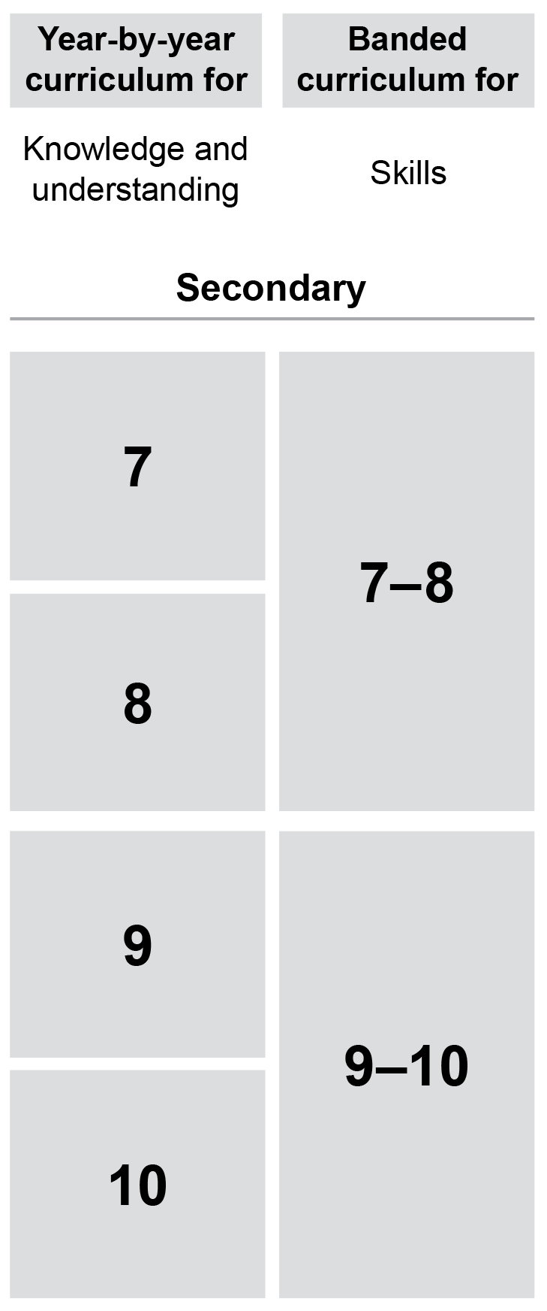
Year-by-year and banded curriculum
Each year of Years 7–10 Civics and Citizenship includes the following structural components:
level description
year-by-year content for the Knowledge and understanding strand
banded content for the Skills strand
year-by-year achievement standards.
The curriculum is developmentally sequenced across the year levels.
Notes:
The Years 7–10 Civics and Citizenship curriculum is structured into both year-by-year and banded curriculum content. The banded curriculum content enables flexible delivery of Civics and Citizenship across Years 7–10 . ​
​
Suggested activity​
What are the implications of the year-by-year curriculum for the planning of your teaching, learning and assessment program?​

Slide 10
Level description
Year 7
In Year 7, students study the key features of democracy and Australia’s federal system of government, and explore how values shape our democracy. Students learn about the key features and principles of Australia’s legal system. They look at how the rights of individuals are protected through the legal system, which aims to provide justice. Students also explore how Australia’s secular system of government supports a diverse society with shared values that promote community cohesion.
Inquiry questions provide a framework for developing students’ knowledge, understanding and skills. The following inquiry questions are examples only and may be used or adapted to suit local contexts:
How is Australia’s system of democratic government shaped by the Constitution?
What principles of justice help to protect the individual’s rights to justice in Australia’s system of law?
How do features of Australian democracy and the legal system uphold and enact democratic values?
How is Australia a diverse society and what factors contribute to a cohesive society?
Context
Inquiry questions
Notes:
Each Years 7–10 Civics and Citizenship level description identifies the:​
​
context for each year​
inquiry questions that may be addressed in each year.

Slide 11
Curriculum content
Year 8
Knowledge and Understanding
Citizenship, diversity and identity
Content description | Content elaborations
how culture and religion may influence individuals' and groups' perceptions and expressions of citizenship and their actions as citizens AC9HC8K05 | exploring how people express different aspects of their personal identity through membership of multiple communities, such as cultural groups, faith groups, professional associations, trade unions, and sporting and social clubs, and how this is reflected in expressions of citizenship; for example, fund-raising for community services or supporting people experiencing health concerns exploring the collective identities of several different groups in Australia’s multicultural society, and how these identities might be represented and perceived discussing the differences between legal citizenship, active citizenship and global citizenship
Notes:
The curriculum content is presented as content descriptions that specify the knowledge, understanding and skills young people are expected to learn and teachers are expected to teach across the years of schooling.
The content descriptions are accompanied by content elaborations. Content elaborations provide illustrations and/or examples that teachers may choose to use in the classroom or as inspiration for their own activities. The content elaborations are not a mandatory aspect of the curriculum and as such are not required to be taught.
Suggested activity
Use the Australian Curriculum: Civics and Citizenship to build an understanding of the sequence of content of the curriculum across year levels: https://v9.australiancurriculum.edu.au/
Within the Australian Curriculum: Civics and Citizenship, select a year level and read the content descriptions.
Consider the content descriptions for the year level prior to and following the selected year level.
In a small group, discuss how the curriculum develops in increasing complexity of cognition and skills across the years/bands.

Slide 12
Curriculum content
Civics and Citizenship content is organised under two interrelated strands:
Knowledge and understanding
Skills.
Notes:
The two strands are interrelated and should be programmed and taught in an integrated way. The content descriptions of the two strands have been written so that at each year this integration is possible. The Knowledge and understanding strand provides the contexts through which skills and understandings of the core concepts are developed in increasing complexity across Years 7–10 .

Slide 13
Strands and sub-strands
Strand | Knowledge and understanding |  | Skills
Sub-strands | Government and democracy |  | Questioning and researching
 | Laws and citizens |  | Analysis, evaluation and interpretation
 | Citizenship, diversity and identity |  | Civic participation and decision-making
 |  |  | Communicating
Notes:
In each strand, curriculum content is further organised into sub-strands. In Civics and Citizenship, there are three sub-strands in the Knowledge and understanding strand, and four sub-strands in the Skills strand.
Suggested activities
What is the relationship between the Strands of Civics and Citizenship?
Prepare a brief statement/overview that would help you describe the Strands to a parent group.

Slide 14
Achievement standards
Year 10
By the end of Year 10, students compare the key features and values of Australia’s system of government to those of another system of government. They describe the Australian Government’s role and responsibilities at a regional and global level. They explain the role of the High Court of Australia. They explain how Australia’s international legal obligations influence the law and government policy. They identify and explain challenges to a resilient democracy and a cohesive society in Australia.
Students develop and refine a range of questions and locate, select and compare relevant and reliable information from a range of sources to investigate political and legal systems, and contemporary civic issues. They analyse information to evaluate perspectives and challenges related to political, legal or civic issues. They evaluate and compare the methods or strategies related to civic participation or action. Students use civics and citizenship knowledge, concepts and terms to develop descriptions, explanations and arguments that synthesise evidence from sources.
Knowledge and understanding
Skills
Notes:
The achievement standard is a statement of what students should know and should be able to do at the end of the year level. In Civics and Citizenship, the first paragraph of the achievement standard relates to Knowledge and understanding and the second paragraph relates to Skills. ​
​
The Years 7–10 Civics and Citizenship achievement standards are available from: https://v9.australiancurriculum.edu.au/
Suggested activities​
​Using the Australian Curriculum: Civics and Citizenship, discuss how the evidence that students need to provide of what they know and can do increases in complexity across year levels.​
​For a given year level, map the achievement standard to the content descriptions.

Slide 15
Key connections
Identify the connections with the other dimensions of the Australian Curriculum including:
the general capabilities
the cross-curriculum priorities
other learning areas within the Australian Curriculum.
Notes:
The key connections are to help teachers identify the links to the other dimensions for the Australian Curriculum including the general capabilities, cross-curriculum priorities and other learning areas to assist teachers to make connections in their planning for student learning.
The key connections are available from: https://v9.australiancurriculum.edu.au/teacher-resources/understand-this-learning-area/humanities-and-social-sciences/.
Suggested activities
Read the key connections section relating to the other learning areas. Partner with a colleague to discuss the following questions:
Which learning areas does the Civics and Citizenship curriculum have key connections to?
Why are these connections important?
Create a concept map showing the connections between other learning areas.

Slide 16
Three-dimensional curriculum: General capabilities
Critical and creative thinking
Digital literacy
Ethical understanding
Intercultural understanding
Literacy
Numeracy
Personal and social capability
Notes:
The seven capabilities are divided into two groups:
capabilities that support students to be successful learners ― literacy, numeracy, digital literacy and critical and creative thinking
capabilities that develop ways of being, behaving and learning to live with others ― personal and social capability, ethical understanding and intercultural understanding.
Continua of learning have been developed for each capability to describe the relevant knowledge, understanding and skills at particular points of schooling, while the literacy and numeracy general capabilities have national learning progressions that describe the skills, understandings and capabilities that students typically acquire as their proficiency increases in a particular aspect of the curriculum over time.
The content outlined in the general capabilities' continua/progressions is embedded in the content descriptions for each learning area, where appropriate. The icons shown on this slide are used to identify where the general capabilities are embedded in content descriptions.
A summary of the focus of each of the general capabilities in the Humanities and social sciences learning area is available from: https://v9.australiancurriculum.edu.au/teacher-resources/understand-this-learning-area/humanities-and-social-sciences/.
Suggested activities
Read the key connection section relating to the general capabilities. Partner with a colleague to discuss the following questions:
To which general capabilities are there key connections?
Why are these connections important?
How could you embed the general capabilities authentically into your teaching and learning programs?

Slide 17
Three-dimensional curriculum: Cross-curriculum priorities
Aboriginal and Torres Strait Islander histories and cultures Asia and Australia’s engagement with Asia Sustainability
Notes:
The Australian Curriculum promotes three cross-curriculum priorities that young Australians should learn about. Each of the priorities is represented in learning areas in ways appropriate to that area.
The three priorities are:
Aboriginal and Torres Strait Islander histories and cultures ― to ensure that all young Australians are given the opportunity to gain a deeper understanding and appreciation of Aboriginal and Torres Strait Islander histories and cultures, their significance for Australia and the impact that these have had, and continue to have, on our world
Asia and Australia’s Engagement with Asia ― to reflect the importance of knowing about Asia and Australia’s engagement with Asia and to encourage better understanding of the countries and cultures of the Asia region so that young people appreciate the economic, political and cultural interconnections that Australia has with the region
Sustainability ― to allow young people to develop an appreciation of the need for more sustainable patterns of living and to build capacities for thinking, valuing and acting that are necessary to create a more sustainable future.
Each of the cross-curriculum priorities contains a set of organising ideas. These are consistent across the curriculum and are reinforced in learning areas. Explicit teaching of the priorities may be incorporated in teaching and learning activities where appropriate.
Suggested activity
Read the key connections section relating to the cross-curriculum priorities. Partner with a colleague to discuss the following questions:
To which cross-curriculum priorities are there key connections?
How are the cross-curriculum priorities reflected in your teaching and learning programs?

Slide 18
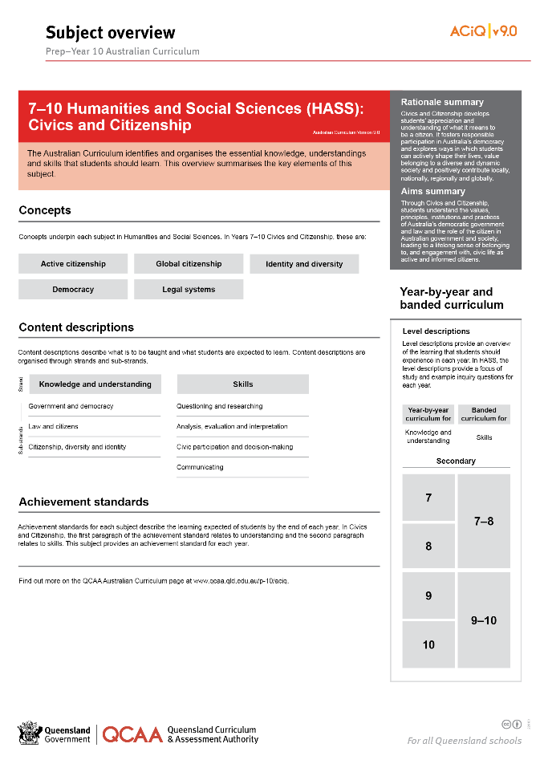
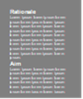
Find out more
Find out more on the QCAA Australian Curriculum webpage.
Notes:
More information about the implementation of Australian Curriculum in Queensland is available on the QCAA website. A one-page overview of the Australian Curriculum: Civics and Citizenship can be accessed through https://www.qcaa.qld.edu.au/p-10/aciq/version-9/learning-areas/p-10-humanities-and-social-sciences/.
Send any further questions to: australiancurriculum@qcaa.qld.edu.au.
Information about requests for further professional learning is available from: www.qcaa.qld.edu.au/pd-events/request-pd.
Suggested activity
Partner with a colleague to discuss the following questions:
What did I learn?
What was confirmed?
What was new?
What challenged my thinking?
What else do I need to do?
What is our plan as a teaching team?

Slide 19
Acknowledgments
© State of Queensland (QCAA) 2022
Licence: https://creativecommons.org/licenses/by/4.0 | Copyright notice: www.qcaa.qld.edu.au/copyright — lists the full terms and conditions, which specify certain exceptions to the licence. | Attribution: ‘© State of Queensland (QCAA) 2022’ — please include the link to our copyright notice.
Other copyright material in this publication is listed below:
Photograph/s of staff and students used with permission.
Unless otherwise indicated, material from Australian Curriculum is © ACARA 2010–present, licensed CC BY 4.0. For the latest information and additional terms of use, see the Australian Curriculum website and its copyright notice.
The three-dimensional curriculum diagram is 'Excluded Material' used under the terms of the Australian Curriculum and its copyright notice and is not modified. © Australian Curriculum, Assessment and Reporting Authority (ACARA) 2009 to present, unless otherwise indicated.
You may view, download, display, print, reproduce (such as by making photocopies) and distribute these Excluded Materials in unaltered form only for your personal, non-commercial educational purposes or for the non-commercial educational purposes of your organisation, provided that you make others aware it can only be used for these purposes and attribute ACARA as the source of the Excluded Material. For the avoidance of doubt, this means that you cannot edit, modify or adapt any of these materials, and you cannot sub-licence any of these materials to others. Apart from any uses permitted under the Copyright Act 1968 (Cth), and those explicitly granted above, all other rights are reserved by ACARA. If you want to use such material in a manner that is outside this restrictive licence, you must request permission from ACARA by emailing (copyright@acara.edu.au).

Slide 20
QCAA social media

