Slide 1
Familiarisation and planning
240864
Australian Curriculum v9.0: Health and Physical Education — Years 7–10
Notes:
This presentation is designed to introduce curriculum leaders and teachers to the Australian Curriculum Version 9.0: Health and Physical Education — Years 7‒10.

Slide 2
Acknowledgment of Country
Notes:
Acknowledgment of Country
The QCAA acknowledges the Traditional Owners and Traditional Custodians of the lands on which we meet today.
We pay our respects to their Elders and their descendants, who continue cultural and spiritual connections to Country, and we extend that respect to Aboriginal people and Torres Strait Islander people here today.
We thank them for sharing their cultures and spiritualities and recognise the important contribution of this knowledge to our understanding of this place we call home.

Slide 3
Learning goal
Understand the implications of changes in the Years 7–10 Australian Curriculum from v8.4 to v9.0: Health and Physical Education for planning.
Success criteria
You will know you are successful if you:
have more knowledge about the intent and structure of the Years 7–10 Australian Curriculum v9.0: Health and Physical Education
can identify actions for planning in your school.
Notes:
The learning goal is to understand the implications of change in the Australian Curriculum v9.0: Health and Physical Education to support planning for the transition in your own context.
You will know you are successful if you have more knowledge about the intent and structure of the Australian Curriculum, from v8.4 to v9.0: Health and Physical Education and can identify actions for planning in your school.

Slide 4
Outline
Introduction to Australian Curriculum v9.0: Health and Physical Education
Understand this learning area
Formulating next steps
Curriculum elements

Slide 5
Outline
Introduction to Australian Curriculum v9.0: Health and Physical Education
Understand this learning area
Formulating next steps
Curriculum elements
Notes:
The first part of the presentation will explore the process of moving to a new curriculum and the purpose and structure of Version 9.0: Health and Physical Education.
Knowing the intent of the curriculum helps teachers to contextualise Health and Physical Education and transition programs to the new version.

Slide 6
The three-dimensional Australian Curriculum
Source: ACARA, www.v9.australiancurriculum.edu.au/help/website-tour
Notes:
In the Australian Curriculum Version 9.0, the three-dimensional interrelated structure has not changed as part of the review. The diagram visually represents these three dimensions.
Source: Script and picture adapted (addition of labels) from video at www.v9.australiancurriculum.edu.au/help/website-tour (time stamp 50 seconds).

Slide 7
HPE in the three-dimensional Australian Curriculum
Source: ACARA, www.v9.australiancurriculum.edu.au/help/website-tour
Notes:
The Australian Curriculum consists of eight learning areas. Health and Physical Education is indicated in dark green.
Source: Script and picture adapted (addition of labels) from video at www.v9.australiancurriculum.edu.au/help/website-tour (time stamp 50 seconds).

Slide 8
The three-dimensional Australian Curriculum
Source: ACARA, www.v9.australiancurriculum.edu.au/help/website-tour
Notes:
There are seven general capabilities:
Literacy
Numeracy
Digital literacy
Critical and creative thinking
Personal and social capability
Intercultural understanding, and
Ethical understanding.
As part of the review, the general capabilities have been refined.
The Information, Communications and Technologies (ICT) general capability in v8.4 has been renamed Digital literacy in v9.0 to reflect current understandings in the field.
The Literacy and Numeracy general capabilities are no longer continua. In v9.0 they are progressions representing the fine-grained indicators of the typical trajectory of literacy and numeracy development.
The remaining general capabilities have had refinements to elements, sub-elements and continua.
Source: Script and picture adapted (addition of labels) from video at www.v9.australiancurriculum.edu.au/help/website-tour (time stamp 50 seconds).

Slide 9
The three-dimensional Australian Curriculum
Source: ACARA, www.v9.australiancurriculum.edu.au/help/website-tour
Notes:
There are three cross-curriculum priorities:
Aboriginal and Torres Strait Islander Histories and Cultures
Asia and Australia’s engagement with Asia, and
Sustainability.
Source: Script and picture adapted (addition of labels) from video at www.v9.australiancurriculum.edu.au/help/website-tour (time stamp 50 seconds).

Slide 10
Organisation of HPE and changes
Version 8.4
Version 9.0
Understand how the learning area works
Rationale
Aims
Key ideas
Structure
Resources (learning area specific)
Understand this learning area
Introduction
Rationale
Aims
Structure
Key considerations
Key connections
Resources
Learning area curriculum
Year level description
Achievement standard
Strands and sub-strands
Content descriptions
Threads (learning area specific)
Content elaborations
Curriculum elements
Level description
Achievement standard
Strands and sub-strands
Content descriptions
Content elaborations
Notes:
This is an overview of the organisation of the Australian Curriculum Version 8.4: Health and Physical Education compared to Version 9.0, with the main changes noted.
Source: Image created in house using SmartArt. Adapted from: https://v9.australiancurriculum.edu.au/teacher-resources/understand-this-learning-area/health-and-physical-education.

Slide 11
Organisation of HPE and changes
Version 8.4
Version 9.0
Understand how the learning area works
Rationale
Aims
Key ideas
Structure
Resources (learning area specific)
Understand this learning area
Introduction
Rationale
Aims
Structure
Key considerations
Key connections
Resources
Learning area curriculum
Year level description
Achievement standard
Strands and sub-strands
Content descriptions
Threads (learning area specific)
Content elaborations
Curriculum elements
Level description
Achievement standard
Strands and sub-strands
Content descriptions
Content elaborations
Notes:
The organisation of the Australian Curriculum in Version 8.4 is in two parts:
Understand how the learning area works, which includes the rationale, aims, key ideas, structure and resources.
Learning area curriculum including the year level description, the achievement standard, strands and sub-strands, content descriptions, threads and content elaborations.
Source: Image created in house using SmartArt. Adapted from https://v9.australiancurriculum.edu.au/teacher-resources/understand-this-learning-area/health-and-physical-education.

Slide 12
Organisation of HPE and changes
Version 8.4
Version 9.0
Understand how the learning area works
Rationale
Aims
Key ideas
Structure
Resources (learning area specific)
Understand this learning area
Introduction
Rationale
Aims
Structure
Key considerations
Key connections
Resources
Learning area curriculum
Year level description
Achievement standard
Strands and sub-strands
Content descriptions
Threads (learning area specific)
Content elaborations
Curriculum elements
Level description
Achievement standard
Strands and sub-strands
Content descriptions
Content elaborations
Notes:
The Version 9.0 learning area structure helps teachers organise the teaching and assessment for Health and Physical Education.
It is organised into two sections:
Understand this learning area and,
Curriculum elements.
The Understand this learning area section provides detail of the intent of the Australian Curriculum v9.0: Health and Physical Education and a snapshot of the structure. In green are two new sections: key considerations and key connections.
The Curriculum elements section shows the elements associated with Health and Physical Education.
Source: Image created in house using SmartArt. Adapted from https://v9.australiancurriculum.edu.au/teacher-resources/understand-this-learning-area/health-and-physical-education.

Slide 13
Outline
Introduction to Australian Curriculum v9.0: Health and Physical Education
Understand this learning area
Formulating next steps
Curriculum elements
Notes:
The Understand this learning area section of the curriculum will be covered next.

Slide 14
Organisation of HPE
Version 9.0
Understand this learning area
Introduction
Rationale
Aims
Structure
Key considerations
Key connections
Resources
Introduction
Rationale
Aims
Curriculum elements
Level description
Achievement standard
Strands and sub-strands
Content descriptions
Content elaborations
Notes:
In Health and Physical Education, the introduction in Version 9.0 is one sentence: ‘The Australian Curriculum: Health and Physical Education is written on the basis that all students will study Health and Physical Education from Foundation to Year 10.’ (ACARA, 2022, https://v9.australiancurriculum.edu.au/teacher-resources/understand-this-learning-area/health-and-physical-education)
The rationale and aims capture the intent of teaching Health and Physical Education and inform teachers’ planning in a school context.
Source: Image created in house using SmartArt. Adapted from https://v9.australiancurriculum.edu.au/teacher-resources/understand-this-learning-area/Health and Physical Education.

Slide 15
Organisation of HPE
Version 9.0
Understand this learning area
Introduction
Rationale
Aims
Structure
Key considerations
Key connections
Resources
Structure
Curriculum elements
Level description
Achievement standard
Strands and sub-strands
Content descriptions
Content elaborations
Notes:
Exploring the structure of Health and Physical Education provides a way for teachers to conceptualise the Australian Curriculum Health and Physical Education.
Source: Image created in house using SmartArt. Adapted from https://v9.australiancurriculum.edu.au/teacher-resources/understand-this-learning-area/Health and Physical Education.

Slide 16
Structure of HPE: Strands
Version 9.0 | (Header row)
Personal, social and community health | Movement and physical activity
Being healthy, safe and active Identities and change Communicating and interacting for health and wellbeing Interacting with others Contributing to healthy and active communities Making healthy and safe choices | Moving our body Moving our bodies Understanding movement Making active choices Learning through movement
Notes:
The structure of the strands in Health and Physical Education remains unchanged.
We still have two strands; personal, social and community health and movement and physical activity.
There has however been a revision of the sub-strands that sit underneath the strands.

Slide 17
Structure of HPE: Strands and sub-strands
Version 9.0 | (Header row)
Personal, social and community health | Movement and physical activity
Being healthy, safe and active Identities and change Communicating and interacting for health and wellbeing Interacting with others Contributing to healthy and active communities Making healthy and safe choices | Moving our body Moving our bodies Understanding movement Making active choices Learning through movement
Notes:
In Health and Physical Education, the curriculum content is organized through strands and sub-strands. The two strands are:
Personal, social and community health
Movement and physical activity.
Each strand is organised into sub-strands. There have been refinements to the sub-strand structure. In black are the Version 9.0 names of strands and sub-strands. In grey and with a strikethrough are the names of the Australian Curriculum Version 8.4 sub-strands. In Version 9, the sub-strand names more accurately reflect the content within each.

Slide 18
HPE focus areas
Alcohol and other drugs
Food and nutrition
Health benefits of physical activity
Mental health and wellbeing
Relationships and sexuality
Safety
Active play and minor games
Challenge and adventure activities
Fundamental movement skills
Games and sports
Lifelong physical activities
Rhythmic and expressive activities
Notes:
In Health and Physical Education, there is an additional structural element, the focus areas. The content descriptions in Health and Physical Education must be taught through the 12 focus areas.
They provide the breadth of learning across Prep to Year 10 that students require to demonstrate the knowledge, understanding and skills described in the achievement standard.
Level descriptions provide guidance about how each focus area can be addressed in the band and the content elaborations provide examples of how and when elements of the focus areas can be addressed.
Decisions about the specific timing of individual aspects of each focus area being taught are the responsibility of schools and teachers.
Focus areas may be addressed discretely in a unit. For example, you might have a discrete Games and sports unit where students are engaged in striking and fielding physical activities. Additionally, there may be opportunities to integrate multiple focus areas into a unit. For example, you might integrate Alcohol and other drugs with Safety.

Slide 19
Organisation of HPE
Version 9.0
Understand this learning area
Introduction
Rationale
Aims
Structure
Key considerations
Key connections
Resources
Key considerations
Key connections
Resources
Curriculum elements
Level description
Achievement standard
Strands and sub-strands
Content descriptions
Content elaborations
Notes:
The final section of Understand this learning area includes the key considerations, key connections and resources that provide further support and advice for teachers when planning for Version 9.0 in Health and Physical Education.
Source: Image created in house using SmartArt. Adapted from https://v9.australiancurriculum.edu.au/teacher-resources/understand-this-learning-area/Health and Physical Education.

Slide 20
Key considerations
HPE propositions
Importance of a healthy school environment
Organisation of learning
Protocols for engaging First Nations Australians
Meeting the needs of diverse learners
Notes:
The key considerations is a new section in v9.0 consistent across all learning areas and includes the refined key ideas from v8.4. It helps teachers to think about teaching and learning specific to Health and Physical Education.
Importance of a healthy school environment recognises that the broader school environment can enhance the delivery of the Health and Physical Education curriculum. A whole-of-school approach can support students to make informed decisions about their health, wellbeing, safety and physical activity participation.
Organisation of learning describes ways that schools may choose to deliver content from the HPE curriculum in different school subjects such as home economics and outdoor education.
Health and Physical Education propositions are elaborated in the next slide.
There are two new considerations in all learning areas which are Protocols for engaging First Nations Australians and Meeting the needs of diverse learners.
Source: Image created in house using SmartArt based on https://v9.australiancurriculum.edu.au/teacher-resources/understand-this-learning-area/HPE.

Slide 21
Key considerations: HPE propositions
Focus on educative purposes
Take a strengths-based approach
Value movement
Build health literacy
Include a critical inquiry approach
Notes:
The Health and Physical Education curriculum is shaped by five propositions.
The propositions are interrelated and provide a framework for exploring the learning described in Health and Physical Education in a way that will create relevance and meaning for all students.
The propositions should be used to guide your planning for teaching, learning and assessment.
To read more about the Health and Physical Education propositions, use your mobile device to scan the QR code on screen.

Slide 22
Key connections
Learning areas
General capabilities
Cross-curriculum priorities
Source: ACARA, www.v9.australiancurriculum.edu.au/help/website-tour
Notes:
The key connections in the curriculum support teachers to integrate Health and Physical Education with other learning areas, embed relevant general capabilities and provide possible contexts for learning through the cross-curriculum priorities.
This integration can enrich and deepen student engagement with learning area content.
However, it should be considered only when it provides appropriate and authentic opportunities to strengthen learning area content.
Source: Image created in house using SmartArt. Adapted from video at www.v9.australiancurriculum.edu.au/help/website-tour.

Slide 23
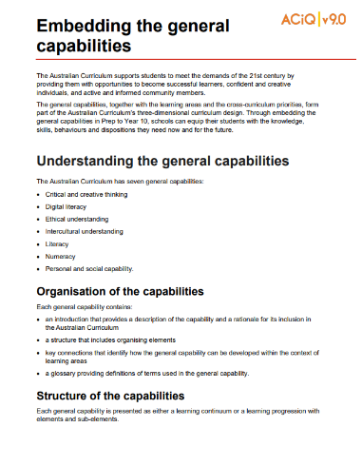
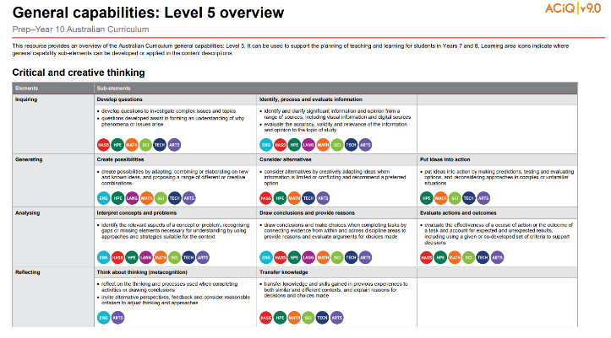
General capabilities advice and resources
www.qcaa.qld.edu.au/p-10/aciq/version-9/cross-curriculum-priorities
Notes:
The QCAA has resources that identify the connections the Australian Curriculum has made between learning areas and the general capabilities.
The general capability level overviews provide an overview of where each general capability can be developed or applied in the content descriptions of the learning areas. For example, the general capability Level 5 and Level 6 align with Years 7–10 learning areas.
The continua resources are available for the general capabilities:
critical and creative thinking
digital literacy
ethical understanding
intercultural understanding and
personal and social capability.
There are resources available that provide a sequence of learning for the capability from Level 1 to Level 6. This can be helpful for teachers when catering for students with diverse needs.
The QCAA has advice documents to support teachers to use the Literacy and Numeracy progressions. These progressions provide observable indicators of increasing complexity in literacy and numeracy which can help teachers to develop targeted teaching and learning programs for students who are working at, above, and below year-level expectations.
These resources can support teaching teams to interrogate connections between the general capabilities and the learning area content in more detail.

Slide 24
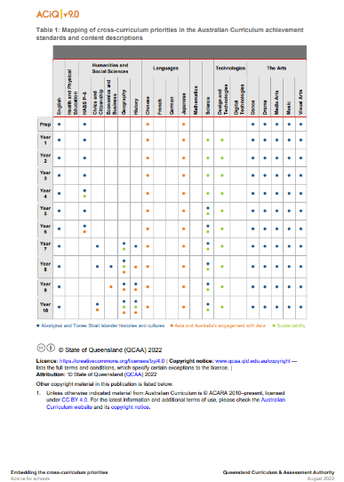
Cross-curriculum priorities advice and resources
www.qcaa.qld.edu.au/p-10/aciq/version-9/cross-curriculum-priorities
Notes:
The QCAA has resources to support schools with understanding how to connect the curriculum with cross-curriculum priorities.
Cross-curriculum priorities are incorporated through learning area content, in ways that are appropriate and authentic. The resources provide an overview of, as well as mapping across learning area and/or subject content descriptions and achievement standards to identify connections to each of the cross-curriculum priorities. ​

Slide 25
Outline
Introduction to Australian Curriculum v9.0: Health and Physical Education
Understand this learning area
Formulating next steps
Curriculum elements

Slide 26
Organisation of HPE
Version 9.0
Understand this learning area
Introduction
Rationale
Aims
Structure
Key considerations
Key connections
Resources
Curriculum elements
Level description
Achievement standard
Strands and sub-strands
Content descriptions
Content elaborations
Level description
Achievement standard
Notes:
The Health and Physical Education level description in the Curriculum elements section provides a high-level overview of the learning students should experience each year.
In Queensland, the achievement standard represents the C standard (or equivalent).
Source: Image created in house using SmartArt. Adapted from https://v9.australiancurriculum.edu.au/teacher-resources/understand-this-learning-area/Health and Physical Education.

Slide 27
HPE: Achievement standard structure
Version 8.4 | Version 9.0
Understanding | Personal, social and community health Movement and physical activity
Skills | Reading and viewing
One paragraph
Notes:
The organisation of the achievement standard in Version 9.0 has been revised.
The achievement standard has two sections which integrate understanding and skills:
Personal, social and community health
Movement and physical activity.

Slide 28
HPE: Achievement standard structure
By the end of Year 8, students analyse factors that influence identities, emotions and responses to change, and describe strategies to respond to these influences. They analyse how stereotypes, respect, empathy and valuing diversity influence relationships. Students analyse the effectiveness of assertive communication strategies, protective behaviours and help-seeking strategies applied online and offline. They analyse health information and messages to propose strategies that enhance their own and others’ health, safety, relationships and wellbeing. Students apply and transfer movement skills and movement concepts across a range of situations. They implement and evaluate the effectiveness of movement strategies on movement outcomes. Students propose and evaluate strategies designed to achieve personal health, fitness and wellbeing outcomes. They select, use and refine strategies to support inclusion, fair play and collaboration across a range of movement contexts.
Personal, social and community health
Movement and physical activity
Notes:
On screen is an example of an achievement standard for a band. For the remainder of this section, we will be using examples from the Years 7–8 band.
The content in the achievement standard related to the Personal, social and community health strand is represented first.
Source: Image created in house using SmartArt. Adapted from: https://v9.australiancurriculum.edu.au/teacher-resources/understand-this-learning-area/health-and-physical-education.

Slide 29
HPE: Achievement standard structure
By the end of Year 8, students analyse factors that influence identities, emotions and responses to change, and describe strategies to respond to these influences. They analyse how stereotypes, respect, empathy and valuing diversity influence relationships. Students analyse the effectiveness of assertive communication strategies, protective behaviours and help-seeking strategies applied online and offline. They analyse health information and messages to propose strategies that enhance their own and others’ health, safety, relationships and wellbeing. Students apply and transfer movement skills and movement concepts across a range of situations. They implement and evaluate the effectiveness of movement strategies on movement outcomes. Students propose and evaluate strategies designed to achieve personal health, fitness and wellbeing outcomes. They select, use and refine strategies to support inclusion, fair play and collaboration across a range of movement contexts.
Personal, social and community health
Movement and physical activity
Notes:
The second part of the achievement standard has content related to the Movement and physical activity strand.
Source: Image created in house using SmartArt. Adapted from: https://v9.australiancurriculum.edu.au/teacher-resources/understand-this-learning-area/health-and-physical-education.

Slide 30
HPE: Achievement standard structure
By the end of Year 8, students analyse factors that influence identities, emotions and responses to change, and describe strategies to respond to these influences. They analyse how stereotypes, respect, empathy and valuing diversity influence relationships. Students analyse the effectiveness of assertive communication strategies, protective behaviours and help-seeking strategies applied online and offline. They analyse health information and messages to propose strategies that enhance their own and others’ health, safety, relationships and wellbeing. Students apply and transfer movement skills and movement concepts across a range of situations. They implement and evaluate the effectiveness of movement strategies on movement outcomes. Students propose and evaluate strategies designed to achieve personal health, fitness and wellbeing outcomes. They select, use and refine strategies to support inclusion, fair play and collaboration across a range of movement contexts.
Paragraph structure:
Identities and change
Interacting with others
Making healthy and safe choices
Moving our bodies
Making active choices
Learning through movement
Notes:
The achievement standard paragraph is structured in a uniform way.
On the left shows the structure of the paragraph.
Highlighted in green is the assessable aspects linked to Identities and change.
Highlighted in yellow is the assessable aspects linked to Moving our bodies.
This structure is consistent across the bands.
Source: Image created in house using SmartArt. Adapted from: https://v9.australiancurriculum.edu.au/teacher-resources/understand-this-learning-area/health-and-physical-education.

Slide 31
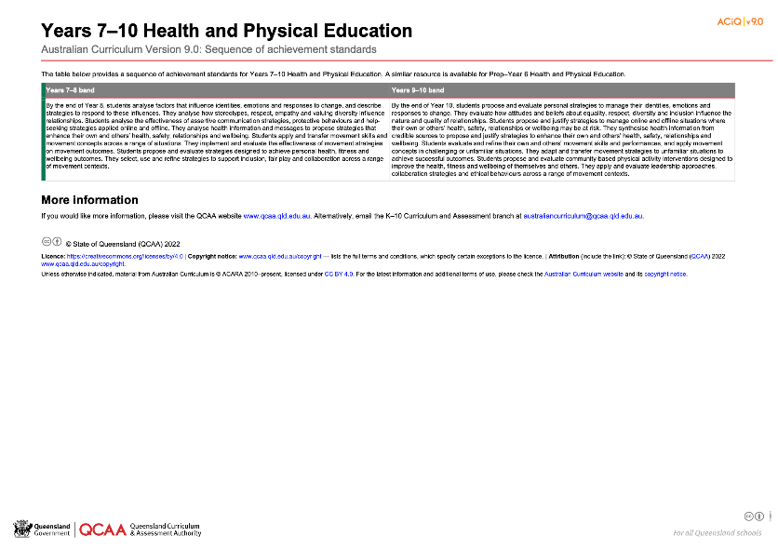
Health and Physical Education: Achievement standard structure
www.qcaa.qld.edu.au/downloads/aciqv9/health-and-physical-education/curriculum/ac9_hpe_yr7-10_as_sequence.pdf
Notes:
On the QCAA website, there is a resource illustrating the sequence of achievement standards from Years 7‒10. There is a similar resource for Prep–Year 6.

Slide 32
Organisation of HPE
Version 9.0
Understand this learning area
Introduction
Rationale
Aims
Structure
Key considerations
Key connections
Resources
Curriculum elements
Level description
Achievement standard
Strands and sub-strands
Content descriptions
Content elaborations
Strands and sub-strands
Content descriptions
Content elaborations
Notes:
The final section of Curriculum elements provides further information regarding the content descriptions in the strands and sub-strands, which inform teaching and learning and assessment.
Content descriptions specify the knowledge, understanding and skills that students learn and that teachers are expected to teach. The content elaborations provide optional examples of how to teach the content descriptions.
Source: Image created in house using SmartArt. Adapted from https://v9.australiancurriculum.edu.au/teacher-resources/understand-this-learning-area/Health and Physical Education.

Slide 33
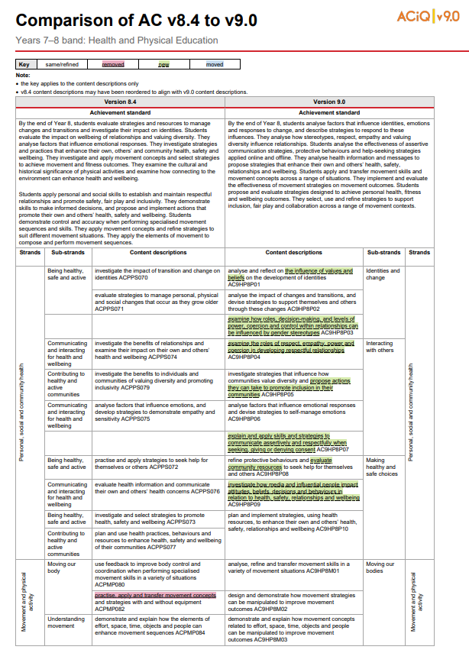
Comparison of AC v8.4 to v9.0 documents
One document for each year level is available on the QCAA website.
Notes:
The comparison documents show the changes to the content descriptions for Health and Physical Education.

Slide 34
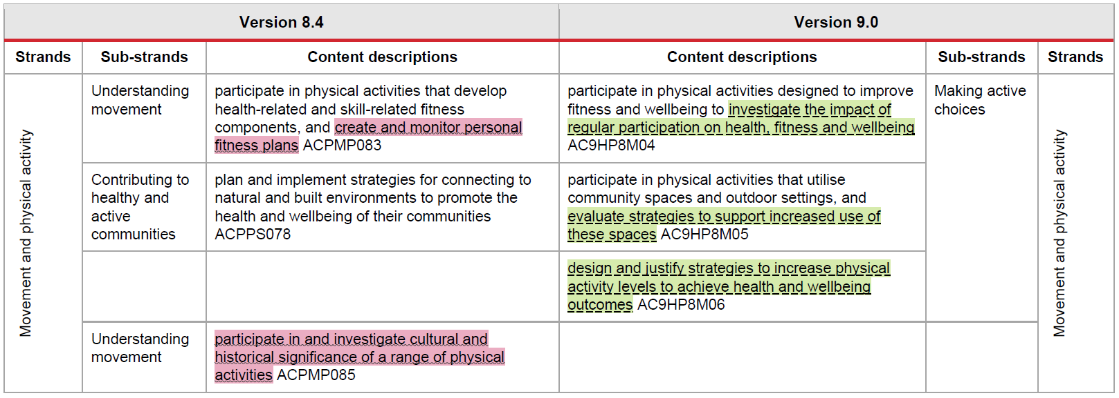
Changes in content descriptions
Notes:
A key is used to show the changes from Version 8.4 to Version 9.0.
Examples from the Years 7–8 Health and Physical Education curriculum will be used to show the changes.

Slide 35
Same/refined content descriptions
Notes:
If something has been refined from Version 8.4, it does not appear in colour.
For example, in version 8.4, movement concepts were referenced in two different content descriptions using different language. To address this duplication, the content descriptions have been refined to reference movement strategies in one and movement concepts in the other.
There have also been some changes to the cognitive verb that is used in the content description. While these changes have not been highlighted in the same/refined content, they may have implications for planning teaching and learning.

Slide 36
Removed content descriptions
 |  | Version 8.4
Understanding movement | Years 7–8 | participate in and investigate cultural and historical significance of a range of physical activities ACPMP085
 | Years 9–10 | examine the role physical activity, outdoor recreation and sport play in the lives of Australians and investigate how this has changed over time ACPMP104
Notes:
On screen now is an example of where content descriptions have been removed.
This thread of content from the movement and physical activity strand has been removed from both Years 7–8 and Years 9–10.
This example is significant as there is language in the version 8.4 achievement standards that aligns directly to these content descriptions. Therefore, the removal of content descriptions has implications for your teaching, learning and assessment program.

Slide 37
New content descriptions
Notes:
This final example shows when new content descriptions have been added.
This could include new language added to a same or refined content description or it could be an entirely new content description.

Slide 38
Outline
Introduction to Australian Curriculum v9.0: Health and Physical Education
Understand this learning area
Formulating next steps
Curriculum elements
Notes:
Let’s formulate the next steps.

Slide 39
Australian Curriculum in Queensland (ACiQ) v9.0 webpages
Notes:
Resources to support the Australian Curriculum Version 9.0 can be found within the Australian Curriculum in Queensland Version 9.0 webpages.
These webpages only include resources that have been created or updated to align with Version 9.0.
Source: Screenshot from QCAA website www.qcaa.qld.edu.au/p-10/aciq.

Slide 40
The ACiQ v9.0 webpages
These webpages house advice and resources to support the three dimensions of the Australian Curriculum:
Learning areas
General capabilities
Cross-curriculum priorities.
Notes:
The Version 9.0 webpages support familiarisation with all three dimensions of the curriculum.
Teachers can access advice and resources for their learning area and/or subject, or the general capabilities, and the cross-curriculum priorities.
Source: Screenshot from QCAA website www.qcaa.qld.edu.au/p-10/aciq/version-9.

Slide 41
Examples of QCAA Resources
Comparison of AC v8.4 to v9.0 (P–10)
Sequence of achievement standards
Sequence of content descriptions
Achievement standard aligned to content descriptions (P–10)
Prepopulated curriculum and assessment plans
Assessment techniques and conditions (P–10)
Standards elaborations
Standards elaborations: glossary of qualifiers
Notes:
On screen now, is a snapshot of some of the resources available to support teachers.

Slide 42
Learning goal
Understand the implications of changes in the Years 7–10 Australian Curriculum from v8.4 to v9.0: Health and Physical Education for planning.
Success criteria
You will know you are successful if you:
have more knowledge about the intent and structure of the Years 7–10 Australian Curriculum v9.0: Health and Physical Education
can identify actions for planning in your school.

Slide 43
Contact
K–10 Curriculum and Assessment Branch​ ​
T +61 7 3120 6102
E australiancurriculum@qcaa.qld.edu.au
W www.qcaa.qld.edu.au
Notes:
If you have any queries regarding Australian Curriculum v9.0: Health and Physical Education, please contact the K-10 Curriculum and Assessment Branch.
​

Slide 44
References
Australian Curriculum, Assessment and reporting Authority 2013, The Shape of the Australian Curriculum Version 4.0, www.docs.acara.edu.au/resources/The_Shape_of_the_Australian_Curriculum_v4.pdf.

Slide 45
Acknowledgments
Third-party copyright material, and QCAA material not covered by the CC BY licence is listed below:
Queensland Government coat of arms, and the QCAA and QSA trademarks may not be reproduced without permission.
Unless otherwise indicated, material from Australian Curriculum is © ACARA 2010–present, licensed CC BY 4.0. For the latest information and additional terms of use, see the Australian Curriculum website and its copyright notice.
Acknowledgment of Country artwork (2023) ‘Growth through Learning’ by Chern’ee, Brooke and Jesse Sutton, Kalkadoon. www.cherneesutton.com.au
Student and staff images have been used with permission.
The three-dimensional curriculum diagram and the glossary are 'Excluded Material' used under the terms of the Australian Curriculum and its copyright notice and not modified. © Australian Curriculum, Assessment and Reporting Authority (ACARA) 2009 to present, unless otherwise indicated. You may view, download, display, print, reproduce (such as by making photocopies) and distribute these Excluded Materials in unaltered form only for your personal, non-commercial educational purposes or for the non-commercial educational purposes of your organisation, provided that you make others aware it can only be used for these purposes and attribute ACARA as the source of the Excluded Material. For the avoidance of doubt, this means that you cannot edit, modify or adapt any of these materials, and you cannot sub-licence any of these materials to others. Apart from any uses permitted under the Copyright Act 1968 (Cth), and those explicitly granted above, all other rights are reserved by ACARA.

Slide 46
Copyright notice
© State of Queensland (QCAA) 2024
Licence: https://creativecommons.org/licenses/by/4.0 | Copyright notice: www.qcaa.qld.edu.au/copyright — lists the full terms and conditions, which specify certain exceptions to the licence. | Attribution: © State of Queensland (QCAA) 2024 www.qcaa.qld.edu.au/copyright.
Other copyright material in this presentation is listed on the previous slide/s.

Slide 47
QCAA social media
Notes:
If you don’t do so already, we recommend you follow QCAA on one or more social media platforms to stay in touch with us, and to find out about upcoming resources and professional learning.

