Slide 1
Health and Physical Education
Prep–Year 10 Australian Curriculum Version 9.0 Learning area overview
220094
Notes:
This presentation supports understanding of the Australian Curriculum Version 9.0: Health and Physical Education (HPE) Prep* – Year 10. It gives insight into the position of Health and Physical Education within the Australian Curriculum and the structure of the Health and Physical Education learning area.
You can use this presentation in your organisation as the basis for professional learning about the Health and Physical Education curriculum. It includes information about the key aspects of the curriculum, as well as activities for becoming familiar with the curriculum. An icon in the bottom-right corner of a slide identifies opportunities for activities. Presenters are encouraged to tailor this presentation to suit the needs of their audience.
The Australian Curriculum content referred to in the presentation is available from:
Australian Curriculum, Assessment and Reporting Authority (ACARA) 2022, Australian Curriculum Version 9 Foundation to Year 10, https://v9.australiancurriculum.edu.au/.
*Prep (P) in Queensland is the Foundation Year (F) of the Australian Curriculum and refers to the year before Year 1. Children beginning Prep in January are required to be five years of age by 30 June.

Slide 2
Learning goals
This presentation aims to:
build understanding of the Australian Curriculum Version 9.0: Health and Physical Education
provide an overview of the structure of the Health and Physical Education learning area.
Notes:
This presentation aims to:
build understanding of the Australian Curriculum, with particular reference to the Health and Physical Education curriculum
provide an overview of the structure of the Health and Physical Education learning area, including the curriculum content and achievement standards.

Slide 3
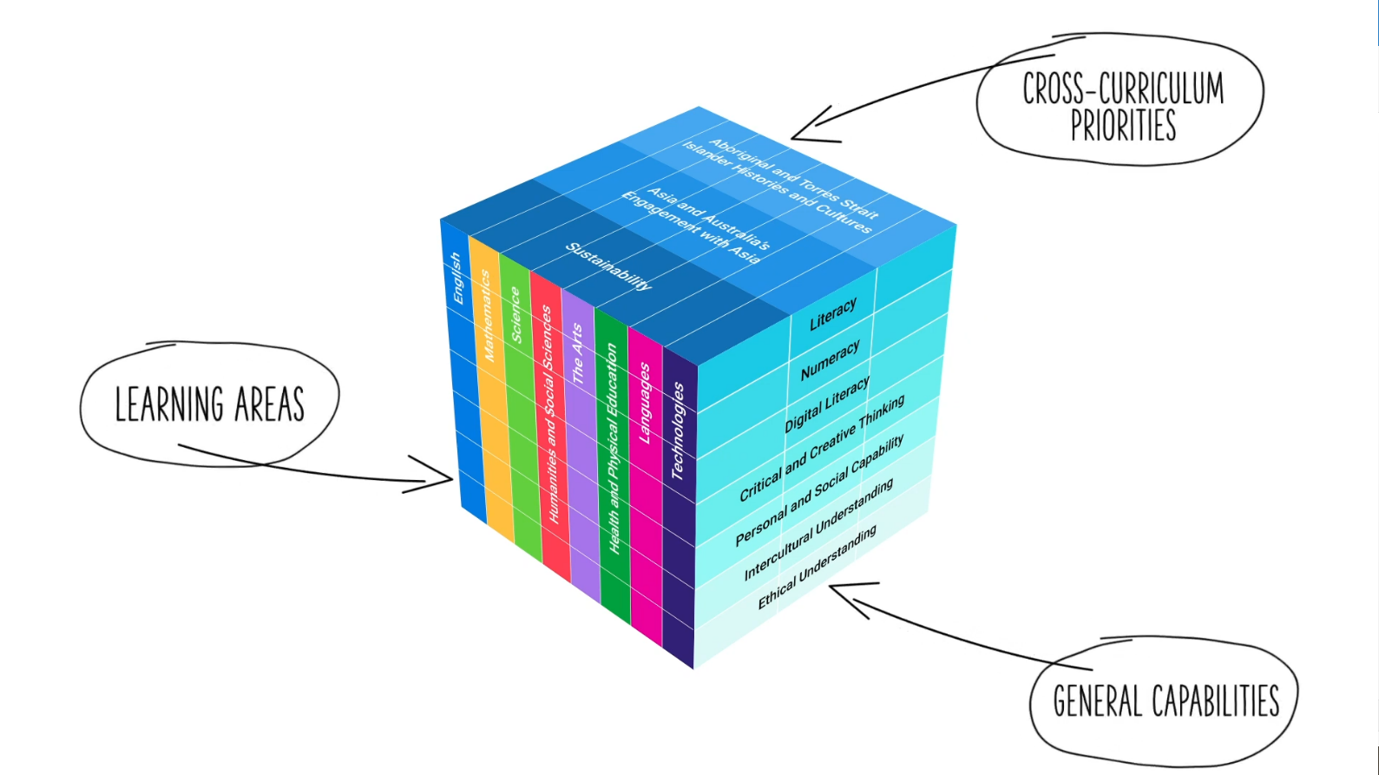
Three-dimensional curriculum
The Australian Curriculum is a three-dimensional curriculum made up of:
learning areas
general capabilities
cross-curriculum priorities.
ACARA image from Summary overview (video): https://v9.australiancurriculum.edu.au/help/website-tour.
Notes:
The Australian Curriculum sets the expectations for what all Australian students should be taught and have the opportunity to learn as they progress through their school life. In Prep to Year 10, the Australian Curriculum provides teachers, students and parents with access to the same content and consistent national standards for determining the progress of student learning.
All Australian students across all education settings and contexts can be supported in their diverse learning needs through the three dimensions of the Australian Curriculum: the learning area content, the general capabilities and the cross-curriculum priorities.
This diagram shows the relationship between these dimensions of the Australian Curriculum. Teachers emphasise one or more dimensions to develop learning programs suited to the strengths, interests and diverse needs of all students.
This presentation provides a brief overview of the general capabilities and cross-curriculum priorities. However, the focus will be on the Health and Physical Education learning area.

Slide 4
Structure of the HPE learning area
Rationale
Aims
Key considerations
Key connections
Structure
Year/banded curriculum*
Focus areas
Achievement standards
Curriculum content
* The Australian Curriculum: HPE is presented in two-year band levels from Year 1 to Year 10, with Prep presented as a single year level
Source: https://v9.australiancurriculum.edu.au/teacher-resources/understand-this-learning-area/health-and-physical-education.
Notes:
The Australian Curriculum sets out what all young people should be taught by specifying the curriculum content and identifies the learning expected at points in their schooling by specifying the achievement standards. The content and achievement standards are supported by additional information that describes the:
curriculum intent (rationale)
aims of learning (aims)
key considerations when planning learning experiences that are unique to the learning area of Health and Physical Education
key connections with the other dimensions of the Australian Curriculum including the general capabilities, cross-curriculum priorities and other learning areas
organising structure and focus for the learning at specific year/band levels including the level descriptions and the achievement standards.
The Australian Curriculum: Health and Physical Education is presented in two-year band levels from Year 1 to Year 10, with Prep presented as a single year level.
The following sections of the presentation will provide an overview of each of these key aspects of the curriculum.

Slide 5
Rationale
Health and Physical Education enables students to develop skills, understanding and willingness to positively influence the health and wellbeing of themselves and their communities. In an increasingly complex, sedentary and rapidly changing world, it is critical for every young Australian to flourish as a healthy, safe, active and informed citizen. It is essential that young people develop their ability to respond to new health issues and evolving physical activity options.
Source: Quoted verbatim and unaltered from ACARA, https://v9.australiancurriculum.edu.au/teacher-resources/understand-this-learning-area/health-and-physical-education.
Notes:
The rationale defines the learning area and describes the importance of the learning area within the curriculum.
The Health and Physical Education rationale promotes:
healthy, safe and active citizens
critical inquiry skills to engage with emerging knowledge about health, safety, wellbeing and physical activity
resilience, empathy and active engagement to advocate for and enhance students’ and others’ wellbeing
a sense of self, as well as the capacity to build and grow respectful relationships
movement skills and participation in physical activities with confidence, competence and creativity
an understanding of how the body moves and positive attitudes to participation in physical activity.
The full rationale is available from: https://v9.australiancurriculum.edu.au/teacher-resources/understand-this-learning-area/health-and-physical-education/.
Suggested activities
Read the full learning area rationale or watch the introductory video. Partner with a colleague to discuss the following questions:
What were the key aspects of the rationale?
Why is the learning area important? What important contribution does the learning make to a student’s education?
Which aspects of this rationale matched your current understanding of the learning area? Which aspects were new understandings?

Slide 6
Aims summary
Health and Physical Education aims to enable students to:
access, evaluate and synthesise information to make informed choices and act to enhance and advocate for their own and others’ health, wellbeing, safety and physical activity participation
develop and use personal, social and cognitive skills and strategies to promote self-identity and wellbeing, and to build and manage respectful relationships
acquire, apply and evaluate movement skills, concepts and strategies to respond confidently, competently and creatively in various physical activity settings
engage in and create opportunities for regular physical activity participation as individuals and for the communities to which they belong
analyse how varied and changing personal and contextual factors shape opportunities for health and physical activity.
Source: Quoted verbatim and unaltered from ACARA, https://v9.australiancurriculum.edu.au/teacher-resources/understand-this-learning-area/health-and-physical-education.
Notes:
The aims flow logically from the rationale and identify the major learning that students will be able to demonstrate as a result of being taught the curriculum.
The Health and Physical Education learning area aims to develop the knowledge, understanding and skills to enable students to:
access, evaluate and synthesise information to take positive action
build on and use personal, behavioural, social and cognitive skills and strategies
acquire, apply and evaluate movement skills, concepts and strategies
engage in and enjoy regular movement-based learning experiences
analyse changing personal and contextual factors for engagement with health and physical activity.
The full aims are available from: https://v9.australiancurriculum.edu.au/teacher-resources/understand-this-learning-area/health-and-physical-education/.
Suggested activities
Prepare a brief statement/overview that would help you describe the aims of the learning area to a parent group.
Identify two or three big ideas in the aims. How do they inform:
your understanding of the learning area?
what is valued in the Australian Curriculum for the learning area?
your teaching and learning approaches?

Slide 7
Key considerations
Health and Physical Education propositions
Importance of a healthy school environment
Organisation of learning
Protocols for engaging First Nations Australians
Meeting the needs of diverse learners
Notes:
The key considerations provide a brief overview of how the Australian Curriculum can accommodate particular approaches to teaching and assessment in Health and Physical Education.
When planning teaching and learning activities in Health and Physical Education, teachers need to consider the:
Health and Physical Education propositions
importance of a healthy school environment — if the messages learnt in Health and Physical Education are reflected in the broader school environment, students are supported to make informed decisions about their health, wellbeing, safety and physical activity participation.
organisation of learning — contextualising the delivery of the curriculum to suit local needs, resource availability and timetabling structures.
This section also supports teachers to consider:
protocols for engaging First Nations Australians
meeting the needs of diverse learners.
The full key considerations are available from: https://v9.australiancurriculum.edu.au/teacher-resources/understand-this-learning-area/health-and-physical-education/.
Suggested activity
How are the key considerations reflected in your Health and Physical Education program?

Slide 8
Health and Physical Education propositions
Focus on educative purposes
Take a strengths-based approach
Value movement
Develop health literacy
Include a critical inquiry approach
Notes:
The Health and Physical Education propositions are shaped by five interrelated propositions that are informed by a strong and diverse research base for a futures-oriented curriculum. The propositions:
focus on educative purposes ― the Health and Physical Education curriculum provides a progression for developing disciplinary knowledge, understanding and skills. Its priority is to provide ongoing, developmentally appropriate and explicit learning about health and movement
take a strengths-based approach ― rather than focusing only on potential health risks or a deficit-based model of health, the curriculum has a stronger focus on supporting students to utilise resources to develop the knowledge, understanding and skills they require to make healthy, safe and active choices that will enhance their own and others’ health and wellbeing
value movement ― Health and Physical Education is the key learning area in the curriculum that focuses explicitly on developing movement skills, concepts and strategies students need to participate in a range of physical activities with competence and confidence
develop health literacy ― health literacy can be understood as an individual’s ability to gain access to, understand, interrogate and use health information and services in ways that promote and maintain health and wellbeing. The Health and Physical Education curriculum promotes the development of health literacy through functional, interactive and critical dimensions
include a critical inquiry approach ― the Health and Physical Education curriculum engages students in critical inquiry processes that help them research, analyse, apply and appraise knowledge in health and movement fields.
Health and Physical Education propositions are available from: https://v9.australiancurriculum.edu.au/teacher-resources/understand-this-learning-area/health-and-physical-education/.
Suggested activities
What are the Health and Physical Education propositions? How do they affect your reading of the content?
How are the propositions reflected in your Health and Physical Education program?

Slide 9
Year/banded curriculum
Each year/band includes the following structural components:
level description
curriculum content
achievement standards.
The curriculum is developmentally sequenced across the year/bands.
Notes:
The Health and Physical Education curriculum is structured in two-year band levels from Year 1 to Year 10, with Prep presented as a single year level.
This banded curriculum enables flexible delivery of Health and Physical Education across P–10.
Suggested activity
What are the implications of the banded curriculum for the planning of your teaching, learning and assessment program?

Slide 10
Level description
Years 1–2
The Years 1­–2 curriculum builds on each student’s prior learning. In the early years, priority is given to the development of movement skills, participation in physical activity, and development of safe and healthy personal practices.
Through exploration and play, students investigate how health and movement concepts exist and impact their lives and the lives of others. They strengthen dispositions for learning including curiosity, confidence, cooperation, investigation and transfer.
Students explore personal qualities and factors that contribute to and influence identities, and understand the importance of assertive behaviour to ensure interactions with others are respectful and safe. As these relationships are formed, students develop an understanding of reciprocal rights and responsibilities, and the ability to see things from other people's viewpoints.
Students strengthen their communication skills by identifying and applying strategies to interact respectfully with others and develop a deeper understanding of how emotions, fairness, diversity and health messages contribute to keeping themselves and others healthy and safe.
Through the continued development of fundamental skills, students participate in a range of different physical activities to explore the benefits of each and what they enjoy about them.
Students are supported in increasing the range and complexity of their fundamental movement skills. They refine and extend skills learnt in Foundation to include locomotor skills such as rolling, leaping, skipping, galloping and dodging, and object control skills such as striking and kicking objects from the ground or moving towards them.
Through participation in active play, small group games and minor games, students apply different ways to move safely, and investigate how to select and apply fundamental movement skills individually, in groups and in teams in a range of movement situations.
Notes:
Each Health and Physical Education level description identifies the:
focus of knowledge, understanding and skills for student learning in that band
interrelated nature of the two strands (Personal, social and community health and Movement and physical activity)
changes in students’ physical, cognitive, social and emotional development attributes from Prep–Year 10
how focus areas could be addressed in the band.

Slide 11
Focus areas
Alcohol and other drugs
Food and nutrition
Health benefits of physical activity
Mental health and wellbeing
Relationships and sexuality
Safety
Active play and minor games
Challenge and adventure activities
Fundamental movement skills
Games and sports
Lifelong physical activities
Rhythmic and expressive activities
Notes:
The 12 focus areas in Health and Physical Education provide the breadth of learning through which the content must be taught to acquire and demonstrate the knowledge, understanding and skills described in the achievement standard.
Decisions about the specific timing of individual aspects of each focus area being taught are the responsibility of schools and teachers. Planning decisions should consider local needs, available resources, students’ readiness and community priorities.
Information on focus areas is available from: https://v9.australiancurriculum.edu.au/teacher-resources/understand-this-learning-area/health-and-physical-education/.

Slide 12
Curriculum content
Years 7–8
Personal, social and community health
Identities and change
Content description | Content elaborations
analyse and reflect on the influence of values and beliefs on the development of identities AC9HP8P01 | examining how their values and beliefs, as well as those of family and friends, influence the development of identities analysing how naming of deceased protocols, such as kumanjayi, can impact the identities of other members within First Nations Australian communities examining how cultural values and beliefs influence the way young people view themselves, including young Australians of Asian heritage examining how cultural beliefs about the physical changes experienced during puberty can influence gender, cultural and sexual identities
Notes:
The curriculum content is presented as content descriptions that specify the knowledge, understanding and skills young people are expected to learn and teachers are expected to teach across the years of schooling.
The content descriptions are accompanied by content elaborations. Content elaborations provide illustrations and/or examples that teachers may choose to use in the classroom or as inspiration for their own activities. The content elaborations are not a mandatory aspect of the curriculum and as such are not required to be taught.
Suggested activity
Use the Australian Curriculum: Health and Physical Education to build an understanding of the sequence of content of the curriculum across bands: https://v9.australiancurriculum.edu.au/.
Within the Australian Curriculum: Health and Physical Education, select a year/band level and read the content descriptions.
Consider the content descriptions for the year/band level prior to and following the selected year/band level.
In a small group, discuss how the curriculum develops in increasing complexity of cognition and skills across the bands.

Slide 13
Strands and sub-strands
 | Strands
 | Personal, social and community health | Movement and physical activity
Sub-strands | Identities and change Interacting with others Making healthy and safe choices | Moving our bodies Making active choices Learning through movement
Notes:
In Health and Physical Education, the curriculum content is organised through strands and sub-strands. The two strands are:
Personal, social and community health
Movement and physical activity.
These strands are interrelated to inform and support each other. Both strands must be taught each year from Prep to Year 10.
Each strand is organised into three sub-strands.
Personal, social and community health:
Identities and change
Interacting with others
Making healthy, safe choices.
Movement and physical activity:
Moving our bodies
Understanding movement
Learning through movement.
Information on the strands and sub-strands are available from: https://v9.australiancurriculum.edu.au/teacher-resources/understand-this-learning-area/health-and-physical-education/.
Suggested activity
What is the relationship between the strands of Health and Physical Education?
Prepare a brief statement/overview that would help you describe the strands to a parent group.

Slide 14
Achievement standards
Years 9–10 achievement standard
By the end of Year 10, students propose and evaluate personal strategies to manage their identities, emotions and responses to change. They evaluate how attitudes and beliefs about equality, respect, diversity and inclusion influence the nature and quality of relationships. Students propose and justify strategies to manage online and offline situations where their own or others’ health, safety, relationships or wellbeing may be at risk. They synthesise health information from credible sources to propose and justify strategies to enhance their own and others’ health, safety, relationships and wellbeing. Students evaluate and refine their own and others’ movement skills and performances, and apply movement concepts in challenging or unfamiliar situations. They adapt and transfer movement strategies to unfamiliar situations to achieve successful outcomes. Students propose and evaluate community-based physical activity interventions designed to improve the health, fitness and wellbeing of themselves and others. They apply and evaluate leadership approaches, collaboration strategies and ethical behaviours across a range of movement contexts.
Notes:
In Health and Physical Education, an achievement standard is provided for each year/band.
Suggested activities
Partner with a colleague and complete the following activities:
Using the Australian curriculum: Health and Physical Education, discuss how the evidence that students need to provide of what they know and can do increases in complexity across the year/band levels: https://v9.australiancurriculum.edu.au/.
For a given year/band level, map the achievement standard to the content descriptions.

Slide 15
Key connections
Identify connections with the other dimensions of the Australian Curriculum including:
the general capabilities
the cross-curriculum priorities
other learning areas within the Australian Curriculum.
Notes:
The key connections are to help teachers identify the links to the other dimensions of the Australian Curriculum, including the general capabilities, the cross-curriculum priorities and the other learning areas to assist teachers to make connections in their planning for student learning.
The key connections are available from: https://v9.australiancurriculum.edu.au/teacher-resources/understand-this-learning-area/health-and-physical-education/.
Suggested activities
Read the key connections section relating to other learning areas. Partner with a colleague to discuss the following questions:
Which learning areas does the Health and Physical Education curriculum have key connections to?
Why are these connections important?
2. Create a concept map showing connections between other learning areas.

Slide 16
Three-dimensional curriculum: General capabilities
Critical and creative thinking
Digital literacy
Ethical understanding
Intercultural understanding
Literacy
Numeracy
Personal and social capability
Notes:
The seven capabilities are divided into two groups:
capabilities that support students to be successful learners ― literacy, numeracy, digital literacy and critical and creative thinking
capabilities that develop ways of being, behaving and learning to live with others ― personal and social capability, ethical understanding and intercultural understanding.
Continua of learning have been developed for each capability to describe the relevant knowledge, understanding and skills at particular points of schooling, while the literacy and numeracy general capabilities have national learning progressions that describe the skills, understandings and capabilities that students typically acquire as their proficiency increases in a particular aspect of the curriculum over time.
The content outlined in the general capabilities' continua/progressions is embedded in the content descriptions for each learning area, where appropriate. The icons shown on this slide are used to identify where the general capabilities are embedded in content descriptions.
A summary of the focus of each of the general capabilities in the Health and Physical Education learning area is available from: https://v9.australiancurriculum.edu.au/teacher-resources/understand-this-learning-area/health-and-physical-education/.
Suggested activities
Read the key connection section relating to the general capabilities. Partner with a colleague to discuss the following questions:
To which general capabilities are there key connections?
Why are these connections important?
How could you embed the general capabilities authentically into your teaching and learning programs?

Slide 17
Three-dimensional curriculum: Cross-curriculum priorities
Aboriginal and Torres Strait Islander Histories and Cultures Asia and Australia’s Engagement with Asia Sustainability
Notes:
The Australian Curriculum promotes three cross-curriculum priorities that young Australians should learn about. Each of the priorities is represented in learning areas in ways appropriate to that area.
The three priorities are:
Aboriginal and Torres Strait Islander histories and cultures ― to ensure that all young Australians are given the opportunity to gain a deeper understanding and appreciation of Aboriginal and Torres Strait Islander histories and cultures, their significance for Australia and the impact that these have had, and continue to have, on our world
Asia and Australia’s engagement with Asia ― to reflect the importance of knowing about Asia and Australia’s engagement with Asia and to encourage better understanding of the countries and cultures of the Asia region so that young people appreciate the economic, political and cultural interconnections that Australia has with the region
Sustainability ― to allow young people to develop an appreciation of the need for more sustainable patterns of living and to build capacities for thinking, valuing and acting that are necessary to create a more sustainable future.
Each of the cross-curriculum priorities contains a set of organising ideas. These are consistent across the curriculum and are reinforced in learning areas. Explicit teaching of the priorities may be incorporated in teaching and learning activities where appropriate.
Suggested activity
Read the key connections section relating to the cross-curriculum priorities. Partner with a colleague to discuss the following questions:
To which cross-curriculum priorities are there key connections?
How are the cross-curriculum priorities reflected in your teaching and learning programs?

Slide 18
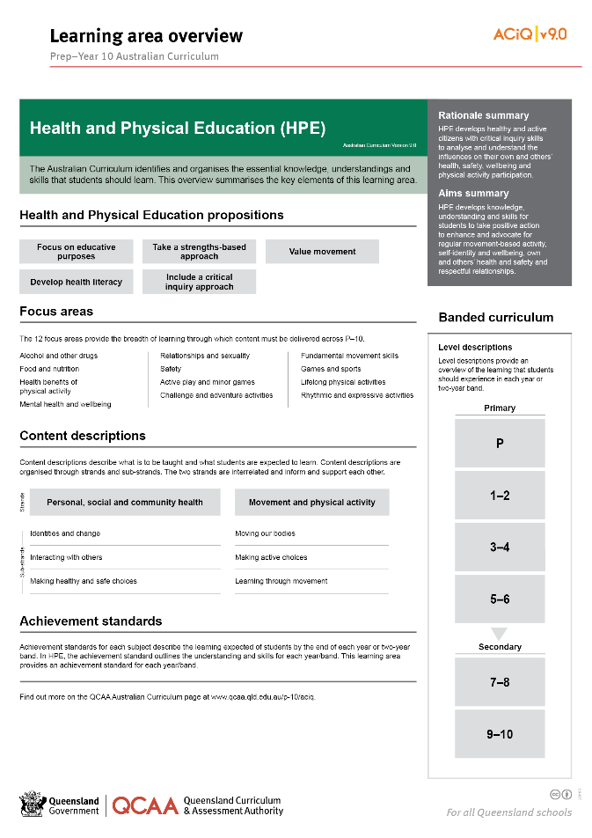
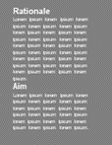
Find out more
Find out more on the QCAA Australian Curriculum webpage.
Notes:
More information about the implementation of Australian Curriculum in Queensland is available on the QCAA website. A one-page overview of the Australian Curriculum: Health and Physical Education can be accessed through https://www.qcaa.qld.edu.au/p-10/aciq/version-9/learning-areas/p-10-health-and-physical-education/.
Send any further questions to: australiancurriculum@qcaa.qld.edu.au.
Information about requests for further professional learning is available from: [insert web address].
Suggested activity
Partner with a colleague to discuss the following questions:
What did I learn?
What was confirmed?
What was new?
What challenged my thinking?
What else do I need to do?
What is our plan as a teaching team?

Slide 19
Acknowledgments
© State of Queensland (QCAA) 2022
Licence: https://creativecommons.org/licenses/by/4.0 | Copyright notice: www.qcaa.qld.edu.au/copyright — lists the full terms and conditions, which specify certain exceptions to the licence. | Attribution: ‘© State of Queensland (QCAA) 2022’ — please include the link to our copyright notice.
Other copyright material in this publication is listed below:
Photograph/s of staff and students used with permission.
Unless otherwise indicated, material from Australian Curriculum is © ACARA 2010–present, licensed CC BY 4.0. For the latest information and additional terms of use, see the Australian Curriculum website and its copyright notice.
The three-dimensional curriculum diagram is 'Excluded Material' used under the terms of the Australian Curriculum and its copyright notice and is not modified. © Australian Curriculum, Assessment and Reporting Authority (ACARA) 2009 to present, unless otherwise indicated.
You may view, download, display, print, reproduce (such as by making photocopies) and distribute these Excluded Materials in unaltered form only for your personal, non-commercial educational purposes or for the non-commercial educational purposes of your organisation, provided that you make others aware it can only be used for these purposes and attribute ACARA as the source of the Excluded Material. For the avoidance of doubt, this means that you cannot edit, modify or adapt any of these materials, and you cannot sub-licence any of these materials to others. Apart from any uses permitted under the Copyright Act 1968 (Cth), and those explicitly granted above, all other rights are reserved by ACARA. If you want to use such material in a manner that is outside this restrictive licence, you must request permission from ACARA by emailing (copyright@acara.edu.au).

Slide 20
QCAA social media

