Slide 1
What you will need for this meeting
This presentation is designed for delivery by a school leader or their delegate to deliver key messages from the QCAA Forum for school leaders (2022) to their communities.
Before you present:
read the guidance for school leaders
engage with the meeting guide for this presentation
review the slideshow
add activities or conversation starters to suit your school’s needs
hide slides that are not appropriate for your context.
Before you start
Notes:
Hide this slide before presenting.

Slide 2
Understanding the changes to the Australian Curriculum Version 9.0
221417
Meeting 2: For use with teachers
Notes:
Talking points
Outline general purpose of session: To develop a shared understanding of why the school is changing to the Australian Curriculum Version 9.0 by:
sharing our learning from the QCAA forum for school leaders
engaging in professional conversations
considering the next steps for our school.
Source of image: QCAA

Slide 3
Acknowledgment of Country
Notes:
Acknowledgment of Country
The schools should use protocols and acknowledgment used in their own context.

Slide 4
Learning goals
To become familiar with the need for the Australian Curriculum v9.0.
To develop a shared understanding of what this version offers students
To begin to develop an understanding of the key changes in v9.0.
Success criteria
By the end of this session, you will:
be aware of key messages from the QCAA and ACARA
know the next steps in the familiarisation phase
share a common vision for success.
Notes:
Talking points
[Share goals and success criteria with participants.]

Slide 5


Australian Curriculum Version 9
In a moment …
What do you already know about why we are moving to the Australian Curriculum v9.0?
Consider this question and then share with the person next to you.
Notes:
Talking points
Today we are going to explore key reasons for a move from the Australian Curriculum v8.4 to Australian Curriculum 9.0.
Some of you may already have some understanding why. Others may not.
Because we are all at different stages of our knowledge, we will explore this together to make sure we have a shared understanding by the time we finish today.
Think for a moment about what you already know about why we are moving to the Australian Curriculum v9.0 from v8.4.
Then, share what you know with the person sitting next to you.
[Provide sufficient time for discussion. Presenter can move around to various pairs, listening to the understandings expressed.]
[Ad-lib observations based on the discussions.]

Slide 6
The Australian Curriculum v9.0: Why?
[Add dot points listing key messages from your elevator pitch — see presenter notes.]
Notes:
Presenter notes
The purpose is to instil confidence and positivity about the Australian Curriculum v9.0, and to support the beginnings of conversations about opportunities provided by v9.0
Add a 30-second elevator pitch to explain the need for the Australian Curriculum v9.0. Use the one created at the Forum for school leaders in 2022, create a new one — see the examples of a pitch below.
Add dot points to the slide to reinforce your pitch for the meeting.
Deliver your pitch to explain the need for the Australian Curriculum v9.0.
Examples of a pitch
Queensland first implemented the Australian Curriculum in 2011. The Australian Curriculum in Queensland is therefore over 11 years old.
Communication was very different in 2011. Think about how many devices were in your home. Most of your students would not have had a significant digital footprint. Had you heard of a professional social influencer?
Think of the other changes in society that have come about — our focus on mental health and well-being, privacy and security. Were these topics as hotly discussed?
In 2011, how did society measure success? Recent world events have made many people change their priorities and goals.
Who were the leaders in education? Were you aware of how Australia compared internationally? What research has taken place since 2011 to inform our practice, resulting in shifts in your knowledge and ways of working?
Was student agency part of our thinking? Were we providing the degree of flexibility that our classrooms now offer?
This refresh of the curriculum is an opportunity for us to move the Australian Curriculum forward to prepare our students for a very different future than that projected in 2011. It is also an opportunity for us to refresh and build on the great work we have already done.

Slide 7
Outline
1. Why are there changes to the Australian Curriculum?
3. What support is in place for teachers?
4. What are the next steps?
2. What are the timelines for change?
Notes:
Talking point
These are the topics we will cover in this session.

Slide 8
Outline
1. Why are there changes to the Australian Curriculum?
3. What support is in place for teachers?
4. What are the next steps?
2. What are the timelines for change?
Notes:
Talking point
[Introduce Section 1].

Slide 9
Looking back
2008 Melbourne Education Declaration
2010
First version
of Australian Curriculum released
2011
Queensland commences implementation
Notes:
Talking points
Before moving forward, let’s take a step back to develop a shared understanding of how Version 9.0 of the Australian Curriculum developed.
There are some key dates along the way, beginning with 2008 when there was agreement by federal and state education ministers to create an Australian Curriculum, through the Australian Curriculum, Assessment and Reporting Authority (ACARA).
This was an action that came from the signing of the Melbourne Education Declaration.
ACARA were tasked with writing the Australian Curriculum. The first version was released in 2010.
Queensland commenced implementation in 2011.
Notes for presenter
This means that the Australian Curriculum in Queensland is now over 11 years old.
Leaders could be asked to pause for a moment and consider where they were in 2010 and the differences between then and 2022. (Ad-lib with a relevant, personal anecdote.)

Slide 10
Looking back
2019
Alice Springs (Mparntwe) Education Declaration
2020–2021 Review, draft, consult and refine
1 April 2022 Version 9.0 of Australian Curriculum approved
9 May 2022 Australian Curriculum v9.0 published
Notes:
Talking points
In December 2019, all Australian education ministers signed the Mparntwe (pronounced M-ban-tua), or Alice Springs, Education Declaration.
2020–2021 — ACARA announced the review of v8.4 to v9.0. This involved a review of v8.4, drafting of the consultation curriculum, consultation process and subsequent refinement.
Queensland teachers were instrumental in this consultation process, offering direct feedback to ACARA through the consultation survey and to the QCAA to form the Queensland response.
The revised v9.0 curriculum was approved by education ministers on 1 April 2022.
It was published in May 2022.
So, we have not had long to engage with Version 9.0.
We will explore why the curriculum update is a positive step for our teachers, our students and our community.

Slide 11


Reflection: A contemporary curriculum
In a moment …
With an elbow partner, consider:
How has the world changed since 2011?
Why is a contemporary curriculum essential for our students’ future success?
Looking back
Looking forward
Notes:
Talking points
With an elbow partner, discuss:
How has the world changed since 2011?
Why is a contemporary curriculum essential for our students’ future success?
You could consider:
How have the ways we communicate changed?
What challenges will students face from 2024?
What would you like to improve for students?
(After sufficient time, invite participants to share their answers with the whole group or at tables.)

Slide 12
Curriculum change: Why?
Vision: A world-class education system
Goal 1:
The Australian education system promotes
excellence and equity.
Goal 2:
All young Australians
become confident and creative individuals, successful lifelong learners and active and informed members of the community.
Education Services Australia 2019, www.dese.gov.au/alice-springs-mparntwe-education-declaration/resources/alice-springs-mparntwe-education-declaration, p. 4
Notes:
Talking points
As we know, in December 2019, all Australian education ministers signed the Mparntwe (pronounced M-ban-tua), or Alice Springs, Education Declaration.
Acknowledging the power of education to transform lives, the declaration sets out a vision for education in Australia and commitment to improving educational outcomes for all Australians.
It builds on past declarations, i.e. Hobart, Adelaide and Melbourne Declarations.
As well as reinforcing foundational understandings and skills, it recognises that education must prepare students ‘to thrive in a time of rapid social and technological change, and complex environmental, social and economic challenges’ (Education Services Australia 2019, p. 2).
The vision is ‘for a world-class education system that encourages and supports every student to be the very best they can be, no matter where they live or what kind of learning challenges they may face’ (ibid).
With this in mind, the declaration sets out two distinct, but interrelated goals — see slide.
These goals underpinned the review of the Australian Curriculum.

Slide 13
Reflection: A world-class curriculum
In a moment …
Individually, consider:
What does world-class curriculum and assessment
mean to us in our school context?
When I say go:
Find an elbow partner and generate a shared understanding of world-class curriculum and assessment in our context.
Notes:
Talking points
We are now familiar with the goals and vision of the Alice Springs Education Declaration.
A world-class education system is the vision for which we all strive.
The challenge is how to enact world-class curriculum and assessment in our school.
Let’s explore what ‘world-class’ means to each of us.
Consider: What does world-class curriculum and assessment mean to you in our school context?
When I say go, find an elbow partner and generate a shared understanding of world-class curriculum and assessment in our context.
Be prepared to share with the whole group.
(After sufficient time, ask for volunteers to share their understandings. Discuss any alignments or areas of divergence that emerge.)
Note for presenters
Consider sharing responses from the school leaders in Meeting 1 and discussing alignments and areas of divergence.
Nominate a teacher or leader to take notes, if desired.

Slide 14
ACARA aims for the revised Australian Curriculum
Contemporary
International benchmarks
Improved clarity
Refined
Notes:
Talking points
ACARA had clear aims for the review.
As you can see on this slide, underpinned by the Alice Springs Declaration and working within the current 3D structure, the aims of the Australian Curriculum Version 9.0 are to:
ensure the curriculum is contemporary
benchmark the Australian Curriculum against other international jurisdictions, including British Columbia, Finland, Singapore and New Zealand
enhance clarity through refined curriculum content and achievement standards
improve user experience on a new website with enhanced functionality.
Source of images
Fibre optics by chaitawat at Pixabay. https://pixabay.com/photos/fiber-optic-cable-blue-network-2749588/
Globe by geralt at Pixabay. https://pixabay.com/photos/globe-earth-world-globalization-2489596/
Leaf and water droplets by ju1959jjj at Pixabay. https://pixabay.com/photos/nature-flower-flowers-yard-macro-2986145/
Computer keyboard by Janeb13 at Pixabay https://pixabay.com/photos/pc-computer-screen-desktop-computer-1207683/ Used under terms of Pixabay license.

Slide 15
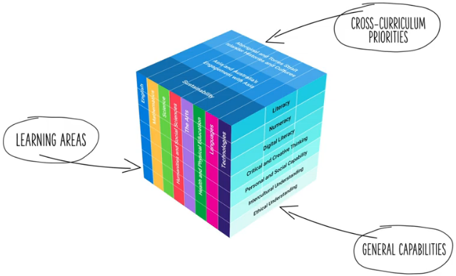
Three dimensions of Australian Curriculum v9.0
Largely unchanged from v8.4
ACARA image from Summary overview (video) https://v9.australiancurriculum.edu.au/help/website-tour
Notes:
Talking points
Let us start with what has not changed in Australian Curriculum v9.0.
Overall the structure of the Australian Curriculum is largely unchanged. We still have:
eight learning areas — English, Health and Physical Education, Humanities and Social Sciences, Languages, Mathematics, Science, Technologies and The Arts
three cross-curriculum priorities to provide students with the ‘tools and language to engage with and better understand their world’ (ACARA, 2012, p. 18). These are Aboriginal and Torres Strait Islander histories and cultures, Asia and Australia’s engagement with Asia, and Sustainability
the continued inclusion of seven general capabilities reflecting the 21st century skills — Critical and creative thinking, Ethical understanding, Intercultural understanding, Literacy, Numeracy, Personal and social understanding, and Digital literacy.
Changes in the structure include:
a naming change in a general capability. Information and communication technology or ICT as it was previously known is now called Digital literacy to reflect the terminology commonly used in industry.
a change in the cross-curriculum priority of Sustainability with the addition of Design.

Slide 16
Outline
1. Why are there changes to the Australian Curriculum?
3. What support is in place for teachers?
4. What are the next steps?
2. What are the timelines for change?
Notes:
Talking points
[Introduce Section 2].

Slide 17
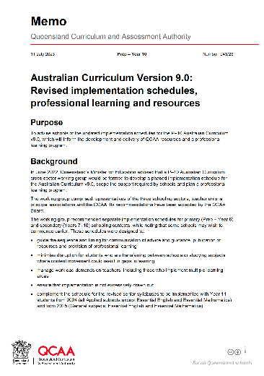
Memo: 057/22
Published 11 July 2023
Separate professional development and support schedules for primary (Prep–Year 6) and secondary (Years 7–10) schooling contexts
Notes:
Talking points
This memo was sent to schools on 11 July 2023.
The purpose was to advise schools of the updated implementation schedules for the P–10 Australian Curriculum v9.0 that will inform the development and delivery of QCAA resources and a professional learning program.

Slide 18
Prep–Year 6: Professional development and support schedule
Year | Familiarisation | Implementation
2023 | English Mathematics
2024 | English — extended Mathematics — extended
 | Sciences Technologies Health and Physical Education
2025 | Sciences — extended Technologies — extended Health and Physical Education — extended | English Mathematics
 | Languages The Arts Humanities and Social Sciences
Notes:
Talking points
(Refer to slide.)
The updated QCAA professional development and support schedule for Prep–Year 6 is available from the QCAA website.
Note for presenter
It might be useful to download the schedule and have copies available for the meeting.
A link to this is available in the Meeting 1 guide.

Slide 19
Prep–Year 6: Professional development and support schedule
Year | Familiarisation | Implementation
2026 | Languages — extended The Arts — extended Humanities and Social Sciences — extended | Sciences Technologies Health and Physical Education
2027 |  | Languages The Arts Humanities and Social Sciences
Notes:
Talking points
(Refer to slide.)
The updated QCAA professional development and support schedule for Prep–Year 6 is available from the QCAA website.
Note for presenter
It might be useful to download this and have copies available for the meeting.
A link to this is available in the Meeting 1 guide.

Slide 20
Years 7–10: Professional development and support schedule
Year | Familiarisation and implementation
2023 | Schools determine their local approach to implementation, e.g. year-level approach or subject/learning area approach. Schools are encouraged to consider the support provided by the QCAA for the transition and the balance of Applied and General subjects offered.
2024
2025
2026
2027 | All learning areas must be fully implemented.
Notes:
Talking points
(Refer to slide.)
The updated QCAA professional development and support schedule for Years 7–10 is available from the QCAA website.
Note for presenter
It might be useful to download this and have copies available for the meeting.
A link to this is available in the Meeting 1 guide.

Slide 21
Australian Curriculum v9.0
Familiarisation
Planning
Implementation
Notes:
Talking points
The QCAA recommends three broad phases when implementing Version 9.0 of the Australian Curriculum:
familiarisation with the Version 9.0 curriculum, including a review of existing school curriculum and assessment plans for alignment to the curriculum
planning for teaching, learning and assessment
implementation of Version 9.0, including designing assessment and making judgments.
The QCAA will offer professional support in two key areas:
curriculum literacy, i.e. knowledge and understanding of the Australian Curriculum; skills to plan with the curriculum for the full range of learners
assessment literacy, i.e. knowledge of assessment design; skills to design assessments, create marking guides and make judgments, and provide feedback aligned to the achievement standards.

Slide 22
Outline
1. Why are there changes to the Australian Curriculum?
3. What support is in place for teachers?
4. What are the next steps?
2. What are the timelines for change?
Notes:
Talking points
(Introduce Section 3.)

Slide 23
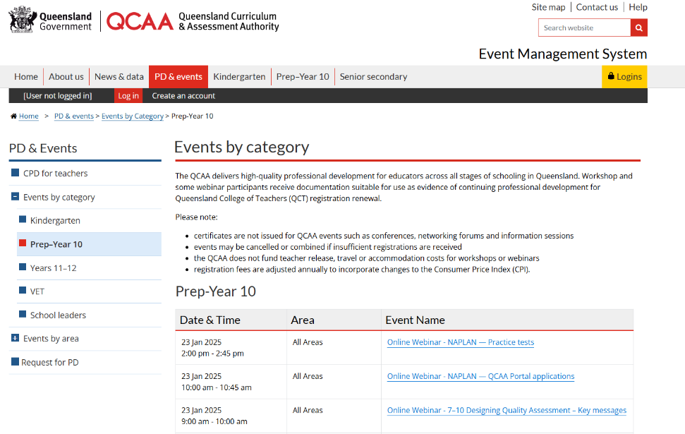
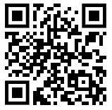
QCAA professional learning support
Notes:
Talking points
ACARA developed the Australian Curriculum v9.0.
The QCAA supports schools in all Queensland sectors with advice, resources and professional learning.
The QCAA professional learning events will be advertised through the QCAA events webpage.

Slide 24

QCAA Australian Curriculum in Queensland (ACiQ v9.0)
Web support
New and updated advice and resources to support:
learning areas
general capabilities
cross-curriculum priorities.
Notes:
Talking points
The QCAA have updated their webpages.
The new pages give you online access to the advice and resources the QCAA is developing for all three dimensions of Version 9.0.
The QCAA website landing page for Australian Curriculum provides the options to access either advice, resources or professional learning for Version 8.4 or Version 9.0.
Access to Version 8.4 aligned advice, resources and professional learning will remain until it is no longer required.
New resources and advice will be available progressively on the Version 9.0 webpages of the QCAA website.

Slide 25
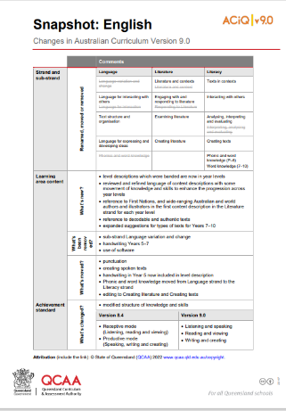

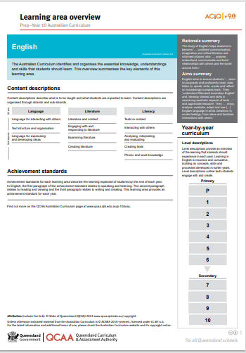
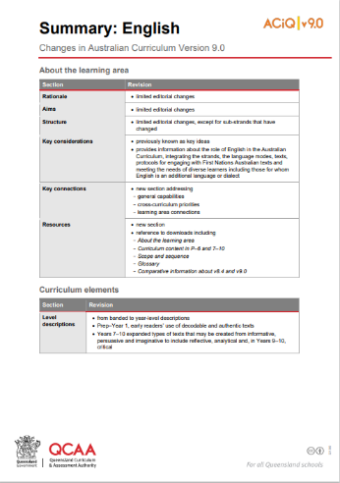
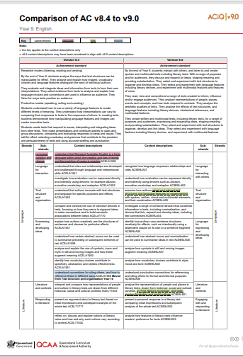
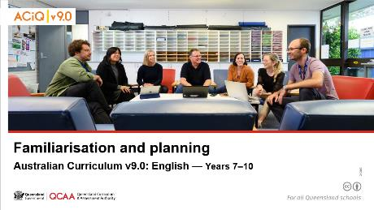
ACiQ v9.0 resources
Resources on the website include learning area:
snapshot of changes
summary of changes
comparison of v8.4 and v9.0
overviews
slideshows.
Notes:
Talking points
The QCAA provide an extensive range of resources via their webpages to support you as you familiarise with the changes from v8.4 to v9.0.
The range will grow throughout the phases of familiarisation, planning and implementation.
We will be well supported in the process of implementation.
The resources can be identified easily by the ACiQ v9.0 stamp in the top-right corner.

Slide 26

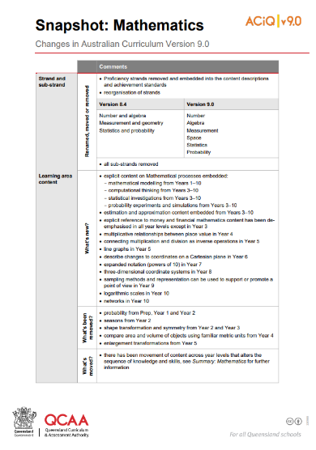
QCAA Snapshot of changes
A snapshot of broad changes to each learning area.
Notes:
Talking points
The snapshot of changes and the summary of changes documents are good places to start to support our awareness of the degree of changes in each learning area.
Purpose: to support familiarisation by providing a high-level summary.
Audience: principals and school leaders.
Use: for leaders to gauge the degree of change in a learning area/subject. For example, a deputy or assistant principal or head of school might use this to identify where most time needs to be allocated.
Note for presenter
Link to the QCAA website: www.qcaa.qld.edu.au/p-10/aciq

Slide 27
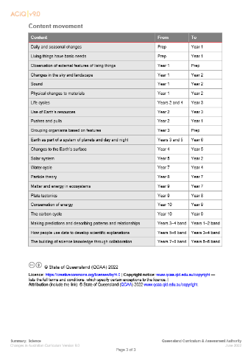
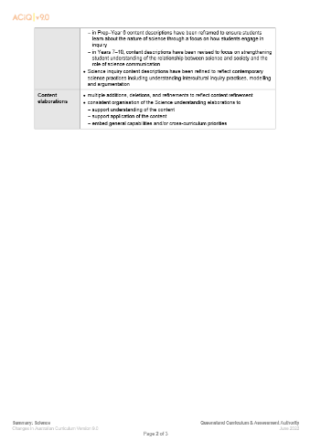
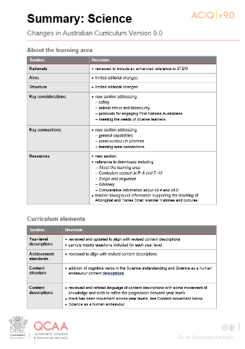
QCAA summary of changes
Summary documents provide detail about the changes in the learning area, e.g. movement of concepts or skills.
Notes:
Talking points
The summary documents are shown here.
Purpose: to support familiarisation by providing a high-level summary, such as the movement of content or skills.
Audience: school leaders, heads of department/curriculum, team leaders.
Use: assists leaders to gauge the degree of change in a learning area/subject. For example, a head of department/curriculum might use this to identify where most time needs to be allocated in reviewing year level programs.
Note for presenter
Link to the QCAA website: https://www.qcaa.qld.edu.au/p-10/aciq

Slide 28
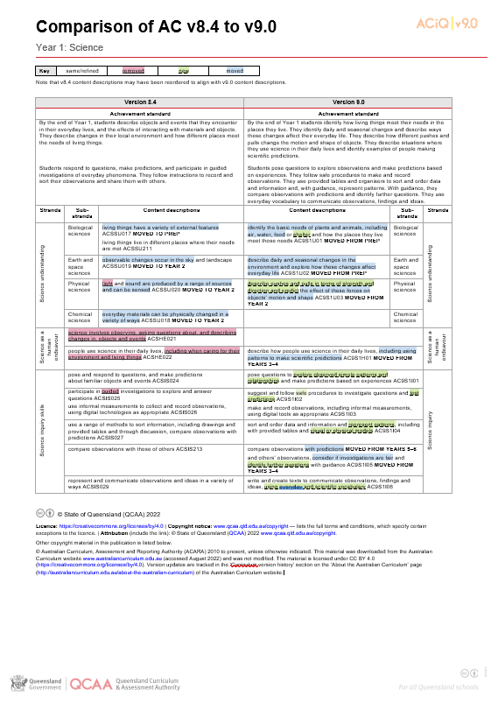
QCAA Comparison of ACv8.4 to v9.0
Comparison documents provide a detailed view of the changes from v8.4 to v9.0 within learning area content across a year level or band.
Key
white | same/refined
pink | removed
green | new
blue | moved
Notes:
Talking points
The comparison documents give a very detailed view of changes within learning area content in each year level.
Purpose: to provide the final level of detailed change within each learning area and year/band. Illustrates through colour what has been removed, what has moved and what is new.
Audience: HODs/HOCs and teachers.
Use: assist with the detailed auditing of Version 8.4 planning and will highlight what needs to be changed to transition to Version 9.0.
Note for presenter
Link to the QCAA website: www.qcaa.qld.edu.au/p-10/aciq

Slide 29
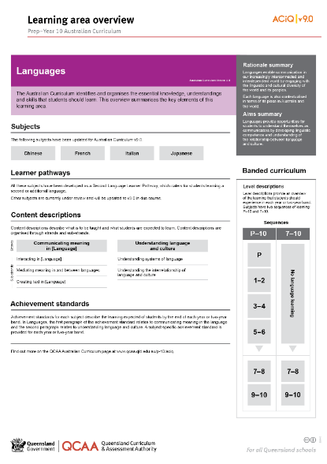
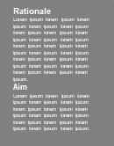
QCAA learning area overview
Learning area overviews provide a visual overview of the structure of each learning area.
Notes:
Talking points
An example Learning area overview is shown here.
Purpose: to provide a visual overview of the structure of each learning area
Audience: school leaders, curriculum leaders or teachers
Use: supports familiarity with a learning area.
Note for presenter
Link to the QCAA website: www.qcaa.qld.edu.au/p-10/aciq

Slide 30
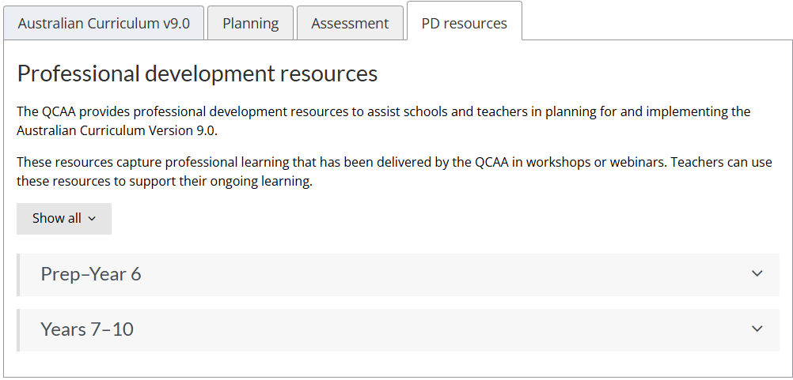
QCAA PD resources
Notes:
Talking notes
The QCAA PD resources tab provides learning area specific professional development resources to assist schools and teachers in planning for and implementing the Australian Curriculum Version 9.0.
Purpose: to support familiarisation by providing resources that capture the professional learning that has been delivered by the QCAA in workshops or webinars.
Audience: HODs/HOCs and teachers.
Use: assist with the familiarisation and implementation of a particular learning area.
Note for presenter
Link to the QCAA website: www.qcaa.qld.edu.au/p-10/aciq

Slide 31
Engaging with changes to the Australian Curriculum v9.0
In a moment …
With an elbow partner:
Read the QCAA Snapshot of changes and Summary of changes resources for a relevant learning area.
Identify two changes that you think are significant. Consider possible considerations for planning, professional learning and resourcing for our school’s context.
Be prepared to report to the whole group.
Notes:
Talking points
(Facilitate discussion as outlined on the slide.)
(After sufficient time, teachers can report to the whole group. For efficiency, reporting might be to table groups or the equivalent.)
Note to presenters
Change the instructions on the slide to suit the specific context of the meeting, including organisation of teaching teams (e.g. learning area or year level teams) and arrangement of furniture.
The Snapshot of changes and Summary of changes can be provided in hard copy or teachers can access them online if you wish them to engage with the QCAA website — see the Meeting 2 guide for links. The latter is likely to take more time.
As you may wish to capture the ideas that are raised, nominate a specific teacher or school leader to make notes as teachers report. Someone from each table should be responsible for recording if reporting will be in table groups.

Slide 32
Outline
1. Why are there changes to the Australian Curriculum?
3. What support is in place for teachers?
4. What are the next steps?
2. What are the timelines for change?
Notes:
Talking point
(Introduce Section 4.)

Slide 33

Our school
Where are we now?
Understanding change
Phase 1: Familiarisation
Resources
TBA
TBA
Professional learning
TBA
What next?
Considerations
Actions
Time for familiarisation and auditing
Communication with our community
TBA
Notes:
Talking points
Today we became aware of why the Australian Curriculum has been refined. We have seen some examples of the resources and professional learning opportunities that will be available to guide us on this journey.
Considerations for our school during the familiarisation stage will include resources, professional learning for teachers, providing time for familiarisation and auditing, and communication with our community, including the students.
These will be matters that are discussed further by the school leadership team, as well as faculties/teaching teams. (Note: Modify this talking point to suit your school’s decision-making processes and structure.)
Note for presenter
The considerations shown above are suggestions. Add in, change or delete information to suit your context.
Refer to your notes from the QCAA forum for school leaders or to the considerations the leadership team identified in Meeting 1: Beginning to plan for the Australian Curriculum v9.0.

Slide 34
School implementation plan — draft
[insert details of proposed school implementation plan, if available.]
Notes:
Talking points
A draft plan has been developed by the leadership team.
[Provide more detail on process used so far and the planned consultation process.]
[Open to discussion, time allowing.]
Note for presenter
A template for a school implementation schedule was included as a resource for Meeting 1.
If completed, a draft could be displayed on the screen (use more than one slide, if required) or hard copies could be distributed. Alternatively, email a digital version before or after Meeting 2.

Slide 35
Topics we discussed this session
1. Why are there changes to the Australian Curriculum?
3. What support is in place for teachers?
4. What are the next steps?
2. What are the timelines for change?
Notes:
Talking point
These are the topics we considered in this meeting.

Slide 36
Meeting goals
To become familiar with the need for the Australian Curriculum v9.0.
To develop a shared understanding of what this version offers students.
To begin to develop an understanding of the key changes in v9.0.
Notes:
Talking points
Our goals today were to help you to:
become familiar with the need for the Australian Curriculum v9.0
develop a shared understanding of what Version 9.0 offers our school and our students.

Slide 37

Reflection — moving to the Australian Curriculum v9.0
In a moment …
Using the table provided, reflect individually on:
a key message from this session
considerations as we move towards v9.0
your feelings about what you have heard today.
Leave reflection sheets in the box as you exit.
Notes:
Talking points
Before we finish, we would like to give you time to reflect on what you have heard today.
These reflections can be anonymous.
We will collate the reflections and use the results to inform our school strategic planning for implementing the Australian Curriculum v9.0.
Note to presenter
You will require:
sufficient copies of the reflection sheets — one per person
a box or other receptacle for collecting completed reflections.

Slide 38
Next steps
After this meeting, we will:
collate reflections from this meeting
provide feedback on the school implementation roadmap
engage with QCAA’s Australian Curriculum in Queensland v9.0 webpages for specific learning areas
in teaching teams/faculties:
    familiarise ourselves with key changes through the QCAA resources, especially snapshots of changes and summary of changes
    further consider opportunities provided by these changes for planning, resourcing and professional learning.
What else?
Notes:
Talking points
(Before finishing, clarify next steps — see slide for possibilities, but modify this to suit your school context and needs, as well as any work already undertaken by school leaders.)

Slide 39
Thank you for your participation today.
Notes:
Talking points
Thank you for your participation in today’s meeting.
Please continue the discussion about moving to the Australian Curriculum v9.0 over the coming days.
Note for presenter
Before leaving the room, ensure someone is responsible for collecting the reflection sheets.

Slide 40
QCAA social media
Notes:
If you don’t do so already, we recommend you follow QCAA on one or more social media platforms to stay in touch with us, and to find out about upcoming resources and professional learning.

Slide 41
Acknowledgments
Third-party copyright material, and QCAA material not covered by the CC BY licence is listed below:
Queensland Government coat of arms, and the QCAA and QSA trademarks may not be reproduced without permission.
Unless otherwise indicated, material from Australian Curriculum is © ACARA 2010–present, licensed
CC BY 4.0. For the latest information and additional terms of use, see the Australian Curriculum website and its copyright notice.
Student and staff images have been used with permission.
The three-dimensional curriculum diagram is 'Excluded Material' used under the terms of the Australian Curriculum and its copyright notice and is not modified. © Australian Curriculum, Assessment and Reporting Authority (ACARA) 2009 to present, unless otherwise indicated. You may view, download, display, print, reproduce (such as by making photocopies) and distribute these Excluded Materials in unaltered form only for your personal, non-commercial educational purposes or for the non-commercial educational purposes of your organisation, provided that you make others aware it can only be used for these purposes and attribute ACARA as the source of the Excluded Material. For the avoidance of doubt, this means that you cannot edit, modify or adapt any of these materials, and you cannot sub-licence any of these materials to others. Apart from any uses permitted under the Copyright Act 1968 (Cth), and those explicitly granted above, all other rights are reserved by ACARA. If you want to use such material in a manner that is outside this restrictive licence, you must request permission from ACARA by emailing (copyright@acara.edu.au).

Slide 42
Acknowledgments
The Alice Springs (Mparntwe) Education Declaration 2019 © Education Services Australia, as the legal entity for the Council of Australian Governments Education. Licensed under a Creative Commons Attribution, Non-Commercial 4.0 International License.
Image of fibre optics by chaitawat at Pixabay. https://pixabay.com/photos/fiber-optic-cable-blue-network-2749588/ Used under terms of Pixabay license.
Image of globe by geralt at Pixabay. https://pixabay.com/photos/globe-earth-world-globalization-2489596/ Used under terms of Pixabay license.
Image of leaf and water droplets by ju1959jjj at Pixabay. https://pixabay.com/photos/nature-flower-flowers-yard-macro-2986145/ Used under terms of Pixabay license.
Image of computer keyboard by Janeb13 at Pixabay https://pixabay.com/photos/pc-computer-screen-desktop-computer-1207683/ Used under terms of Pixabay license.

Slide 43
Copyright notice
© State of Queensland (QCAA) 2025
Licence: https://creativecommons.org/licenses/by/4.0 | Copyright notice: www.qcaa.qld.edu.au/copyright — lists the full terms and conditions, which specify certain exceptions to the licence. |
Attribution (include the link): © State of Queensland (QCAA) 2025 www.qcaa.qld.edu.au/copyright.
Other copyright material in this presentation is listed on the previous slide/s.

