Slide 1
What you will need for this meeting
This presentation is designed for delivery by a principal or their delegate to deliver key messages from the QCAA School Leaders Forum and to develop with their school leaders a shared vision and narrative around the changes to the curriculum.
Before you present:
read the guidance for school leaders
engage with the meeting guide for this presentation
review the slideshow
add activities or conversation starters to suit your school’s needs
hide slides that are not appropriate for your context.
Before you start
Notes:
Note to presenter
Hide this slide before presenting.

Slide 2
Beginning to plan for the Australian Curriculum Version 9.0
Meeting 1 — For use with school leadership team
221414
Notes:
Note to presenter:
The general purpose of the session is to become familiar with Australian Curriculum Version 9.0 and develop a shared understanding across the school by:
sharing our learning from the leaders’ forum
engaging in professional conversations
considering the next steps for our school.
Source of image: QCAA

Slide 3
Acknowledgment of Country
Notes:
Acknowledgment of Country
The schools should use protocols and acknowledgment used in their own context.

Slide 4
Session learning goals
To activate prior knowledge and develop a shared understanding of why the Australian Curriculum has changed.
To share key timelines and support available from the QCAA.
To prompt strategic thinking, develop a shared understanding of what Version 9.0 offers our school and begin to plan for implementation.
Success criteria
By the end of this session, you will:
be aware of key messages from the QCAA and ACARA
have engaged in professional conversations about the change
know the next steps in the familiarisation phase
share a common vision for success.
Notes:
Talking point
(Share the learning goals and success criteria with the group.)

Slide 5

The Australian Curriculum has been refreshed.
Notes:
Talking points:
After an extensive period of review to which many Queensland teachers and school leaders provided feedback, the Australian Curriculum has been refreshed from Version 8.4 to Version 9.0.
We are meeting today as a leadership team to share key messages and to develop a shared vision and narrative around the changes to the curriculum.
Image source: Rainbow Coast Sunset - Free photo on Pixabay (https://pixabay.com/photos/rainbow-coast-sunset-beach-sky-1467988)

Slide 6
Leadership and change
By thinking about our own attitudes and perceptions, and those of the people we lead, we can start to understand ourselves and others.
It is through this understanding that we inspire, empower and encourage others.
It is through collaboration that we innovate and move forward as a united team.
Notes:
Talking points
Prompt the leadership team to reflect on their own attitudes and perceptions about change.
Communicate about how the team can work together effectively to enact change.
Note to presenter:
The text on this slide appears on a click. There are three animated paragraphs.

Slide 7

Responding to change
By thinking about our own response to change, we begin to understand the challenges and personal journey that others will undertake.
Today, let us keep in mind those we lead and how to best meet their needs as we undertake to learn more about the refreshed curriculum.
Notes:
Talking points
Today, let us keep in mind those we lead and how to best meet their needs as we undertake to learn more about the refreshed curriculum.
Image source: https://pixabay.com/illustrations/butterfly-animal-print-pattern-1073709/

Slide 8
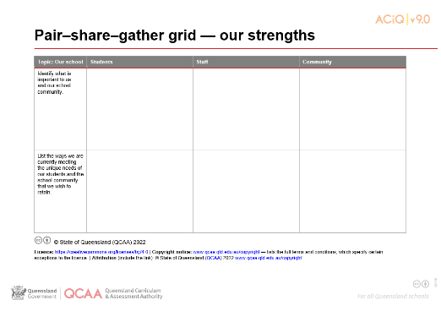

Reflection: Our strengths
In a moment …
In pairs, identify what is important to us and our school community.
List the ways we are currently meeting the unique needs of our students and the school community that we wish to retain.
Notes:
Talking points
Let’s consider our school and what makes it unique.
What is it that we value and want to maintain as we move towards Version 9.0 of the Australian Curriculum?
Through this period, there will be many things that we want to keep and protect.
Let’s list them here.
Note to presenter:
Your school may have already embarked on an effective improvement strategy that will continue to align with the curriculum. You may have been developing an innovation that has proven to be successful in your school. Perhaps you have accessed current research that informs teaching and learning. There may be some personal attributes that you are fostering in students and your staff.
Collect pair–share–gather grids now or at the end of the session.

Slide 9
Outline
1. Why are there changes to the Australian Curriculum?
3. What support is in place for teachers?
4. What are the next steps?
2. What are the timelines for change?
Notes:
Talking point
These are the topics we will cover in this session.

Slide 10
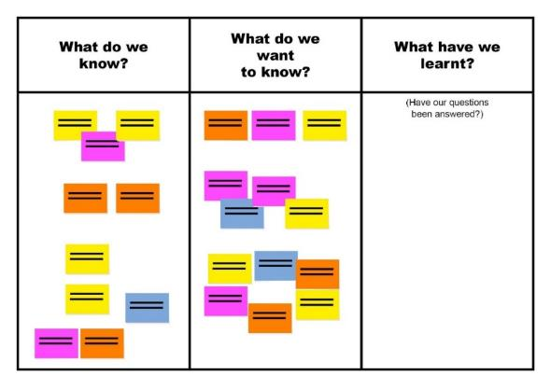

KWL: Understanding of the Australian Curriculum v9.0
In a moment …
On the sticky notes provided, answer the questions:
What do you already know about why the Australian Curriculum has been updated?
What do you still want to know?
When ready, post them on the wall chart.
Notes:
Talking points
Today we are going to look at some of the reasons behind the curriculum update.
Some of you may already have some understanding about why the curriculum was updated.
Because we are all at different stages of our knowledge, we will explore this together to make sure we have a shared understanding by the time we finish today.

Slide 11
Outline
1. Why are there changes to the Australian Curriculum?
3. What support is in place for teachers?
4. What are the next steps?
2. What are the timelines for change?
Notes:
Talking point
(Introduce Section 1.)

Slide 12
Looking back
2008 Melbourne Education Declaration
2010
First version
of Australian Curriculum released
2011
Queensland commences implementation
Notes:
Talking points
Before moving forward, let’s take a step back to develop a shared understanding of how Version 9.0 of the Australian Curriculum developed.
There are some key dates along the way, beginning with 2008 when there was agreement by federal and state education ministers to create an Australian Curriculum, through the Australian Curriculum, Assessment and Reporting Authority (ACARA).
This was an action that came from the signing of the Melbourne Education Declaration.
ACARA were tasked with writing the Australian Curriculum. The first version was released in 2010.
Queensland commenced implementation in 2011.
Notes for presenter
This means that the Australian Curriculum in Queensland is now over 11 years old.
Leaders could be asked to pause for a moment and consider where they were in 2010 and the differences between then and 2022. (Ad-lib with a relevant, personal anecdote.)

Slide 13
Looking back
2019
Alice Springs (Mparntwe) Education Declaration
2020–2021 Review, draft, consult and refine
1 April 2022 Version 9.0 of Australian Curriculum approved
9 May 2022 Australian Curriculum v9.0 published
Notes:
Talking points
In December 2019, all Australian education ministers signed the Mparntwe (pronounced M-ban-tua), or Alice Springs, Education Declaration.
2020–2021 — ACARA announced the review of v8.4 to v9.0. This involved a review of v8.4, drafting of the consultation curriculum, consultation process and subsequent refinement.
Queensland teachers were instrumental in this consultation process, offering direct feedback to ACARA through the consultation survey and to the QCAA to form the Queensland response.
The revised v9.0 curriculum was approved by education ministers on 1 April 2022.
It was published in May 2022.
So, we have not had long to engage with Version 9.0.
We will explore why the curriculum update is a positive step for our teachers, our students and our community.

Slide 14


Reflection: A contemporary curriculum
In a moment …
With an elbow partner, consider:
How has the world changed since 2011?
Why is a contemporary curriculum essential for our students’ future success?
Looking back
Looking forward
Notes:
Talking points
With an elbow partner, discuss:
How has the world changed since 2011?
Why is a contemporary curriculum essential for our students’ future success?
You could consider:
How have the ways we communicate changed?
What challenges will students face from 2024 and beyond?
What would you like to improve for students?
(After sufficient time, invite participants to share their answers.)

Slide 15
Alice Springs (Mparntwe) Education Declaration, 2019
Vision: A world-class education system
Goal 1:
The Australian education system promotes
excellence and equity.
Goal 2:
All young Australians
become confident and creative individuals, successful lifelong learners and active and informed members of the community.
Education Services Australia 2019, www.education.gov.au/alice-springs-mparntwe-education-declaration/resources/alice-springs-mparntwe-education-declaration, p. 4
Notes:
Talking points
As we know, in December 2019, all Australian education ministers signed the Mparntwe (pronounced M-ban-tua), or Alice Springs, Education Declaration.
Acknowledging the power of education to transform lives, the declaration sets out a vision for education in Australia and commitment to improving educational outcomes for all Australians.
It builds on past declarations, i.e. Hobart, Adelaide and Melbourne Declarations.
As well as reinforcing foundational understandings and skills, it recognises that education must prepare students ‘to thrive in a time of rapid social and technological change, and complex environmental, social and economic challenges’ (Education Services Australia 2019, p. 2).
The vision is ‘for a world-class education system that encourages and supports every student to be the very best they can be, no matter where they live or what kind of learning challenges they may face’ (ibid).
With this in mind, the declaration sets out two distinct, but interrelated goals — see slide.
These goals underpinned the review of the Australian Curriculum.

Slide 16
Reflection: A world-class curriculum
In a moment …
Individually, consider:
What does world-class curriculum and assessment
mean to you in our school context?
When I say go:
Find an elbow partner and generate a shared understanding of world-class curriculum and assessment in our context.
Notes:
Talking points
We are now familiar with the goals and vision of the Alice Springs Education Declaration.
A world-class education system is the vision for which we all strive.
The challenge is how to enact world-class curriculum and assessment in our school.
Our leadership group will have ideas about what makes curriculum and assessment world class.
Let’s explore what ‘world-class’ means to each of us.
Consider: What does world-class curriculum and assessment mean to you in our school context?
When I say go, find an elbow partner and generate a shared understanding of world-class curriculum and assessment in our context.
Be prepared to share with the whole group.
(After sufficient time, ask for volunteers to share their understandings. Discuss alignments and divergences amongst responses.)

Slide 17
ACARA’s aims for the Australian Curriculum v9.0
Contemporary
Internationally benchmarked
Improved clarity
Refined
Notes:
Talking points
ACARA had clear aims for the review.
As you can see on this slide, underpinned by the Alice Springs Declaration and working within the current 3D structure, the aims of the Australian Curriculum Version 9.0 are to:
ensure the curriculum is contemporary
benchmark the Australian Curriculum against other international jurisdictions, including British Columbia, Finland, Singapore and New Zealand
enhance clarity through refined curriculum content and achievement standards
improve user experience on a new website with enhanced functionality.
Source of images
Fibre optics by chaitawat at Pixabay, https://pixabay.com/photos/fiber-optic-cable-blue-network-2749588
Globe by geralt at Pixabay, https://pixabay.com/photos/globe-earth-world-globalization-2489596
Leaf and water droplets by ju1959jjj at Pixabay, https://pixabay.com/photos/nature-flower-flowers-yard-macro-2986145
Computer keyboard by Janeb13 at Pixabay https://pixabay.com/photos/pc-computer-screen-desktop-computer-1207683 Used under terms of Pixabay licence.

Slide 18
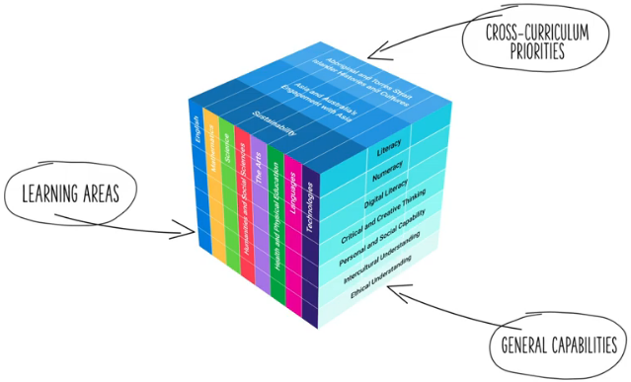
Three dimensions of Australian Curriculum v9.0
Largely unchanged from v8.4
ACARA image from Summary overview (video) https://v9.australiancurriculum.edu.au/help/website-tour
Notes:
Talking points
Let us start with what has not changed in Australian Curriculum v9.0.
Overall the structure of the Australian Curriculum is largely unchanged. We still have:
eight learning areas — English, Health and Physical Education, Humanities and Social Sciences, Languages, Mathematics, Science, Technologies and The Arts
three cross-curriculum priorities to provide students with the ‘tools and language to engage with and better understand their world’ (ACARA, 2012, p. 18). These are Aboriginal and Torres Strait Islander histories and cultures, Asia and Australia’s engagement with Asia, and Sustainability
the continued inclusion of seven general capabilities reflecting the 21st century skills — Critical and creative thinking, Ethical understanding, Intercultural understanding, Literacy, Numeracy, Personal and social understanding, and Digital literacy.
Changes in the structure include:
a naming change in a general capability. Information and communication technology or ICT as it was previously known is now called Digital literacy to reflect the terminology commonly used in industry.
a change in the cross-curriculum priority of Sustainability with the addition of Design.

Slide 19
Outline
1. Why are there changes to the Australian Curriculum?
3. What support is in place for teachers?
4. What are the next steps?
2. What are the timelines for change?
Notes:
Talking point
(Introduce Section 2.)

Slide 20

Memo: 057/22
Published 11 July 2023
Separate professional development and support schedules for primary (Prep–Year 6) and secondary (Years 7–10) schooling contexts
Notes:
Talking points
This memo was sent to schools on 11 July 2023.
The purpose was to advise schools of the updated implementation schedules for the P–10 Australian Curriculum v9.0 that will inform the development and delivery of QCAA resources and a professional learning program.

Slide 21
Prep–Year 6: Professional development and support schedule
Year | Familiarisation | Implementation
2023 | English Mathematics
2024 | English — extended Mathematics — extended
 | Sciences Technologies Health and Physical Education
2025 | Sciences — extended Technologies — extended Health and Physical Education — extended | English Mathematics
 | Languages The Arts Humanities and Social Sciences
Notes:
Talking points
(Refer to slide.)
The updated QCAA professional development and support schedule for Prep–Year 6 is available from the QCAA website.
Note for presenter
It might be useful to download the schedule and have copies available for the meeting.
A link to this is available in the Meeting 1 guide.

Slide 22
Prep–Year 6: Professional development and support schedule
Year | Familiarisation | Implementation
2026 | Languages — extended The Arts — extended Humanities and Social Sciences — extended | Sciences Technologies Health and Physical Education
2027 |  | Languages The Arts Humanities and Social Sciences
Notes:
Talking points
(Refer to slide.)
The updated QCAA professional development and support schedule for Prep–Year 6 is available from the QCAA website.
Note for presenter
It might be useful to download this and have copies available for the meeting.
A link to this is available in the Meeting 1 guide.

Slide 23
Years 7–10: Professional development and support schedule
Year | Familiarisation and implementation
2023 | Schools determine their local approach to implementation, e.g. year-level approach or subject/learning area approach. Schools are encouraged to consider the support provided by the QCAA for the transition and the balance of Applied and General subjects offered.
2024
2025
2026
2027 | All learning areas must be fully implemented.
Notes:
Talking points
(Refer to slide.)
The updated QCAA professional development and support schedule for Years 7–10 is available from the QCAA website.
Note for presenter
It might be useful to download this and have copies available for the meeting.
A link to this is available in the Meeting 1 guide.

Slide 24
Australian Curriculum v9.0
Familiarisation
Planning
Implementation
Notes:
Talking points
The QCAA recommends three broad phases when implementing Version 9.0 of the Australian Curriculum:
familiarisation with the Version 9.0 curriculum, including a review of existing school curriculum and assessment plans for alignment to the curriculum
planning for teaching, learning and assessment
implementation of Version 9.0, including designing assessment and making judgments.
The QCAA will offer professional support in two key areas:
curriculum literacy, i.e. knowledge and understanding of the Australian Curriculum; skills to plan with the curriculum for the full range of learners
assessment literacy, i.e. knowledge of assessment design; skills to design assessments, create marking guides and make judgments, and provide feedback aligned to the achievement standards.

Slide 25
Outline
1. Why are there changes to the Australian Curriculum?
3. What support is in place for teachers?
4. What are the next steps?
2. What are the timelines for change?
Notes:
Talking point
(Introduce Section 3.)

Slide 26
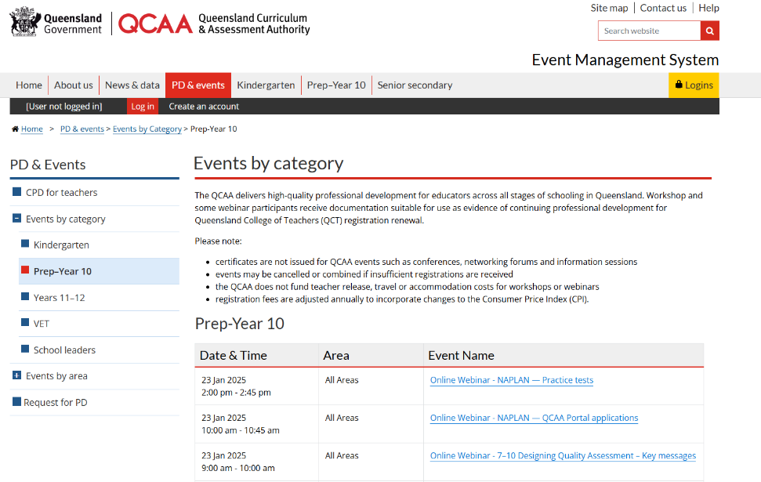
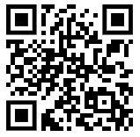
QCAA professional learning support
Notes:
Talking points
ACARA developed the Australian Curriculum v9.0.
The QCAA supports schools in all Queensland sectors with advice, resources and professional learning.
The QCAA professional learning events will be advertised through the QCAA events webpage.

Slide 27

QCAA Australian Curriculum in Queensland (ACiQ v9.0)
Web support
New and updated advice and resources to support:
learning areas
general capabilities
cross-curriculum priorities.
Notes:
Talking points
The QCAA have updated their webpages.
The new pages give you online access to the advice and resources the QCAA is developing for all three dimensions of Version 9.0.
The QCAA website landing page for Australian Curriculum provides the options to access either advice, resources or professional learning for Version 8.4 or Version 9.0.
Access to Version 8.4 aligned advice, resources and professional learning will remain until it is no longer required.
New resources and advice will be available progressively on the Version 9.0 webpages of the QCAA website.

Slide 28
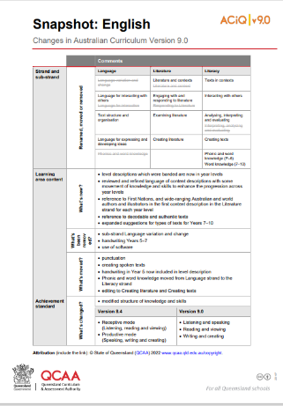

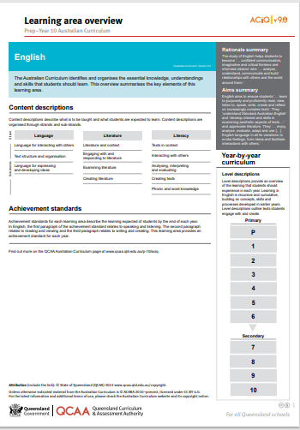
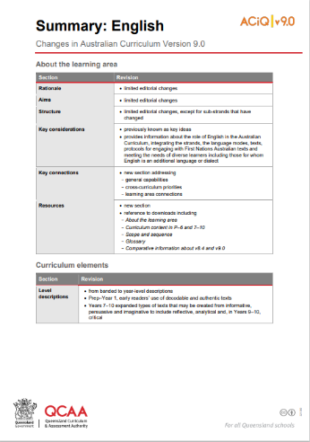
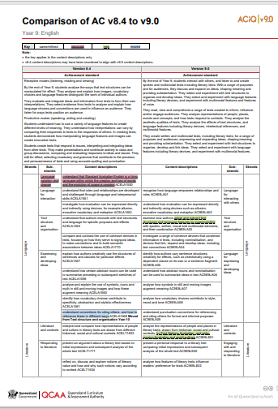
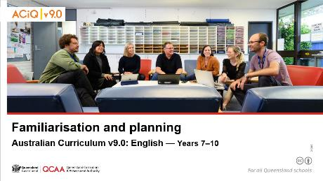
ACiQ v9.0 resources
Resources on the website include learning area:
snapshot of changes
summary of changes
comparison of v8.4 and v9.0
overviews
PD resources.
Notes:
Talking points
The QCAA provide an extensive range of resources via their webpages to support you as you familiarise with the changes from v8.4 to v9.0.
The range will grow throughout the phases of familiarisation, planning and implementation.
We will be well supported in the process of implementation.
The resources can be identified easily by the ACiQ v9.0 stamp in the top-right corner.

Slide 29
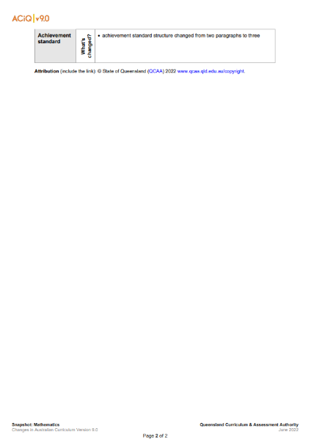
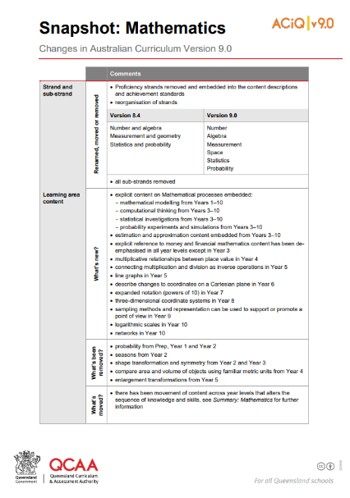
QCAA Snapshot of changes
A snapshot of broad changes to each learning area.
Notes:
Talking points
The snapshot of changes and the summary of changes documents are good places to start to support our awareness of the degree of changes in each learning area.
Purpose: to support familiarisation by providing a high-level summary.
Audience: principals and school leaders.
Use: for leaders to gauge the degree of change in a learning area/subject. For example, a deputy or assistant principal or head of school might use this to identify where most time needs to be allocated.
Note for presenter
Link to the QCAA website: www.qcaa.qld.edu.au/p-10/aciq

Slide 30
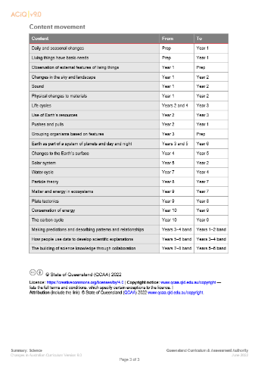
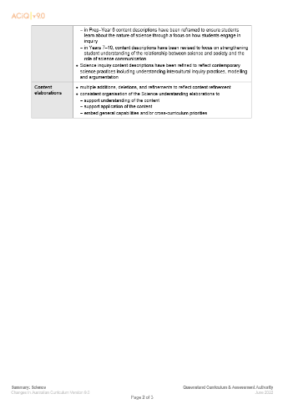
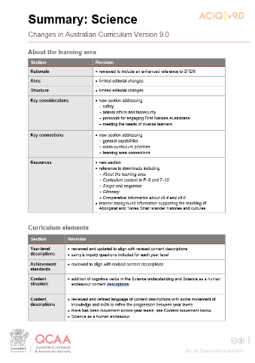
QCAA summary of changes
Summary documents provide detail about the changes in the learning area, e.g. movement of concepts or skills.
Notes:
Talking points
The summary documents are shown here.
Purpose: to support familiarisation by providing a high-level summary, such as the movement of content or skills.
Audience: principals and school leaders.
Use: assists leaders to gauge the degree of change in a learning area/subject. For example, a deputy or assistant principal or head of school might use this to identify where most time needs to be allocated.
Note for presenter
Link to the QCAA website: https://www.qcaa.qld.edu.au/p-10/aciq

Slide 31
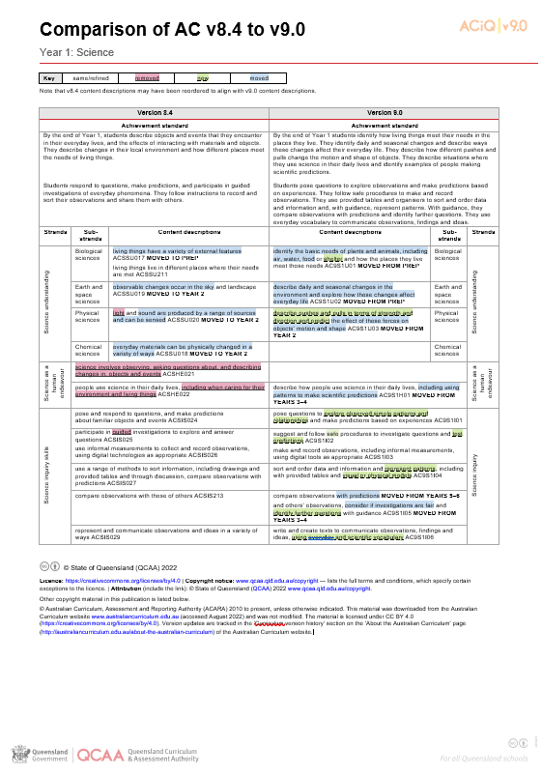
QCAA Comparison of ACv8.4 to v9.0
Comparison documents provide a detailed view of the changes from v8.4 to v9.0 within learning area content across a year level or band.
Key
white | same/refined
pink | removed
green | new
blue | moved
Notes:
Talking points
The comparison documents give a very detailed view of changes within learning area content in each year level.
Purpose: to provide the final level of detailed change within each learning area and year/band. Illustrates through colour what has been removed, what has moved and what is new.
Audience: HODs/HOCs and teachers.
Use: assist with the detailed auditing of Version 8.4 planning and will highlight what needs to be changed to transition to Version 9.0.
Note for presenter
Link to the QCAA website: www.qcaa.qld.edu.au/p-10/aciq

Slide 32
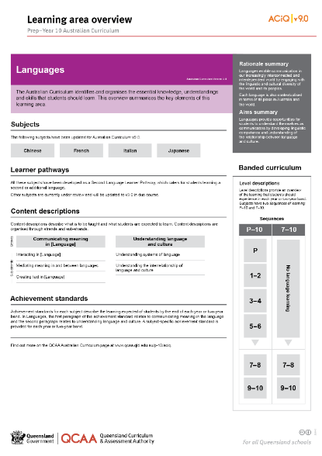
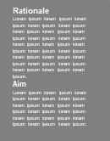
QCAA learning area overview
Learning area overviews provide a visual overview of the structure of each learning area.
Notes:
Talking points
An example Learning area overview is shown here.
Purpose: to provide a visual overview of the structure of each learning area
Audience: school leaders, curriculum leaders or teachers
Use: supports familiarity with a learning area.
Note for presenter
Link to the QCAA website: www.qcaa.qld.edu.au/p-10/aciq

Slide 33
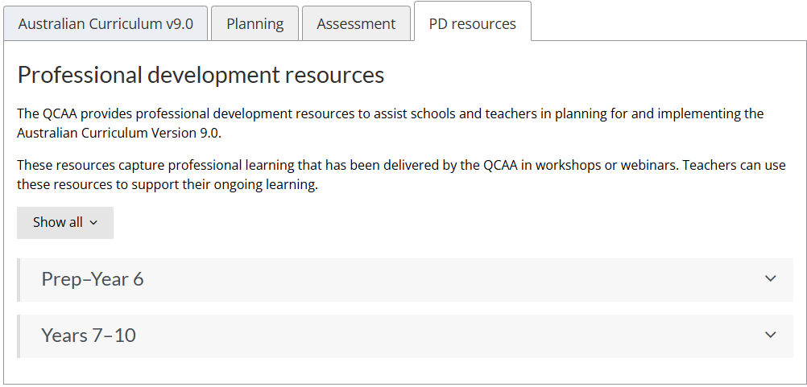
QCAA PD resources
Notes:
Talking notes
The QCAA PD resources tab provides learning area specific professional development resources to assist schools and teachers in planning for and implementing the Australian Curriculum Version 9.0.
Purpose: to support familiarisation by providing resources that capture the professional learning that has been delivered by the QCAA in workshops or webinars.
Audience: HODs/HOCs and teachers.
Use: assist with the familiarisation and implementation of a particular learning area.
Note for presenter
Link to the QCAA website: www.qcaa.qld.edu.au/p-10/aciq

Slide 34
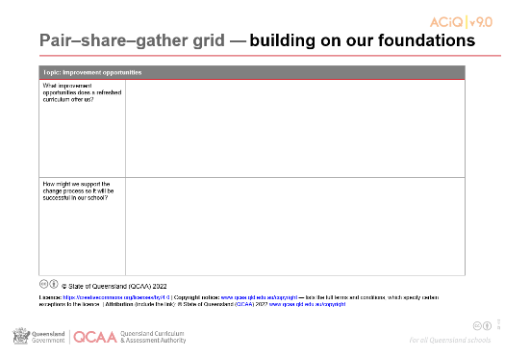
Reflection: Building on our foundations
In a moment …
With an elbow partner, consider:
What improvement opportunities does the Australian Curriculum v9.0 offer our school?
What considerations might there be for professional development, resourcing and staffing?
Notes:
Talking points
In pairs or small groups, leaders discuss and record on the pair–share–gather grid — building on our foundations:
What improvement opportunities does a refreshed curriculum offer our school?
What considerations might there be for professional development, resourcing and staffing?

Slide 35
Reflection: Building on our foundations
In a moment …
Share your ideas with the whole group:
What improvement opportunities does the Australian Curriculum v9.0 offer our school?
What considerations might there be for professional development, resourcing and staffing?
Notes:
Talking points
(Facilitate discussion as outlined on the screen.)
Note to presenter
Collect pair–share–gather grids now or at the end of the session.

Slide 36
Outline
1. Why are there changes to the Australian Curriculum?
3. What support is in place for teachers?
4. What are the next steps?
2. What are the timelines for change?
Notes:
Talking points
(Introduce Section 4.)

Slide 37
Modelling confidence and a positive vision
We began the session considering our own personal response to the changes to the Australian Curriculum.
What we need to do now is present a united, positive approach to change and move together in making the next steps.
Notes:
Talking points
(Talk to slide — see Meeting 1 guide for further details.)

Slide 38
Elevator pitch
In a moment …
With an elbow partner:
revise, refine or build on one of the examples of a pitch or
create a new pitch.
Purpose: To spark positive attitudes and interest in the work ahead.
Audience: Teaching staff, other members of the school community
Notes:
Talking points
Anticipating reactions to change, how might we support change conversations and share a common vision?
Your task in a moment is to develop a 30-second elevator pitch to explain the need for a new curriculum. An elevator pitch is a concise explanation of a topic or issue designed to achieve buy-in quickly.
(Model task using the elevator pitch developed at the Forum for leaders or use one or more of the examples below.)
In pairs, revise, refine or build on the examples provided or create a new pitch.
Be prepared to share your responses.
Examples of a pitch
Queensland first implemented the Australian Curriculum in 2011. The Australian Curriculum in Queensland is therefore over 11 years old.
Communication was very different in 2011. Think about how many devices were in your home. Most of your students would not have had a significant digital footprint. Had you heard of a professional social influencer?
Think of the other changes in society that have come about — our focus on mental health and well-being, privacy and security. Were these topics as hotly discussed?
In 2011, how did society measure success? Recent world events have made many people change their priorities and goals.
Who were the leaders in education? Were you aware of how Australia compared internationally? What research has taken place since 2011 to inform our practice, resulting in shifts in your knowledge and ways of working?
Was student agency part of our thinking? Were we providing the degree of flexibility that our classrooms now offer?
This refresh of the curriculum is an opportunity for us to move the Australian Curriculum forward to prepare our students for a very different future than that projected in 2011. It is also an opportunity for us to refresh and build on the great work we have already done.

Slide 39
Topics we discussed this session
1. Why are there changes to the Australian Curriculum?
3. What support is in place for teachers?
4. Next steps and conclusion
2. What are the timelines for change?
Notes:
Talking point
On screen are the topics we considered in this session.

Slide 40
Meeting 1 goals
To activate prior knowledge and develop a shared understanding of why the Australian Curriculum has changed.
To share key timelines and support available from the QCAA.
To prompt strategic thinking, develop a shared understanding of what Version 9.0 offers our school and begin to plan for implementation.
With this in mind …
Notes:
Talking points
(Refer to the slide to briefly review session goals.)

Slide 41


KWL: Towards our school’s implementation roadmap
In a moment …
Based on what you know:
What might implementation look like in our context?
What do we need to consider in terms of teacher support, students and our families?
Write your ideas on the sticky notes provided. When ready, post them on the wall chart.
Notes:
Talking points
Today we looked at some of the reasons the curriculum was updated and roadmaps of QCAA’s professional development and resource support.
We have also considered what opportunities the Australian Curriculum v9.0 might offer our school.
We explored this together to make sure we have a shared understanding.
One of our next steps is to develop an implementation roadmap for our school. (If desired, show the template developed by QCAA as an example.)
Now, reflect on what implementation might look like in our context, for example:
sequence of rollout of learning areas and year levels
timing of professional development offerings
how we might best manage the logistics of the rollout, e.g. by establishing an implementation team
considerations for resourcing and staffing
considerations for students and our families, e.g. communication strategies.
Write your ideas on the sticky notes and then, when you are ready, post your ideas onto the wall chart under ‘What have we learnt?’.
(Provide sufficient time for leaders to brainstorm ideas. When ready, discuss ideas as a group.)
Note for presenter
A possible template for a school implementation roadmap is included in the leaders’ pack. Adapt this to suit your needs or develop your own.

Slide 42
Next steps
After this meeting, we will:
collate reflections
form an implementation team
engage with the QCAA’s snapshot and summary of change resources
develop a school implementation roadmap
plan a teacher session, including date and time.
What else?
Notes:
Talking points
(Before finishing, clarify next steps — see slide for possibilities, but modify this to suit your school context and needs.)

Slide 43
Thank you.
Notes:
Talking points
Thank you for your participation in today’s meeting.
Please continue the discussion about moving to the Australian Curriculum v9.0 over the coming days.
Note for presenter
Before leaving the room, ensure someone is responsible for collecting the various resources — e.g. completed grids, KWL and other feedback notes — and for collating the ideas of the group.

Slide 44
QCAA social media
Notes:
If you don’t do so already, we recommend you follow QCAA on one or more social media platforms to stay in touch with us, and to find out about upcoming resources and professional learning.

Slide 45
References
Australian Curriculum, Assessment and Reporting Authority 2013, The Shape of the Australian Curriculum Version 4.0, https://docs.acara.edu.au/resources/The_Shape_of_the_Australian_Curriculum_v4.pdf.
Education Services Australia 2019, ‘The Alice Springs (Mparntwe) Education Declaration’, www.education.gov.au/alice-springs-mparntwe-education-declaration/resources/alice-springs-mparntwe-education-declaration.

Slide 46
Acknowledgments
Third-party copyright material and QCAA material not covered by the CC BY licence is listed below:
Queensland Government coat of arms, and the QCAA and QSA trademarks may not be reproduced without permission.
Unless otherwise indicated, material from Australian Curriculum is © ACARA 2010–present, licensed
CC BY 4.0. For the latest information and additional terms of use, see the Australian Curriculum website and its copyright notice.
Student and staff images have been used with permission.
The Alice Springs (Mparntwe) Education Declaration 2019 © Education Services Australia, as the legal entity for the Council of Australian Governments Education. Licensed under a Creative Commons Attribution, Non-Commercial 4.0 International License.
Slides 17 and 18 (Educational Services Australia 2019, p. 2).

Slide 47
Acknowledgments
Third-party copyright material and QCAA material not covered by the CC BY licence is listed below:
Rainbow Coast Sunset — Free photo on Pixabay https://pixabay.com/photos/rainbow-coast-sunset-beach-sky-1467988/
Butterfly Animal Print Pattern — Free image on Pixabay, https://pixabay.com/illustrations/butterfly-animal-print-pattern-1073709/
Fibre optics by chaitawat at Pixabay. https://pixabay.com/photos/fiber-optic-cable-blue-network-2749588/ Used under terms of Pixabay license.
Globe by geralt at Pixabay. https://pixabay.com/photos/globe-earth-world-globalization-2489596/ Used under terms of Pixabay license.
Leaf and water droplets by ju1959jjj at Pixabay. https://pixabay.com/photos/nature-flower-flowers-yard-macro-2986145/ Used under terms of Pixabay license
Computer keyboard by Janeb13 at Pixabay https://pixabay.com/photos/pc-computer-screen-desktop-computer-1207683/ Used under terms of Pixabay license.
.

Slide 48
Acknowledgments
Third-party copyright material and QCAA material not covered by the CC BY licence is listed below:
12. The three-dimensional curriculum diagram is 'Excluded Material' used under the terms of the Australian Curriculum and its copyright notice and not modified. © Australian Curriculum, Assessment and Reporting Authority (ACARA) 2009 to present, unless otherwise indicated. You may view, download, display, print, reproduce (such as by making photocopies) and distribute these Excluded Materials in unaltered form only for your personal, non-commercial educational purposes or for the non-commercial educational purposes of your organisation, provided that you make others aware it can only be used for these purposes and attribute ACARA as the source of the Excluded Material. For the avoidance of doubt, this means that you cannot edit, modify or adapt any of these materials, and you cannot sub-licence any of these materials to others. Apart from any uses permitted under the Copyright Act 1968 (Cth), and those explicitly granted above, all other rights are reserved by ACARA. If you want to use such material in a manner that is outside this restrictive licence, you must request permission from ACARA by emailing (copyright@acara.edu.au).

Slide 49
Copyright notice
© State of Queensland (QCAA) 2025
Licence: https://creativecommons.org/licenses/by/4.0 | Copyright notice: www.qcaa.qld.edu.au/copyright — lists the full terms and conditions, which specify certain exceptions to the licence. |
Attribution (include the link): © State of Queensland (QCAA) 2025 www.qcaa.qld.edu.au/copyright.
Other copyright material in this presentation is listed on the previous slide/s.

