Slide 1
This presentation reproduces the key slides from the literacy writing workshop delivered in 2025 and is designed to be delivered with a year level/learning area team.
** Hide this slide before presenting **
Before you start
Read — Guidance for teachers: Teaching strategies for writing in Years 3–9. This will provide additional context and purpose for the presentation.
Check the QCAA resources to support the writing presentation.
Consider your school context, learning area content and/or topic.
Notes:
** Hide this slide before presenting. **

Slide 2
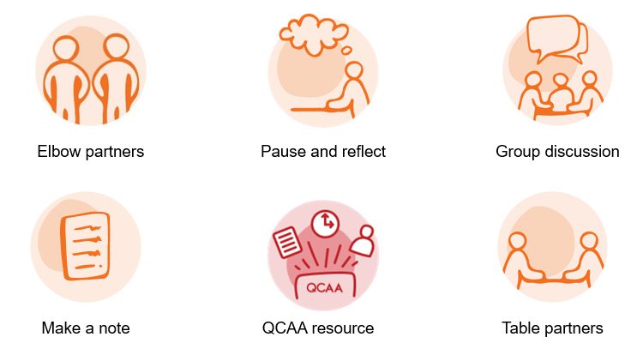
Look for activity icons.
Throughout this presentation, icons are used to indicate different activities
** Hide this slide before presenting **
Before you start
Notes:
** Hide this slide before presenting. **

Slide 3

Years 3–6: Improving writing proficiency levels
251279
Australian Curriculum Version 9.0
Notes:
This presentation reproduces the key slides from a writing workshop.
For more information, please email australiancurriculum@qcaa.qld.edu.au.
Source: 240605_Corinda High_04234_QCAA_S.jpg

Slide 4
Acknowledgment of Country
Notes:
Note: Schools to consider protocols and acknowledgment used in their own context.

Slide 5
Success criteria
Learning goal
To understand how to use the Australian Curriculum v9.0 and writing strategies across the learning areas in Years 3–6 to improve students’ writing.
You will know you are successful if
you can:
use the Australian Curriculum v9.0
and its Literacy general capability to inform the teaching of writing across learning areas
explore practical teaching strategies to improve student writing outcomes using a teaching and learning cycle.

Slide 6

Building a writing culture
In a moment …
Discuss what a classroom with a positive writing culture looks like,
sounds like and feels like.
Looks like
Sounds like
Feels like
Notes:
Delete slide if activity not required.
Image created in-house

Slide 7
Outline
Understanding writing and the curriculum
Curriculum in the primary writing classroom
Additional resources

Slide 8
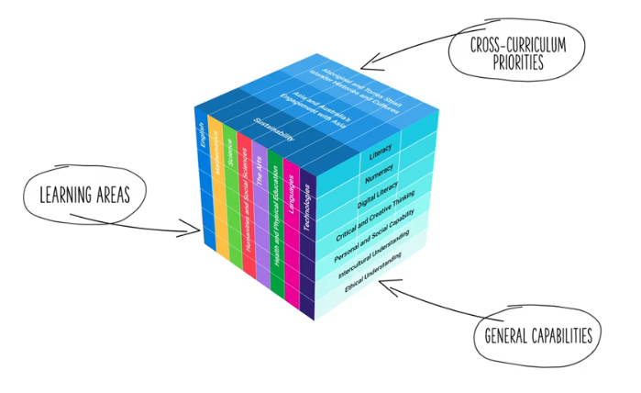
Writing and the Australian Curriculum Version 9.0
English
Literacy general capability
Other learning areas
Source: Australian Curriculum, https://v9.australiancurriculum.edu.au/help/website-tour
Notes:
The Australian Curriculum Version 9.0: English assists teachers in developing students’ literacy skills, including those particular to writing development.
The literacy general capability provides teachers with the additional detail to support the development of students’ literacy skills, including writing.
Other learning areas also provide learning area specific information that supports the teaching of writing e.g. informative report writing in Science.

Slide 9
The English curriculum aims to ensure that students:
1. learn to purposefully and proficiently read, view, listen to, speak, write, create and reflect on increasingly complex texts across a growing range of contexts
2. understand how Standard Australian English works in its spoken and written forms, and in combination with non-linguistic forms of communication, to create meaning
3. develop interest and skills in examining the aesthetic aspects
of texts and develop an informed appreciation of literature
4. appreciate, enjoy, analyse, evaluate, adapt and use the richness and power of the English language in all its variations to evoke feelings, form ideas and facilitate interaction with others.
Source: Australian Curriculum, https://v9.australiancurriculum.edu.au/teacher-resources/understand-this-learning-area/english
Notes:
The English curriculum has four aims that identify the intent of the curriculum and reflect the 3 English strands: Language, Literature and Literacy.
Aspects from the aims in bold relate to writing.
Our aim is to ensure that students:
- learn to purposefully and proficiently write and create increasingly complex texts across a growing range of contexts
- understand how Standard Australian English works in its written forms to create meaning and
- use the richness and power of the English language in all its variations to evoke feelings, form ideas and facilitate interaction with others.
Source: Adapted from: https://v9.australiancurriculum.edu.au/teacher-resources/understand-this-learning-area/english

Slide 10
The English curriculum: Strands and sub-strands
Version 9.0 | (Header row)
Language | Literature | Literacy
Language for interacting with others | Literature and contexts | Texts in context
Text structure and organisation | Engaging with and responding to literature | Interacting with others
Language for expressing and developing ideas | Examining literature | Analysing, interpreting and evaluating
 | Creating literature | Creating texts
 |  | Phonic and word knowledge (P–6) Word knowledge (7–10)
Notes:
The English curriculum is presented in year levels from Prep to Year 10. Content is organised under 3 interrelated strands: Language, Literature and Literacy and their subsequent sub-strands.
The content descriptions within the sub-strands provide teachers with the year-level specific detail that informs the teaching and learning experiences.
The English curriculum is recursive and cumulative, building on concepts, skills and processes developed in earlier years, e.g. full stops are last mentioned in Year 1, apostrophes in Year 3 etc.

Slide 11
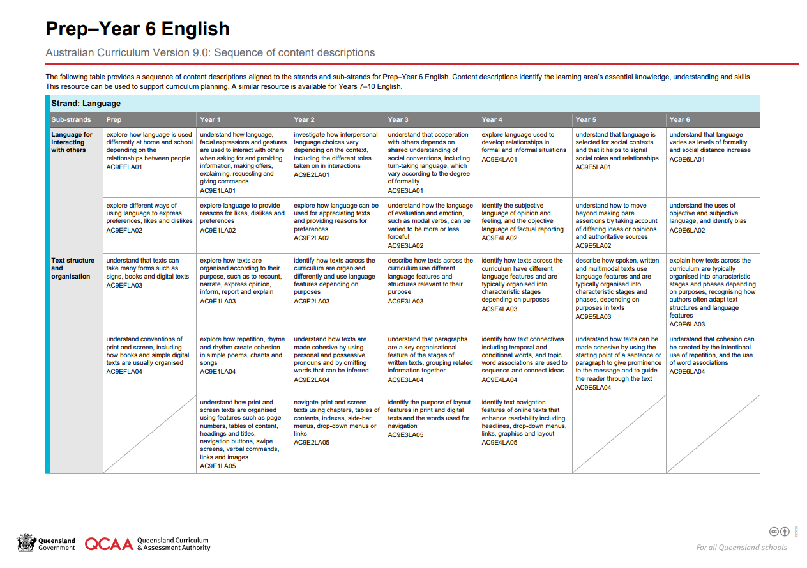

The English curriculum: Sequence of content descriptions
Notes:
The QCAA resource: Sequence of content descriptions aligns to the strands and sub-strands for Prep–Year 6 English.
This resource can be used to support curriculum planning, including planning the teaching of writing.
A similar resource is available for Years 7–10.

Slide 12
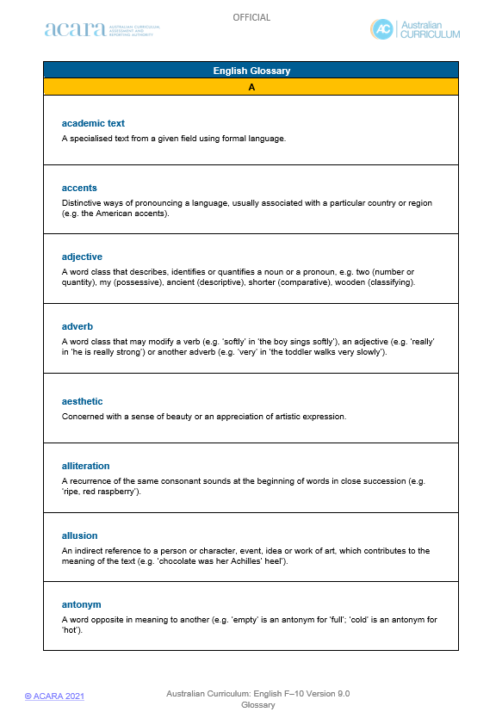
Defining key terms — English glossary
Source: https://v9.australiancurriculum.edu.au/downloads/learning-areas#accordion-b71b085f07-item-49001e70bc
Notes:
A resource that supports teachers’ understanding of the English curriculum is the English glossary.

Slide 13
Glossary definition
Write: ‘Producing text using pencils, pens, digital tools and/or technologies, and/or using a scribe. Writers plan, compose, edit and publish in print or digital forms.’
Source: https://v9.australiancurriculum.edu.au/downloads/learning-areas#accordion-b71b085f07-item-49001e70bc
Notes:
For example, the Australian Curriculum v9.0 English glossary defines the term ‘write’ as ‘Producing text using pencils, pens, digital tools and/or technologies, and/or using a scribe. Writers plan, compose, edit and publish in print or digital forms.’
Source: https://v9.australiancurriculum.edu.au/downloads/learning-areas#accordion-b71b085f07-item-49001e70bc

Slide 14
Glossary definition
Create: to imagine or conceive, develop or produce (in print or digital form) spoken, written or multimodal texts and edit and publish work for an audience.
imagine or conceive
develop or produce
edit and publish
Source: https://v9.australiancurriculum.edu.au/downloads/learning-areas#accordion-b71b085f07-item-49001e70bc
Notes:
Teachers can also refer to the glossary definition for ‘create’ as this refers to the writing process. Create: ‘to imagine or conceive, develop or produce (in print or digital form) spoken, written or multimodal texts and edit and publish work for an audience.’
Note: The term ‘edit’ means: ‘to prepare, alter, adapt or refine with attention to grammar, spelling, punctuation and vocabulary.’ It is recommended to use the English glossary when exploring the English achievement standard and aligned content descriptions.

Slide 15
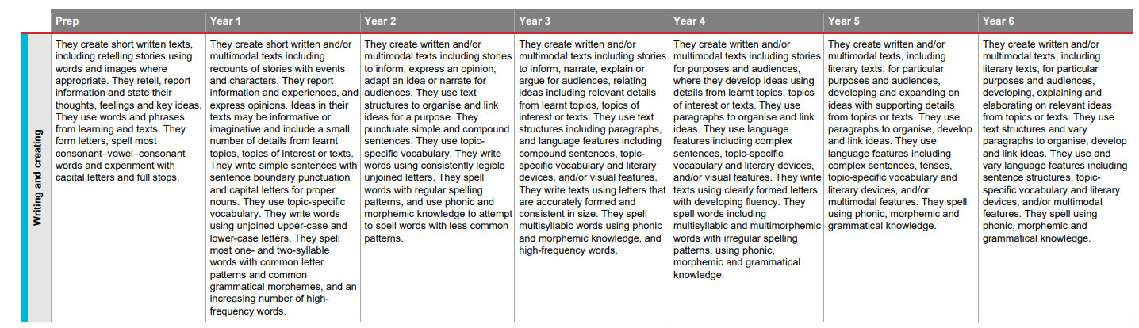
Sequencing of English achievement standard —
Writing and creating
Notes:
The English achievement standard outlines what students should know and be able to do at the end of each year.
To assist teachers in understanding the development of students’ writing skills, we may refer to sequencing resources such as the QCAA P–6 English achievement standard resource.
This resource demonstrates the progression of the Writing and creating paragraph, illustrating the writing skills that students should demonstrate at the standard. In Queensland this is the C standard.
A similar resource is available for Years 7–10.

Slide 16


Comparing Years 4–6 achievement standard
In a moment …
Highlight the different qualities/aspects of writing represented in the paragraph of the achievement standards for Years 4–6.
Then, label these different qualities/aspects of writing.
Discuss what you notice.
Notes:
Delete slide if activity not required.

Slide 17
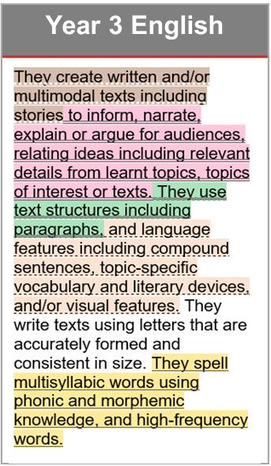
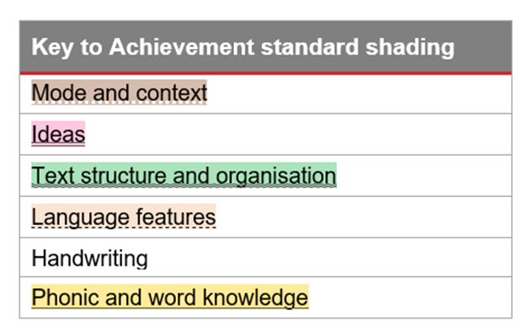
Unpacking the English achievement standard
Source: https://v9.australiancurriculum.edu.au/f-10-curriculum/learning-areas/english/year-3?view=quick&detailed-content-descriptions=0&hide-ccp=0&hide-gc=0&side-by-side=1&strands-start-index=0
Notes:
Each Writing and creating paragraph across the years follows a consistent internal structure.
Information is provided in terms of the mode and context, followed by ideas, text structure and organisation, language features, handwriting and phonic and word knowledge. These achievement standard aspects work together.
This structure is the same across the years, with a shift in handwriting and phonic and word knowledge as students progress through the years.
Source:
https://v9.australiancurriculum.edu.au/f-10-curriculum/learning-areas/english/year-3?view=quick&detailed-content-descriptions=0&hide-ccp=0&hide-gc=0&side-by-side=1&strands-start-index=0

Slide 18
Writing and the Literacy general capability
Source: Australian Curriculum, https://v9.australiancurriculum.edu.au/help/website-tour
Notes:
Additionally, the Literacy general capability can support the teaching of writing.
Script and picture adapted (addition of labels) from video at www.v9.australiancurriculum.edu.au/help/website-tour (time stamp 50 seconds) and https://v9.australiancurriculum.edu.au/curriculum-information/understand-this-general-capability/literacy

Slide 19
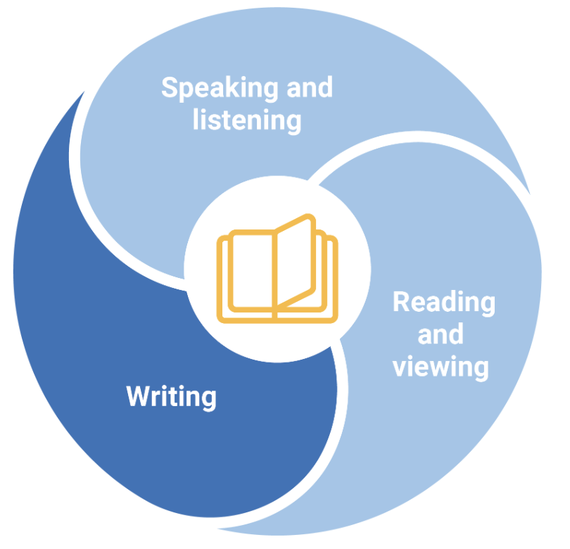
Literacy general capability — elements
Source: ACARA image, www.australiancurriculum.edu.au/f-10-curriculum/general-capabilities/literacy?element=2&sub-element=LWCrT
Notes:
The Literacy general capability has three elements:
Speaking and listening
Reading and viewing
Writing.

Slide 20
The Literacy general capability: Writing
Writing sub-elements in the general capability:
Creating texts — a holistic sub-element supported by the other sub elements (crafting ideas, text form and features, vocabulary)
Grammar
Punctuation
Spelling
Handwriting and keyboarding
Source: www.qcaa.qld.edu.au/downloads/aciqv9/general-resources/ac9_gc_literacy_advice.pdf
Notes:
The focus of this presentation is on the Creating texts sub-element.
Creating texts is a holistic sub-element, which is supported by the other sub-elements in the Writing elements. This sub-element describes how a student becomes increasingly proficient at creating texts for a range of purposes and audiences across learning areas. Students’ writing progresses from representing basic concepts and simple ideas to conveying abstract concepts and complex ideas, in line with the demands of the learning areas.
Source: https://www.qcaa.qld.edu.au/downloads/aciqv9/general-resources/ac9_gc_literacy_advice.pdf and https://v9.australiancurriculum.edu.au/curriculum-information/understand-this-general-capability/literacy

Slide 21
The Literacy learning progression: Writing
To support writing development the progression can:
provide finer-grained detail of observable indicators of the trajectory of writing development
support planning for targeted writing knowledge, skills and dispositions for individuals and groups, at, above and not yet at the expected level
provide several relevant indicators from writing and its sub-elements that can be explained, modelled and practised.
Source: www.qcaa.qld.edu.au/downloads/aciqv9/general-resources/ac9_gc_literacy_advice.pdf
Notes:
The Literacy learning progression describes the increasing complexity of Standard Australian English and the common developmental pathway of literacy learning across the three elements of Speaking and listening, Reading and viewing, and Writing.
The Literacy learning progression can help teachers develop targeted teaching and learning programs for students who are working at, above or below year-level expectations.
Source: https://www.qcaa.qld.edu.au/downloads/aciqv9/general-resources/ac9_gc_literacy_advice.pdf

Slide 22
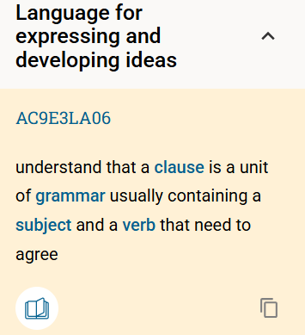
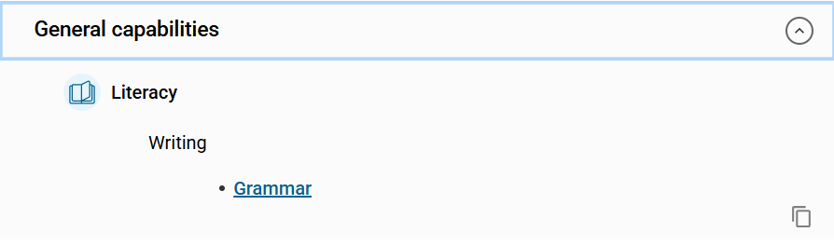
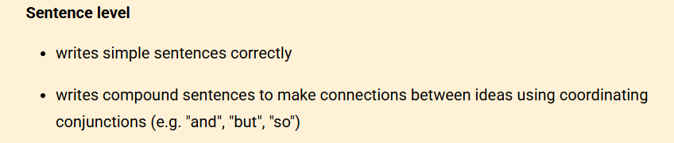
Accessing the Literacy general capability — Year 3 example
2
1
Source: https://v9.australiancurriculum.edu.au/f-10-curriculum/learning-areas/english/year-3/content-description?subject-identifier=ENGENGY3&content-description-code=AC9E3LA06&detailed-content-descriptions=0&hide-ccp=0&hide-gc=0&side-by-side=1&strands-start-index=0&view=quick
Notes:
This an example of how to access the Literacy general capability information and the relevant learning progression extracts.
To find the finer-grained detail, teachers select the content description they want to teach. They then identify the Literacy general capability book icon. By clicking on the book icon, teachers can explore how this content description connects to the writing element of the general capability. In this example, the sub-element of grammar appears and provides teachers with the finer-grained detail from the Literacy learning progression, showing the alignment of the progression with this content.
Source: https://v9.australiancurriculum.edu.au/curriculum-information/understand-this-general-capability/literacy

Slide 23
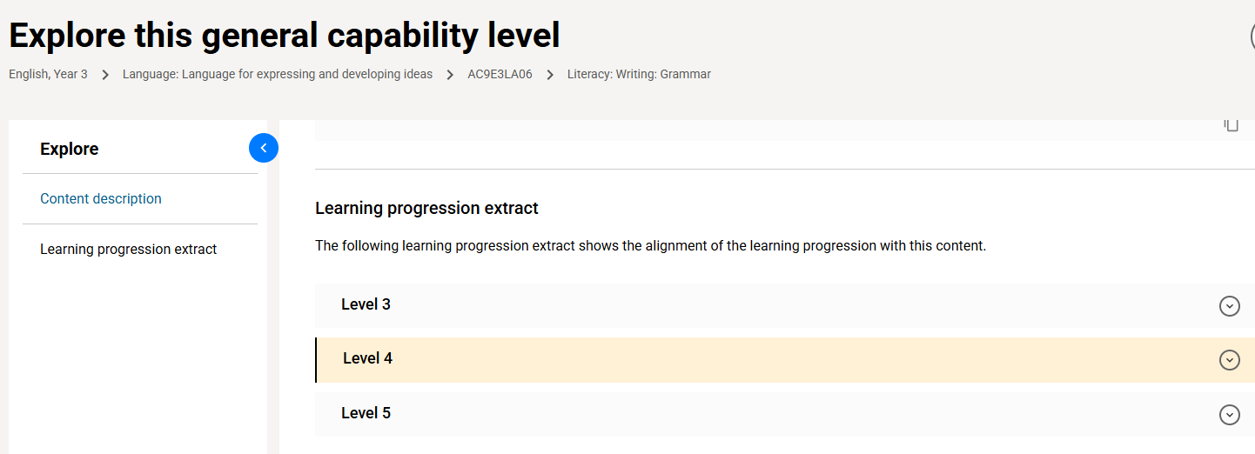
Connection to Literacy general capability v9.0 — Year 3
Source: Australian Curriculum, https://v9.australiancurriculum.edu.au/f-10-curriculum/learning-areas/english/year-3/general-capability-snapshot?subject-identifier=ENGENGY3&content-description-code=AC9E3LA06&general-capability-code=L&element-code=LW&sub-element-index=0&sub-element-code=LWGrA&detailed-content-descriptions=0&hide-ccp=0&hide-gc=0&side-by-side=1&strands-start-index=0&view=quick
Notes:
Teachers can use the Literacy learning progression to support the development of targeted teaching and learning programs and to set clearer learning goals for individual students. For example, teaching decisions can be based on judgments about student capability that relate to a single indicator rather than all indicators at a level.
Note: While the aligned progression level may be highlighted as Level 4 in this example, students can display indicators within sub-elements regardless of their year level. For example, a student in Year 5 could display indicators at Level 3, 4 or 5. The indicated level is therefore used as a guide only.

Slide 24
Writing and other learning areas
Source: https://v9.australiancurriculum.edu.au/help/website-tour
Notes:
Literacy is fundamental to all learning areas as each requires learning area specific literacy skills that enable students to communicate successfully in a variety of contexts.
Students write and create a range of texts across learning areas. It is important for teachers to consider the specific detail that supports the teaching of writing in a learning area.
Teachers can look to the key connection between the learning area and the Literacy general capability.
The consistent structure of the Version 9 learning area curriculums means that each learning area consists of a Key connections section that identifies the connection between the learning area and the general capabilities and cross-curriculum priorities. This key connection section can be helpful in identifying the link between a learning area and the Literacy general capability, assisting in understanding the literacy demands in a particular learning area including those related to writing.

Slide 25

Literacy general capability across learning areas
In a moment …
Read the key connection for Literacy and Science and highlight references to the:
ideas and purposes of texts
texts and their structures
language features.
Notes:
Delete slide if activity not required.
Note: The key connection section is located in the Understand this learning area section for all learning areas. Other learning areas can be selected for this activity.

Slide 26
Key connections: Literacy general capability and Science
Science and Literacy
In Science, students develop literacy capability as they explore and investigate their world. They comprehend and compose texts including those that give information; describe events and phenomena; recount experiments; present and evaluate data; give explanations; and present ideas, opinions and claims. They comprehend and compose multimodal texts such as charts, graphs, diagrams, pictures, maps, animations, models and visual media. Language structures and text structures are used to link information and ideas, give descriptions and explanations, formulate hypotheses and construct evidence-based arguments capable of expressing an informed position…
Ideas and purposes
Texts and structures
Source: https://v9.australiancurriculum.edu.au/curriculum-information/understand-this-learning-area/science
Notes:
All learning area are connected to the Literacy general capability.
For example, from the key connection section for Science, teachers are provided with the additional detail related to ideas and purposes (blue) and texts and structures (green) which is relevant to writing.
Source: https://v9.australiancurriculum.edu.au/curriculum-information/understand-this-learning-area/science

Slide 27
Key connections: Literacy general capability and Science
Science and Literacy
…Scientific vocabulary is often technical and includes specific terms for concepts and features of the world, as well as terms that encapsulate an entire process in a single word, such as a "photosynthesis". Language is therefore essential in providing the link between the concept itself and student understanding, and assessing whether the student has understood the concept.
Language features
Source: https://v9.australiancurriculum.edu.au/curriculum-information/understand-this-learning-area/science
Notes:
Additionally, teachers are provided with the additional detail related to language features (orange).
Note: The key connection section is located in the Understand this learning area section for all learning areas.
Source: https://v9.australiancurriculum.edu.au/curriculum-information/understand-this-learning-area/science

Slide 28
Outline
Understanding writing and the curriculum
Curriculum in the primary writing classroom
Additional resources

Slide 29
Pedagogies for writing
In a moment …
In a few words, share some strategies you are already using to teach writing in your classroom.
Notes:
Delete slide if activity not required.

Slide 30

Context for writing: An example
Write a persuasive descriptive report of a Tiny House for a website.
Notes:
In order to explore writing further, the topic of tiny houses will be used.
Using this topic or any other learning area topic, teachers may consider the culminating task or writing goal set for students. For example, perhaps Year 5 students may be asked to write a persuasive descriptive report of a Tiny House for a website.
Source: Tiny House scene, Vicious-Speed, https://pixabay.com/illustrations/tiny-house-scene-clip-art-4249900/

Slide 31
Descriptive report and English achievement standard
Year 5 English achievement standard
They create written and/or multimodal texts, including literary texts,
for particular purposes and audiences, developing and expanding on
ideas with supporting details from topics or texts. They use paragraphs to organise, develop and link ideas. They use language features including complex sentences, tenses, topic-specific vocabulary and literary devices, and/or multimodal features. They spell using phonic, morphemic and grammatical knowledge.
Notes:
If assessing the task using the Year 5 English achievement standard, the identified aspects of the achievement standard may have been selected.

Slide 32
Descriptive report and example content descriptions
Year 5 content descriptions
Text structure and organisation
describe how spoken, written and multimodal texts use language features and are typically organised into characteristic stages and phases, depending on purposes in texts (AC9E5LA03)
understand how texts can be made cohesive by using the starting point of a sentence or paragraph to give prominence to the message and to guide the reader through the text (AC9E5LA04)
Language for expressing and developing ideas
understand how noun groups can be expanded in a variety of ways to provide a fuller description of a person, place, thing or idea (AC9E5LA06)
Source: https://v9.australiancurriculum.edu.au/f-10-curriculum/learning-areas/english/year-5?view=quick&detailed-content-descriptions=0&hide-ccp=0&hide-gc=0&side-by-side=1&strands-start-index=0
Notes:
Teachers may then refer to the aligned Year 5 English content descriptions to assist in developing their unit and plan for the teaching of writing, aligned to the curriculum.
For illustrative purposes, the content descriptions from the sub-strands Text structure and organisation and Language for expressing and developing ideas have been used to show the detail that can be obtained from the aligned content descriptions when planning a unit. These content descriptions from the English curriculum allow teachers to plan age-appropriate learning experiences.
In this unit, teachers may support their Year 5 students to describe how written texts use language features and are typically organised into characteristic stages and phases, depending on purposes in texts. For the Tiny House unit, this may include the exploration of descriptive and persuasive reports.
In addition, teachers may include writing activities that allow students to understand how texts can be made cohesive by using the starting point of a sentence or paragraph to give prominence to the message and to guide the reader through the text. Teachers may also include activities that encourage students to learn about noun groups and how these can be expanded in a variety of ways to provide a fuller description of a person, place, thing or idea.
Note: This process can be replicated for other year levels and learning areas.

Slide 33
Descriptive report and example content descriptions
Year 4 content description
Language for interacting with others
identify the subjective language of opinion and feeling, and the objective language of factual reporting (AC9E4LA02)
Revisiting Year 4 content — recursive, cumulative curriculum
Source: https://v9.australiancurriculum.edu.au/f-10-curriculum/learning-areas/english/year-4?view=quick&detailed-content-descriptions=0&hide-ccp=0&hide-gc=0&side-by-side=1&strands-start-index=0
Notes:
As the English curriculum is recursive and cumulative, teachers may also revisit content from previous years. For example, Year 4 content such as in the sub-strand Language for interacting with others in which students would have identified the subjective language of opinion and feeling, and the objective language of factual reporting would be revisited to support persuasive writing about a tiny house.

Slide 34
Literacy general capability to support Year 5 students
Creating texts
Grammar
Punctuation
Spelling
Handwriting
Notes:
Additionally, teachers may refer to the literacy learning progression for Year 5 Creating texts to obtain some of the finer-grained details to support the teaching of writing.

Slide 35
Literacy general capability to support Year 5 students
Supporting not yet at expected level | Supporting above expected level
Creating texts, Level 6 Crafting ideas writes ideas appropriate to a task or topic in sequenced sentences (e.g. writes informative texts with all the facts related to the topic) | Creating texts, Level 8 Informative text indicators uses adjectives to create more accurate description (e.g. "the warm-blooded mammal")
Source: https://v9.australiancurriculum.edu.au/f-10-curriculum/general-capabilities/literacy?element=2&sub-element=LWCrT
Notes:
To illustrate this, to support a Year 5 student who is not yet at the expected level for ‘creating texts’ teachers may know that students can write ideas appropriate to a task or topic in sequenced sentences (e.g. writes informative texts with all the facts related to the topic) whereas a Year 5 student who is working above expected level may be supported to use adjectives to create more accurate description (e.g. ‘the warm-blooded mammal’)
Source: https://v9.australiancurriculum.edu.au/f-10-curriculum/general-capabilities/literacy?element=2&sub-element=LWCrT

Slide 36
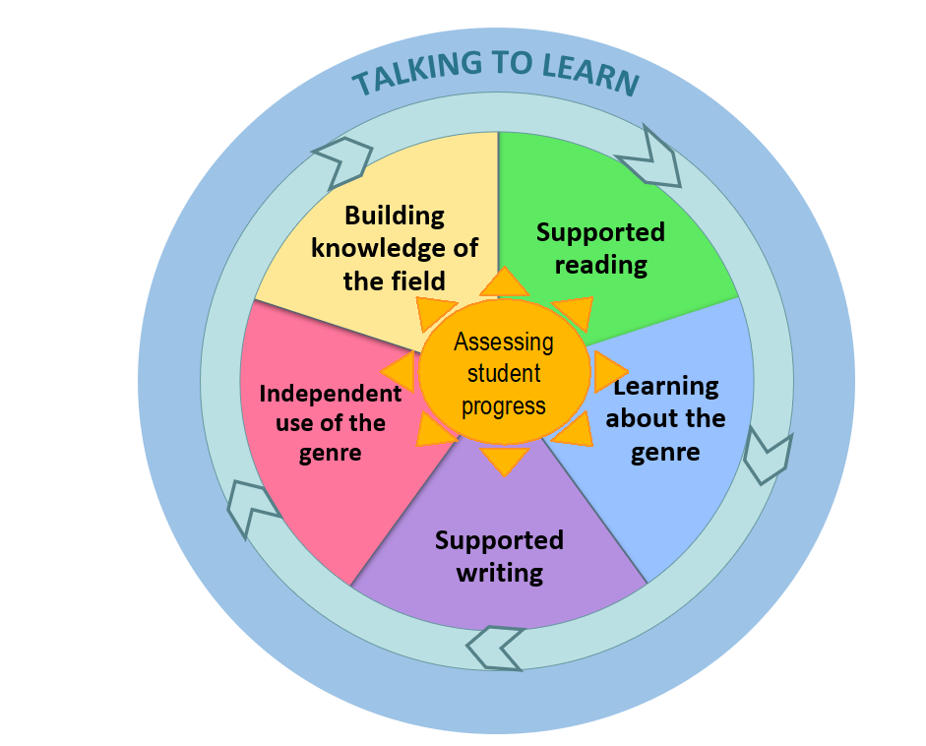
Planning — sequencing for explicit teaching
‘Teaching learning cycle’ diagram supplied by Bev Derewianka co-author of Derewianka B and Jones P (2022) Teaching Language in Context Oxford University Press.
Notes:
There are various ways teachers may approach the teaching of writing, including using a teaching and learning framework such as the example on the slide.
This teaching and learning cycle is from the work of Beverley Derewianka and Pauline Jones and is based on the notion of having high expectations supported by strong scaffolding and explicit teaching.
Activities are sequenced in such a way to build students’ knowledge and skills so that they can experience success.
Note: Guidance for teachers and templates for the following writing activities can be located in the ‘Literacy general capability’ tab on the QCAA website.
Source: Version 3 Fig 3.1 Beverley Derewianka and Pauline Jones (2022) Teaching Language in Context Oxford University Press (p. 52) Versions 2 &3 'Teaching learning cycle' diagram supplied by Bev Derewianka co-author of Derewianka B and Jones P (2022) Teaching Language in Context Oxford University Press.

Slide 37
Teaching learning cycle: Building knowledge of the field
To build knowledge of the field, consider:
concepts related to the topic
the vocabulary including topic-specific and technical terms
the language features used.
‘Teaching learning cycle’ diagram supplied by Bev Derewianka co-author of Derewianka B and Jones P (2022) Teaching Language in Context Oxford University Press.
Notes:
This first stage of the teaching and learning cycle is called Building knowledge of the field.
Here teachers may focus on developing students' language and ideas related to the topic and help them develop shared understandings through discussion and collaborative learning.
Focusing on language and ideas equips students with the vocabulary needed to communicate their ideas about the topic in a more precise way.
Field building activities will vary according to school context and how well students already understand the genre and the topic.
Teachers may ask: What do students need to know, understand and be able to do to write about the topic?
They then design and lead activities to build shared understandings of the topic.
Source: Derewianka, B. (2020). Exploring how texts works (2nd ed.).
Supported by: Derewianka, B. & Jones, P. (2022). Teaching language in context (2nd ed.).

Slide 38
Tapping into prior knowledge of vocabulary and concepts — word cloud
Students share five words that capture what they know about a topic,
e.g. tiny houses.
off-grid
cosy
portable
small
minimalist
eco-friendly
Notes:
This activity to Build knowledge of the field includes pre-testing through the creation of a word cloud to assist with developing a shared understanding of a concept and ways of knowing about the topic, e.g. tiny houses.
Note: This activity can be completed as a digital word cloud or on a classroom whiteboard.
Image created in-house with Word Art

Slide 39

Tapping into prior knowledge of vocabulary and concepts — word cloud
In a moment …
Share five words that capture what you know about the topic,
e.g. tiny houses.
Notes:
Delete slide if activity not required.

Slide 40
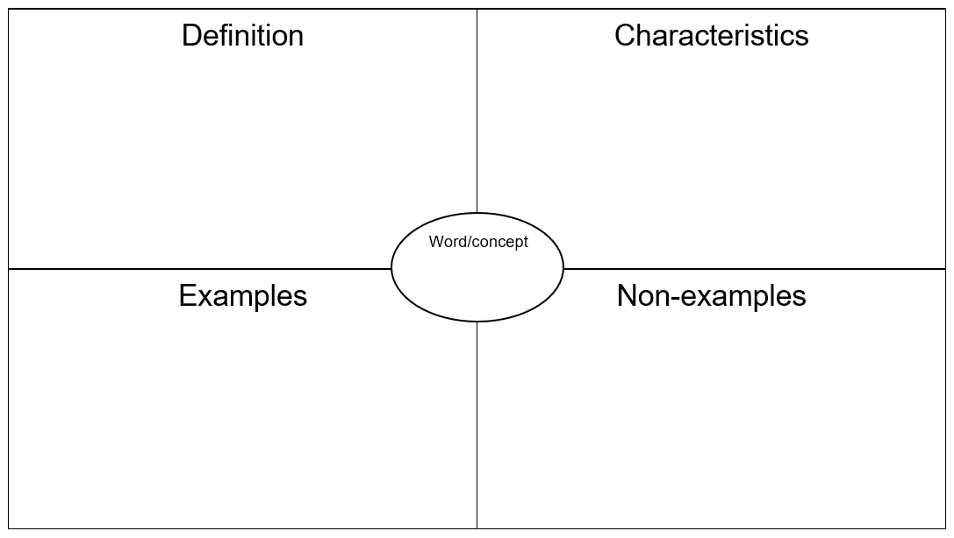
Developing a deeper understanding —
Frayer model
Students use the Frayer model to explore the topic further.
Notes:
Students complete a Frayer model to develop a deeper understanding of the topic.
The word or idea is added to the centre box as it is the idea to be further explored. Students may then individually, in pairs or in small groups provide information based on the sub-headings My definition, Characteristics, Examples and Non-examples.
Note: A Frayer model template can be located in the Literacy general capability tab on the QCAA website.

Slide 41

Developing a deeper understanding —
Frayer model
In a moment …
Use the model below to explore the idea of a tiny house.
Notes:
Delete slide if activity not required.

Slide 42



Texts to build knowledge of the field including vocabulary, concepts and language features
Notes:
Another strategy teachers may use to build knowledge of the field is engage students in various texts on a particular topic.
For example, texts may include those that are print/digital, auditory such as podcasts and visual such as short films and/or advertisements.
Sources:
https://pixabay.com/vectors/text-paper-document-draft-read-146110/
https://pixabay.com/vectors/headphones-earphones-audio-sound-309805/
https://pixabay.com/vectors/eye-see-viewing-icon-1103592/

Slide 43
Teaching learning cycle: Supported reading
To support students’ reading, consider:
guiding students to read key texts purposefully
engaging students by asking questions about the key texts
working with smaller groups on supported reading activities.
‘Teaching learning cycle’ diagram supplied by Bev Derewianka co-author of Derewianka B and Jones P (2022) Teaching Language in Context Oxford University Press.
Notes:
The next section of the teaching and learning cycle: Supported reading reflects the texts that may have been used to build knowledge of the field.
Here the focus is on helping students to comprehend, analyse and interpret these selected texts that contribute to building the knowledge of the field.
Supported reading acknowledges that students need to be taught how to read texts, particularly as the texts increase in complexity across the years.

Slide 44
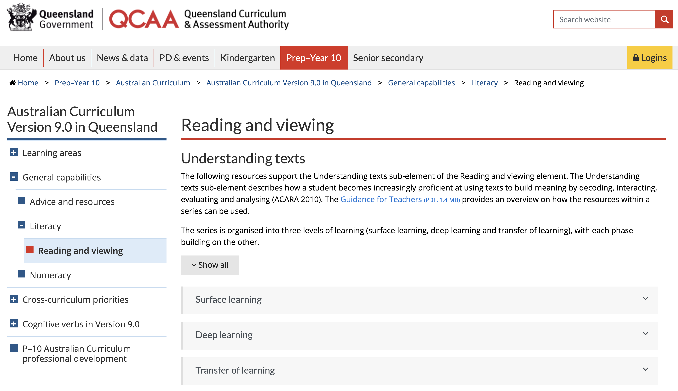
QCAA resources to support reading
Source: www.qcaa.qld.edu.au/p-10/aciq/version-9/general-capabilities/literacy/reading-and-viewing
Notes:
The QCAA has several resources available to assist teachers help students become increasingly proficient at using texts to build meaning.
Located in the Literacy general capability tab, the Reading and viewing resources support three levels of learning: surface learning, deep learning and transfer of learning.

Slide 45
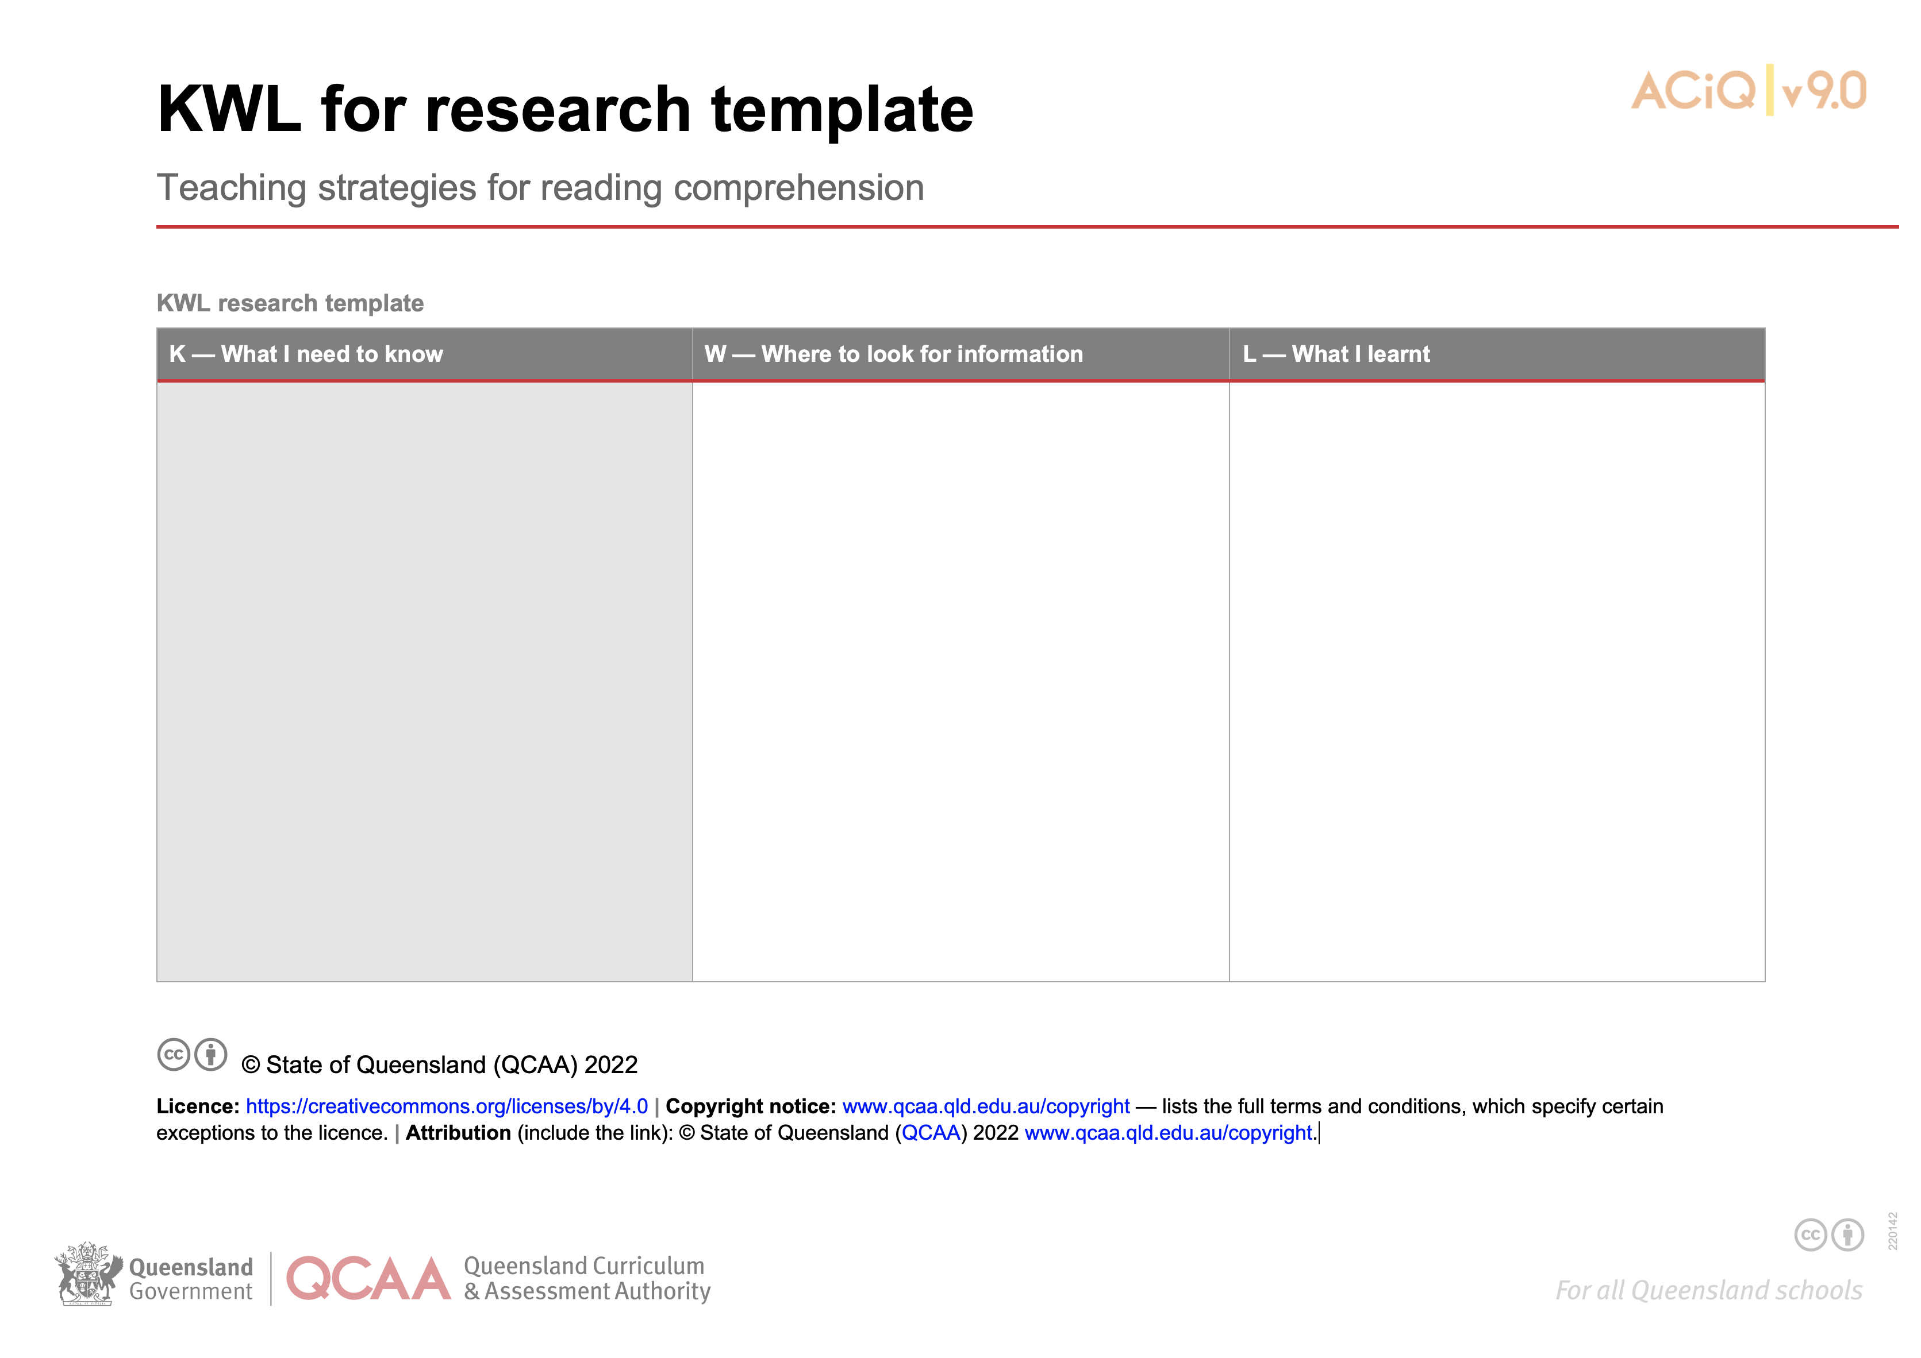
KWL: What I know, what I want to know, what I learnt
Source: www.qcaa.qld.edu.au/p-10/aciq/version-9/general-capabilities/literacy/reading-and-viewing
Notes:
One resource that can be used for supported reading is the KWL for research template.
The template is structured so that students respond to the prompts:
- What do I need to know (brainstorming what a student already knows about the topic),
- Where to look for information (sets goals for the research)
- What I learnt (recording new knowledge and insights about the topic)
This strategy for reading comprehension encourages students to be active learners when engaging with a text and through this they also build knowledge of the field.
Source: https://www.qcaa.qld.edu.au/p-10/aciq/version-9/general-capabilities/literacy/reading-and-viewing

Slide 46
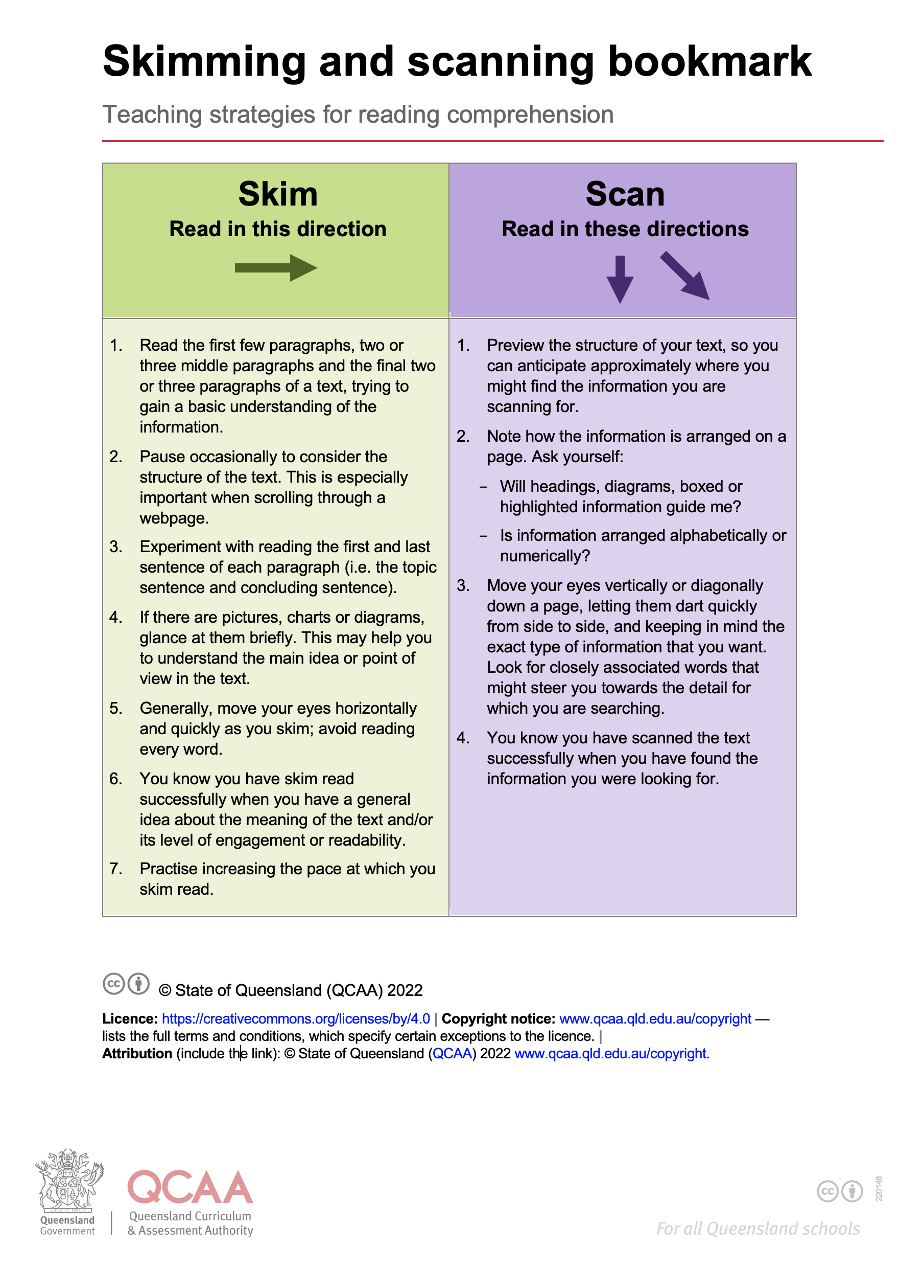
Previewing the text — skimming and scanning
Source: www.qcaa.qld.edu.au/p-10/aciq/version-9/general-capabilities/literacy/reading-and-viewing
Notes:
Additionally, teachers may use a strategy such as the QCAA skimming and scanning bookmark.
The bookmark provides instructions of how students may skim and scan when reading.
Skimming:
- Purpose: to get a general idea of the content or the main idea of a text.
- How it is used: students read quickly, looking at titles, headings, subheadings, keywords, and the first sentences of paragraphs.
- When to use: when teachers want students to preview a text or decide if it is useful for their research.
Scanning:
- Purpose: to find specific information or details quickly without reading everything.
- How it’s used: students move their eyes quickly over the text to locate names, dates, numbers, or keywords.
- When to use: when teachers want students to look for a specific fact or answer.
Source: QCAA, https://www.qcaa.qld.edu.au/p-10/aciq/version-9/general-capabilities/literacy/reading-and-viewing

Slide 47
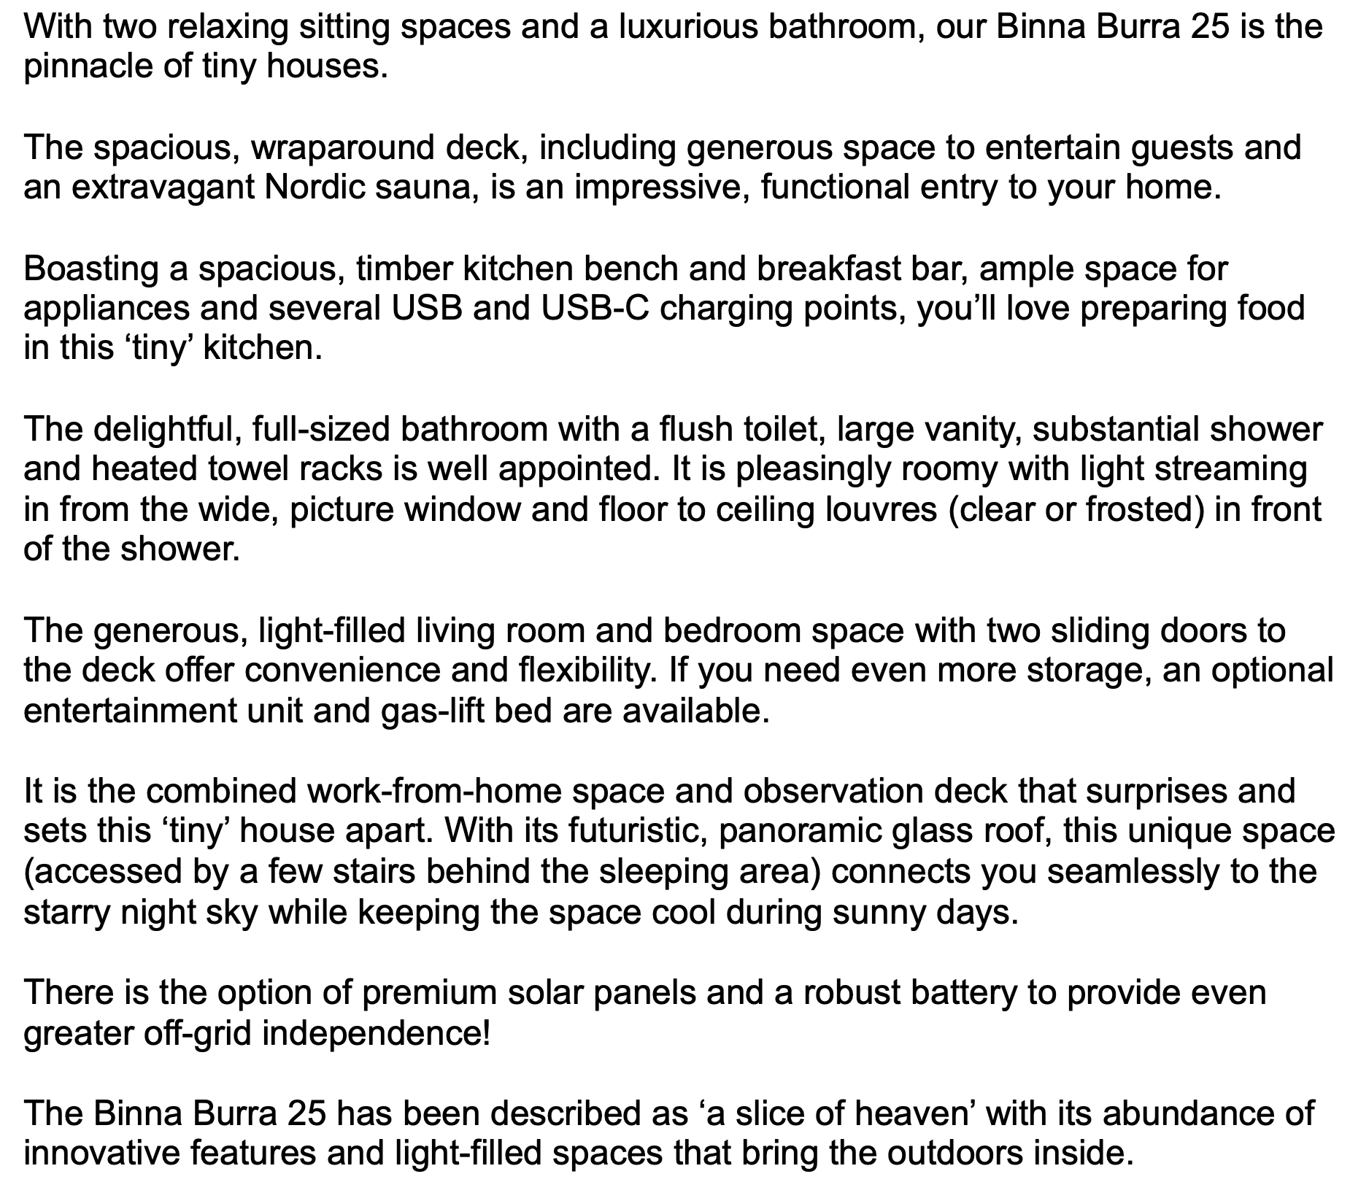
Supported reading — skimming and scanning
Binna Burra 25
Notes:
Teachers may select a suitable text and have students engage in the skimming and scanning activity.
Note: The Binna Burra 25 text is available for use and can be located in the Literacy general capability tab on the QCAA website.
Source: Text written in-house by QCAA officer.

Slide 48

Supported reading — skimming and scanning
In a moment …
Use the bookmark to skim and scan the text:
Who could this text be for?
Who may be the creator of this text?
What is the purpose of this text?
Binna Burra 25
Notes:
Delete slide if activity not required.
Source: Text written in-house by QCAA officer.

Slide 49
Supported reading — chunking the text
Students identify the three ‘big chunks’ in the text (e.g. descriptive report):
an introduction
a longer, body section
a conclusion.
Notes:
Students may then be asked to identify the three ‘big chunks’ in the text.

Slide 50

Chunking the text — answers
An introduction that makes an opening statement about the Binna Burra 25 tiny house
A longer, body section that describes the various parts/features of the tiny house
A conclusion that provides a summary about the Binna Burra 25 tiny house.
Notes:
Note: Chunking the text answers if using the Binna Burra 25 text.
Text created by QCAA officer

Slide 51
Identifying finer ‘chunks’ in the body
Students scan the body section for key words that signal key parts or features of the tiny house, identifying the smaller chunks within the body of the text, e.g. Binna Burra 25.
Notes:
Students may then be asked to further explore the text by scanning the body section of a text and identifying finer ‘chunks’. For example, if using the Binna Burra 25 text, students may identify the key parts or features of the tiny house.

Slide 52
Identifying finer chunks in the body — answers
The spacious, wraparound deck...
Boasting a spacious, timber kitchen bench...
The delightful, full-sized bathroom...
The generous, light-filled living room and bedroom space...
It is the combined work-from-home space and observation deck...
There is the option...
Notes:
Note: Identifying finer chunks in the body answers if using the Binna Burra 25 text.

Slide 53
Teaching learning cycle: Learning about the genre
To support learning about the genre, consider:
engaging students in deconstructing a
model sample of the genre that students
will be writing
developing students’ understanding of metalanguage used to refer to stages and phases of texts
using various activities to familiarise students with the characteristics of the genre.
‘Teaching learning cycle’ diagram supplied by Bev Derewianka co-author of Derewianka B and Jones P (2022) Teaching Language in Context Oxford University Press.
Notes:
The next section of the teaching and learning cycle is Learning about the genre which emphasises the creation of the students’ written texts.
A variety of activities can be used to familiarise students with the characteristics of the genre e.g. comparing genres, sorting and sequencing.
Teachers may begin by reinforcing the purpose for writing a particular text, followed by identifying the typical stages that the text goes through in achieving its purpose.

Slide 54
Relationship between purposes and stages
‘Texts across the curriculum are typically organised into characteristic stages and phases, depending on purposes in texts’.
Source: Australian Curriculum, F-10 Curriculum | English – Foundation Year, Year 1, 2, 3, 4, 5, 6, 7, 8, 9, 10 (australiancurriculum.edu.au)
Notes:
When developing students’ understanding of metalanguage used to refer to stages and phases of texts it is worth teaching students to consider the purpose of a text as this allows them to organise a text in such a way that assists them in achieving that purpose.
Therefore, purposes influences the stages of a text.

Slide 55
English glossary definition — stages
Stages
The stable pattern of the organisation of a genre such as the orientation, complication and resolution of a story or the introduction, body and conclusion of an argument. Stages are broken into phases.
Quoted verbatim and unaltered from Australian Curriculum: https://v9.australiancurriculum.edu.au/downloads/learning-areas
Notes:
The Australian Curriculum English glossary definition of stages.
Source: Quoted verbatim and unaltered from Australian Curriculum: https://v9.australiancurriculum.edu.au/downloads/learning-areas

Slide 56
English glossary definition — genre
Stages
The stable pattern of the organisation of a genre such as the orientation, complication
and resolution of a story or the introduction, body and conclusion of an argument. Stages are broken into phases.
‘Categories of texts based on their subject matter or their form and structure.’
Australian Curriculum glossary
Quoted verbatim and unaltered from Australian Curriculum: https://v9.australiancurriculum.edu.au/downloads/learning-areas
Notes:
The Australian Curriculum English glossary definition of genre.
Source: Quoted verbatim and unaltered from Australian Curriculum: https://v9.australiancurriculum.edu.au/downloads/learning-areas

Slide 57
English glossary definition — phases
Stages
Phases
The stable pattern of the organisation of a genre such as the orientation, complication and resolution of a story or the introduction, body and conclusion of an argument. Stages are broken into phases.
The variable patterns which unfold in each stage of a text such as the paragraph describing the setting in the orientation of a narrative or the placement of evidence in the body of an argument.
Quoted verbatim and unaltered from Australian Curriculum: https://v9.australiancurriculum.edu.au/downloads/learning-areas
Notes:
The Australian Curriculum English glossary definition of phases.
Source: Quoted verbatim and unaltered from Australian Curriculum: https://v9.australiancurriculum.edu.au/downloads/learning-areas

Slide 58
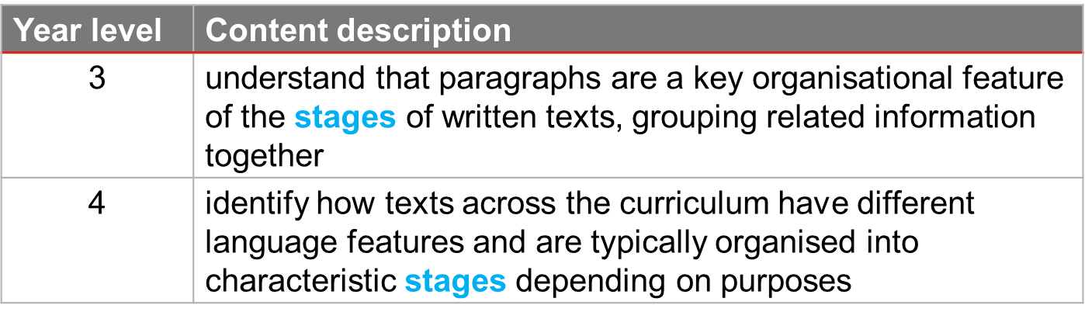
Stages and phases: Text structure and organisation
Source: Australian Curriculum, F-10 Curriculum | English – Foundation Year, Year 1, 2, 3, 4, 5, 6, 7, 8, 9, 10 (australiancurriculum.edu.au
Notes:
Information related to the stages (and phases) of texts can be located in the English Language strand, sub-strand Text structure and organisation’.
Stages are first mentioned in the English curriculum in Year 3 and again in Year 4.
Source: Quoted verbatim and unaltered from Australian Curriculum: https://v9.australiancurriculum.edu.au/downloads/learning-areas

Slide 59
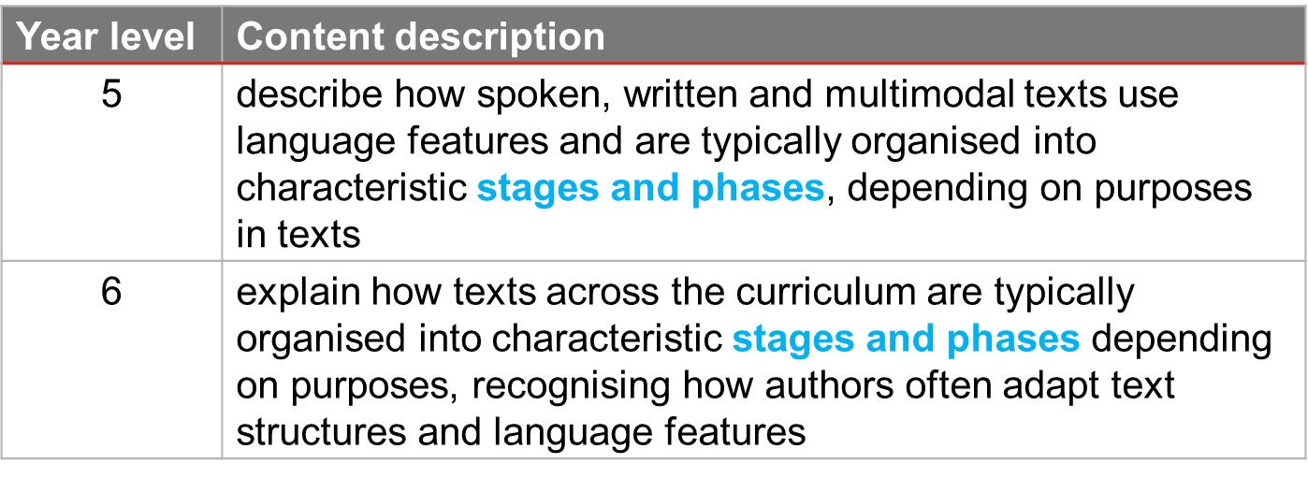
Stages and phases: Text structure and organisation
Source: Australian Curriculum, F-10 Curriculum | English – Foundation Year, Year 1, 2, 3, 4, 5, 6, 7, 8, 9, 10 (australiancurriculum.edu.au)
Notes:
Stages and phases are mentioned in Years 5 and Year 6.
In the definition of stages, these are broken into phases — phases, therefore, are a sub-set of stages.
While students learning genres is important, there is sometimes a risk that students will use the stages of a particular genre in formulaic ways.
That is the reason that by Year 6, the Australian Curriculum expects that students will continue to learn about characteristic stages and also recognise ‘how authors often adapt text structures and language features’.
Source: Quoted verbatim and unaltered from Australian Curriculum glossary: https://v9.australiancurriculum.edu.au/downloads/learning-areas

Slide 60
Stages and possible phases: Descriptive report example
Stages | Possible phases
Title
General statement | topic sentence elaboration examples
Description | features characteristics activities behaviour
Summary | recommendation
List of phases based on work in Derewianka and Jones (2023)
Notes:
If focusing on students creating a descriptive and persuasive report, teachers may have students explore the stages of the report and its possible phases.
The phases can be re-ordered based on an intended purpose.
Acknowledgment: phases for a report from Derewianka and Jones (2023)

Slide 61
Stages of the Binna Burra 25 descriptive report
Stages | Binna Burra 25 text
TITLE | Binna Burra 25
GENERAL STATEMENT | With two relaxing sitting spaces ... the pinnacle of tiny houses.
DESCRIPTION | The spacious, wraparound deck, including generous space to entertain ... even greater off-grid independence!
SUMMARY | The Binna Burra 25 has been described ... that bring the outdoors inside.
Notes:
The chunks of text already identified are the stages of the text.
Just as the stages can be identified, the phases can be identified too.

Slide 62
Focus on identifying the finer chunks — phases
Stage | Phases | Binna Burra 25 text
DESCRIPTION | deck | The spacious, wraparound deck, including generous space ... entry to your home
 | kitchen | Boasting a spacious timber kitchen bench...this ‘tiny’ kitchen’.
 | bathroom | The delightful, full-sized bathroom...of the shower.
 | living & bedroom | The generous, light-filled living room and bedroom space...are available.
 | WFH & observation deck | It is the combined work-from-home space and observation deck...keeping the space cool during sunny days.
 | options | There is the option of premium solar panels... greater off-grid independence!
Notes:
As the phases are more variable and not stable like the stages, they are named according to the function they perform in the text.
Referring to the Binna Burra 25 text, the smaller chunks of text reflect the spaces or features in the tiny house that is being described, and these can be identified as the phases of the text.
In this example, some of the phases are only one sentence long, but other phases are longer.
Another feature that makes this text easy to label is that the phases correspond to the paragraph breaks.
Other texts can be less straight forward — for example, the writer might not signal the different phases as neatly.
Another feature of this text is that we don’t need to look for smaller chunks in the opening and concluding stages given they are just one sentence long each.
In other longer texts the introduction and conclusion stages may be broken into phases.
In this text, the phases are organised in the order of the way people may take if they were walking through the tiny house.
That is only one possible way of ordering the phases. Other possibilities may have a different effect on the reader of the text.

Slide 63
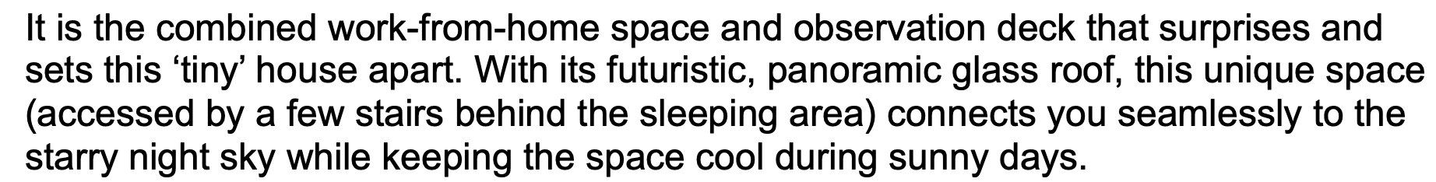
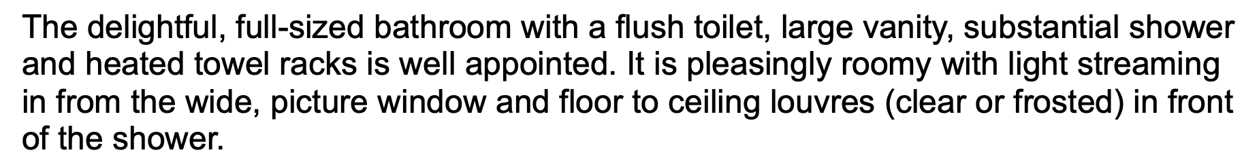
Effect of re-ordering the phases
Students re-order the DESCRIPTION phases by moving the strips of texts around and then discuss the effect this has on the overall meaning and effectiveness of this stage.
Notes:
Students may then be given an opportunity to re-order the phases to help them understand how phases are variable. This also helps students move away from formulaic writing structures.
To do this, the text in a particular stage (e.g. description) may be cut into strips (one for each phase) and students engage in re-ordering the phases and discussing the effects this re-ordering has on the overall meaning and effectiveness of this stage.
Note: The order may vary according to the audience of the text.
Image created in-house from snips of text written by QCAA officer

Slide 64
Effect of re-ordering the phases
In a moment …
Re-order the DESCRIPTION phases by moving the strips around.
Discuss the effect this has on the overall meaning and effectiveness of this stage.
Notes:
Delete slide if activity not required.
Image created in-house from snips of text written by QCAA officer

Slide 65
Language features — starting point of sentence or paragraph
‘understand how texts can be made cohesive by using the starting point of a sentence or paragraph to give prominence to the message and to guide the reader through the text’ (AC9E5LA04)
The spacious, wraparound deck...
Boasting a spacious, timber kitchen bench...
The delightful, full-sized bathroom...
The generous, light-filled living room and bedroom space...
It is the combined work-from-home space and observation deck...
There is the option...
Notes:
As these writing activities in the example are designed for Year 5 students, teachers may turn to the curriculum content descriptions to guide further Learning about the genre activities.
Students may identify the phases and in particular the starting point of paragraphs and sentences. In the description stage of the Binna Burra 25 text, these starting points have allowed the writer to signal the changing focus of the paragraphs to the reader. However, the starting points of a sentence can help guide the reader in other ways.

Slide 66
Language features — starting point of sentence or paragraph
The delightful, full-sized bathroom with a flush toilet, large vanity, substantial shower and heated towel racks is well appointed.
It is pleasingly roomy with light streaming in from the wide, picture window and floor to ceiling louvres (clear or frosted) in front of the shower.
The generous, light-filled living room and bedroom space with two sliding doors to the deck offer convenience and flexibility.
If you need even more storage, an optional entertainment unit and gas-lift bed are available.
Notes:
In the extract, students can see that the starting point for the first sentence has been picked up in the second sentence — with the pronoun ‘it’ encapsulating all the previous detail.
Teachers may explore students’ understanding, focusing on how bathroom is not repeated and instead it is used. Also, explore why it does not refer to the shower. This strategy for cohesion is called pronoun reference.
Note: Teachers may also refer to previous years’ content descriptions to support these activities.
For example,
YEAR 2 AC v9.0: English
understand how texts are made cohesive by using personal and possessive pronouns and by omitting words that can be inferred
AC9E2LA04
YEAR 4 AC v9.0: English
identify how text connectives including temporal and conditional words, and topic word associations are used to sequence and connect ideas
AC9E4LA04

Slide 67
Language features — starting point of sentence or paragraph
The delightful, full-sized bathroom with a flush toilet, large vanity, substantial shower and heated towel racks is well appointed.
It is pleasingly roomy with light streaming in from the wide, picture window and floor to ceiling louvres (clear or frosted) in front of the shower.
The generous, light-filled living room and bedroom space with two sliding doors to the deck offer convenience and flexibility.
If you need even more storage, an optional entertainment unit and gas-lift bed are available.
Notes:
Then, in the next paragraph, the starting point for the first sentence signals the change of focus from the bathroom to the living room and bedroom space.
In these examples, the starting point for the first sentence of each paragraph is an extended noun group or phrase: ‘the delightful, full-sized bathroom with a flush toilet, large vanity, substantial shower and heated towel rack’ and ‘the generous, light-filled living room and bedroom space with two sliding doors to the deck’.

Slide 68
Language features — pronoun references
In a moment …
Identify the pronoun references in the Binna Burra 25 text.
Notes:
Delete slide if activity not required.

Slide 69
Language features — noun groups
‘understand how noun groups can be expanded in a variety of ways to provide a fuller description of a person, place, thing or idea’ (AC9E5LA06)
Stage | Binna Burra 25 text
GENERAL STATEMENT | With two relaxing sitting spaces and a luxurious bathroom, our Binna Burra 25 is the pinnacle of tiny houses.
Source: Australian Curriculum glossary, https://v9.australiancurriculum.edu.au/downloads/learning-areas
Notes:
Further exploration of the text, may lead to students’ learning about noun groups and their parts.
A noun group is defined in the Australian Curriculum English glossary as ‘a group of words related to or building on a main noun or pronoun’.
The focus in Year 5 is understanding ‘how noun groups can be expanded in a variety of ways to provide a fuller description of a person, place, thing or idea’.
In the opening stage, the General Statement, of the Binna Burra 25 text, there are four noun groups ranging from 3–4 words in length.
Note: A noun group can be just one word, e.g. ‘it’ is a noun group because it is a pronoun standing in place of the long noun group at the beginning of the sentence.
Source: from Australian Curriculum glossary, https://v9.australiancurriculum.edu.au/downloads/learning-areas

Slide 70
Language features — expanding noun groups
Stage | Binna Burra 25 text
GENERAL STATEMENT | With two relaxing sitting spaces and a luxurious bathroom, our Binna Burra 25 is the pinnacle of tiny houses.
Stage | Binna Burra 25 text
DESCRIPTION | The delightful, full-sized bathroom with a flush toilet, large vanity, substantial shower and heated towel racks is well appointed.
Notes:
Students may also be taught how a feature from the general statement may then be expanded on in the description stage.
In the Binna Burra 25 text, an example of this is the feature, ‘a luxurious bathroom’, is provided with more detail which expands on what ‘luxurious’ entails: ‘the delightful, full-sized bathroom with a flush toilet, large vanity, substantial shower and heated towel racks’.

Slide 71
Parts of a noun group
Stage | Binna Burra 25 text
GENERAL STATEMENT | With two relaxing sitting spaces and a luxurious bathroom, our Binna Burra 25 is the pinnacle of tiny houses.
 | Adjectives
Article | How many? | What’s it like? | What type? | Main noun | Other information
a |  | luxurious |  | bathroom
Based on Year 2 content elaboration for ACE9LA07
Notes:
Using content drawn from Year 2 — remember that the English curriculum is recursive and cumulative — teachers may can identify the building blocks of these noun groups:
the thing the noun group is about — the main noun
then before the main noun, an article
a block that tells us how many things
a block that tells us what the thing is like
what type of thing it is and,
after the main noun, the writer can give the reader more information.

Slide 72
Parts of a noun group
Stage | Binna Burra 25 text
DESCRIPTION | The delightful, full-sized bathroom with a flush toilet, large vanity, substantial shower and heated towel racks is well appointed.
 | Adjectives
Article | How many? | What’s it like? | What type? | Main noun | Other information
The |  | delightful | full-sized | bathroom | with a flush toilet, large vanity, substantial shower and heated towel racks
Notes:
Additionally, in the description stage, the reader finds out that the bathroom is ‘delightful’ (what it is like), full-sized (what type), ‘with a flush toilet, large vanity, substantial shower and heated towel racks’ (other information) — all adding up to ‘luxurious’, based on what you might be expecting of a bathroom in a tiny house.
This last block — other information — is an addition from those listed in the Year 2 elaboration and can help extend students above the expected level for Year 5 by supporting them to ‘build richer descriptions’ (Level 6 Grammar, Literacy general capability).

Slide 73
Using flip cards to create sentences — front
Article
(a, an, the)
How many?
What’s it like?
What type?
Main noun
Other information
Notes:
Flip cards can be used to support students in creating sentences, e.g. extended noun groups — using the selected text Binna Burra 25.
On the front of the cards, the parts of the sentence can be printed.
Depending on a teacher’s knowledge of their students, teachers may wish to exclude ‘other information’ initially. Working in groups allows students to talk to learn.
Note: Flip cards to create sentences templates can be located in the Literacy general capability tab on the QCAA website.
Image crated using PPT shape

Slide 74
Using flip cards to create sentences — back
The
luxurious
claw-foot
bathtub
with a view
of the private, plant-filled courtyard
Notes:
Supporting students to write their own sentences, e.g. for noun groups, they may be informed that they do not need to fill all possible spaces in the noun group all the time.
Note: Flip cards to create sentences templates can be located in the Literacy general capability tab on the QCAA website.

Slide 75
Creating your own sentences, e.g. noun groups
In a moment …
Using the flip card template provided, create your own noun group to describe a feature of a tiny house.
Share your creations with others.
Notes:
Delete slide if activity not required.
Note: Flip cards to create noun groups templates can be located in the ‘Literacy general capability’ tab on the QCAA website.

Slide 76
Teaching learning cycle: Supported writing
To support students’ writing, consider:
engaging students in a range of modelled writing activities
jointly composing a text with students, encouraging student input and feedback
giving students opportunities to experience the writing process.
‘Teaching learning cycle’ diagram supplied by Bev Derewianka co-author of Derewianka B and Jones P (2022) Teaching Language in Context Oxford University Press.
Notes:
The next section of the teaching and learning cycle is supported writing, also known as joint construction.
At this point in the cycle, students have explored and extended their ideas on the topic, engaged with language, and been taught stages and phases of texts.
Supported writing activities may include modelled, shared, guided and collaborative writing.
Source: Derewianka, B. (2020). Exploring how texts works (2nd ed.).
Supported by: Derewianka, B. & Jones, P. (2022). Teaching language in context (2nd ed.).

Slide 77
Example activity to support joint construction
Planning template
Stages | Possible phases | Planning notes
General statement (one sentence)
Description (multiple paragraphs) | kitchen
 | bathroom
 | [add additional rows and names for other relevant phases]
Summary (one sentence)
Notes:
Teachers may use a planning template to support joint construction.
While the stages of a text will not change, the teacher and students can make collaborative decisions about which phases to include, related to the spaces and features they wish to highlight based on an intended purpose.
Teachers may model the use of the template, followed by joint construction in which students may work collaboratively in small groups. Students working in small groups supports talking to learn.
Note: A joint construction template can be located in the Literacy general capability tab on the QCAA website.
Additional resource
PETAA video, ‘Jointly constructing a text in class’:https://www.youtube.com/watch?v=WByszvdMWm4.

Slide 78
Example activities to support joint construction
Sentence frames, sentence starters and vocabulary
With two relaxing sitting spaces and a luxurious bathroom, | our Binna Burra 25 | is | the pinnacle of tiny houses.
With [noun group for feature] and [noun group for feature], | our [words for the noun group naming the type of tiny house] | is | the [synonym meaning height of achievement] of tiny houses.
Notes:
Students may also be supported to write their own, original sentences using frames or models from the text/texts they have been reading and analysing.

Slide 79
Example activities to support joint construction
In a moment …
Share strategies you use to teach sentence frames, sentence starters and/or vocabulary.
Notes:
Delete slide if activity not required.

Slide 80
Teaching learning cycle: Independent use of the genre
To support students’ independent use of
the genre, consider:
encouraging students to apply their learnings to the creation of their own texts
providing explicit criteria for students to revise and edit their texts
creating opportunities for feedback.
‘Teaching learning cycle’ diagram supplied by Bev Derewianka co-author of Derewianka B and Jones P (2022) Teaching Language in Context Oxford University Press.
Notes:
The next section of the teaching and learning cycle is the Independent use of the genre also known as independent construction.
At this point, students have developed their knowledge of the field, they have shaped their text into stages and phases that achieve the purpose, and they have incorporated key language/multimodal features. They can now edit the text to flow smoothly, to improve vocabulary choices and to attend to the needs of the reader.
Students may progress to the independent construction stage at different rates, needing further opportunities for learning about the genre, modelling or building knowledge of the field through independent research tasks. Similarly, some students may reach this stage quicker than others, and not every writing task will necessarily need to draw on the whole teaching and learning cycle to be successful.
This independent construction stage involves students in the process of drafting, editing, and publishing, and will usually involve explicit criteria for what makes good writing in this particular context.
Source: Derewianka, B. (2020). Exploring how texts works (2nd ed.).
Supported by: Derewianka, B. & Jones, P. (2022). Teaching language in context (2nd ed.).

Slide 81
Independent writing
Students independently write the opening of a text (e.g. descriptive persuasive report of a tiny house) using the structure and language features learnt.
Purpose: (e.g. to inform and persuade)
Audience: (e.g. potential buyers visiting a tiny house sales website)
Notes:
Students independently write the opening of a text (e.g. descriptive persuasive report of a tiny house) using the structure and language features learnt.
Purpose: (e.g. to inform and persuade)
Audience: (e.g. potential buyers visiting a tiny house sales website)

Slide 82
Feedback strategy — whole-class reflection
Whole-class feedback or conferencing:
Share improved draft on board (with student permission).
Have students discuss feedback provided and how this improved the written text.
Prompt students to notice certain aspects that need further improvement.
Provide model sentence starters for constructive feedback.
Model the skill or understanding.
Notes:
Part of independent writing construction may include giving students feedback on their writing.
Feedback can have a whole class focus. Peer and self-feedback are also important strategies to support students’ writing development.

Slide 83
Using a simple checklist (descriptive report example)
Questions | Yes | No | Suggestion
Purpose and audience: Overall, will the descriptive report inform and persuade buyers?
Ideas: Is there enough relevant detail?
Structure (stages and phases): Is there a general statement, description and summary? Do the phases reflect the detail that needs to be included?
Language features: Is there evidence of effective use of the start of sentences and paragraphs? short and extended noun groups?
Notes:
A checklist can be used that aligns to the valued qualities that teachers may want to see in students’ writing. This may include questions related to spelling or additional language features listed in the achievement standard.
The features that end up on a checklist should align with what has been taught and be appropriate for the type of text being created.
Note: A feedback template can be located in the Literacy general capability tab on the QCAA website.

Slide 84
Outline
Understanding writing and the curriculum
Curriculum in the primary writing classroom
Additional resources

Slide 85
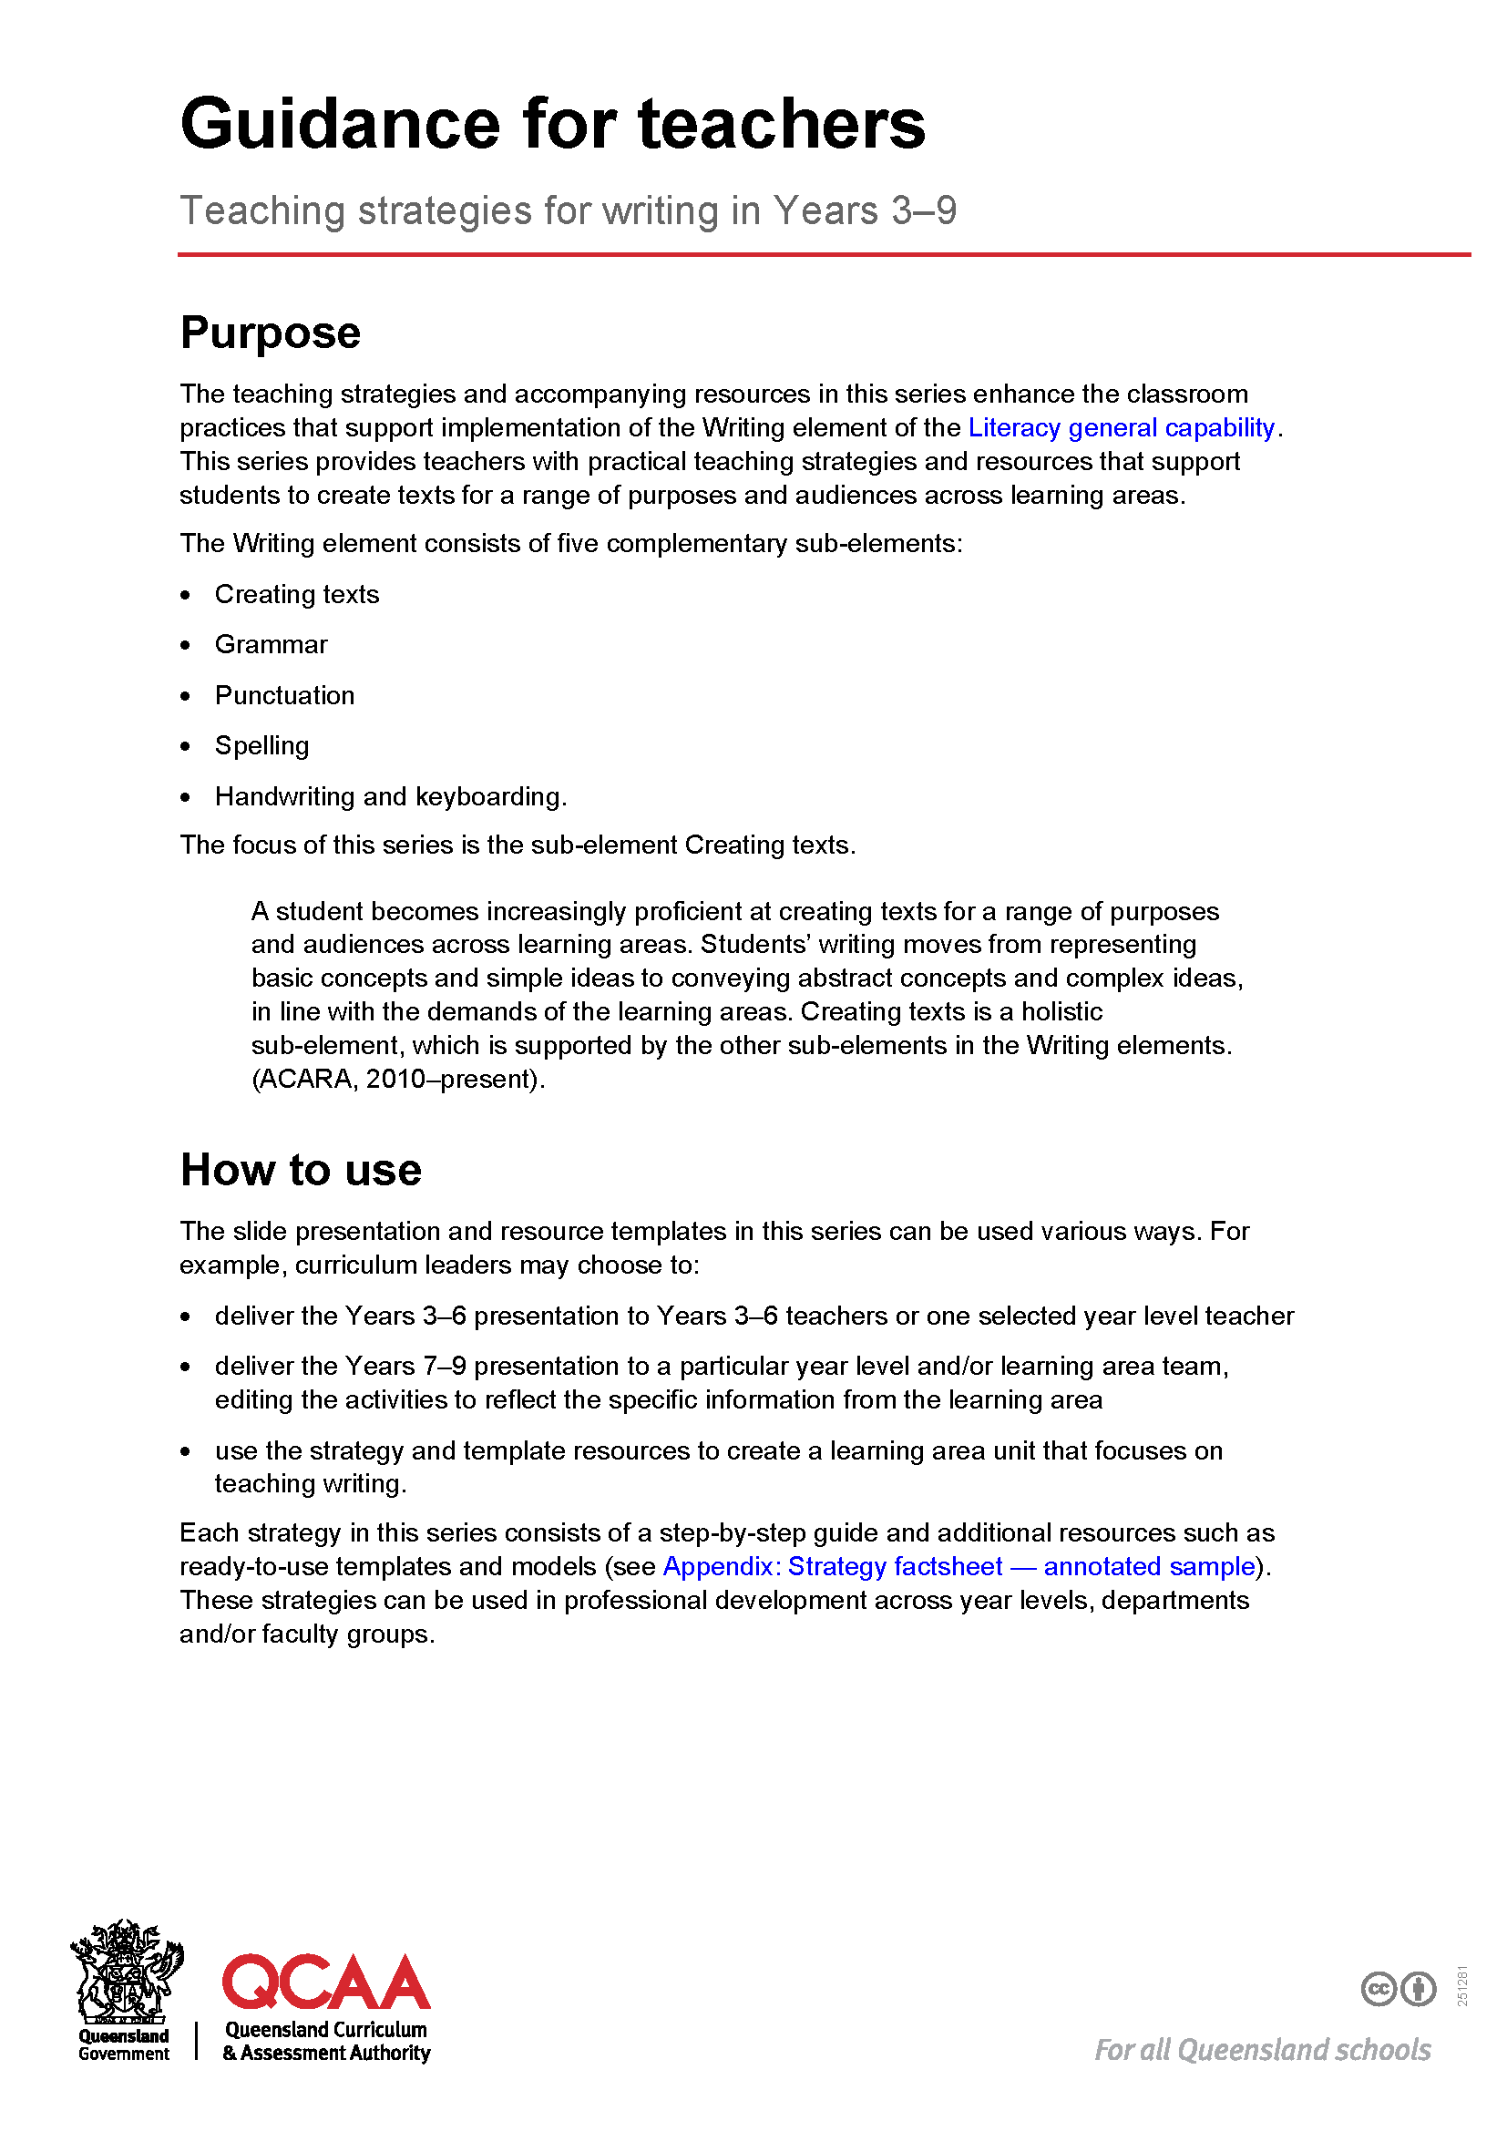
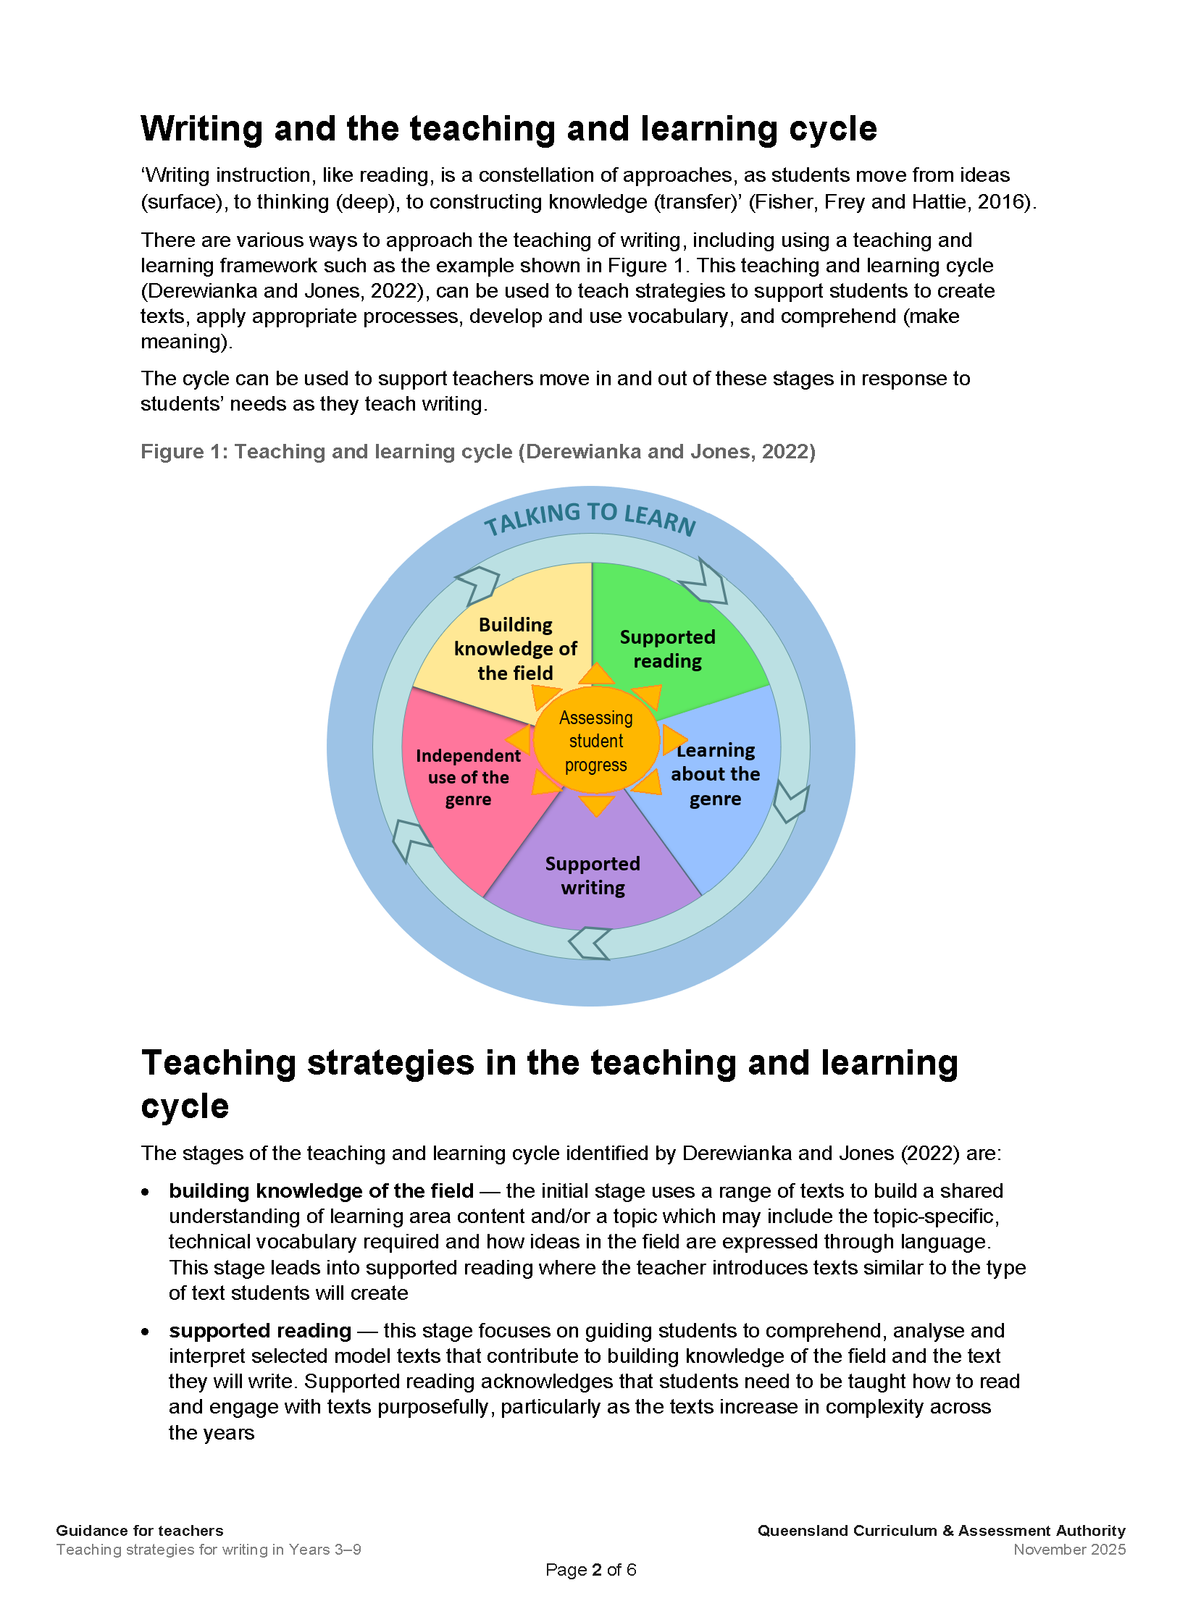
Resources — QCAA literacy resource for writing
Notes:
QCAA have a guidance and template resources to support the implementation of writing strategies explored in this PowerPoint.
Note: These can be accessed from the Literacy general capability tab on the QCAA website.

Slide 86
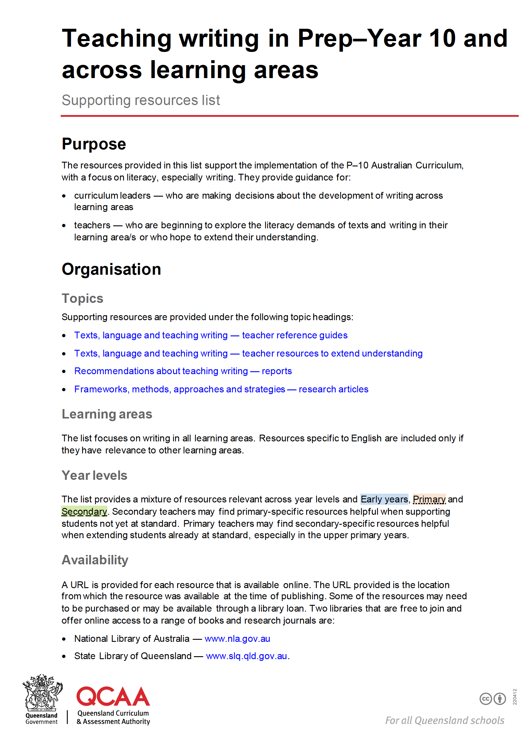
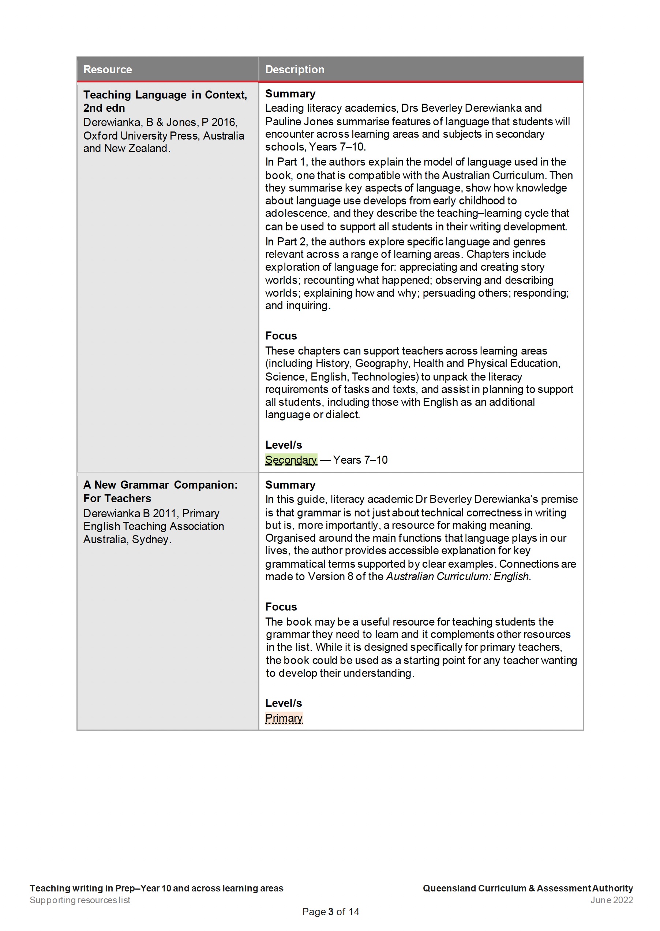
Resources — QCAA literacy resource for writing
Notes:
Additionally, QCAA have a resource available to support the teaching of writing in Prep–Year 10 and across learning areas.
The resource provides a list of published resources to support the implementation of the P–10 Australian Curriculum, with a focus on literacy especially writing.

Slide 87
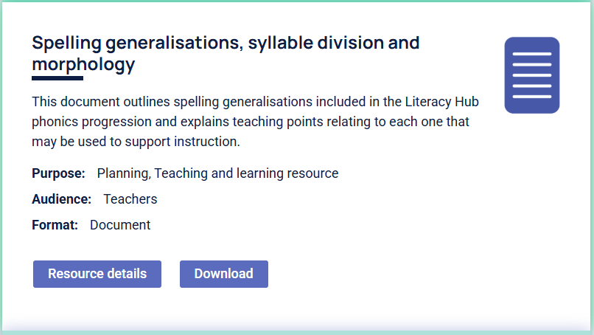
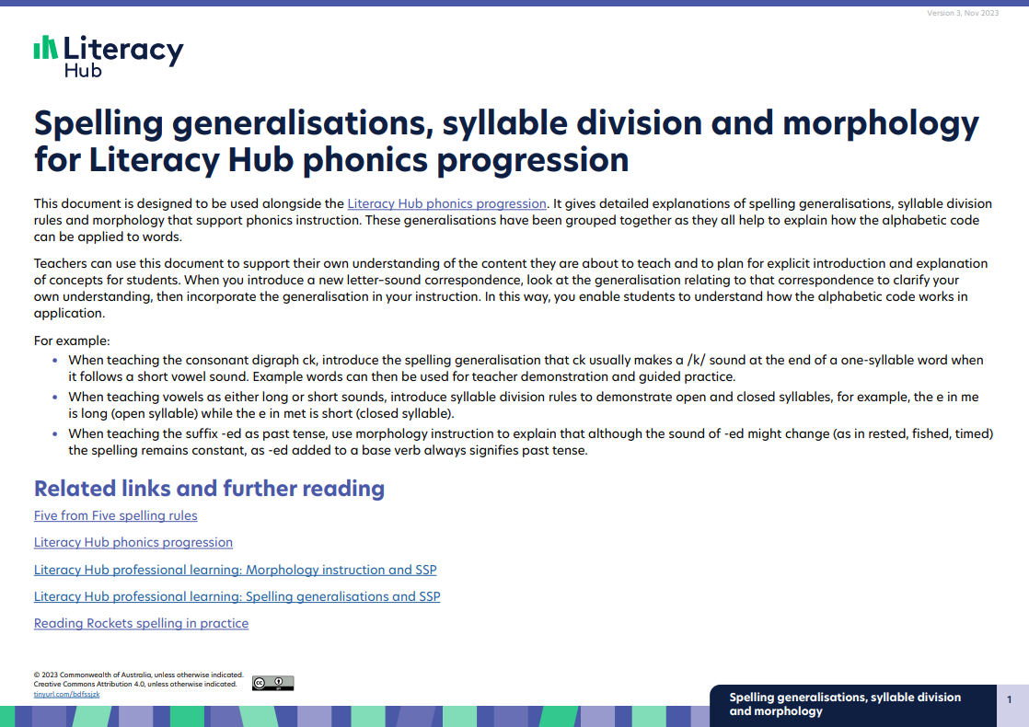
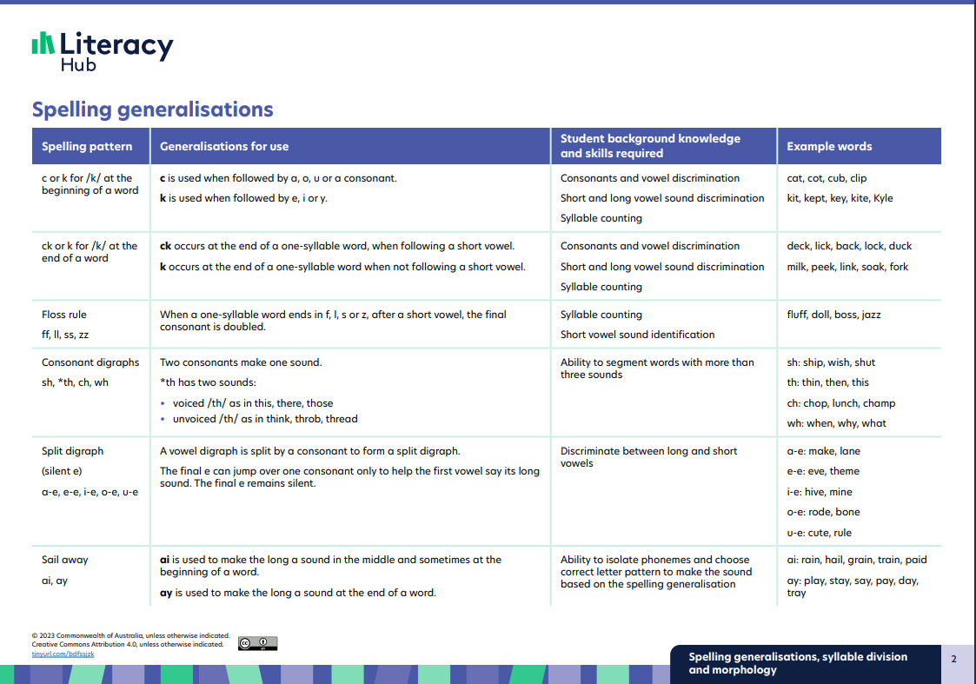
Resource from Education Services Australia (ESA)
Literacy Hub: Spelling generalisations
Notes:
Additionally, the Literacy Hub provides helpful resources to assist with the teaching of phonics.
Explanations of the spelling generalisations, syllable division rules and morphology that support phonics instruction, as well as advice on how to use the material in the classroom are available.
While several resources are for Prep-Year 2 teachers, these can be used to support students alongside the literacy progression at an age-equivalent level. It may also be of interest to teachers beyond Year 2, providing detail about which spelling rules to reinforce in Years 4-6.
Sources:
Commonwealth of Australia. (2023). Spelling generalisations, syllable division and morphology. https://www.literacyhub.edu.au/search/?keywords=spelling&p=1&items=8
Commonwealth of Australia. (2023). Spelling generalisations, syllable division and morphology for Literacy Hub phonics progression. https://www.literacyhub.edu.au/media/bk3diqyj/spelling-generalisations.pdf (pp.1-2)

Slide 88
Success criteria
Learning goal
To understand how to use the Australian Curriculum v9.0 and writing strategies across the learning areas in Years 3–6 to improve students’ writing.
You will know you are successful if
you can:
use the Australian Curriculum v9.0
and its Literacy general capability to inform the teaching of writing across learning areas
explore practical teaching strategies to improve student writing outcomes using a teaching and learning cycle.

Slide 89
Reflect on your learning
In a moment …
Reflect on and consolidate your learning using the following questions:
How will you use the Australian Curriculum v9.0 and its Literacy general capability to inform the teaching of writing across learning areas?
How will you apply practical teaching strategies to improve student writing outcomes using a teaching and learning cycle?
How will you use QCAA resources to support the teaching of writing?
Notes:
Delete slide if activity not required.

Slide 90
Acknowledgments
Third-party copyright material, and QCAA material not covered by the CC BY licence, is listed below:
Queensland Government coat of arms, and the QCAA and QSA trademarks may not be reproduced without permission.
Acknowledgment of Country artwork (2023) ‘Growth through Learning’ by Chern’ee, Brooke and Jesse Sutton, Kalkadoon. www.cherneesutton.com.au
Student and staff images have been used with permission.
Unless otherwise indicated, material from Australian Curriculum is © ACARA 2010–present, licensed CC BY 4.0. For the latest information and additional terms of use, see the Australian Curriculum website and its copyright notice.
Glossary terms are from the Australian Curriculum: English F-10 Version 9.0 Glossary.
The three-dimensional curriculum and organising elements diagrams are 'Excluded Material’, are used under the terms of the Australian Curriculum and its copyright notice and are not modified. © Australian Curriculum, Assessment and Reporting Authority (ACARA) 2009 to present, unless otherwise indicated. You may view, download, display, print, reproduce (such as by making photocopies) and distribute these Excluded Materials in unaltered form only for your personal, non-commercial educational purposes or for the non-commercial educational purposes of your organisation, provided that you make others aware it can only be used for these purposes and attribute ACARA as the source of the Excluded Material. For the avoidance of doubt, this means that you cannot edit, modify or adapt any of these materials, and you cannot sub-licence any of these materials to others. Apart from any uses permitted under the Copyright Act 1968 (Cth), and those explicitly granted above, all other rights are reserved by ACARA. If you want to use such material in a manner that is outside this restrictive licence, you must request permission from ACARA by emailing (copyright@acara.edu.au).

Slide 91
Acknowledgments
Third-party copyright material, and QCAA material not covered by the CC BY licence, is listed below:
Image of tiny house on wheels: Viscious-Speed on Pixabay, https://pixabay.com/illustrations/tiny-house-scene-clip-art-4249900/ Used under terms of Pixabay licence.
'Teaching learning cycle' diagram supplied by Bev Derewianka co-author of Derewianka B and Jones P (2022) Teaching Language in Context Oxford University Press.
Image of text paper: OpenClipart-Vectors on Pixabay, https://pixabay.com/vectors/text-paper-document-draft-read-146110/ Used under terms of Pixabay licence.
Image of earphones: Clker-Free-Vector-Images on Pixabay, https://pixabay.com/vectors/headphones-earphones-audio-sound-309805/ Used under terms of Pixabay licence.
Image of eye: IO-Images on Pixabay, https://pixabay.com/vectors/eye-see-viewing-icon-1103592/ Used under terms of Pixabay licence.
Education Services Australia, Literacy Hub: Literacy monitoring materials, https://www.literacyhub.edu.au/search/progress-monitoring-tools-phases-1-5 © Commonwealth of Australia, licensed CC BY 4.0. Logos have been retained in the screenshots with permission.

Slide 92
Copyright notice
© State of Queensland (QCAA) 2026
Licence: www.creativecommons.org/licenses/by/4.0 | Copyright notice: www.qcaa.qld.edu.au/copyright — lists the full terms and conditions, which specify certain exceptions to the licence. |
Attribution (include the link): © State of Queensland (QCAA) 2026 www.qcaa.qld.edu.au/copyright.
Other copyright material in this presentation is listed on the previous slide/s.

Slide 93
QCAA social media

