Slide 1
P–10 Embedding the Personal and social capability in planning: Australian Curriculum v9.0
251536
Notes:
This resource reproduces key slides from the webinar delivered in Semester 2, 2025.
For more resources see the Australian Curriculum v9.0 in Queensland page https://www.qcaa.qld.edu.au/p-10/aciq/version-9/general-capabilities/advice-and-resources

Slide 2
Success criteria
Learning goal
To develop a deeper understanding of the Australian Curriculum v9.0 Personal and social general capability.
You will know you are
successful if you:
understand the structure
and content of the Personal
and social general capability
identify strategies to embed
this general capability
use QCAA resources to
inform and support planning.
Notes:
Note: General capability is sometimes referred to as GC.

Slide 3
Outline
Identifying connections to learning area content
Embedding the capability in planning
Next steps
Understanding the Personal and social general capability

Slide 4
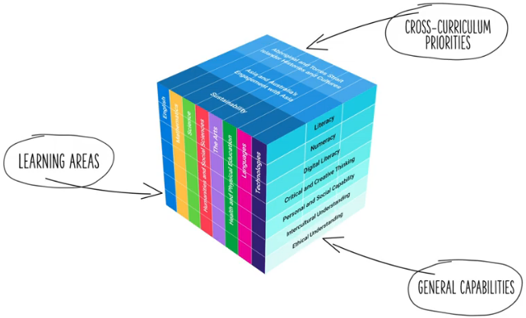
Three-dimensional Australian Curriculum v9.0
Source: [v9] ACARA image from Summary overview (video) https://v9.australiancurriculum.edu.au/help/website-tour
Notes:
The Australian Curriculum has a three-dimensional design to recognise that learning extends beyond subjects, with students requiring a set of knowledge, skills, behaviours, competencies and dispositions to equip them to become confident, lifelong learners in a complex, global environment.
While the learning areas are the foundation of the Australian Curriculum (ACARA video), the teaching of learning area content is strengthened by the application of relevant general capabilities, which should be embedded within learning area content where most authentic and appropriate.
When teachers intentionally connect and teach the general capabilities through curriculum content, both content and skills are deepened.
Source:
[v9] ACARA image from Summary overview (video) https://v9.australiancurriculum.edu.au/help/website-tour

Slide 5
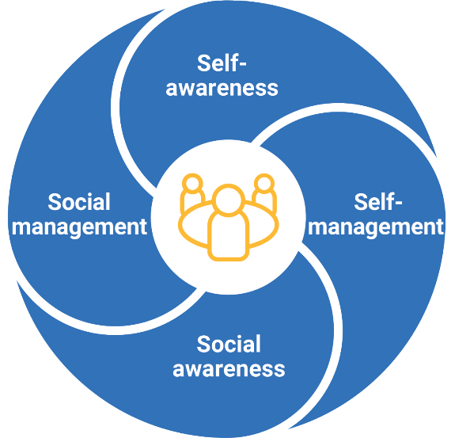
Personal and social capability: Structure
Source: ACARA general capability diagram & sub-elements https://www.australiancurriculum.edu.au/curriculum-information/understand-this-general-capability/personal-and-social-capability
Notes:
This diagram, developed by ACARA, represents the structure of the Personal and social capability.
It illustrates four distinct sections, known as elements.
Each general capability includes its own diagram, outlining the specific elements within that capability.
Sources:
ACARA general capability diagram and sub-element names www.australiancurriculum.edu.au/curriculum-information/understand-this-general-capability/personal-and-social-capability
The Shape of the Australian Curriculum Version 5.0 p. 17 www.acara.edu.au/docs/default-source/curriculum/the_shape_of_the_australian_curriculum_version5_for-website.pdf

Slide 6
Personal and social capability: Structure
Personal awareness
Emotional awareness
Reflective practice
Communication
Collaboration
Leadership
Decision-making
Conflict resolution
Goal setting
Emotional regulation
Perseverance and adaptability
Empathy
Relational awareness
Community awareness
Source: ACARA general capability diagram & sub-elements https://www.australiancurriculum.edu.au/curriculum-information/understand-this-general-capability/personal-and-social-capability
Notes:
Each element is broken into sub-elements (shown in light blue).
Together, the elements and sub-elements guide teachers to plan opportunities for students to develop the understanding and skills needed to be confident and creative individuals, lifelong learners and active citizens.
Sources:
ACARA general capability diagram and sub-element names www.australiancurriculum.edu.au/curriculum-information/understand-this-general-capability/personal-and-social-capability
The Shape of the Australian Curriculum Version 5.0 p. 17 www.acara.edu.au/docs/default-source/curriculum/the_shape_of_the_australian_curriculum_version5_for-website.pdf

Slide 7
Personal and social capability: Structure
Personal awareness
Emotional awareness
Reflective practice
Sub-element description:
Supports students to develop an appreciation of their personal qualities and areas for growth. Through acknowledgment and assessment of their thoughts, feelings, actions and abilities, students can plan for growth across a range of contexts.
Communication
Collaboration
Leadership
Decision-making
Conflict resolution
Goal setting
Emotional regulation
Perseverance and adaptability
Empathy
Relational awareness
Community awareness
Source: ACARA general capability diagram & sub-elements https://www.australiancurriculum.edu.au/curriculum-information/understand-this-general-capability/personal-and-social-capability
Notes:
Each sub-element includes a description to support a shared understanding of what it might look like in practice.
Some general capabilities align more closely with particular learning areas and subjects. For example, the Personal and social capability has a strong connection with Health and Physical education.
Source:
ACARA general capability diagram and sub-element names www.australiancurriculum.edu.au/curriculum-information/understand-this-general-capability/personal-and-social-capability

Slide 8
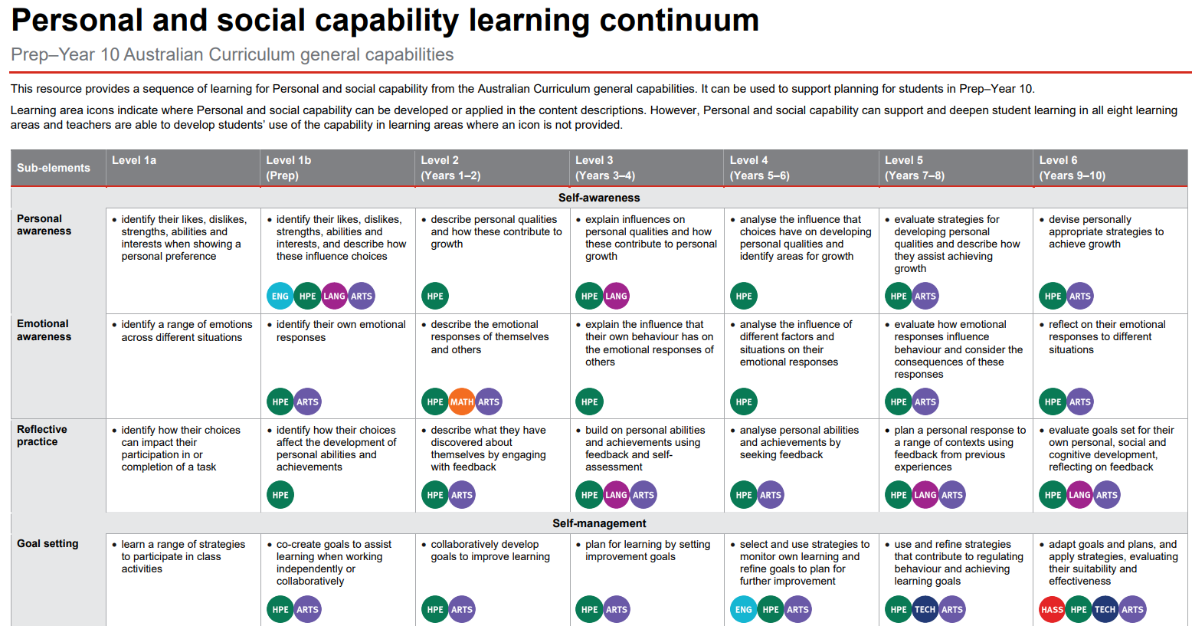

Learning continuum
Notes:
ACARA has developed continua for the general capabilities that describe the knowledge, skills, behaviours and dispositions that students typically will have developed at particular stages of schooling.
The QCAA has reformatted these learning continua for each general capability, adding coloured symbols that highlight the learning areas where the general capabilities can be developed in the content descriptions in authentic and meaningful ways.
The Personal and social capability learning continuum outlines developmental progress from Level 1a through to Level 6.
Level 1a supports students with disability to access the curriculum and participate in learning on the same basis as their peers.
Source:
QCAA Personal and social learning continuum www.qcaa.qld.edu.au/downloads/aciqv9/general-resources/ac9_gc_personal_social_capability_learning_continuum.pdf

Slide 9
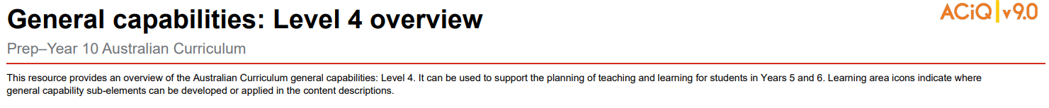
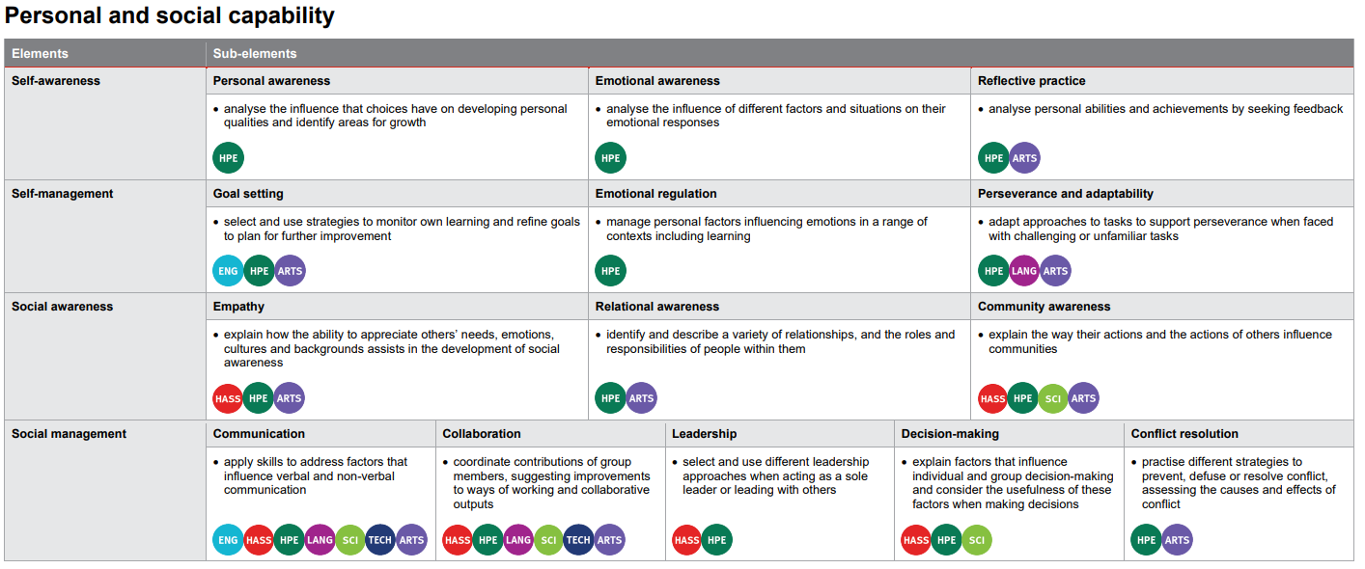
Level overviews
Notes:
The QCAA has also developed overviews for each level of the capability.
The elements are displayed alongside their sub-elements, making it easier to identify the specific knowledge and skills to be developed at each level.
Coloured learning area symbols are again used to show where the general capability can be developed or applied in the content descriptions.
Source:
QCAA General capabilities: Level 4 overview www.qcaa.qld.edu.au/downloads/aciqv9/general-resources/ac9_gc_level_4_overview.pdf

Slide 10
Outline
Identifying connections to learning area content
Embedding the capability in planning
Next steps
Understanding the Personal and social general capability

Slide 11
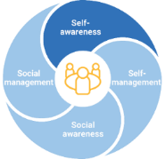




Identifying connections to learning area content
Personal awareness
Sub-element description: Supports students to develop an appreciation of their personal qualities and areas for growth. Through acknowledgment and assessment of their thoughts, feelings, actions and abilities, students can plan for growth across a range of contexts.
Learning continuum
Sub-element | Level 1a | Level 1b (Prep) | Level 2 (Years 1–2) | Level 3 (Years 3–4) | Level 4 (Years 5–6) | Level 5 (Years 7–8) | Level 6 (Years 9–10)
Self-awareness
Personal awareness | identify their likes, dislikes, strengths, abilities and interests when showing a personal preference | identify their likes, dislikes, strengths, abilities and interests, and describe how these influence choices | describe personal qualities and how these contribute to growth | explain influences on personal qualities and how these contribute to personal growth | analyse the influence that choices have on developing personal qualities and identify areas for growth | evaluate strategies for developing personal qualities and describe how they assist achieving growth | devise personally appropriate strategies to achieve growth
AC9HPFP01 investigate who they are and the people in their world | AC9HP2P01 describe their personal qualities and those of others, and explain how they contribute to developing identities | AC9HP4P01 investigate how success, challenge, setbacks and failure strengthen resilience and identities in a range of context | AC9HP6P01 explain how identities can be influenced by people and places, and how we can create positive self identities | AC9HP8P01 analyse and reflect on the influence of values and beliefs on the development of identities | AC9HP10P01 analyse factors that shape identities and evaluate how individuals influence the identities of others
Notes:
General capabilities are integrated through learning area content rather than being taught separately as standalone skills.
In the example on screen from the Self-awareness element, the Personal awareness sub-element is used to illustrate alignment with HPE.
The Level 1b description indicates that students should be be able to identify their likes, dislikes, strengths, abilities and interests.
This aligns with the Prep content description (AC9HPFP01) requiring students to explore their sense of self.
Source:
ACARA general capability diagram, sub-element & description www.australiancurriculum.edu.au/curriculum-information/understand-this-general-capability/personal-and-social-capability
QCAA Personal and social learning continuum www.qcaa.qld.edu.au/downloads/aciqv9/general-resources/ac9_gc_personal_social_capability_learning_continuum.pdf

Slide 12
Identifying connections to learning area content
Personal awareness
Sub-element description: Supports students to develop an appreciation of their personal qualities and areas for growth. Through acknowledgment and assessment of their thoughts, feelings, actions and abilities, students can plan for growth across a range of contexts.
Learning continuum
Sub-element | Level 1a | Level 1b (Prep) | Level 2 (Years 1–2) | Level 3 (Years 3–4) | Level 4 (Years 5–6) | Level 5 (Years 7–8) | Level 6 (Years 9–10)
Self-awareness
Personal awareness | identify their likes, dislikes, strengths, abilities and interests when showing a personal preference | identify their likes, dislikes, strengths, abilities and interests, and describe how these influence choices | describe personal qualities and how these contribute to growth | explain influences on personal qualities and how these contribute to personal growth | analyse the influence that choices have on developing personal qualities and identify areas for growth | evaluate strategies for developing personal qualities and describe how they assist achieving growth | devise personally appropriate strategies to achieve growth
AC9HPFP01 investigate who they are and the people in their world | AC9HP2P01 describe their personal qualities and those of others, and explain how they contribute to developing identities | AC9HP4P01 investigate how success, challenge, setbacks and failure strengthen resilience and identities in a range of context | AC9HP6P01 explain how identities can be influenced by people and places, and how we can create positive self identities | AC9HP8P01 analyse and reflect on the influence of values and beliefs on the development of identities | AC9HP10P01 analyse factors that shape identities and evaluate how individuals influence the identities of others
Notes:
Similar alignment is evident across the bands in HPE.
General capabilities should be embedded only where appropriate, based on authentic opportunities within the content.
Source:
ACARA general capability diagram, sub-element & description www.australiancurriculum.edu.au/curriculum-information/understand-this-general-capability/personal-and-social-capability
QCAA Personal and social learning continuum www.qcaa.qld.edu.au/downloads/aciqv9/general-resources/ac9_gc_personal_social_capability_learning_continuum.pdf

Slide 13

Identifying connections to learning area content
Emotional awareness
Sub-element description: Supports students to recognise the emotions, abilities, needs and concerns of others. They develop their understanding about how respecting the perspectives, emotional states and needs of others is essential to social interactions.
Learning continuum
Sub-element | Level 1a | Level 1b (Prep) | Level 2 (Years 1–2) | Level 3 (Years 3–4) | Level 4 (Years 5–6) | Level 5 (Years 7–8) | Level 6 (Years 9–10)
Self-awareness
Emotional awareness | identify a range of emotions across different situations | identify their own emotional responses | describe the emotional responses of themselves and others | explain the influence that their own behaviour has on the emotional responses of others | analyse the influence of different factors and situations on their emotional responses | evaluate how emotional responses influence behaviour and consider the consequences of these responses | reflect on their emotional responses to different situations
Media Arts
Music
Visual Art
AC9AMAFD01 use play, imagination, arts knowledge, processes and/or skills to discover possibilities and develop ideas
AC9AMU8D02 reflect on their own and others’ music to inform choices they make as composers and performers about how they will manipulate elements of music and/or compositional devices
AC9AVA10D02 reflect on the way they and other visual artists respond to influences to inspire, develop and resolve choices they make in their own visual arts practice
Notes:
This example is drawn from the Self-awareness element.
It highlights how emotional awareness is authentically embedded into The Arts in Prep, Years 7–8 and Years 9–10.
The Prep Media Arts content description (AC9AMAFD01) expects students to use play, imagination, arts knowledge, processes and/or skills to discover possibilities and develop ideas.
The Level 1b description states that students are expected to recognize their own emotional responses, illustrating a link between the sub-element and learning area content.
Similar context-specific connections are evident at Levels 5 and 6.
These opportunities still support the development of emotional awareness through the learning area content of The Arts learning.
Note: The learning area content at Level 2 for The Arts aligns with a different content description outside the Developing Practices and Skills strand and has therefore not been highlighted in this example.
Source:
ACARA general capability diagram, sub-element & description www.australiancurriculum.edu.au/curriculum-information/understand-this-general-capability/personal-and-social-capability

Slide 14
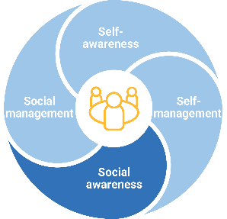




Identifying connections to learning area content
Empathy
Sub-element description: Supports students to explore the factors that influence emotions in themselves and in others, and how emotional responses affect behaviour in a range of contexts.
Learning continuum
Sub-element | Level 1a | Level 1b (Prep) | Level 2 (Years 1–2) | Level 3 (Years 3–4) | Level 4 (Years 5–6) | Level 5 (Years 7–8) | Level 6 (Years 9–10)
social-awareness
Empathy | acknowledge that people have different needs, emotions and abilities | demonstrate an awareness of the needs, emotions, cultures and backgrounds of others | describe similarities and differences between the needs, emotions, cultures and backgrounds of themselves and others | discuss the value of different needs, emotions, cultures and backgrounds | explain how the ability to appreciate others’ needs, emotions, cultures, and backgrounds assists in the development of social awareness | acknowledge the emotions, needs, cultures and backgrounds of different groups and compare with their own | evaluate the effect of people’s actions towards others’ needs, emotions, cultures and backgrounds, acknowledging the influence empathy has on developing social awareness
P–6 HASS
P–6 HASS
AC9HS1S04 discuss perspectives related to objects, people, places and events
AC9HS3S04 analyse information and data, and identify perspectives
Notes:
This example, drawn from the Social awareness element, highlights how empathy can be authentically embedded in HASS in Year 1 and Year 3.
The content descriptions and empathy level descriptions show aligned progression, with consistent themes from Level 2 (Years 1–2) to Level 3 (Years 3–4).
This reinforces that general capabilities can be purposefully integrated within learning area content wherever authentic and meaningful connections exist.
Note: While the red HASS learning area circle appears at other levels, these instances correspond to different content descriptions within the HASS curriculum.
Source:
ACARA general capability diagram, sub-element & description www.australiancurriculum.edu.au/curriculum-information/understand-this-general-capability/personal-and-social-capability

Slide 15
Outline
Identifying connections to learning area content
Embedding the capability in planning
Next steps
Understanding the Personal and social general capability

Slide 16
An approach for embedding the capability in planning
Identify curriculum
Sequence teaching and learning
Identify authentic connections
Select and sequence learning activities
within
planning
Incorporate learning activities that model the general capability
Provide opportunities for students to practise and receive feedback
Learning area
General capability
Aspect/s of the achievement standard
Element/s
Content description/s
Sub-element/s
Notes:
This is one approach to embedding the Personal and social capability within curriculum planning.
The process draws on guidance from the QCAA Elements for effective planning, which provides support for the planning of teaching, learning, and assessment.
It incorporates the Identify curriculum and Sequence teaching and learning elements.
Source:
ACARA information in image — QCAA Planning for teaching, learning and assessment www.qcaa.qld.edu.au/downloads/aciq/general-resources/teaching/ac_plan_teach_learn_assess.pdf

Slide 17
Identify curriculum
Identify curriculum
Sequence teaching and learning
Identify authentic connections
Select and sequence learning activities
within
planning
Incorporate learning activities that model the general capability
Provide opportunities for students to practise and receive feedback
Learning area
General capability
Aspect/s of the achievement standard
Element/s
Content description/s
Sub-element/s
Notes:
Once the curriculum elements have been identified, teachers can use the Australian Curriculum website and/or QCAA resources to identify the elements and sub-elements of the relevant general capabilities that can be purposefully embedded to strengthen student learning.
Source:
ACARA information in image — QCAA Planning for teaching, learning and assessment www.qcaa.qld.edu.au/downloads/aciq/general-resources/teaching/ac_plan_teach_learn_assess.pdf

Slide 18
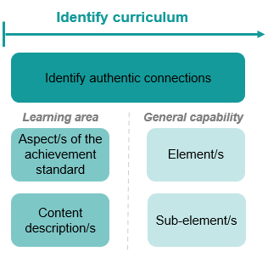
Identify curriculum: Years 5–6 HPE example
Aspect of the achievement standard | Relevant content description/s
They describe contributions they can make as a group and team member to support fair play and inclusion across a range of movement contexts. | devise and test alternative rules and game modifications to support fair play and inclusive participation (AC9HP6M08).
 | participate positively in groups and teams by contributing to group activities, encouraging others and negotiating roles and responsibilities (AC9HP6M09).
Unit 4 — Lunchtime legends
Through participation in striking games (e.g. cricket, softball, rounders, tee-ball) students describe contributions they can make as a team member to support fair play and inclusivity (e.g. encourage teammates, follow rules). Students suggest ways games can be modified to make them fairer. In groups, students select an activity from the ones they have played in their HPE class. Students work together to create a name for their club and discuss how they will make their activity fun and fair. They run the activity for younger students at lunchtimes as part of a lunchtime club.
Notes:
A Year 5–6 HPE example will be used to illustrate the ‘Identify curriculum’ phase of the process.
The relevant aspect of the achievement standard, along with the aligned content descriptions, has informed the context and focus of the example unit titled ‘Lunchtime legends’.
Connections to the Personal and social capability may be identified by reviewing the unit description.
Sources:
ACARA information in image — QCAA Planning for teaching, learning and assessment www.qcaa.qld.edu.au/downloads/aciq/general-resources/teaching/ac_plan_teach_learn_assess.pdf
Achievement standard and aligned content descriptions — QCAA Years 5–6 band Health and Physical Education Australian Curriculum Version 9.0: Achievement standard aligned to content descriptions www.qcaa.qld.edu.au/downloads/aciqv9/health-and-physical-education/curriculum/ac9_hpe_yr5-6_as_cd_alignment.pdf

Slide 19
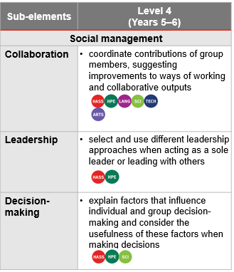
Identify curriculum: Years 5–6 HPE example
Aspect of the achievement standard | Relevant content description/s
They describe contributions they can make as a group and team member to support fair play and inclusion across a range of movement contexts. | devise and test alternative rules and game modifications to support fair play and inclusive participation (AC9HP6M08).
 | participate positively in groups and teams by contributing to group activities, encouraging others and negotiating roles and responsibilities (AC9HP6M09).
Unit 4 — Lunchtime legends
Through participation in striking games (e.g. cricket, softball, rounders, tee-ball) students describe contributions they can make as a team member to support fair play and inclusivity (e.g. encourage teammates, follow rules). Students suggest ways games can be modified to make them fairer. In groups, students select an activity from the ones they have played in their HPE class. Students work together to create a name for their club and discuss how they will make their activity fun and fair. They run the activity for younger students at lunchtimes as part of a lunchtime club.
Notes:
In this unit, students are required to ‘describe contributions they can make as a group and team member to support fair play and inclusion across a range of movement contexts’.
By referring to the aspects of the achievement standard that are assessed, along with the aligned content descriptions, the learning continuum indicates where there are opportunities to embed elements and sub-elements of the Personal and social capability.
Only embed the identified elements and sub-elements that are most beneficial for achieving the outcomes of the unit. Professional judgment should guide the selection of these.
Sources:
ACARA information in image — QCAA Planning for teaching, learning and assessment www.qcaa.qld.edu.au/downloads/aciq/general-resources/teaching/ac_plan_teach_learn_assess.pdf
Achievement standard and aligned content descriptions — QCAA Years 5–6 band Health and Physical Education Australian Curriculum Version 9.0: Achievement standard aligned to content descriptions www.qcaa.qld.edu.au/downloads/aciqv9/health-and-physical-education/curriculum/ac9_hpe_yr5-6_as_cd_alignment.pdf
Sub-element level descriptions — QCAA General capabilities: Level 4 overview www.qcaa.qld.edu.au/downloads/aciqv9/general-resources/ac9_gc_level_4_overview.pdf

Slide 20
Identify curriculum: Years 5–6 HPE example
Aspect of the achievement standard | Relevant content description/s
They describe contributions they can make as a group and team member to support fair play and inclusion across a range of movement contexts. | devise and test alternative rules and game modifications to support fair play and inclusive participation (AC9HP6M08).
 | participate positively in groups and teams by contributing to group activities, encouraging others and negotiating roles and responsibilities (AC9HP6M09).
Unit 4 — Lunchtime legends
Through participation in striking games (e.g. cricket, softball, rounders, tee-ball) students describe contributions they can make as a team member to support fair play and inclusivity (e.g. encourage teammates, follow rules). Students suggest ways games can be modified to make them fairer. In groups, students select an activity from the ones they have played in their HPE class. Students work together to create a name for their club and discuss how they will make their activity fun and fair. They run the activity for younger students at lunchtimes as part of a lunchtime club.
Notes:
In this example, the Collaboration sub-element has been selected as it provides opportunities to explicitly teach and model collaboration, while also allowing students to practise and develop collaboration skills.
Sources:
ACARA information in image — QCAA Planning for teaching, learning and assessment www.qcaa.qld.edu.au/downloads/aciq/general-resources/teaching/ac_plan_teach_learn_assess.pdf
Achievement standard and aligned content descriptions — QCAA Years 5–6 band Health and Physical Education Australian Curriculum Version 9.0: Achievement standard aligned to content descriptions www.qcaa.qld.edu.au/downloads/aciqv9/health-and-physical-education/curriculum/ac9_hpe_yr5-6_as_cd_alignment.pdf
Sub-element level descriptions — QCAA General capabilities: Level 4 overview www.qcaa.qld.edu.au/downloads/aciqv9/general-resources/ac9_gc_level_4_overview.pdf

Slide 21
Identify curriculum: Year 7 Science example
Aspect of the achievement standard | Relevant content description/s
They explain the role of science communication in shaping viewpoints, policies and regulations. | explore the role of science communication in informing individual viewpoints and community policies and regulations (AC9S7H04)
Unit — Life under water: Biological science
Environmental scientists use classification tools to measure the biodiversity of an ecosystem and monitor biotic and abiotic factors. This understanding of healthy systems provides a standard against which damage from floodwater can be predicted and monitored, and the success of remediation processes measured. In this unit, students continue to think like scientists as they gain the skills to order and organise organisms and measure the health of seagrass beds. They investigate the impact of floodwaters and predict the effect of silt in this marine ecosystem. There is a focus on sustainability, identification of potential ethical issues with the use of secondary data and recognition of the need for intercultural consideration when accessing field locations in this unit. This supports students to see themselves responding to contemporary science issues as they continue to think like scientists.
Notes:
This example shows the process for Year 7 Science.
The relevant aspect of the achievement standard, together with the aligned content description, has informed the context and focus of the unit.
Sources:
ACARA information in image — QCAA ACARA information in image — QCAA Planning for teaching, learning and assessment www.qcaa.qld.edu.au/downloads/aciq/general-resources/teaching/ac_plan_teach_learn_assess.pdf
Achievement standard and aligned content descriptions — QCAA Year 7 Science Australian Curriculum Version 9.0: Achievement standard aligned to content descriptions www.qcaa.qld.edu.au/downloads/aciqv9/science/curriculum/ac9_science_yr7_as_cd_alignment.pdf

Slide 22
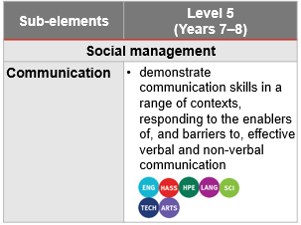
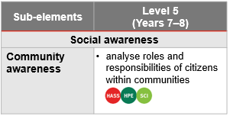
Identify curriculum: Year 7 Science example
Aspect of the achievement standard | Relevant content description/s
They explain the role of science communication in shaping viewpoints, policies and regulations. | explore the role of science communication in informing individual viewpoints and community policies and regulations (AC9S7H04)
Unit — Life under water: Biological science
Environmental scientists use classification tools to measure the biodiversity of an ecosystem and monitor biotic and abiotic factors. This understanding of healthy systems provides a standard against which damage from floodwater can be predicted and monitored, and the success of remediation processes measured. In this unit, students continue to think like scientists as they gain the skills to order and organise organisms and measure the health of seagrass beds. They investigate the impact of floodwaters and predict the effect of silt in this marine ecosystem. There is a focus on sustainability, identification of potential ethical issues with the use of secondary data and recognition of the need for intercultural consideration when accessing field locations in this unit. This supports students to see themselves responding to contemporary science issues as they continue to think like scientists.
Notes:
The learning continuum indicates where there are opportunities to embed elements and sub-elements.
Sources:
ACARA information in image — QCAA ACARA information in image — QCAA Planning for teaching, learning and assessment www.qcaa.qld.edu.au/downloads/aciq/general-resources/teaching/ac_plan_teach_learn_assess.pdf
Achievement standard and aligned content descriptions — QCAA Year 7 Science Australian Curriculum Version 9.0: Achievement standard aligned to content descriptions www.qcaa.qld.edu.au/downloads/aciqv9/science/curriculum/ac9_science_yr7_as_cd_alignment.pdf
Sub-element level descriptions — QCAA General capabilities: Level 4 overview www.qcaa.qld.edu.au/downloads/aciqv9/general-resources/ac9_gc_level_5_overview.pdf

Slide 23
Identify curriculum: Year 7 Science example
Aspect of the achievement standard | Relevant content description/s
They explain the role of science communication in shaping viewpoints, policies and regulations. | explore the role of science communication in informing individual viewpoints and community policies and regulations (AC9S7H04)
Unit — Life under water: Biological science
Environmental scientists use classification tools to measure the biodiversity of an ecosystem and monitor biotic and abiotic factors. This understanding of healthy systems provides a standard against which damage from floodwater can be predicted and monitored, and the success of remediation processes measured. In this unit, students continue to think like scientists as they gain the skills to order and organise organisms and measure the health of seagrass beds. They investigate the impact of floodwaters and predict the effect of silt in this marine ecosystem. There is a focus on sustainability, identification of potential ethical issues with the use of secondary data and recognition of the need for intercultural consideration when accessing field locations in this unit. This supports students to see themselves responding to contemporary science issues as they continue to think like scientists.
Notes:
There are opportunities to embed the sub-elements of Communication within this unit, as students are likely to work in groups to collect, classify, and interpret data, requiring effective peer communication.
This general capability can also be used by the teacher to support students to develop the skills and attributes required for effective and respectful group work.
Sources:
ACARA information in image — QCAA ACARA information in image — QCAA Planning for teaching, learning and assessment www.qcaa.qld.edu.au/downloads/aciq/general-resources/teaching/ac_plan_teach_learn_assess.pdf
Achievement standard and aligned content descriptions — QCAA Year 7 Science Australian Curriculum Version 9.0: Achievement standard aligned to content descriptions www.qcaa.qld.edu.au/downloads/aciqv9/science/curriculum/ac9_science_yr7_as_cd_alignment.pdf
Sub-element level descriptions — QCAA General capabilities: Level 4 overview www.qcaa.qld.edu.au/downloads/aciqv9/general-resources/ac9_gc_level_5_overview.pdf

Slide 24



Sequence teaching and learning
Identify curriculum
Sequence teaching and learning
Identify authentic connections
Select and sequence learning activities within planning
Incorporate learning activities that model the general capability
Provide opportunities for students to practise and receive feedback
Learning area
General capability
Aspect/s of the achievement standard
Element/s
Content description/s
Sub-element/s
Notes:
The next phase of the process relates to the deliberate selection and then sequencing of learning activities within the teacher's unit planning.
1 —The first point emphasises the intentional planning of when and how a general capability will be developed through the teaching of content descriptions, ensuring that students build the knowledge, understanding, and skills outlined in the achievement standard.
2 — While planning, teachers should identify opportunities to model the general capability. This involves explicitly explaining and demonstrating the knowledge, understanding, and skills of the capability so that students can observe it in practice.
3 — After modelling, it is important to provide students with opportunities to practise the capability through learning activities, reinforcing knowledge, skills, behaviours and dispositions. As with all learning, students should receive informal feedback on their progress in developing the general capability.
Source:
ACARA information in image — QCAA ACARA information in image — QCAA Planning for teaching, learning and assessment www.qcaa.qld.edu.au/downloads/aciq/general-resources/teaching/ac_plan_teach_learn_assess.pdf

Slide 25
Select and sequence learning activities
Sequence teaching and learning
Select and sequence learning activities within planning
Incorporate learning activities that model the general capability
Provide opportunities for students to practise and receive feedback
Unit 4 — Lunchtime legends
Through participation in striking games (e.g. cricket, softball, rounders, tee-ball) students describe contributions they can make as a team member to support fair play and inclusivity (e.g. encourage teammates, follow rules). Students suggest ways games can be modified to make them fairer. In groups, students select an activity from the ones they have played in their HPE class. Students work together to create a name for their club and discuss how they will make their activity fun and fair. They run the activity for younger students at lunchtimes as part of a lunchtime club.
Where (select) are there opportunities to embed collaboration into the unit?
When (sequence) should these opportunities be incorporated?
What specific learning activities and experiences could be incorporated to explicitly teach and model collaboration?
Where are there opportunities for students to practise collaboration?
How will students receive informal feedback about their progress?
Notes:
Referring to the previous Year 5–6 HPE example, at this stage of the suggested process, teachers would be asking questions such as:
Where are opportunities to embed collaboration within the unit?
When should these opportunities be incorporated within the sequence of learning?
Sources:
ACARA information in image — QCAA ACARA information in image — QCAA Planning for teaching, learning and assessment www.qcaa.qld.edu.au/downloads/aciq/general-resources/teaching/ac_plan_teach_learn_assess.pdf
Sub-element level descriptions — QCAA General capabilities: Level 4 overview www.qcaa.qld.edu.au/downloads/aciqv9/general-resources/ac9_gc_level_4_overview.pdf

Slide 26
Incorporate learning activities, practice and feedback
Sequence teaching and learning
Select and sequence learning activities within planning
Incorporate learning activities that model the general capability
Provide opportunities for students to practise and receive feedback
Unit 4 — Lunchtime legends
Through participation in striking games (e.g. cricket, softball, rounders, tee-ball) students describe contributions they can make as a team member to support fair play and inclusivity (e.g. encourage teammates, follow rules). Students suggest ways games can be modified to make them fairer. In groups, students select an activity from the ones they have played in their HPE class. Students work together to create a name for their club and discuss how they will make their activity fun and fair. They run the activity for younger students at lunchtimes as part of a lunchtime club.
Where (select) are there opportunities to embed collaboration into the unit?
When (sequence) should these opportunities be incorporated?
What specific learning activities and experiences could be incorporated to explicitly teach and model collaboration?
Where are there opportunities for students to practise collaboration?
How will students receive informal feedback about their progress?
Notes:
Referring back to the previous Year 5–6 HPE example, at this stage of the suggested process, teachers would be asking questions such as:
What specific learning activities and experiences can be used to explicitly teach and model collaboration?
Sources:
ACARA information in image — QCAA ACARA information in image — QCAA Planning for teaching, learning and assessment www.qcaa.qld.edu.au/downloads/aciq/general-resources/teaching/ac_plan_teach_learn_assess.pdf
Sub-element level descriptions — QCAA General capabilities: Level 4 overview www.qcaa.qld.edu.au/downloads/aciqv9/general-resources/ac9_gc_level_4_overview.pdf

Slide 27
Incorporate learning activities, practice and feedback
Sequence teaching and learning
Select and sequence learning activities within planning
Incorporate learning activities that model the general capability
Provide opportunities for students to practise and receive feedback
Unit 4 — Lunchtime legends
Through participation in striking games (e.g. cricket, softball, rounders, tee-ball) students describe contributions they can make as a team member to support fair play and inclusivity (e.g. encourage teammates, follow rules). Students suggest ways games can be modified to make them fairer. In groups, students select an activity from the ones they have played in their HPE class. Students work together to create a name for their club and discuss how they will make their activity fun and fair. They run the activity for younger students at lunchtimes as part of a lunchtime club.
Where (select) are there opportunities to embed collaboration into the unit?
When (sequence) should these opportunities be incorporated?
What specific learning activities and experiences could be incorporated to explicitly teach and model collaboration?
Where are there opportunities for students to practise collaboration?
How will students receive informal feedback about their progress?
Notes:
Referring to the previous Year 5–6 HPE example, at this stage of the suggested process, teachers would be asking questions such as:
Where can students practise collaboration effectively?
How will students receive informal feedback on their progress in developing collaboration skills?
Sources:
ACARA information in image — QCAA ACARA information in image — QCAA Planning for teaching, learning and assessment www.qcaa.qld.edu.au/downloads/aciq/general-resources/teaching/ac_plan_teach_learn_assess.pdf
Sub-element level descriptions — QCAA General capabilities: Level 4 overview www.qcaa.qld.edu.au/downloads/aciqv9/general-resources/ac9_gc_level_4_overview.pdf

Slide 28
Outline
Identifying connections to learning area content
Embedding the capability in planning
Next steps
Understanding the Personal and social general capability

Slide 29

Next steps
Consider …
Where there are authentic opportunities for you to develop elements and sub-elements of the Personal and social capability within your learning area content.
Notes:
Consider where there are authentic opportunities to develop elements and sub-elements of the Personal and social capability within your learning area content.

Slide 30
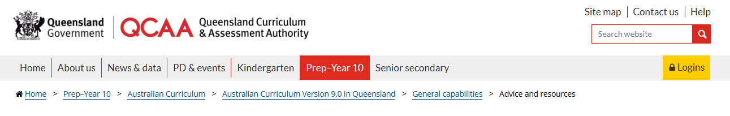
QCAA resources
Embedding the general capabilities
Mapping the general capabilities
Learning continua
Level overviews
PD resources
Notes:
QCAA resources can assist teachers with understanding the general capabilities.
These can be accessed on the General capabilities page of the QCAA website using the link below.
Source:
Website snip — QCAA website www.qcaa.qld.edu.au/p-10/aciq/version-9/general-capabilities/advice-and-resources

Slide 31
Acknowledgments
Third-party copyright material, and QCAA material not covered by the CC BY licence is listed below:
Queensland Government coat of arms, and the QCAA and QSA trademarks may not be reproduced without permission.
Acknowledgment of Country artwork (2023) ‘Growth through Learning’ by Chern’ee, Brooke and Jesse Sutton, Kalkadoon. www.cherneesutton.com.au
The three-dimensional cube and Personal and social capability diagrams are 'Excluded Material' used under the terms of the Australian Curriculum and its copyright notice and are not modified © Australian Curriculum, Assessment and Reporting Authority (ACARA) 2009 to present, unless otherwise indicated. You may view, download, display, print, reproduce (such as by making photocopies) and distribute these Excluded Materials in unaltered form only for your personal, non-commercial educational purposes or for the non-commercial educational purposes of your organisation, provided that you make others aware it can only be used for these purposes and attribute ACARA as the source of the Excluded Material. For the avoidance of doubt, this means that you cannot edit, modify or adapt any of these materials, and you cannot sub-license any of these materials to others. Apart from any uses permitted under the Copyright Act 1968 (Cth), and those explicitly granted above, all other rights are reserved by ACARA. If you want to use such material in a manner that is outside this restrictive licence, you must request permission from ACARA by emailing (copyright@acara.edu.au) or by submitting a request through the online enquiry form.
Unless otherwise indicated, material from Australian Curriculum is © ACARA 2010–present, licensed CC BY 4.0. For the latest information and additional terms of use, see the Australian Curriculum website and its copyright notice.
Student and staff images have been used with permission.

Slide 32
Copyright notice
© State of Queensland (QCAA) 2026
Licence: https://creativecommons.org/licenses/by/4.0 | Copyright notice: www.qcaa.qld.edu.au/copyright — lists the full terms and conditions, which specify certain exceptions to the licence. |
Attribution (include the link): © State of Queensland (QCAA) 2026 www.qcaa.qld.edu.au/copyright.
Other copyright material in this presentation is listed on the previous slide/s.

