Slide 1
P–10 Embedding the Intercultural understanding general capability in planning: Australian Curriculum v9.0
251536
Notes:
This resource reproduces key slides to support teachers to embed the Intercultural understanding general capability in planning.
For more resources see the Australian Curriculum v9.0 in Queensland page www.qcaa.qld.edu.au/p-10/aciq/version-9/general-capabilities/advice-and-resources

Slide 2
Success criteria
Learning goal
To develop a deeper understanding of the Australian Curriculum v9.0 Intercultural understanding general capability.
You will know you are successful if you:
understand the structure and content of the Intercultural understanding general capability
identify strategies to embed this general capability
use QCAA resources to inform and support planning.
Notes:
Note: General capability is sometimes referred to as GC.

Slide 3
Outline
Identifying connections to learning area content
Embedding the capability in planning
Next steps
Understanding the Critical and creative thinking general capability

Slide 4
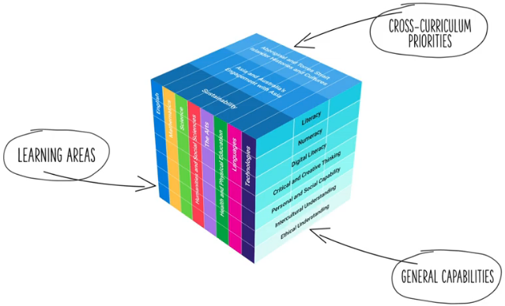
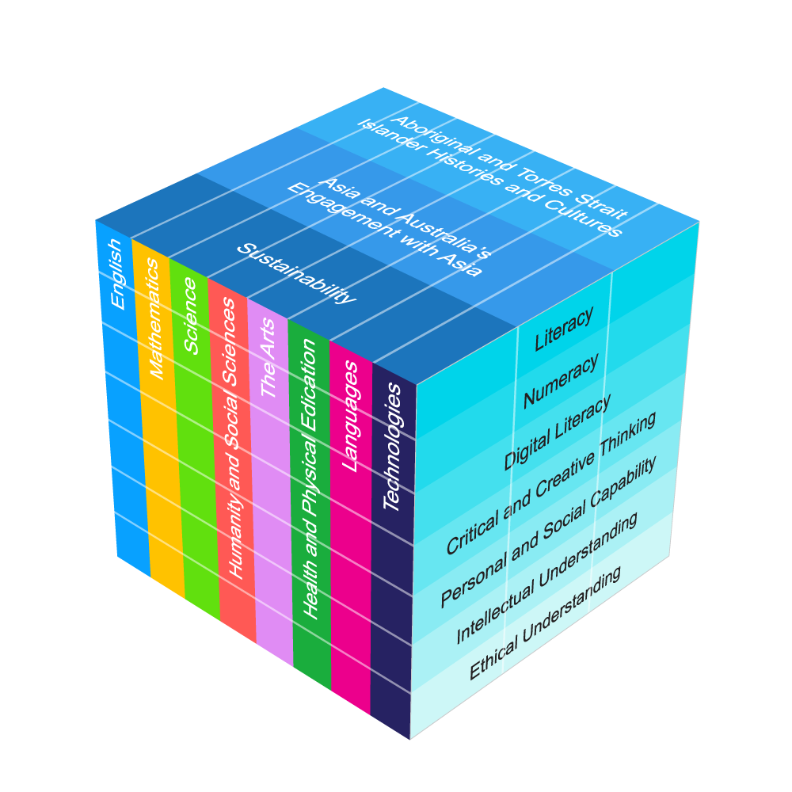
Three-dimensional Australian Curriculum v9.0
Source: [v9] ACARA image from Summary overview (video) https://v9.australiancurriculum.edu.au/help/website-tour
Notes:
The Australian Curriculum has a three-dimensional design to recognise that learning extends beyond subjects, with students requiring a set of knowledge, skills, behaviours, competencies and dispositions to equip them to become confident, lifelong learners in a complex, global environment.
While the learning areas are the foundation of the Australian Curriculum (ACARA video), the teaching of learning area content is strengthened by the application of relevant general capabilities, which should be embedded within learning area content where most authentic and appropriate.
When teachers intentionally connect and teach the general capabilities through curriculum content, both content and skills are deepened.
Source:
[v9] ACARA image from Summary overview (video) https://v9.australiancurriculum.edu.au/help/website-tour

Slide 5
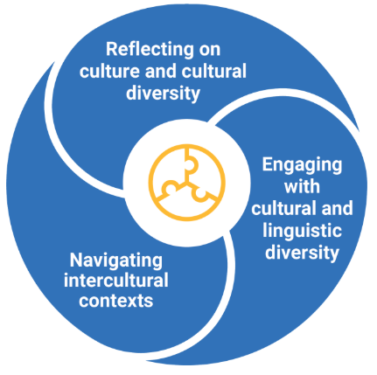
Intercultural understanding general capability: Structure
Source: ACARA general capability image https://www.australiancurriculum.edu.au/curriculum-information/understand-this-general-capability/intercultural-understanding
Notes:
This diagram, developed by ACARA, represents the structure of the Intercultural understanding general capability.
It illustrates three distinct sections, known as elements.
Each general capability has its own diagram, outlining the specific elements within that capability.
Sources:
ACARA general capability diagram and sub-element names https://www.australiancurriculum.edu.au/curriculum-information/understand-this-general-capability/intercultural-understanding
The Shape of the Australian Curriculum Version 5.0 p. 17 www.acara.edu.au/docs/default-source/curriculum/the_shape_of_the_australian_curriculum_version5_for-website.pdf

Slide 6
Intercultural understanding general capability: Structure
Reflect on the relationship
between cultures and identities
Examine cultural perspectives and
world views
Explore the influence of cultures on
interactions
Consider responses to intercultural experiences
Respond to biases, stereotypes, prejudices and discrimination
Adapt in intercultural exchanges
Communicate responsively
Develop multiple perspectives
Develop empathy
Source: ACARA general capability diagram & sub-elements: https://www.australiancurriculum.edu.au/curriculum-information/understand-this-general-capability/intercultural-understanding
Notes:
Each element is broken into sub-elements (shown in light blue).
Together, the elements and sub-elements guide teachers to plan opportunities for students to develop the understanding and skills needed to be confident and adaptable individuals, lifelong learners and active citizens.
Sources:
ACARA general capability diagram and element names www.australiancurriculum.edu.au/curriculum-information/understand-this-general-capability/intercultural-understanding
The Shape of the Australian Curriculum Version 5.0 p. 17 www.acara.edu.au/docs/default-source/curriculum/the_shape_of_the_australian_curriculum_version5_for-website.pdf

Slide 7
Intercultural understanding general capability: Structure
Reflect on the relationship between cultures and identities
Sub-element description: Supports students to discuss their own cultural identities and draw connections with those of others. They transition from familiar to less familiar contexts, and explore cultural continuity and change. They examine how people experience intercultural contexts differently.
Consider responses to intercultural experiences
Respond to biases, stereotypes, prejudices and discrimination
Adapt in intercultural exchanges
Communicate responsively
Develop multiple perspectives
Develop empathy
Source: ACARA general capability diagram & sub-elements: https://www.australiancurriculum.edu.au/curriculum-information/understand-this-general-capability/intercultural-understanding
Notes:
Each sub-element includes a description to support a shared understanding of what it might look like in practice.
Some general capabilities align more closely with particular learning areas and subjects. For example, the Intercultural understanding general capability has a strong connection with Languages and English.
Source:
ACARA general capability diagram and sub-element names www.australiancurriculum.edu.au/curriculum-information/understand-this-general-capability/intercultural-understanding

Slide 8
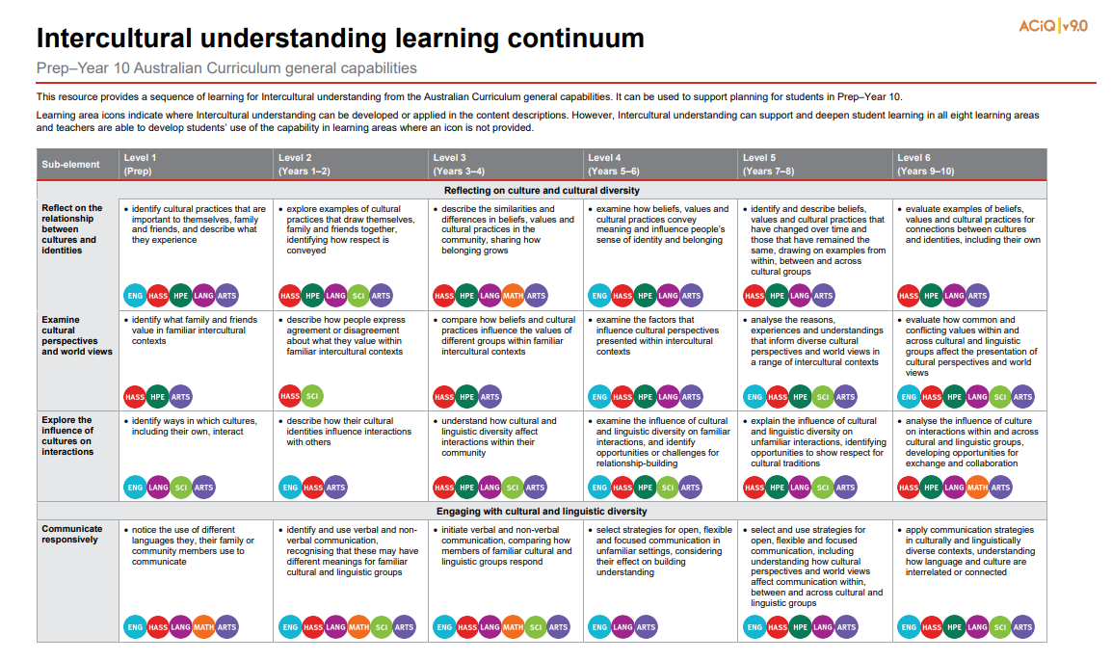

Learning continuum
Source: QCAA Intercultural understanding learning continuum: https://www.qcaa.qld.edu.au/downloads/aciqv9/general-resources/ac9_gc_intercultural_understanding_learning_continuum.pdf
Notes:
ACARA has developed continua for the general capabilities that describe the knowledge, skills, behaviours and dispositions that students typically will have developed at particular stages of schooling.
The QCAA has reformatted these learning continua for each general capability, adding coloured symbols that highlight the learning areas where the general capabilities can be developed in the content descriptions in authentic and meaningful ways.
The Intercultural understanding general capability learning continuum outlines developmental progress from Level 1 through to Level 6.
Source:
QCAA Intercultural understanding learning continuum www.qcaa.qld.edu.au/downloads/aciqv9/general-resources/ac9_gc_intercultural_understanding_learning_continuum.pdf

Slide 9
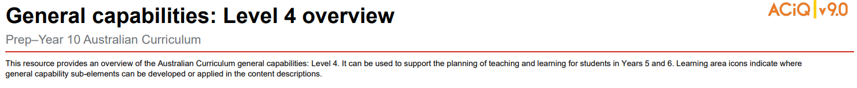
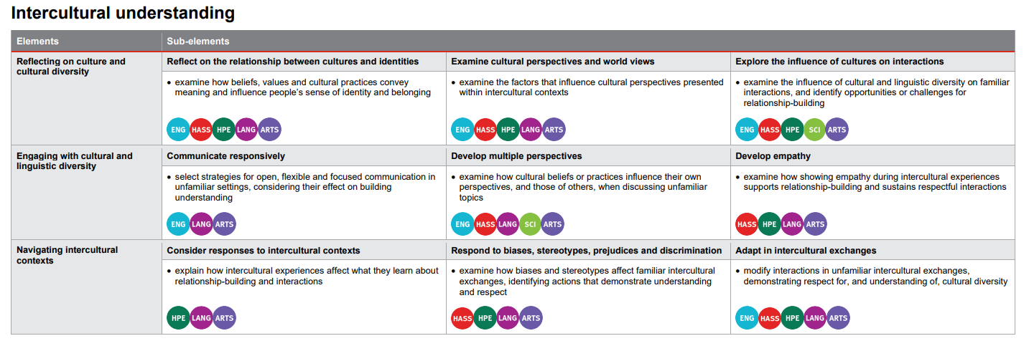
Level overviews
Source: QCAA General capabilities Level 4 overview: https://www.qcaa.qld.edu.au/downloads/aciqv9/general-resources/ac9_gc_level_4_overview.pdf
Notes:
The QCAA has also developed overviews for each level of the capability.
The elements are displayed alongside their sub-elements, making it easier to identify the specific knowledge and skills to be developed at each level.
Coloured learning area symbols are again used to show where the general capability can be developed or applied in the content descriptions.
Source:
QCAA General capabilities: Level 4 overview www.qcaa.qld.edu.au/downloads/aciqv9/general-resources/ac9_gc_level_4_overview.pdf

Slide 10
Outline
Identifying connections to learning area content
Embedding the capability in planning
Next steps
Understanding the Critical and creative thinking general capability

Slide 11
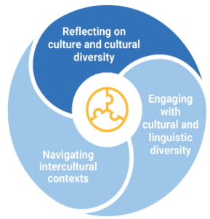
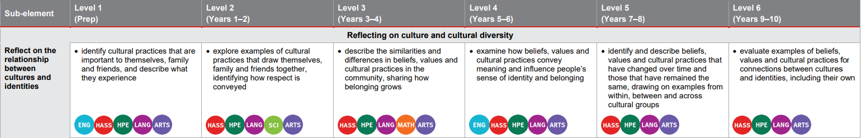
Identifying connections to learning area content
Reflect on the relationship between cultures and identities
Sub-element description: Supports students to discuss their own cultural identities and draw connections with those of others. They transition from familiar to less familiar contexts and explore cultural continuity and change. They examine how people experience intercultural contexts differently.
Learning continuum
AC9LF2U04 notice that people use language in ways that reflect cultural practices
Notes:
General capabilities are integrated through learning area content rather than being taught separately as standalone skills.
In the example on screen from the Reflecting on culture and cultural diversity element, the Reflect on the relationship between cultures and identities sub-element is used to illustrate alignment with the Languages learning area.
The Level 2 description indicates that students should explore examples of cultural practices that draw themselves, family and friends together and identify how respect is conveyed.
This aligns with the French Years 1–2 content description (AC9LF2U04) requiring students to notice that people use language in ways that reflect cultural practices.
Sources:
ACARA general capability diagram, sub-element & description www.australiancurriculum.edu.au/curriculum-information/understand-this-general-capability/intercultural-understanding
QCAA Intercultural understanding learning continuum www.qcaa.qld.edu.au/downloads/aciqv9/general-resources/ac9_gc_intercultural_understanding_learning_continuum.pdf

Slide 12
Identifying connections to learning area content
Reflect on the relationship between cultures and identities
Sub-element description: Supports students to discuss their own cultural identities and draw connections with those of others. They transition from familiar to less familiar contexts and explore cultural continuity and change. They examine how people experience intercultural contexts differently.
Learning continuum
AC9LFF01 with support, recognise and communicate meaning in French | AC9LF2U04 notice that people use language in ways that reflect cultural practices | AC9LF4U03 recognise familiar French language features and compare with those of English, in known contexts | AC9LF6U04 recognise that language reflects cultural practices, values and identity, and that this impacts on non-verbal and verbal communication | AC9LF8U04 reflect on and explain how identity is shaped by language(s), culture(s), beliefs, attitudes and values | AC9LF10U04 reflect on and evaluate how identity is shaped by language(s), culture(s), beliefs, attitudes and values and how these affect ways of communicating
Notes:
Similar alignment is evident across the bands in Languages.
General capabilities should be embedded only where appropriate, based on authentic opportunities within the content.
Sources:
ACARA general capability diagram, sub-element & description www.australiancurriculum.edu.au/curriculum-information/understand-this-general-capability/intercultural-understanding
QCAA Intercultural understanding learning continuum www.qcaa.qld.edu.au/downloads/aciqv9/general-resources/ac9_gc_intercultural_understanding_learning_continuum.pdf

Slide 13
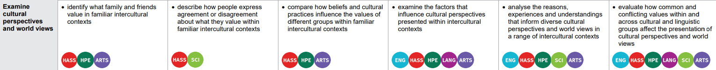
Identifying connections to learning area content
Examine cultural perspectives and worldviews
Sub-element description: Supports students to analyse how these are shaped, preserved or transmitted over time and place.
Learning continuum
Dance
Drama
Media Arts
Visual Arts
Music
AC9ADAFE01 explore how and why the arts are important for people and communities
AC9ADR4E01 explore where, why and how drama is created and/or performed across cultures, times, places and/or other contexts
AC9AMA6E02 explore ways First Nations Australians use media arts to continue and revitalise cultures
AC9AVA8E02 investigate the diversity of First Nations Australians’ artworks and arts practices, considering culturally responsive approaches to Indigenous Cultural and Intellectual Property rights
AC9AMU10E02 investigate the ways that First Nations Australian performers and/or composers celebrate and challenge multiple perspectives of Australian identity through music
Notes:
This example is also drawn from the Reflecting on culture and cultural diversity element.
The learning continuum highlights how the Examine cultural perspectives and worldviews sub-element is authentically embedded into The Arts learning area in Prep, Years 3–4, Years 5–6, Years 7–8 and Years 9–10.
The Dance Prep content description (AC9ADAFE01) expects students to explore how and why the arts are important for people and communities.
The Level 1 description states that students are expected to identify what family and friends value in familiar intercultural contexts, illustrating a link between the sub-element and the learning area content.
Similar context-specific connections are evident from Level 3 to Level 6.
These opportunities support the development of the sub-element through the learning area content of The Arts.
Sources:
ACARA general capability diagram, sub-element & description www.australiancurriculum.edu.au/curriculum-information/understand-this-general-capability/intercultural-understanding
QCAA Intercultural understanding learning continuum www.qcaa.qld.edu.au/downloads/aciqv9/general-resources/ac9_gc_intercultural_understanding_learning_continuum.pdf

Slide 14
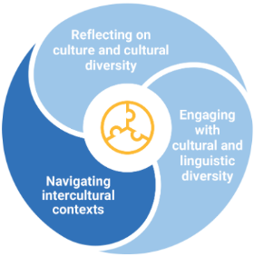
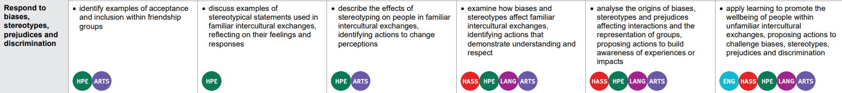
Identifying connections to learning area content
Respond to biases, stereotypes, prejudices and discrimination
Sub-element description: Supports students to examine their origin, respectfully challenging prejudicial and discriminatory behaviour, and propose action to promote the wellbeing of people while valuing their cultural identities.
Learning continuum
AC9E10LY01 analyse and evaluate how people, places, events and concepts are represented in texts and reflect contexts
Notes:
This example, drawn from the Navigating intercultural contexts element, highlights how the Respond to biases, stereotypes, prejudices and discrimination sub-element can be authentically embedded in the English learning area in Year 10.
The English content description (AC9E10LY01) asks students to ‘analyse and evaluate how people, places, events and concepts are represented in texts and reflect contexts’, aligning with the Level 6 description: ‘apply learning to promote the wellbeing of people within unfamiliar intercultural exchanges, proposing actions to challenge biases, stereotypes, prejudices and discrimination’.
This reinforces that general capabilities can be purposefully integrated within learning area content wherever authentic and meaningful connections exist.
Sources:
ACARA general capability diagram, sub-element & description www.australiancurriculum.edu.au/curriculum-information/understand-this-general-capability/intercultural-understanding
QCAA Intercultural understanding learning continuum www.qcaa.qld.edu.au/downloads/aciqv9/general-resources/ac9_gc_intercultural_understanding_learning_continuum.pdf

Slide 15
Outline
Identifying connections to learning area content
Embedding the capability in planning
Next steps
Understanding the Critical and creative thinking general capability

Slide 16
An approach for embedding the capability in planning
Identify curriculum
Sequence teaching and learning
Identify authentic connections
Select and sequence learning activities within planning
Incorporate learning activities that model the general capability
Provide opportunities for students to practise and receive feedback
Learning area
General capability
Aspect/s of the achievement standard
Element/s
Content description/s
Sub-element/s
Notes:
This is one approach to embedding the Intercultural understanding general capability within curriculum planning.
The process draws on guidance from the QCAA Elements for effective planning, which provides support for the planning of teaching, learning, and assessment.
Source:
ACARA information in image — QCAA Planning for teaching, learning and assessment www.qcaa.qld.edu.au/downloads/aciq/general-resources/teaching/ac_plan_teach_learn_assess.pdf

Slide 17
Identify curriculum
Identify curriculum
Sequence teaching and learning
Identify authentic connections
Select and sequence learning activities within planning
Incorporate learning activities that model the general capability
Provide opportunities for students to practise and receive feedback
Learning area
General capability
Aspect/s of the achievement standard
Element/s
Content description/s
Sub-element/s
Notes:
Once the curriculum elements have been identified, teachers can use the Australian Curriculum website and/or QCAA resources to identify the elements and sub-elements of the relevant general capabilities that can be purposefully embedded to strengthen student learning.
Source:
ACARA information in image — QCAA Planning for teaching, learning and assessment www.qcaa.qld.edu.au/downloads/aciq/general-resources/teaching/ac_plan_teach_learn_assess.pdf

Slide 18
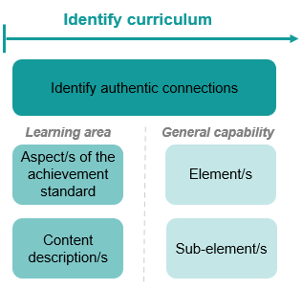
Identify curriculum: Year 3 HASS example
Aspect of the achievement standard | Relevant content description
They identify the significance of events, symbols and emblems to Australia’s identity and diversity. | significant events, symbols and emblems that are important to Australia’s identity and diversity, and how they are celebrated, commemorated or recognised in Australia, including Australia Day, Anzac Day, NAIDOC Week, National Sorry Day, Easter, Christmas, and other religious and cultural festivals (History) (AC9HS3K01).
Unit 3 — Honouring the Anzacs
In this unit, students identify the significance of Anzac Day as a symbol of courage, service, and remembrance in Australia’s national identity. Through stories and images, they learn how Anzac Day is commemorated across the country and why it continues to hold meaning for many Australians today. Students investigate the symbols, traditions, and ceremonies connected to Anzac Day, such as the poppy, the dawn service, and the Anzac spirit, to understand how these represent values like mateship, sacrifice, and respect. By exploring how people from different backgrounds participate in Anzac Day, students reflect on what these commemorations reveal about Australia and deepen their understanding of Australia’s history and values.
Notes:
A Year 3 HASS example will be used to illustrate the Identify curriculum phase of the process.
The relevant aspect of the achievement standard, along with the aligned content description, has informed the context and focus of the example unit, Honouring the Anzacs.
Connections to the Intercultural understanding general capability may be identified by reviewing the unit description.
Sources:
ACARA information in image — QCAA Planning for teaching, learning and assessment www.qcaa.qld.edu.au/downloads/aciq/general-resources/teaching/ac_plan_teach_learn_assess.pdf
Achievement standard and aligned content descriptions — QCAA Year 3 HASS Australian Curriculum Version 9.0: Achievement standard aligned to content descriptions www.qcaa.qld.edu.au/downloads/aciqv9/humanities-and-social-sciences/curriculum/ac9_hass_yr3_as_cd_alignment.pdf

Slide 19


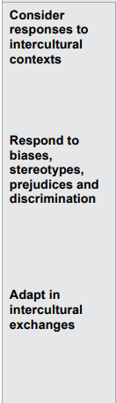
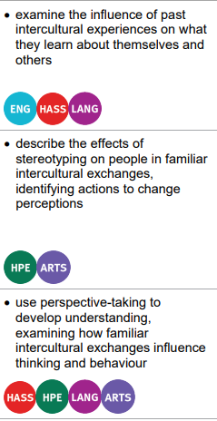
Identify curriculum: Year 3 HASS example
Aspect of the achievement standard | Relevant content description
They identify the significance of events, symbols and emblems to Australia’s identity and diversity. | significant events, symbols and emblems that are important to Australia’s identity and diversity, and how they are celebrated, commemorated or recognised in Australia, including Australia Day, Anzac Day, NAIDOC Week, National Sorry Day, Easter, Christmas, and other religious and cultural festivals (History) (AC9HS3K01).
Unit 3 — Honouring the Anzacs
In this unit, students identify the significance of Anzac Day as a symbol of courage, service, and remembrance in Australia’s national identity. Through stories and images, they learn how Anzac Day is commemorated across the country and why it continues to hold meaning for many Australians today. Students investigate the symbols, traditions, and ceremonies connected to Anzac Day, such as the poppy, the dawn service, and the Anzac spirit, to understand how these represent values like mateship, sacrifice, and respect. By exploring how people from different backgrounds participate in Anzac Day, students reflect on what these commemorations reveal about Australia and deepen their understanding of Australia’s history and values.
Notes:
In this unit, students are required to ‘identify the significance of Anzac Day as a symbol of courage, service, and remembrance in Australia’s national identity’ and ‘explore how people from different backgrounds participate in Anzac Day’.
By referring to the aspect of the Year 3 HASS achievement standard that is assessed, along with the aligned content description, and the learning continuum of the Intercultural understanding general capability, we can identify where there are opportunities to embed elements and sub-elements of the general capability.
Only embed the identified elements and sub-elements that are most beneficial for achieving the outcomes of the unit. Professional judgment should guide this selection.
Sources:
ACARA information in image — QCAA Planning for teaching, learning and assessment www.qcaa.qld.edu.au/downloads/aciq/general-resources/teaching/ac_plan_teach_learn_assess.pdf
Achievement standard and aligned content descriptions — QCAA Year 3 HASS Australian Curriculum Version 9.0: Achievement standard aligned to content descriptions www.qcaa.qld.edu.au/downloads/aciqv9/humanities-and-social-sciences/curriculum/ac9_hass_yr3_as_cd_alignment.pdf
Sub-element level descriptions — QCAA General capabilities: Level 3 overview www.qcaa.qld.edu.au/downloads/aciqv9/general-resources/ac9_gc_intercultural_understanding_learning_continuum.pdf

Slide 20
Identify curriculum: Year 3 HASS example
Aspect of the achievement standard | Relevant content description
They identify the significance of events, symbols and emblems to Australia’s identity and diversity. | significant events, symbols and emblems that are important to Australia’s identity and diversity, and how they are celebrated, commemorated or recognised in Australia, including Australia Day, Anzac Day, NAIDOC Week, National Sorry Day, Easter, Christmas, and other religious and cultural festivals (History) (AC9HS3K01).
Unit 3 — Honouring the Anzacs
In this unit, students identify the significance of Anzac Day as a symbol of courage, service, and remembrance in Australia’s national identity. Through stories and images, they learn how Anzac Day is commemorated across the country and why it continues to hold meaning for many Australians today. Students investigate the symbols, traditions, and ceremonies connected to Anzac Day, such as the poppy, the dawn service, and the Anzac spirit, to understand how these represent values like mateship, sacrifice, and respect. By exploring how people from different backgrounds participate in Anzac Day, students reflect on what these commemorations reveal about Australia and deepen their understanding of Australia’s history and values.
Notes:
In this example, the Consider responses to intercultural contexts sub-element has been selected as the unit provides opportunities to examine the influence of past intercultural experiences, while exploring Australia’s identity and diversity through the lens of Anzac Day.
Sources:
ACARA information in image — QCAA Planning for teaching, learning and assessment www.qcaa.qld.edu.au/downloads/aciq/general-resources/teaching/ac_plan_teach_learn_assess.pdf
Achievement standard and aligned content descriptions — QCAA Year 3 HASS Australian Curriculum Version 9.0: Achievement standard aligned to content descriptions www.qcaa.qld.edu.au/downloads/aciqv9/humanities-and-social-sciences/curriculum/ac9_hass_yr3_as_cd_alignment.pdf
Sub-element level descriptions — QCAA General capabilities: Level 3 overview www.qcaa.qld.edu.au/downloads/aciqv9/general-resources/ac9_gc_intercultural_understanding_learning_continuum.pdf

Slide 21
Identify curriculum: Year 7 French example
Aspect of the achievement standard | Relevant content description
They demonstrate awareness that the French language is connected with culture and identity, and that this is reflected in their own language(s), culture(s) and identity. | recognise how identity is shaped by language(s), culture(s), beliefs, attitudes and values (AC9LF8EU04)
Unit 2 — Beyond stereotypes
In this unit, students explore how stereotypes about language, culture, and identity can influence how people understand and communicate with one another. They learn simple French to describe themselves and others, and consider how choices such as using tu or vous show levels of respect and formality in French interactions. By comparing this to the Australian tendency to be informal with people of all ages, students discuss how behaviour that feels friendly in one culture might be seen as disrespectful in another. Through short French conversations, videos, and creative tasks, students challenge stereotypes about French and Australian people and reflect on how language helps express individuality and build respectful connections across cultures.
Notes:
This example shows the process for Year 7 French.
The relevant aspect of the achievement standard, together with the aligned content description, has informed the context and focus of the example unit, Beyond stereotypes.
Connections to the Intercultural understanding general capability may be identified by reviewing the unit description.
Sources:
ACARA information in image — QCAA Planning for teaching, learning and assessment www.qcaa.qld.edu.au/downloads/aciq/general-resources/teaching/ac_plan_teach_learn_assess.pdf
Achievement standard and aligned content descriptions — QCAA Years 7–8 band French (7–10 Sequence) Australian Curriculum Version 9.0: Achievement standard aligned to content descriptions www.qcaa.qld.edu.au/downloads/aciqv9/languages/curriculum/ac9_lang_french_yr7-8_7-10_seq_as_cd_alignment.pdf

Slide 22
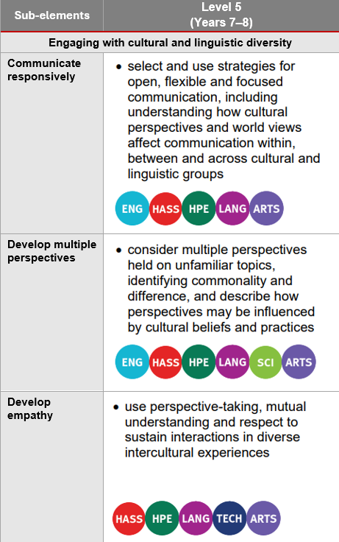
Identify curriculum: Year 7 French example
Aspect of the achievement standard | Relevant content description
They demonstrate awareness that the French language is connected with culture and identity, and that this is reflected in their own language(s), culture(s) and identity. | recognise how identity is shaped by language(s), culture(s), beliefs, attitudes and values (AC9LF8EU04)
Unit 2 — Beyond stereotypes
In this unit, students explore how stereotypes about language, culture, and identity can influence how people understand and communicate with one another. They learn simple French to describe themselves and others, and consider how choices such as using tu or vous show levels of respect and formality in French interactions. By comparing this to the Australian tendency to be informal with people of all ages, students discuss how behaviour that feels friendly in one culture might be seen as disrespectful in another. Through short French conversations, videos, and creative tasks, students challenge stereotypes about French and Australian people and reflect on how language helps express individuality and build respectful connections across cultures.
Notes:
In this unit, students are required to demonstrate their awareness that language is connected to culture and identity through comparing language choices across cultures and reflecting on how language helps express individuality.
By referring to the aspect of the Year 7 French achievement standard that is assessed, along with the aligned content description, and the learning continuum of the Intercultural understanding general capability, we can identify where there are opportunities to embed elements and sub-elements of the general capability.
Only embed the identified elements and sub-elements that are most beneficial for achieving the outcomes of the unit. Professional judgment should guide this selection.
Sources:
ACARA information in image — QCAA Planning for teaching, learning and assessment www.qcaa.qld.edu.au/downloads/aciq/general-resources/teaching/ac_plan_teach_learn_assess.pdf
Achievement standard and aligned content descriptions — QCAA Years 7–8 band French (7–10 Sequence) Australian Curriculum Version 9.0: Achievement standard aligned to content descriptions www.qcaa.qld.edu.au/downloads/aciqv9/languages/curriculum/ac9_lang_french_yr7-8_7-10_seq_as_cd_alignment.pdf
Sub-element level descriptions — QCAA General capabilities: Level 5 overview www.qcaa.qld.edu.au/downloads/aciqv9/general-resources/ac9_gc_level_5_overview.pdf

Slide 23
Identify curriculum: Year 7 French example
Aspect of the achievement standard | Relevant content description
They demonstrate awareness that the French language is connected with culture and identity, and that this is reflected in their own language(s), culture(s) and identity. | recognise how identity is shaped by language(s), culture(s), beliefs, attitudes and values (AC9LF8EU04)
Unit 2 — Beyond stereotypes
In this unit, students explore how stereotypes about language, culture, and identity can influence how people understand and communicate with one another. They learn simple French to describe themselves and others, and consider how choices such as using tu or vous show levels of respect and formality in French interactions. By comparing this to the Australian tendency to be informal with people of all ages, students discuss how behaviour that feels friendly in one culture might be seen as disrespectful in another. Through short French conversations, videos, and creative tasks, students challenge stereotypes about French and Australian people and reflect on how language helps express individuality and build respectful connections across cultures.
Notes:
There are opportunities to embed the Develop empathy sub-element within this unit, as students explore stereotypes and perspective-taking.
This general capability can also be used by the teacher to support students to develop the skills and attributes required to live in an interconnected world.
Sources:
ACARA information in image — QCAA Planning for teaching, learning and assessment www.qcaa.qld.edu.au/downloads/aciq/general-resources/teaching/ac_plan_teach_learn_assess.pdf
Achievement standard and aligned content descriptions — QCAA Years 7–8 band French (7–10 Sequence) Australian Curriculum Version 9.0: Achievement standard aligned to content descriptions www.qcaa.qld.edu.au/downloads/aciqv9/languages/curriculum/ac9_lang_french_yr7-8_7-10_seq_as_cd_alignment.pdf
Sub-element level descriptions — QCAA General capabilities: Level 5 overview www.qcaa.qld.edu.au/downloads/aciqv9/general-resources/ac9_gc_level_5_overview.pdf

Slide 24



Sequence teaching and learning
Identify curriculum
Sequence teaching and learning
Identify authentic connections
Select and sequence learning activities within planning
Incorporate learning activities that model the general capability
Provide opportunities for students to practise and receive feedback
Learning area
General capability
Aspect/s of the achievement standard
Element/s
Content description/s
Sub-element/s
Notes:
The next phase of the process relates to the deliberate selection and then sequencing of learning activities within the teacher's unit planning.
1 —The first point emphasises the intentional planning of when and how a general capability will be developed through the teaching of content descriptions, ensuring that students build the knowledge, understanding, and skills outlined in the achievement standard.
2 — While planning, teachers should identify opportunities to model the general capability. This involves explicitly explaining and demonstrating the knowledge, understanding, and skills of the capability so that students can observe it in practice.
3 — After modelling, it is important to provide students with opportunities to practise the capability through learning activities, reinforcing knowledge, skills, behaviours and dispositions. As with all learning, students should receive informal feedback on their progress in developing the general capability.
Source:
ACARA information in image — QCAA Planning for teaching, learning and assessment www.qcaa.qld.edu.au/downloads/aciq/general-resources/teaching/ac_plan_teach_learn_assess.pdf

Slide 25

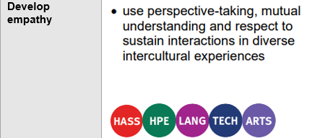
Select and sequence learning activities
Sequence teaching and learning
Select and sequence learning activities within planning
Incorporate learning activities that model the general capability
Provide opportunities for students to practise and receive feedback
Unit 2 — Beyond stereotypes
In this unit, students explore how stereotypes about language, culture, and identity can influence how people understand and communicate with one another. They learn simple French to describe themselves and others, and consider how choices such as using tu or vous show levels of respect and formality in French interactions. By comparing this to the Australian tendency to be informal with people of all ages, students discuss how behaviour that feels friendly in one culture might be seen as disrespectful in another. Through short French conversations, videos, and creative tasks, students challenge stereotypes about French and Australian people and reflect on how language helps express individuality and build respectful connections across cultures.
Where (select) are there opportunities to embed the concept of empathy into the unit?
When (sequence) should these opportunities be incorporated?
What specific learning activities and experiences could be incorporated to explicitly teach and model empathy?
Where are there opportunities for students to practise empathy?
How will students receive informal feedback about their progress?
Notes:
Referring to the previous Year 7 French example, at this stage of the suggested process, teachers would be asking questions such as:
Where are opportunities to embed the concept of empathy within the unit?
When should these opportunities be incorporated within the sequence of learning?
Sources:
ACARA information in image — QCAA Planning for teaching, learning and assessment www.qcaa.qld.edu.au/downloads/aciq/general-resources/teaching/ac_plan_teach_learn_assess.pdf
Sub-element level descriptions — QCAA General capabilities: Level 5 overview www.qcaa.qld.edu.au/downloads/aciqv9/general-resources/ac9_gc_level_5_overview.pdf

Slide 26
Select and sequence learning activities
Sequence teaching and learning
Select and sequence learning activities within planning
Incorporate learning activities that model the general capability
Provide opportunities for students to practise and receive feedback
Unit 2 — Beyond stereotypes
In this unit, students explore how stereotypes about language, culture, and identity can influence how people understand and communicate with one another. They learn simple French to describe themselves and others, and consider how choices such as using tu or vous show levels of respect and formality in French interactions. By comparing this to the Australian tendency to be informal with people of all ages, students discuss how behaviour that feels friendly in one culture might be seen as disrespectful in another. Through short French conversations, videos, and creative tasks, students challenge stereotypes about French and Australian people and reflect on how language helps express individuality and build respectful connections across cultures.
Where (select) are there opportunities to embed the concept of empathy into the unit?
When (sequence) should these opportunities be incorporated?
What specific learning activities and experiences could be incorporated to explicitly teach and model empathy?
Where are there opportunities for students to practise empathy?
How will students receive informal feedback about their progress?
Notes:
Referring to the previous Year 7 French example, at this stage of the suggested process, teachers would be asking questions such as:
What specific learning activities and experiences can be used to explicitly teach and model empathy?
Sources:
ACARA information in image — QCAA Planning for teaching, learning and assessment www.qcaa.qld.edu.au/downloads/aciq/general-resources/teaching/ac_plan_teach_learn_assess.pdf
Sub-element level descriptions — QCAA General capabilities: Level 5 overview www.qcaa.qld.edu.au/downloads/aciqv9/general-resources/ac9_gc_level_5_overview.pdf

Slide 27
Select and sequence learning activities
Sequence teaching and learning
Select and sequence learning activities within planning
Incorporate learning activities that model the general capability
Provide opportunities for students to practise and receive feedback
Unit 2 — Beyond stereotypes
In this unit, students explore how stereotypes about language, culture, and identity can influence how people understand and communicate with one another. They learn simple French to describe themselves and others, and consider how choices such as using tu or vous show levels of respect and formality in French interactions. By comparing this to the Australian tendency to be informal with people of all ages, students discuss how behaviour that feels friendly in one culture might be seen as disrespectful in another. Through short French conversations, videos, and creative tasks, students challenge stereotypes about French and Australian people and reflect on how language helps express individuality and build respectful connections across cultures.
Where (select) are there opportunities to embed the concept of empathy into the unit?
When (sequence) should these opportunities be incorporated?
What specific learning activities and experiences could be incorporated to explicitly teach and model empathy?
Where are there opportunities for students to practise empathy?
How will students receive informal feedback about their progress?
Notes:
Referring to the previous Year 7 French example, at this stage of the suggested process, teachers would be asking questions such as:
Where are there opportunities for students to practise empathy?
How will students receive informal feedback on their progress?
Sources:
ACARA information in image — QCAA Planning for teaching, learning and assessment www.qcaa.qld.edu.au/downloads/aciq/general-resources/teaching/ac_plan_teach_learn_assess.pdf
Sub-element level descriptions — QCAA General capabilities: Level 5 overview www.qcaa.qld.edu.au/downloads/aciqv9/general-resources/ac9_gc_level_5_overview.pdf

Slide 28
Outline
Identifying connections to learning area content
Embedding the capability in planning
Next steps
Understanding the Critical and creative thinking general capability

Slide 29

Next steps
Consider …
Where there are authentic opportunities for you to develop elements and sub-elements of the Intercultural understanding general capability within your learning area content.
Notes:
Consider where there are authentic opportunities to develop elements and sub-elements of the Intercultural understanding general capability within your learning area content.

Slide 30
Acknowledgments
Third-party copyright material, and QCAA material not covered by the CC BY licence is listed below:
Queensland Government coat of arms, and the QCAA and QSA trademarks may not be reproduced without permission.
Acknowledgment of Country artwork (2023) ‘Growth through Learning’ by Chern’ee, Brooke and Jesse Sutton, Kalkadoon. www.cherneesutton.com.au
The three-dimensional cube and Intercultural understanding general capability diagrams are 'Excluded Material' used under the terms of the Australian Curriculum and its copyright notice and are not modified © Australian Curriculum, Assessment and Reporting Authority (ACARA) 2009 to present, unless otherwise indicated. You may view, download, display, print, reproduce (such as by making photocopies) and distribute these Excluded Materials in unaltered form only for your personal, non-commercial educational purposes or for the non-commercial educational purposes of your organisation, provided that you make others aware it can only be used for these purposes and attribute ACARA as the source of the Excluded Material. For the avoidance of doubt, this means that you cannot edit, modify or adapt any of these materials, and you cannot sub-license any of these materials to others. Apart from any uses permitted under the Copyright Act 1968 (Cth), and those explicitly granted above, all other rights are reserved by ACARA. If you want to use such material in a manner that is outside this restrictive licence, you must request permission from ACARA by emailing (copyright@acara.edu.au) or by submitting a request through the online enquiry form.
Unless otherwise indicated, material from Australian Curriculum is © ACARA 2010–present, licensed CC BY 4.0. For the latest information and additional terms of use, see the Australian Curriculum website and its copyright notice.
Student and staff images have been used with permission.

Slide 31
Copyright notice
© State of Queensland (QCAA) 2026
Licence: https://creativecommons.org/licenses/by/4.0 | Copyright notice: www.qcaa.qld.edu.au/copyright — lists the full terms and conditions, which specify certain exceptions to the licence. | Attribution (include the link): © State of Queensland (QCAA) 2026 www.qcaa.qld.edu.au/copyright.
Other copyright material in this presentation is listed on the previous slide/s.

