Slide 1
P–10 Embedding the Ethical understanding general capability in planning: Australian Curriculum v9.0
251536
Notes:
This resource reproduces key slides to support teachers to embed the Ethical understanding general capability in planning.
For more resources see the Australian Curriculum v9.0 in Queensland page www.qcaa.qld.edu.au/p-10/aciq/version-9/general-capabilities/advice-and-resources.

Slide 2
Success criteria
Learning goal
To develop a deeper understanding of the Australian Curriculum v9.0 Ethical understanding general capability.
You will know you are successful if you:
understand the structure and content of the Ethical understanding general capability
identify strategies to embed this general capability
use QCAA resources to inform and support planning.
Notes:
Note: General capability is sometimes referred to as GC.

Slide 3
Outline
Identifying connections to learning area content
Embedding the capability in planning
Next steps
Understanding the Ethical understanding general capability

Slide 4
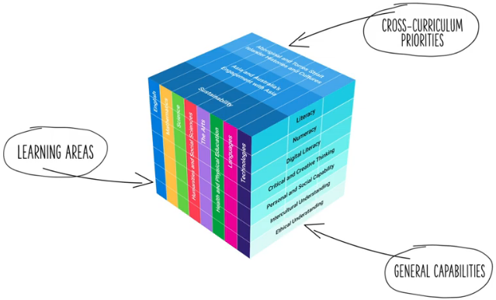
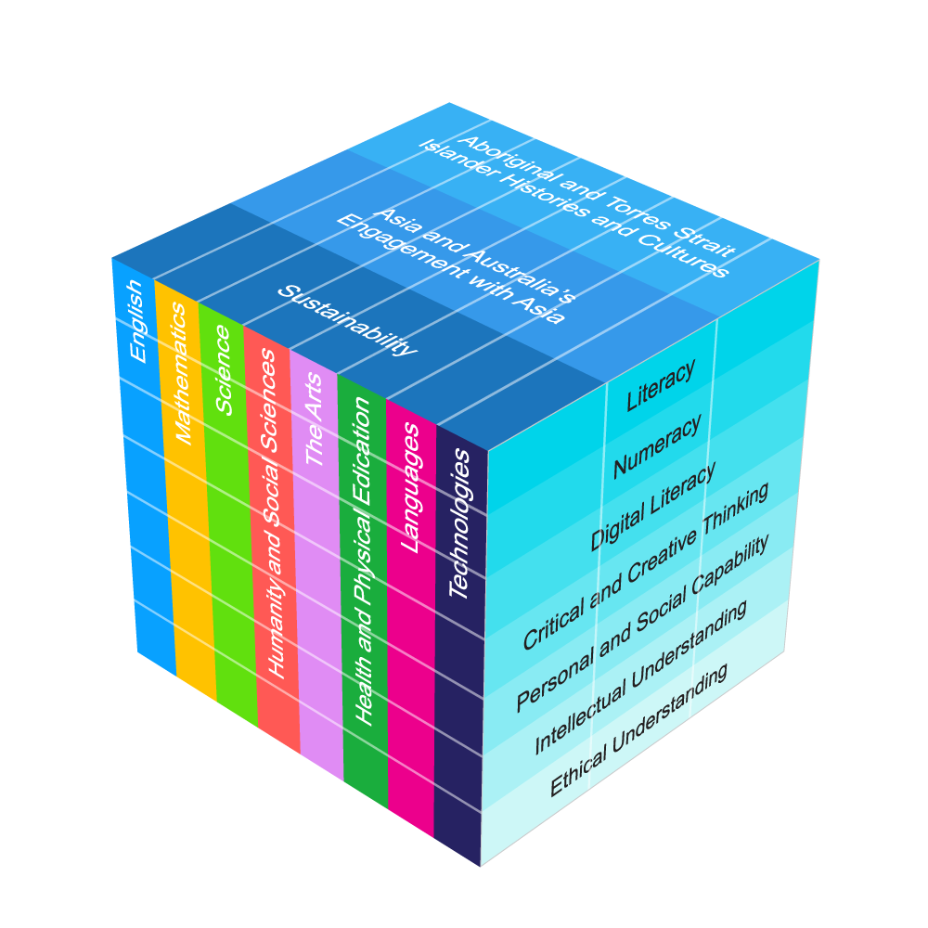
Three-dimensional Australian Curriculum v9.0
Notes:
The Australian Curriculum has a three-dimensional design to recognise that learning extends beyond subjects, with students requiring a set of knowledge, skills, behaviours, competencies and dispositions to equip them to become confident, lifelong learners in a complex, global environment.
While the learning areas are the foundation of the Australian Curriculum (ACARA video), the teaching of learning area content is strengthened by the application of relevant general capabilities, which should be embedded within learning area content where most authentic and appropriate.
When teachers intentionally connect and teach the general capabilities through curriculum content, both content and skills are deepened.
Source:
[v9] ACARA image from Summary overview (video) https://v9.australiancurriculum.edu.au/help/website-tour

Slide 5
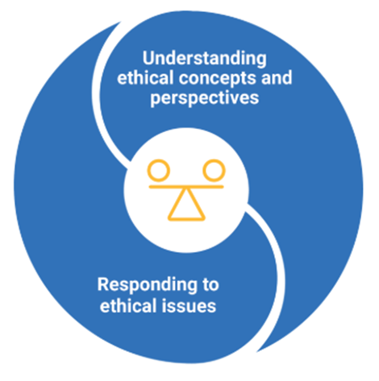
Ethical understanding capability: Structure
Source: ACARA general capability diagram & sub-elements https://www.australiancurriculum.edu.au/curriculum-information/understand-this-general-capability/ethical-understanding
Notes:
This diagram, developed by ACARA, represents the structure of the Ethical understanding general capability.
It illustrates two distinct sections, known as elements.
Each general capability includes its own diagram, outlining the specific elements within that capability.
Sources:
ACARA general capability diagram and sub-element names www.australiancurriculum.edu.au/f-10-curriculum/general-capabilities/ethical-understanding?element=0&sub-element=EUUNDA
The Shape of the Australian Curriculum Version 5.0 p. 17 www.acara.edu.au/docs/default-source/curriculum/the_shape_of_the_australian_curriculum_version5_for-website.pdf

Slide 6

Ethical understanding capability: Structure
Explore ethical concepts
Examine values, rights and
responsibilities, and ethical norms
Recognise influences on ethical
behaviour and perspectives
Explore ethical perspectives and frameworks
Explore ethical issues
Make and reflect on ethical decisions
Source: ACARA general capability diagram & sub-elements https://www.australiancurriculum.edu.au/curriculum-information/understand-this-general-capability/ethical-understanding
Notes:
Each element is broken into sub-elements (shown in light blue).
Together, the elements and sub-elements guide teachers to plan opportunities for students to recognise what is right and wrong, see different points of view, and think ethically when faced with real-world situations.
Sources:
ACARA general capability diagram and sub-element names www.australiancurriculum.edu.au/f-10-curriculum/general-capabilities/ethical-understanding?element=0&sub-element=EUUNDA
The Shape of the Australian Curriculum Version 5.0 p. 17 www.acara.edu.au/docs/default-source/curriculum/the_shape_of_the_australian_curriculum_version5_for-website.pdf

Slide 7
Ethical understanding general capability: Structure
Explore ethical concepts
Sub-element description: Supports students to identify and examine ethical concepts. They discuss and examine the dimensions of ethical concepts and how they relate to the actions we take in a range of situations.
Explore ethical perspectives and frameworks
Explore ethical issues
Make and reflect on ethical decisions
Source: ACARA general capability diagram & sub-elements: https://www.australiancurriculum.edu.au/curriculum-information/understand-this-general-capability/ethical-understanding
Notes:
Each sub-element includes a description to support a shared understanding of what it might look like in practice.
Some general capabilities align more closely with particular learning areas and subjects. For example, the Ethical understanding capability has a strong connection with Humanities and Social Sciences (HASS).
Source:
ACARA general capability diagram and sub-element names https://www.australiancurriculum.edu.au/curriculum-information/understand-this-general-capability/ethical-understanding

Slide 8
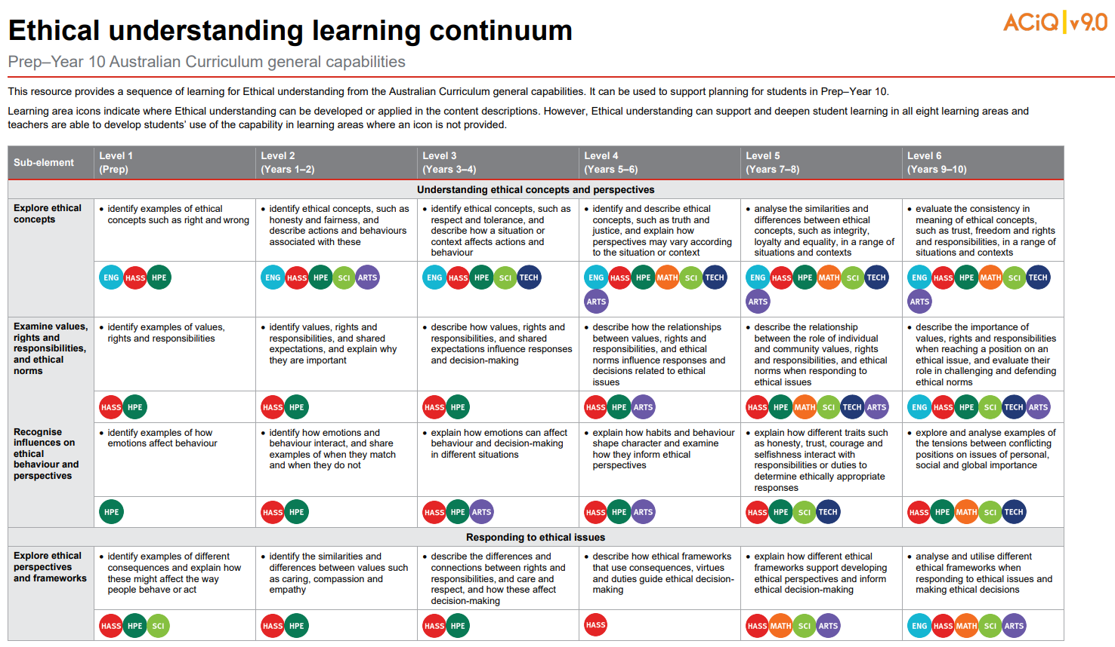

Learning continuum
Source: QCAA Ethical understanding learning continuum: https://www.qcaa.qld.edu.au/downloads/aciqv9/general-resources/ac9_gc_ethical_understanding_learning_continuum.pdf
Notes:
ACARA has developed continua for the general capabilities that describe the knowledge, skills, behaviours and dispositions that students typically will have developed at particular stages of schooling.
The QCAA has reformatted these learning continua for each general capability, adding coloured symbols that highlight the learning areas where the general capabilities can be developed in the content descriptions in authentic and meaningful ways.
The Ethical understanding capability learning continuum outlines developmental progress from Level 1 through to Level 6.
Source:
QCAA Ethical understanding learning continuum www.qcaa.qld.edu.au/downloads/aciqv9/general-resources/ac9_gc_ethical_understanding_learning_continuum.pdf

Slide 9
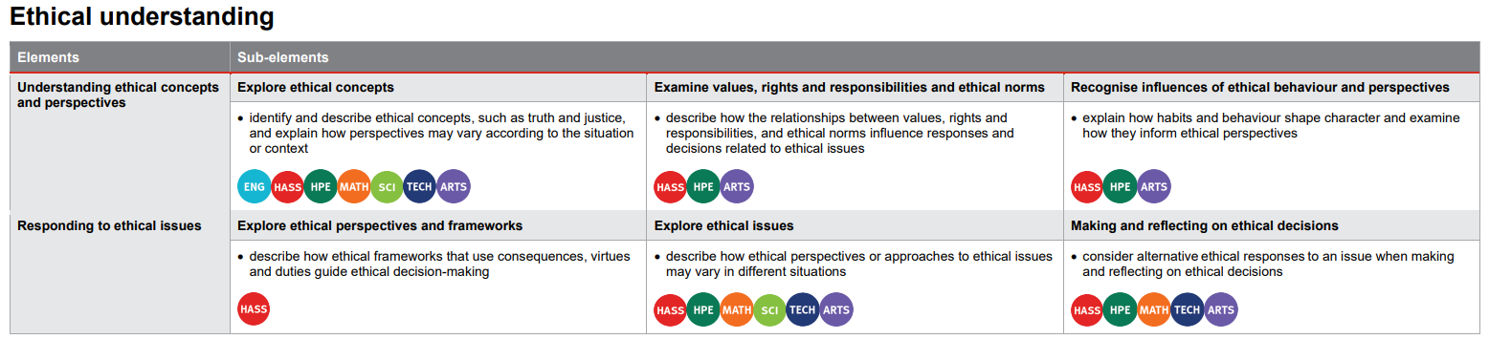
Level overviews
Source: QCAA General capabilities Level 4 overview: https://www.qcaa.qld.edu.au/downloads/aciqv9/general-resources/ac9_gc_level_4_overview.pdf
Notes:
The QCAA has also developed overviews for each level of the capability.
The elements are displayed alongside their sub-elements, making it easier to identify the specific knowledge and skills to be developed at each level.
Coloured learning area symbols are again used to show where the general capability can be developed or applied in the content descriptions.
Source:
QCAA General capabilities: Level 4 overview www.qcaa.qld.edu.au/downloads/aciqv9/general-resources/ac9_gc_level_4_overview.pdf

Slide 10
Outline
Identifying connections to learning area content
Embedding the capability in planning
Next steps
Understanding the Ethical understanding general capability

Slide 11
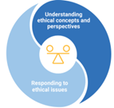
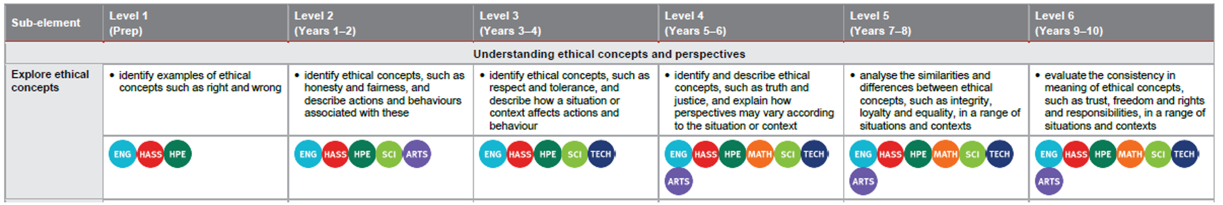

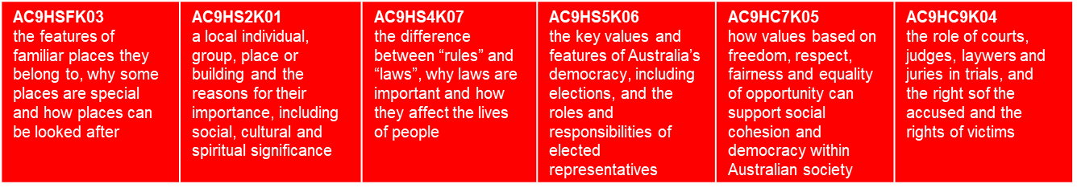

Identifying connections to learning area content
Explore ethical concepts
Sub-element description: Supports students to identify and examine ethical concepts. They discuss and examine the dimensions of ethical concepts and how they relate to the actions we take in a range of situations.
Learning continuum
Notes:
General capabilities are integrated through learning area content rather than being taught separately as standalone skills.
In the example on screen from the Understanding ethical concepts and perspectives element, the Explore ethical concepts sub-element is used to illustrate alignment with the HASS learning area.
The Level 1 description indicates that students should be able to identify examples of ethical concepts such as right and wrong.
This aligns with the Prep content description (AC9HSFK03) where students may consider right and wrong ways that places can be looked after.
Sources:
ACARA general capability diagram, sub-element & description www.australiancurriculum.edu.au/curriculum-information/understand-this-general-capability/ethical-understanding
QCAA Personal and social learning continuum www.qcaa.qld.edu.au/downloads/aciqv9/general-resources/ac9_gc_ethical_understanding_learning_continuum.pdf

Slide 12


Identifying connections to learning area content
Explore ethical concepts
Sub-element description: Supports students to identify and examine ethical concepts. They discuss and examine the dimensions of ethical concepts and how they relate to the actions we take in a range of situations.
Learning continuum
Notes:
Similar alignment is evident across the bands in HASS.
General capabilities should be embedded only where appropriate, based on authentic opportunities within the content.
Sources:
ACARA general capability diagram, sub-element & description www.australiancurriculum.edu.au/curriculum-information/understand-this-general-capability/ethical-understanding
QCAA Personal and social learning continuum www.qcaa.qld.edu.au/downloads/aciqv9/general-resources/ac9_gc_ethical_understanding_learning_continuum.pdf

Slide 13
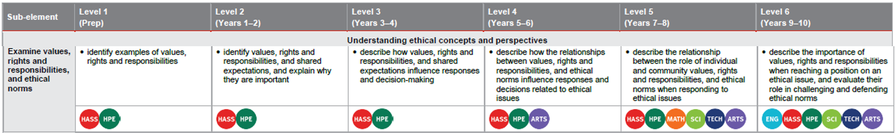
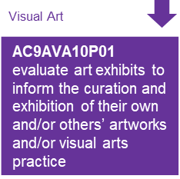
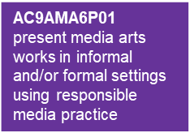
Identifying connections to learning area content
Examine values, rights and responsibilities and ethical norms
Sub-element description: Supports students to understand the role that values, rights and responsibilities and norms have in ethical decisions. They consider how a range of values relate to established norms of ethical behaviour
Learning continuum
Media Arts
Notes:
This example is also drawn from the Understanding ethical concepts and perspectives element.
The learning continuum highlights how the Examine values, rights and responsibilities and ethical norms sub-element is authentically embedded into The Arts learning area in Years 5–6 and Years 9–10.
The Years 5–6 Media Arts content description (AC9AMA6P01) expects students to present media arts works in informal and/or formal settings using responsible media practice.
The Level 4 description states that students are expected to describe how […] ethical norms influence responses and decisions related to ethical issues, illustrating a link between the sub-element and the learning area content where students learn how values and responsibilities guide ethical choices. Students apply this understanding by using respectful and responsible practices when creating and sharing media.
Similar context-specific connections are evident in Level 6.
These opportunities support the development of the sub-element through the learning area content of The Arts.
Source:
ACARA general capability diagram, sub-element & description www.australiancurriculum.edu.au/curriculum-information/understand-this-general-capability/ethical-understanding

Slide 14
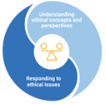
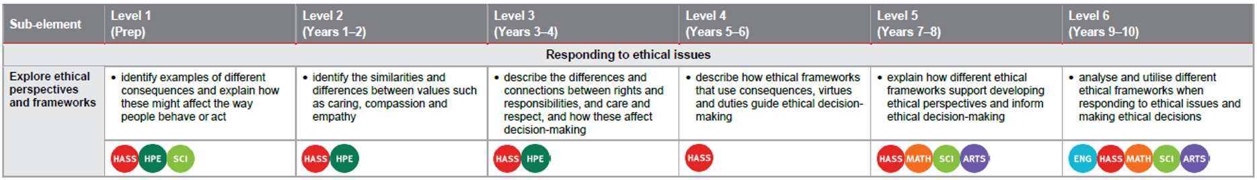
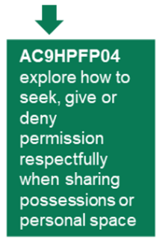
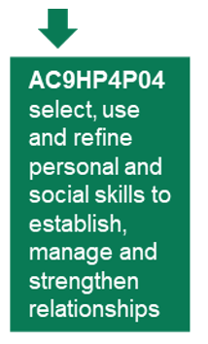
Identifying connections to learning area content
Explore ethical perspectives and frameworks
Sub-element description: Supports students to explore the factors that influence emotions in themselves and in others, and how emotional responses affect behaviour in a range of contexts.
Learning continuum
Notes:
This example, drawn from the Responding to ethical issues element, highlights how ethical perspectives and frameworks can be authentically embedded in HPE in Prep and Years 3–4.
The HPE content descriptions (AC9HPFP04 and AC9HP4P04) and Explore ethical perspectives and frameworks level descriptions show opportunities to develop the attribute while at the same time, strengthening the learning area content.
This reinforces that general capabilities can be purposefully integrated within learning area content wherever authentic and meaningful connections exist.
Source:
ACARA general capability diagram, sub-element & description www.australiancurriculum.edu.au/curriculum-information/understand-this-general-capability/ethical-understanding

Slide 15
Outline
Identifying connections to learning area content
Embedding the capability in planning
Next steps
Understanding the Ethical understanding general capability

Slide 16
An approach for embedding the capability in planning
Identify curriculum
Sequence teaching and learning
Identify authentic connections
Select and sequence learning activities within planning
Incorporate learning activities that model the general capability
Provide opportunities for students to practise and receive feedback
Learning area
General capability
Aspect/s of the achievement standard
Element/s
Content description/s
Sub-element/s
Notes:
This is one approach to embedding the Ethical understanding general capability within curriculum planning.
The process draws on guidance from the QCAA Elements for effective planning, which provides support for the planning of teaching, learning, and assessment.
Source:
ACARA information in image — QCAA Planning for teaching, learning and assessment www.qcaa.qld.edu.au/downloads/aciq/general-resources/teaching/ac_plan_teach_learn_assess.pdf

Slide 17
Identify curriculum
Identify curriculum
Sequence teaching and learning
Identify authentic connections
Select and sequence learning activities within planning
Incorporate learning activities that model the general capability
Provide opportunities for students to practise and receive feedback
Learning area
General capability
Aspect/s of the achievement standard
Element/s
Content description/s
Sub-element/s
Notes:
Once the curriculum elements have been identified, teachers can use the Australian Curriculum website and/or QCAA resources to identify the elements and sub-elements of the relevant general capabilities that can be purposefully embedded to strengthen student learning.
Source:
ACARA information in image — QCAA Planning for teaching, learning and assessment www.qcaa.qld.edu.au/downloads/aciq/general-resources/teaching/ac_plan_teach_learn_assess.pdf

Slide 18
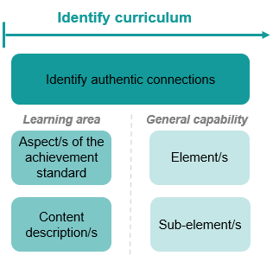
Identify curriculum: Years 4 HASS example
Aspect of the achievement standard | Relevant content descriptions
They describe the importance and role of local government, community members and laws, and the cultural and social factors that shape identity. | the difference between “rules” and “laws”, why laws are important how they affect the lives of people (Civics and Citizenship) (AC9HS4K07)
 | the roles of local government and how members of the community use and contribute to local services (Civics and Citizenship) (AC9HS4K08)
 | diversity of cultural, religious and/or social groups to which they and others in the community belong, and their importance to identity (Civics and Citizenship) (AC9HS4K09)
Unit 1 — Me and my community
Students reflect on how their identity is shaped by their connections, culture and shared experiences. The class collaboratively develops a list of factors that may shape a person’s identity and identify the diversity of cultural, religious and/or social groups in their own community. Students describe the groups they belong to that contribute to shaping their identity (e.g. family, school groups, community groups). They also examine the role of rules, laws, First Nations Lore and other cultural guiding systems in supporting fair, safe and respectful communities. Students locate and collect information to create a storyboard showing themselves as part of their community.
Notes:
A Year 4 HASS example will be used to illustrate the Identify curriculum phase of the process.
The relevant aspect of the achievement standard, along with the aligned content descriptions, has informed the context and focus of the example unit, Me and my community.
Connections to the Ethical understanding general capability may be identified by reviewing the unit description.
Sources:
ACARA information in image — QCAA Planning for teaching, learning and assessment www.qcaa.qld.edu.au/downloads/aciq/general-resources/teaching/ac_plan_teach_learn_assess.pdf
Achievement standard and aligned content descriptions — QCAA Year 4 HASS Australian Curriculum Version 9.0: Achievement standard aligned to content descriptions www.qcaa.qld.edu.au/downloads/aciqv9/humanities-and-social-sciences/curriculum/ac9_hass_yr4_as_cd_alignment.pdf

Slide 19
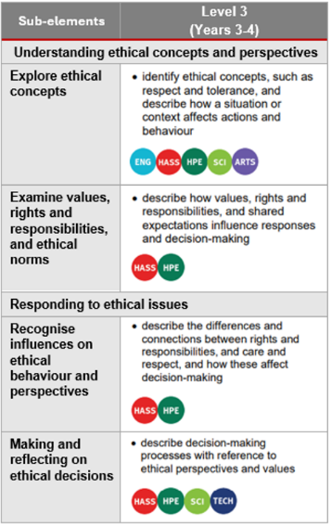
Identify curriculum: Years 4 HASS example
Aspect of the achievement standard | Relevant content descriptions
They describe the importance and role of local government, community members and laws, and the cultural and social factors that shape identity. | the difference between “rules” and “laws”, why laws are important how they affect the lives of people (Civics and Citizenship) (AC9HS4K07)
 | the roles of local government and how members of the community use and contribute to local services (Civics and Citizenship) (AC9HS4K08)
 | diversity of cultural, religious and/or social groups to which they and others in the community belong, and their importance to identity (Civics and Citizenship) (AC9HS4K09)
Unit 1 — Me and my community
Students reflect on how their identity is shaped by their connections, culture and shared experiences. The class collaboratively develops a list of factors that may shape a person’s identity and identify the diversity of cultural, religious and/or social groups in their own community. Students describe the groups they belong to that contribute to shaping their identity (e.g. family, school groups, community groups). They also examine the role of rules, laws, First Nations Lore and other cultural guiding systems in supporting fair, safe and respectful communities. Students locate and collect information to create a storyboard showing themselves as part of their community.
Notes:
In this unit, students are required to ‘identify the diversity of cultural, religious and/or social groups in their own community and examine the role of rules, laws, First Nations Lore and other cultural guiding systems in supporting fair, safe and respectful communities’.
By referring to the aspect of the Year 4 HASS achievement standard that is assessed, along with the aligned content descriptions, and the learning continuum of the Ethical understanding general capability, we can identify where there are opportunities to embed elements and sub-elements of the general capability.
Only embed the identified elements and sub-elements that are most beneficial for achieving the outcomes of the unit. Professional judgment should guide this selection.
Sources:
ACARA information in image — QCAA Planning for teaching, learning and assessment www.qcaa.qld.edu.au/downloads/aciq/general-resources/teaching/ac_plan_teach_learn_assess.pdf
Achievement standard and aligned content descriptions — QCAA Year 4 HASS Australian Curriculum Version 9.0: Achievement standard aligned to content descriptions www.qcaa.qld.edu.au/downloads/aciqv9/humanities-and-social-sciences/curriculum/ac9_hass_yr4_as_cd_alignment.pdf
Sub-element level descriptions — QCAA General capabilities: Level 3 overview www.qcaa.qld.edu.au/downloads/aciqv9/general-resources/ac9_gc_level_3_overview.pdf

Slide 20
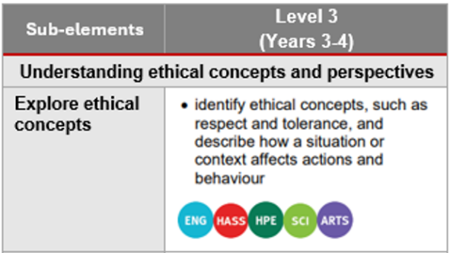
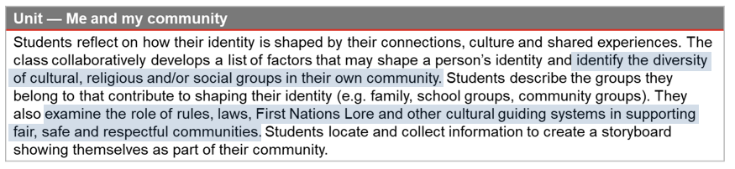
Identify curriculum: Years 4 HASS example
Notes:
In this example, the Explore ethical concepts and perspectives sub-element has been selected as it provides opportunities to explicitly teach guiding systems (rules, laws, and Lore) and support respectful communities, requiring students to identify core concepts like respect.
The sub-element is also evident where students investigate factors shaping identity, specifically when they identify the diversity of cultural, religious and/or social groups in their community.
Recognising and discussing this diversity necessitates engaging with the ethical concept of tolerance, which students at Level 3 are to identify.
Sources:
ACARA information in image — QCAA Planning for teaching, learning and assessment www.qcaa.qld.edu.au/downloads/aciq/general-resources/teaching/ac_plan_teach_learn_assess.pdf
Achievement standard and aligned content descriptions — QCAA Year 4 HASS Australian Curriculum Version 9.0: Achievement standard aligned to content descriptions www.qcaa.qld.edu.au/downloads/aciqv9/humanities-and-social-sciences/curriculum/ac9_hass_yr4_as_cd_alignment.pdf
Sub-element level descriptions — QCAA General capabilities: Level 3 overview www.qcaa.qld.edu.au/downloads/aciqv9/general-resources/ac9_gc_level_3_overview.pdf

Slide 21
Identify curriculum: Years 7–8 HPE example
Aspect of the achievement standard | Relevant content descriptions
They analyse how stereotypes, respect, empathy and valuing diversity influence relationships | examine how roles, decision-making, and levels of power, coercion and control within relationships can be influenced by gender stereotypes (AC9HP8P03)
 | examine the roles of respect, empathy, power and coercion in developing respectful relationships (AC9HP8P04)
 | investigate strategies that influence how communities value diversity and propose actions they can take to promote inclusion in their communities (AC9HP8P05)
Unit 1 — Breaking down barriers
In this unit, students develop an understanding of assumptions and stereotypes and learn how to promote inclusion in their communities. They analyse social and cultural values related to race, gender, disability and sexuality to develop strategies for addressing disrespectful behaviours. Through case studies, students examine how respectful values and beliefs influence the health and wellbeing of others. They explore how international games, such as Olympic and Paralympic games, and local games, such as traditional Aboriginal games promote fairness, cooperation and inclusivity. Working collaboratively, students adapt movement skills, rules and equipment to design a game that supports inclusive participation and enhances wellbeing.
Notes:
This example shows the process for Years 7–8 HPE.
The relevant aspect of the achievement standard, together with the aligned content descriptions, has informed the context and focus of the unit, Breaking down barriers.
Connections to the Ethical understanding general capability may be identified by reviewing the unit description.
Sources:
ACARA information in image — QCAA Planning for teaching, learning and assessment www.qcaa.qld.edu.au/downloads/aciq/general-resources/teaching/ac_plan_teach_learn_assess.pdf
Achievement standard and aligned content descriptions — QCAA Years 7-8 band Health and Physical Education Australian Curriculum Version 9.0: Achievement standard aligned to content descriptions www.qcaa.qld.edu.au/downloads/aciqv9/health-and-physical-education/curriculum/ac9_hpe_yr7-8_as_cd_alignment.pdf

Slide 22
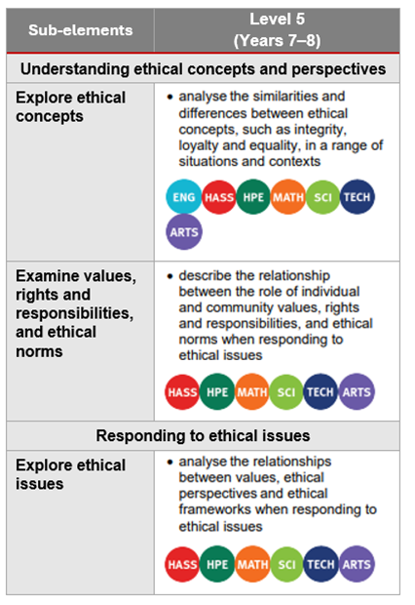
Identify curriculum: Years 7–8 HPE example
Unit 1 — Breaking down barriers
In this unit, students develop an understanding of assumptions and stereotypes and learn how to promote inclusion in their communities. They analyse social and cultural values related to race, gender, disability and sexuality to develop strategies for addressing disrespectful behaviours. Through case studies, students examine how respectful values and beliefs influence the health and wellbeing of others. They explore how international games, such as Olympic and Paralympic games, and local games, such as traditional Aboriginal games promote fairness, cooperation and inclusivity. Working collaboratively, students adapt movement skills, rules and equipment to design a game that supports inclusive participation and enhances wellbeing.
Notes:
In this unit, students are required to analyse how stereotypes, respect, empathy and valuing diversity influence relationships and select, use and refine strategies to support inclusion across a range of movement contexts.
By referring to the aspect of the Years 7–8 HPE achievement standard that is assessed, along with the aligned content descriptions, and the learning continuum of the Ethical understanding general capability, we can identify where there are opportunities to embed elements and sub-elements of the general capability.
Only embed the identified elements and sub-elements that are most beneficial for achieving the outcomes of the unit. Professional judgment should guide this selection.
Sources:
ACARA information in image — QCAA Planning for teaching, learning and assessment www.qcaa.qld.edu.au/downloads/aciq/general-resources/teaching/ac_plan_teach_learn_assess.pdf
Achievement standard and aligned content descriptions — QCAA Years 7-8 band Health and Physical Education Australian Curriculum Version 9.0: Achievement standard aligned to content descriptions www.qcaa.qld.edu.au/downloads/aciqv9/health-and-physical-education/curriculum/ac9_hpe_yr7-8_as_cd_alignment.pdf
Sub-element level descriptions — QCAA General capabilities: Level 5 overview www.qcaa.qld.edu.au/downloads/aciqv9/general-resources/ac9_gc_level_5_overview.pdf

Slide 23

Identify curriculum: Years 7–8 HPE example
Unit 1 — Breaking down barriers
In this unit, students develop an understanding of assumptions and stereotypes and learn how to promote inclusion in their communities. They analyse social and cultural values related to race, gender, disability and sexuality to develop strategies for addressing disrespectful behaviours. Through case studies, students examine how respectful values and beliefs influence the health and wellbeing of others. They explore how international games, such as Olympic and Paralympic games, and local games, such as traditional Aboriginal games promote fairness, cooperation and inclusivity. Working collaboratively, students adapt movement skills, rules and equipment to design a game that supports inclusive participation and enhances wellbeing.
Notes:
There are opportunities to embed the Explore ethical issues sub-element within this unit.
This sub-element can be explicitly addressed through the analysis of values and is immediately followed by a required response (developing strategies) to an ethical context.
After analysing discriminatory values, students develop strategies for addressing disrespectful behaviours.
This allows students to develop and practise the skills of applying their understanding of ethical concepts, values and perspective to HPE-related ethical contexts.
Sources:
ACARA information in image — QCAA Planning for teaching, learning and assessment www.qcaa.qld.edu.au/downloads/aciq/general-resources/teaching/ac_plan_teach_learn_assess.pdf
Achievement standard and aligned content descriptions — QCAA Years 7-8 band Health and Physical Education Australian Curriculum Version 9.0: Achievement standard aligned to content descriptions www.qcaa.qld.edu.au/downloads/aciqv9/health-and-physical-education/curriculum/ac9_hpe_yr7-8_as_cd_alignment.pdf
Sub-element level descriptions — QCAA General capabilities: Level 5 overview www.qcaa.qld.edu.au/downloads/aciqv9/general-resources/ac9_gc_level_5_overview.pdf

Slide 24



Sequence teaching and learning
Identify curriculum
Sequence teaching and learning
Identify authentic connections
Select and sequence learning activities within planning
Incorporate learning activities that model the general capability
Provide opportunities for students to practise and receive feedback
Learning area
General capability
Aspect/s of the achievement standard
Element/s
Content description/s
Sub-element/s
Notes:
The next phase of the process relates to the deliberate selection and then sequencing of learning activities within the teacher's unit planning.
1 — The first point emphasises the intentional planning of when and how a general capability will be developed through the teaching of content descriptions, ensuring that students build the knowledge, understanding, and skills outlined in the achievement standard.
2 — While planning, teachers should identify opportunities to model the general capability. This involves explicitly explaining and demonstrating the knowledge, understanding, and skills of the capability so that students can observe it in practice.
3 — After modelling, it is important to provide students with opportunities to practise the capability through learning activities, reinforcing knowledge, skills, behaviours and dispositions. As with all learning, students should receive informal feedback on their progress in developing the general capability.
Source:
ACARA information in image — QCAA Planning for teaching, learning and assessment www.qcaa.qld.edu.au/downloads/aciq/general-resources/teaching/ac_plan_teach_learn_assess.pdf

Slide 25
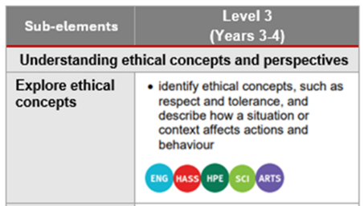
Select and sequence learning activities
Sequence teaching and learning
Select and sequence learning activities within planning
Incorporate learning activities that model the general capability
Provide opportunities for students to practise and receive feedback
Unit 1 — Me and my community
Students reflect on how their identity is shaped by their connections, culture and shared experiences. The class collaboratively develops a list of factors that may shape a person’s identity and identify the diversity of cultural, religious and/or social groups in their own community. Students describe the groups they belong to that contribute to shaping their identity (e.g. family, school groups, community groups). They also examine the role of rules, laws, First Nations Lore and other cultural guiding systems in supporting fair, safe and respectful communities. Students locate and collect information to create a storyboard showing themselves as part of their community.
Where (select) are there opportunities to embed explore ethical concepts into the unit?
When (sequence) should these opportunities be incorporated?
What specific learning activities and experiences could be incorporated to explicitly teach and model ethical concepts?
Where are there opportunities for students to practise ethical concepts?
How will students receive informal feedback about their progress?
Notes:
Referring to the previous Year 4 HASS example, at this stage of the suggested process, teachers would be asking questions such as:
Where are opportunities to embed explore ethical concepts within the unit?
When should these opportunities be incorporated within the sequence of learning?
Sources:
ACARA information in image — QCAA Planning for teaching, learning and assessment www.qcaa.qld.edu.au/downloads/aciq/general-resources/teaching/ac_plan_teach_learn_assess.pdf
Sub-element level descriptions — QCAA General capabilities: Level 3 overview www.qcaa.qld.edu.au/downloads/aciqv9/general-resources/ac9_gc_level_3_overview.pdf

Slide 26
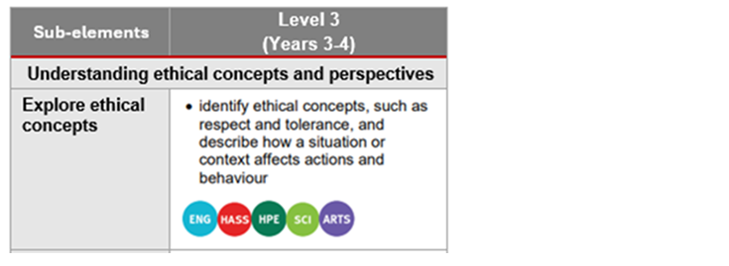
Incorporate learning activities, practice and feedback
Sequence teaching and learning
Select and sequence learning activities within planning
Incorporate learning activities that model the general capability
Provide opportunities for students to practise and receive feedback
Unit 1 — Me and my community
Students reflect on how their identity is shaped by their connections, culture and shared experiences. The class collaboratively develops a list of factors that may shape a person’s identity and identify the diversity of cultural, religious and/or social groups in their own community. Students describe the groups they belong to that contribute to shaping their identity (e.g. family, school groups, community groups). They also examine the role of rules, laws, First Nations Lore and other cultural guiding systems in supporting fair, safe and respectful communities. Students locate and collect information to create a storyboard showing themselves as part of their community.
Where (select) are there opportunities to embed explore ethical concepts into the unit?
When (sequence) should these opportunities be incorporated?
What specific learning activities and experiences could be incorporated to explicitly teach and model ethical concepts?
Where are there opportunities for students to practise ethical concepts?
How will students receive informal feedback about their progress?
Notes:
Referring back to the previous Year 4 HASS example, at this stage of the suggested process, teachers would be asking questions such as:
What specific learning activities and experiences can be used to explicitly teach and model ethical concepts, e.g. respect and tolerance?
Sources:
ACARA information in image — QCAA Planning for teaching, learning and assessment www.qcaa.qld.edu.au/downloads/aciq/general-resources/teaching/ac_plan_teach_learn_assess.pdf
Sub-element level descriptions — QCAA General capabilities: Level 3 overview www.qcaa.qld.edu.au/downloads/aciqv9/general-resources/ac9_gc_level_3_overview.pdf

Slide 27
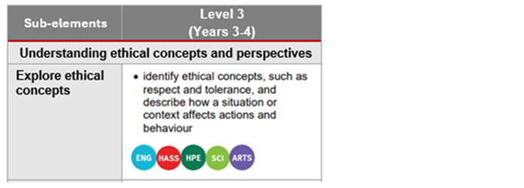
Incorporate learning activities, practice and feedback
Sequence teaching and learning
Select and sequence learning activities within planning
Incorporate learning activities that model the general capability
Provide opportunities for students to practise and receive feedback
Unit 1 — Me and my community
Students reflect on how their identity is shaped by their connections, culture and shared experiences. The class collaboratively develops a list of factors that may shape a person’s identity and identify the diversity of cultural, religious and/or social groups in their own community. Students describe the groups they belong to that contribute to shaping their identity (e.g. family, school groups, community groups). They also examine the role of rules, laws, First Nations Lore and other cultural guiding systems in supporting fair, safe and respectful communities. Students locate and collect information to create a storyboard showing themselves as part of their community.
Where (select) are there opportunities to embed explore ethical concepts into the unit?
When (sequence) should these opportunities be incorporated?
What specific learning activities and experiences could be incorporated to explicitly teach and model ethical concepts?
Where are there opportunities for students to practise ethical concepts?
How will students receive informal feedback about their progress?
Notes:
Referring to the previous Year 4 HASS example, at this stage of the suggested process, teachers would be asking questions such as:
Where can students practise ethical concepts (e.g. respect and tolerance) effectively?
How will students receive informal feedback on their progress in developing ethical concept skills?
Sources:
ACARA information in image — QCAA Planning for teaching, learning and assessment www.qcaa.qld.edu.au/downloads/aciq/general-resources/teaching/ac_plan_teach_learn_assess.pdf
Sub-element level descriptions — QCAA General capabilities: Level 3 overview www.qcaa.qld.edu.au/downloads/aciqv9/general-resources/ac9_gc_level_3_overview.pdf

Slide 28
Outline
Identifying connections to learning area content
Embedding the capability in planning
Next steps
Understanding the Ethical understanding general capability

Slide 29

Next steps
Consider …
Where there are authentic opportunities for you to develop elements and sub-elements of the Ethical understanding general capability within your learning area content.
Notes:
Consider where there are authentic opportunities to develop elements and sub-elements of the Ethical understanding capability within your learning area content.

Slide 30
Acknowledgments
Third-party copyright material, and QCAA material not covered by the CC BY licence is listed below:
Queensland Government coat of arms, and the QCAA and QSA trademarks may not be reproduced without permission.
Acknowledgment of Country artwork (2023) ‘Growth through Learning’ by Chern’ee, Brooke and Jesse Sutton, Kalkadoon. www.cherneesutton.com.au
The three-dimensional cube and Personal and social capability diagrams are 'Excluded Material' used under the terms of the Australian Curriculum and its copyright notice and are not modified © Australian Curriculum, Assessment and Reporting Authority (ACARA) 2009 to present, unless otherwise indicated. You may view, download, display, print, reproduce (such as by making photocopies) and distribute these Excluded Materials in unaltered form only for your personal, non-commercial educational purposes or for the non-commercial educational purposes of your organisation, provided that you make others aware it can only be used for these purposes and attribute ACARA as the source of the Excluded Material. For the avoidance of doubt, this means that you cannot edit, modify or adapt any of these materials, and you cannot sub-license any of these materials to others. Apart from any uses permitted under the Copyright Act 1968 (Cth), and those explicitly granted above, all other rights are reserved by ACARA. If you want to use such material in a manner that is outside this restrictive licence, you must request permission from ACARA by emailing (copyright@acara.edu.au) or by submitting a request through the online enquiry form.
Unless otherwise indicated, material from Australian Curriculum is © ACARA 2010–present, licensed CC BY 4.0. For the latest information and additional terms of use, see the Australian Curriculum website and its copyright notice.
Student and staff images have been used with permission.

Slide 31
Copyright notice
© State of Queensland (QCAA) 2026
Licence: https://creativecommons.org/licenses/by/4.0 | Copyright notice: www.qcaa.qld.edu.au/copyright — lists the full terms and conditions, which specify certain exceptions to the licence. | Attribution (include the link): © State of Queensland (QCAA) 2026 www.qcaa.qld.edu.au/copyright.
Other copyright material in this presentation is listed on the previous slide/s.

