Slide 1
P–10 Embedding the Digital literacy general capability in planning: Australian Curriculum v9.0
260094
Notes:
This resource reproduces key slides to support teachers to embed the Digital literacy general capability in planning.
For more resources see the Australian Curriculum v9.0 in Queensland page www.qcaa.qld.edu.au/p-10/aciq/version-9/general-capabilities/advice-and-resources

Slide 2
Success criteria
Learning goal
To develop a deeper understanding of the Australian Curriculum v9.0 Digital literacy general capability.
You will know you are
successful if you:
understand the structure
and content of the Digital literacy general capability
identify strategies to embed
this general capability
use QCAA resources to
inform and support planning.
Notes:
Note: General capability is sometimes referred to as GC.

Slide 3
Outline
Identifying connections to learning area content
Embedding the capability in planning
Next steps
Understanding the Digital literacy general capability

Slide 4
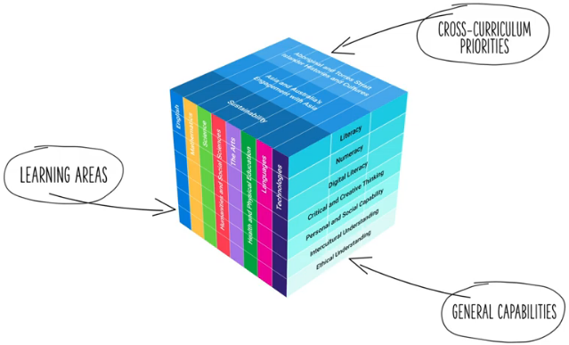
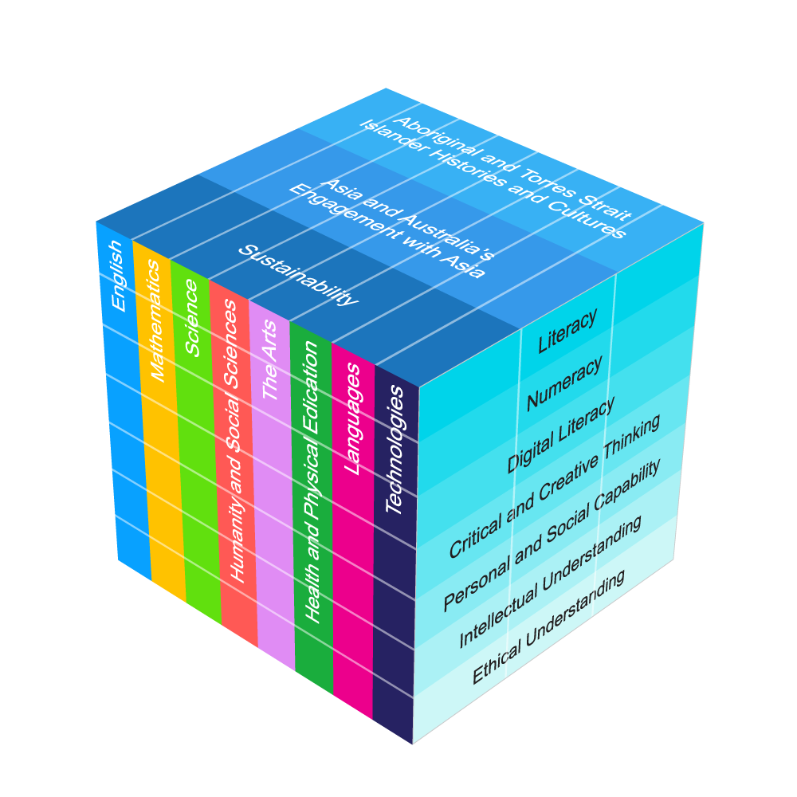
Three-dimensional Australian Curriculum v9.0
Notes:
The Australian Curriculum has a three-dimensional design to recognise that learning extends beyond subjects, with students requiring a set of knowledge, skills, behaviours, competencies and dispositions to equip them to become confident, lifelong learners in a complex, global environment.
While the learning areas are the foundation of the Australian Curriculum (ACARA video), the teaching of learning area content is strengthened by the application of relevant general capabilities, which should be embedded within learning area content where most authentic and appropriate.
When teachers intentionally connect and teach the general capabilities through curriculum content, both content and skills are deepened.
Source:
[v9] ACARA image from Summary overview (video) https://v9.australiancurriculum.edu.au/help/website-tour

Slide 5
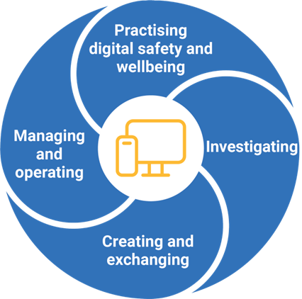
Digital literacy general capability: Structure
Source: ACARA general capability image: https://www.australiancurriculum.edu.au/curriculum-information/understand-this-general-capability/digital-literacy
Notes:
This diagram, developed by ACARA, represents the structure of the Digital literacy general capability.
It illustrates four distinct sections, known as elements.
Each general capability has its own diagram, outlining the specific elements within that capability.
Sources:
ACARA general capability diagram and element names www.australiancurriculum.edu.au/curriculum-information/understand-this-general-capability/digital-literacy
The Shape of the Australian Curriculum Version 5.0 p. 17 www.acara.edu.au/docs/default-source/curriculum/the_shape_of_the_australian_curriculum_version5_for-website

Slide 6
Digital literacy general capability: Structure
Manage online safety
Manage digital privacy and identity
Manage digital wellbeing
Manage content
Protect content
Select and operate tools
Locate information
Acquire and collate data
Interpret data
Plan
Create, communicate, collaborate
Respect intellectual property
Source: ACARA general capability diagram & sub-elements: https://www.australiancurriculum.edu.au/curriculum-information/understand-this-general-capability/digital-literacy
Notes:
Each element is broken into sub-elements (shown in light blue).​
Together, the elements and sub-elements guide teachers to plan opportunities for students to develop the understanding and skills needed to be confident and adaptable individuals, lifelong learners and active citizens.​
​
Sources: ​
ACARA general capability diagram and element names www.australiancurriculum.edu.au/curriculum-information/understand-this-general-capability/digital-literacy
The Shape of the Australian Curriculum Version 5.0 p. 17 www.acara.edu.au/docs/default-source/curriculum/the_shape_of_the_australian_curriculum_version5_for-website.pdf

Slide 7
Digital literacy general capability: Structure
Manage content
Protect content
Select and operate tools
Manage online safety
Manage content
Protect content
Select and operate tools
Sub-element description:
Supports students to develop the appropriate technical, social, cognitive, communicative and decision-making skills to address online risks. They recognise the content risks that they face online, such as hurtful user-generated content, and the strategies involved in dealing with them.
Plan
Create, communicate, collaborate
Respect intellectual property
Source: ACARA general capability diagram & sub-elements: https://www.australiancurriculum.edu.au/curriculum-information/understand-this-general-capability/digital-literacy
Notes:
Each sub-element includes a description to support a shared understanding of what it might look like in practice.
Some general capabilities align more closely with particular learning areas and subjects. For example, the Digital literacy general capability has a strong connection with Technologies.
Source:
ACARA general capability diagram and sub-element names www.australiancurriculum.edu.au/curriculum-information/understand-this-general-capability/digital-literacy

Slide 8
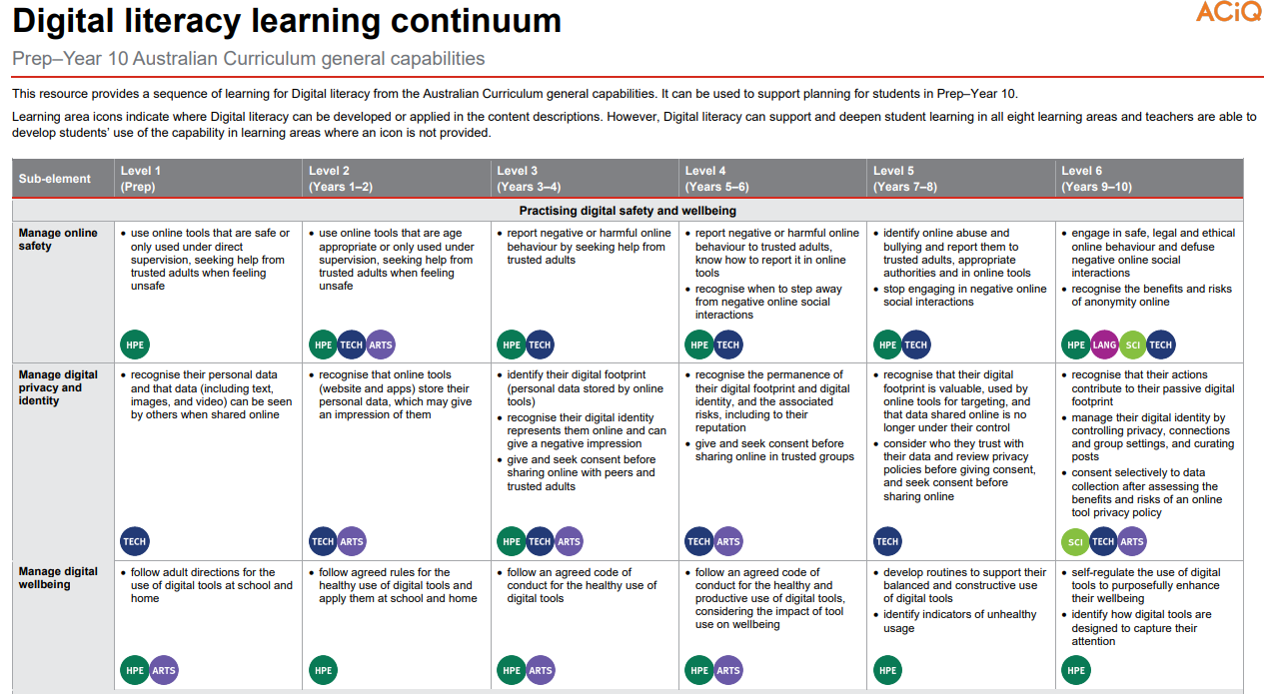
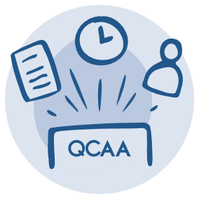
Learning continuum
Source: QCAA Digital literacy learning continuum: https://www.qcaa.qld.edu.au/downloads/aciqv9/general-resources/ac9_gc_digital_literacy_learning_continuum.pdf
Notes:
ACARA has developed continua for the general capabilities that describe the knowledge, skills, behaviours and dispositions that students typically will have developed at particular stages of schooling.
The QCAA has reformatted these learning continua for each general capability, adding coloured symbols that highlight the learning areas where the general capabilities can be developed in the content descriptions in authentic and meaningful ways.
The Digital literacy general capability learning continuum outlines developmental progress from Level 1 through to Level 6.
Source:
QCAA Digital literacy learning continuum www.qcaa.qld.edu.au/downloads/aciqv9/general-resources/ac9_gc_digital_literacy_learning_continuum.pdf

Slide 9
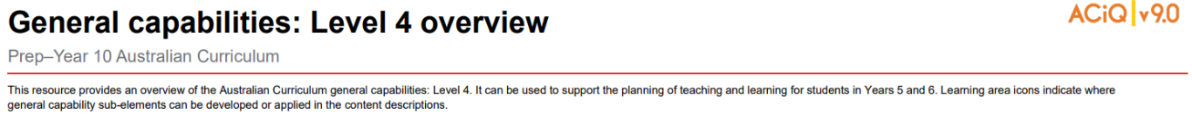
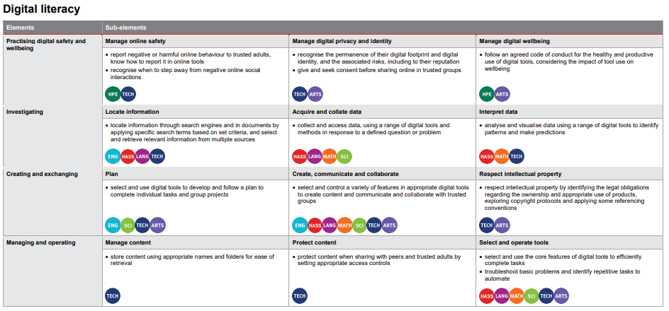
Level overviews
Source: QCAA General capabilities Level 4 overview: https://www.qcaa.qld.edu.au/downloads/aciqv9/general-resources/ac9_gc_level_4_overview.pdf
Notes:
The QCAA has also developed overviews for each level of the capability.
The elements are displayed alongside their sub-elements, making it easier to identify the specific knowledge and skills to be developed at each level.
Coloured learning area symbols are again used to show where the general capability can be developed or applied in the content descriptions.
Source:
QCAA General capabilities: Level 4 overview www.qcaa.qld.edu.au/downloads/aciqv9/general-resources/ac9_gc_level_4_overview.pdf

Slide 10
Outline
Identifying connections to learning area content
Embedding the capability in planning
Next steps
Understanding the Digital literacy general capability

Slide 11
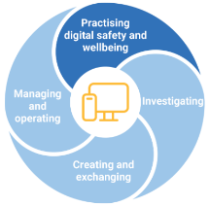
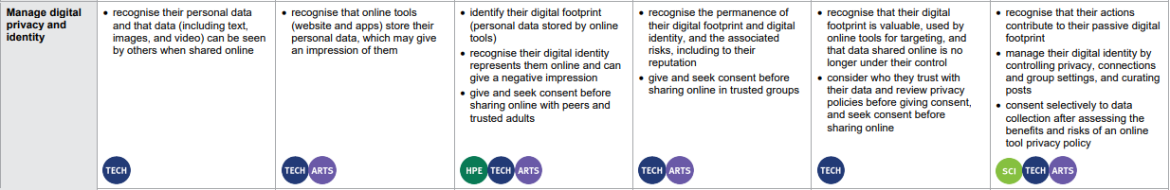
Identifying connections to learning area content
Manage digital privacy and identity
Sub-element description: Supports students to recognise the importance of controlling and shaping their own digital identity. They create and curate their online identities to positively tell their stories, while recognising how personal use of digital media may have implications for their digital footprint.
Learning continuum
AC9TDIFP01 identify some data that is personal and owned by them
Notes:
General capabilities are integrated through learning area content rather than being taught separately as standalone skills.
In the example on screen from the Practising digital safety and wellbeing element, the Manage digital privacy and identity sub-element is used to illustrate alignment with Digital Technologies.
The Level 1 description indicates that students should ‘recognise their personal data and that data (including text, images and video) can be seen by others when shared online’.
This aligns with the Digital Technologies Prep content description (AC9TDIFP01) requiring students to identify some data that is personal and owned by them.
Sources:
ACARA general capability diagram, sub-element & description www.australiancurriculum.edu.au/curriculum-information/understand-this-general-capability/digital-literacy
QCAA Digital literacy learning continuum www.qcaa.qld.edu.au/downloads/aciqv9/general-resources/ac9_gc_digital_literacy_learning_continuum.pdf

Slide 12
Identifying connections to learning area content
Manage digital privacy and identity
Sub-element description: Supports students to recognise the importance of controlling and shaping their own digital identity. They create and curate their online identities to positively tell their stories, while recognising how personal use of digital media may have implications for their digital footprint.
Learning continuum
AC9TDIFP01 identify some data that is personal and owned by them
AC9TDI2P07 discuss that some websites and apps store their personal data online | AC9TDI4P09 identify what personal data is stored and shared in their online accounts and discuss any associated risk | AC9TDI6P10 explain the creation and permanence of their digital footprint and consider privacy when collecting user data | AC9TDI8P14 investigate and manage the digital footprint existing systems and student solutions collect and assess if the data is essential to their purpose | AC9TDI10P14 apply the Australian Privacy Principles to critique and manage the digital footprint that existing systems and student solutions collect
Notes:
Similar alignment is evident across the bands in Digital Technologies.
General capabilities should be embedded only where appropriate, based on authentic opportunities within the content.
Sources:
ACARA general capability diagram, sub-element & description www.australiancurriculum.edu.au/curriculum-information/understand-this-general-capability/digital-literacy
QCAA Digital literacy learning continuum www.qcaa.qld.edu.au/downloads/aciqv9/general-resources/ac9_gc_digital_literacy_learning_continuum.pdf

Slide 13
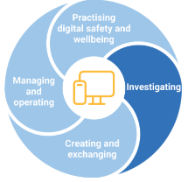
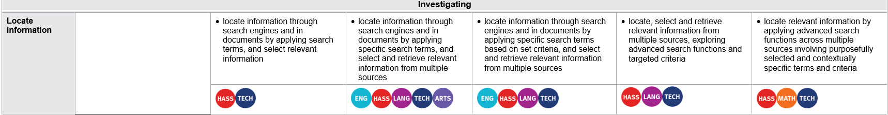
Identifying connections to learning area content
Sub-element description: Supports students to curate information from digital resources. They effectively use research strategies to locate information and other resources. Students articulate their information and content needs and effectively navigate information and content they encounter.
Locate information
Learning continuum
HASS
HASS
History
AC9HS2S03 interpret information and data from observations and provided sources, including the comparison of objects from the past and present
AC9HS6S02 locate, collect and organise information and data from primary and secondary sources in a range of formats
AC9HH10S02 locate, identify and compare primary and secondary sources to use in a historical inquiry
Notes:
This example is drawn from the Investigating element.
The learning continuum highlights how the Locate information sub-element is authentically embedded into the HASS learning area in Years 1–2, Years 5–6 and Years 9–10.
The Year 2 HASS content description (AC9HS2S03) expects students to ‘interpret information and data from observations and provided sources, including the comparison of objects from the past and present’.
The Level 2 description states that students are expected to locate information through search engines and in documents by applying search terms, and select relevant information, illustrating a link between the sub-element and the learning area content.
Similar connections are evident in Level 4 and Level 6.
These opportunities support the development of the sub-element through the learning area content of HASS.
There is a link between the sub-element and learning area content where students locate information through search engines and in documents by applying search terms and selecting relevant information.
Sources:
ACARA general capability diagram, sub-element & description www.australiancurriculum.edu.au/curriculum-information/understand-this-general-capability/digital-literacy
QCAA Digital literacy learning continuum www.qcaa.qld.edu.au/downloads/aciqv9/general-resources/ac9_gc_digital_literacy_learning_continuum.pdf

Slide 14
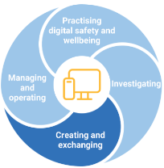
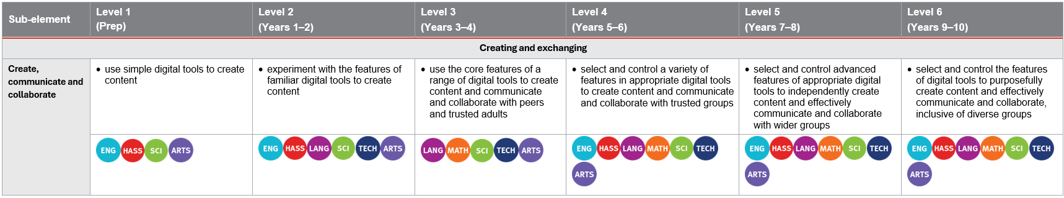
Identifying connections to learning area content
Sub-element description: Supports students to execute plans for the design of digital content and to develop, test and refine models to create original products. Students recognise different types of peer-to-peer communication and collaboration strategies, tools and formats, and decide which methods are most effective for individual or collaborative goals.
Create, communicate and collaborate
Learning continuum
Media Arts
Media Arts
AC9AMA4D01 develop media production skills by exploring ways of shaping ideas using media technologies, images, sounds, text and/or interactive elements
AC9AMA8D01 develop media production skills throughout the production process to construct representations using media languages and media technologies
Notes:
This example is drawn from the Creating and exchanging element.
The learning continuum highlights how the Create, communicate and collaborate sub-element is authentically embedded into The Arts learning area in Years 3–4 and Years 7–8.
The Media Arts Years 3–4 content description (AC9AMA4D01) expects students to develop media production skills by exploring ways of shaping ideas using media technologies, images, sounds, text and/or interactive elements.
The Level 3 description states that students are expected to use the core features of a range of digital tools to create content, illustrating a link between the sub-element and the learning area content.
Similar context-specific connections are evident for Level 5.
These opportunities support the development of the sub-element through the learning area content of The Arts.
Sources:
ACARA general capability diagram, sub-element & description www.australiancurriculum.edu.au/curriculum-information/understand-this-general-capability/digital-literacy
QCAA Digital literacy learning continuum www.qcaa.qld.edu.au/downloads/aciqv9/general-resources/ac9_gc_digital_literacy_learning_continuum.pdf

Slide 15
Outline
Identifying connections to learning area content
Embedding the capability in planning
Next steps
Understanding the Digital literacy general capability

Slide 16
An approach for embedding the capability in planning
Identify curriculum
Sequence teaching and learning
Identify authentic connections
Select and sequence learning activities
within
planning
Incorporate learning activities that model the general capability
Provide opportunities for students to practise and receive feedback
Learning area
General capability
Aspect/s of the achievement standard
Element/s
Content description/s
Sub-element/s
Notes:
This is one approach to embedding the Digital literacy general capability within curriculum planning.
The process draws on guidance from the QCAA Elements for effective planning, which provides support for the planning of teaching, learning, and assessment.
Source:
ACARA information in image — QCAA Planning for teaching, learning and assessment www.qcaa.qld.edu.au/downloads/aciq/general-resources/teaching/ac_plan_teach_learn_assess.pdf

Slide 17
Identify curriculum
Identify curriculum
Sequence teaching and learning
Identify authentic connections
Select and sequence learning activities
within
planning
Incorporate learning activities that model the general capability
Provide opportunities for students to practise and receive feedback
Learning area
General capability
Aspect/s of the achievement standard
Element/s
Content description/s
Sub-element/s
Notes:
Once the curriculum elements have been identified, teachers can use the Australian Curriculum website and/or QCAA resources to identify the elements and sub-elements of the relevant general capabilities that can be purposefully embedded to strengthen student learning.
Source:
ACARA information in image — QCAA Planning for teaching, learning and assessment www.qcaa.qld.edu.au/downloads/aciq/general-resources/teaching/ac_plan_teach_learn_assess.pdf

Slide 18
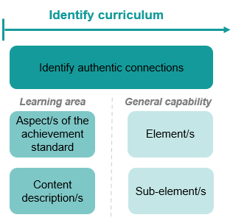
Identify curriculum: Years 7–8 Design and Technologies example
Aspect of the achievement standard | Relevant content description
They communicate design ideas and solutions to audiences using technical terms and graphical representation techniques, including using digital tools. | Generate, test, iterate and communicate design ideas, processes and solutions using technical terms and graphical representation techniques, including using digital tools (AC9TDE8P02).
Unit 1 — Promoting healthy food in the digital age
Students analyse opportunities for sharing meal recipes and use food preparation and presentation techniques to encourage healthy eating. They produce a recipe and capture images to support the recipes step-by-step instructions and the presentation of the finished meal. Students communicate their designed solution to encourage healthy eating using a mock social media post or digital recording including digital images.
Notes:
A Years 7–8 Design and Technologies example will be used to illustrate the Identify curriculum phase of the process.
The relevant aspect of the achievement standard, along with the aligned content description, has informed the context and focus of the example unit, Promoting healthy food in the digital age.
Connections to the Digital literacy general capability may be identified by reviewing the unit description.
Sources:
ACARA information in image — QCAA Planning for teaching, learning and assessment www.qcaa.qld.edu.au/downloads/aciq/general-resources/teaching/ac_plan_teach_learn_assess.pdf
Achievement standard and aligned content descriptions — QCAA Years 7–8 band Design and Technologies Australian Curriculum Version 9.0: Achievement standard aligned to content descriptions www.qcaa.qld.edu.au/downloads/aciqv9/technologies/curriculum/ac9_tech_design_yr7-8_as_cd_alignment.pdf

Slide 19
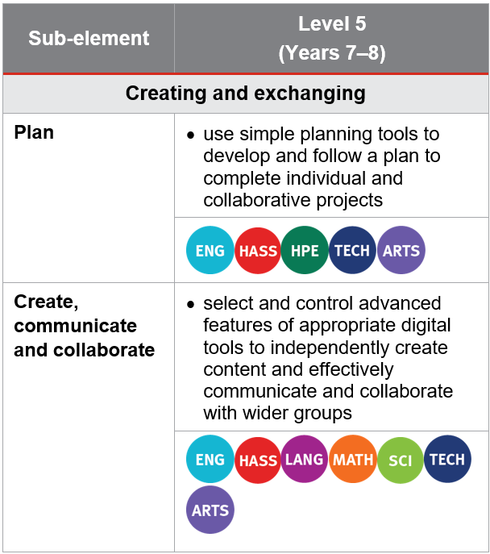
Identify curriculum: Years 7–8 Design and Technologies example
Aspect of the achievement standard | Relevant content description
They communicate design ideas and solutions to audiences using technical terms and graphical representation techniques, including using digital tools. | Generate, test, iterate and communicate design ideas, processes and solutions using technical terms and graphical representation techniques, including using digital tools (AC9TDE8P02).
Unit 1 — Promoting healthy food in the digital age
Students analyse opportunities for sharing meal recipes and use food preparation and presentation techniques to encourage healthy eating. They produce a recipe and capture images to support the recipes step-by-step instructions and the presentation of the finished meal. Students communicate their designed solution to encourage healthy eating using a digital recording including digital images.
Notes:
In this unit, students are required to ‘communicate their designed solution to encourage healthy eating using a digital recording including digital images’.
By referring to the aspect of the Years 7–8 Design and Technologies achievement standard that is assessed, along with the aligned content description, and the learning continuum of the Digital literacy general capability, we can identify where there are opportunities to embed elements and sub-elements of the general capability.
Only embed the identified elements and sub-elements that are most beneficial for achieving the outcomes of the unit. Professional judgment should guide this selection.
Sources:
ACARA information in image — QCAA Planning for teaching, learning and assessment www.qcaa.qld.edu.au/downloads/aciq/general-resources/teaching/ac_plan_teach_learn_assess.pdf
Achievement standard and aligned content descriptions — QCAA Years 7–8 band Design and Technologies Australian Curriculum Version 9.0: Achievement standard aligned to content descriptions www.qcaa.qld.edu.au/downloads/aciqv9/technologies/curriculum/ac9_tech_design_yr7-8_as_cd_alignment.pdf
Sub-element level descriptions — QCAA General capabilities: Level 5 overview www.qcaa.qld.edu.au/downloads/aciqv9/general-resources/ac9_gc_digital_literacy_learning_continuum.pdf

Slide 20
Identify curriculum: Years 7–8 Design and Technologies example
Aspect of the achievement standard | Relevant content description
They communicate design ideas and solutions to audiences using technical terms and graphical representation techniques, including using digital tools. | Generate, test, iterate and communicate design ideas, processes and solutions using technical terms and graphical representation techniques, including using digital tools (AC9TDE8P02).
Unit 1 — Promoting healthy food in the digital age
Students analyse opportunities for sharing meal recipes and use food preparation and presentation techniques to encourage healthy eating. They produce a recipe and capture images to support the recipes step-by-step instructions and the presentation of the finished meal. Students communicate their designed solution to encourage healthy eating using a digital recording including digital images.
Notes:
In this example, the Create, communicate and collaborate sub-element has been selected as the unit provides opportunities for students to effectively communicate their designed solution using a digital recording to encourage a wider group to eat healthy food.
Sources:
ACARA information in image — QCAA Planning for teaching, learning and assessment www.qcaa.qld.edu.au/downloads/aciq/general-resources/teaching/ac_plan_teach_learn_assess.pdf
Achievement standard and aligned content descriptions — QCAA Years 7–8 band Design and Technologies Australian Curriculum Version 9.0: Achievement standard aligned to content descriptions www.qcaa.qld.edu.au/downloads/aciqv9/technologies/curriculum/ac9_tech_design_yr7-8_as_cd_alignment.pdf
Sub-element level descriptions — QCAA General capabilities: Level 5 overview www.qcaa.qld.edu.au/downloads/aciqv9/general-resources/ac9_gc_digital_literacy_learning_continuum.pdf

Slide 21
Identify curriculum: Year 5 Science example
Aspect of the achievement standard | Relevant content description
They use equipment to generate data with appropriate precision. | use equipment to observe, measure and record data with reasonable precision, using digital tools as appropriate (AC9S5I03)
Unit 2 — Erosion mitigation: Geological science
In this geological science unit, students build their understanding of the geological processes that change the Earth’s surface, with a focus on erosion. They apply this understanding to develop a management plan that mitigates the effects of these processes. Working in a controlled environment and in groups, students model the process of erosion by pouring water into a cut soft drink bottle containing dirt or sand. They identify variables to be changed and measured and make reasoned predictions. Students then propose a solution to erosion in a local context based on their experimental findings. They use digital tools to collate data to support conclusions about the suitability of their proposal.
Notes:
This example shows the process for Year 5 Science.
The relevant aspect of the achievement standard, together with the aligned content description, has informed the context and focus of the example unit, Erosion mitigation: Geological science.
Connections to the Digital literacy general capability may be identified by reviewing the unit description.
Sources:
ACARA information in image — QCAA Planning for teaching, learning and assessment www.qcaa.qld.edu.au/downloads/aciq/general-resources/teaching/ac_plan_teach_learn_assess.pdf
Achievement standard and aligned content descriptions — QCAA Year 5 Science Australian Curriculum Version 9.0: Achievement standard aligned to content descriptions www.qcaa.qld.edu.au/downloads/aciqv9/science/curriculum/ac9_science_yr5_as_cd_alignment.pdf

Slide 22
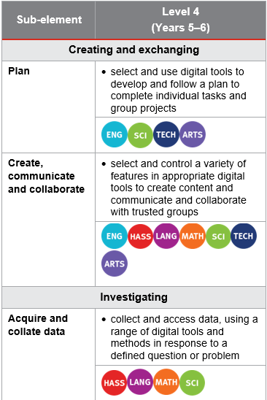
Identify curriculum: Year 5 Science example
Aspect of the achievement standard | Relevant content description
They use equipment to generate data with appropriate precision. | use equipment to observe, measure and record data with reasonable precision, using digital tools as appropriate (AC9S5I03)
Unit 2 — Erosion mitigation: Geological science
In this geological science unit, students build their understanding of the geological processes that change the Earth’s surface, with a focus on erosion. They apply this understanding to develop a management plan that mitigates the effects of these processes. Working in a controlled environment and in groups, students model the process of erosion by pouring water into a cut soft drink bottle containing dirt or sand. They identify variables to be changed and measured and make reasoned predictions. Students then propose a solution to erosion in a local context based on their experimental findings. They use digital tools to collate data to support conclusions about the suitability of their proposal.
Notes:
In this unit, students are required to use equipment to collate data.
By referring to the aspect of the Year 5 Science achievement standard that is assessed, along with the aligned content description, and the learning continuum of the Digital literacy general capability, we can identify where there are opportunities to embed elements and sub-elements of the general capability.
Only embed the identified elements and sub-elements that are most beneficial for achieving the outcomes of the unit. Professional judgment should guide this selection.
Sources:
ACARA information in image — QCAA Planning for teaching, learning and assessment www.qcaa.qld.edu.au/downloads/aciq/general-resources/teaching/ac_plan_teach_learn_assess.pdf
Achievement standard and aligned content descriptions — QCAA Year 5 Science Australian Curriculum Version 9.0: Achievement standard aligned to content descriptions www.qcaa.qld.edu.au/downloads/aciqv9/science/curriculum/ac9_science_yr5_as_cd_alignment.pdf
Sub-element level descriptions – QCAA General capabilities: Level 4 overview www.qcaa.qld.edu.au/downloads/aciqv9/general-resources/ac9_gc_level_4_overview.pdf

Slide 23
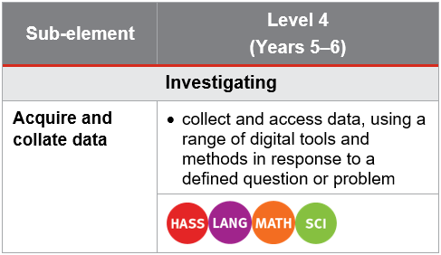
Identify curriculum: Year 5 Science example
Aspect of the achievement standard | Relevant content description
They use equipment to generate data with appropriate precision. | use equipment to observe, measure and record data with reasonable precision, using digital tools as appropriate (AC9S5I03)
Unit 2 — Erosion mitigation: Geological science
In this geological science unit, students build their understanding of the geological processes that change the Earth’s surface, with a focus on erosion. They apply this understanding to develop a management plan that mitigates the effects of these processes. Working in a controlled environment and in groups, students model the process of erosion by pouring water into a cut soft drink bottle containing dirt or sand. They identify variables to be changed and measured and make reasoned predictions. Students then propose a solution to erosion in a local context based on their experimental findings. They use digital tools to collate data to support conclusions about the suitability of their proposal.
Notes:
There are opportunities to embed the Acquire and collate data sub-element within this unit.
This sub-element can be explicitly addressed through the use of digital tools to collate data to support conclusions about the suitability of their proposal.
This allows students to practice the skills of using digital tools to Science-related contexts.
Sources:
ACARA information in image — QCAA Planning for teaching, learning and assessment www.qcaa.qld.edu.au/downloads/aciq/general-resources/teaching/ac_plan_teach_learn_assess.pdf
Achievement standard and aligned content descriptions — QCAA Year 5 Science Australian Curriculum Version 9.0: Achievement standard aligned to content descriptions www.qcaa.qld.edu.au/downloads/aciqv9/science/curriculum/ac9_science_yr5_as_cd_alignment.pdf
Sub-element level descriptions — QCAA General capabilities: Level 4 overview www.qcaa.qld.edu.au/downloads/aciqv9/general-resources/ac9_gc_level_4_overview.pdf

Slide 24



Sequence teaching and learning
Identify curriculum
Sequence teaching and learning
Identify authentic connections
Select and sequence learning activities within planning
Incorporate learning activities that model the general capability
Provide opportunities for students to practise and receive feedback
Learning area
General capability
Aspect/s of the achievement standard
Element/s
Content description/s
Sub-element/s
Notes:
The next phase of the process relates to the deliberate selection and then sequencing of learning activities within the teacher's unit planning.
1 —The first point emphasises the intentional planning of when and how a general capability will be developed through the teaching of content descriptions, ensuring that students build the knowledge, understanding, and skills outlined in the achievement standard.
2 — While planning, teachers should identify opportunities to model the general capability. This involves explicitly explaining and demonstrating the knowledge, understanding, and skills of the capability so that students can observe it in practice.
3 — After modelling, it is important to provide students with opportunities to practise the capability through learning activities, reinforcing knowledge, skills, behaviours and dispositions. As with all learning, students should receive informal feedback on their progress in developing the general capability.
Source:
ACARA information in image — QCAA Planning for teaching, learning and assessment www.qcaa.qld.edu.au/downloads/aciq/general-resources/teaching/ac_plan_teach_learn_assess.pdf

Slide 25
Select and sequence learning activities
Sequence teaching and learning
Select and sequence learning activities within planning
Incorporate learning activities that model the general capability
Provide opportunities for students to practise and receive feedback
Unit 2 — Erosion mitigation: Geological science
In this geological science unit, students build their understanding of the geological processes that change the Earth’s surface, with a focus on erosion. They apply this understanding to develop a management plan that mitigates the effects of these processes. Working in a controlled environment and in groups, students model the process of erosion by pouring water into a cut soft drink bottle containing dirt or sand. They identify variables to be changed and measured and make reasoned predictions. Students then propose a solution to erosion in a local context based on their experimental findings. They use digital tools to collate data to support conclusions about the suitability of their proposal.
Where (select) are there opportunities for students to acquire and collate data in the unit?
When (sequence) should these opportunities be incorporated?
What specific learning activities and experiences could be incorporated to explicitly teach and model acquiring and collating data?
Where are there opportunities for students to practise acquiring and collating data?
How will students receive informal feedback about their progress?
Notes:
Referring to the previous Year 5 Science example, at this stage of the suggested process, teachers would be asking questions such as:
Where are opportunities for students to acquire and collate data in the unit?
When should these opportunities be incorporated within the sequence of learning?
Sources:
ACARA information in image — QCAA Planning for teaching, learning and assessment www.qcaa.qld.edu.au/downloads/aciq/general-resources/teaching/ac_plan_teach_learn_assess.pdf
Sub-element level descriptions — QCAA General capabilities: Level 4 overview www.qcaa.qld.edu.au/downloads/aciqv9/general-resources/ac9_gc_level_4_overview.pdf

Slide 26
Select and sequence learning activities
Sequence teaching and learning
Select and sequence learning activities within planning
Incorporate learning activities that model the general capability
Provide opportunities for students to practise and receive feedback
Unit 2 — Erosion mitigation: Geological science
In this geological science unit, students build their understanding of the geological processes that change the Earth’s surface, with a focus on erosion. They apply this understanding to develop a management plan that mitigates the effects of these processes. Working in a controlled environment and in groups, students model the process of erosion by pouring water into a cut soft drink bottle containing dirt or sand. They identify variables to be changed and measured and make reasoned predictions. Students then propose a solution to erosion in a local context based on their experimental findings. They use digital tools to collate data to support conclusions about the suitability of their proposal.
Where (select) are there opportunities for students to acquire and collate data in the unit?
When (sequence) should these opportunities be incorporated?
What specific learning activities and experiences could be incorporated to explicitly teach and model acquiring and collating data?
Where are there opportunities for students to practise acquiring and collating data?
How will students receive informal feedback about their progress?
Notes:
Referring to the previous Year 5 Science example, at this stage of the suggested process, teachers would be asking questions such as:
What specific learning activities and experiences could be incorporated to explicitly teach and model acquiring and collating data?
Sources:
ACARA information in image — QCAA Planning for teaching, learning and assessment www.qcaa.qld.edu.au/downloads/aciq/general-resources/teaching/ac_plan_teach_learn_assess.pdf
Sub-element level descriptions — QCAA General capabilities: Level 4 overview www.qcaa.qld.edu.au/downloads/aciqv9/general-resources/ac9_gc_level_4_overview.pdf

Slide 27
Select and sequence learning activities
Sequence teaching and learning
Select and sequence learning activities within planning
Incorporate learning activities that model the general capability
Provide opportunities for students to practise and receive feedback
Unit 2 — Erosion mitigation: Geological science
In this geological science unit, students build their understanding of the geological processes that change the Earth’s surface, with a focus on erosion. They apply this understanding to develop a management plan that mitigates the effects of these processes. Working in a controlled environment and in groups, students model the process of erosion by pouring water into a cut soft drink bottle containing dirt or sand. They identify variables to be changed and measured and make reasoned predictions. Students then propose a solution to erosion in a local context based on their experimental findings. They use digital tools to collate data to support conclusions about the suitability of their proposal.
Where (select) are there opportunities for students to acquire and collate data in the unit?
When (sequence) should these opportunities be incorporated?
What specific learning activities and experiences could be incorporated to explicitly teach and model acquiring and collating data?
Where are there opportunities for students to practise acquiring and collating data?
How will students receive informal feedback about their progress?
Notes:
Referring to the previous Year 5 Science example, at this stage of the suggested process, teachers would be asking questions such as:
Where are there opportunities for students to practise acquiring and collating data?
How will students receive informal feedback about their progress?
Sources:
ACARA information in image — QCAA Planning for teaching, learning and assessment www.qcaa.qld.edu.au/downloads/aciq/general-resources/teaching/ac_plan_teach_learn_assess.pdf
Sub-element level descriptions — QCAA General capabilities: Level 4 overview www.qcaa.qld.edu.au/downloads/aciqv9/general-resources/ac9_gc_level_4_overview.pdf

Slide 28
Outline
Identifying connections to learning area content
Embedding the capability in planning
Next steps
Understanding the Digital literacy general capability

Slide 29

Next steps
Consider…
Where there are authentic opportunities for you to develop elements and sub-elements of the Digital literacy general capability within your learning area content.
Notes:
Consider where there are authentic opportunities to develop elements and sub-elements of the Digital literacy general capability within your learning area content.

Slide 30
Acknowledgments
Third-party copyright material, and QCAA material not covered by the CC BY licence is listed below:
Queensland Government coat of arms, and the QCAA and QSA trademarks may not be reproduced without permission.
Acknowledgment of Country artwork (2023) ‘Growth through Learning’ by Chern’ee, Brooke and Jesse Sutton, Kalkadoon. www.cherneesutton.com.au
The three-dimensional cube and Digital literacy general capability diagrams are 'Excluded Material' used under the terms of the Australian Curriculum and its copyright notice and are not modified © Australian Curriculum, Assessment and Reporting Authority (ACARA) 2009 to present, unless otherwise indicated. You may view, download, display, print, reproduce (such as by making photocopies) and distribute these Excluded Materials in unaltered form only for your personal, non-commercial educational purposes or for the non-commercial educational purposes of your organisation, provided that you make others aware it can only be used for these purposes and attribute ACARA as the source of the Excluded Material. For the avoidance of doubt, this means that you cannot edit, modify or adapt any of these materials, and you cannot sub-license any of these materials to others. Apart from any uses permitted under the Copyright Act 1968 (Cth), and those explicitly granted above, all other rights are reserved by ACARA. If you want to use such material in a manner that is outside this restrictive licence, you must request permission from ACARA by emailing (copyright@acara.edu.au) or by submitting a request through the online enquiry form.
Unless otherwise indicated, material from Australian Curriculum is © ACARA 2010–present, licensed CC BY 4.0. For the latest information and additional terms of use, see the Australian Curriculum website and its copyright notice.
Student and staff images have been used with permission.

Slide 31
Copyright notice
© State of Queensland (QCAA) 2026
Licence: https://creativecommons.org/licenses/by/4.0 | Copyright notice: www.qcaa.qld.edu.au/copyright — lists the full terms and conditions, which specify certain exceptions to the licence. |
Attribution (include the link): © State of Queensland (QCAA) 2026 www.qcaa.qld.edu.au/copyright.
Other copyright material in this presentation is listed on the previous slide/s.

