Slide 1
P–10 Embedding the Critical and creative thinking general capability in planning: Australian Curriculum v9.0
260093
Notes:
This resource reproduces key slides to support teachers to embed the Critical and creative thinking general capability in planning.
For more resources see the Australian Curriculum v9.0 in Queensland page www.qcaa.qld.edu.au/p-10/aciq/version-9/general-capabilities/advice-and-resources

Slide 2
Success criteria
Learning goal
To develop a deeper understanding of the Australian Curriculum v9.0 Critical and creative thinking general capability.
You will know you are
successful if you:
understand the structure
and content of the Critical and creative thinking general capability
identify strategies to embed
this general capability
use QCAA resources to
inform and support planning.
Notes:
Note: General capability is sometimes referred to as GC.

Slide 3
Outline
Identifying connections to learning area content
Embedding the capability in planning
Next steps
Understanding the Critical and creative thinking general capability

Slide 4
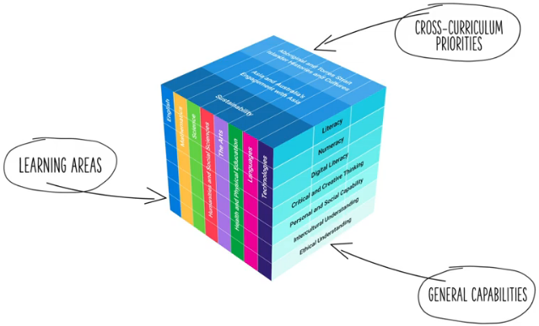
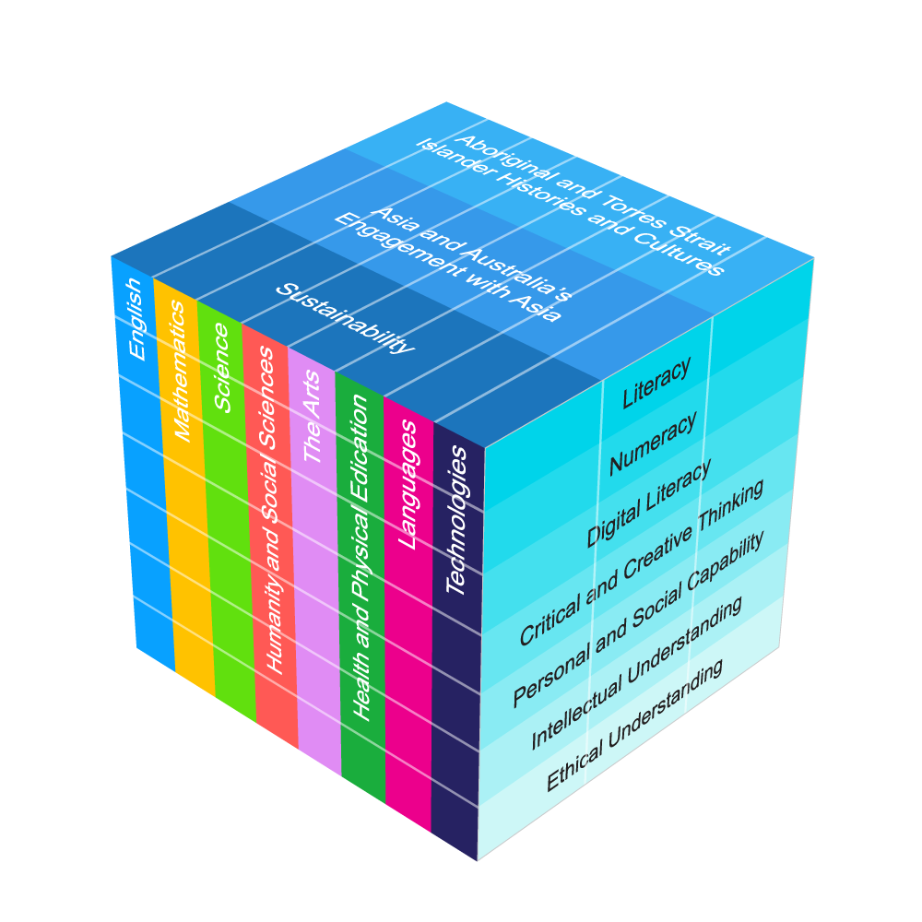
Three-dimensional Australian Curriculum v9.0
Source: [v9] ACARA image from Summary overview (video) https://v9.australiancurriculum.edu.au/help/website-tour
Notes:
The Australian Curriculum has a three-dimensional design to recognise that learning extends beyond subjects, with students requiring a set of knowledge, skills, behaviours, competencies and dispositions to equip them to become confident, lifelong learners in a complex, global environment.
While the learning areas are the foundation of the Australian Curriculum (ACARA video), the teaching of learning area content is strengthened by the application of relevant general capabilities, which should be embedded within learning area content where most authentic and appropriate.
When teachers intentionally connect and teach the general capabilities through curriculum content, both content and skills are deepened.
Source:
[v9] ACARA image from Summary overview (video) https://v9.australiancurriculum.edu.au/help/website-tour

Slide 5
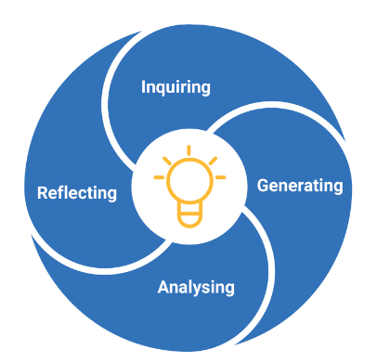
Critical and creative thinking capability: Structure
Source: ACARA general capability diagram & sub-elements: https://v9.australiancurriculum.edu.au/teacher-resources/understand-this-general-capability/critical-and-creative-thinking
Notes:
This diagram, developed by ACARA, represents the structure of the Critical and creative thinking general capability.
It illustrates four distinct sections, known as elements.
Each general capability includes its own diagram, outlining the specific elements within that capability.
Sources:
ACARA general capability diagram and sub-element names www.australiancurriculum.edu.au/curriculum-information/understand-this-general-capability/critical-and-creative-thinking
The Shape of the Australian Curriculum Version 5.0 p. 17 www.acara.edu.au/docs/default-source/curriculum/the_shape_of_the_australian_curriculum_version5_for-website.pdf

Slide 6
Critical and creative thinking capability: Structure
Develop questions
Identify, process and evaluate information
Think about thinking (metacognition)
Transfer knowledge
Interpret concepts and problems
Draw conclusions and provide reasons
Evaluate actions and outcomes
Create possibilities
Consider alternatives
Put ideas into action
Source: ACARA general capability diagram & sub-elements: https://v9.australiancurriculum.edu.au/teacher-resources/understand-this-general-capability/critical-and-creative-thinking
Notes:
Talking Points
Each element is broken into sub-elements (shown in light blue).
Together, the elements and sub-elements represent two important ways of thinking that guide teachers to plan opportunities for students to inquire into the world around them.
Sources:
ACARA general capability diagram and sub-element names www.australiancurriculum.edu.au/curriculum-information/understand-this-general-capability/critical-and-creative-thinking
The Shape of the Australian Curriculum Version 5.0 p. 17 www.acara.edu.au/docs/default-source/curriculum/the_shape_of_the_australian_curriculum_version5_for-website.pdf

Slide 7
Critical and creative thinking capability: Structure
Develop questions
Sub-element description:
Supports students to narrow or expand the focus of their thinking and explore ideas and concepts critically and creatively. When they develop different kinds of questions, students can further their inquiry. They can find more information about a topic and form a better understanding of how something works or why something is the way it is.
Think about thinking (metacognition)
Transfer knowledge
Interpret concepts and problems
Draw conclusions and provide reasons
Evaluate actions and outcomes
Create possibilities
Consider alternatives
Put ideas into action
Source: ACARA general capability diagram & sub-elements: https://v9.australiancurriculum.edu.au/teacher-resources/understand-this-general-capability/critical-and-creative-thinking
Notes:
Each sub-element includes a description to support a shared understanding of what it might look like in practice.
Some general capabilities align more closely with particular learning areas and subjects. For example, the Critical and creative thinking capability has a strong connection with The Arts.
Source:
ACARA general capability diagram and sub-element names www.australiancurriculum.edu.au/curriculum-information/understand-this-general-capability/critical-and-creative-thinking

Slide 8
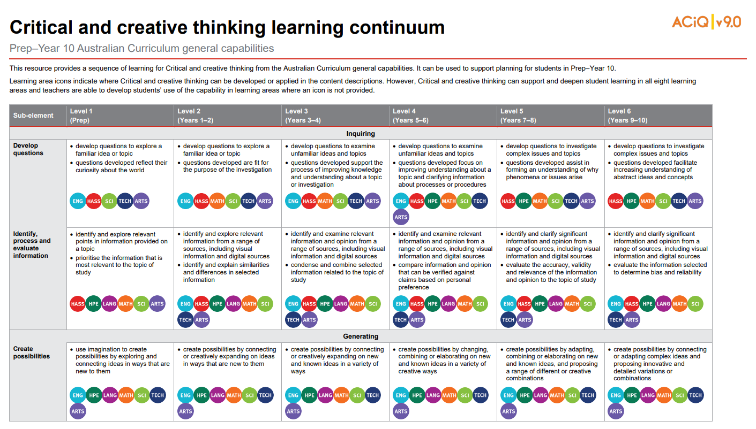

Learning continuum
Source: QCAA Critical and creative thinking learning continuum www.qcaa.qld.edu.au/downloads/aciqv9/general-resources/ac9_gc_critical_creative_thinking_learning_continuum.pdf
Notes:
ACARA has developed continua for the general capabilities that describe the knowledge, skills, behaviours and dispositions that students typically will have developed at particular stages of schooling.
The QCAA has reformatted these learning continua for each general capability, adding coloured symbols that highlight the learning areas where the general capabilities can be developed in the content descriptions in authentic and meaningful ways.
The Critical and creative thinking learning continuum outlines developmental progress from Level 1 through to Level 6.
Source:
QCAA Critical and creative thinking learning continuum www.qcaa.qld.edu.au/downloads/aciqv9/general-resources/ac9_gc_critical_creative_thinking_learning_continuum.pdf

Slide 9
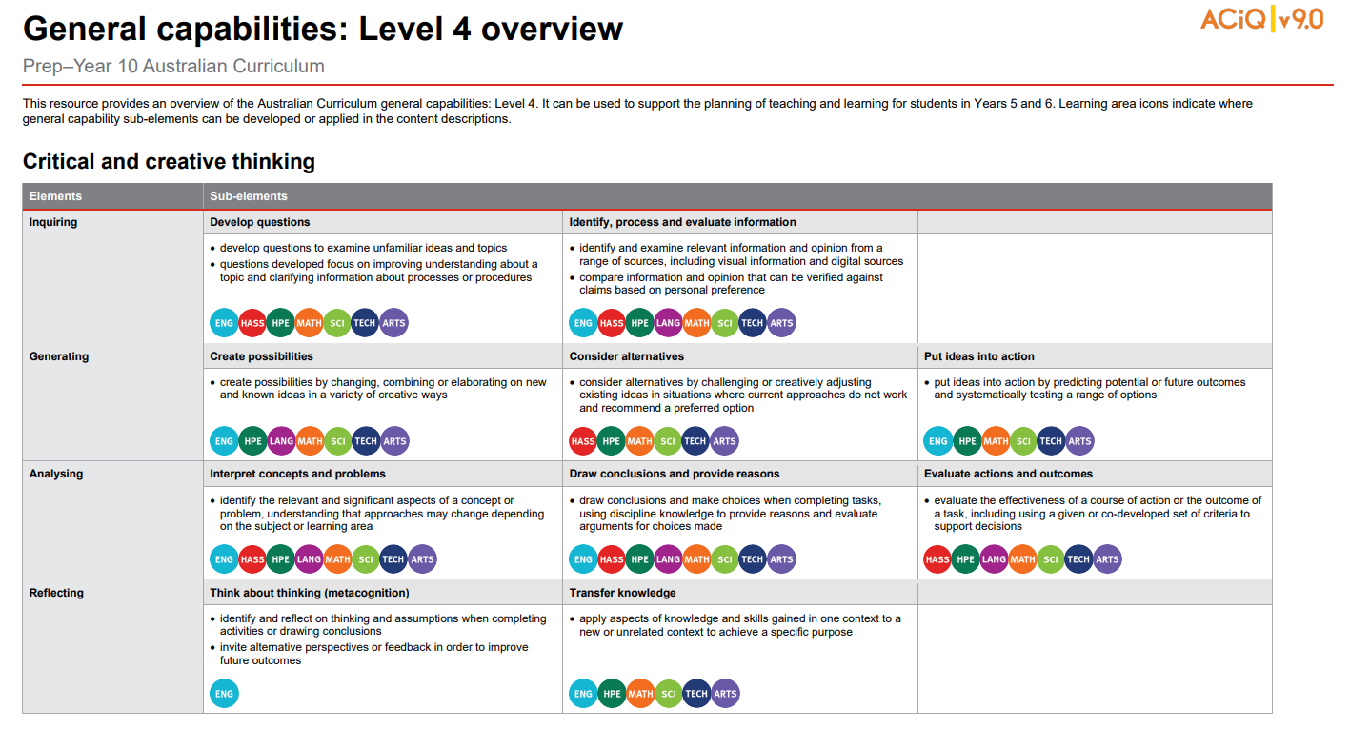
Level overviews
Source: QCAA General capabilities Level 4 overview: https://www.qcaa.qld.edu.au/downloads/aciqv9/general-resources/ac9_gc_level_4_overview.pdf
Notes:
The QCAA has also developed overviews for each level of the capability.
The elements are displayed alongside their sub-elements, making it easier to identify the specific knowledge and skills to be developed at each level.
Coloured learning area symbols are again used to show where the general capability can be developed or applied in the content descriptions.
Source:
QCAA General capabilities: Level 4 overview www.qcaa.qld.edu.au/downloads/aciqv9/general-resources/ac9_gc_level_4_overview.pdf

Slide 10
Outline
Identifying connections to learning area content
Embedding the capability in planning
Next steps
Understanding the Critical and creative thinking general capability

Slide 11
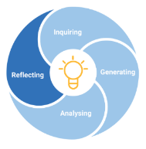
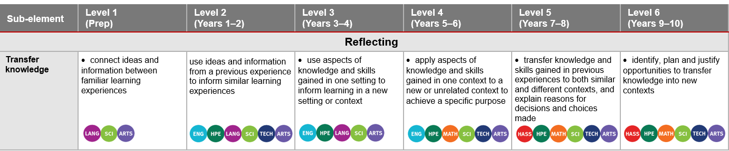
Identifying connections to learning area content
Transfer knowledge
Sub-element description: Supports students to develop an appreciation of their personal qualities and areas for growth. Through acknowledgment and assessment of their thoughts, feelings, actions and abilities, students can plan for growth across a range of contexts.
Learning continuum
AC9MAF01 use play, imagination, arts knowledge and processes and/or skills to discover possibilities and develop ideas | AC9DR2DO1 use the elements of drama and imagination in dramatic play and/or process drama | AC9VA4C01 use visual conventions, visual arts processes and materials to create artworks that communicate ideas, perspectives and/or meaning | AC9MU6C01 manipulate elements of music and use compositional devices to communicate ideas, perspectives and/or meaning when composing and practising music for performance, and notate, document and/or record the music they compose | AC9DA8D02 reflect on own and others’ dance works and/or practices to inform choreographic choices and use of technical and expressive skills | AC9DR10P01 perform improvised, devised and/or scripted drama to audiences, using performance skills and conventions to shape the drama
Notes:
General capabilities are integrated through learning area content rather than being taught separately as standalone skills.
In the example on screen from the Reflecting element, the Transfer knowledge sub-element is used to illustrate alignment with The Arts learning area.
The Level 1 description indicates that students should be able to ‘connect ideas and information between familiar learning experiences’.
This aligns with the Prep content description (AC9MAFO1) requiring students to use play, imagination, arts knowledge and processes and/or skills to discover possibilities and develop ideas.
Sources:
ACARA general capability diagram, sub-element & description www.australiancurriculum.edu.au/curriculum-information/understand-this-general-capability/critical-and-creative-thinking
QCAA Critical and creative thinking learning continuum www.qcaa.qld.edu.au/downloads/aciqv9/general-resources/ac9_gc_critical_creative_thinking_learning_continuum.pdf

Slide 12
Identifying connections to learning area content
Transfer knowledge
Sub-element description: Supports students to develop an appreciation of their personal qualities and areas for growth. Through acknowledgment and assessment of their thoughts, feelings, actions and abilities, students can plan for growth across a range of contexts.
Learning continuum
AC9MAF01 use play, imagination, arts knowledge and processes and/or skills to discover possibilities and develop ideas | AC9DR2DO1 use the elements of drama and imagination in dramatic play and/or process drama | AC9VA4C01 use visual conventions, visual arts processes and materials to create artworks that communicate ideas, perspectives and/or meaning | AC9MU6C01 manipulate elements of music and use compositional devices to communicate ideas, perspectives and/or meaning when composing and practising music for performance, and notate, document and/or record the music they compose | AC9DA8D02 reflect on own and others’ dance works and/or practices to inform choreographic choices and use of technical and expressive skills | AC9DR10P01 perform improvised, devised and/or scripted drama to audiences, using performance skills and conventions to shape the drama
Notes:
Similar alignment is evident across the bands in The Arts.
General capabilities should be embedded only where appropriate, based on authentic opportunities within the content.
Sources:
ACARA general capability diagram, sub-element & description www.australiancurriculum.edu.au/curriculum-information/understand-this-general-capability/critical-and-creative-thinking
QCAA Critical and creative thinking learning continuum www.qcaa.qld.edu.au/downloads/aciqv9/general-resources/ac9_gc_critical_creative_thinking_learning_continuum.pdf

Slide 13
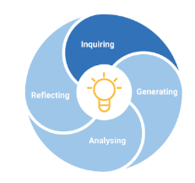
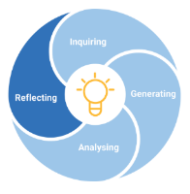
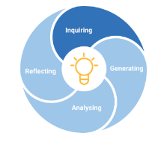
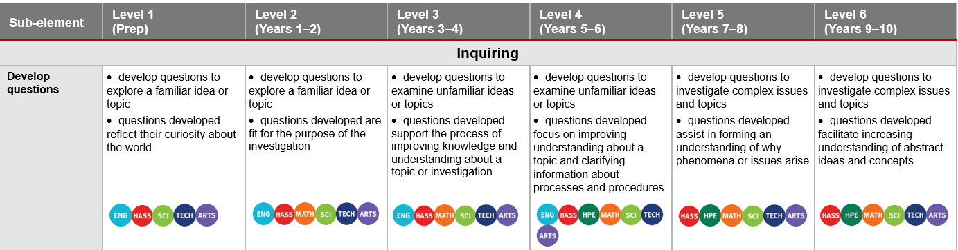
Identifying connections to learning area content
Develop questions
Sub-element description: Supports students to narrow or expand the focus of their thinking and explore ideas and concepts critically and creatively. When they develop different kinds of questions, students can further their inquiry. They can find more information about a topic and form a better understanding of how something works or why something is the way it is.
Learning continuum
AC9HSFS01 pose questions about familiar objects, people, places and events | AC9HS2FS02 develop questions about objects, people, places and events in the past and present | AC9HS4S01 develop questions to guide investigations about people, events, places and issues | AC9HS6S01 develop questions to investigate people, events, developments, places and systems | AC9HG8S01 develop questions for a geographical inquiry related to a phenomenon or challenge | AC9HG10S01 develop a range of questions for a geographical inquiry related to a phenomenon or challenge
Notes:
This example is drawn from the Inquiring element.
The learning continuum highlights how the Develop questions sub-element is authentically embedded into the HASS learning area from Prep to Year 10.
The Prep HASS content description (AC9HSFS01) expects students to ‘pose questions about familiar objects, people, places and events’.
The Level 1 description states that students are expected to develop questions to explore a familiar idea or topic, illustrating a link between the sub-element and learning area content.
Similar context-specific connections are evident from Level 2 to Level 6.
These opportunities support the ability to develop questions through the learning area content of HASS.
Source:
ACARA general capability diagram, sub-element & description www.australiancurriculum.edu.au/curriculum-information/understand-this-general-capability/critical-and-creative-thinking

Slide 14
Outline
Identifying connections to learning area content
Embedding the capability in planning
Next steps
Understanding the Critical and creative thinking general capability

Slide 15
An approach for embedding the capability in planning
Identify curriculum
Sequence teaching and learning
Identify authentic connections
Select and sequence learning activities
within
planning
Incorporate learning activities that model the general capability
Provide opportunities for students to practise and receive feedback
Learning area
General capability
Aspect/s of the achievement standard
Element/s
Content description/s
Sub-element/s
Notes:
This is one approach to embedding the Critical and creative thinking general capability within curriculum planning.
The process draws on guidance from the QCAA Elements for effective planning, which provides support for the planning of teaching, learning, and assessment.
Source:
ACARA information in image — QCAA Planning for teaching, learning and assessment www.qcaa.qld.edu.au/downloads/aciq/general-resources/teaching/ac_plan_teach_learn_assess.pdf

Slide 16
Identify curriculum
Identify curriculum
Sequence teaching and learning
Identify authentic connections
Select and sequence learning activities
within
planning
Incorporate learning activities that model the general capability
Provide opportunities for students to practise and receive feedback
Learning area
General capability
Aspect/s of the achievement standard
Element/s
Content description/s
Sub-element/s
Notes:
Once the curriculum elements have been identified, teachers can use the Australian Curriculum website and/or QCAA resources to identify the elements and sub-elements of the relevant general capabilities that can be purposefully embedded to strengthen student learning.
Source:
ACARA information in image — QCAA Planning for teaching, learning and assessment www.qcaa.qld.edu.au/downloads/aciq/general-resources/teaching/ac_plan_teach_learn_assess.pdf

Slide 17
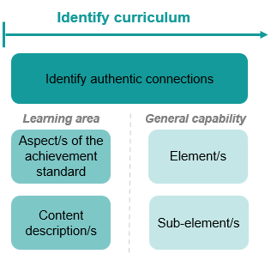
Identify curriculum: Year 4 HASS example
Aspect of the achievement standard | Relevant content descriptions
They interpret and analyse information and data to identify perspectives, and draw conclusions. | interpret information and data displayed in different formats (AC9HS4S03)
 | analyse information and data, and identify perspectives (AC9HS4S04)
 | draw conclusions based on analysis of information (AC9HS4S05)
Unit 1 — Getting the message out
Students work collaboratively to investigate one type of environment (e.g., desert rainforest) and use maps to locate and describe each environment. They interpret information and data from a range of sources to draw conclusions and provide reasons why this environment is important to people. Students then categorise images of resources into renewable and non-renewable resources. They learn about the allocation and management of resources used in their daily lives through a mini-inquiry investigation on the resources used to create a household item (e.g., toy, toothbrush). Students build their critical and creative thinking skills as they identify relationships and draw conclusions about the sustainable use and management of the resources used to create the household item.
Notes:
A Year 4 HASS example will be used to illustrate the Identify curriculum phase of the process.
The relevant aspect of the achievement standard, along with the aligned content descriptions, has informed the context and focus of the example unit, Getting the message out.
Connections to the Critical and creative thinking general capability may be identified by reviewing the unit description.
Sources:
ACARA information in image — QCAA Planning for teaching, learning and assessment www.qcaa.qld.edu.au/downloads/aciq/general-resources/teaching/ac_plan_teach_learn_assess.pdf
Achievement standard and aligned content descriptions — QCAA Year 4 HASS Australian Curriculum Version 9.0: Achievement standard aligned to content descriptions www.qcaa.qld.edu.au/downloads/aciqv9/humanities-and-social-sciences/curriculum/ac9_hass_yr4_as_cd_alignment.pdf

Slide 18
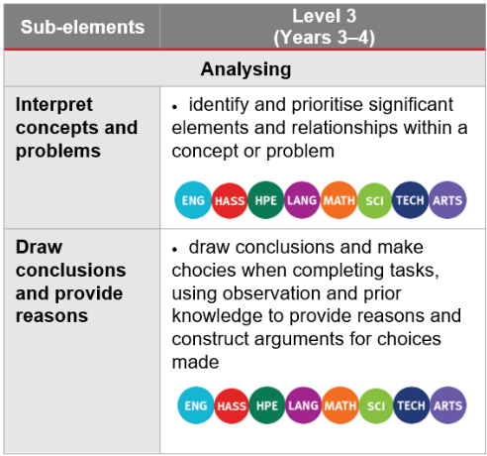
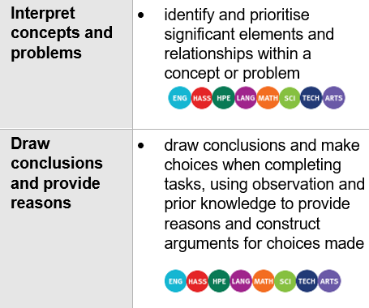
Identify curriculum: Year 4 HASS example
Aspect of the achievement standard | Relevant content descriptions
They interpret and analyse information and data to identify perspectives, and draw conclusions. | interpret information and data displayed in different formats (AC9HS4S03)
 | analyse information and data, and identify perspectives (AC9HS4S04)
 | draw conclusions based on analysis of information (AC9HS4S05)
Unit 1 — Getting the message out
Students work collaboratively to investigate one type of environment (e.g., desert rainforest) and use maps to locate and describe each environment. They interpret information and data from a range of sources to draw conclusions and provide reasons why this environment is important to people. Students then categorise images of resources into renewable and non-renewable resources. They learn about the allocation and management of resources used in their daily lives through a mini-inquiry investigation on the resources used to create a household item (e.g., toy, toothbrush). Students build their critical and creative thinking skills as they identify relationships and draw conclusions about the sustainable use and management of the resources used to create the household item.
Notes:
In this unit, students are required to ‘identify relationships and draw conclusions about the sustainable use and management of the resources used to create the household item’.
By referring to the aspect of the Year 4 HASS achievement standard that is assessed, along with the aligned content descriptions, and the learning continuum of the Critical and creative thinking general capability, we can identify where there are opportunities to embed elements and sub-elements of the general capability
Only embed the identified elements and sub-elements that are most beneficial for achieving the outcomes of the unit. Professional judgment should guide this selection.
Sources:
ACARA information in image — QCAA Planning for teaching, learning and assessment www.qcaa.qld.edu.au/downloads/aciq/general-resources/teaching/ac_plan_teach_learn_assess.pdf
Achievement standard and aligned content descriptions — QCAA Year 4 HASS Australian Curriculum Version 9.0: Achievement standard aligned to content descriptions www.qcaa.qld.edu.au/downloads/aciqv9/humanities-and-social-sciences/curriculum/ac9_hass_yr4_as_cd_alignment.pdf
Sub-element level descriptions — QCAA General capabilities: Level 3 overview www.qcaa.qld.edu.au/downloads/aciqv9/general-resources/ac9_gc_level_3_overview.pdf

Slide 19
Identify curriculum: Year 4 HASS example
Aspect of the achievement standard | Relevant content descriptions
They interpret and analyse information and data to identify perspectives, and draw conclusions. | interpret information and data displayed in different formats (AC9HS4S03)
 | analyse information and data, and identify perspectives (AC9HS4S04)
 | draw conclusions based on analysis of information (AC9HS4S05)
Unit 1 — Getting the message out
Students work collaboratively to investigate one type of environment (e.g., desert rainforest) and use maps to locate and describe each environment. They interpret information and data from a range of sources to draw conclusions and provide reasons why this environment is important to people. Students then categorise images of resources into renewable and non-renewable resources. They learn about the allocation and management of resources used in their daily lives through a mini-inquiry investigation on the resources used to create a household item (e.g., toy, toothbrush). Students build their critical and creative thinking skills as they identify relationships and draw conclusions about the sustainable use and management of the resources used to create the household item.
Notes:
In this example, the Draw conclusions and provide reasons sub-element has been selected as the unit provides opportunities to explicitly teach how to draw conclusions using observations, investigating and applying knowledge, understanding and skills across a range of contexts.
Sources:
ACARA information in image — QCAA Planning for teaching, learning and assessment www.qcaa.qld.edu.au/downloads/aciq/general-resources/teaching/ac_plan_teach_learn_assess.pdf
Achievement standard and aligned content descriptions — QCAA Year 4 HASS Australian Curriculum Version 9.0: Achievement standard aligned to content descriptions www.qcaa.qld.edu.au/downloads/aciqv9/humanities-and-social-sciences/curriculum/ac9_hass_yr4_as_cd_alignment.pdf
Sub-element level descriptions — QCAA General capabilities: Level 3 overview www.qcaa.qld.edu.au/downloads/aciqv9/general-resources/ac9_gc_level_3_overview.pdf

Slide 20
Identify curriculum: Year 8 Drama example
Aspect of the achievement standard | Relevant content descriptions
Students work collaboratively to manipulate elements of drama and conventions to shape and sustain dramatic action in improvised, devised and/or scripted drama. | improvise and devise drama and/or interpret scripted drama, manipulating elements of drama and applying conventions relevant to the style/form (AC9ADR8C01)
 | evaluate and refine use of elements of drama and/or conventions to shape and sustain dramatic action and/or communicate ideas, perspectives and/or meaning (AC9ADR8C02)
 | reflect on their own and others’ drama to inform choices when manipulating elements of drama and/or conventions to shape dramatic action (AC9ADR8D02)
Unit 4 — What is a hero?
In this unit, students explore the concept of heroism in fiction and real life. Students use drama to celebrate and inform. Using contemporary performance styles and forms including physical theatre and collage drama, students examine the characteristics of a hero. Responding to a range of stimulus, students create possibilities for communicating ideas as they devise scenes to communicate the impact of a hero using physical movement, gesture, and narration. Students collaboratively workshop scenes for their chosen real-life hero. They devise drama to communicate information about their hero to inspire a teenage audience. Students refine their performance skills through ongoing critical thinking and reflection on peer and teacher feedback.
Notes:
This example shows the process for Year 8 Drama.
The relevant aspect of the achievement standard, together with the aligned content description, has informed the context and focus of the example unit, What is a hero?
Connections to the Critical and creative thinking general capability may be identified by reviewing the unit description.
Sources:
ACARA information in image — QCAA Planning for teaching, learning and assessment www.qcaa.qld.edu.au/downloads/aciq/general-resources/teaching/ac_plan_teach_learn_assess.pdf
Achievement standard and aligned content descriptions — QCAA Year 7–8 band Drama Australian Curriculum Version 9.0: Achievement standard aligned to content descriptions www.qcaa.qld.edu.au/downloads/aciqv9/the-arts/curriculum/ac9_drama_yr7-8_as_cd_alignment.pdf

Slide 21
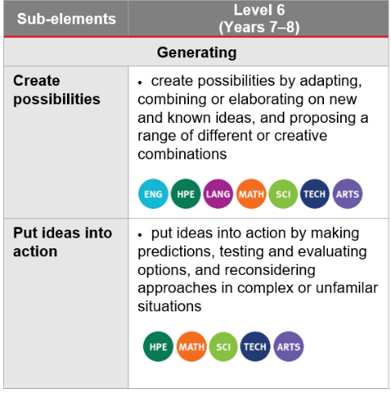
Identify curriculum: Year 8 Drama example
Aspect of the achievement standard | Relevant content descriptions
Students work collaboratively to manipulate elements of drama and conventions to shape and sustain dramatic action in improvised, devised and/or scripted drama. | improvise and devise drama and/or interpret scripted drama, manipulating elements of drama and applying conventions relevant to the style/form (AC9ADR8C01)
 | evaluate and refine use of elements of drama and/or conventions to shape and sustain dramatic action and/or communicate ideas, perspectives and/or meaning (AC9ADR8C02)
 | reflect on their own and others’ drama to inform choices when manipulating elements of drama and/or conventions to shape dramatic action (AC9ADR8D02)
Unit 4 — What is a hero?
In this unit, students explore the concept of heroism in fiction and real life. Students use drama to celebrate and inform. Using contemporary performance styles and forms including physical theatre and collage drama, students examine the characteristics of a hero. Responding to a range of stimulus, students create possibilities for communicating ideas as they devise scenes to communicate the impact of a hero using physical movement, gesture, and narration. Students collaboratively workshop scenes for their chosen real-life hero. They devise drama to communicate information about their hero to inspire a teenage audience. Students refine their performance skills through ongoing critical thinking and reflection on peer and teacher feedback.
Notes:
In this unit, students are required to work collaboratively to manipulate elements of drama through workshopping scenes for their chosen real-life hero.
By referring to the aspect of the Year 8 Drama achievement standard that is assessed, along with the aligned content description, and the learning continuum of the Critical and creative thinking general capability, we can identify where there are opportunities to embed elements and sub-elements of the general capability.
Only embed the identified elements and sub-elements that are most beneficial for achieving the outcomes of the unit. Professional judgment should guide this selection.
The learning continuum indicates where there are opportunities to embed elements and sub-elements.
Sources:
ACARA information in image — QCAA Planning for teaching, learning and assessment www.qcaa.qld.edu.au/downloads/aciq/general-resources/teaching/ac_plan_teach_learn_assess.pdf
Achievement standard and aligned content descriptions — QCAA Years 7–8 band Drama Australian Curriculum Version 9.0: Achievement standard aligned to content descriptions www.qcaa.qld.edu.au/downloads/aciqv9/the-arts/curriculum/ac9_drama_yr7-8_as_cd_alignment.pdf
Sub-element level descriptions — QCAA General capabilities: Level overview www.qcaa.qld.edu.au/downloads/aciqv9/general-resources/ac9_gc_level_6_overview.pdf

Slide 22

Identify curriculum: Year 8 Drama example
Aspect of the achievement standard | Relevant content descriptions
Students work collaboratively to manipulate elements of drama and conventions to shape and sustain dramatic action in improvised, devised and/or scripted drama. | improvise and devise drama and/or interpret scripted drama, manipulating elements of drama and applying conventions relevant to the style/form (AC9ADR8C01)
 | evaluate and refine use of elements of drama and/or conventions to shape and sustain dramatic action and/or communicate ideas, perspectives and/or meaning (AC9ADR8C02)
 | reflect on their own and others’ drama to inform choices when manipulating elements of drama and/or conventions to shape dramatic action (AC9ADR8D02)
Unit 4 — What is a hero?
In this unit, students explore the concept of heroism in fiction and real life. Students use drama to celebrate and inform. Using contemporary performance styles and forms including physical theatre and collage drama, students examine the characteristics of a hero. Responding to a range of stimulus, students create possibilities for communicating ideas as they devise scenes to communicate the impact of a hero using physical movement, gesture, and narration. Students collaboratively workshop scenes for their chosen real-life hero. They devise drama to communicate information about their hero to inspire a teenage audience. Students refine their performance skills through ongoing critical thinking and reflection on peer and teacher feedback.
Notes:
There are opportunities to embed the Create possibilities sub-element within this unit, as students devise scenes to communicate the impact of a hero and workshop ideas to experiment, improvise and make decisions.
Sources:
ACARA information in image — QCAA Planning for teaching, learning and assessment www.qcaa.qld.edu.au/downloads/aciq/general-resources/teaching/ac_plan_teach_learn_assess.pdf
Achievement standard and aligned content descriptions — QCAA Year 7–8 band Drama Australian Curriculum Version 9.0: Achievement standard aligned to content descriptions www.qcaa.qld.edu.au/downloads/aciqv9/the-arts/curriculum/ac9_drama_yr7-8_as_cd_alignment.pdf
Sub-element level descriptions — QCAA General capabilities: Level 5 overview www.qcaa.qld.edu.au/downloads/aciqv9/general-resources/ac9_gc_level_5_overview.pdf

Slide 23



Sequence teaching and learning
Identify curriculum
Sequence teaching and learning
Identify authentic connections
Select and sequence learning activities within planning
Incorporate learning activities that model the general capability
Provide opportunities for students to practise and receive feedback
Learning area
General capability
Aspect/s of the achievement standard
Element/s
Content description/s
Sub-element/s
Notes:
The next phase of the process relates to the deliberate selection and then sequencing of learning activities within the teacher's unit planning.
1 — The first point emphasises the intentional planning of when and how a general capability will be developed through the teaching of content descriptions, ensuring that students build the knowledge, understanding, and skills outlined in the achievement standard.
2 — While planning, teachers should identify opportunities to model the general capability. This involves explicitly explaining and demonstrating the knowledge, understanding, and skills of the capability so that students can observe it in practice.
3 — After modelling, it is important to provide students with opportunities to practise the capability through learning activities, reinforcing knowledge, skills, behaviours and dispositions. As with all learning, students should receive informal feedback on their progress in developing the general capability.
Source:
ACARA information in image — QCAA Planning for teaching, learning and assessment www.qcaa.qld.edu.au/downloads/aciq/general-resources/teaching/ac_plan_teach_learn_assess.pdf

Slide 24
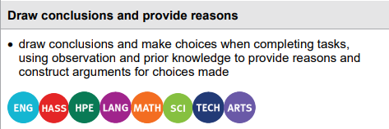
Select and sequence learning activities
Sequence teaching and learning
Select and sequence learning activities within planning
Incorporate learning activities that model the general capability
Provide opportunities for students to practise and receive feedback
Unit 1 — Get the message out
Students work collaboratively to investigate one type of environment (e.g., desert rainforest) and use maps to locate and describe each environment. They interpret information and data from a range of sources to draw conclusions and provide reasons why this environment is important to people. Students then categorise images of resources into renewable and non-renewable resources. They learn about the allocation and management of resources used in their daily lives through a mini-inquiry investigation on the resources used to create a household item (e.g., toy, toothbrush). Students build their critical and creative thinking skills as they identify relationships and draw conclusions about the sustainable use and management of the resources used to create the household item.
Where (select) are there opportunities to embed drawing conclusions and providing reasons within the unit?
When (sequence) should these opportunities be incorporated?
What specific learning activities and experiences can be used to explicitly teach and model how to draw conclusions and provide reasons?
Where can students practise drawing conclusions and providing reasons?
How will students receive informal feedback on their progress in drawing conclusions and providing reasons?
Notes:
Referring to the previous Year 4 HASS example, at this stage of the suggested process, teachers would be asking questions such as:
Where are opportunities to embed drawing conclusions and providing reasons within the unit?
When should these opportunities be incorporated within the sequence of learning?
Sources:
ACARA information in image — QCAA Planning for teaching ,learning and assessment www.qcaa.qld.edu.au/downloads/aciq/general-resources/teaching/ac_plan_teach_learn_assess.pdf
Sub-element level descriptions — QCAA General capabilities: Level 3 overview www.qcaa.qld.edu.au/downloads/aciqv9/general-resources/ac9_gc_level_3_overview.pdf

Slide 25
Incorporate learning activities, practice and feedback
Sequence teaching and learning
Select and sequence learning activities within planning
Incorporate learning activities that model the general capability
Provide opportunities for students to practise and receive feedback
Unit 1 — Get the message out
Students work collaboratively to investigate one type of environment (e.g., desert rainforest) and use maps to locate and describe each environment. They interpret information and data from a range of sources to draw conclusions and provide reasons why this environment is important to people. Students then categorise images of resources into renewable and non-renewable resources. They learn about the allocation and management of resources used in their daily lives through a mini-inquiry investigation on the resources used to create a household item (e.g., toy, toothbrush). Students build their critical and creative thinking skills as they identify relationships and draw conclusions about the sustainable use and management of the resources used to create the household item.
Where (select) are there opportunities to embed drawing conclusions and providing reasons within the unit?
When (sequence) should these opportunities be incorporated?
What specific learning activities and experiences can be used to explicitly teach and model how to draw conclusions and provide reasons?
Where can students practise drawing conclusions and providing reasons?
How will students receive informal feedback on their progress in drawing conclusions and providing reasons?
Notes:
Referring back to the previous Year 4 HASS example, at this stage of the suggested process, teachers would be asking questions such as:
What specific learning activities and experiences can be used to explicitly teach and model how to draw conclusions and provide reasons?
Sources:
ACARA information in image — QCAA Planning for teaching, learning and assessment www.qcaa.qld.edu.au/downloads/aciq/general-resources/teaching/ac_plan_teach_learn_assess.pdf
Sub-element level descriptions — QCAA General capabilities: Level 3 overview www.qcaa.qld.edu.au/downloads/aciqv9/general-resources/ac9_gc_level_3_overview.pdf

Slide 26
Incorporate learning activities, practice and feedback
Sequence teaching and learning
Select and sequence learning activities within planning
Incorporate learning activities that model the general capability
Provide opportunities for students to practise and receive feedback
Unit 1 — Get the message out
Students work collaboratively to investigate one type of environment (e.g., desert rainforest) and use maps to locate and describe each environment. They interpret information and data from a range of sources to draw conclusions and provide reasons why this environment is important to people. Students then categorise images of resources into renewable and non-renewable resources. They learn about the allocation and management of resources used in their daily lives through a mini-inquiry investigation on the resources used to create a household item (e.g., toy, toothbrush). Students build their critical and creative thinking skills as they identify relationships and draw conclusions about the sustainable use and management of the resources used to create the household item.
Where (select) are there opportunities to embed drawing conclusions and providing reasons within the unit?
When (sequence) should these opportunities be incorporated?
What specific learning activities and experiences can be used to explicitly teach and model how to draw conclusions and provide reasons?
Where can students practise drawing conclusions and providing reasons?
How will students receive informal feedback on their progress in drawing conclusions and providing reasons?
Notes:
Referring to the previous Year 4 HASS example, at this stage of the suggested process, teachers would be asking questions such as:
Where can students practise drawing conclusions and providing reasons?
How will students receive informal feedback on their progress in drawing conclusions and providing reasons?
Sources:
ACARA information in image — QCAA Planning for teaching, learning and assessment www.qcaa.qld.edu.au/downloads/aciq/general-resources/teaching/ac_plan_teach_learn_assess.pdf
Sub-element level descriptions — QCAA General capabilities: Level 3 overview www.qcaa.qld.edu.au/downloads/aciqv9/general-resources/ac9_gc_level_3_overview.pdf

Slide 27
Outline
Identifying connections to learning area content
Embedding the capability in planning
Next steps
Understanding the Critical and creative thinking general capability

Slide 28

Next steps
Consider …
Where there are authentic opportunities for you to develop elements and sub-elements of the Critical and creative thinking general capability within your learning area content.
Notes:
Consider where there are authentic opportunities to develop elements and sub-elements of the Critical and creative thinking capability within your learning area content.

Slide 29
Acknowledgments
Third-party copyright material, and QCAA material not covered by the CC BY licence is listed below:
Queensland Government coat of arms, and the QCAA and QSA trademarks may not be reproduced without permission.
Acknowledgment of Country artwork (2023) ‘Growth through Learning’ by Chern’ee, Brooke and Jesse Sutton, Kalkadoon. www.cherneesutton.com.au
The three-dimensional cube and Personal and social capability diagrams are 'Excluded Material' used under the terms of the Australian Curriculum and its copyright notice and are not modified © Australian Curriculum, Assessment and Reporting Authority (ACARA) 2009 to present, unless otherwise indicated. You may view, download, display, print, reproduce (such as by making photocopies) and distribute these Excluded Materials in unaltered form only for your personal, non-commercial educational purposes or for the non-commercial educational purposes of your organisation, provided that you make others aware it can only be used for these purposes and attribute ACARA as the source of the Excluded Material. For the avoidance of doubt, this means that you cannot edit, modify or adapt any of these materials, and you cannot sub-license any of these materials to others. Apart from any uses permitted under the Copyright Act 1968 (Cth), and those explicitly granted above, all other rights are reserved by ACARA. If you want to use such material in a manner that is outside this restrictive licence, you must request permission from ACARA by emailing (copyright@acara.edu.au) or by submitting a request through the online enquiry form.
Unless otherwise indicated, material from Australian Curriculum is © ACARA 2010–present, licensed CC BY 4.0. For the latest information and additional terms of use, see the Australian Curriculum website and its copyright notice.
Student and staff images have been used with permission.

Slide 30
Copyright notice
© State of Queensland (QCAA) 2026
Licence: https://creativecommons.org/licenses/by/4.0 | Copyright notice: www.qcaa.qld.edu.au/copyright — lists the full terms and conditions, which specify certain exceptions to the licence. |
Attribution (include the link): © State of Queensland (QCAA) 2026 www.qcaa.qld.edu.au/copyright.
Other copyright material in this presentation is listed on the previous slide/s.

