Slide 1
P–10 Embedding the Sustainability cross-curriculum priority (CCP) in planning
260877
Notes:
This resource reproduces key slides to support teachers to embed the Sustainability cross-curriculum priority in planning.
For more resources see the Australian Curriculum v9.0 in Queensland page: https://www.qcaa.qld.edu.au/p-10/aciq/version-9/cross-curriculum-priorities

Slide 2
Learning goal
Success criteria
To develop a deeper understanding and build confidence when embedding the Sustainability CCP into planning.
You will know you are successful
if you can:
understand the purpose and
structure of this CCP
identify strategies to embed the Sustainability CCP in curriculum planning
use QCAA resources to inform and support planning.

Slide 3
Overview
Identifying connections to learning area content
Embedding the CCP in planning
Next steps
Understanding the Sustainability CCP

Slide 4
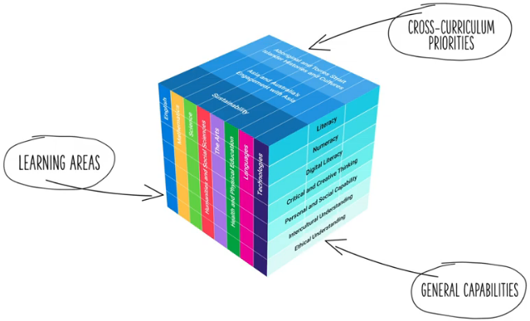
Three-dimensional Australian Curriculum v9.0
Source: [v9] ACARA from Summary overview (video) https://v9.australiancurriculum.edu.au/help/website-tour
Notes:
The Australian Curriculum v9.0 has a three-dimensional structure consisting of eight learning areas, seven general capabilities (GCs) and three cross-curriculum priorities.
CCPs and GCs are incorporated in learning area content in ways that are appropriate and authentic; they are not separate learning areas or subjects.

Slide 5
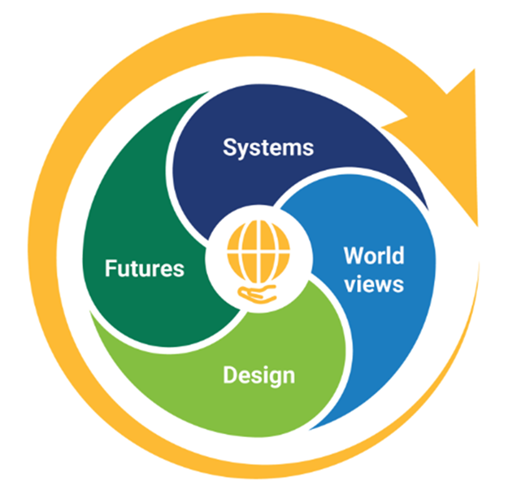
Sustainability: Structure
Structure
Key connections
Downloads
Source: www.australiancurriculum.edu.au/f-10-curriculum/cross-curriculum-priorities/sustainability?organising-idea=SS%2CSW%2CSD
Notes:
This diagram, developed by ACARA, represents the structure of the Sustainability CCP.
It illustrates four distinct sections, known as sets of organising ideas.​
Each CCP includes its own diagram, outlining the specific sets of organising ideas within that priority.
Source: https://www.australiancurriculum.edu.au/curriculum-information/understand-this-cross-curriculum-priority/sustainability

Slide 6

Sustainability: Structure
These organising ideas address the interdependence of the Earth’s systems (geosphere, biosphere, hydrosphere, atmosphere) that support all life on Earth, and social and economic systems.
These organising ideas encourage ways of thinking
and acting that seek to empower young people to design action that will lead to an equitable, sustainable and inclusive future.
These organising ideas address the role of innovation and creativity in sustainably designed solutions, including products, environments and services, which aim to reduce present and future impacts or
to restore the health or diversity of environmental, social and economic systems.
These organising ideas address sets of attitudes, values and beliefs about the world around us which inform our thoughts and actions that shape individual and community ideas about how the world works and our role in the world.
Source: www.australiancurriculum.edu.au/help/cross-curriculum-priorities
Notes:
The Sustainability CCP is structured according to four sets of organising ideas:
Systems
World views
Design
Futures.
Each set of organising ideas is then broken down into organising ideas.

Slide 7

Organising ideas
Systems | World views | Design | Futures
All life forms, including human life, are connected through Earth’s systems (geosphere, biosphere, hydrosphere and atmosphere) on which they depend for their wellbeing and survival. (SS1) | World views that recognise the interdependence of Earth’s systems, and value diversity, equity and social justice, are essential for achieving sustainability. (SW1) | Sustainably designed products, environments and services aim to minimise the impact on or restore the quality and diversity of environmental, social and economic systems. (SD1) | Sustainable futures are achieved through informed individual, community, business and political action that values local, national and global equity and fairness across generations into the future. (SF1)
Sustainable patterns of living require the responsible use of resources, maintenance of clean air, water and soils, and preservation or restoration of healthy environments. (SS2) | World views are formed by experiences at personal, local, national and global levels, and are linked to individual, community, business and political actions for sustainability. (SW2) | Creative and innovative design is integral to the identification of new ways of sustainable living. (SD2) | Sustainable futures require individuals to seek information, identify solutions, reflect on and evaluate past actions, and collaborate with and influence others as they work towards a desired change. (SF2)
Social, economic and political systems influence the sustainability of Earth’s systems. (SS3) |  | Sustainable design requires an awareness of place, past practices, research and technological developments, and balanced judgements based on projected environmental, social and economic impacts. (SD3)
Notes:
The organising ideas highlight key knowledge, understanding, and skills related to Sustainability.
Source: https://www.australiancurriculum.edu.au/curriculum-information/understand-this-cross-curriculum-priority/sustainability

Slide 8
Overview
Identifying connections to learning area content
Embedding the CCP in planning
Next steps
Understanding the Sustainability CCP

Slide 9
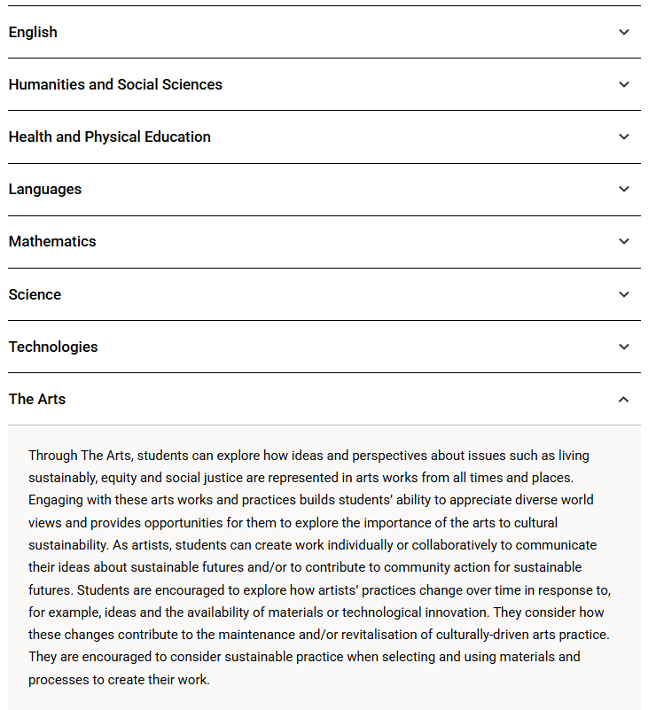
Sustainability: Key connections
Structure
Key connections
Downloads
Notes:
The Key connections section of the Australian Curriculum v9.0 provides information on how the Sustainability CCP may be developed within each learning area.
This section is found under the Understand this cross-curriculum priority section of the Australian Curriculum website.
The example for The Arts highlights how students can explore how artists represent ideas about sustainable futures and learn to make creative choices, such as the materials they use, that reflect sustainable and culturally respectful practices. to develop sustainable living, equity and social justice.
When developing teaching and learning sequences that address this priority, teachers are also encouraged to:
draw on their school’s context to support and inform the engagement of the capability within their individual setting
use the elements of the priority as scaffolding to develop and enrich content knowledge, understanding and skills within the learning area/s.
Source: http://www.australiancurriculum.edu.au/curriculum-information/understand-this-cross-curriculum-priority/sustainability#accordion-7b93a5b466-item-ee4e927d42

Slide 10
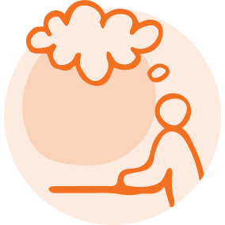
Exploring an organising idea
Consider where this organising idea naturally connects with your learning area and year level.
Identify how you might embed it in ways that are authentic and appropriate for all students.
Design
Sustainably designed products, environments and services aim to minimise the impact on or restore the quality and diversity of environmental, social and economic systems. (SD1)
Notes:
Identify a learning area and year level.
Using that context, consider where the organising idea from the Design set of organising ideas naturally connects with the learning area and year level content.
Consider:
where this organising idea aligns with what students are already learning
how this organising idea could be embedded in ways that are authentic and appropriate for all students.

Slide 11
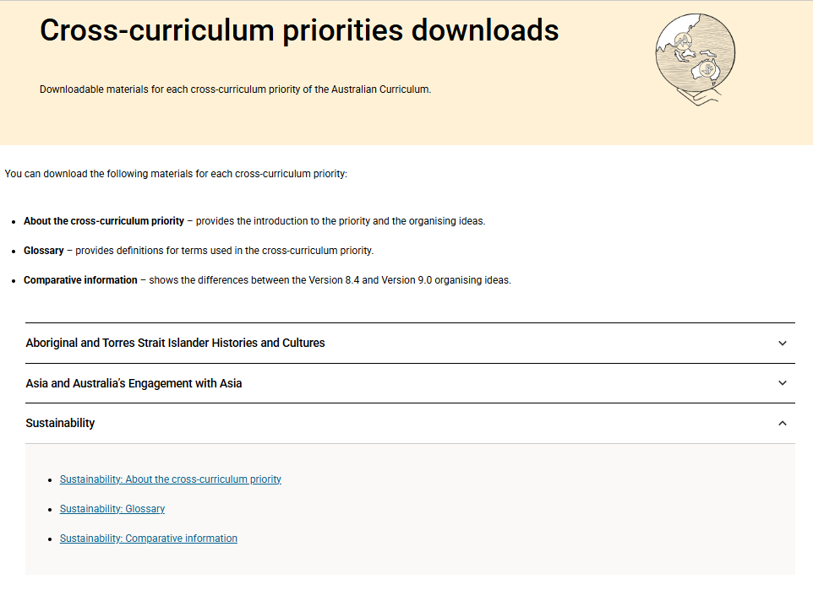
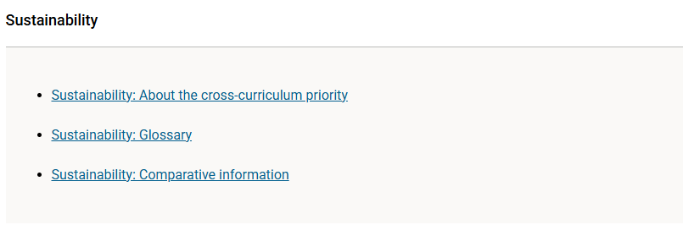
Sustainability: Downloads
What?
Structure
Key connections
Downloads
Source: ACARA www.australiancurriculum.edu.au/downloads/cross-curriculum-priorities
Notes:
More information about the priority (including glossary and comparative information) is available in the Downloads section on the Australian Curriculum website.
Source: https://www.australiancurriculum.edu.au/curriculum-information/understand-this-cross-curriculum-priority/sustainability

Slide 12
Overview
Identifying connections to learning area content
Embedding the CCP in planning
Next steps
Understanding the Sustainability CCP

Slide 13
An approach for embedding the CCP in planning
Identify curriculum
Clarify and contextualise
Identify appropriate and authentic connections
Contextual engagement
Professional conversations
Language/ resources
Learning area
CCP
Achievement standard
Sets of organising ideas
Content description/s
Organising ideas
Notes:
This is one approach to embedding the Sustainability CCP within curriculum planning.
The process draws on guidance from the QCAA Elements for effective planning, which provides support for the planning of teaching, learning and assessment.
The process highlights two key phases:
identify curriculum
clarify and contextualise.

Slide 14
Identify curriculum
Identify curriculum
Clarify and contextualise
Identify appropriate and authentic connections
Contextual engagement
Professional conversations
Language/ resources
Learning area
CCP
Achievement standard
Sets of organising ideas
Content description/s
Organising ideas
Notes:
Once the curriculum elements have been identified, teachers can use the Australian Curriculum website and/or QCAA resources to identify the sets of organising ideas and organising ideas of the relevant CCP that can be authentically and appropriately embedded to enrich student learning.

Slide 15
Identify relevant organising ideas
Systems | World views | Design | Futures
All life forms, including human life, are connected through Earth’s systems (geosphere, biosphere, hydrosphere and atmosphere) on which they depend for their wellbeing and survival. (SS1) | World views that recognise the interdependence of Earth’s systems, and value diversity, equity and social justice, are essential for achieving sustainability. (SW1) | Sustainably designed products, environments and services aim to minimise the impact on or restore the quality and diversity of environmental, social and economic systems. (SD1) | Sustainable futures are achieved through informed individual, community, business and political action that values local, national and global equity and fairness across generations into the future. (SF1)
Sustainable patterns of living require the responsible use of resources, maintenance of clean air, water and soils, and preservation or restoration of healthy environments. (SS2) | World views are formed by experiences at personal, local, national and global levels, and are linked to individual, community, business and political actions for sustainability. (SW2) | Creative and innovative design is integral to the identification of new ways of sustainable living. (SD2) | Sustainable futures require individuals to seek information, identify solutions, reflect on and evaluate past actions, and collaborate with and influence others as they work towards a desired change. (SF2)
Social, economic and political systems influence the sustainability of Earth’s systems. (SS3) |  | Sustainable design requires an awareness of place, past practices, research and technological developments, and balanced judgements based on projected environmental, social and economic impacts. (SD3)
Source: https://www.australiancurriculum.edu.au/f-10-curriculum/cross-curriculum-priorities/sustainability?organising-idea=SS%2CSW%2CSD
Notes:
A Years 1–2 Design and Technologies example will be used to illustrate the Identify curriculum phase of the process.
The highlighted (red) boxes show the relevant organising ideas from the CCP. The following slides demonstrate how these organising ideas may be embedded within a Years 1–2 unit.

Slide 16
Identify relevant organising ideas
Unit — Farming for food
In this unit, students learn how food gets from farms to their plate. They find out where food comes from and what happens to make it ready to eat. They learn that all living things — people, plants, and animals — are connected and rely on Earth’s air, water, soil, and sunlight to stay alive and healthy. Students explore tools and machines farmers use on different farms, like dairy farms and crop farms. Students visit a local farm or talk to a farmer online to see how farmers look after the land and grow food for their community. They discover simple ways farmers save water and make harvesting easier, such as planting in rows. They learn how farmers use tools and technologies to care for animals, grow crops, and look after natural resources, such as soil and water, and compare past and present farming practices. Students establish a mini garden (environment) out of a reused container (e.g. small ice cream tub) to grow an edible plant, like beans or radishes. They care for their plant and learn how it can be prepared for eating.
Notes:
The relevant aspect/s of the achievement standard, along with the aligned content descriptions, has informed the context and focus of the example unit, Farming for food.
The unit description incorporates language and themes of the organising ideas across the sets of organising ideas of Systems, Design and Futures.

Slide 17
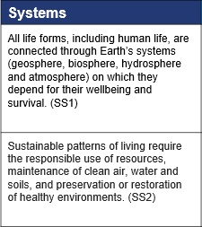
Identify organising ideas: Systems
Unit — Farming for food
In this unit, students learn how food gets from farms to their plate. They find out where food comes from and what happens to make it ready to eat. They learn that all living things — people, plants, and animals — are connected and rely on Earth’s air, water, soil, and sunlight to stay alive and healthy. Students explore tools and machines farmers use on different farms, like dairy farms and crop farms. Students visit a local farm or talk to a farmer online to see how farmers look after the land and grow food for their community. They discover simple ways farmers save water and make harvesting easier, such as planting in rows. They learn how farmers use tools and technologies to care for animals, grow crops, and look after natural resources, such as soil and water, and compare past and present farming practices. Students establish a mini garden (environment) out of a reused container (e.g. small ice cream tub) to grow an edible plant, like beans or radishes. They care for their plant and learn how it can be prepared for eating.
Notes:
Systems:
Through the Systems organising ideas, students learn that all living things are connected and rely on Earth’s air, water, soil and sunlight to stay healthy.
As they explore paddock-to-plate systems, students begin to understand how farms, food, people and places work together to support sustainable communities.
Caring for their own mini garden helps students see how simple actions can support healthy environments and contribute to sustainable patterns of living.

Slide 18
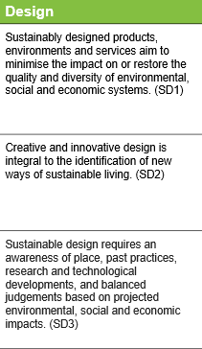
Organising ideas: Design
Unit — Farming for food
In this unit, students learn how food gets from farms to their plate. They find out where food comes from and what happens to make it ready to eat. They learn that all living things — people, plants, and animals — are connected and rely on Earth’s air, water, soil, and sunlight to stay alive and healthy. Students explore tools and machines farmers use on different farms, like dairy farms and crop farms. Students visit a local farm or talk to a farmer online to see how farmers look after the land and grow food for their community. They discover simple ways farmers save water and make harvesting easier, such as planting in rows. They learn how farmers use tools and technologies to care for animals, grow crops, and look after natural resources, such as soil and water, and compare past and present farming practices. Students establish a mini garden (environment) out of a reused container (e.g. small ice cream tub) to grow an edible plant, like beans or radishes. They care for their plant and learn how it can be prepared for eating.
Notes:
Design:
Through sustainable design inquiry, students think about how farmers and communities care for places now and in the past, and how simple design choices can help us look after the environment in the future.
As they investigate food and farming, student notice how different tools, machines and practices can help protect soil, water and animals and begin to make simple judgments about which practices help keep Earth’s resources healthy.
A focus on sustainable food and farming practices provides opportunities for students to deepen their understanding of how everyday actions and industry practices influence long-term sustainability.

Slide 19
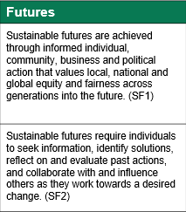
Organising ideas: Futures
Unit — Farming for food
In this unit, students learn how food gets from farms to their plate. They find out where food comes from and what happens to make it ready to eat. They learn that all living things — people, plants, and animals — are connected and rely on Earth’s air, water, soil, and sunlight to stay alive and healthy. Students explore tools and machines farmers use on different farms, like dairy farms and crop farms. Students visit a local farm or talk to a farmer online to see how farmers look after the land and grow food for their community. They discover simple ways farmers save water and make harvesting easier, such as planting in rows. They learn how farmers use tools and technologies to care for animals, grow crops, and look after natural resources, such as soil and water, and compare past and present farming practices. Students establish a mini garden (environment) out of a reused container (e.g. small ice cream tub) to grow an edible plant, like beans or radishes. They care for their plant and learn how it can be prepared for eating.
Notes:
Futures:
Through the Futures organising idea, students think about how things were done in the past, how they are done now and how their choices can help make positive changes in the future.
This helps them understand that small sustainable actions, like caring for their mini garden or using materials thoughtfully, can make a difference in their world over time.

Slide 20
Clarify and contextualise
Identify curriculum
Clarify and contextualise
Identify appropriate and authentic connections
Contextual engagement
Professional conversations
Language/ resources
Learning area
CCP
Achievement standard
Sets of organising ideas
Content description/s
Organising ideas
Notes:
The next phase of the process relates to clarifying and contextualising the role of the priority in teaching and learning.
Three areas of clarify and contextualise for the embedding of the Sustainability priority are:
contextual engagement — collaborate/connect with organisations or local experts, e.g. environmental groups, councils, sustainability consultants.
professional conversations — engage in professional discussions to deepen understanding of sustainability dimensions across disciplines, sustainable thinking, values and future design.
language/resources — use futures-oriented, systems-thinking language. Review terminology and ensure alignment with global sustainability frameworks, e.g. United Nations Sustainable Development Goals. Terms such as sustainable patterns of living, balanced judgments based on projected impacts, and informed action for a sustainable future should guide both teacher language and student understanding.

Slide 21
Contextual engagement
Unit — Farming for food
In this unit, students learn how food gets from farms to their plate. They find out where food comes from and what happens to make it ready to eat. They learn that all living things — people, plants, and animals — are connected and rely on Earth’s air, water, soil, and sunlight to stay alive and healthy. Students explore tools and machines farmers use on different farms, like dairy farms and crop farms. Students visit a local farm or talk to a farmer online to see how farmers look after the land and grow food for their community. They discover simple ways farmers save water and make harvesting easier, such as planting in rows. They learn how farmers use tools and technologies to care for animals, grow crops, and look after natural resources, such as soil and water, and compare past and present farming practices. Students establish a mini garden (environment) out of a reused container (e.g. small ice cream tub) to grow an edible plant, like beans or radishes. They care for their plant and learn how it can be prepared for eating.
Notes:
Contextual engagement helps clarify and authentically embed the priority within units by making learning relevant to students’ experiences and environments.
It connects the curriculum to real people, places and initiatives that are actively working toward a sustainable future.
Anchoring sustainability in local and lived contexts deepens student understanding and helps them see themselves as capable agents of change.

Slide 22
Language and resources
Unit — Farming for food
In this unit, students learn how food gets from farms to their plate. They find out where food comes from and what happens to make it ready to eat. They learn that all living things — people, plants, and animals — are connected and rely on Earth’s air, water, soil, and sunlight to stay alive and healthy. Students explore tools and machines farmers use on different farms, like dairy farms and crop farms. Students visit a local farm or talk to a farmer online to see how farmers look after the land and grow food for their community. They discover simple ways farmers save water and make harvesting easier, such as planting in rows. They learn how farmers use tools and technologies to care for animals, grow crops, and look after natural resources, such as soil and water, and compare past and present farming practices. Students establish a mini garden (environment) out of a reused container (e.g. small ice cream tub) to grow an edible plant, like beans or radishes. They care for their plant and learn how it can be prepared for eating.
Notes:
When incorporating sustainability in planning, it is important to use language that empowers action and promotes systems thinking.
Clear, purposeful language helps both teachers and students shift from awareness to action. It also strengthens alignment with global frameworks such as the United Nations Sustainable Development Goals, encouraging global citizenship.

Slide 23
Overview
Identifying connections to learning area content
Embedding the CCP in planning
Next steps
Understanding the Sustainability CCP

Slide 24
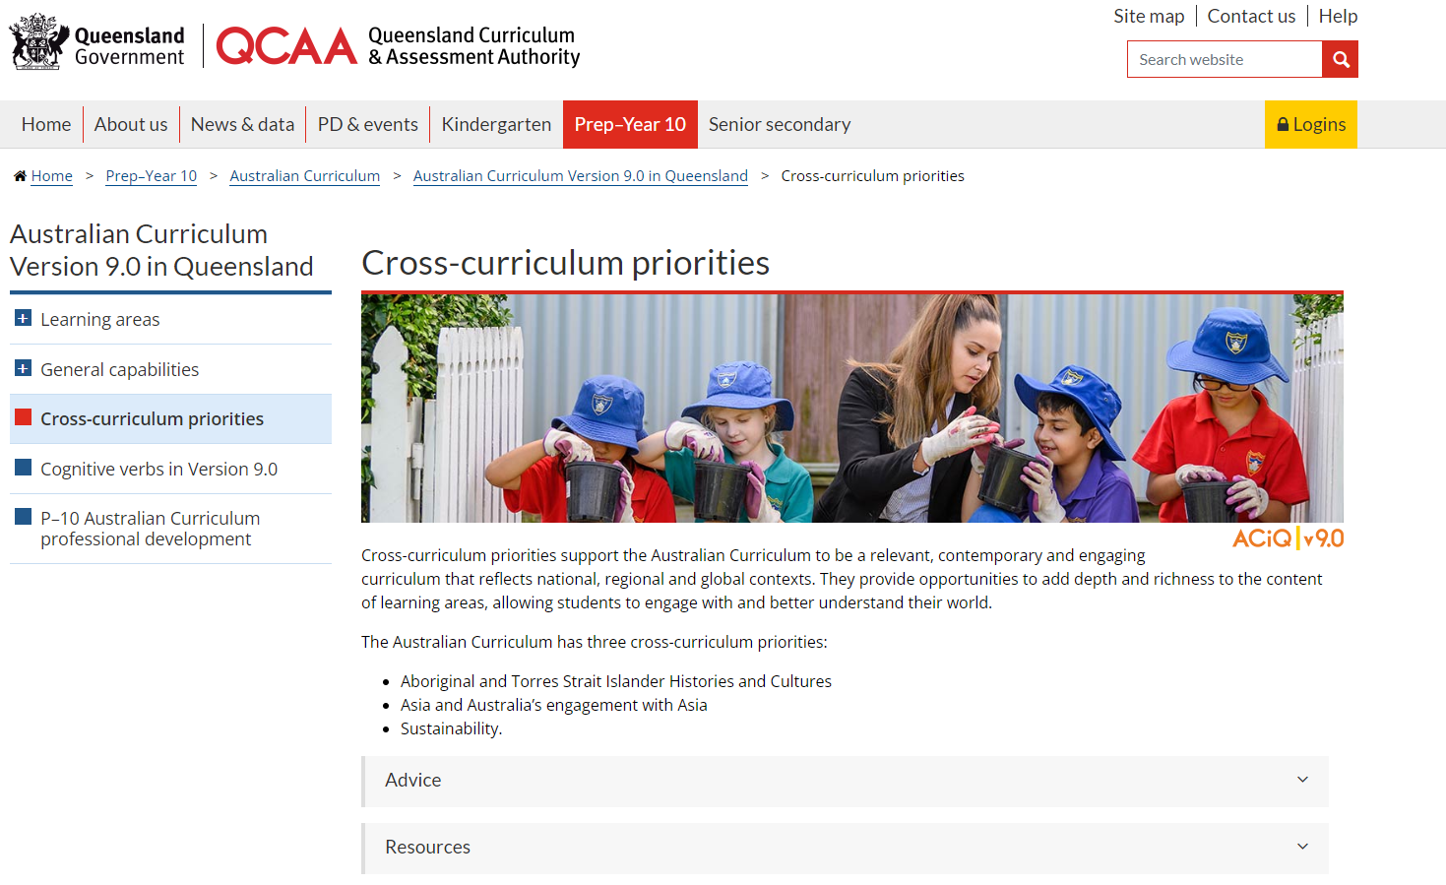

Cross-curriculum priorities resources
Notes:
Explore the QCAA website to locate key resources to support educators in planning and embedding the CCPs. These include the advice and resource documents for the CCPs.
Source: https://www.qcaa.qld.edu.au/p-10/aciq/version-9/cross-curriculum-priorities

Slide 25
Learning goal
Success criteria
To develop a deeper understanding and build confidence when embedding the Sustainability CCP into planning.
You will know you are successful
if you can:
understand the purpose and
structure of this CCP
identify strategies to embed the Sustainability CCP in curriculum planning
use QCAA resources to inform and support planning.

Slide 26
References
Australian Curriculum Assessment and Reporting Authority. (n.d.). Cross-curriculum downloads. Australian Curriculum. Australian Curriculum Assessment and Reporting Authority. https://v9.australiancurriculum.edu.au/downloads/cross-curriculum-priorities#accordion-00dfddc453-item-c84c8658c0.
Australian Curriculum Assessment and Reporting Authority. (2021). Australian Curriculum: Cross-curriculum priorities — Sustainability. Australian Curriculum. Australian Curriculum Assessment and Reporting Authority. https://www.qcaa.qld.edu.au/downloads/aciqv9/general-resources/ac9_ccp_sustainability.pdf

Slide 27
Acknowledgments
Third-party copyright material, and QCAA material not covered by the CC BY licence is listed below:
Queensland Government coat of arms, and the QCAA and QSA trademarks may not be reproduced without permission.
Acknowledgment of Country artwork (2023) ‘QCAA’s Journey’ by Chern’ee, Brooke and Jesse Sutton, Kalkadoon, www.cherneesutton.com.au.
Unless otherwise indicated, material from Australian Curriculum is © ACARA 2010–present, licensed CC BY 4.0. For the latest information and additional terms of use, see the Australian Curriculum website and its copyright notice.
Student and staff images have been used with permission.
ACARA diagrams and graphics are ‘Excluded Material’ used under the terms of the Australian Curriculum and its copyright notice and is not modified. © Australian Curriculum, Assessment and Reporting Authority (ACARA) 2009 to present, unless otherwise indicated. You may view, download, display, print, reproduce (such as by making photocopies) and distribute these Excluded Materials in unaltered form only for your personal, non-commercial educational purposes or for the non-commercial educational purposes of your organisation, provided that you make others aware it can only be used for these purposes and attribute ACARA as the source of the Excluded Material. For the avoidance of doubt, this means that you cannot edit, modify or adapt any of these materials, and you cannot sub-license any of these materials to others. Apart from any uses permitted under the Copyright Act 1968 (Cth), and those explicitly granted above, all other rights are reserved by ACARA. If you want to use such material in a manner that is outside this restrictive licence, you must request permission from ACARA by submitting a request through the online enquiry form.

Slide 28
Copyright notice
© State of Queensland (QCAA) 2026
Licence: https://creativecommons.org/licenses/by/4.0 | Copyright notice: www.qcaa.qld.edu.au/copyright — lists the full terms and conditions, which specify certain exceptions to the licence. |
Attribution (include the link): © State of Queensland (QCAA) 2026 www.qcaa.qld.edu.au/copyright.
Other copyright material in this presentation is listed on the previous slide/s.

