Slide 1
P–10 Embedding the Aboriginal and Torres Strait Islander histories and cultures cross-curriculum priority (CCP) in planning
260878
Notes:
This resource supports key slides to support teachers to embed the Aboriginal and Torres Strait Islander histories and cultures cross curriculum priority in planning.
For more resources see the Australian Curriculum v9.0 in Queensland page advice and resources https://www.qcaa.qld.edu.au/p-10/aciq/version-9/cross-curriculum-priorities

Slide 2
Learning goal
Success criteria
To develop a deeper understanding and build confidence when embedding the Aboriginal and Torres Strait Islander histories and cultures CCP into planning.
You will know you are successful if you can:
understand the purpose and structure of this CCP
identify strategies to embed the Aboriginal and Torres Strait Islander histories and cultures CCP in curriculum planning
use QCAA resources to inform and support planning.

Slide 3
Overview
Identifying connections to learning area content
Embedding the CCP in planning
Next steps
Understanding the Aboriginal and Torres Strait Islander histories and cultures CCP

Slide 4
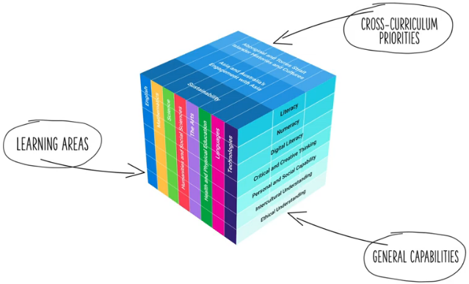
Three-dimensional Australian Curriculum v9.0
Source: [v9] ACARA from Summary overview (video) https://v9.australiancurriculum.edu.au/help/website-tour
Notes:
The Australian Curriculum v9.0 has a three-dimensional structure consisting of eight learning areas, seven general capabilities (GCs) and three cross-curriculum priorities.
CCPs and GCs are incorporated in learning area content in ways that are appropriate and authentic; they are not separate learning areas or subjects.

Slide 5
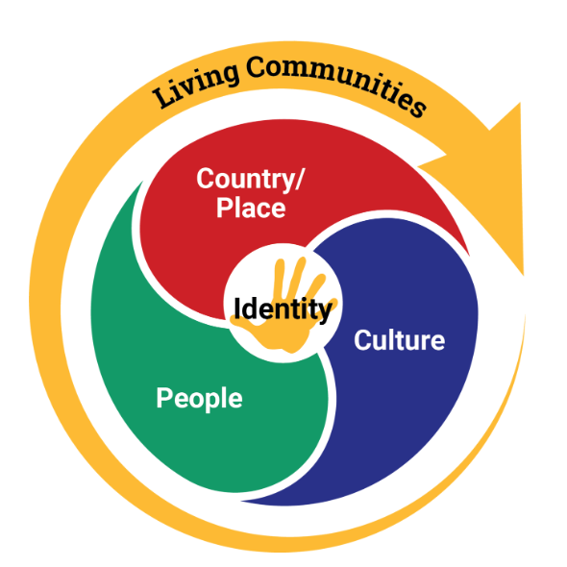
Aboriginal and Torres Strait Islander histories and cultures: Structure
Structure
Key connections
Downloads
Source: Asia and Australia's Engagement with Asia | V9 Australian Curriculum
Notes:
This diagram, developed by ACARA, represents the structure of the Aboriginal and Torres Strait Islander histories and cultures CCP.
It illustrates Living communities and Identity as central to Aboriginal and Torres Strait Islander histories and cultures.
There are also three distinct sections, known as aspects.
Each CCP includes its own diagram, outlining the specific aspects (or sets of organising ideas) within that priority.
Source: https://www.australiancurriculum.edu.au/curriculum-information/understand-this-cross-curriculum-priority/aboriginal-and-torres-strait-islander-histories-and-cultures

Slide 6
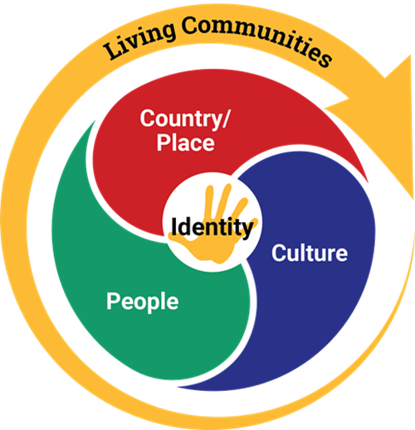
CCP: Aboriginal and Torres Strait Islander histories and cultures
These organising ideas recognise the special connection of First Nations Australians to Country/Place and acknowledge the impacts of colonisation
on their ownership of and
access to Country/Place.
These organising ideas recognise that Australia
has 2 distinct First Nations Peoples, each encompassing a diversity of nations and peoples, and examine the significant contributions of First Nations Australians’ histories and cultures on
a local, national and
global scale.
These organising ideas examine the cultural diversity of the First Peoples of Australia and the First Nations Peoples of the Torres Strait and recognise Australian First Nations Peoples as belonging to the world’s oldest continuous cultures.
Source: Aboriginal and Torres Strait Islander Histories and Cultures | V9 Australian Curriculum, pp. 2–4
Notes:
The Aboriginal and Torres Strait Islander histories and cultures CCP is structured according to three aspects:
Country/Place
Culture
People.
Each aspect (or sets of organising ideas) is then broken down into organising ideas.
For a deeper exploration of the structure of the Aboriginal and Torres Strait Islander histories and cultures CCP, you may refer to the recording on the QCAA website: https://www.qcaa.qld.edu.au/p-10/aciq/version-9/cross-curriculum-priorities/understanding-the-aboriginal-and-torres-strait-islander-histories-and-cultures-ccp-p-10

Slide 7
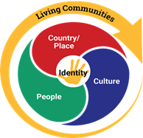
Organising ideas
Country/Place | Culture | People
First Nations communities of Australia maintain a deep connection to, and responsibility for, Country/Place and have holistic values and belief systems that are connected to the land, sea, sky and waterways. (A_TSICP1) | First Nations Australian societies are diverse and have distinct cultural expressions such as language, customs and beliefs. As First Nations Peoples of Australia they have the right to maintain, control, protect and develop their cultural expressions, while also maintaining the right to control, protect and develop culture as Indigenous Cultural and Intellectual Property. (A_TSIC1) | Australia has 2 distinct First Nations Peoples; each encompasses a diversity of nations across Australia. Aboriginal Peoples are the first peoples of Australia and have occupied the Australian continent for more than 60,000 years. Torres Strait Islander Peoples are the First Nations Peoples of the Torres Strait and have occupied the region for over 4,000 years. (A_TSIP1)
The occupation and colonisation of Australia by the British, under the now overturned doctrine of terra nullius, were experienced by First Nations Australians as an invasion that denied their occupation of, and connection to, Country/Place. (A_TSICP2) | First Nations Australians’ ways of life reflect unique ways of being, knowing, thinking and doing. (A_TSIC2) | First Nations Australians have sophisticated political, economic and social organisation systems, which include family and kinship structures, laws, traditions, customs, land tenure systems and protocols for strong governance and authority. (A_TSIP2)
The First Peoples of Australia are the traditional owners of Country/Place, protected in Australian Law by the Native Title Act 1993 which recognises pre-existing sovereignty, continuing systems of law and customs, and connection to Country/Place. This recognised legal right provides for economic sustainability and a voice into the development and management of Country/Place. (A_TSICP3) | The First Peoples of Australia (Aboriginal Peoples) belong to the world’s oldest continuous cultures. First Nations Australians demonstrate resilience in the maintenance, practice and revitalisation of culture despite the many historic and enduring impacts of colonisation, and continue to celebrate and share the past, present and future manifestations of their cultures. (A_TSIC3) | The significant and ongoing contributions of First Nations Australians and their histories and cultures are acknowledged locally, nationally and globally. (A_TSIP3)
Notes:
The organising ideas highlight core themes such as deep connections to Country, resilience and continuity of cultures, and the strength and diversity of First Nations Peoples.
Source: https://www.australiancurriculum.edu.au/downloads/cross-curriculum-priorities#accordion-293b2b1daa-item-f76f4633e7

Slide 8
Overview
Identifying connections to learning area content
Embedding the CCP in planning
Next steps
Understanding the Aboriginal and Torres Strait Islander histories and cultures CCP

Slide 9
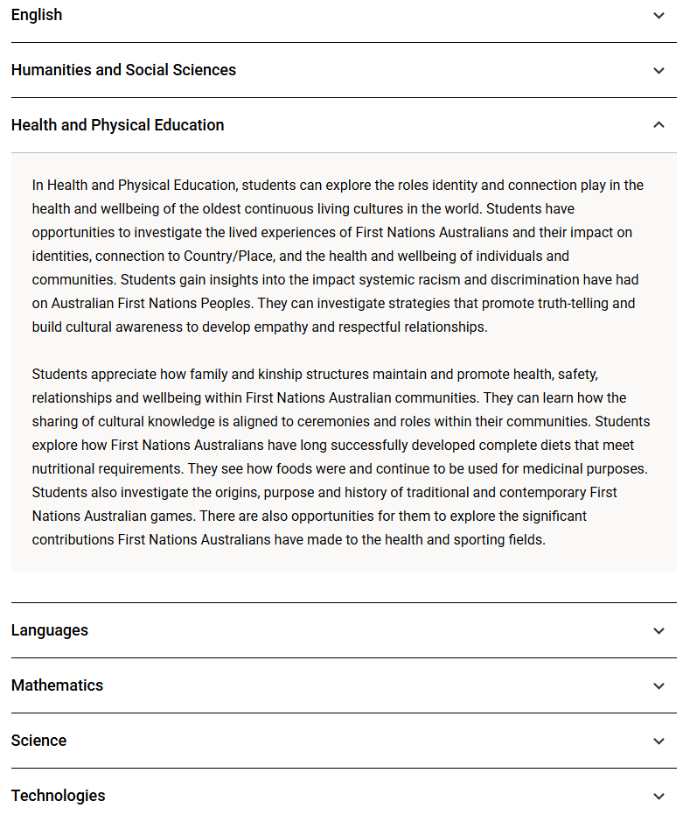
Aboriginal and Torres Strait Islander histories and cultures: Key connections
Structure
Key connections
Downloads
Notes:
The Key connections section of the Australian Curriculum v9.0 provides information on how the Aboriginal and Torres Strait Islander histories and cultures CCP may be developed within each learning area.
This section is found under the Understand this cross-curriculum priority section of the Australian Curriculum website.
The example for Health and Physical Education (HPE) highlights that students explore the roles identity and connection play in the health and wellbeing of the oldest continuous living cultures in the world. Within HPE, students can investigate the lived experiences of First Nations Australians and their impact on identities, connection to Country/Place, and the health and wellbeing of individuals and communities.
When developing teaching and learning sequences that address this priority, teachers are also encouraged to:
draw on their school’s context to support and inform the engagement of the capability within their individual setting
use the elements of the priority as scaffolding to develop and enrich content knowledge, understanding and skills within the learning area/s.
Source: https://www.australiancurriculum.edu.au/curriculum-information/understand-this-cross-curriculum-priority/aboriginal-and-torres-strait-islander-histories-and-cultures

Slide 10

Exploring an organising idea
Consider where this organising idea naturally connects with your learning area and year level.
Identify how you might embed it in ways that are authentic and appropriate for all students.
People
The significant and ongoing contributions of First Nations Australians and their histories and cultures are acknowledged locally, nationally and globally. (A_TSIP3)
Notes:
Identify a learning area and year level.
Using that context, consider where the organising idea from the People aspect naturally connects with the learning area and year level content.
Consider:
where this organising idea aligns with what students are already learning
how this organising idea could be embedded in ways that are authentic and appropriate for all students.

Slide 11
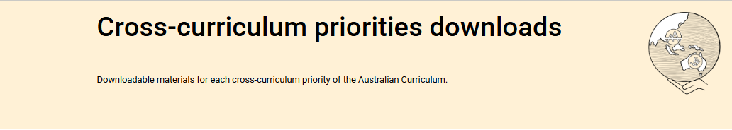
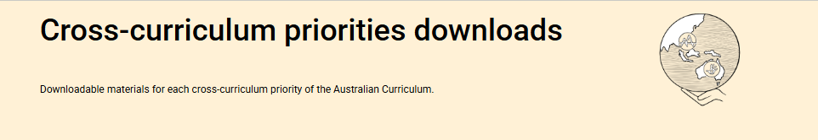
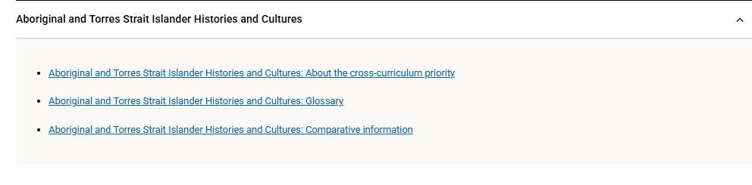
Aboriginal and Torres Strait histories and cultures: Downloads
What?
Structure
Key connections
Downloads
Source: ACARA https://www.australiancurriculum.edu.au/curriculum-information/understand-this-cross-curriculum-priority/aboriginal-and-torres-strait-islander-histories-and-cultures
Notes:
More information about the priority (including glossary and comparative information) is available in the Downloads section on the Australian Curriculum website.
Source: https://www.australiancurriculum.edu.au/curriculum-information/understand-this-cross-curriculum-priority/aboriginal-and-torres-strait-islander-histories-and-cultures

Slide 12
Overview
Identifying connections to learning area content
Embedding the CCP in planning
Next steps
Understanding the Aboriginal and Torres Strait Islander histories and cultures CCP

Slide 13
An approach for embedding the CCP in planning
Identify curriculum
Clarify and contextualise
Identify appropriate and authentic connections
Engagement with community
Professional conversations
Language/ resources
Learning area
CCP
Achievement standard
Aspects
Content description/s
Organising ideas
Notes:
This is one approach to embedding the Aboriginal and Torres Strait Islander histories and cultures CCP within curriculum planning.
The process draws on guidance from the QCAA Elements for effective planning, which provides support for the planning of teaching, learning and assessment.
The process highlights two key stages:
identify curriculum
clarify and contextualise.

Slide 14
Identify curriculum
Identify curriculum
Clarify and contextualise
Identify appropriate and authentic connections
Engagement with community
Professional conversations
Language/ resources
Learning area
CCP
Achievement standard
Aspects
Content description/s
Organising ideas
Notes:
Once the curriculum elements have been identified, teachers can use the Australian Curriculum website and/or QCAA resources to identify the aspects (or sets of organising ideas) and organising ideas of the relevant CCP that can be authentically and appropriately embedded to enrich student learning.

Slide 15
Identify relevant organising ideas
Country/Place | Culture | People
First Nations communities of Australia maintain a deep connection to, and responsibility for, Country/Place and have holistic values and belief systems that are connected to the land, sea, sky and waterways. (A_TSICP1) | First Nations Australian societies are diverse and have distinct cultural expressions such as language, customs and beliefs. As First Nations Peoples of Australia they have the right to maintain, control, protect and develop their cultural expressions, while also maintaining the right to control, protect and develop culture as Indigenous Cultural and Intellectual Property. (A_TSIC1) | Australia has 2 distinct First Nations Peoples; each encompasses a diversity of nations across Australia. Aboriginal Peoples are the first peoples of Australia and have occupied the Australian continent for more than 60,000 years. Torres Strait Islander Peoples are the First Nations Peoples of the Torres Strait and have occupied the region for over 4,000 years. (A_TSIP1)
The occupation and colonisation of Australia by the British, under the now overturned doctrine of terra nullius, were experienced by First Nations Australians as an invasion that denied their occupation of, and connection to, Country/Place. (A_TSICP2) | First Nations Australians’ ways of life reflect unique ways of being, knowing, thinking and doing. (A_TSIC2) | First Nations Australians have sophisticated political, economic and social organisation systems, which include family and kinship structures, laws, traditions, customs, land tenure systems and protocols for strong governance and authority. (A_TSIP2)
The First Peoples of Australia are the traditional owners of Country/Place, protected in Australian Law by the Native Title Act 1993 which recognises pre-existing sovereignty, continuing systems of law and customs, and connection to Country/Place. This recognised legal right provides for economic sustainability and a voice into the development and management of Country/Place. (A_TSICP3) | The First Peoples of Australia (Aboriginal Peoples) belong to the world’s oldest continuous cultures. First Nations Australians demonstrate resilience in the maintenance, practice and revitalisation of culture despite the many historic and enduring impacts of colonisation, and continue to celebrate and share the past, present and future manifestations of their cultures. (A_TSIC3) | The significant and ongoing contributions of First Nations Australians and their histories and cultures are acknowledged locally, nationally and globally. (A_TSIP3)
Notes:
A Years 5–6 HPE example will be used to illustrate the Identify curriculum phase of the process.
The highlighted (red) boxes show the relevant organising ideas from the CCP. The following slides demonstrate how these organising ideas may be embedded within a Years 5–6 HPE unit.
Source: https://www.australiancurriculum.edu.au/curriculum-information/understand-this-cross-curriculum-priority/aboriginal-and-torres-strait-islander-histories-and-cultures

Slide 16
Identify relevant organising ideas
Years 5–6 Unit 2 — Empowering identities for belonging
In this unit, students explore how personal strengths, family, peers and popular culture can influence their choices (e.g. clothing, activities, music) and contribute to the development of their identity. They share cultural practices (e.g. location of language, connection to Country/Place, stories and values) that contribute to their identity and explain how the ability to appreciate other cultures and backgrounds assists in the development of social awareness. Students explore ways the school and the local community celebrate culture and examine how showing empathy during intercultural experiences shapes identities
and supports relationship building, cultural resilience and sustains respectful interactions.
Students examine values, beliefs and cultural practices and expressions of Aboriginal cultures and Torres Strait Islander cultures with connection to ‘Country/Place’ (e.g. language use, kinship systems, hunting and gathering food, ceremonial gatherings, traditional dress, storytelling and games) and how this conveys meaning and influences Aboriginal Peoples and Torres Strait Islander Peoples’ sense of identity and belonging. They reflect on ways that different groups use cultural practices
and expressions to represent themselves. Students participate in traditional Aboriginal games and Torres Strait Islander games using the Australian Government Yulunga Traditional Indigenous Games resource, acknowledging the traditional language location of where the game originates from and where it is being introduced. They investigate ways the games foster respectful interactions between community members and value connections to land, sea, sky and waterways.
Students select a group who signify their identity through colour/s, dress and/or symbol/s and propose a way to celebrate the group in their local community.
Note: Through consultation with local Traditional Custodians/First Nations community members, students may be guided and given consent to engage in additional Aboriginal and Torres Strait Islander cultural practices and expressions, e.g. languages, totem constructions, traditional dance.
Notes:
The relevant aspect/s of the achievement standard, along with the aligned content descriptions, has informed the context and focus of the example unit, Empowering identities for belonging.
The unit description incorporates language and themes of the organising ideas across the aspects of Country/Place, Culture and People.

Slide 17
Organising ideas: Country/Place
Country/Place
First Nations communities of Australia maintain a deep connection to, and responsibility for, Country/Place and have holistic values and belief systems that are connected to the land, sea, sky and waterways. (A_TSICP1)
Years 5–6 Unit 2 — Empowering identities for belonging
In this unit, students explore how personal strengths, family, peers and popular culture can influence their choices (e.g. clothing, activities, music) and contribute to the development of their identity. They share
cultural practices (e.g. location of language, connection to Country/Place, stories and values) that
contribute to their identity and explain how the ability to appreciate other cultures and backgrounds
assists in the development of social awareness. Students explore ways the school and the local community
celebrate culture and examine how showing empathy during intercultural experiences shapes identities
and supports relationship building, cultural resilience and sustains respectful interactions.
Students examine values, beliefs and cultural practices and expressions of Aboriginal cultures and Torres Strait Islander cultures with connection to ‘Country/Place’ (e.g. language use, kinship systems, hunting and gathering food, ceremonial gatherings, traditional dress, storytelling and games) and how this conveys meaning and influences Aboriginal Peoples and Torres Strait Islander Peoples’ sense of identity and belonging. They reflect on ways that different groups use cultural practices and expressions to represent themselves. Students participate in traditional Aboriginal games and Torres Strait Islander games using
the Australian Government Yulunga Traditional Indigenous Games resource, acknowledging the traditional language location of where the game originates from and where it is being introduced. They investigate ways the games foster respectful interactions between community members and value connections
to land, sea, sky and waterways.
Students select a group who signify their identity through colour/s, dress and/or symbol/s and propose
a way to celebrate the group in their local community.
Note: Through consultation with local Traditional Custodians/First Nations community members, students may be guided and given consent to engage in additional Aboriginal and Torres Strait Islander cultural practices and expressions, e.g. languages, totem constructions, traditional dance.
Notes:
Country/Place:
Learning is explicitly connected to understanding Country, and the responsibilities that come with that relationship.
Students investigate how traditional games encourage respectful interactions within communities.
Through these experiences, students also explore and value the deep connections to land, sea, sky and waterways (organising idea A_TSICP1).

Slide 18
Organising ideas: Culture
Culture
First Nations Australian societies are diverse and have distinct cultural expressions such as language, customs and beliefs. As First Nations Peoples of Australia they have the right to maintain, control, protect and develop their cultural expressions, while also maintaining the right to control, protect and develop culture as Indigenous Cultural and Intellectual Property. (A_TSIC1)
First Nations Australians’ ways of life reflect unique ways of being, knowing, thinking and doing. (A_TSIC2)
Years 5–6 Unit 2 — Empowering identities for belonging
In this unit, students explore how personal strengths, family, peers and popular culture can influence their choices (e.g. clothing, activities, music) and contribute to the development of their identity. They share cultural practices (e.g. location of language, connection to Country/Place, stories and values) that contribute to their identity and explain how the ability to appreciate other cultures and backgrounds assists
in the development of social awareness. Students explore ways the school and the local community
celebrate culture and examine how showing empathy during intercultural experiences shapes identities
and supports relationship building, cultural resilience and sustains respectful interactions.
Students examine values, beliefs and cultural practices and expressions of Aboriginal cultures and Torres Strait Islander cultures with connection to ‘Country/Place’ (e.g. language use, kinship systems, hunting and gathering food, ceremonial gatherings, traditional dress, storytelling and games) and how this conveys meaning and influences Aboriginal Peoples and Torres Strait Islander Peoples’ sense of identity and belonging. They reflect on ways that different groups use cultural practices and expressions to represent themselves. Students participate in traditional Aboriginal games and Torres Strait Islander games using the Australian Government Yulunga Traditional Indigenous Games resource, acknowledging the traditional language location of where the game originates from and where it is being introduced. They investigate ways the games foster respectful interactions between community members and value connections to land, sea, sky and waterways.
Students select a group who signify their identity through colour/s, dress and/or symbol/s and propose
a way to celebrate the group in their local community.
Note: Through consultation with local Traditional Custodians/First Nations community members, students
may be guided and given consent to engage in additional Aboriginal and Torres Strait Islander cultural practices and expressions, e.g. languages, totem constructions, traditional dance.
Notes:
Culture:
Students examine values, beliefs and cultural practices and expressions of Aboriginal cultures and Torres Strait Islander cultures and how this conveys meaning and influence.
Students take part in traditional Aboriginal and Torres Strait Islander games, bringing the organising idea (Culture A_TSIC1) to life through lived cultural expressions.

Slide 19
Organising ideas: People
People
Australia has 2 distinct First Nations Peoples; each encompasses a diversity of nations across Australia. Aboriginal Peoples are the first peoples of Australia and have occupied the Australian continent for more than 60,000 years. Torres Strait Islander Peoples are the First Nations Peoples of the Torres Strait and have occupied the region for over 4,000 years. (A_TSIP1)
First Nations Australians have sophisticated political, economic and social organisation systems, which include family and kinship structures, laws, traditions, customs, land tenure systems and protocols for strong governance and authority. (A_TSIP2)
The significant and ongoing contributions of First Nations Australians and their histories and cultures are acknowledged locally, nationally and globally. (A_TSIP3)
Years 5–6 Unit 2 — Empowering identities for belonging
In this unit, students explore how personal strengths, family, peers and popular culture can influence their choices (e.g. clothing, activities, music) and contribute to the development of their identity. They share cultural practices (e.g. location of language, connection to Country/Place, stories and values) that contribute to their identity and explain how the ability to appreciate other cultures and backgrounds assists in the development
of social awareness. Students explore ways the school and the local community celebrate culture and examine how showing empathy during intercultural experiences shapes identities and supports relationship building, cultural resilience and sustains respectful interactions.
Students examine values, beliefs and cultural practices and expressions of Aboriginal cultures and Torres Strait Islander cultures with connection to ‘Country/Place’ (e.g. language use, kinship systems, hunting and gathering food, ceremonial gatherings, traditional dress, storytelling and games) and how this conveys meaning and influences Aboriginal Peoples and Torres Strait Islander Peoples’ sense of identity and belonging. They reflect on ways that different groups use cultural practices and expressions to represent themselves. Students participate in traditional Aboriginal games and Torres Strait Islander games using
the Australian Government Yulunga Traditional Indigenous Games resource, acknowledging the traditional language location of where the game originates from and where it is being introduced. They investigate
ways the games foster respectful interactions between community members and value connections to
land, sea, sky and waterways.
Students select a group who signify their identity through colour/s, dress and/or symbol/s and propose
a way to celebrate the group in their local community.
Note: Through consultation with local Traditional Custodians/First Nations community members, students
may be guided and given consent to engage in additional Aboriginal and Torres Strait Islander cultural practices and expressions, e.g. languages, totem constructions, traditional dance.
Notes:
People:
Students explore how the school and local community celebrate Aboriginal and Torres Strait Islander cultures.
Learning connects to kinship systems, governance and social structures, and recognises the ongoing contributions of Aboriginal and Torres Strait Islander peoples to local, national and global communities.

Slide 20
Clarify and contextualise
Identify curriculum
Clarify and contextualise
Identify appropriate and authentic connections
Engagement with community
Professional conversations
Language/ resources
Learning area
CCP
Achievement standard
Aspects
Content description/s
Organising ideas
Notes:
The next phase of the process relates to clarifying and contextualising the role of the priority in teaching and learning.
Three areas of clarify and contextualise for the embedding of Aboriginal and Torres Strait Islander histories and cultures priority are:
engagement with community — collaborate/connect with organisations or local experts
professional conversations — engage in professional discussions to deepen understanding of Aboriginal and Torres Strait Islander histories and cultures
language/resources — use strengths-based language and resources that promote understanding and counter stereotypes.

Slide 21
Engagement with community
Years 5–6 Unit 2 — Empowering identities for belonging
In this unit, students explore how personal strengths, family, peers and popular culture can influence their choices (e.g. clothing, activities, music) and contribute to the development of their identity. They share cultural practices (e.g. location of language, connection to Country/Place, stories and values) that contribute to their identity and explain how the ability to appreciate other cultures and backgrounds assists in the development of social awareness. Students explore ways the school and the local community celebrate culture and examine how showing empathy during intercultural experiences shapes identities and supports relationship building, cultural resilience and sustains respectful interactions.
Students examine values, beliefs and cultural practices and expressions of Aboriginal cultures and Torres Strait Islander cultures with connection to ‘Country/Place’ (e.g. language use, kinship systems, hunting and gathering food, ceremonial gatherings, traditional dress, storytelling and games) and how this conveys meaning and influences Aboriginal Peoples and Torres Strait Islander Peoples’ sense of identity and belonging. They reflect on ways that different groups use cultural practices and expressions to represent themselves. Students participate in traditional Aboriginal games and Torres Strait Islander games using the Australian Government Yalunga Traditional Indigenous Games resource, acknowledging the traditional language location of where the game originates from and where it is being introduced. They investigate ways the games foster respectful interactions between community members and value connections to land, sea, sky and waterways.
Students select a group who signify their identity through colour/s, dress and/or symbol/s and propose a way to celebrate the group in their local community.
Note: Through consultation with local Traditional Custodians/First Nations community members, students may
be guided and given consent to engage in additional Aboriginal and Torres Strait Islander cultural practices and
expressions, e.g. languages, totem constructions, traditional dance.
Notes:
The note at the bottom of the unit description outlines the importance of consultation and fostering meaningful relationships with Traditional Custodians and/or First Nations community members.

Slide 22
Language and Resources
Years 5–6 Unit 2 — Empowering identities for belonging
In this unit, students explore how personal strengths, family, peers and popular culture can influence their choices (e.g. clothing, activities, music) and contribute to the development of their identity. They share cultural practices (e.g. location of language, connection to Country/Place, stories and values) that contribute to their identity and explain how the ability to appreciate other cultures and backgrounds assists in the development of social awareness. Students explore ways the school and the local community celebrate culture and examine how showing empathy during intercultural experiences shapes identities and supports relationship building, cultural resilience and sustains respectful interactions.
Students examine values, beliefs and cultural practices and expressions of Aboriginal cultures and Torres Strait Islander cultures with connection to ‘Country/Place’ (e.g. language use, kinship systems, hunting and gathering food, ceremonial gatherings, traditional dress, storytelling and games) and how this conveys meaning and influences Aboriginal Peoples and Torres Strait Islander Peoples’ sense of identity and belonging. They reflect on ways that different groups use cultural practices and expressions to represent themselves. Students participate in traditional Aboriginal games and Torres Strait Islander games using the Australian Government Yulunga Traditional Indigenous Games resource, acknowledging the traditional language location of where the game originates from and where it is being introduced. They investigate ways the games foster respectful interactions between community members and value connections to land, sea, sky and waterways.
Students select a group who signify their identity through colour/s, dress and/or symbol/s and propose a way to celebrate the group in their local community.
Note: Through consultation with local Traditional Custodians/First Nations community members, students may
be guided and given consent to engage in additional Aboriginal and Torres Strait Islander cultural practices and
expressions, e.g. languages, totem constructions, traditional dance.
Notes:
When incorporating Aboriginal and Torres Strait Islander histories and cultures in planning, it is important to use culturally appropriate resources.
In this example Years 5–6 HPE unit, a key resource is the Australian Government’s Yulunga Traditional Indigenous Games resource. This collection of games provides students with an opportunity to experience and appreciate Aboriginal and Torres Strait Islander cultures through play while reinforcing values of respect, belonging and community engagement.

Slide 23
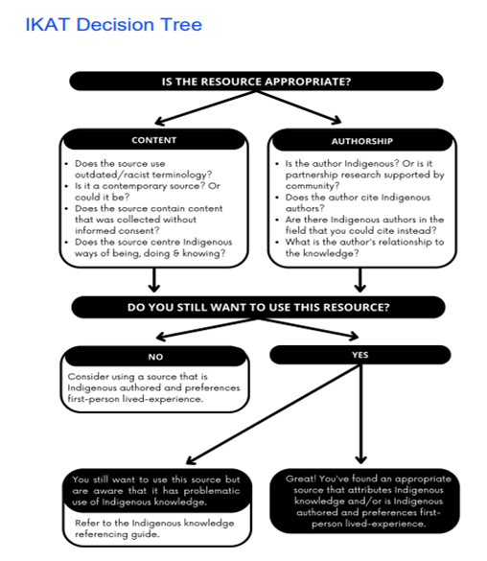
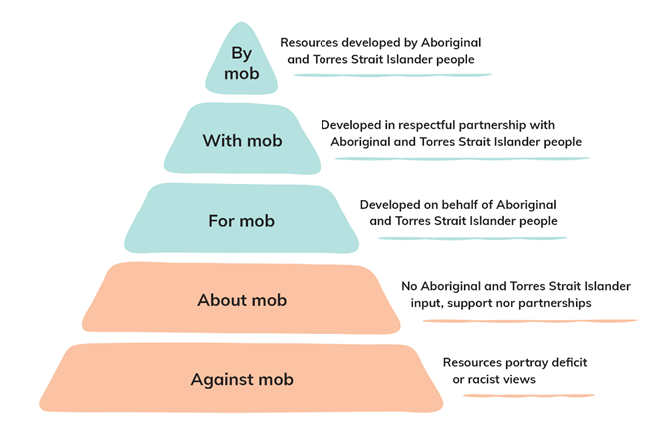
Clarify and contextualise: Resources
Evaluation pyramid diagram from Australian Institute of Aboriginal and Torres Strait Islander Studies (AIATSIS) 2022, AIATSIS Guide to evaluating and selecting education resources, https://aiatsis.gov.au/publication/118125. Used with permission.
Indigenous Knowledge Attribution Toolkit (IKAT) Decision Tree
Indigenous Archives Collective, Faulkhead, S., Thorpe, K., Sentance, N., Booker, L. & Barrowcliffe, R. (2023.) Indigenous Referencing Guidance for Indigenous Knowledges. Indigenous Archives Collective and the UTS Jumbunna Institute of Indigenous Education and Research.
Notes:
When selecting resources, it is important to critically evaluate their reliability, authenticity and cultural appropriateness.
Evaluation tools, such as these on the slide, can assist in making informed, integrity-based decisions for First Nations Australians’ texts and resources.

Slide 24
Overview
Identifying connections to learning area content
Embedding the CCP in planning
Next steps
Understanding the Aboriginal and Torres Strait Islander histories and cultures CCP

Slide 25
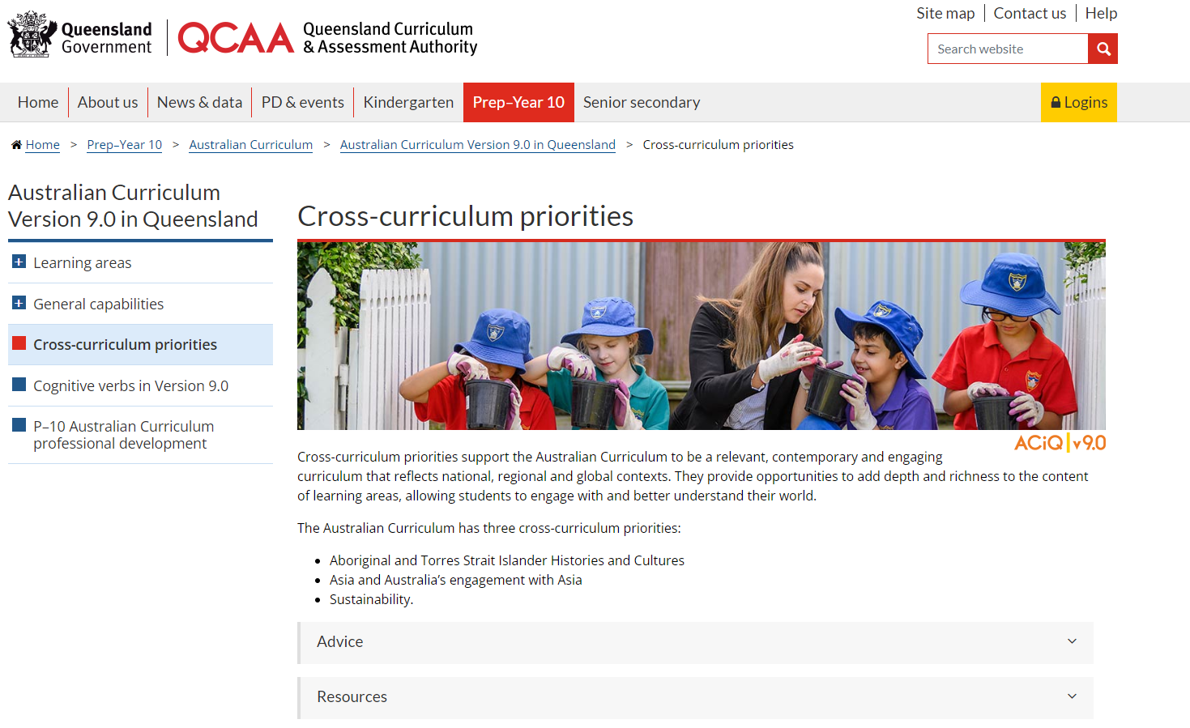
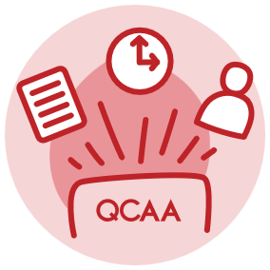
Cross-curriculum priorities resources
Notes:
Explore the QCAA website to locate key resources to support educators in planning and embedding the CCPs. These include the advice and resource documents for the CCPs.
Source: https://www.qcaa.qld.edu.au/p-10/aciq/version-9/cross-curriculum-priorities

Slide 26
Learning goal
Success criteria
To develop a deeper understanding and build confidence when embedding the Aboriginal and Torres Strait Islander histories and cultures CCP into planning.
You will know you are successful if you can:
understand the purpose and structure of this CCP
identify strategies to embed the Aboriginal and Torres Strait Islander histories and cultures CCP in curriculum planning
use QCAA resources to inform and support planning.

Slide 27
References
Australian Curriculum Assessment and Reporting Authority. (n.d.). Cross-curriculum downloads. Australian Curriculum. Australian Curriculum Assessment and Reporting Authority. https://v9.australiancurriculum.edu.au/downloads/cross-curriculum-priorities#accordion-00dfddc453-item-c84c8658c0.
Australian Curriculum Assessment and Reporting Authority. (2021). Australian Curriculum: Cross-curriculum priorities — Aboriginal and Torres Strait Islander Histories and Cultures. Australian Curriculum. Australian Curriculum Assessment and Reporting Authority. https://v8.australiancurriculum.edu.au/media/7137/ccp_atsi_histories_and_cultures_consultation.pdf
Department of Education, Skills and Employment. (2019). Alice Springs (Mparntwe) education declaration. Department of Education. https://www.education.gov.au/alice-springs-mparntwe-education-declaration/resources/alice-springs-mparntwe-education-declaration

Slide 28
Acknowledgments
Third-party copyright material, and QCAA material not covered by the CC BY licence is listed below:
Queensland Government coat of arms, and the QCAA and QSA trademarks may not be reproduced without permission.
Acknowledgment of Country artwork (2023) ‘QCAA’s Journey’ by Chern’ee, Brooke and Jesse Sutton, Kalkadoon, www.cherneesutton.com.au.
Unless otherwise indicated, material from Australian Curriculum is © ACARA 2010–present, licensed CC BY 4.0. For the latest information and additional terms of use, see the Australian Curriculum website and its copyright notice.
Student and staff images have been used with permission.
The Alice Springs (Mparntwe) Education Declaration 2019 © Education Services Australia, as the legal entity for the Council of Australian Governments Education Council. Licensed under a Creative Commons Attribution, Non-Commercial 4.0 International Licence.
ACARA diagrams and graphics are ‘Excluded Material’ used under the terms of the Australian Curriculum and its copyright notice and is not modified. © Australian Curriculum, Assessment and Reporting Authority (ACARA) 2009 to present, unless otherwise indicated. You may view, download, display, print, reproduce (such as by making photocopies) and distribute these Excluded Materials in unaltered form only for your personal, non-commercial educational purposes or for the non-commercial educational purposes of your organisation, provided that you make others aware it can only be used for these purposes and attribute ACARA as the source of the Excluded Material. For the avoidance of doubt, this means that you cannot edit, modify or adapt any of these materials, and you cannot sub-license any of these materials to others. Apart from any uses permitted under the Copyright Act 1968 (Cth), and those explicitly granted above, all other rights are reserved by ACARA. If you want to use such material in a manner that is outside this restrictive licence, you must request permission from ACARA by submitting a request through the online enquiry form.
IKAT Decision Tree, The Indigenous Archives Collective; Faulkhead, S; Thorpe, K; Sentance, N; Booker, L; & R Barrowcliffe. (2023) Indigenous Referencing Guidance for Indigenous Knowledges. Indigenous Archives Collective and the UTS Jumbunna Institute of Indigenous Education and Research. https://indigenousarchives.net. Licensed CC BY-NC-SA.
Evaluation pyramid diagram from Australian Institute of Aboriginal and Torres Strait Islander Studies (AIATSIS) 2022, AIATSIS Guide to evaluating and selecting education resources, https://aiatsis.gov.au/publication/118125. Used with permission.

Slide 29
Copyright notice
© State of Queensland (QCAA) 2026
Licence: https://creativecommons.org/licenses/by/4.0 | Copyright notice: www.qcaa.qld.edu.au/copyright — lists the full terms and conditions, which specify certain exceptions to the licence. |
Attribution (include the link): © State of Queensland (QCAA) 2026 www.qcaa.qld.edu.au/copyright.
Other copyright material in this presentation is listed on the previous slide/s.

