Slide 1
P–10 Embedding the Asia and Australia’s engagement with Asia cross-curriculum priority (CCP) in planning
260879
Notes:
This resource reproduces key slides to support teachers to embed the Asia and Australia’s engagement with Asia cross-curriculum priority in planning.
For more resources see the Australian Curriculum v9.0 in Queensland page: https://www.qcaa.qld.edu.au/p-10/aciq/version-9/cross-curriculum-priorities

Slide 2
Learning goal
Success criteria
To develop a deeper understanding and build confidence when embedding the Asia and Australia’s engagement with Asia CCP into planning.
You will know you are successful if you can:
understand the purpose and structure of this CCP
identify strategies to embed the Asia and Australia’s engagement with Asia CCP in curriculum planning
use QCAA resources to inform
and support planning.

Slide 3
Outline
Identifying connections to learning area content
Embedding the CCP in planning
Next steps
Understanding the Asia and Australia’s engagement with Asia CCP

Slide 4
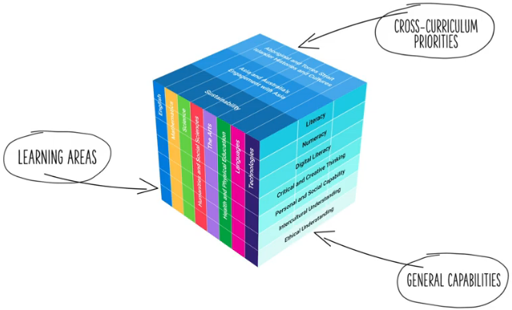
Three-dimensional Australian Curriculum Version 9.0
Source: [v9] ACARA from Summary overview (video) https://v9.australiancurriculum.edu.au/help/website-tour
Notes:
The Australian Curriculum v9.0 has a three-dimensional structure consisting of eight learning areas, seven general capabilities (GCs) and three cross-curriculum priorities. ​
CCPs and GCs are incorporated in learning area content in ways that are appropriate and authentic; they are not separate learning areas or subjects.​

Slide 5
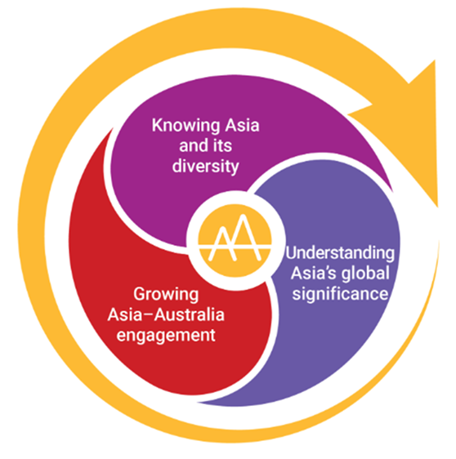
Asia and Australia’s engagement with Asia: Structure
Structure
Key connections
Downloads
Source: https://www.australiancurriculum.edu.au/curriculum-information/understand-this-cross-curriculum-priority/asia-and-australias-engagement-with-asia
Notes:
This diagram, developed by ACARA, represents the structure of the Asia and Australia’s engagement with Asia CCP.
It illustrates three distinct sections, known as sets of organising ideas.
Each CCP includes its own diagram, outlining the specific elements within that priority.
Source: https://www.australiancurriculum.edu.au/curriculum-information/understand-this-cross-curriculum-priority/asia-and-australias-engagement-with-asia

Slide 6

Asia and Australia’s engagement with Asia: Structure
These organising ideas
emphasise the need to appreciate the backgrounds, experiences, stories, religions, beliefs and perspectives within and among
the nations of the Asia region and the interconnections with Australia.
These organising ideas
include the relationship-building contribution of Australians with Asian heritage and explore how active connections between young people and Asia’s diverse communities can
be deepened and contribute
to global citizenship.
These organising ideas examine the ways in which different significant nations in Asia have affected change and contributed
to global developments.
Source: https://www.australiancurriculum.edu.au/content/dam/en/curriculum/ac-version-9/downloads/cross-curriculum-priorities/cross-curriculum-priorities-asia-and-australia%27s-engagement-with-asia-about-the-cross-curriculum-priority-v9.docx
Notes:
The Asia and Australia’s engagement with Asia CCP is structured according to three sets of organising ideas:
Knowing Asia and its diversity
Understanding Asia’s global significance
Growing Asia–Australia engagement.
Each set of organising ideas is then broken down into organising ideas.

Slide 7

Organising ideas
Knowing Asia and its diversity | Understanding Asia’s global significance | Growing Asia–Australia engagement
Peoples of the Asia region are diverse in backgrounds, experiences, stories, religions, beliefs and perspectives. (AAK1) | The nations of Asia influence historical and contemporary global relationships, including international responses to global developments and events. (AAU1) | Australia’s developing and deepening relationships with the peoples of Asia influence both mutual understandings and expressions of citizenship and culture nationally, regionally and globally. (AAG1)
The interrelationships between people and the diverse environments and systems across the Asia region have global implications. (AAK2) | The peoples of Asia shape human endeavour through aesthetic, creative, political, sporting, economic, technological and scientific domains. (AAU2) | Australia and Asia are interdependent through a range of historical and contemporary connections. (AAG2)
Notes:
The organising ideas highlight key knowledge, understanding, and skills related to Asia and Australia’s engagement with Asia.
Source: https://www.australiancurriculum.edu.au/curriculum-information/understand-this-cross-curriculum-priority/asia-and-australias-engagement-with-asia

Slide 8
Outline
Identifying connections to learning area content
Embedding the CCP in planning
Next steps
Understanding the Asia and Australia’s engagement with Asia CCP

Slide 9
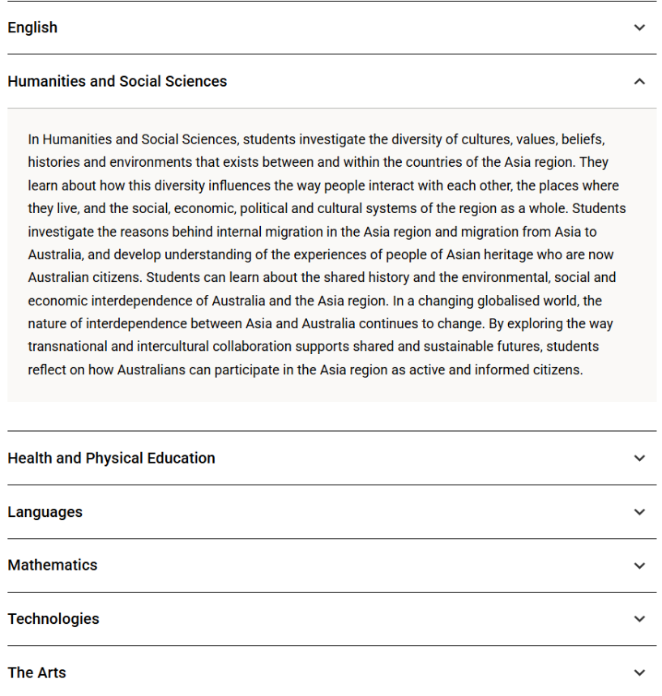
Asia and Australia’s engagement with Asia: Key connections
Structure
Key connections
Downloads
Notes:
The Key connections section of the Australian Curriculum v9.0 provides information on how the Asia and Australia’s engagement with Asia CCP may be developed within each learning area.
This section is found under the Understand this cross-curriculum priority section of the Australian Curriculum website.
The example for Humanities and Social Sciences (HASS) highlights how students explore the diversity of cultures, values, beliefs, histories and environments across the Asia region. They consider how these influence interactions between people and the development of social, economic, political and cultural systems.​
When developing teaching and learning sequences that address this priority, teachers are also encouraged to:
draw on their school’s context to support and inform the engagement of the capability within their individual setting
use the elements of the priority as scaffolding to develop and enrich content knowledge, understanding and skills within the learning area/s.
Source: https://www.australiancurriculum.edu.au/curriculum-information/understand-this-cross-curriculum-priority/asia-and-australias-engagement-with-asia#accordion-f4be89675c-item-3e91ef7beb

Slide 10
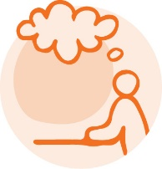
Exploring an organising idea
Consider where this organising idea naturally connects with your learning area and year level.
Identify how you might embed it in ways that are authentic and appropriate for all students.
Knowing Asia and its diversity
Peoples of the Asia region are diverse in backgrounds, experiences, stories, religions, beliefs and perspectives. (AAK1)
Notes:
Identify a learning area and year level.
Using that context, consider where the organising idea from the Knowing Asia and its diversity set of organising ideas naturally connects with the learning area and year level content.
Consider:
where this organising idea aligns with what students are already learning
how this organising idea could be embedded in ways that are authentic and appropriate for all students.

Slide 11
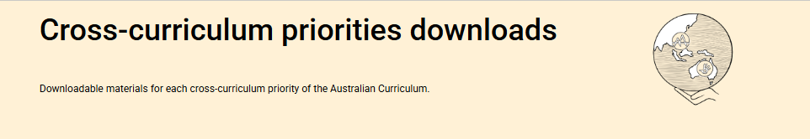
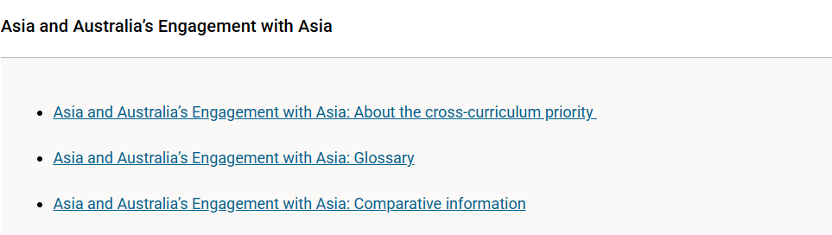
Asia and Australia’s engagement with Asia: Downloads
What?
Structure
Key connections
Downloads
Notes:
More information about the priority (including glossary and comparative information) is available in the Downloads section on the Australian Curriculum website.
Source: https://www.australiancurriculum.edu.au/curriculum-information/understand-this-cross-curriculum-priority/asia-and-australias-engagement-with-asia

Slide 12
Outline
Identifying connections to learning area content
Embedding the CCP in planning
Next steps
Understanding the Asia and Australia’s engagement with Asia CCP

Slide 13
An approach for embedding the CCP in planning
Identify curriculum
Clarify and contextualise
Identify appropriate and authentic connections
Intercultural engagement opportunities
Professional conversations
Language/ resources
Learning area
CCP
Achievement standard
Sets of organising
ideas
Content description/s
Organising ideas
Notes:
This is one approach to embedding the Asia and Australia’s engagement with Asia CCP within curriculum planning.
The process draws on guidance from the QCAA Elements for effective planning, which provides support for the planning of teaching, learning and assessment.
The process highlights two key phases:
identify curriculum
clarify and contextualise.
​

Slide 14
An approach for embedding the CCP in planning:
Identify curriculum
Identify curriculum
Clarify and contextualise
Identify appropriate and authentic connections
Intercultural engagement opportunities
Professional conversations
Language/ resources
Learning area
CCP
Achievement standard
Sets of organising
ideas
Content description/s
Organising ideas
Notes:
Once the curriculum elements have been identified, teachers can use the Australian Curriculum website and/or QCAA resources to identify the sets of organising ideas and organising ideas of the relevant CCP that can be authentically and appropriately embedded to enrich student learning.

Slide 15
Identify relevant organising ideas
Knowing Asia and its diversity | Understanding Asia’s global significance | Growing Asia–Australia engagement
Peoples of the Asia region are diverse in backgrounds, experiences, stories, religions, beliefs and perspectives. (AAK1) | The nations of Asia influence historical and contemporary global relationships, including international responses to global developments and events. (AAU1) | Australia’s developing and deepening relationships with the peoples of Asia influence both mutual understandings and expressions of citizenship and culture nationally, regionally and globally. (AAG1)
The interrelationships between people and the diverse environments and systems across the Asia region have global implications. (AAK2) | The peoples of Asia shape human endeavour through aesthetic, creative, political, sporting, economic, technological and scientific domains. (AAU2) | Australia and Asia are interdependent through a range of historical and contemporary connections. (AAG2)
Source: https://www.australiancurriculum.edu.au/f-10-curriculum/cross-curriculum-priorities/sustainability?organising-idea=SS%2CSW%2CSD
Notes:
A Year 6 HASS example will be used to illustrate the Identify curriculum phase of the process.
The highlighted (red boxes) show the relevant organising ideas from the CCP. The following slides demonstrate how these organising ideas may be embedded within a Year 6 unit.

Slide 16
Identify relevant organising ideas
Year 6 Unit 2 — Our regional neighbourhood
The connections we share across places, cultures and economies influence every facet of our daily lives. From the migration stories that have shaped Australian communities to the goods and services we trade with our Asia–Pacific neighbours, the interconnectedness of our world is central to understanding Australia’s past and present.
In this unit, students explore the geographical diversity of the Asia–Pacific region, recognising that the peoples and countries of Asia have a rich diversity of environments, histories and cultures. They investigate the distribution of population, climate and resources, using online geospatial applications to create a digital map of selected countries, including Australia. When students share findings with peers and annotate their maps, they draw conclusions and consider how these variations influence settlement patterns, ways of living and cultural expression across the region.
Students explore the ways their researched country connects with Australia, considering trade, education, tourism and cultural exchange. They explore data sets, media sources and contemporary examples, identifying patterns and trends to explain how these connections reflect the global interdependence of peoples and countries in Asia and record conclusions on a digital map.
Students investigate migration to Australia since Federation, including stories of migrants from Asia. Using Australian Bureau of Statistics data, they create graphs to compare historical and contemporary population compositions, identify patterns, and draw inferences about population changes. Students analyse case studies to explain the causes and effects of migration and record their findings on a digital map, highlighting interconnections created by migration. They investigate how peoples and countries of Asia have contributed to world history and human endeavour, shaping Australia’s identity and communities through cultural, social and economic contributions.
Students explore how the goods and resources they use connect Australia with the Asia–Pacific region, investigating how individual choices connect them
to regional and global economies. They conduct a classroom audit to identify the origin of products and evaluate influences on consumer decisions, such as labelling, origin, cost, sustainability, and ethical considerations. They trace the origins of everyday goods and services, exploring supply chains, imports and exports, to demonstrate how Australia’s interrelationships with Asia are significant for its economic, cultural and political life, both now and into
the future.
Notes:
The relevant aspect/s of the achievement standard, along with the aligned content descriptions, has informed the context and focus of the example unit, Our regional neighbourhood.
The unit description incorporates language and themes of the organising ideas across the sets of organising ideas of Knowing Asia and its diversity, Understanding Asia’s global significance and Growing Asia-Australia engagement.

Slide 17
Organising ideas: Knowing Asia and its diversity
Knowing Asia and its diversity
Peoples of the Asia region are diverse in backgrounds, experiences, stories, religions, beliefs and perspectives. (AAK1)
The interrelationships between people and the diverse environments and systems across the Asia region have global implications. (AAK2)
Year 6 Unit 2 — Our regional neighbourhood
The connections we share across places, cultures and economies influence every facet of our daily lives. From the migration stories that have shaped Australian communities to the goods and services we trade with our Asia–Pacific neighbours, the interconnectedness of our world is central to understanding Australia’s past and present.
In this unit, students explore the geographical diversity of the Asia–Pacific region, recognising that the peoples and countries of Asia have a rich diversity of environments, histories and cultures. They investigate the distribution of population, climate and resources, using online geospatial applications to create a digital map of selected countries, including Australia. When students share findings with peers and annotate their maps, they draw conclusions and consider how these variations influence settlement patterns, ways of living and cultural expression across the region.
Students explore the ways their researched country connects with Australia, considering trade, education, tourism and cultural exchange. They explore data sets, media sources and contemporary examples, identifying patterns and trends to explain how these connections reflect the global interdependence of peoples and countries in Asia and record conclusions on a digital map.
Students investigate migration to Australia since Federation, including stories of migrants from Asia. Using Australian Bureau of Statistics data, they create graphs to compare historical and contemporary population compositions, identify patterns, and draw inferences about population changes. Students analyse case studies to explain the causes and effects of migration and record their findings on a digital map, highlighting interconnections created by migration. They investigate how peoples and countries of Asia have contributed to world history and human endeavour, shaping Australia’s identity and communities through cultural, social and economic contributions.
Students explore how the goods and resources they use connect Australia with the Asia–Pacific region, investigating how individual choices connect them to regional and global economies. They conduct a classroom audit to identify the origin of products and evaluate influences on consumer decisions, such as labelling, origin, cost, sustainability, and ethical considerations. They trace the origins of everyday goods and services, exploring supply chains, imports and exports, to demonstrate how Australia’s interrelationships with Asia are significant for its economic, cultural and political life, both now and into the future.
Notes:
Knowing Asia and its diversity:
Through the Knowing Asia and its diversity organising ideas, students recognise the rich diversity of peoples, cultures and environments across the Asia-Pacific region and explore how these interrelationships shape communities.
As students investigate the geographical diversity of Asia, they consider how these variations influence settlement patterns, ways of living and cultural expression across the region.
Language from the organising ideas is made explicit through references to diversity, interrelationships and global connections, supporting students to connect the content focus of the unit with the intent of the CCP.

Slide 18
Organising ideas: Understanding Asia’s global significance
Understanding Asia’s global significance
The nations of Asia influence historical and contemporary global relationships, including international responses to global developments and events. (AAU1)
Year 6 Unit 2 — Our regional neighbourhood
The connections we share across places, cultures and economies influence every facet of our daily lives. From the migration stories that have shaped Australian communities to the goods and services we trade with our Asia–Pacific neighbours, the interconnectedness of our world is central to understanding Australia’s past and present.
In this unit, students explore the geographical diversity of the Asia–Pacific region, recognising that the peoples and countries
of Asia have a rich diversity of environments, histories and cultures. They investigate the distribution of population, climate and resources, using online geospatial applications to create a digital map of selected countries, including Australia. When students share findings with peers and annotate their maps, they draw conclusions and consider how these variations influence settlement patterns, ways of living and cultural expression across the region.
Students explore the ways their researched country connects with Australia, considering trade, education, tourism and cultural exchange. They explore data sets, media sources and contemporary examples, identifying patterns and trends to explain how these connections reflect the global interdependence of peoples and countries in Asia and record conclusions on a digital map.
Students investigate migration to Australia since Federation, including stories of migrants from Asia. Using Australian Bureau of Statistics data, they create graphs to compare historical and contemporary population compositions, identify patterns, and draw inferences about population changes. Students analyse case studies to explain the causes and effects of migration and record their findings on a digital map, highlighting interconnections created by migration. They investigate how peoples and countries of Asia have contributed to world history and human endeavour, shaping Australia’s identity and communities through cultural, social and economic contributions.
Students explore how the goods and resources they use connect Australia with the Asia–Pacific region, investigating how individual choices connect them to regional and global economies. They conduct a classroom audit to identify the origin of products and evaluate influences on consumer decisions, such as labelling, origin, cost, sustainability, and ethical considerations. They trace the origins of everyday goods and services, exploring supply chains, imports and exports, to demonstrate how Australia’s interrelationships with Asia are significant for its economic, cultural and political life, both now and into the future.
Notes:
Understanding Asia’s global significance:
Through the Understanding Asia’s global significance organising ideas, students investigate migration to Australia since Federation to understand how people-to-people connections have shaped Australia’s communities and identity.
As students explore Asia’s contributions to world history and human endeavour across multiple domains, they recognise the region’s global significance and the shared human experiences that connect Australia with its neighbours.
A focus on human contribution and innovation deepens students’ understanding of how the achievements of peoples and countries in Asia influence Australia’s cultural, social and economic life, reinforcing the importance of Asia in Australia’s past, present and future.

Slide 19
Organising ideas: Growing Asia–Australia engagement
Growing Asia– Australia engagement
Australia’s developing and deepening relationships with the peoples of Asia influence both mutual understandings and expressions of citizenship and culture nationally, regionally and globally. (AAG1)
Australia and Asia are interdependent through a range of historical and contemporary connections. (AAG2)
Year 6 Unit 2 — Our regional neighbourhood
The connections we share across places, cultures and economies influence every facet of our daily lives. From the migration stories that have shaped Australian communities to the goods and services we trade with our Asia–Pacific neighbours, the interconnectedness of our world is central to understanding Australia’s past and present.
In this unit, students explore the geographical diversity of the Asia–Pacific region, recognising that the peoples and countries
of Asia have a rich diversity of environments, histories and cultures. They investigate the distribution of population, climate and resources, using online geospatial applications to create a digital map of selected countries, including Australia. When students share findings with peers and annotate their maps, they draw conclusions and consider how these variations influence settlement patterns, ways of living and cultural expression across the region.
Students explore the ways their researched country connects with Australia, considering trade, education, tourism and cultural exchange. They explore data sets, media sources and contemporary examples, identifying patterns and trends to explain how these connections reflect the global interdependence of peoples and countries in Asia and record conclusions on a
digital map.
Students investigate migration to Australia since Federation, including stories of migrants from Asia. Using Australian Bureau of Statistics data, they create graphs to compare historical and contemporary population compositions, identify patterns, and draw inferences about population changes. Students analyse case studies to explain the causes and effects of migration and record their findings on a digital map, highlighting interconnections created by migration. They investigate how peoples and countries
of Asia have contributed to world history and human endeavour, shaping Australia’s identity and communities through cultural, social and economic contributions.
Students explore how the goods and resources they use connect Australia with the Asia–Pacific region, investigating how individual choices connect them to regional and global economies. They conduct a classroom audit to identify the origin of products and evaluate influences on consumer decisions, such as labelling, origin, cost, sustainability, and ethical considerations. They trace the origins of everyday goods and services, exploring supply chains, imports and exports, to demonstrate how Australia’s interrelationships with Asia are significant for its economic, cultural and political life, both now and
into the future.
Notes:
Growing Asia-Australia engagement:
Through the Growing Asia-Australia engagement organising ideas, students examine how the global interdependence of peoples and countries in Asia shapes Australia’s economic, cultural and political relationships, both now and into the future.
As students explore Australia’s expanding connections with Asia, they recognise how these relationships contribute to national identity, citizenship and shared responsibility in a global context.

Slide 20
Clarify and contextualise
Identify curriculum
Clarify and contextualise
Identify appropriate and authentic connections
Intercultural engagement opportunities
Professional conversations
Language/ resources
Learning area
CCP
Achievement standard
Sets of organising
ideas
Content description/s
Organising ideas
Notes:
The next phase of the process relates to clarifying and contextualising the role of the priority in teaching and learning.
Three areas of clarify and contextualise for the embedding of the Asia and Australia’s engagement with Asia priority are:
intercultural engagement — collaborate with local communities, Asian cultural organisations, diaspora networks or individuals with lived experience of the Asia region. Consider partnerships that can bring contemporary Asian perspectives into the classroom through language, literature, media, arts or STEM.
professional conversations — engage in reflective discussions with colleagues to deepen understanding of intercultural learning and the diverse historical, political and cultural contexts of the Asia region. Consider how the priority connects to values, such as empathy, mutual respect, global awareness and ethical engagement.
language/resources — use language that promotes intercultural understanding and counters stereotypes. Review terminology for accuracy and respect. Ensure alignment with frameworks that support ethical and inclusive engagement, e.g. UNESCO’s global citizenship education, Australia’s foreign policy priorities. Phrases such as mutual understanding, diverse perspectives, intercultural capability and active regional/global citizenship should shape both teacher language and student learning goals.

Slide 21
Intercultural engagement opportunities
Year 6 Unit 2 — Our regional neighbourhood
The connections we share across places, cultures and economies influence every facet of our daily lives. From the migration stories that have shaped Australian communities to the goods and services we trade with our Asia–Pacific neighbours, the interconnectedness of our world is central to understanding Australia’s past and present.
In this unit, students explore the geographical diversity of the Asia–Pacific region, recognising that the peoples and countries of Asia have a rich diversity
of environments, histories and cultures. They investigate the distribution of population, climate and resources, using online geospatial applications to create a digital map of selected countries, including Australia. When students share findings with peers and annotate their maps, they draw conclusions and consider how these variations influence settlement patterns, ways of living and cultural expression across the region.
Students explore the ways their researched country connects with Australia, considering trade, education, tourism and cultural exchange. They explore data sets, media sources and contemporary examples, identifying patterns and trends to explain how these connections reflect the global interdependence of peoples
and countries in Asia and record conclusions on a digital map.
Students investigate migration to Australia since Federation, including stories of migrants from Asia. Using Australian Bureau of Statistics data, they create graphs to compare historical and contemporary population compositions, identify patterns, and draw inferences about population changes. Students analyse case studies to explain the causes and effects of migration and record their findings on a digital map, highlighting interconnections created by migration. They investigate how peoples and countries of Asia have contributed to world history and human endeavour, shaping Australia’s identity and communities through cultural, social and economic contributions.
Students explore how the goods and resources they use connect Australia with the Asia–Pacific region, investigating how individual choices connect them to regional and global economies. They conduct a classroom audit to identify the origin of products and evaluate influences on consumer decisions, such as labelling, origin, cost, sustainability, and ethical considerations. They trace the origins of everyday goods and services, exploring supply chains, imports and exports, to demonstrate how Australia’s interrelationships with Asia are significant for its economic, cultural and political life, both now and into the future.
Notes:
Intercultural engagement opportunities ensures learning about Asia and Australia’s engagement with Asia is relevant, place-based and meaningful.

Slide 22
Language and resources
Year 6 Unit 2 — Our regional neighbourhood
The connections we share across places, cultures and economies influence every facet of our daily lives. From the migration stories that have shaped Australian communities to the goods and services we trade with our Asia–Pacific neighbours, the interconnectedness of our world is central to understanding Australia’s past and present.
In this unit, students explore the geographical diversity of the Asia–Pacific region, recognising that the peoples and countries of Asia have a rich diversity
of environments, histories and cultures. They investigate the distribution of population, climate and resources, using online geospatial applications to create a digital map of selected countries, including Australia. When students share findings with peers and annotate their maps, they draw conclusions and consider how these variations influence settlement patterns, ways of living and cultural expression across the region.
Students explore the ways their researched country connects with Australia, considering trade, education, tourism and cultural exchange. They explore data sets, media sources and contemporary examples, identifying patterns and trends to explain how these connections reflect the global interdependence of peoples and countries in Asia and record conclusions on their digital map.
Students investigate migration to Australia since Federation, including stories of migrants from Asia. Using Australian Bureau of Statistics data, they create graphs to compare historical and contemporary population compositions, identify patterns, and draw inferences about population changes. Students analyse case studies to explain the causes and effects of migration and record their findings on a digital map, highlighting interconnections created by migration. They investigate how peoples and countries of Asia have contributed to world history and human endeavour, shaping Australia’s identity and communities through cultural, social and economic contributions.
Students explore how the goods and resources they use connect Australia with the Asia–Pacific region, investigating how individual choices connect them to regional and global economies. They conduct a classroom audit to identify the origin of products and evaluate influences on consumer decisions, such as labelling, origin, cost, sustainability, and ethical considerations. They trace the origins of everyday goods and services, exploring supply chains, imports and exports, to demonstrate how Australia’s interrelationships with Asia are significant for its economic, cultural and political life, both now and into the future.
Notes:
When incorporating the Asia and Australia’s engagement with Asia CCP, it is important to use language that acknowledges interconnections, promotes understanding of cultural diversity and empowers students to engage thoughtfully with Asia.
The language used in planning, teaching and assessing shapes how students see Australia’s place within the Asia–Pacific region, and the ways they can actively engage with its peoples, cultures and economies.
Language should reflect the intent of the CCP and help students develop future-focused, intercultural and globally aware thinking.

Slide 23
Outline
Identifying connections to learning area content
Embedding the CCP in planning
Next steps
Understanding the Asia and Australia’s engagement with Asia CCP

Slide 24
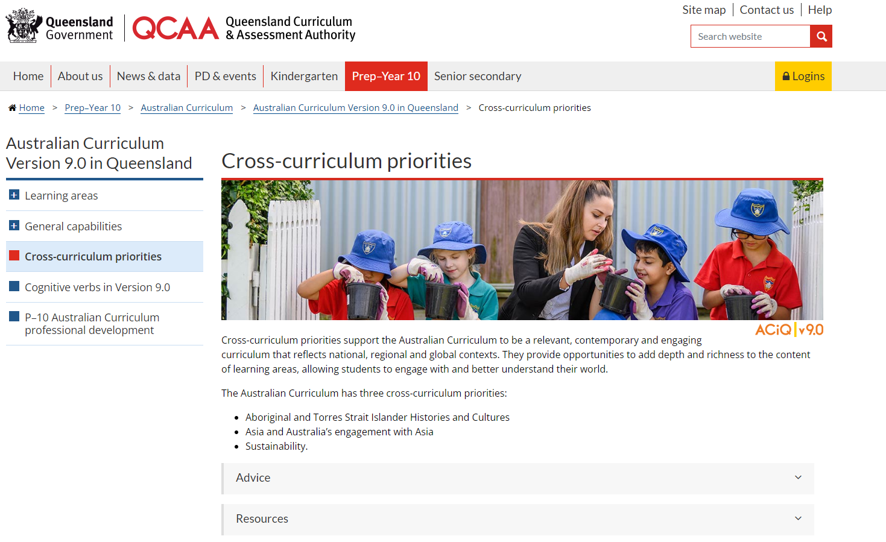
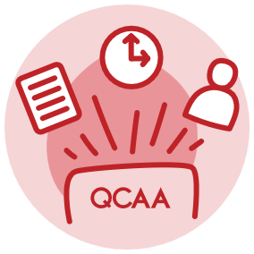
Cross-curriculum priorities resources
Notes:
Explore the QCAA website to locate key resources to support educators in planning and embedding the CCPs. These include the advice and resource documents for the CCPs.
Source: https://www.qcaa.qld.edu.au/p-10/aciq/version-9/cross-curriculum-priorities

Slide 25
Learning goal
Success criteria
To develop a deeper understanding and build confidence when embedding the Asia and Australia’s engagement with Asia CCP into planning.
You will know you are successful if you can:
understand the purpose and structure of this CCP
identify strategies to embed the Asia and Australia’s engagement with Asia CCP in curriculum planning
use QCAA resources to inform
and support planning.

Slide 26
References
Australian Curriculum Assessment and Reporting Authority. (n.d.). Cross-curriculum downloads. Australian Curriculum. Australian Curriculum Assessment and Reporting Authority. https://v9.australiancurriculum.edu.au/downloads/cross-curriculum-priorities#accordion-00dfddc453-item-c84c8658c0.

Slide 27
Acknowledgments
Third-party copyright material, and QCAA material not covered by the CC BY licence is listed below:
Queensland Government coat of arms, and the QCAA and QSA trademarks may not be reproduced without permission.
Unless otherwise indicated, material from Australian Curriculum is © ACARA 2010–present, licensed CC BY 4.0. For the latest information and additional terms of use, see the Australian Curriculum website and its copyright notice.
Student and staff images have been used with permission.
The three-dimensional curriculum diagram, and other ACARA graphics are a Conceptual Framework diagram and First framework (Living communities) diagram is ‘Excluded Material’ used under the terms of the Australian Curriculum and its copyright notice and is not modified. © Australian Curriculum, Assessment and Reporting Authority (ACARA) 2009 to present, unless otherwise indicated. You may view, download, display, print, reproduce (such as by making photocopies) and distribute these Excluded Materials in unaltered form only for your personal, non-commercial educational purposes or for the non-commercial educational purposes of your organisation, provided that you make others aware it can only be used for these purposes and attribute ACARA as the source of the Excluded Material. For the avoidance of doubt, this means that you cannot edit, modify or adapt any of these materials, and you cannot sub-license any of these materials to others. Apart from any uses permitted under the Copyright Act 1968 (Cth), and those explicitly granted above, all other rights are reserved by ACARA. If you want to use such material in a manner that is outside this restrictive licence, you must request permission from ACARA by submitting a request through the online enquiry form.
Clker-Free-Vector-Images. (2012). Download Australia, Map, Continent. Royalty-Free Vector Graphic. Pixabay.Com. https://pixabay.com/vectors/australia-map-continent-earth-23522/

Slide 28
Copyright notice
© State of Queensland (QCAA) 2026
Licence: https://creativecommons.org/licenses/by/4.0 | Copyright notice: www.qcaa.qld.edu.au/copyright — lists the full terms and conditions, which specify certain exceptions to the licence. |
Attribution (include the link): © State of Queensland (QCAA) 2026 www.qcaa.qld.edu.au/copyright.
Other copyright material in this presentation is listed on the previous slide/s.

