Slide 1
Prep–Year 2 Part 2: Assessing reading
250777
Australian Curriculum v9.0: English
Notes:
This resource reproduces the key slides from the webinar delivered in Semester 1, 2025. This is part two of a part-two series.
For more information, please email australiancurriculum@qcaa.qld.edu.au.

Slide 2
Acknowledgment of Country

Slide 3
Learning goal
Success criteria
To understand ways to plan for assessing reading in Prep–Year 2 using the Australian Curriculum v9.0: English.
You will know you are successful if you:
can understand the Australian Curriculum v9.0: English achievement standard
are more familiar with ways to plan for assessing reading using the Australian Curriculum v9.0: English.

Slide 4
Outline
Understanding the AC English achievement standard
Assessing reading in Prep–Year 2 English

Slide 5
Achievement standards — comparison
Prep
By the end of Foundation, students listen to texts, interact with others and create short spoken texts, including retelling stories. They share thoughts and preferences, retell events and report information or key ideas to an audience. They use language features including words and phrases from learning and texts. They listen for and identify rhymes, letter patterns and sounds (phonemes) in words. They orally blend and segment phonemes in single-syllable words.
They read, view and comprehend texts, making connections between characters, settings and events, and to personal experiences. They identify the language features of texts including connections between print and images. They name the letters of the English alphabet and know and use the most common sounds (phonemes) represented by these letters (graphs). They read words including consonant–vowel–consonant words and some high-frequency words.
They create short written texts, including retelling stories using words and images where appropriate. They retell, report information and state their thoughts, feelings and key ideas. They use words and phrases from learning and texts. They form letters, spell most consonant–vowel–consonant words and experiment with capital letters and full stops.
Year 1
By the end of Year 1, students interact with others, and listen to and create short spoken texts including recounts of stories. They share ideas and retell or adapt familiar stories, recount or report on events or experiences, and express opinions using a small number of details from learnt topics, topics of interest or texts. They sequence ideas and use language features including topic-specific vocabulary and features of voice.
They read, view and comprehend texts, monitoring meaning and making connections between the depiction of characters, settings and events, and to personal experiences. They identify the text structures of familiar narrative and informative texts, and their language features and visual features. They blend short vowels, common long vowels, consonants and digraphs to read one-syllable words. They read one- and two-syllable words with common letter patterns, and an increasing number of high-frequency words. They use sentence boundary punctuation to read with developing phrasing and fluency.
They create short written and/or multimodal texts including recounts of stories with events and characters. They report information and experiences, and express opinions. Ideas in their texts may be informative or imaginative and include a small number of details from learnt topics, topics of interest or texts. They write simple sentences with sentence boundary punctuation and capital letters for proper nouns. They use topic-specific vocabulary. They write words using unjoined upper-case and lower-case letters. They spell most one- and two-syllable words with common letter patterns and common grammatical morphemes, and an increasing number of high-frequency words.
Notes:
The achievement standards indicate what students should know and be able to do by the end of the respective year levels.
The reading and viewing paragraphs of the Prep and Year 1 Australian Curriculum v9.0: English achievement standards are highlighted in blue. The reading and viewing paragraph is always the second of the three achievement standard paragraphs.

Slide 6
Achievement standard paragraph — reading and viewing
Prep | Year 1 | Year 2
They read, view and comprehend texts, making connections between characters, settings and events, and to personal experiences. They identify the language features of texts including connections between print and images. They name the letters of the English alphabet and know and use the most common sounds (phonemes) represented by these letters (graphs). They read words including consonant–vowel–consonant words and some high-frequency words. | They read, view and comprehend texts, monitoring meaning and making connections between the depiction of characters, settings and events, and to personal experiences. They identify the text structures of familiar narrative and informative texts, and their language features and visual features. They blend short vowels, common long vowels, consonants and digraphs to read one-syllable words. They read one- and two-syllable words with common letter patterns, and an increasing number of high-frequency words. They use sentence boundary punctuation to read with developing phrasing and fluency. | They read, view and comprehend texts, identifying literal and inferred meaning, and how ideas are presented through characters and events. They describe how similar topics and information are presented through the structure of narrative and informative texts, and identify their language features and visual features. They use phonic and morphemic knowledge, and grammatical patterns to read unfamiliar words and most high-frequency words. They use punctuation for phrasing and fluency.
https://v9.australiancurriculum.edu.au/f-10-curriculum/learning-areas/english/foundation-year_year-1_year-2?view=quick&detailed-content-descriptions=0&hide-ccp=0&hide-gc=0&side-by-side=1&strands-start-index=0&subjects-start-index=0
Notes:
The Prep–Year 2 reading and viewing paragraphs from the English achievement standards show the development of reading skills across the early years.

Slide 7
Prep–Year 2 achievement standard — mode and context
Prep | Year 1 | Year 2
They read, view and comprehend texts … | They read, view and comprehend texts … | They read, view and comprehend texts …
https://v9.australiancurriculum.edu.au/f-10-curriculum/learning-areas/english/foundation-year_year-1_year-2?view=quick&detailed-content-descriptions=0&hide-ccp=0&hide-gc=0&side-by-side=1&strands-start-index=0&subjects-start-index=0
Notes:
In each year level, teachers assess students’ ability to read, view and comprehend texts.

Slide 8
Prep–Year 2 achievement standard — ideas
Prep | Year 1 | Year 2
… making connections between characters, settings and events, and to personal experiences. | … monitoring meaning and making connections between the depiction of characters, settings and events, and to personal experiences. | … identifying literal and inferred meaning, and how ideas are presented through characters and events.
https://v9.australiancurriculum.edu.au/f-10-curriculum/learning-areas/english/foundation-year_year-1_year-2?view=quick&detailed-content-descriptions=0&hide-ccp=0&hide-gc=0&side-by-side=1&strands-start-index=0&subjects-start-index=0
Notes:
As students read and comprehend, they will develop the range of ideas that they can comprehend, including those related to characters, settings and events (where relevant).

Slide 9
Prep–Year 2 achievement standard — text structure and organisation
Prep | Year 1 | Year 2
 | … They identify the text structures of familiar narrative and informative texts … | … They describe how similar topics and information are presented through the structure of narrative and informative texts …
https://v9.australiancurriculum.edu.au/f-10-curriculum/learning-areas/english/foundation-year_year-1_year-2?view=quick&detailed-content-descriptions=0&hide-ccp=0&hide-gc=0&side-by-side=1&strands-start-index=0&subjects-start-index=0
Notes:
In Year 1 and Year 2, students have opportunities to demonstrate knowledge and understanding of text structure.
While students in Prep may discuss text structure as part of their teaching and learning, it is not an aspect of the achievement standard that they are expected to demonstrate yet.

Slide 10
Prep–Year 2 achievement standard — language features
Prep | Year 1 | Year 2
…They identify the language features of texts including connections between print and images. | … and their language features and visual features. | … and identify their language features and visual features.
https://v9.australiancurriculum.edu.au/f-10-curriculum/learning-areas/english/foundation-year_year-1_year-2?view=quick&detailed-content-descriptions=0&hide-ccp=0&hide-gc=0&side-by-side=1&strands-start-index=0&subjects-start-index=0
Notes:
Across Prep–Year 2, students have opportunities to demonstrate knowledge and understanding of language features of the texts they are reading.
Teaching and assessment can focus systematically on language features outlined in the relevant level description and content descriptions in the language strand, as well as language features that arise opportunistically from texts selected to engage students in your context.

Slide 11
Prep–Year 2 achievement standard — phonic and word knowledge
Prep | Year 1 | Year 2
… They name the letters of the English alphabet and know and use the most common sounds (phonemes) represented by these letters (graphs). They read words including consonant–vowel–consonant words and some high-frequency words. | … They blend short vowels, common long vowels, consonants and digraphs to read one-syllable words. They read one- and two-syllable words with common letter patterns, and an increasing number of high-frequency words. They use sentence boundary punctuation to read with developing phrasing and fluency. | They use phonic and morphemic knowledge, and grammatical patterns to read unfamiliar words and most high-frequency words. They use punctuation for phrasing and fluency.
https://v9.australiancurriculum.edu.au/f-10-curriculum/learning-areas/english/foundation-year_year-1_year-2?view=quick&detailed-content-descriptions=0&hide-ccp=0&hide-gc=0&side-by-side=1&strands-start-index=0&subjects-start-index=0
Notes:
In Prep–Year 2, there is a focus on providing structured opportunities for students to demonstrate their developing phonic and word knowledge — outlined in general terms in the achievement standard.

Slide 12
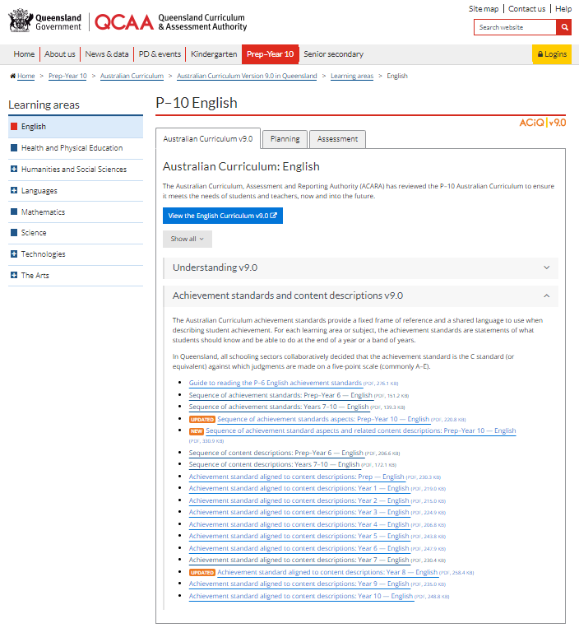
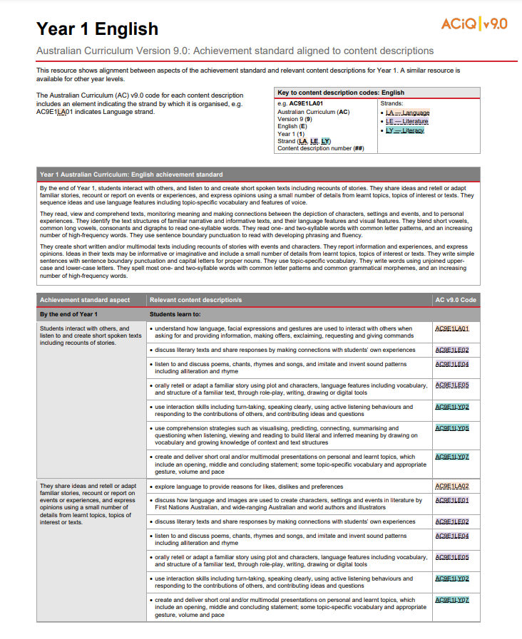
Achievement standard aligned to content descriptions
Notes:
To support you in aligning content descriptions and the achievement standard, the QCAA has produced alignment resources for each learning area and year level.

Slide 13
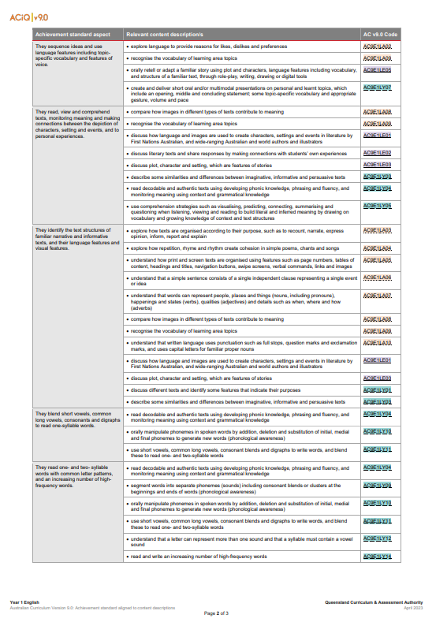
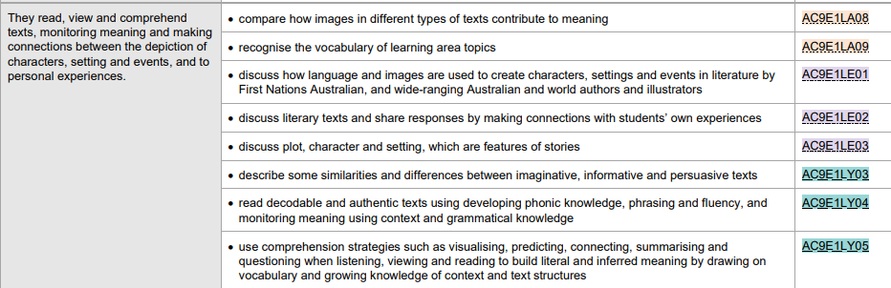
Aspects of the achievement standard and strands
Language
Literature
Literacy
Notes:
These resources show how the aspect of the achievement standard is supported by relevant content descriptions across the strands.

Slide 14
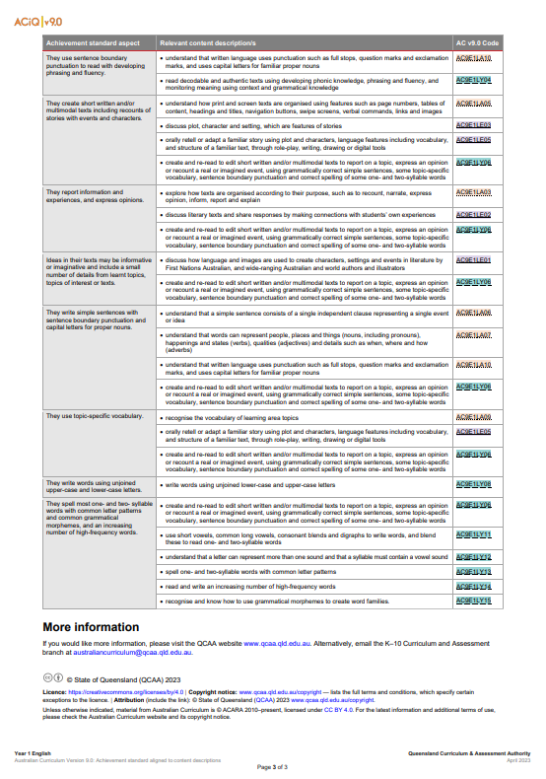
Aspect of the achievement standard — phrasing and fluency
Notes:
In particular, phrasing and fluency is supported by content descriptions from both the Language and Literacy strands.
In most cases, aspects of the achievement standard can be assessed authentically as students undertake tasks that combine and integrate the use of various knowledge, skills and dispositions.
For example, students may participate in a structured literature circle and enjoy a book by reading it aloud, drawing on their knowledge of sentence boundary punctuation and developing phonic and word knowledge. The students may then discuss aspects of the plot, character and setting, making connections to personal experiences.

Slide 15
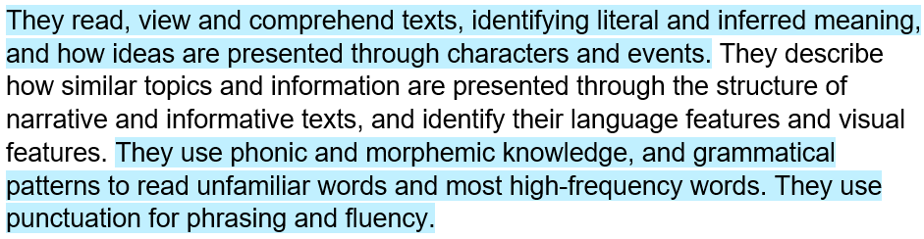
Year 2 example: Assessing through ‘authentic’ tasks
https://www.australiancurriculum.edu.au/f-10-curriculum/learning-areas/english/foundation-year_year-1_year-2?view=quick&detailed-content-descriptions=0&hide-ccp=0&hide-gc=0&side-by-side=0&strands-start-index=0&subjects-start-index=ENGENGY2
Notes:
‘Authentic’ tasks such as the use of a literature circle where students collaboratively discuss aspects of a common book allow students to demonstrate the achievement standard in a holistic way; that is, to show the interconnected nature of a range of skills and knowledge when they are used by students to read, comprehend and enjoy.

Slide 16
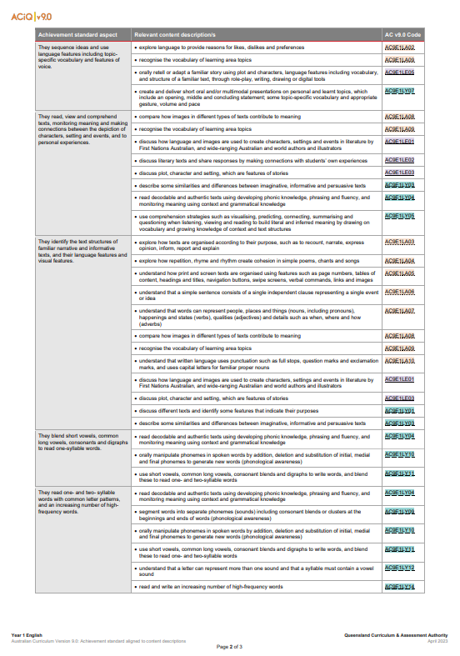
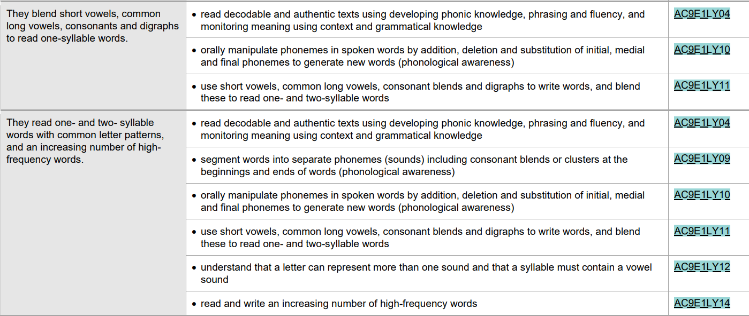
Aspects of the achievement standard — Phonic and word knowledge
Notes:
However, aspects of the achievement standard related to the constrained skills of decoding in Prep–Year 2 are supported mainly by content descriptions in the Phonic and word knowledge sub-strand in the Literacy strand as illustrated in the example on screen from Year 1.

Slide 17
Outline
Understanding the AC English achievement standard
Assessing reading in Prep–Year 2 English

Slide 18

Formatively assessing phonic and word knowledge
Professional learning, e.g. implementing a systematic synthetic phonics approach
Literacy Hub
(Education Services Australia)
Plan, teach, assess, e.g. Year 1 phonics check
Source: Education Services Australia, Literacy Hub https://www.esa.edu.au/solutions/our-solutions/literacy-hub
Notes:
For formative assessment of phonic and word knowledge, teachers may have an instrument that they use, e.g. provided as part of a phonics program.
Education Services Australia, offers numerous, free resources to support systematic teaching and assessment of reading (including phonic and word knowledge) in the early years.
The Literacy Hub includes a range of resource for:
professional learning, e.g. The Big 6 of Literacy webinars, Implementing a systematic synthetic phonics approach
planning, teaching, assessing, e.g. a series of shared reading texts for reading aloud; planning resources; phonics check for Year 1; student learning support
school leaders and families.

Slide 19
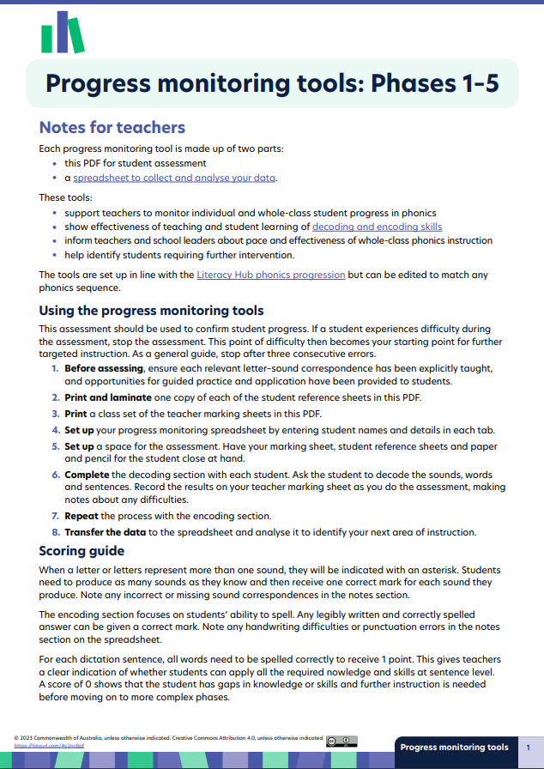
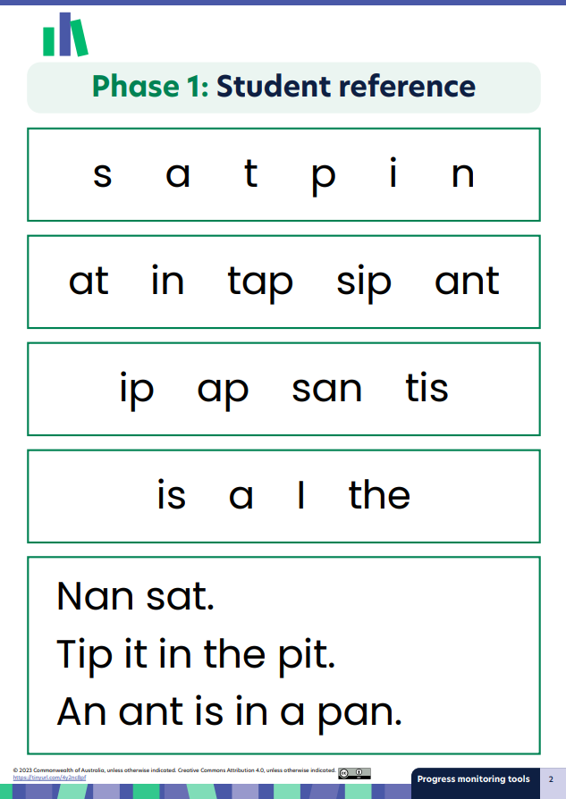
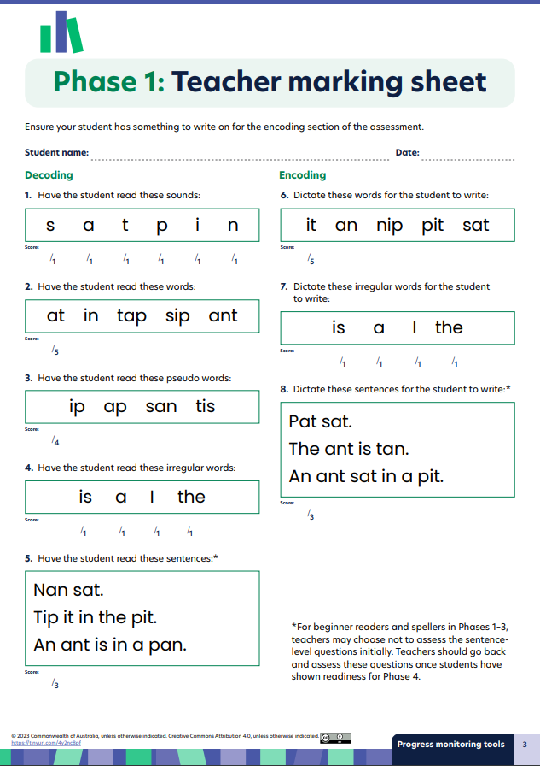
Literacy Hub — progress monitoring tools
Source: Education Services Australia, Literacy Hub, https://www.literacyhub.edu.au/search/progress-monitoring-tools-phases-1-5/
Notes:
Additionally, progress monitoring tools for phonic development are located on the Literacy Hub website.

Slide 20
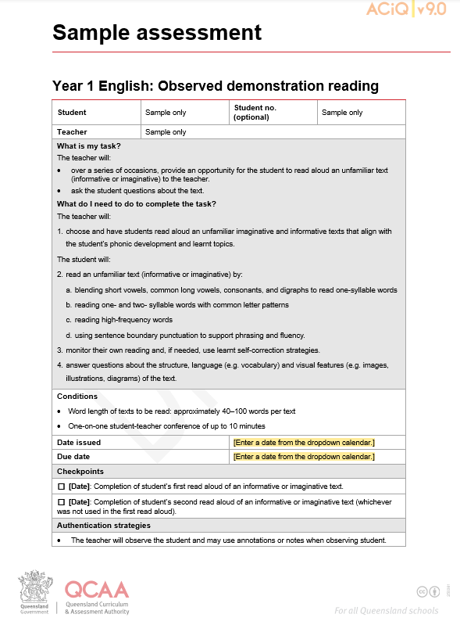
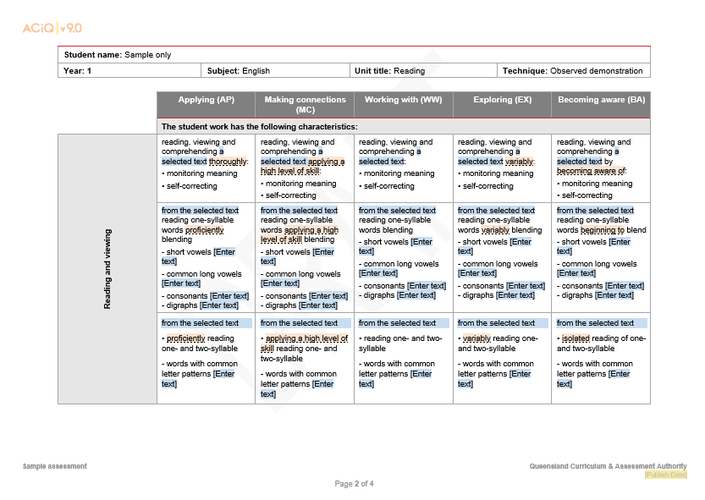

Summatively assessing reading — Year 1
Notes:
For summative reporting purposes, information should be collected about students’ reading development with the requirements outlined in the English achievement standards.
In addition to on-going, formative assessment, teachers may observe students’ demonstration of aspects of the achievement standard at points in time.
The Year 1 sample assessment task and task-specific marking guide could be used to assess selected aspects of the achievement standard for reading. The sample uses the technique of an observed demonstration.
Assessment templates are available online on the QCAA website and can also be developed using the QCAA P–10 planning app.
Students demonstrating their phonic and word knowledge may be observed during small group reading, or one-on-one, and the teacher may record evidence of knowledge and skills observed.
When choosing texts for teaching and learning, and assessing, it is important to note that: ‘Teachers and schools are best placed to make decisions about the selection of texts in their teaching and learning programs to address the content in the English curriculum while also meeting the needs of the students in their classes’. ACARA, 2025.
Using the sample assessment, reading aloud imaginative and informative texts:
The teacher selects appropriate decodable and/or authentic texts drawing on understanding from the achievement standard and content descriptions.
Students read a variety of imaginative and informative texts across the semester (2 or 3 reading conferences as required) to allow the teacher to make a valid and reliable judgment of students’ knowledge and skills.
Note that context and processes are outlined in the assessment task. There is clarity for students and teachers. These would be determined in the design process through professional conversations to establish shared understanding and expectations. For example, how will evidence be collected and recorded (notes, checklists, digital recordings) what will the context look like (group, one on one).

Slide 21
Alignment — task and aspects of achievement standard
They read, view and comprehend texts, monitoring meaning and making connections between the depiction of characters, settings and events, and to personal experiences. They identify the text structures of familiar narrative and informative texts, and their language features and visual features. They blend short vowels, common long vowels, consonants and digraphs to read one-syllable words. They read one- and two-syllable words with common letter patterns, and an increasing number of high-frequency words. They use sentence boundary punctuation to read with developing phrasing and fluency.
https://www.australiancurriculum.edu.au/f-10-curriculum/learning-areas/english/foundation-year_year-1_year-2?view=quick&detailed-content-descriptions=0&hide-ccp=0&hide-gc=0&side-by-side=0&strands-start-index=0&subjects-start-index=ENGENGY1
Notes:
When developing assessment tasks, teachers ensure tasks are valid, i.e. the task aligns to the curriculum and provides the opportunity for students to demonstrate selected aspects of the achievement standard, perhaps multiple times.

Slide 22
Alignment — task and aspects of achievement standard
Task | Aspects of achievement standard
The student will: read an unfamiliar text (informative or imaginative) by: ​blending short vowels, common long vowels, consonants, and digraphs to read one-syllable words ​reading one- and two-syllable words with common letter patterns ​reading high-frequency words ​using sentence boundary punctuation to support phrasing and fluency monitor their own reading and, if needed, use self-correction strategies. answer questions about the structure, language (e.g. vocabulary), and visual features (e.g. images, illustrations, diagrams) of the text. | They read, view and comprehend texts, monitoring meaning and making connections between the depiction of characters, settings and events, and to personal experiences. They identify the text structures of familiar narrative and informative texts, and their language features and visual features. They blend short vowels, common long vowels, consonants and digraphs to read one-syllable words. They read one- and two-syllable words with common letter patterns, and an increasing number of high-frequency words. They use sentence boundary punctuation to read with developing phrasing and fluency.
https://www.australiancurriculum.edu.au/f-10-curriculum/learning-areas/english/foundation-year_year-1_year-2?view=quick&detailed-content-descriptions=0&hide-ccp=0&hide-gc=0&side-by-side=0&strands-start-index=0&subjects-start-index=ENGENGY1
Notes:
In the sample assessment task, students will read an unfamiliar text so that students who are applying knowledge, understanding and skills can demonstrate what they know and can do.
While the text is unfamiliar, it will include the short vowels, common long vowels, consonants and diagraphs that have been taught and learned. The one- and two-syllable words may be unfamiliar. The high frequency words are familiar.

Slide 23
Alignment — task and aspects of achievement standard
Task | Aspects of achievement standard
The student will: read an unfamiliar text (informative or imaginative) by: ​blending short vowels, common long vowels, consonants, and digraphs to read one-syllable words ​reading one- and two-syllable words with common letter patterns ​reading high-frequency words ​using sentence boundary punctuation to support phrasing and fluency monitor their own reading and, if needed, use self-correction strategies. answer questions about the structure, language (e.g. vocabulary), and visual features (e.g. images, illustrations, diagrams) of the text. | They read, view and comprehend texts, monitoring meaning and making connections between the depiction of characters, settings and events, and to personal experiences. They identify the text structures of familiar narrative and informative texts, and their language features and visual features. They blend short vowels, common long vowels, consonants and digraphs to read one-syllable words. They read one- and two-syllable words with common letter patterns, and an increasing number of high-frequency words. They use sentence boundary punctuation to read with developing phrasing and fluency.
https://www.australiancurriculum.edu.au/f-10-curriculum/learning-areas/english/foundation-year_year-1_year-2?view=quick&detailed-content-descriptions=0&hide-ccp=0&hide-gc=0&side-by-side=0&strands-start-index=0&subjects-start-index=ENGENGY1
Notes:
The third instruction on the task sheet aligns to the aspect of the achievement standard in which students ‘… identify the text structures of familiar narrative and informative texts, and their language features and visual features’.
If teachers choose not to assess this aspect of the achievement in this particular reading task, then the third instruction would be removed. The instructions and wording used in the assessment task should align to the achievement standard.

Slide 24
Alignment — task and aspects of achievement standard
Task | Aspects of achievement standard
The student will: read an unfamiliar text (informative or imaginative) by: ​blending short vowels, common long vowels, consonants, and digraphs to read one-syllable words ​reading one- and two-syllable words with common letter patterns ​reading high-frequency words ​using sentence boundary punctuation to support phrasing and fluency monitor their own reading and, if needed, use self-correction strategies. answer questions about the structure, language (e.g. vocabulary), and visual features (e.g. images, illustrations, diagrams) of the text. | They read, view and comprehend texts, monitoring meaning and making connections between the depiction of characters, settings and events, and to personal experiences. They identify the text structures of familiar narrative and informative texts, and their language features and visual features. They blend short vowels, common long vowels, consonants and digraphs to read one-syllable words. They read one- and two-syllable words with common letter patterns, and an increasing number of high-frequency words. They use sentence boundary punctuation to read with developing phrasing and fluency.
https://www.australiancurriculum.edu.au/f-10-curriculum/learning-areas/english/foundation-year_year-1_year-2?view=quick&detailed-content-descriptions=0&hide-ccp=0&hide-gc=0&side-by-side=0&strands-start-index=0&subjects-start-index=ENGENGY1
Notes:
The sample assessment task also shows that students will demonstrate how they blend short vowels, common long vowels, consonants and digraphs to read one-syllable words. They read one- and two-syllable words with common letter patterns, and an increasing number of high-frequency words. They will also use sentence boundary punctuation to read with developing phrasing and fluency.

Slide 25
Opportunities to assess decoding and comprehending
Aspects of achievement standard
They read, view and comprehend texts, monitoring meaning and making connections between the depiction of characters, settings and events, and to personal experiences. They identify the text structures of familiar narrative and informative texts, and their language features and visual features. They blend short vowels, common long vowels, consonants and digraphs to read one-syllable words. They read one- and two-syllable words with common letter patterns, and an increasing number of high-frequency words. They use sentence boundary punctuation to read with developing phrasing and fluency.
https://www.australiancurriculum.edu.au/f-10-curriculum/learning-areas/english/foundation-year_year-1_year-2?view=quick&detailed-content-descriptions=0&hide-ccp=0&hide-gc=0&side-by-side=0&strands-start-index=0&subjects-start-index=ENGENGY1
Notes:
Assessment tasks created to assess reading can be designed to assess decoding or comprehending or both decoding and comprehending.
If the Year 1 sample was to assess reading comprehension, then the assessment task may have included an additional instruction, e.g. Answer questions about the connection between and depiction of characters, setting and events to your own personal experiences.
Teachers must always review the alignment between the text selected and the marking guide so that the text allows students to demonstrate the relevant aspects of the achievement standard.
The intention of the task is that it could be used each term to assess students at various points across the year, complementing on-going formative assessment.
Note: Adjustments to assessment tasks including those created to assess reading may occur owing to school-based decisions and/or sector advice.

Slide 26
Learning goal
Success criteria
To understand ways to plan for assessing reading in Prep–Year 2 using the Australian Curriculum v9.0: English.
You will know you are successful if you:
can understand the Australian Curriculum v9.0: English achievement standard
are more familiar with ways to plan for assessing reading using the Australian Curriculum v9.0: English.

Slide 27
Acknowledgments
Third-party copyright material, and QCAA material not covered by the CC BY licence is listed below:
Queensland Government coat of arms, and the QCAA and QSA trademarks may not be reproduced without permission.
Acknowledgment of Country artwork (2023) ‘Growth through Learning’ by Chern’ee, Brooke and Jesse Sutton, Kalkadoon. www.cherneesutton.com.au
Student and staff images have been used with permission
Unless otherwise indicated, material from Australian Curriculum is © ACARA 2010–present, licensed CC BY 4.0. For the latest information and additional terms of use, see the Australian Curriculum website and its copyright notice.
You may view, download, display, print, reproduce (such as by making photocopies) and distribute these Excluded Materials in unaltered form only for your personal, non-commercial educational purposes or for the non-commercial educational purposes of your organisation, provided that you make others aware it can only be used for these purposes and attribute ACARA as the source of the Excluded Material. For the avoidance of doubt, this means that you cannot edit, modify or adapt any of these materials, and you cannot sub-licence any of these materials to others. Apart from any uses permitted under the Copyright Act 1968 (Cth), and those explicitly granted above, all other rights are reserved by ACARA. If you want to use such material in a manner that is outside this restrictive licence, you must request permission from ACARA by emailing (copyright@acara.edu.au).
  Education Services Australia, Literacy Hub: Literacy monitoring materials, https://www.literacyhub.edu.au/search/progress-monitoring-tools-phases-1-5 © Commonwealth of Australia, licensed CC BY 4.0. Logos have been retained in the screenshots with permission.

Slide 28
Acknowledgments
Further third-party copyright material, and QCAA material not covered by the CC BY licence is listed below:
6. Image of open book: Clker-Free-Vector-Images at Pixabay, https://pixabay.com/vectors/book-open-empty-read-library-308767/. Used under terms of Pixabay license.

Slide 29
Copyright notice
© State of Queensland (QCAA) 2025
Licence: https://creativecommons.org/licenses/by/4.0 | Copyright notice: www.qcaa.qld.edu.au/copyright — lists the full terms and conditions, which specify certain exceptions to the licence. |
Attribution (include the link): © State of Queensland (QCAA) 2025 www.qcaa.qld.edu.au/copyright.
Other copyright material in this presentation is listed on the previous slide/s.

Slide 30
QCAA social media

