Slide 1
English
Prep–Year 10 Australian Curriculum Version 9.0
Learning area overview
220087
Notes:
This presentation supports understanding of the Version 9.0 Australian Curriculum: English Prep*–Year 10. It gives insight into the position of English within the Australian Curriculum and the structure of the English learning area.
You can use this presentation in your organisation as the basis for professional learning about the English curriculum. It includes information about the key aspects of the curriculum, as well as activities for becoming familiar with the curriculum. An icon in the bottom-right corner of a slide identifies opportunities for activities. Presenters are encouraged to tailor this presentation to suit the needs of their audience.
The Australian Curriculum content referred to in this presentation is available from:
Australian Curriculum, Assessment and Reporting Authority (ACARA) 2022, Australian Curriculum Version 9 Foundation to Year 10, https://v9.australiancurriculum.edu.au/
*Prep (P) in Queensland is the Foundation Year (F) of the Australian Curriculum and refers to the year before Year 1. Children beginning Prep in January are required to be five years of age by 30 June.

Slide 2
Learning goals
This presentation aims to:
build understanding of the Australian Curriculum Version 9.0: English
provide an overview of the structure of the English learning area.
Notes:
This presentation aims to:
build understanding of the Australian Curriculum, with particular reference to the English curriculum
provide an overview of the structure of the English learning area, including the curriculum content and achievement standards.

Slide 3
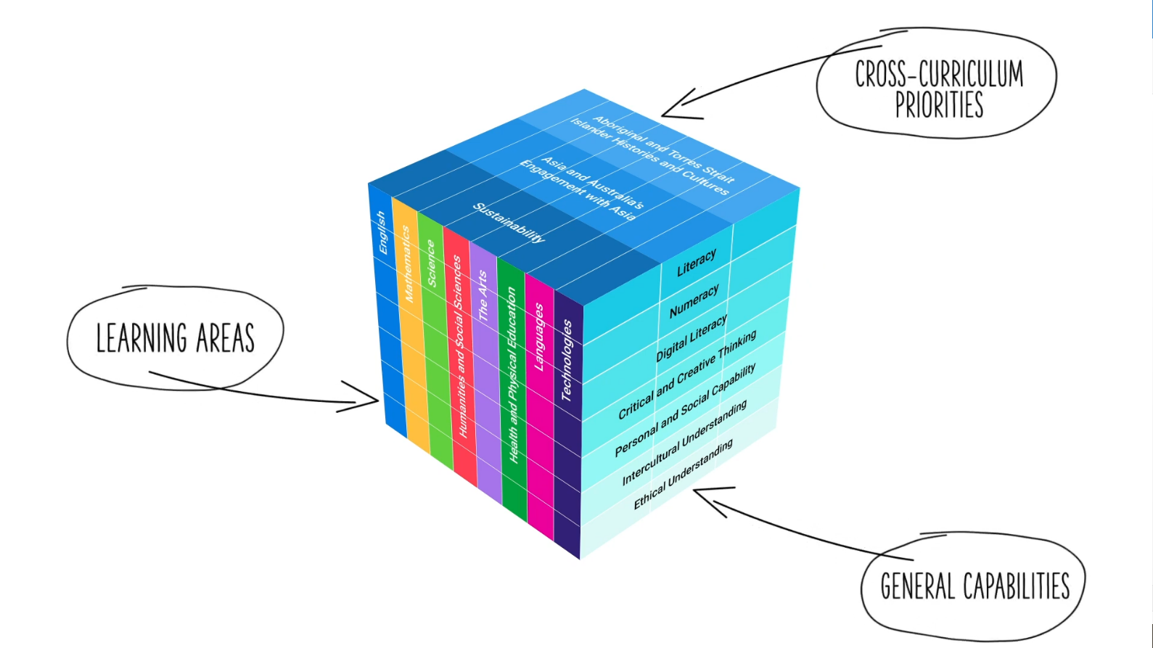
Three-dimensional curriculum
The Australian Curriculum is a three-dimensional curriculum made up of:
learning areas
general capabilities
cross-curriculum priorities.
ACARA image from Summary overview (video): https://v9.australiancurriculum.edu.au/help/website-tour.
Notes:
The Australian Curriculum sets the expectations for what all Australian students should be taught and have the opportunity to learn as they progress through their school life. In Prep to Year 10, the Australian Curriculum provides teachers, students and parents with access to the same content and consistent national standards for determining the progress of student learning.
All Australian students across all education settings and contexts can be supported in their diverse learning needs through the three dimensions of the Australian Curriculum: the learning area content, the general capabilities and the cross-curriculum priorities.
This diagram shows the relationship between these dimensions of the Australian Curriculum. Teachers emphasise one or more dimensions to develop learning programs suited to the strengths, interests and diverse needs of all students.
This presentation provides a brief overview of the general capabilities and cross-curriculum priorities. However, the focus will be on the English learning area.

Slide 4
Structure of the English learning area
Rationale
Aims
Key considerations
Key connections
Structure
Year-by-year curriculum
Achievement standards
Curriculum content
Source: https://v9.australiancurriculum.edu.au/teacher-resources/understand-this-learning-area/english.
Notes:
The Australian Curriculum sets out what all young people should be taught by specifying the curriculum content and identifies the learning expected at points in their schooling by specifying the achievement standards. The content and achievement standards are supported by additional information that describes the:
curriculum intent (rationale)
aims of learning (aims)
key considerations when planning learning experiences that are unique to the learning area of English
key connections with the other dimensions for the Australian Curriculum including the general capabilities, cross-curriculum priorities and other learning areas
organising structure and focus for the learning at specific year levels including the level descriptions, achievement standards and the curriculum content.
The following sections of the presentation will provide an overview of each of these key aspects of the curriculum.

Slide 5
Rationale
English is the national language of Australia and, as such, is central to the lives, learning and development of all young Australians. Through the study of English, individuals learn to analyse, understand, communicate and build relationships with others and the world around them. It helps create confident communicators, imaginative and critical thinkers, and informed citizens.
Australia is a linguistically and culturally diverse country, with links to Asia. Participation in many aspects of Australian life is dependent on effective communication in Standard Australian English. This is central to the study of the English curriculum and all other learning areas. In addition, proficiency in English is invaluable globally.
The English curriculum helps students to engage imaginatively and critically with literature and appreciate its aesthetic qualities. They explore ideas and perspectives about human experience and cultural significance, interpersonal relationships, and ethical and global issues within real-world and fictional settings. Students are exposed to literature from a range of historical, cultural and social contexts. Through the study of texts, students develop an understanding of themselves and their place in the world. The English curriculum explores the richness of First Nations Australian voices and voices from wide-ranging Australian and world literature.
The study of English plays a key role in the development of literacy, which gives young people the knowledge and skills needed for education, training and the workplace. It helps them become ethical, informed, perceptive, innovative and active members of society. The English curriculum plays an important part in developing the understanding, attitudes and capabilities of those who will take responsibility for Australia’s future.
Source: Quoted verbatim and unaltered from ACARA, https://v9.australiancurriculum.edu.au/teacher-resources/understand-this-learning-area/english.
Notes:
The rationale defines the learning area and describes the importance of the learning area within the curriculum.
The English rationale promotes:
confident communicators, imaginative thinkers, critical thinkers and informed individuals who learn to analyse, understand, communicate and build relationships with others and develop an understanding of their place in the world
a linguistically and culturally diverse country, with links to Asia
effective communication in Standard Australian English
engagement with literature (imaginatively and critically)
literature from a range of historical, cultural and social contexts
value and exploration of the richness of First Nations Australian voices and voices from wide-ranging Australian and world literature
literacy skills which help young people participate in education, training and the workplace.
The full rationale is available from: https://v9.australiancurriculum.edu.au/teacher-resources/understand-this-learning-area/english/.
Suggested activities
Read the full rationale. Partner with a colleague to discuss the following questions:
What were the key aspects of the rationale?
Why is the learning area important? What important contribution does the learning make to a student’s education?
Which aspects of this rationale matched your current understanding of the learning area? Which aspects were new understandings?

Slide 6
Aims
The English curriculum aims to ensure that students:
learn to purposefully and proficiently read, view, listen to, speak, write, create and reflect on increasingly complex texts across a growing range of contexts
understand how Standard Australian English works in its spoken and written forms, and in combination with non-linguistic forms of communication, to create meaning
develop interest and skills in examining the aesthetic aspects of texts and develop an informed appreciation of literature
appreciate, enjoy, analyse, evaluate, adapt and use the richness and power of the English language in all its variations to evoke feelings, form ideas and facilitate interaction with others.
Source: Quoted verbatim and unaltered from ACARA, https://v9.australiancurriculum.edu.au/teacher-resources/understand-this-learning-area/english.
Notes:
The aims flow logically from the rationale and identify the major learning that students will be able to demonstrate as a result of being taught the curriculum.
The Australian Curriculum: English aims to ensure that students:
learn to purposefully and proficiently read, view, list to, speak, write, create and reflect on increasingly complex texts across a growing range of contexts
develop an understanding of how the various forms of text work in combination to create meaning
develop interest and skills in examining aesthetic aspects of texts and an informed appreciation of literature
appreciate, enjoy, analyse, evaluate, adapt and use the richness and power of the English language to evoke feelings, form ideas and facilitate interaction with others.
The aims are available from: https://v9.australiancurriculum.edu.au/teacher-resources/understand-this-learning-area/english/.
Suggested activities
Prepare a brief statement/overview that would help you describe the aims of the learning area to a parent group.
Identify two or three big ideas in the aims. How do they inform:
your understanding of the learning area?
what is valued in the Australian Curriculum for the learning area?
your teaching and learning approaches?

Slide 7
Key considerations
The role of English in the Australian Curriculum
Integrating the strands in planning
Language modes
Texts
Protocols for engaging First Nations Australians
Meeting the needs of diverse learners
Notes:
The key considerations provide a brief overview of how the Australian Curriculum can accommodate particular approaches to teaching and assessment in English.
When planning teaching and learning activities teachers need to consider:
the role of English in the Australian Curriculum
integrating the strands in planning
language modes
texts.
This section also supports teachers to consider:
protocols for engaging in First Nations Australians
inclusive practices that are relevant to the students needs.
Suggested activity
How are the key considerations reflected in your English program?

Slide 8
Year-by-year curriculum
Primary
Each year includes the following structural components:
level description
curriculum content
achievement standards.
The curriculum is developmentally sequenced across the year levels.
P
1
2
3
4
5
6
Secondary
7
8
9
10
Notes:
The English curriculum is structured into year levels.
Suggested activity
What are the implications of the year-by-year curriculum for the planning of your teaching, learning and assessment program?

Slide 9
Level description
P–10 English
Year 1
The English curriculum is built around the 3 interrelated strands of Language, Literature and Literacy. Teaching and learning programs should balance and integrate all 3 strands. Together, the 3 strands focus on developing students’ knowledge, understanding and skills in listening, reading, viewing, speaking, writing and creating. Learning in English is recursive and cumulative, building on concepts, skills and processes developed in earlier years.
In Year 1, students learn that language is communicated in ways that meet the needs of diverse learners. They learn to interact with familiar audiences for different purposes.
Students engage with a variety of texts for enjoyment. They listen to, read and view spoken, written and multimodal texts. Texts may include picture books, various types of stories, rhyming verse, poetry, non-fiction, various types of information texts, short films and animations, dramatic performances, and texts used by students as models for constructing their own texts.
The range of literary texts for Foundation to Year 10 comprises the oral narrative traditions and literature of First Nations Australians, and classic and contemporary literature from wide-ranging Australian and world authors, including texts from and about Asia.
Year 1 students develop their reading in a text-rich environment through engagement with a range of texts. This range includes literature that expands and reflects their world and texts that support learning in English and across the curriculum. Some students will continue to practise their reading with decodable texts that align with phonic development. These texts systematically introduce words with grapheme–phoneme correspondences. Developing readers engage with authentic texts that support and extend them as independent readers. These texts include straightforward sequences of events and everyday happenings with recognisably realistic or imaginary characters. Informative texts, with illustrations and diagrams, present a small amount of new content about familiar topics of interest and topics being studied in other learning areas. These texts use a small range of language features including simple and compound sentences, some unfamiliar vocabulary, high frequency words and other words that need to be decoded using developing phonic knowledge.
Year 1 students create short texts whose purposes may be imaginative, informative and persuasive. These texts may explain simple procedures, recount real or imagined events or experiences, report and describe learning area content, retell stories, express opinions, and describe real or imagined people, places or things for an audience.
Year-level specific
Types of text
Notes:
Each English level description identifies the:
interrelatedness of the strands and content descriptions for each year
learning from each new year that builds on concepts, skills and processes from earlier years to further develop and strengthen these as needed
student engagement with a range of texts
suggested types of text for that year level and suggestions about the creation of texts.

Slide 10
Curriculum content
Year 7
Language
Language for expressing and developing ideas
Content description | Content elaborations
investigate the role of vocabulary in building specialist and technical knowledge, including terms that have both everyday and technical meanings AC9E7LA08 | recognising vocabulary used to represent high utility, abstract academic concepts; for example, ‘factor’, ‘hypothesise’, ‘issue’ and ‘critique’ identifying vocabulary used to write about a topic; for example, using terms for poetic devices and words to explain the effects of the devices in poems
Notes:
The curriculum content is presented as content descriptions that specify the knowledge, understanding and skills young people are expected to learn and teachers are expected to teach across the years of schooling.
The content descriptions are accompanied by content elaborations. Content elaborations provide illustrations and/or examples that teachers may choose to use in the classroom or as inspiration for their own activities. The content elaborations are not a mandatory aspect of the curriculum and as such are not required to be taught.
Suggested activity
Use the Australian Curriculum: English to build an understanding of the sequence of content of the curriculum across year levels: https://v9.australiancurriculum.edu.au/
Within the Australian Curriculum: English, select a year level and read the content descriptions.
Consider the content descriptions for the year level prior to and following the selected year level.
In a small group, discuss how the curriculum develops in increasing complexity of cognition and skills across the years.

Slide 11
Strands and sub-strands
 | Strands
 | Language | Literature | Literacy
Sub-strands | Language for interacting with others Text structure and organisation Language for expressing and developing ideas | Literature and context Engaging with and responding to literature Examining literature Creating literature | Texts in context Interacting with others Analysing, interpreting and evaluating Creating texts Phonic and word knowledge
Notes:
In English, the curriculum content is organised through strands and sub-strands. The three strands are:
Language
Literature
Literacy.
These strands are interrelated to inform and support each other. All strands must be taught each year from Prep to Year 10.
Each strand is organised into sub-strands:
Language
Language for interacting with others
Text structure and organisation
Language for expressing and developing ideas
Literature
Literature and contexts
Engaging with and responding to literature
Examining literature
Creating literature
Literacy
Texts in context
Interacting with others
Analysing, interpreting and evaluating
Creating texts
Phonic and word knowledge
Information on strands and sub-strands is available from: https://v9.australiancurriculum.edu.au/teacher-resources/understand-this-learning-area/english/.
Suggested activities
1. What is the relationship between the strands of English?
2. Prepare a brief statement/overview that would help you describe the strands to a parent group.

Slide 12
Achievement standards
Year 10
By the end of Year 10, students interact with others, and listen to and create spoken and multimodal texts including literary texts. With a range of purposes and for audiences, they discuss ideas and responses to representations, making connections and providing substantiation. They select and experiment with text structures to organise and develop ideas. They select, vary and experiment with language features including rhetorical and literary devices, and experiment with multimodal features and features of voice.
They read, view and comprehend a range of texts created to inform, influence and engage audiences. They analyse and evaluate representations of people, places, events and concepts, and how interpretations of these may be influenced by readers and viewers. They analyse the effects of text structures, and language features including literary devices, intertextual connections, and multimodal features, and their contribution to the aesthetic qualities of texts.
They create written and multimodal texts, including literary texts, for a range of purposes and audiences, expressing ideas and representations, making connections and providing substantiation. They select and experiment with text structures to organise, develop and link ideas and representations. They select, vary and experiment with language features including literary devices, and experiment with multimodal features.
Listening, speaking and creating
Reading and viewing
Writing and creating
Notes:
The achievement standard is a statement of what students should know and should be able to do at the end of the year level. In English, the achievement standards are written according to three pairings of modes: listening and speaking; reading and viewing; creating and writing.
The first paragraph of the achievement standard relates to listening and speaking, the second paragraph relates to reading and viewing and the third paragraph relates to creating and writing. In English, a learning area achievement standard is provided for each year.
Suggested activities
Partner with a colleague and complete the following activities:
Using the Australian Curriculum: English, discuss how the evidence that students need to provide of what they know and can do increases in complexity across year levels: https://v9.australiancurriculum.edu.au/
For a given year level, map the achievement standard to the content descriptions.

Slide 13
Key connections
Identify the connections with the other dimensions for the Australian Curriculum including:
the general capabilities
the cross-curriculum priorities
other learning areas within the Australian Curriculum.
Notes:
The key connections help teachers identify the links to the other dimensions for the Australian Curriculum including the general capabilities, cross-curriculum priorities and other learning areas to assist teachers to make connections in their planning for student learning.
The key connections are available from: https://v9.australiancurriculum.edu.au/teacher-resources/understand-this-learning-area/english/.
Suggested activities
Read the key connections section relating to other learning areas. Partner with a colleague to discuss the following questions:
Which learning areas does the English curriculum have key connections to?
Why are these connections important?
Create a concept map showing the connections between other learning areas.

Slide 14
Three-dimensional curriculum: General capabilities
Critical and creative thinking
Digital literacy
Ethical understanding
Intercultural understanding
Literacy
Numeracy
Personal and social capability
Notes:
The seven capabilities are divided into two groups:
capabilities that support students to be successful learners ― literacy, numeracy, digital literacy and critical and creative thinking
capabilities that develop ways of being, behaving and learning to live with others ― personal and social capability, ethical understanding and intercultural understanding.
Continua of learning have been developed for each capability to describe the relevant knowledge, understanding and skills at particular points of schooling, while the literacy and numeracy general capabilities have national learning progressions that describe the skills, understandings and capabilities that students typically acquire as their proficiency increases in a particular aspect of the curriculum over time.
The content outlined in the general capabilities' continua/progressions is embedded in the content descriptions for each learning area, where appropriate. The icons shown on this slide are used to identify where the general capabilities are embedded in content descriptions.
A summary of the focus of each of the general capabilities in the English learning area is available from: https://v9.australiancurriculum.edu.au/teacher-resources/understand-this-learning-area/english/.
Suggested activities
Read the key connection section relating to the general capabilities. Partner with a colleague to discuss the following questions:
To which general capabilities are there key connections?
Why are these connections important?
How could you embed the general capabilities authentically into your teaching and learning programs?

Slide 15
Three-dimensional curriculum: Cross-curriculum priorities
Aboriginal and Torres Strait Islander histories and cultures Asia and Australia’s engagement with Asia Sustainability
Notes:
The Australian Curriculum promotes three cross-curriculum priorities that young Australians should learn about. Each of the priorities is represented in learning areas in ways appropriate to that area.
The three priorities are:
Aboriginal and Torres Strait Islander histories and cultures ― to ensure that all young Australians are given the opportunity to gain a deeper understanding and appreciation of Aboriginal and Torres Strait Islander histories and cultures, their significance for Australia, and the impact that these have had, and continue to have, on our world
Asia and Australia’s engagement with Asia ― to reflect the importance of knowing about Asia and Australia’s engagement with Asia, and to encourage better understanding of the countries and cultures of the Asia region so that young people appreciate the economic, political and cultural interconnections that Australia has with the region
Sustainability ― to allow young people to develop an appreciation of the need for more sustainable patterns of living, and to build capacities for thinking, valuing and acting that are necessary to create a more sustainable future.
Each of the cross-curriculum priorities contains a set of organising ideas. These are consistent across the curriculum and are reinforced in learning areas. Explicit teaching of the priorities may be incorporated in teaching and learning activities where appropriate. ​
Suggested activity
Read the key connection section relating to the cross-curriculum priorities. Partner with a colleague to discuss the following questions:
To which cross-curriculum priorities are there key connections?
How are the cross-curriculum priorities reflected in your teaching and learning programs?

Slide 16
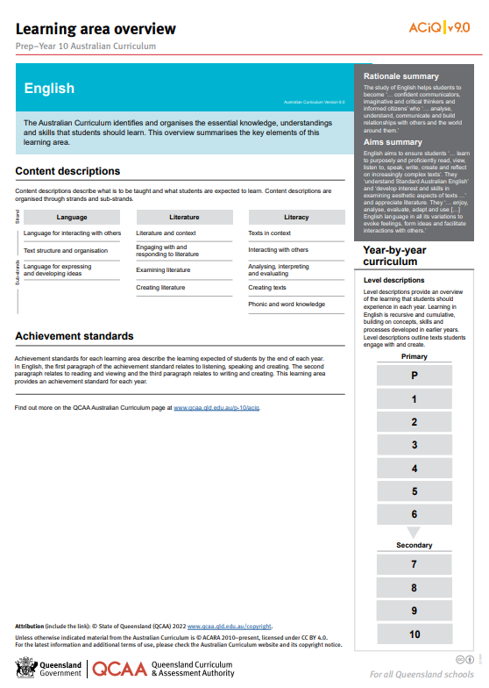
Find out more
Find out more on the QCAA Australian Curriculum webpage.
Notes:
More information about the implementation of Australian Curriculum in Queensland is available on the QCAA website. A one-page overview of the Australian Curriculum: English can be accessed through https://www.qcaa.qld.edu.au/p-10/aciq/version-9/learning-areas/p-10-english/.
Send any further questions to: australiancurriculum@qcaa.qld.edu.au.
Information about requests for further professional learning is available from: www.qcaa.qld.edu.au/pd-events/request-pd.
Suggested activity
Partner with a colleague to discuss the following questions.:
What did I learn?​
What was confirmed?
What was new?​
What challenged my thinking?​
What else do I need to do?​
What is our plan as a teaching team?

Slide 17
Acknowledgments
© State of Queensland (QCAA) 2022
Licence: https://creativecommons.org/licenses/by/4.0 | Copyright notice: www.qcaa.qld.edu.au/copyright — lists the full terms and conditions, which specify certain exceptions to the licence. | Attribution: ‘© State of Queensland (QCAA) 2022’ — please include the link to our copyright notice.
Other copyright material in this publication is listed below:
Photograph/s of staff and students used with permission.
Unless otherwise indicated, material from Australian Curriculum is © ACARA 2010–present, licensed CC BY 4.0. For the latest information and additional terms of use, see the Australian Curriculum website and its copyright notice.
The three-dimensional curriculum diagram is 'Excluded Material' used under the terms of the Australian Curriculum and its copyright notice and is not modified. © Australian Curriculum, Assessment and Reporting Authority (ACARA) 2009 to present, unless otherwise indicated.
You may view, download, display, print, reproduce (such as by making photocopies) and distribute these Excluded Materials in unaltered form only for your personal, non-commercial educational purposes or for the non-commercial educational purposes of your organisation, provided that you make others aware it can only be used for these purposes and attribute ACARA as the source of the Excluded Material. For the avoidance of doubt, this means that you cannot edit, modify or adapt any of these materials, and you cannot sub-licence any of these materials to others. Apart from any uses permitted under the Copyright Act 1968 (Cth), and those explicitly granted above, all other rights are reserved by ACARA. If you want to use such material in a manner that is outside this restrictive licence, you must request permission from ACARA by emailing (copyright@acara.edu.au).

Slide 18
QCAA social media

