Slide 1
National Numeracy Learning Progression
201030
Notes:
This presentation adds detail about the National Numeracy Learning Progression. It is useful to have seen or presented the ‘National Literacy and Numeracy Learning Progressions: Overview’ presentation before engaging with this resource.
The following slides and notes provide information about Version 3 of the National Numeracy Learning Progression, a resource available on the Australian Curriculum website that teachers and schools may choose to use.
Website: www.australiancurriculum.edu.au/resources/national-literacy-and-numeracy-learning-progressions

Slide 2
The Australian Curriculum
The Australian Curriculum: Mathematics has a central role in the development of numeracy.
In addition, all Australian Curriculum learning areas require students to apply and develop
discipline-specific numeracy knowledge and skills.
Notes:
Numeracy is explicit and foregrounded in the Mathematics curriculum more than in other learning areas. The Mathematics curriculum provides the opportunity to apply mathematical understanding and skills in context, in other learning areas and in real-world contexts. In addition, all Australian Curriculum learning areas require the application and development of discipline-specific numeracy skills.
‘In the Australian Curriculum, students become numerate as they develop the knowledge and skills to use mathematics confidently across other learning areas at school and in their lives more broadly. Numeracy encompasses the knowledge, skills, behaviours and dispositions that students need to use mathematics in a wide range of situations. It involves students recognising and understanding the role of mathematics in the world and having the dispositions and capacities to use mathematical knowledge and skills purposefully.’ www.australiancurriculum.edu.au/f-10-curriculum/general-capabilities/numeracy

Slide 3

Relationship: Learning areas and resources
Australian Curriculum Learning area | General capability: Numeracy Numeracy continuum
 | National Numeracy Learning Progression
Notes:
The Australian Curriculum offers multiple opportunities, across learning areas, to support students’ development of numeracy. This slide identifies the connections between the Australian Curriculum and other resources.
The learning areas’ content descriptions specify a sequence of development of knowledge, understanding and skills.
For each learning area, the numeracy continuum identifies opportunities to build numeracy into teaching and learning. The suggestions for numeracy learning are identified by a symbol underneath the content descriptions that can be clicked to reveal a drop-down list of relevant numeracy teaching and learning opportunities. The numeracy continuum describes what can reasonably be expected of students at particular year levels.
The National Numeracy Learning Progression describes, in detail, the steps of numeracy development. These steps are not organised by learning area, content, year levels or stages of schooling.

Slide 4
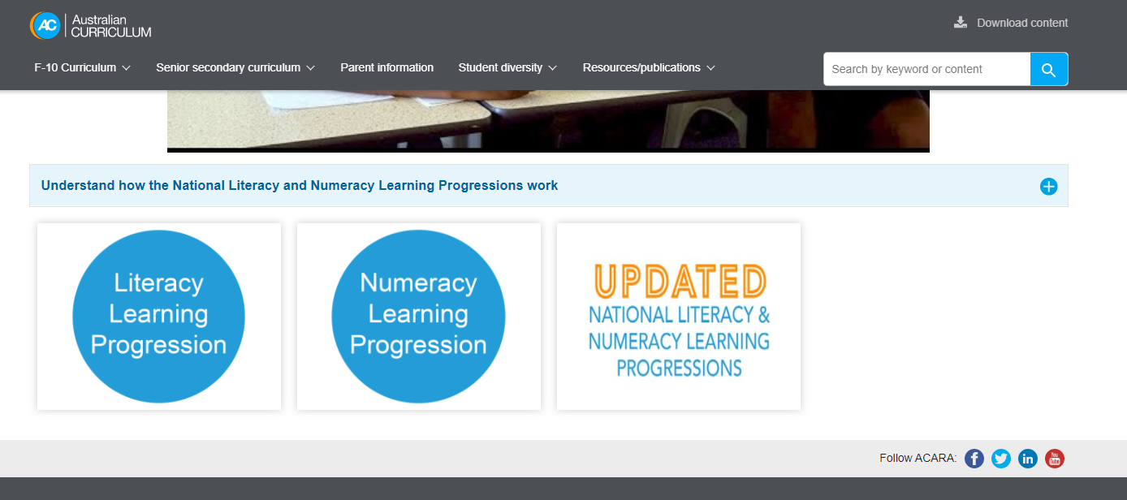
Where to find the Numeracy Learning Progression
Notes:
Clip source: https://australiancurriculum.edu.au/resources/national-literacy-and-numeracy-learning-progressions
On the National Literacy and Numeracy Learning Progressions page, you will find links to both Version 2 and the newly refined Version 3 of the progressions. This allows interested schools and jurisdictions to access Version 3 and also provides a transition time for those currently using Version 2 of the progressions.

Slide 5
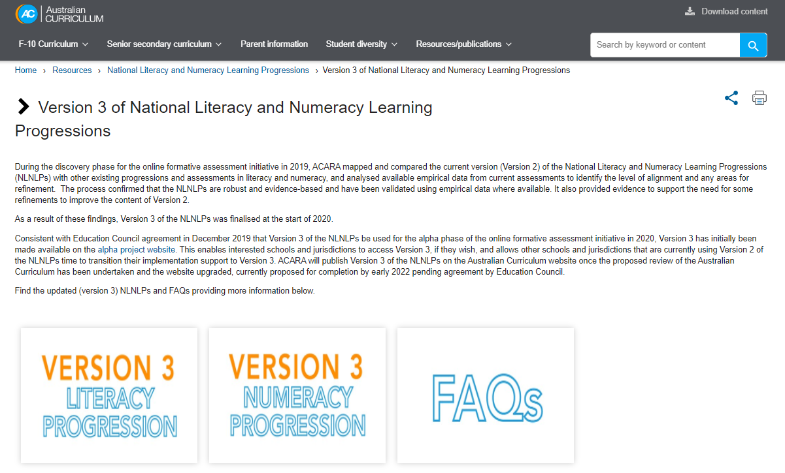
Version 3 of National Literacy and Numeracy Learning Progressions
Notes:
Clip source: www.australiancurriculum.edu.au/resources/national-literacy-and-numeracy-learning-progressions/version-3-of-national-literacy-and-numeracy-learning-progressions
Version 3 of the National Literacy and Numeracy Learning Progressions was finalised at the start of 2020 and is the basis of this presentation.
A frequently asked questions document is also available for additional information.

Slide 6
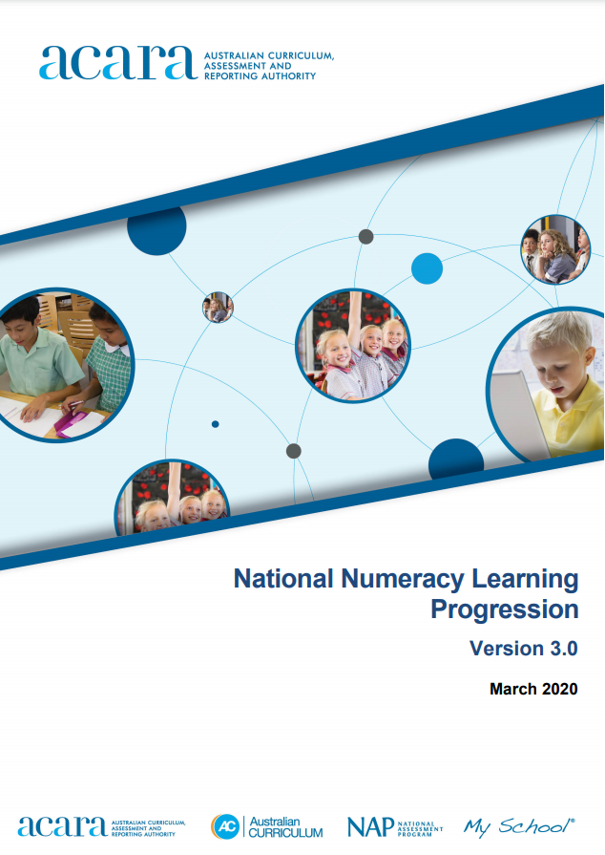
National Numeracy Learning Progression Version 3.0
Version 3 refinements include:
reorganisation of sub-elements for clarity of progression sequence
systematic representation of skill development across levels
consistent terminology
greater clarity within indicators
and examples
additional content to cover identified gaps.
Notes:
Clip source: www.lpofai.edu.au/media/jjsazrlm/national-numeracy-learning-progression-v3-for-publication.pdf
Version 3 of the National Numeracy Learning Progression is currently available as a PDF. It is planned that Version 3 of the progressions will be incorporated into the Australian Curriculum website upgrade, once the Australian Curriculum review is finalised.
Version 3 refinements include:
reorganisation of sub-elements for clarity of progression sequence
systematic representation of skill development across levels
consistent use of terminology
greater clarity of indicators and examples
additional content to cover identified gaps.

Slide 7
Using the Numeracy Learning Progression
The progression is a tool to:
locate each student’s current level of numeracy development on the learning progression
identify the next steps for numeracy learning
develop a shared understanding of numeracy development.

Slide 8
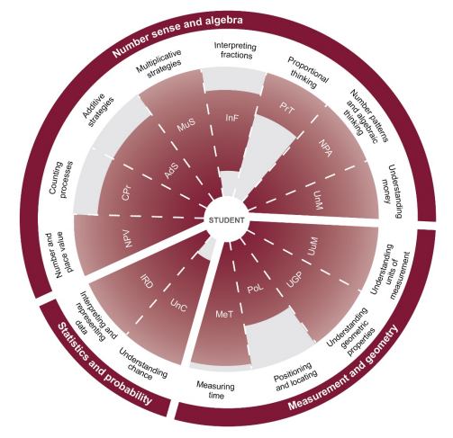
Structure: Numeracy Learning Progression
Elements
Levels
Sub-elements
Credit: National Numeracy Learning Progression
Notes:
Clip source: www.lpofai.edu.au/media/jjsazrlm/national-numeracy-learning-progression-v3-for-publication.pdf
There are common structural and organisational features in the National Literacy and Numeracy Learning Progressions. The largest structural unit is an element, and there are three in the Numeracy Learning Progression: number sense and algebra, measurement and geometry, and statistics and probability. These elements are further divided into fourteen sub-elements, which are populated with indicators. Indicators within a sub-element are grouped together to form developmental levels.
This graphic shows the structure of the Numeracy Learning Progression. It can be found online in the National Numeracy Learning Progression PDF under the heading: How is the National Numeracy Learning Progression structured? (p. 5)

Slide 9
Numeracy elements and sub-elements
Element | Sub-element
Number sense and algebra | Number and place value Counting processes Additive strategies Multiplicative strategies Interpreting fractions Proportional thinking Number patterns and algebraic thinking Understanding money
Measurement and geometry | Measuring time Positioning and locating Understanding geometric properties Understanding units of measurement
Statistics and probability | Interpreting and representing data Understanding chance
Notes:
This is a table of the elements (which provide a holistic view of numeracy) and the sub-elements (which represent evidence-based aspects of numeracy development).

Slide 10
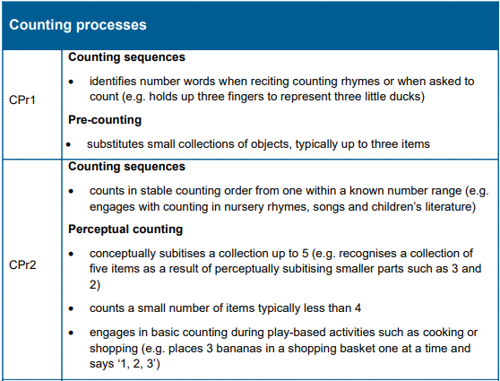
Example
Element: Number sense and algebra
Sub-element
Level
Sub-heading
Indicators
Credit: National Numeracy Learning Progression
Notes:
Clip source: www.lpofai.edu.au/media/jjsazrlm/national-numeracy-learning-progression-v3-for-publication.pdf
This slide provides an example of the Numeracy Learning Progression.
The example sits within the element: Number sense and algebra.
And is drawn from the sub-element: Counting processes.
Sub-element levels are identified by initials of the sub-element name followed by ascending numbers.
Indicators within a level are non-hierarchical.
Sub-headings are used to group related indicators.
As the PowerPoint progresses, annotations appear.

Slide 11
Using the Numeracy Learning Progression
When using the progression to identify student development note that:
teachers make a holistic judgment when placing students on a level
teachers identify next steps in numeracy progression
indicators at each level are neither hierarchical nor prescriptive
the progression is not designed to be used as a checklist.
Notes:
Teachers are encouraged to draw on a diverse range of learning experiences to make holistic judgments about students’ levels in the Numeracy Learning Progression. Teachers may consider the elements and sub-elements in determining what steps should be taken next to support a student’s numeracy progression.

Slide 12
Where to now?
QCAA advises that the National Literacy and Numeracy Learning Progressions are a resource schools may choose to use.
Schools are best placed to decide how to use the learning progressions, with advice from their sector.
The National Numeracy Learning Progression is on the Australian Curriculum website under the ‘Resources/publications’ tab:
https://australiancurriculum.edu.au/resources/national-literacy-and-numeracy-learning-progressions

Slide 13

Acknowledgments
© State of Queensland (QCAA) 2020
Licence: https://creativecommons.org/licenses/by/4.0 | Copyright notice: www.qcaa.qld.edu.au/copyright — lists the full terms and conditions, which specify certain exceptions to the licence. |
Attribution: ‘© State of Queensland (QCAA) 2020— please include the link to our copyright notice.
Other copyright material in this publication is listed below:
Content from ACARA, including the National Literacy and Numeracy Learning Progressions, is © ACARA 2010–2020, licensed under CC BY 4.0. For the latest information and additional terms of use, please check the Australian Curriculum website and its copyright notice.

