Slide 1
Foundational concepts in fractions
Unit 3: Fractions as a measure
Notes:
Welcome to the third unit in the Foundational concepts in fractions course.
In this unit, you will consider in detail fractions as a measure.

Slide 2
Fraction constructs
Fractions as a part-whole (Years 1 and 2)
Fractions as a measure (Year 3)
Fractions as division (Year 6)
Fractions as operators (Year 6)
Fractions as ratios (Year 7)
F
1
2
3
4
5
6
7
Notes:
Fractions can be thought of in different ways. Fractions can represent five different but interrelated fraction constructs — fractions as a part-whole, fractions as a measure, fractions as division, fractions as an operator and fractions as a ratio.
Reference: Adapted from Way, J n.d. ‘Big ideas’, Top Drawer Teachers: Resources for teachers of mathematics, Australian Association of Mathematics Teachers, https://topdrawer.aamt.edu.au/Fractions/Big-ideas.

Slide 3
Foundational concepts in fractions
Course overview
Fractional thinking through representations
Unit 1
Fractions as a part-whole Unit 2
Fractions as a measure Unit 3
Notes:
Foundational concepts in fractions rely on understanding the two fraction constructs shown on-screen, and these are the focus of this course.
Within the course:
Unit 1 explores the effective use of fractional representations that underpin the development of foundational concepts in fractions across Unit 2 and Unit 3.
Unit 2 addresses fractions as a part-whole. Understanding this construct involves students participating in activities such as finding equal parts of shapes or of a group of objects.
This current unit, Unit 3, is based on fractions as a measure.

Slide 4
Before you begin
Access your Reflections on fractions summary document and record your current understanding of:
You can add to these initial ideas as you work through the content in this unit.
Introducing fraction number lines
Establishing referents for fractions
Counting by fractions
Enhancing understanding of equivalent fractions
Access your version of the table Mathematical representations for fractional thinking and continue to add ideas for representing fractions as you work through this unit.
Notes:
Before you begin this unit:
access the Reflections on fractions document that you created in Unit 1, and record your current strategies to develop students’ understanding of fractions on a number line. In particular, consider
– introducing fraction number lines
– establishing referents for fractions
– counting by fractions
– enhancing understanding of equivalent fractions
You can add to these initial ideas as you work through the content in the unit.
access the table Mathematical representations for fractional thinking that you created in Unit 1, and continue to record ideas for representing fractions.

Slide 5
Learning goal
Develop understanding of foundational fractional concepts in Prep to Year 4.
Enhance targeted teaching strategies to improve student understanding.
Notes:
The learning goals for this unit are the same as for the entire course:
develop understanding of foundational fractional concepts in Prep to Year 4
enhance targeted teaching strategies to improve student understanding.

Slide 6
Learning goal
Success criteria
Develop understanding of foundational fractional concepts in Prep to Year 4.
Enhance targeted teaching strategies to improve student understanding.
By the end of this unit, you should be able to:
describe the three main representation types related to fractions as a measurement
explain the teaching and learning sequence for fractions on a number line
select teaching strategies to develop students’ understanding of fractions on a number line.
Notes:
By the end of this unit, Fractions as a measure, you should be able to:
describe the three main representation types related to fractions as a measurement
explain the teaching and learning sequence for fractions on a number line
select teaching strategies to develop students’ understanding of fractions on a number line, with a particular focus on
establishing referents for working with fractions on the number line
developing students’ understanding and skills in counting in fractions
using number lines to enhance understanding of equivalent fractions.

Slide 7
Fractions as a measure construct
The fractions as a measure construct encompasses three main types of measure:
a part-whole segment of a line, region or volume that is considered one whole
a part-whole point on a line where the line is one whole
a point on a number line that has a zero point.
(Adapted from Mitchell & Horne 2011)
Notes:
The fractions as a measure construct encompasses three main types of measure. The first two types relate to part-whole understandings:
a part-whole segment of a line, region or volume that is considered one whole
a part-whole point on a line where the line is assumed to be the whole.
The third type is:
a point on a number line. Here we are thinking of fractions as numbers that have a position or ‘point’ on a number line.
While we will briefly examine the first two types that relate to part-whole representations, part-whole fractions as a measure has been covered in Unit 2 of this course. This unit focuses on fractions as a number with a point on a number line.
Reference: Mitchell, A & Horne, M 2011, ‘Measurement matters: Fraction number lines and length concepts are related’, in J Way & J Bobis (eds), Fractions: Teaching for understanding, The Australian Association of Mathematics Teachers, Adelaide, pp. 52–62.

Slide 8
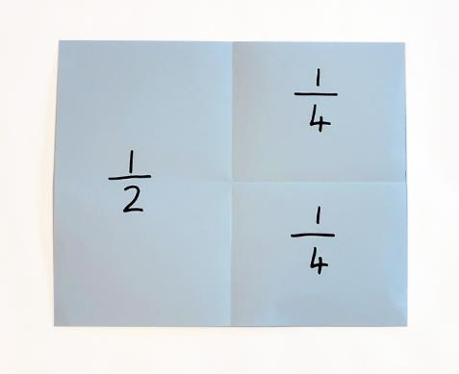
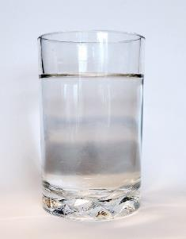
1. Part-whole segment of a line, region or volume
A fraction can be represented as a part-whole segment of a line, area or volume.
Repeating the segment four times fills the whole strip.
Notes:
The first way to think of fractions as a measure is as a part-whole segment of a line, area or volume.
Early experiences build understanding by evenly partitioning linear models such as paper strips to produce fractional parts or measures of the whole strip. In the example shown, each quarter measures a segment that is one-quarter of the length of the whole strip.

Slide 9
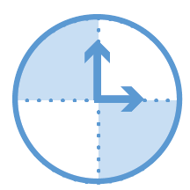
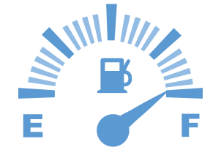
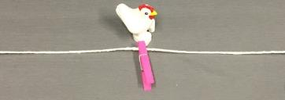
2. Part-whole point on a line
A fraction can be represented as a point on a line where the line is the whole.
Early experiences that build understanding include folding pieces of string to locate fractional points along the string.
$$\frac{1}{2}$$
Notes:
The second way to think of fractions as a measure is as a part-whole point on a line, where the line represents the whole. This may also include other measurement scales with curved lines, such as clocks and gauges.
Early experiences that build understanding include folding pieces of string to locate fractional points along the string. In the example shown at the bottom of the screen, the marked point represents the measure of half the length of one whole piece of string.
These two forms of representation were covered in detail in Units 1 and 2.

Slide 10
3. Fractions as a point on a number line
Fractions are numbers with a distance from 0 on a number line.
$\frac{3}{4}$ is the number that is three-quarters of the distance between 0 and 1.
0
$$\frac{1}{4}$$
$$\frac{2}{4}$$
$$\frac{3}{4}$$
1
Dept of Education WA 2013, First Steps in Mathematics: Number — Book 1.
Notes:
The third representation of fractions as a measure is fractions as a point on a number line. Fractions are often used to describe quantities such as three-quarters of an apple or three-quarters of a cup, but fractions also represent numbers and have their own properties and place on a number line.
Like all number lines, a fraction number line has a zero point and can extend indefinitely in either direction.
For example, on a number line, $\frac{3}{4}$ is three-quarters of the distance between 0 and 1.
For the rest of this unit, we will focus on fractions as numbers with a position on a number line.

Slide 11
Number lines
Notes:
Early-years students will have ordered, located and represented whole numbers on number lines, and may have used number lines to demonstrate thinking when operating with whole numbers. In Year 3, students may have used number lines to model and represent unit fractions and their multiples between 0 and 1. However, students may find fraction number lines conceptually difficult. Many students entering Year 4 find the concept that additional numbers exist between each whole number difficult. Students require the key understanding that fractions exist between any two numbers on the number line.

Slide 12
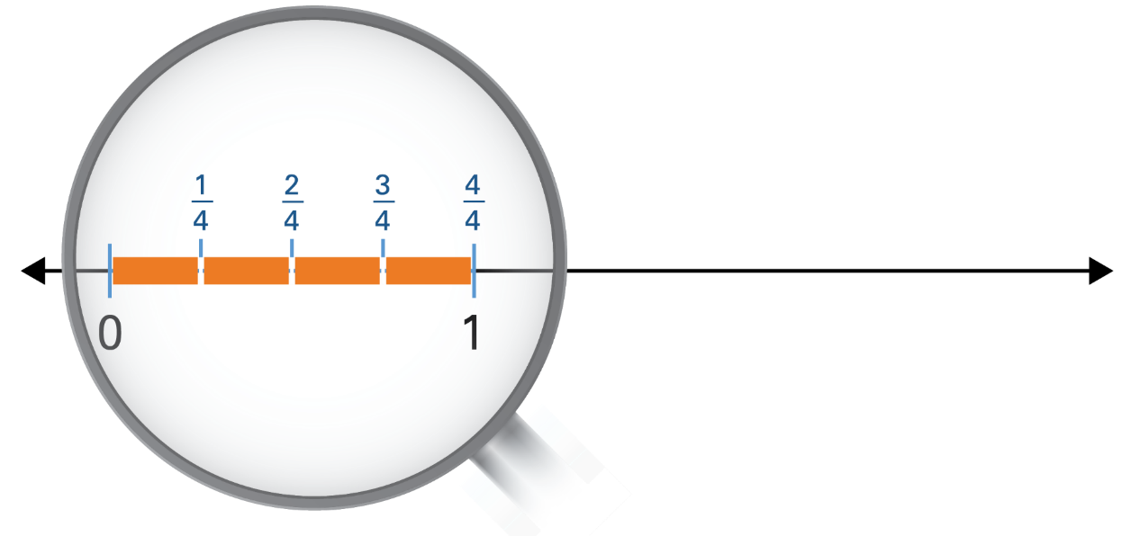
Number lines
Partitioning the space between two whole numbers creates fractions. An infinite number of fractions can exist between each number.
Notes:
The space between two numbers on a number line can be partitioned or broken up into progressively smaller sections to create an infinite number of fractions. Students may struggle with this idea of an infinite number of fractions between 0 and 1, or any other two numbers.
The rest of this unit explores how to support students to deepen their understanding of fractions as numbers on a number line. We will begin by examining references to fractions on a number line in the Australian Curriculum: Mathematics from Prep to Year 4.

Slide 13
Fractions in the Australian Curriculum
Explicit references to fractions on a number line
By the end of Prep | Year 1 | Year 2 | Year 3 | Year 4
Australian Curriculum: Numeracy learning continuum | Australian Curriculum: Mathematics achievement standard
recognise that a whole object can be divided into equal parts |  | divide collections and shapes into halves, quarters and eighths | model and represent unit fractions | locate familiar fractions on a number line recognise common equivalent fractions
 | Australian Curriculum: Mathematics content descriptions
 | recognise and describe one-half as one of two equal parts of a whole | recognise and interpret common uses of halves, quarters and eighths of shapes and collections | model and represent unit fractions including $\frac{1}{2}, \frac{1}{4}, \frac{1}{3} , \frac{1}{5}$ and their multiples to complete a whole Elaboration: locating unit fractions on a number line | investigate equivalent fractions count by quarters halves and thirds, including with mixed numerals locate and represent these fractions on a number line
Adapted from ACARA 2020
Notes:
This table identifies references to fractions within the Prep to Year 4 achievement standards and content descriptions. Explicit references to number lines are highlighted in green.
Note the progression in complexity of the fractions students are working with: initially halves and quarters, then a range of unit fractions including $\frac{1}{2}, \frac{1}{4}, \frac{1}{3} , \frac{1}{5}$ and their multiples. In Year 4, students also work with mixed numerals.
The representations used to show understanding also progress from physical materials to a range of models and representations, with number lines specifically mentioned in the Year 3 elaborations and Year 4 achievement standard.
The Years 5 and 6 curriculums also include direct references to number lines.

Slide 14
Fractions on a number line
Thinking of a fraction as a number on a number line is critical for developing fraction sense.
Incorporating the use of the number line supports students in:
locating and representing fractions
recognising common equivalent fractions
counting by fractions, including counting with mixed numerals.
Notes:
Thinking of a fraction as a number on a number line is critical for developing fraction sense.
The number line is a key tool used to represent fractions and develop the fractional thinking required in the Australian Curriculum by the end of Year 4.
This unit explores the sequence of teaching and learning activities that incorporate the use of the number line and support students in:
comparing and ordering fractions
recognising equivalent fractions
counting by fractions forward or backward along the number line, including with mixed numerals.

Slide 15
Fractions between 0 and 1
Initially the focus of teaching and learning activities is on the fractions between 0 and 1, as reflected in the Year 3 content descriptions.
Year 3 content description: model and represent unit fractions including $\frac{1}{2}, \frac{1}{4}, \frac{1}{3}, \frac{1}{5}$ and their multiples to complete a whole.
Notes:
Students have been using a number line to represent whole numbers since Year 1, where the achievement standard asks them to locate numbers to 100 on a number line. However, the shift to using this representation for fractions requires a sequenced introduction to ensure that students develop a deep conceptual understanding.
Initially the focus of teaching and learning activities is on the fractions between 0 and 1, as reflected in the Year 3 content descriptions.

Slide 16
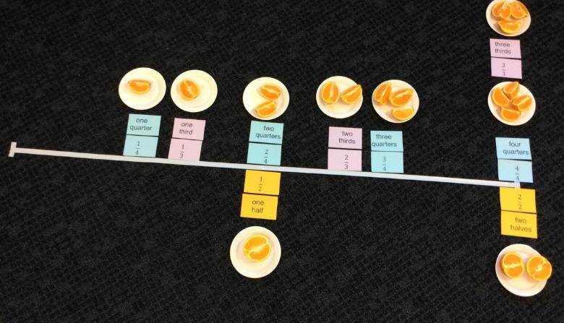
Sequence of introduction
Bridging experiences
Help students to develop understanding of fractions as numbers by making connections to what they already know about fractions.
Creating a fraction number line
Notes:
Help students to develop understanding of fractions as numbers by making connections to what they already know about fractions.
We can achieve this by making explicit links to physical representations students have already encountered, as in the activity shown on-screen.
This is a language-rich activity with student involvement, discussion and explanation encouraged at each step.
Students match the word and symbol form of a fraction and help to create a physical representation of a fraction using oranges.
This activity is explained in detail in the resource accompanying this unit, Creating a fraction number line.

Slide 17
Sequence of introduction
Bridging experiences
‘The “fraction as a measure” idea is best demonstrated using a linear model. The measure model supports the understanding that a fraction is a number, with a position on a number line.’
Way, J n.d.
Notes:
As demonstrated in the previous activity, ‘[t]he “fraction as a measure” idea is best demonstrated using a linear model. The measure model supports the understanding that a fraction is a number, with a position on a number line.’
Reference: Way, J n.d. ‘Fractions as a measure’, Top Drawer Teachers: Resources for teachers of mathematics, Australian Association of Mathematics Teachers.

Slide 18
Sequence of introduction
Bridging experiences
Using paper strips as linear representations is an effective way to demonstrate the partitioning and placement of fractions on a number line.
0
$$\frac{1}{4}$$
$$\frac{2}{4}$$
$$\frac{3}{4}$$
1
Notes:
Using paper strips as linear representations is an effective way to demonstrate the partitioning and placement of fractions on a number line. Making the connection between physical and visual representations promotes understanding of fractions as numbers on a number line.
Consider the example on-screen where a paper strip is folded into fourths or quarters.
By drawing a corresponding number line beneath the strip and marking 0 as the starting point and 1 as the end point, we can then locate all of the fourths fractions between 0 and 1.
Draw students’ attention to the fact that the distance on the number line between zero and one is partitioned into four equal spaces.

Slide 19
Sequence of introduction
Use similar number line experiences to those used with whole numbers.
Provide students with a range of teaching and learning experiences on pre-partitioned number lines, including:
counting in fractions along a number line
identifying fractions on a number line.
0
$$\frac{1}{4}$$
$$\frac{2}{4}$$
$$\frac{3}{4}$$
1
Notes:
Provide students with similar experiences to those used for whole numbers when working with number lines. Initially work with pre-partitioned number lines that have marked segments and include opportunities to:
count in fractions along a number line, building familiarity with the fraction sequence
identify fractions on a number line by asking questions such as
Can you point to one-quarter?
Where is three-quarters?

Slide 20
Sequence of introduction
Use large-scale physical fraction number lines.
Notes:
Students may benefit from incorporating large-scale number lines, such as the one shown on-screen, that they can move along to complete various activities. Guide discussion during and after activities to clarify student thinking. Alternatives to explore the structure and relationships in a fraction number line include using painters tape on the floor or large number line mats. Students work as a whole class or in small groups with these physical representations of structured number lines to build familiarity before undertaking individual fraction number line activities.

Slide 21
Sequence of introduction
Link the physical fraction number lines to visual representations.
0
$$\frac{1}{4}$$
$$\frac{2}{4}$$
$$\frac{3}{4}$$
1
Notes:
Make explicit links to various representations of fraction number lines students have worked with already and the more formal visual representations.
Using images of class or group work as the basis for creating these visual representations helps students to build connections.
Introduce students to halves and quarters before proceeding to thirds and fifths.
These activities build fluency in reading and saying fractions aloud, but also enhance understanding of the relative size and position of a fraction in relation to other fractions, and in relation to 0 and 1.

Slide 22
Sequence of introduction
Gradually reduce the amount of number labels.
0
$$\frac{1}{4}$$
?
$$\frac{3}{4}$$
1
Model the explicit thinking behind decisions of what number to place in an ‘unknown’ space.
Encourage students to use number relationships to explain their thinking when choosing answers.
Notes:
Enhance students’ understanding of fractions as a number by using increasingly complex activities with fewer fractions included on the number line.
Make explicit the thinking behind decisions of what number to place in an ‘unknown’ space. In the example shown, we would model the thinking that two-fourths goes between one-fourth and three-fourths. In similar examples, we would ask students to use the number relationships to explain their thinking.

Slide 23
Sequence of introduction
Gradually reduce the amount of number labels.
Students’ explanations of the strategies they used to place a fraction provide an insight into their level of fractional number sense.
Notes:
Eventually, remove all the fractional numbers, but leave in the partitions. Ask students to place given fractions such as three-quarters on the line and explain the strategies they used to decide where the fraction should be placed.
For example, students may:
count up in fourths from 0
recognise two-fourths as the halfway point between 0 and 1, and count on from there
jump back one-fourth from one whole.
Each strategy is valid, but you can see how the strategies students choose provide insight into their level of fractional number sense.

Slide 24
Sequence of introduction
Open number lines
Model how to partition the distance between 1 and 0 to identify the position of fractions. For example, when locating fourths we create four equal parts by:
first partitioning into two equal parts
0
1
0
1
Notes:
Support transitioning to empty number lines that have no marked partitions by using think-alouds. Emphasise that a number line measures the distance from 0, and the focus is on the spaces between the marks used to partition the line. Students begin by partitioning numbers between 0 and 1.
Explicitly make the link to previous work folding and marking physical linear representations such as paper strips or string. Emphasise that the number of parts the number line space is divided into determines the fraction name: fourths means four parts, thirds means three parts etc.
For example, when working with fourths or quarters, model how to partition the distance between 1 and 0 into four equal parts by:
first partitioning into two equal parts by finding the halfway point

Slide 25
Sequence of introduction
Open number lines
then halving each of these creates four even parts or fourths
the fourths fractions between 0 and 1 can now be named.
0
1
0
$$\frac{1}{4}$$
$$\frac{2}{4}$$
$$\frac{3}{4}$$
1
Notes:
The next step is to halve each of these partitions to create four even parts or fourths.
The fourths fractions between 0 and 1 can now be named.

Slide 26
Establishing fraction referents
Initially use physical representations to help establish simple commonly used fractions as referents or benchmarks.
$$\frac{1}{3}$$
$$0$$
$$1$$
Notes:
Establishing referents or benchmarks reinforces the relative size and relative position of fractions.
Referents or benchmark values of fractions are simple, commonly used fractions, such as $\frac{1}{2}$, 1, $\frac{1}{4}$, $\frac{3}{4}$ and $\frac{1}{3}$. These help students to visualise fractional quantities, equivalences and the location of fractions on a number line.
Again, begin with linear representations such as paper strips and demonstrate how number lines can be drawn using these as a basis, as in the example for thirds.

Slide 27
Establishing fraction referents
Present visual representations and encourage students to compare the various fraction referents.
$$0$$
$$\frac{1}{2}$$
$$1$$
$$0$$
$$\frac{1}{4}$$
$$\frac{3}{4}$$
$$1$$
$$0$$
$$\frac{1}{3}$$
$$\frac{2}{3}$$
$$1$$
Notes:
Presenting visual number line representations of the relative size and relative location of these fractions referents helps students to develop the mental visualisation skills necessary to compare and order fractions.

Slide 28
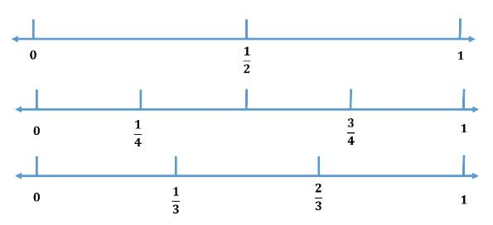
Establishing fraction referents
Focus students’ attention on the relationship between various fraction referents by displaying a visual and using questioning.
For example:
If I know where $\frac{1}{2}$ is, how can I find $\frac{1}{4}$ ?
If I know where $\frac{1}{2}$ is, how can I find $\frac{3}{4}$ ?
Which is bigger: $\frac{1}{3}$ or $\frac{1}{4}$ ?
Is $\frac{2}{3}$ closer to 1 or closer to $\frac{1}{2}$ ?
Notes:
Develop students’ familiarity with these referents and the relationship between them by displaying a visual and using questioning, e.g.
If I know where $\frac{1}{2}$ is, how can I find $\frac{1}{4}$ ?
If I know where $\frac{1}{2}$ is, how can I find $\frac{3}{4}$ ?
Which is bigger: $\frac{1}{3}$ or $\frac{1}{4}$ ?
Is $\frac{2}{3}$ closer to 1 or closer to $\frac{1}{2}$ ?

Slide 29
Establishing fraction referents
Alternatively, pose open questions such as:
What do you notice?
Notes:
Alternatively, pose more open questions such as ‘What do you notice?’ and record students’ observations.

Slide 30
Establishing fraction referents
Alternatively, pose open questions such as:
What do you notice?
Possible observations:
$\frac{1}{4}$ is halfway between 0 and $\frac{1}{2}$
$\frac{3}{4}$ is halfway between $\frac{1}{2}$ and 1
$\frac{1}{3}$ is between $\frac{1}{4}$ and $\frac{1}{2}$
$\frac{2}{3}$ is between $\frac{1}{2}$ and 1
$\frac{3}{4}$ is bigger than $\frac{2}{3}$
Notes:
Some possible student observations for the visual shown here are recorded on-screen.
The aim is for students to eventually be able to use this knowledge to locate a fraction on an open number line.

Slide 31
Using referents to locate fractions on a number line
Where would $\frac{1}{4}$ be on this number line?
Notes:
As with whole numbers, it is important to support students in the move from using pre-partitioned number lines to open number lines, and developing referents for locating fractions helps with this process. In the example on-screen where we are asked to locate one-quarter, we would first consider where one-half would be.

Slide 32
Using referents to locate fractions on a number line
Where would $\frac{1}{4}$ be on this number line?
$$\frac{1}{2}$$
First, place $\frac{1}{2}$ on the number line.
Notes:
After one-half is located, this is used as a referent to partition again and find the halfway point between 0 and $\frac{1}{2}$ .

Slide 33
Using referents to locate fractions on a number line
Where would $\frac{1}{4}$ be on this number line?
$$\frac{1}{4}$$
$$\frac{1}{2}$$
First, place $\frac{1}{2}$ on the number line.
Then use $\frac{1}{2}$ as a benchmark to locate $\frac{1}{4}.$
Notes:
We have now placed one-quarter.

Slide 34
Using referents to locate fractions on a number line
Pegged number lines
Attach starting and end points to a string number line: in this case 0 and 1.
Have a student:
estimate and mark the location of a given fraction on the line
explain their reasoning.
Invite others to share how the exact location of the fraction could be found and check placement.
Notes:
Another possible strategy to support students in developing skills working with open number lines is activities using a pegged number line.
The following suggested sequence uses a number line from 0 to 1 and the fraction $\frac{3}{4}$:
Select a volunteer to peg a card on the line with $\frac{3}{4}$ written on it (by estimating).
Ask the student to explain how they located the fraction.
Invite others in the group to propose how they would find the exact location of three-quarters and share these solutions.
The pegs allow students to easily alter the positions of given fractions if they realise they have made an error. The complexity of the task can also be easily changed by altering the start and end points of the number line.

Slide 35
Fractions beyond 1
Extend understanding of fractions on a number line by working with fractions beyond 1.
Year 4 content description: Count by quarters, halves and thirds, including with mixed numerals. Locate and represent these fractions on a number line.
Notes:
Our initial focus has been on fractions that fall between 0 and 1.
In Year 4, we would then work through similar activities with fractions beyond 1.

Slide 36
Fractions beyond 1
Provide opportunities to:
partition a number line
count in fractions along a number line
identify ‘missing’ fractions on a number line and justify choices.
0
1
2
$$\frac{1}{4}$$
$$\frac{2}{4}$$
$$\frac{3}{4}$$
$$\frac{4}{4}$$
$$\frac{5}{4}$$
$$\frac{6}{4}$$
$$\frac{7}{4}$$
$$\frac{8}{4}$$
Notes:
Building on students’ experiences with fractions between 0 and 1, use an extended range of fractions to explore relative size, relative location and equivalence of fractions.
Students will benefit from opportunities to:
partition a number line
count in fractions along a number line
identify ‘missing’ fractions on a number line and justify choices.

Slide 37
Fractions beyond 1
Create an open number line with string and use markers to identify key points on the line.
Label the end points of the number line.
0
1
Ask: Can students correctly label the place where the chicken is standing?
Notes:
The next activity sequence focuses on relative size, relative location and equivalence of fractions. It moves from considering numbers between 0 and 1 to using a similar procedure to work with fractions beyond 1.

Slide 38
Fractions beyond 1
Ask: Can students correctly label the other two markers on the line?
$$\frac{1}{2}$$
0
1

Slide 39
Fractions beyond 1
$$\frac{1}{4}$$
$$\frac{1}{2}$$
$$\frac{3}{4}$$
0
1
Notes:
At each stage, provide opportunities for students to discuss their reasons for naming each marked point.
You can use the same process for other fraction families, e.g. thirds or fifths.

Slide 40
Fractions beyond 1
What will it look like if we change the end point to 2?
Ask: Can students correctly label the markers on the line?
?
?
?
0
1
2
Notes:
Once students have developed a sense of the relative size and location of fractions between 0 and 1, use a similar procedure to work with fractions beyond 1.

Slide 41
Counting fractions beyond 1
Provide opportunities to count in fractions and mixed numbers.
Initially, use visual representations as a scaffold for counting and draw students’ attention to links between the two models of counting.
0
$$\frac{1}{2}$$
$$\frac{2}{2}$$
$$\frac{3}{2}$$
$$\frac{4}{2}$$
$$\frac{5}{2}$$
$$\frac{6}{2}$$
0
$$\frac{1}{2}$$
$$1$$
1 $\frac{1}{2}$
2
2 $\frac{1}{2}$
3
Notes:
Provide multiple opportunities for students to develop fluency in counting with fractions and mixed numbers.
Initially, use visual representations as a scaffold to support students’ counting in fractions and draw attention to the links between the two models of counting.

Slide 42
Equivalent fractions
Students can be taught fairly quickly to produce equivalent fractions by rote. However, learning by rote does not ensure understanding, so students may forget what they learnt just as easily.
× 2
$$\frac{1}{2}$$
$$\frac{2}{4}$$
is the same as
× 2
Notes:
As discussed in Unit 2, students can be taught fairly quickly to produce equivalent fractions by rote. However, this does not ensure understanding, so students may forget the rote procedure just as easily.
Unit 2 examined strategies for using part-whole representations to explore equivalent fractions. Number line representations of fractions with related denominators are another powerful way to build on this and reinforce the relationships between equivalent fractions.

Slide 43
Equivalence
Compare counting patterns between related denominators to explore relationships and equivalence.
0
$$\frac{1}{2}$$
$$\frac{2}{2}$$
$$\frac{3}{2}$$
$$\frac{4}{2}$$
$$\frac{5}{2}$$
$$\frac{6}{2}$$
0
$$\frac{1}{4}$$
$$\frac{2}{4}$$
$$\frac{3}{4}$$
$$\frac{4}{4}$$
$$\frac{5}{4}$$
$$\frac{6}{4}$$
$$\frac{7}{4}$$
$$\frac{8}{4}$$
$$\frac{9}{4}$$
$$\frac{10}{4}$$
$$\frac{11}{4}$$
$$\frac{12}{4}$$
Notes:
Using visual representations of counting patterns allows students to explore the relationship between related denominators and equivalence. For example, the representations shown on-screen make it clear that for every half, there are two corresponding quarters.
This highlights the fact that some fractions occupy the same position on a number line and therefore represent the same quantity.

Slide 44
Equivalence
Explicitly model forming an equivalent fraction by splitting or merging partitions of the original fraction.
0
$$\frac{1}{6}$$
$$\frac{2}{6}$$
$$\frac{3}{6}$$
$$\frac{4}{6}$$
$$\frac{5}{6}$$
$$\frac{6}{6}$$
$$\frac{7}{6}$$
$$\frac{8}{6}$$
$$\frac{9}{6}$$
$$\frac{10}{6}$$
$$\frac{11}{6}$$
$$\frac{12}{6}$$
0
$$\frac{1}{3}$$
$$\frac{2}{3}$$
$$\frac{3}{3}$$
$$\frac{4}{3}$$
$$\frac{5}{3}$$
$$\frac{6}{3}$$
1 2
Notes:
Forming an equivalent fraction involves changing the unit of measure by either splitting or merging the partitions of the original fraction. In the previous slide, we moved from halves to quarters by splitting each partition equally. In the example above, we move from sixths to thirds by merging two of the one-sixth partitions to create a third.
This emphasises that equivalent fractions are a different way of naming the same quantity.
You can also see how we are laying the groundwork to prepare students in later years for adding and subtracting fractions with the same or related denominators.

Slide 45
Equivalence
‘The exploration of equivalence allows students to develop an understanding of equivalent fractions as simply being a different way of naming the same quantity; it also supports them in viewing the fraction as a numeric value.’
(Bruce et al. 2013)
Notes:
After reviewing the literature, Dr Catherine Bruce and her colleagues concluded that ‘[t]he exploration of equivalence allows students to develop an understanding of equivalent fractions as simply being a different way of naming the same quantity; it also supports them in viewing the fraction as a numeric value’.
Reference: Bruce, C, Chang, D, Flynn, T & Yearley, S 2013, Foundations to Learning and Teaching Fractions: Addition and subtraction, (literature review), 21 June, Ontario Ministry of Education, www.edugains.ca/resourcesMath/CE/LessonsSupports/Fractions/FoundationstoLearningandTeachingFractions.pdf.

Slide 46
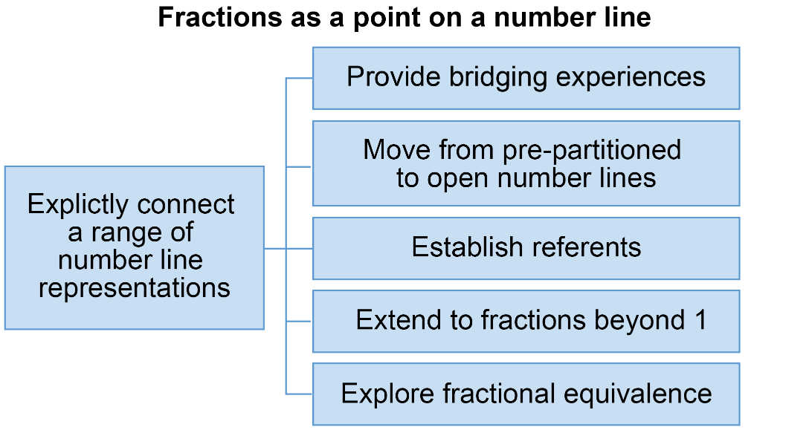
Review of Unit 3
Reflect on the work you have engaged with in this unit.
Notes:
Congratulations on completing Unit 3 in the course Foundational concepts in fractions.
On-screen is a brief review of the main concepts addressed in the unit.
This unit focused on fractions as a point on a number line. It explored a suggested sequence of teaching and learning experiences that all involved explicitly connecting a range of number line representations to build student understanding. These included:
providing bridging experiences
moving from pre-partitioned to open number lines
establishing referents
extending to fractions beyond 1
exploring fractional equivalence.

Slide 47
Review of Unit 3 success criteria
You should now be able to:
describe the three main representation types related to fractions as a measurement
explain the teaching and learning sequence for fractions on a number line
select teaching strategies to develop students’ understanding of fractions on a number line.
Notes:
After completing this unit, you should now be able to:
describe the three main representation types related to fractions as a measurement
explain the teaching and learning sequence for fractions on a number line
select teaching strategies to develop students’ understanding of fractions on a number line, with particular focus on
– establishing referents for working with fractions on a number line
– developing students’ understanding and skills in counting in fractions
– using number lines to enhance understanding of equivalent fractions.

Slide 48
Implications for your context
Reflect on the information covered in this unit about developing students’ understanding of fractions on a number line.
What are your main takeaways from the topics that you considered at the start of the unit?
Record one key thing from two of the topics that you will try as a result of your learning.
A sequence to introduce fraction number lines
Establishing referents for fractions
Counting by fractions
Enhancing understanding of equivalent fractions
Notes:
On-screen are the main topics that you considered at the start of the unit in your Reflections on fractions summary.
Look back on your notes and the information covered in this unit to:
reflect on the main takeaways you gained from the unit
record or highlight these in your notes
choose at least one key thing from two of the topics that you want to try as a result of your learning.

Slide 49
Final reflections on the course
Review your notes from each unit and consider the content you have engaged with across the course.
In your final reflection, record the following:
three key things I have learnt
two teaching and learning activities I want to try
one key idea that I want to incorporate into my teaching of fractions to enhance students’ understanding.
Notes:
Congratulations on completing the Foundational concepts in fractions course.
We recommend that you take some time to consider the work you have engaged with across the three units of the course by reviewing the notes you recorded in these documents:
Reflections on fractions
Mathematical representations for fractional thinking
Key concepts underpinning fractional thinking.
As a final reflection on the course, record the following:
three key things I have learnt
two teaching and learning activities I want to try
one key idea that I want to incorporate into my teaching of fractions to enhance students’ understanding of fractions.
You may like to discuss these with a colleague.

Slide 50
References
Australian Curriculum, Assessment and Reporting Authority (ACARA), Australian Curriculum, www.australiancurriculum.edu.au.
Bruce, C, Chang, D, Flynn, T & Yearley, S 2013, Foundations to Learning and Teaching Fractions: Addition and subtraction, (literature review), 21 June, Ontario Ministry of Education, www.edugains.ca/resourcesMath/CE/LessonsSupports/Fractions/FoundationstoLearningandTeachingFractions.pdf.
Mitchell, A & Horne, M 2011, ‘Measurement matters: Fraction number lines and length concepts are related’, in J Way & J Bobis (eds), Fractions: Teaching for understanding, The Australian Association of Mathematics Teachers, Adelaide, pp. 52–62.
Way, J n.d. ‘Big ideas’, Top Drawer Teachers: Resources for teachers of mathematics, Australian Association of Mathematics Teachers, https://topdrawer.aamt.edu.au/Fractions/Big-ideas.
Way, J n.d. ‘Fractions as a measure’, Top Drawer Teachers: Resources for teachers of mathematics, Australian Association of Mathematics Teachers, https://topdrawer.aamt.edu.au/Fractions/Big-ideas/Fractions-as-a-measure
Western Australia Department of Education 2013, First Steps in Mathematics: Number — Book 1, http://det.wa.edu.au/stepsresources/detcms/education/stepsresources/first-steps-mathematics/number--book-1.en?cat-id=13603739.

Slide 51
Acknowledgments
© State of Queensland (QCAA) 2020
Licence: https://creativecommons.org/licenses/by/4.0 | Copyright notice: www.qcaa.qld.edu.au/copyright — lists the full terms and conditions, which specify certain exceptions to the licence. | Attribution: ‘© State of Queensland (QCAA) 2020’ — please include the link to our copyright notice.
Other copyright material in this publication is listed below:
Slide 2: Adapted from Way, J n.d. ‘Big ideas’, Top Drawer Teachers: Resources for teachers of mathematics, Published by the Australian Association of Mathematics Teachers, https://topdrawer.aamt.edu.au/Fractions/Big-ideas. Used with permission.
Slide 7: Adapted from Mitchell, A & Horne, M 2011, ‘Measurement matters: Fraction number lines and length concepts are related’, in J Way & J Bobis (eds), Fractions: Teaching for understanding, The Australian Association of Mathematics Teachers, Adelaide, pp. 52–62.
Slide 10: Dept of Education WA 2013, First Steps in Mathematics: Number — Book 1.
Slide 13: ‘Extract of Australian Curriculum © ACARA 2010–2019, licensed under CC BY 4.0. For the latest information and additional terms of use, please check the Australian Curriculum website and its copyright notice.
Slide 17: Way, J n.d. ‘Fractions as a measure’, Top Drawer Teachers: Resources for teachers of mathematics, Australian Association of Mathematics Teachers, https://topdrawer.aamt.edu.au/Fractions/Big-ideas/Fractions-as-a-measure. Used with permission.
Slide 45: Bruce, C, Chang, D, Flynn, T & Yearley, S 2013, Foundations to Learning and Teaching Fractions: Addition and subtraction, (literature review), 21 June, Ontario Ministry of Education.

Slide 52
QCAA social media

