Slide 1
Foundational concepts in fractions
Unit 2: Fractions as part of a whole
201095
Notes:
Welcome to the second unit in the course Foundational concepts in fractions.
In this unit, you will consider in detail fractions as part of a whole.

Slide 2
Fraction constructs
Fractions as a part-whole (Years 1 and 2)
Fractions as a measure (Year 3)
Fractions as division (Year 6)
Fractions as operators (Year 6)
Fractions as ratios (Year 7)
F
1
2
3
4
5
6
7
Notes:
Fractions can be thought of in different ways. Fractions can represent five different but interrelated fraction constructs — fractions as a part-whole, fractions as a measure, fractions as division, fractions as an operator and fractions as a ratio.
Source: Adapted from Way, J n.d. ‘Big ideas’, Top Drawer Teachers: Resources for teachers of mathematics, Australian Association of Mathematics Teachers, https://topdrawer.aamt.edu.au/Fractions/Big-ideas.

Slide 3
Foundational concepts in fractions
Course overview
Fractional thinking through representations
Unit 1
Fractions as a part-whole Unit 2
Fractions as a measure Unit 3
Notes:
Foundational concepts in fractions rely on understanding the two fraction constructs shown on-screen: fractions as a part-whole and fractions as a measure. These are the focus of this course.
Within this course, Unit 1 explores the effective use of fractional representations that underpin the development of foundational concepts in fractions across Units 2 and Unit 3.
This current unit, Unit 2, addresses fractions as a part-whole.
Unit 3 is based on fractions as a measure. Understanding of fractions as a measure is developed through teaching and learning activities such as folding paper strips and locating fractions on a number line.

Slide 4
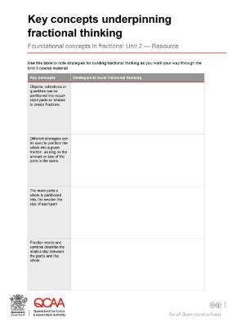
Before you begin
Access your version of the table Mathematical representations used for fractional thinking from Unit 1 and continue to add ideas for representing fractions as you work through this unit.
Open and save a copy of Key concepts underpinning fractional thinking. Use this document to record learnings from this unit.
Notes:
Before you begin this unit:
access your version of the table Mathematical representations used for fractional thinking from Unit 1 and continue to add ideas for representing fractions
open and save a copy of Key concepts underpinning fractional thinking. Use this document to record learnings from this unit.

Slide 5
Learning goal
Develop understanding of foundational fractional concepts in Prep to Year 4.
Enhance targeted teaching strategies to improve student understanding.
Notes:
The learning goals for this unit are the same as for the entire course:
Develop understanding of foundational fractional concepts in Prep to Year 4.
Enhance targeted teaching strategies to improve student understanding.

Slide 6
Learning goal
Success criteria
Develop understanding of foundational fractional concepts in Prep to Year 4.
Enhance targeted teaching strategies to improve student understanding.
By the end of this unit, you should be able to:
describe the key concepts underpinning fractional thinking
identify common student misconceptions
select teaching strategies to develop students’ understanding of fractions as part of a whole.
Notes:
By the end of this unit, Fractions as part of a whole, you should be able to:
describe the key concepts underpinning fractional thinking
identify common student misconceptions
select teaching strategies to develop students’ understanding of fractions as part of a whole.

Slide 7
Fractions as part of a whole
‘The basis of fractional understanding is that fractions are a part of a whole — that is, when one whole thing is split into equal parts, each part is a fraction in relation to the original whole.’
(Jorgensen & Dole 2011)
Notes:
The basis of fractional understanding is that fractions are a part of a whole. Jorgensen and Dole (2011) define this as ‘when one whole thing is split into equal parts, each part is a fraction in relation to the original whole’.
Reference: Jorgensen, R & Dole, S 2011, Teaching Mathematics in Primary Schools, 2nd edn, Allen & Unwin Academic, Crows Nest, NSW.

Slide 8
Key concepts underpinning fractional thinking
Key concept 1
Objects, collections or quantities can be partitioned into equal-sized parts or ‘shares’ to create fractions.
Key concept 2
Different strategies can be used to partition the whole into a given fraction, as long as the amount or size of the parts is the same.
Key concept 3
The more parts a whole is partitioned into, the smaller the size of each part.
Key concept 4
Fraction words and symbols describe the relationship between the part/s and the whole.
Notes:
Four key concepts underpin fractional thinking within this overarching idea of fractions as part of a whole.
Key concept 1: Objects, collections or quantities can be partitioned into equal-sized parts or ‘shares’ to create fractions.
Key concept 2: Different strategies can be used to partition the whole into a given fraction, as long as the amount or size of the parts is the same.
Key concept 3: The more parts a whole is partitioned into, the smaller the size of each part.
Key concept 4: Fraction words and symbols describe the relationship between the part/s and the whole.
We will explore each of these key concepts in greater detail throughout this unit before considering how to further extend student thinking of fractions as part of a whole.

Slide 9
Key concept 1
Objects, collections or quantities can be partitioned into equal-sized parts or ‘shares’ to create fractions.
Notes:
The first key concept is that objects, collections or quantities can be partitioned into equal-sized parts or ‘shares’ to create fractions.

Slide 10
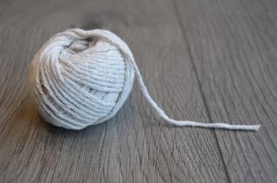
Identifying the whole
The first step to build conceptual understanding of fractions is for students to be able to identify the whole and know that fractions are created by partitioning the whole object, area, length or set into equal-sized parts or ‘shares’.
It is important to expose students to a range of real-world examples of wholes and explore how these can be equally partitioned.
Sources: Apple Red Delicious by Jarmoluk, Asphalt Tennis Court by slvmarketing, Ball of String Yarn by ClaradoodlaK, Buttons by LeoNeoBoy, All free for commercial use, Pixabay.
object
area
length
set
Notes:
The first step to build conceptual understanding of fractions is for students to be able to identify the whole and know that fractions are created by partitioning the whole into equal-sized parts or ‘shares’.
It is important to expose students to a range of real-world examples of wholes. Draw attention to familiar examples from the classroom and playground, and discuss how each of these can be equally partitioned.
Model the physical partitioning of a whole in a variety of contexts and explicitly make the link for students that where the split occurs is the partition.

Slide 11
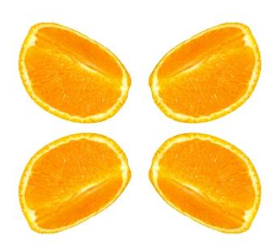
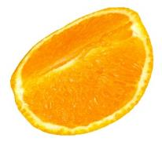
Identifying the whole
Reinforce the notion of the ‘whole’ through the language you use to describe the partitions in relation to the whole.
This is one-half of one sandwich.
This is one-fourth of one orange.
Source: Orange Fruit Quarter Fruit Sliced by StevenGiacomelli, Free for commercial use, Pixabay.
Notes:
As students explore how real-world examples of wholes can be equally partitioned, reinforce the notion of the ‘whole’ through the language (verbal representations) you use to describe the partitions in relation to the whole.
Rather than saying ‘this is a half’, say ‘this is one-half of one sandwich’.
When talking about quarters, it is also correct to use ‘fourths’. Using fourths may help students to make the connection with how many pieces the whole is broken into.

Slide 12
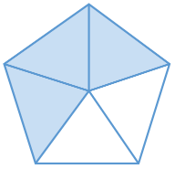
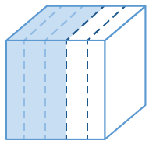
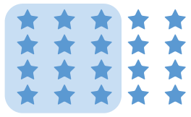
Fractions as part of a whole
Provide opportunities for students to partition a range of ‘wholes’.
Each time you partition a whole, draw students’ attention to:
the number of equal parts and what they are called
how many parts have been chosen
how the fraction is named.
area
object
set
length
Notes:
Provide opportunities for students to partition a range of ‘wholes’, including areas, objects, sets and lengths, using physical representations initially before introducing visual representations.
Each time you partition a whole, draw students’ attention to:
the number of equal parts and what they are called
how many parts have been chosen
how the fraction is named.

Slide 13
Fractions as part of a whole
Consider each case below where the whole has been partitioned into 5 equal parts.
area
object
set
length
The 5 tells the name or size of the parts (fifths), because 5 equal parts fill a whole.
Three of those parts have been chosen. The 3 tells us that we have chosen 3 of those fifths.
In each case, the fraction represented is three-fifths or $\frac{3}{5}$ of the whole.
Notes:
For example, consider each case on-screen where the whole has been partitioned into five equal parts.
The 5 tells the name or size of the parts (fifths) because 5 equal parts fill a whole.
Of those parts, 3 have been chosen. The 3 tells us that we have chosen 3 of those fifths.
The fraction represented in each whole is three-fifths or $\frac{3}{5}$.
Use a range of physical and visual representations to reinforce that the process for determining a fraction stays the same, but the size of the resulting fraction will vary depending on the size of the initial whole that was partitioned.

Slide 14
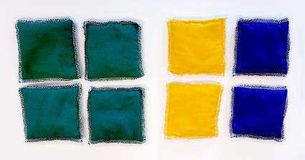
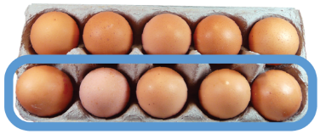
Fractions as part of a whole
The amount or size of a fraction is related to the amount or size of the whole.
Use a range of physical and visual representations to reinforce that:
the process for determining a fraction is the same
the size of the resulting fraction will vary depending on the size of the initial whole that was partitioned.
For example:
One-half of the set of eggs is five eggs. Source: Egg Pack Food by dgazdik, Free for commercial use, Pixabay.
One-half of the set of beanbags is four beanbags.
Notes:
When introducing students to fractions as part of a whole, it is important to emphasise that the amount or size of a fraction is related to the amount or size of the whole.
Use a range of physical and visual representations to reinforce that the process for determining a fraction stays the same (as shown in the last two slides), but the size of the resulting fraction will vary depending on the size of the initial whole that was partitioned.

Slide 15
Common misconceptions
‘Making errors and experimenting with new strategies are a natural part of learning. However, if inappropriate thinking about fractions is established as a misconception, a barrier to progress in conceptual understanding is formed.’
(Way n.d.)
We will now examine two common misconceptions that can be formed in the early stages of fractional thinking and explore ways to address these.
Notes:
‘Making errors and experimenting with new strategies are a natural part of learning. However, if inappropriate thinking about fractions is established as a misconception, a barrier to progress in conceptual understanding is formed.’
Reference: Way, J n.d. ‘Misunderstandings’, Top Drawer Teachers Resource, Australian Association of Mathematics Teachers, https://topdrawer.aamt.edu.au/Fractions/Misunderstandings.
We will now examine two common misconceptions that can be formed in the early stages of fractional thinking and explore ways to address these.

Slide 16
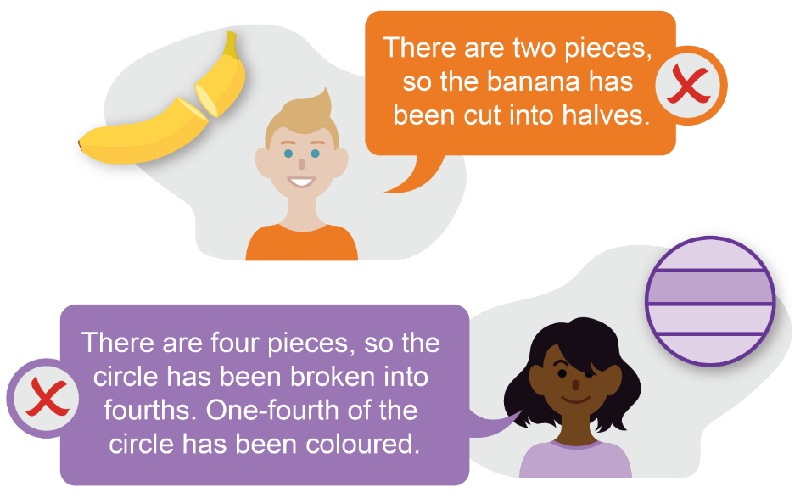
Equality of the parts: Misconception 1
A misconception can arise when students only notice the number of parts and do not consider the equality of parts.
This thinking is exemplified in the examples below.
Source: Banana by hungblueads, Free for commercial use, Pixabay.
Notes:
The first misconception we will examine relates to equality of the parts a whole has been partitioned into.
A misconception can arise when students split things into two parts and only notice the number of parts and not the equality of the parts.
They associate the word ‘half’ with the process of splitting into two, rather than creating two equal parts.
This thinking is exemplified in the examples shown on-screen.

Slide 17
Addressing misconception 1
Understanding the importance of partitioning a whole into equal quantities or sizes is fundamental to recognising the part-whole relationship between the numerator and denominator in fractions.
To develop this understanding, provide examples of partitioning into equal and unequal parts.
correct example
incorrect example
Sources: Orange Fruit Food by Clker-Free-Vector-Images, Banana by hungblueads, Free for commercial use, Pixabay.
Notes:
Addressing this misconception is vital, as understanding the importance of partitioning a whole into equal quantities or sizes is fundamental to recognising the part-whole relationship between the numerator and denominator in fractions.
To develop this understanding, provide examples of partitioning into equal and unequal parts.
Sources: Orange Fruit Food by Clker-Free-Vector-Images
Banana by hungblueads, Free for commercial use, Pixabay.

Slide 18
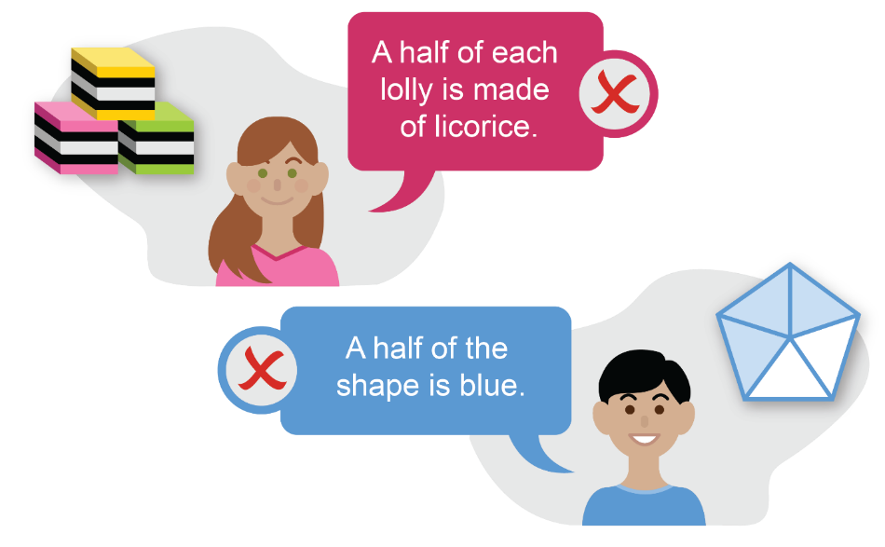
Quantity of the parts: misconception 2
A misconception can arise when students notice that some of the parts are distinctly different from the other parts in the whole and don’t consider the quantity of the two types of parts.
This thinking is exemplified in the examples below.
Notes:
The second common misconception in early fractional thinking arises when students notice that some of the parts are distinctly different from the other parts in the whole and don’t consider the quantity of the two types of parts.
This thinking is exemplified in the examples shown on-screen.

Slide 19
Addressing misconception 2
Model how to identify fractions using think-alouds. For example, you could work through the following questions to address the claim that ‘half the lolly is licorice’:
What is the whole? |  | A licorice lolly
What are the parts we are considering? |  | Two parts: licorice and candy
Are the parts equal? |  | No. There are more candy layers than licorice layers.
Is half the lolly licorice? |  | No. The parts are not equal, so the lolly is not half licorice.
Notes:
To address this misconception, model how to identify fractions using think-alouds. For example, you could work through the questions shown on-screen to address the claim that ‘half the lolly is licorice’.
Provide other examples and encourage students to use this language and work through the process in pairs and/or on their own to decide if a particular claim is true or false.

Slide 20
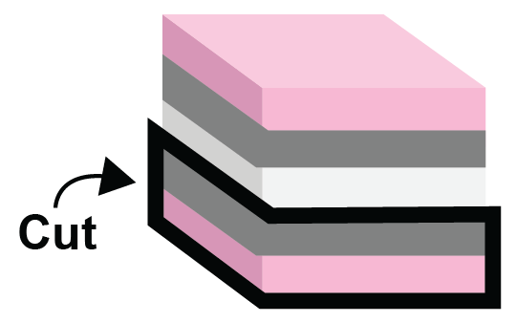
Addressing misconception 2
Consolidate students’ understanding by:
Cut the lolly so there are only two layers: one licorice and one candy.
asking them to change the original image so that licorice is half of the lolly
having them draw their own image where licorice is half of the lolly.
Notes:
Students’ understanding can be further consolidated through activities such as:
asking them to change the original image so that licorice is half of the lolly
having them draw their own lolly where licorice is half of the lolly.

Slide 21
Key concept 2
Different strategies can be used to partition the whole into a given fraction, as long as the amount or size of the parts is the same.
Notes:
The second key concept is that different strategies can be used to partition the whole into a given fraction, as long as the amount or size of the parts is the same.
Partitioning objects, areas or sets to form fractions involves dividing or splitting the whole into smaller equal-sized pieces or amounts.
Students’ experiences may lead them to form the misconception that there is only one ‘right’ way to partition a whole into halves, fourths etc.
We can provide many learning experiences to reinforce the key concept that partitioning can be done in different ways, as long as the amount or size of the parts is the same.

Slide 22
Different strategies can be used to partition
Students should initially be involved in partitioning physical representations of a whole to create halves.
For example, consider how halves can be created from a piece of paper.
The whole may be split into two equal pieces a number of ways.
Emphasise: The amount or size of the parts must be the same.
Notes:
Students should initially be involved in creating halves from physical representations of a whole.
The example on-screen involves partitioning paper to create halves.
Emphasise that the amount or size of the parts is the same by demonstrating how a grid overlay placed on the various representations of one-half results in the same number of grid squares being coloured. Reinforce that each half is made up of the same amount of paper — each half has the same area.

Slide 23
Different strategies can be used to partition
Similarly, students could be asked to partition one whole piece of paper to create fourths.
Encourage them to find as many different ways as possible to partition the paper to create fourths.
One whole
One-fourth of a whole piece of paper
One-fourth of a whole piece of paper
Emphasise: The amount or size of the parts must be the same.
Notes:
Similarly, students could be asked to partition one whole piece of paper to create fourths.
Encourage them to find as many different ways as possible to partition the paper to create fourths.
Again, you can highlight that the amount or size of the parts is the same by demonstrating how a grid overlay placed on the various representations of one-fourth shows the same number of grid squares.
Using the language of ‘fourths’ rather than ‘quarters’, particularly in these early stages, reinforces the connection between the fraction name and the number of parts the whole is partitioned into.

Slide 24
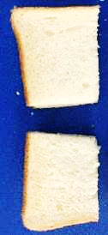
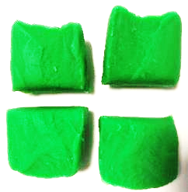
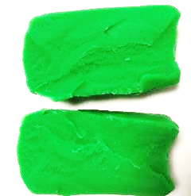
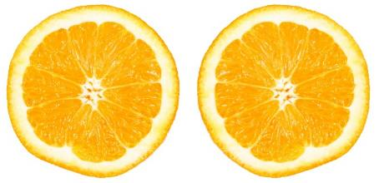
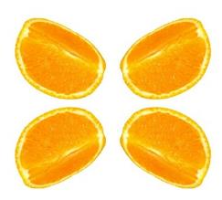
Different strategies can be used to partition
Students should have experience in partitioning a range of physical representations of a whole.
Sources: Orange Fruit Vitamins Healthy by jarmoluk, Orange Fruit Quarter Fruit Sliced by StevenGiacomelli, Free for commercial use, Pixabay.
Emphasise: The amount or size of the parts must be the same.
Notes:
Engage students in similar experiences partitioning things such as sandwiches, playdough and fruit into fractional parts.
Sources: Orange Fruit Vitamins Healthy by jarmoluk, Orange Fruit Quarter Fruit Sliced by StevenGiacomelli, Free for commercial use, Pixabay.

Slide 25
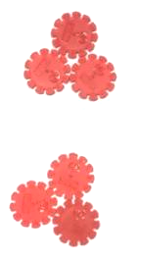
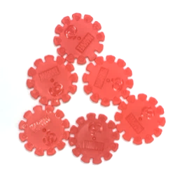
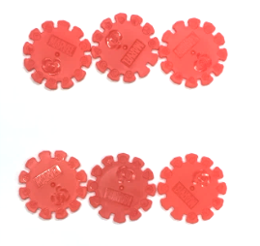
Different strategies can be used to partition
Students should also be involved in partitioning sets to create fractions.
Introduce the creation of fractions from set models by partitioning physical models such as counters or blocks.
The whole
Three ways of splitting the whole into halves.
Emphasise: The amount or size of the parts must be the same.
Notes:
Students should also be involved in partitioning sets to create fractions.
Introduce the creation of fractions from set models by partitioning physical models such as counters or blocks.
Again, the emphasis is that the amount or size of the parts must be the same.

Slide 26
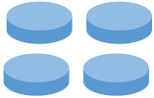
Different strategies can be used to partition
Finding a fraction of a set model is cognitively demanding, as the solution is not a fraction part but is a number of individual items that can be counted.
For example, model the process using think-alouds and then work jointly with students to:
use counters to make a set
identify the set as ‘one whole’
find a specific fraction of that set.
Four counters is one whole set.
Two counters is one-half of the whole set.
Notes:
Finding a fraction of a set model is cognitively more demanding than finding the fraction of a whole object, area or length, as the solution is not a fraction part but is a number of individual items that can be counted.
For example, model the process using think-alouds and then work jointly with students to:
use counters to make a set – four counters
identify the set as ‘one whole’ – four counters is one whole set
find a specific fraction of that set – two counters is one-half of the whole set.

Slide 27
Key concept 3
The more parts a whole is partitioned into, the smaller the size of each part.
Notes:
The third key concept students need to understand is that the more parts a whole is partitioned into, the smaller the size of each part.

Slide 28
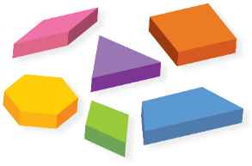
Exploring relative size with physical models
Introduce the creation of fractions by partitioning area models using physical models such as pattern blocks.
For example,
if is 1 whole, use blocks to show fractions such as:
Note: These pre-partitioned physical models are a good starting point, but it is important to transition to activities that require students to partition by themselves in order to create given fractions.
$$\frac{1}{2}$$
$$\frac{1}{4}$$
Notes:
Introduce the creation of fractions by partitioning area models using physical models such as pattern blocks.
Students are able to compare the size of fractions by physically placing the blocks on top of each other to take note of how many of one type it takes to complete the ‘whole’.
Note that these pre-partitioned physical models are a good starting point, but it is important to transition to activities that require students to partition by themselves in order to create given fractions.

Slide 29
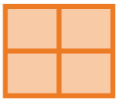
Exploring relative size with physical models
Folding shapes or strips of paper has been found to promote deep understanding of the relative size of fractions.
Initially, fold using a halving strategy to represent a half.
Halving
Explore how successive partitioning in half creates fourths or quarters.
Half of half
Notes:
Folding shapes and strips of paper is a good example of an activity that promotes deep understanding of the relative size of fractions.
Initially, use a halving strategy to represent a half.
Then explore how successive partitioning in half creates quarters or fourths.

Slide 30
Exploring relative size with physical models
Compare the size of each unit part.
One-quarter is smaller than one-half.
$\frac{1}{4}$ is smaller than $\frac{1}{2}$
The more parts a whole is partitioned into, the smaller the size of each part.
Notes:
Finally, ask students to physically compare the size of each unit part.
The main concept to reinforce through these activities is that the more parts a whole is partitioned into, the smaller the size of each part.

Slide 31
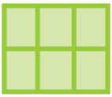
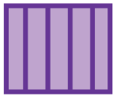
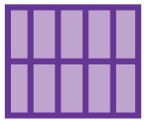
Exploring relative size with physical models
Comparing unit fractions
After using a halving strategy to represent a half, students can explore how successive partitioning creates quarters, eighths and sixteenths.
Similarly, the ‘thirding’ strategy can be used to create thirds, and then halving used to create sixths.
The ‘fifthing’ strategy can be used to create fifths, and then halving used to create tenths.
Notes:
The halving strategy can be further extended beyond quarters to create eighths and sixteenths.
Similarly, the ‘thirding’ strategy can be used to create thirds, and then halving used to create sixths.
And the ‘fifthing’ strategy can be used to create fifths, and then halving used to create tenths.
Again, draw students’ attention to the fact that the more parts a whole is partitioned into, the smaller the size of each part.

Slide 32
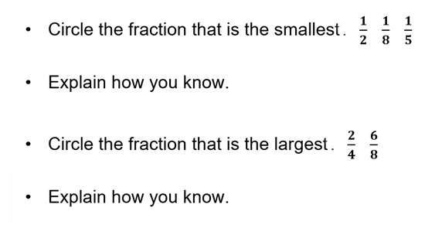
Relative size of fractions: Misconceptions
Students may have developed misconceptions about the relative size of unit fractions and/or common fractions.
These can usually be uncovered through a simple diagnostic assessment such as:
Notes:
Students may have developed misconceptions about the relative size of unit fractions and/or common fractions.
These can usually be uncovered through a simple diagnostic assessment such as the example on-screen. Students can sometimes choose the right answer for the wrong reason. It is important to make students explain the reasoning behind their choices, either in writing or by speaking, as this provides an insight into any faulty thinking.
We will now examine the thinking behind each misconception and explore strategies for addressing these.

Slide 33
Misconception 1
Relative size of unit fractions
Students may treat the numerators and denominators as separate whole numbers.
When comparing unit fractions, this leads to the misconception that the bigger the denominator, the larger the fraction.
For example, students may apply the whole-number thinking of ‘2 is smaller than 8’ and incorrectly conclude that:
✗
$\frac{1}{2}$ is smaller than $\frac{1}{8}$
Notes:
The first misconception relates to the relative size of unit fractions and results from students treating the numerators and denominators as separate whole numbers.
When comparing unit fractions, students who develop this misconception focus on the ‘size’ of the numeral in the denominator, believing that the bigger the denominator, the larger the fraction.
For example, students may apply the whole-number thinking of ‘2 is smaller than 8’ and incorrectly conclude that $\frac{1}{2}$ is smaller than $\frac{1}{8}$.

Slide 34
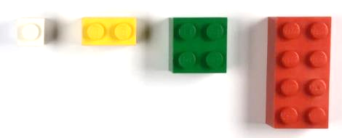
Addressing misconception 1
Relative size of unit fractions
Provide multiple opportunities for students to work with physical and visual models to create and compare unit fractions.
$\frac{1}{8}$
1 $\frac{1}{2}$
$\frac{1}{4}$
Notes:
To address misconceptions students may have developed about the relative size of unit fractions, provide multiple opportunities for them to work with physical and visual models to create and compare unit fractions.

Slide 35
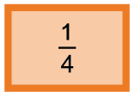
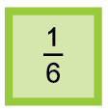
Addressing misconception 1
Relative size of unit fractions
By creating their own fraction wall, students develop their ability to visualise and understand that the more parts a whole is partitioned into, the smaller the size of each unit part.
Have students cut or fold the fraction strips to allow direct comparison of each unit fraction.
Notes:
Involving students in creating their own fraction wall helps them to develop visualisation skills to support the understanding that the more parts a whole is partitioned into, the smaller the size of each unit part.
To reinforce this, have students cut or fold the fraction strips to allow direct comparison of each unit fraction.

Slide 36
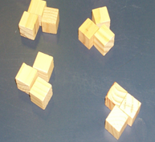
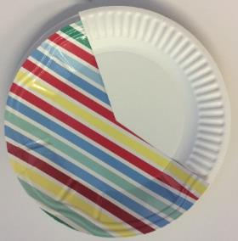
Addressing misconception 1
Relative size of unit fractions
The resources for this unit include two activities to improve students’ ability to visualise and compare the relative size of unit fractions:
Fractions warm-up routine
Fraction wheels
Notes:
Students require multiple opportunities for guided and individual practice across a range of contexts to improve their ability to visualise and compare the relative size of unit fractions.
The resources for this unit provide two activities to help students understand the relative size of unit fractions:
Fractions warm-up routine (using sets)
Fraction wheels (using an area model).

Slide 37
Misconception 2
Relative size of common fractions
Students may focus on the ‘helpful hint’ that ‘the larger the denominator, the smaller the fraction’, but fail to also consider the effect of the numerator on the size of the fraction.
For example, students may focus on the fact that sixths are smaller than halves without considering how many of each fractional part there are, and so incorrectly think:
✗
$\frac{5}{6}$ is smaller than $\frac{1}{2}$
Notes:
The second misconception relates to the relative size of common fractions and arises when students focus on the ‘helpful hint’ that ‘the larger the denominator, the smaller the fraction’. They fail to also take into account the effect of the numerator on the size of the fraction.
For example, students may focus on the fact that eighths are smaller than quarters without considering how many of each fractional part there are, and so incorrectly think $\frac{7}{8}$ is smaller than $\frac{2}{4}$.

Slide 38
Addressing misconception 2
Relative size of common fractions
Provide multiple opportunities for students to directly compare common fractions in a range of formats, e.g.
one whole
five-sixths
one-half
✓
$\frac{1}{2}$ is smaller than $\frac{5}{6}$
Notes:
To address this misconception and promote correct thinking, provide multiple opportunities for students to directly compare common fractions in a range of formats, e.g:
have students cut or fold fraction strips to allow direct comparison of given common fractions
use similar comparison strategies with sets of objects.

Slide 39
Key concept 4
Fraction words and symbols describe the relationship between the part/s and the whole.
Notes:
The final key concept we will examine in this unit is that fraction words and symbols describe the relationship between the part/s and the whole.

Slide 40
Verbal representations
Words before symbols
Initially, emphasise the meaning of fraction words rather than the symbolic form.
For example, when working with physical representations of sixths, students should be able to say:
The whole is divided into six equal parts, and each part is one­-sixth.
Gradually, students will develop the more complete idea that:
One-sixth is one of six equal parts of the whole.
(WA Dept of Education 2013, First Steps in Mathematics: Number — Book 1, p.117)
Notes:
Initially, emphasise the meaning of fraction words rather than the symbolic form.
For example, when working with physical representations of sixths, students should be able to say:
The whole is divided into six equal parts and each part is one-sixth.
Gradually, students will develop the more complete idea that:
One-sixth is one of six equal parts of the whole.
Reference: Western Australia Department of Education 2013, First Steps in Mathematics: Number — Book 1, p. 117, © Department of Education WA 2013, Licensed under CC BY-NC-ND 3.0.

Slide 41
Symbolic representations
Parts of the fraction symbol
The denominator tells us how many equal parts the whole has been divided into.
The numerator tells us how many parts have been chosen.
$$3$$
numerator
$$−$$
out of
$$8$$
denominator
Notes:
The symbolic representation of fractions is strongly linked to the meaning of the fraction.
Explicitly teach students the meaning behind each part of the fraction symbol as in the example on the screen.
The denominator tells us how many equal parts the whole has been divided into. In this case, there are 8 buttons or 8 parts.
The numerator tells us how many parts have been chosen and is written above the denominator.
The fraction symbol represents that three out of the eight parts are coloured purple.

Slide 42
Symbolic representations
Parts of the fraction symbol
The denominator tells us how many equal parts the whole has been divided into.
The numerator tells us how many parts have been chosen.
$$3$$
numerator
$$−$$
vinculum
$$8$$
denominator
Three out of eight parts are coloured purple.
Three-eighths of the buttons are purple.
Notes:
The vinculum or fraction bar is placed between the denominator and the numerator.
Our fraction is three-eighths. Three-eighths of the buttons are purple.

Slide 43
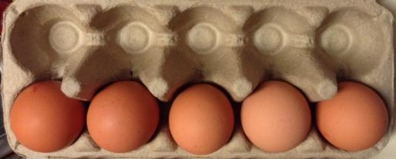
Describing fractions
Model how to describe fractions through using think-alouds and then encourage students to work through the process in pairs and on their own. For example:
What is the whole?
How many parts is it broken into?
Are the parts equal?
How many parts are selected?
What fraction is selected?
$$5$$
$$−$$
$$10$$
Notes:
Model how to use fraction words and symbols to describe the relationship between the part/s and the whole through the use of think-alouds as in the example on the screen.
That is:
What is the whole? – an egg carton
How many parts is it broken into? – 10 parts
Are the parts equal? – yes
How many parts are selected? – five parts
What is the fraction? – five-tenths, $\frac{5}{10}$
Then provide opportunities for students to build understanding by working through the process with other images or physical representations in pairs and on their own.

Slide 44
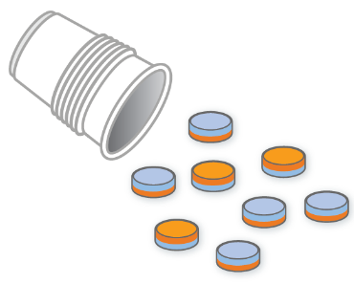
Describing fractions
Provide a range of contexts in which students can practise making and/or describing fractions.
The resources for this unit provide activities that incorporate a range of representations, e.g.
Creating and naming fractions with double-sided counters
Notes:
Students require guided and individual practice across a range of contexts to practise making and/or describing fractions.
The resources for this unit provide activities that incorporate a range of representations, e.g. Creating and naming fractions with double-sided counters.

Slide 45
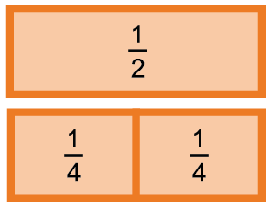
Describing fractions: Equivalent fractions
Equivalent fractions is a term used to describe the relationship between fractions when they represent the same number or quantity.
Fractions can have different numerators and denominators and represent the same share of the whole.
For example:
$$\frac{1}{2}$$
$$\frac{2}{4}$$
is the same as
Notes:
Equivalent fractions is a term used to describe the relationship between fractions when they represent the same number or quantity.
Fractions can have different numerators and denominators and represent the same share of the whole, as shown in the example on-screen.

Slide 46
Describing fractions: Equivalent fractions
Students can be taught fairly quickly to produce equivalent fractions by rote. However, they may forget just as easily because they have little conceptual understanding of what they are doing.
× 2
$$\frac{1}{2}$$
$$\frac{2}{4}$$
is the same as
× 2
Notes:
Students can be taught fairly quickly to produce equivalent fractions by rote. However, they may forget just as easily because they have little conceptual understanding of what they are doing.

Slide 47
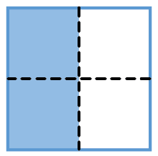
Describing fractions: Equivalent fractions misconception
Some students hold the misconception that the denominator must match the number of partitions of the whole and so will have difficulty comprehending equivalence. For example, these students won’t recognise that $\frac{2}{4}$is the same as $\frac{1}{2}$.
Notes:
Some students hold the misconception that the denominator must match the number of partitions of the whole and so will have difficulty comprehending equivalence.

Slide 48
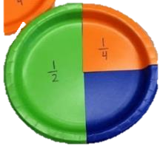
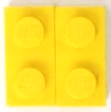
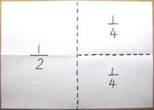
Addressing misconceptions: Equivalent fractions
Providing a range of physical representations for students to manipulate, create and talk about equivalent fractions has proven effective in developing a deep understanding and ensuring misconceptions do not arise.
$$\frac{1}{4}$$
$$\frac{1}{2}$$
$$\frac{1}{4}$$
$$\frac{2}{4}$$
$$\frac{1}{2}$$
is the same as
Notes:
Rather than showing students ‘short cuts’ for establishing equivalent fractions, provide a range of physical representations for students to manipulate, create and talk about equivalent fractions. This has proven effective in developing a deep understanding of equivalence and overcoming misconceptions.

Slide 49
Addressing misconceptions: Equivalent fractions
Diagnostic activity
Organise students into groups.
Give each group several ‘sandwiches’ of the same size drawn on sheets of paper.
Ask students to take half a sandwich each.
Do students accept two of the quarters as half a sandwich?
Do students think their piece is a ‘half’?
Ask students to explain their thinking to others in the group and then contribute to a teacher-led whole-class discussion. (Adapted from First Steps in Mathematics: Number — Book 1, p. 131)
Notes:
For some students, the connection between half and two is so strong that they believe you can only have halves if the whole is divided into exactly two pieces. This type of diagnostic activity challenges any existing misconceptions. It invites discussion — encouraging students to present their reasoning to each other. A whole-class discussion then allows the teacher to highlight key understandings essential to equivalence.

Slide 50
Extending fractional thinking
A deeper understanding of fractions can be developed by reversing the order of an investigation.
Whole to part Part to whole
Notes:
The final thing to consider when teaching fractions as part of a whole is how to extend student thinking.
We will examine one strategy for developing a deeper understanding — reversing the order of a ‘typical’ investigation.
That is, instead of starting with the whole and creating parts, start with a part and determine the whole.

Slide 51
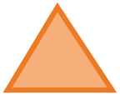
Extending fractional thinking
Part to whole: area model One strategy to deepen understanding of fractions of an area is to provide a fractional amount and ask students to find the whole.
For example, pose questions such as:
If a is $\frac{1}{4}$, build 1 whole.
If a is $\frac{1}{5}$, build 1 whole.
If a is $\frac{1}{2}$, build 3 wholes.
Notes:
One strategy to deepen understanding of fractions of an area is to provide a fractional amount and ask students to find the whole, as suggested by the example questions on-screen.

Slide 52
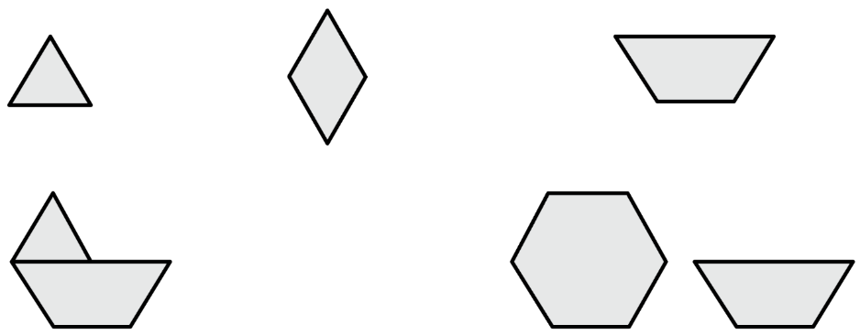
Extending fractional thinking
Challenge students further with questions such as:
If this shape is 1 whole
what fractions and mixed numbers do these shapes represent?
Notes:
The example on-screen provides another way of extending students’ fractional thinking.

Slide 53
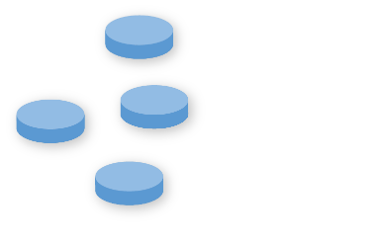
Extending fractional thinking
Part to whole: set model
Use counters to make a group.
Identify the group as a fraction of a whole set.
Four counters is one-half of a whole set.
Notes:
Similarly, deeper understanding of fractions of a set can be developed by reversing the order of the investigation as in the example provided, i.e.
1. Use counters to make a group — four counters.
2. Identify the group as a fraction of a whole set — four counters is one-half of a whole set of counters.

Slide 54
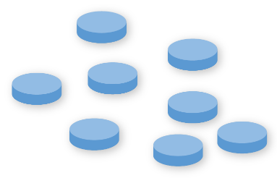
Extending fractional thinking
Part to whole: set model
Find the whole in relation to the specific fraction given.
Eight counters is one whole set.
Encourage mental calculation by asking students to visualise the counters in their mind as they explore solutions.
Notes:
3. Find the whole in relation to the specific fraction given — eight counters is one whole set.
Encourage mental calculation by asking students to visualise the counters in their mind as they explore solutions.

Slide 55
Review of Unit 2
Reflect on the work you have engaged with in this unit.
Key concept 1
Objects, collections or quantities can be partitioned into equal-sized parts or ‘shares’ to create fractions.
Key concept 2
Different strategies can be used to partition the whole into a given fraction, as long as the amount or size of the parts is the same.
Key concept 3
The more parts a whole is partitioned into, the smaller the size of each part.
Key concept 4
Fraction words and symbols describe the relationship between the part/s and the whole.
Notes:
Congratulations on completing Unit 2 in the course Foundational concepts in fractions.
On-screen is an overview of the main concepts addressed in this unit. The exploration of concepts included identifying:
common student misconceptions
teaching strategies to address misconceptions and develop conceptual understanding of fractions as part of a whole.
The unit also explored how to extend students’ thinking by reversing the order of an investigation.
Take some time to reflect on your key takeaways from this unit.

Slide 56
Review of Unit 2 success criteria
You should now be able to:
describe the key concepts underpinning fractional thinking
identify common student misconceptions
select teaching strategies to develop students’ understanding of fractions as part of a whole.
Notes:
After completing this unit, you should now be able to:
describe the key concepts underpinning fractional thinking
identify common student misconceptions
select teaching strategies to develop students’ understanding of fractions as part of a whole.
Reflect on the implications for your context. Use the questions on the next slide to guide your reflection.

Slide 57
Implications for your context
Review the notes you recorded in the Key concepts underpinning fractional thinking table:
Highlight your main ‘takeaways’.
Underline at least one key concept that you will focus on in the coming weeks to build student understanding. Consider
What key strategies will you incorporate to address existing misconceptions?
What representations will you include?
What questions will you ask to challenge thinking?
What will you do to extend student thinking?
You may also like to record this information in your Reflections on fractions summary document.
Notes:
Review the notes you recorded in the Key concepts underpinning fractional thinking table and:
highlight your key takeaways that may help address areas of difficulty for students that you identified at the start of this course
underline at least one key concept that you will focus on in the coming weeks to build student understanding. Consider
What key strategies will you incorporate to address existing misconceptions?
What representations will you include?
What questions will you ask to challenge thinking?
What will you do to extend student thinking?
You may also like to record this information in your Reflections on fractions document.

Slide 58
References
ClaradoodlaK, Ball of String Yarn, Pixabay, https://pixabay.com/photos/ball-of-string-string-yarn-ball-5447556.
Dgazdik, Egg Pack Food, Pixabay, https://pixabay.com/photos/egg-pack-food-egg-box-egg-carton-1505021.
Hungblueads, Banana, Pixabay, https://pixabay.com/illustrations/banana-banana-illustrator-4330436.
Jarmoluk, Apple Red Delicious, Pixabay, https://pixabay.com/photos/apple-red-delicious-fruit-256268.
— — Orange Fruit Vitamins Healthy, Pixabay, https://pixabay.com/photos/orange-fruit-vitamins-428070.
Jorgensen, R & Dole, S 2011, Teaching Mathematics in Primary Schools, 2nd edn, Allen & Unwin Academic, Crows Nest, NSW.
LeoNeoBoy, Buttons, Pixabay, https://pixabay.com/photos/buttons-colored-buttons-1821331.
Slvmarketing, Asphalt Tennis Court, https://pixabay.com/photos/asphalt-tennis-court-tennis-court-5354328.
StevenGiacomelli, Orange Fruit Quarter Fruit Sliced, Pixabay, https://pixabay.com/photos/orange-fruit-quarter-slice-sliced-1263821.
StockFreeImages, Licorice, www.stockfreeimages.com/5243641/Licorice.html.
Way, J n.d. ‘Big ideas’, Top Drawer Teachers Resource, Australian Association of Mathematics Teachers, https://topdrawer.aamt.edu.au/Fractions/Big-ideas. Used with permission.
Way, J n.d. ‘Misunderstandings’, Top Drawer Teachers Resource, Australian Association of Mathematics Teachers, https://topdrawer.aamt.edu.au/Fractions/Misunderstandings. Used with permission.
Western Australia Department of Education 2013, First Steps in Mathematics: Number — Book 1, http://det.wa.edu.au/stepsresources/detcms/education/stepsresources/first-steps-mathematics/number--book-1.en?cat-id=13603739.

Slide 59
Acknowledgments
© State of Queensland (QCAA) 2020
Licence: https://creativecommons.org/licenses/by/4.0 | Copyright notice: www.qcaa.qld.edu.au/copyright — lists the full terms and conditions, which specify certain exceptions to the licence. | Attribution: ‘© State of Queensland (QCAA) 2020’ — please include the link to our copyright notice.
Other copyright material in this publication is listed below:
Slide 2: Way, J n.d. ‘Big ideas’, Top Drawer Teachers Resource, Published by the Australian Association of Mathematics Teachers, https://topdrawer.aamt.edu.au/Fractions/Big-ideas. Used with permission.
Slide 7: Jorgensen, R & Dole, S 2011, Teaching Mathematics in Primary Schools, 2nd edn, Allen & Unwin Academic, Crows Nest, NSW.
Slide 15: Way, J n.d. ‘Misunderstandings’, Top Drawer Teachers Resource, Published by the Australian Association of Mathematics Teachers, https://topdrawer.aamt.edu.au/Fractions/Misunderstandings. Used with permission.
Slides 40 & 49: First Steps in Mathematics: Number — Book 1, © Department of Education WA 2013, Licensed under CC BY-NC-ND 3.0.

Slide 60
QCAA social media

