Slide 1
Foundational concepts in fractions
Unit 1: Fractional thinking through representations
Notes:
Welcome to the first unit in the Foundational concepts in fractions course.
In this unit, you will consider how to use mathematical representations to build fractional thinking.

Slide 2
Fraction constructs
Fractions as a part-whole (Years 1 and 2)
Fractions as a measure (Year 3)
Fractions as division (Year 6)
Fractions as operators (Year 6)
Fractions as ratios (Year 7)
F
1
2
3
4
5
6
7
Notes:
Fractions can be thought of in different ways. Fractions can represent five different but interrelated fraction constructs — fractions as a part-whole, fractions as a measure, fractions as division, fractions as an operator and fractions as a ratio.
Source: Adapted from Way, J n.d. ‘Big ideas’, Top Drawer Teachers: Resources for teachers of mathematics, Australian Association of Mathematics Teachers, https://topdrawer.aamt.edu.au/Fractions/Big-ideas.

Slide 3
Foundational concepts in fractions
Course overview
Fractional thinking through representations
Unit 1
Fractions as a part-whole Unit 2
Fractions as a measure Unit 3
Notes:
Foundational concepts in fractions rely on understanding the two fraction constructs shown on-screen: fractions as a part-whole and fractions as a measure. These are the focus of this course.
The main focus of Unit 1 is exploring the effective use of fractional representations that underpin the development of foundational concepts in fractions across Unit 2 and Unit 3.
Within this course, Unit 2 addresses fractions as a part-whole. Understanding this construct involves students participating in activities such as finding equal parts of shapes or of a group of objects.
Unit 3 is based on fractions as a measure. Students develop understanding of fractions as a measure through teaching and learning activities such as folding paper strips and locating fractions on a number line.

Slide 4
Before you begin
Create an electronic document with the title Reflections on fractions and record:
examples of where you and your students encounter fractions in everyday life
what most students in your context can do well when working with fractions
the areas where some students in your context experience difficulty when working with fractions.
Notes:
Before you begin this unit, create an electronic document with the title Reflections on fractions and record:
examples of where you and your students encounter fractions in everyday life
what most students in your context can do well when working with fractions
the areas where some students in your context experience difficulty when working with fractions.
You will be asked to refer back to this document later in the unit and across the course.

Slide 5
Learning goals
Develop understanding of foundational fractional concepts in Prep to Year 4.
Enhance targeted teaching strategies to improve student understanding.
Notes:
The learning goals for this unit are the same as for the entire course:
Develop understanding of foundational fractional concepts in Prep to Year 4.
Enhance targeted teaching strategies to improve student understanding.

Slide 6
Learning goals
Success criteria
Develop understanding of foundational fractional concepts in Prep to Year 4.
Enhance targeted teaching strategies to improve student understanding.
By the end of this unit, you should be able to:
describe why fractional thinking is important
explain the different representations of fractions that underpin fractional thinking
discuss some of the key considerations when using representations.
Notes:
Now consider the success criteria for this unit.
By the end of this unit, you should be able to:
describe why fractional thinking is important
explain the different representations of fractions that underpin fractional thinking
discuss some of the key considerations when using representations.

Slide 7
Online course learning goal
Take a moment to consider …
Where are you now?
Not using Beginning Developing Applying Innovating
Record your thoughts in your Reflections on fractions document.
Notes:
No matter where we currently are or what our role is, we all have the capacity to improve and build our understanding of fractional thinking.
Reflect on where you feel your understanding is currently, and record your thoughts in your Reflections on fractions document.

Slide 8
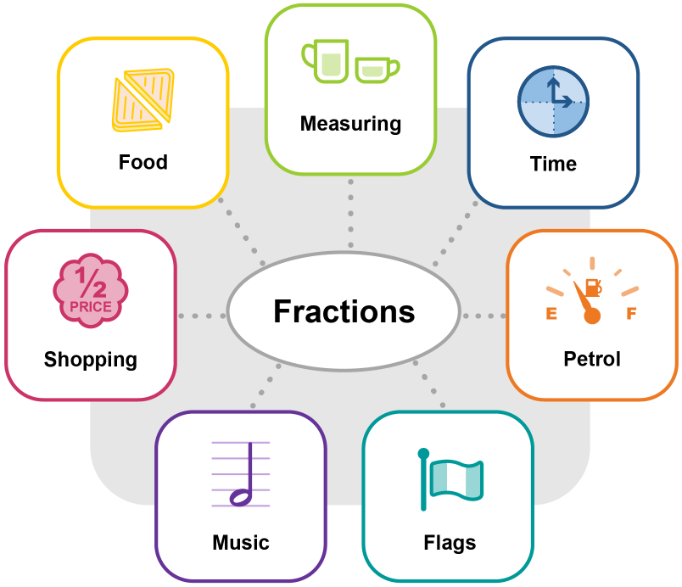
Why is fractional thinking important?
A key aspect of numeracy in the 21st century
Even young students are exposed to fractions in many areas of their everyday lives.
Notes:
Fractions are widely recognised as a key aspect of numeracy in the 21st century.
Even young students are exposed to fractions in many areas of their everyday lives.
You may have included many of the ideas shown on-screen as examples of where you and your students encounter fractions in everyday life. You may have included other everyday examples that reinforce the importance of fractional thinking.

Slide 9
Why is fractional thinking important?
Foundational for other mathematics content
‘Fractions both underpin the development of proportional reasoning and are important for future mathematics study, including that of algebra and probability.’
(Clarke, Roche & Mitchell 2008)
Notes:
Fractional thinking is also important because it develops the foundational understanding and skills necessary for many other mathematics content areas where proportional reasoning is required, including those shown on-screen: decimals, percentage, rates and ratios.
Reference: Clarke, D, Roche, A & Mitchell, A 2008, ‘10 practical tips for making fractions come alive and make sense’, Mathematics Teaching in the Middle School, vol. 13, no. 7, pp. 372–80.

Slide 10
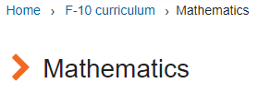
Why is fractional thinking important?
Fractional thinking in the Australian Curriculum
Fractional thinking is detailed in:
General capability Learning continuum of numeracy
Australian Curriculum: Mathematics
Notes:
Fractional thinking is detailed in the Australian Curriculum in both:
the General capability Learning continuum of Numeracy for the element Using fractions, decimals, percentages, ratios and rates
Reference: Australian Curriculum: Learning continuum of numeracy, ACARA,
www.australiancurriculum.edu.au/f-10-curriculum/general-capabilities/numeracy/learning-continuum/?element=Using%20fractions,%20decimals,%20percentages,%20ratios%20and%20rates
the learning area content of the Australian Curriculum: Mathematics within the Number and algebra content strand
Reference: Australian Curriculum: Mathematics, ACARA, www.australiancurriculum.edu.au/f-10-curriculum/mathematics. (Select ‘Foundation Year – Year 4’ in ‘Year Levels’ tab; select ‘Number and algebra’ from ‘Strands’ tab.)

Slide 11
Why is fractional thinking important?
Progression of early fractional thinking
By the end of Prep | Year 1 | Year 2 | Year 3 | Year 4
Australian Curriculum: Numeracy learning continuum | Australian Curriculum: Mathematics achievement standard
recognise that a whole object can be divided into equal parts |  | divide collections and shapes into halves, quarters and eighths | model and represent unit fractions | locate familiar fractions on a number line recognise common equivalent fractions
 | Australian Curriculum: Mathematics content descriptions
 | recognise and describe one-half as one of two equal parts of a whole | recognise and interpret common uses of halves, quarters and eighths of shapes and collections | model and represent unit fractions including $\frac{1}{2}, \frac{1}{4}, \frac{1}{3} , \frac{1}{5}$ and their multiples | investigate equivalent fractions count by quarters, halves and thirds, including with mixed numerals locate and represent these fractions on a number line
Source: Extract of Australian Curriculum © ACARA 2010–2019, licensed under CC BY 4.0
Notes:
The above table summarises the progression of early fractional thinking across the General capability Learning continuum of Numeracy and the Australian Curriculum: Mathematics for Prep to Year 4.
Note the progression in the complexity of the fractions students are working with: initially halves and quarters, then a range of unit fractions including $\frac{1}{2}, \frac{1}{4}, \frac{1}{3} , \frac{1}{5}$ and their multiples, before also including mixed numerals in Year 4.
The representations used to show understanding also progress from using physical materials to a range of models and representations. Number lines are specifically mentioned in the Year 4 achievement standard and the Year 3 elaborations (not shown on-screen).

Slide 12
The challenge of fractional thinking
Transitioning from whole-number to fractional thinking
Students’ early number sense experiences involve positive integers, and the transition from whole-number thinking to fractional thinking can be quite challenging.
(Way, n.d.)
Notes:
NAPLAN results have consistently identified fractional thinking as an area where Queensland students experience difficulty.
Jennifer Way describes the challenge of fractional thinking as arising from difficulties in transitioning from whole-number thinking.
Students’ early number sense experiences involve positive integers, and the transition from whole-number thinking to fractional thinking can be quite challenging.
Reference: Way, J n.d. ‘Fractions’, Top Drawer Teachers: Resources for teachers of mathematics, Australian Association of Mathematics Teachers, https://topdrawer.aamt.edu.au/Fractions.

Slide 13
The challenge of fractional thinking
Transitioning from whole-number to fractional thinking
Students may find it challenging to:
comprehend that there are additional numbers between 0 and 1 that are known as fractions
extend early fractional understanding beyond 1, to include improper fractions and mixed numerals.
These challenges can be addressed through carefully sequenced teaching and learning activities to develop a deep conceptual understanding of fractions or fraction sense.
(Way, n.d.)
Notes:
Students may find it challenging to:
comprehend that there are additional numbers between 0 and 1 that are known as fractions
extend early fractional understanding beyond 1, to include improper fractions and mixed numerals.
We can address these challenges through carefully sequenced teaching and learning activities to develop a deep conceptual understanding of fractions or fraction sense.
Reference: Way, J n.d. ‘Fractions’, Top Drawer Teachers: Resources for teachers of mathematics, Australian Association of Mathematics Teachers, https://topdrawer.aamt.edu.au/Fractions.

Slide 14
Addressing the challenge of fractional thinking
A focus on mathematical representations
‘Effective teaching of mathematics engages students in making connections among mathematical representations to deepen understanding of mathematics concepts and procedures and as tools for problem solving.’
(National Council of Teachers of Mathematics 2014)
Notes:
When addressing the challenge of fractional thinking, as in all other areas of mathematics, ‘[e]ffective teaching … engages students in making connections among mathematical representations to deepen understanding of mathematics concepts and procedures and as tools for problem solving’. (NCTM 2014, p. 24)
Reference: National Council of Teachers of Mathematics 2014

Slide 15
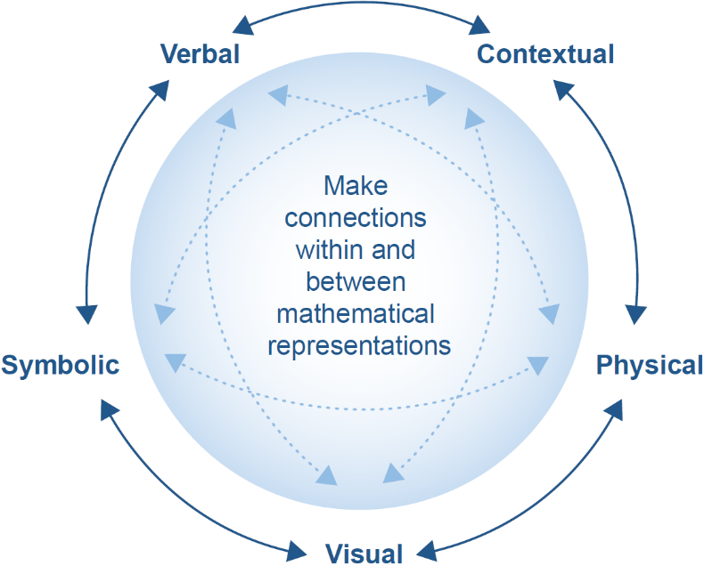
Mathematical representations
Students develop deep understanding when they are able to represent their thinking using physical materials, visuals and symbols, while using appropriate language in a suitable context.
Source: Adapted from National Council of Teachers of Mathematics, 2014
Notes:
The National Council of Teachers of Mathematics outlines the five types of mathematical representations students should be exposed to and encouraged to use.
Students develop a deep understanding when they represent their thinking using physical materials, visuals and symbols, while using appropriate language in a suitable context.
Reference: National Council of Teachers of Mathematics 2014, Principles to Actions: Ensuring mathematical success for all, National Council of Teachers of Mathematics, Reston, VA, p. 25.

Slide 16
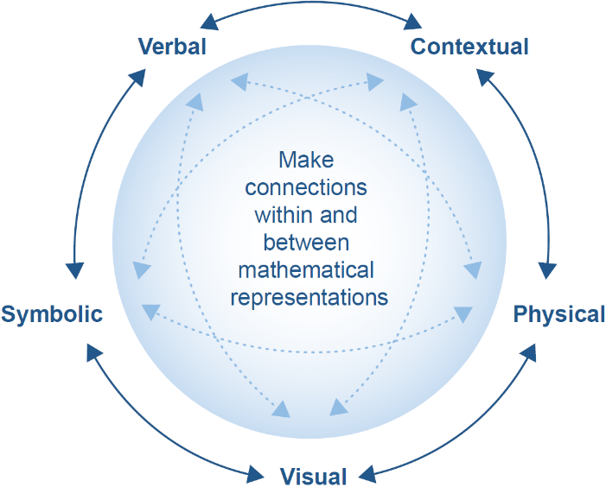
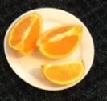
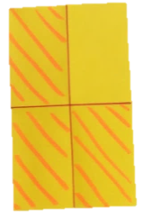
Mathematical representations
Examples of fractional representations
Three-quarters.
Three of four parts are left.
An orange is cut in four equal pieces. I eat one piece. What fraction of the orange is left?
$$\frac{3}{4}$$
Source: Adapted from National Council of Teachers of Mathematics, 2014
Notes:
Let’s consider examples of each of these fractional representations in turn:
Physical = tangible objects
Visual = pictures, sketches, can be based on physical representations
Symbolic = abstract form of maths — includes numerals and operation signs
Language = used to talk about all representation types
Contextual = realistic scenario in which the maths is situated and where students can see how the mathematics describes what is happening.
Representations provide a way for students to access what are often abstract ideas in mathematics. As educators, we need to explicitly plan for and provide opportunities for students to engage in making connections within and between mathematical representations.

Slide 17
Activity
Take a moment to:
open and/or print the A3 table Mathematical representations for fractional thinking
consider the different types of mathematical representations in the table and record current examples of fractional representations from your context.
Notes:
Before we look at some of these mathematical representations in detail:
open and/or print the A3 table Mathematical representations for fractional thinking
consider the different types of mathematical representations in the table and record current examples of fractional representations from your context.

Slide 18
Activity
As you work through the rest of the information in this unit, use this resource to:
add additional examples
record key considerations when using the various representations.
Notes:
As you work through the rest of the information in this unit, use this resource to:
add additional examples
record key considerations when using the various representations.
Continue adding to this resource as you work through the remaining two units in this course.

Slide 19
Mathematical representations
We will now examine four of the representation types related to fractional thinking in detail:
physical
verbal
visual
symbolic.
Notes:
As you work through each type, consider how you could provide a context that would make learning more meaningful for your students.

Slide 20
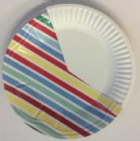
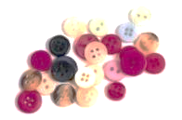
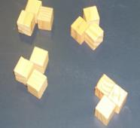
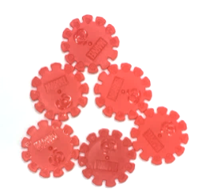
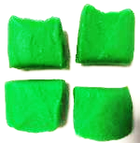
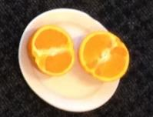
Physical representations
Physical representations fall into two major categories:
Objects
Continuous wholes that can be partitioned by measurement.
Sets or collections
A number of individual objects that collectively form a whole.
linear
area
volume
Based on WA Dept of Education 2013, First Steps in Mathematics: Number — Book 1
Notes:
We will begin by examining physical representations. These fall into two major categories:
objects — continuous wholes that can be partitioned by measurement. Objects can be partitioned by considering area, such as in paper shapes; linear measurement to partition things such as string and number lines; or volume, which would be used to partition objects such as playdough, fruit and even liquids
sets or collections — a number of individual objects that collectively form a whole, e.g. a bag of buttons, a group of blocks, a collection of toys.
Reference: Western Australia Department of Education 2013, First Steps in Mathematics: Number — Book 1, http://det.wa.edu.au/stepsresources/detcms/education/stepsresources/first-steps-mathematics/number--book-1.en?cat-id=13603739.

Slide 21
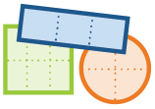
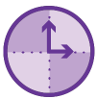
Physical representations
Objects
Folding
Example: paper
Cutting
Example: apple
Pouring
Example: liquids
Weighing
Example: playdough
Measuring
Example: time
Provide multiple opportunities to construct fractions through partitioning physical representations
Based on WA Dept of Education 2013, First Steps in Mathematics: Number — Book 1
Notes:
First Steps in Mathematics (2013) advises that, in order to promote deep understanding, students need to be provided with multiple opportunities to construct fractions through partitioning physical representations.
Partitioning objects should include experiences such as folding, cutting, pouring, weighing and measuring, as shown in the examples on-screen.
Reference: Western Australia Department of Education 2013, First Steps in Mathematics: Number — Book 1, http://det.wa.edu.au/stepsresources/detcms/education/stepsresources/first-steps-mathematics/number--book-1.en?cat-id=13603739.

Slide 22
Physical representations
Provide multiple opportunities to construct fractions through partitioning physical representations.
Collections
Dealing
Example: cards
Distributing
Example: lollies
Based on WA Dept of Education 2013, First Steps in Mathematics: Number — Book 1
Notes:
Also provide multiple opportunities to partition sets or collections to create fractions by dealing or distributing evenly.
Reference: Western Australia Department of Education 2013, First Steps in Mathematics: Number — Book 1, http://det.wa.edu.au/stepsresources/detcms/education/stepsresources/first-steps-mathematics/number--book-1.en?cat-id=13603739.

Slide 23
Verbal representations
one-fourth
Words before symbols
Initially, emphasise the meaning of fraction words, rather than the symbolic form.
For example, when working with physical representations of fourths, students should be able to say:
The whole paper shape is divided into four equal parts and each part is one-fourth of the whole shape.
Gradually, students will develop the more complete idea that:
One-fourth is one of four equal parts of the whole shape.
WA Dept of Education 2013, First Steps in Mathematics: Number — Book 1
Notes:
Verbal representations are integral to work performed with physical representations.
Initially, emphasise the meaning of fraction words rather than the symbolic form.
For example, when working with physical representations of fourths, students should be able to say:
The whole is divided into four equal parts and each part is one-fourth of the whole shape.
Gradually, students will develop the more complete idea that:
One-fourth is one of four equal parts of the whole shape.
Reference: Western Australia Department of Education 2013, First Steps in Mathematics: Number — Book 1, http://det.wa.edu.au/stepsresources/detcms/education/stepsresources/first-steps-mathematics/number--book-1.en?cat-id=13603739.

Slide 24
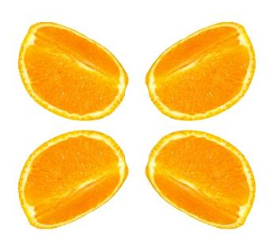
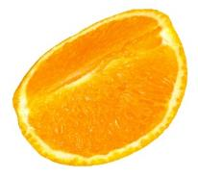
Verbal representations
Reinforce the notion of the ‘whole’ through the language you use to describe the partitions in relation to the whole.
This is one-half of one whole sandwich.
This is one-fourth of one whole orange.
Notes:
As students explore how real-world examples of wholes can be equally partitioned, reinforce the notion of the ‘whole’ through the language you use to describe the partitions in relation to the whole.
Rather than saying ‘this is a half’, say ‘this is one-half of one whole sandwich’.
When talking about quarters, it is also correct to use ‘fourths’. Using fourths may help students to make the connection with how many pieces the whole is broken into.
Source: Orange Fruit Quarter Slice Sliced, by Steven Giacomelli.

Slide 25
Visual representations
Visual representations help students to think mathematically, explain their ideas and solve problems.
It is important that students are able to both interpret existing visual representations and create their own visual representations of fractions.
The whole is a paper square.
It is divided into four equal parts.
Each part is one-fourth.
One-fourth of the paper is white.
Three-fourths of the whole paper are green.
Notes:
Visual representations help students to think mathematically, explain their ideas and solve problems. It is important that students are able to both interpret existing visual representations and create their own visual representations of fractions.
Consider the example on-screen of a folded and coloured square of paper. We want students to be able to verbally describe this example as a basis for the cognition they need to create a visual representation. A verbal description would be similar to this:
The whole is a paper square.
It is divided into four equal parts.
Each part is one-fourth.
One-fourth of the paper is white.
Three-fourths of the paper are green.

Slide 26
Visual representations
Using teacher think-alouds* explicitly models for students:
how to create visual representations of fractions
the language of fractions
the connections among mathematical representations.
Notes:
Using teacher think-alouds* is a powerful strategy for building students’ understanding of how to create and interpret visual representations. Teachers should explicitly model for students:
how to create visual representations of fractions
the language of fractions, and
the connections among mathematical representations.
*Think-alouds: Think-alouds involve teachers voicing their thinking processes aloud during the teaching of a concept or process. In mathematics, teachers use think-alouds when unpacking a question, modelling a strategy or as part of the process of solving a mathematical problem. The intention is to make the implicit thinking underlying the mathematics visible to students.

Slide 27
Visual representations
A group of eight students is asked to sit at the front of the class. Each student is given a large coloured card to hold. Six cards are white and two are green.
Teacher think-aloud | Representations
The whole group has eight parts, so I need to draw eight. Students, can you organise yourselves in two rows so it is easier for me to draw you. | Students organise themselves into two rows of four.
I am going to represent each one in the group with a circle to make it easy to draw. So I draw the four at the back and then the four in front of them.
Let’s check together: the whole has (count the parts) eight parts, and so each part is one-eighth. | Write: The whole has eight parts. Each part is one-eighth.
Look at the cards each person is holding. Two are green and the others are white. So two parts of the group need to be coloured green.
Two parts out of eight parts are green. That means that two-eighths are green. | Write: Two parts out of eight parts are green. Two-eighths are green.
Notes:
Consider this example of how a think-aloud could be used to model the connection between physical, verbal and visual representations for students. It is based on the context of a group of students in the classroom.
Ask the group to sit at the front of the class to help students visualise as you are talking. In the example, eight students are each given a large coloured card to hold. Six cards are white and two are green. The size of the group or the proportion of coloured cards could be varied.

Slide 28
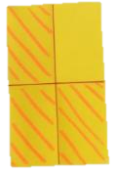
Visual representations
Physical representations constructed by students are effective models on which to base visual representations. Use verbal prompts to draw attention to how to transform a physical model into a visual representation.
Physical representation | Verbal prompts | Visual representation
 | What shape is the paper? How many pieces have you made by folding it? What shape are the pieces? How are they organised? How many of the pieces are shaded?
 | How many pieces of chocolate have you placed in the collection? How many pieces are covered in pink foil? How can we organise the collection to better show the relationship between the whole and the coloured parts?
or
Notes:
Physical representations constructed by students are effective models on which to base visual representations.
Think-alouds are an effective way to draw students’ attention to the way objects and sets have been partitioned. Many students also require additional verbal prompts to draw attention to how to transform a physical model into a visual representation by focusing on the shape and organisation of partitions.
Examples are provided in the table on-screen.

Slide 29
Visual representations
Providing pre-partitioned shapes for students to name or colour a given fraction means that they don’t have to visualise how the shape could be partitioned evenly to create fractional parts.
This may create a barrier to developing an understanding of the part-whole nature of fractions.
Consider the deeper level of thinking required to answer these types of questions:
What fraction of the shape is shaded?
What fraction of the shape is shaded?
Colour one-third of the shape.
Notes:
Providing pre-partitioned shapes for students to name or colour a given fraction means that they don’t have to visualise how the shape could be partitioned evenly to create fractional parts.
In the first example using the pre-partitioned circle, students could simply count the number of shaded parts without recognising the fractional relationship between the parts and the whole.
This may become a barrier to developing an understanding of the part-whole nature of fractions.
Consider the deeper level of thinking required to answer the question at the bottom of the screen. Students must first decide how the shape is being equally partitioned and then name or create the fraction.

Slide 30
Symbolic representations
Parts of the fraction symbol
The denominator tells us how many equal parts the whole has been divided into.
The numerator tells us how many parts have been chosen.
$$3$$
numerator
$$−$$
out of
$$8$$
denominator
Notes:
As discussed earlier, the symbolic representation is only introduced once students are very familiar with the verbal representations and the connection to physical and visual representations.
The symbolic representation of fractions is strongly linked to the meaning of the fraction.
Explicitly teach students the meaning behind each part of the fraction symbol as in the example on the screen.
The denominator tells us how many equal parts the whole has been divided into. In this case, there are 8 buttons or 8 parts.
The numerator tells us how many parts have been chosen and is written above the denominator.
The fraction symbol represents that 3 out of the 8 parts are coloured purple.

Slide 31
Symbolic representations
Parts of the fraction symbol
The denominator tells us how many equal parts the whole has been divided into.
The numerator tells us how many parts have been chosen.
$$3$$
numerator
$$−$$
vinculum
$$8$$
denominator
Three out of eight parts are coloured purple.
Three-eighths of the buttons are purple.
Notes:
The vinculum or fraction bar is placed between the denominator and the numerator.
Our fraction is three-eighths. Three-eighths of the buttons are purple.

Slide 32
Symbolic representations
Types of fractions
Unit fractions
A unit fraction is a fraction with a numerator of 1, e.g. $\frac{1}{2}$ and $\frac{1}{4}.$
Common fractions
Common fractions are fractions that are less than 1, e.g. $\frac{2}{4}$ and $\frac{3}{4}.$
Students in Prep to Year 3 work largely with unit and common fractions.
Notes:
There are four main categories of fractions. Students in Prep to Year 3 work largely with unit and common fractions.
A unit fraction is a fraction whose numerator is one, e.g. $\frac{1}{2}$ and $\frac{1}{4}$.
Common fractions are fractions that are less than one, e.g. $\frac{2}{4}$ and $\frac{3}{4}$ .

Slide 33
Symbolic representations
Types of fractions
Improper fractions
Improper fractions are fractions that are greater than 1, e.g. $\frac{6}{4}$.
Mixed fractions
Mixed fractions are a combination of a whole number and a proper fraction, e.g. 1 $\frac{1}{2}$.
Improper and mixed fractions are formally introduced in the Australian Curriculum: Mathematics in Year 4.
However, students may have some experience of these in earlier year levels in problem-solving situations.
Notes:
Improper fractions are fractions that are greater than 1, e.g. $\frac{6}{4}$ and $\frac{5}{3}$.
Mixed fractions are a combination of a whole number and a proper fraction, e.g. 1 $\frac{1}{2}$.
Improper and mixed fractions are formally introduced in the Australian Curriculum: Mathematics in Year 4.
However, students may have some experience of these in earlier year levels in problem-solving situations.

Slide 34
Review of Unit 1
Reflect on the work you have engaged with in this unit.
Importance of fractional thinking
Important aspect of numeracy in the 21st century
Key mathematics concept
Underpins many other mathematics content areas
Notes:
Congratulations on completing the first unit in the course Foundational concepts in fractions.
As you work through this brief review of the main concepts addressed in Unit 1, take some time to reflect on your key takeaways from the unit.
Unit 1 began with a review of the importance of fractional thinking. Key points included:
fractions are widely recognised as an important aspect of numeracy in the 21st century, and even young students are exposed to fractions in many areas of their everyday lives
fractional thinking is a key mathematics concept detailed in the Australian Curriculum in:
– the General capability Learning continuum of Numeracy
– the learning area content of the Australian Curriculum: Mathematics
fractional thinking is also important because it develops the foundational understanding and skills necessary for many other mathematics content areas.

Slide 35
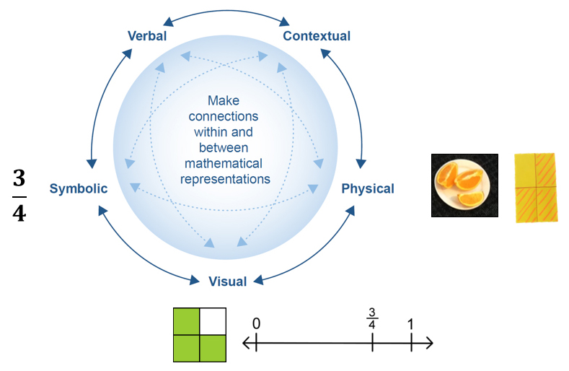
Review of Unit 1
Planned teaching and learning experiences support students to represent their fractional thinking using physical materials, visuals, symbols and appropriate language in a suitable context.
Three-quarters.
Three of four parts are left.
An orange is cut in four equal pieces. I eat one piece. What fraction of the orange is left?
Source: Adapted from National Council of Teachers of Mathematics, 2014
Notes:
The unit then examined the different representations of fractions that underpin fractional thinking and explored some of the key considerations when using representations in teaching and learning experiences.
Reference: National Council of Teachers of Mathematics 2014, Principles to Actions: Ensuring mathematical success for all, National Council of Teachers of Mathematics, Reston, VA.

Slide 36
Review of Unit 1 success criteria
You should now be able to:
describe why fractional thinking is important
explain the different representations of fractions that underpin fractional thinking
discuss some of the key considerations when using representations.
Notes:
In completing this unit, you should now be able to:
describe why fractional thinking is important
explain the different representations of fractions that underpin fractional thinking
discuss some of the key considerations when using representations.
Take some time now to reflect on the implications for your context. Use the questions on the next slide to guide your reflection.

Slide 37
Implications for your context
Review the two documents Reflections on fractions and Mathematical representations for fractional thinking.
What else can you now add?
Choose at least one area of fractions where your students are experiencing difficulty. Plan to address this in the next 10 days. Consider:
What representation/s will you focus on — physical, visual, verbal, contextual and/or symbolic?
What resources will you incorporate?
What questions will you ask to encourage discussion and challenge student thinking?
Notes:
Reflect on the work you have engaged with in this unit and record any new learnings in your Reflections on fractions document.
Choose at least one area of fractions where your students are experiencing difficulty. Plan to address this in the next 10 days. Consider:
What representation/s will you focus on — physical, visual, verbal, contextual and/or symbolic?
What resources will you incorporate?
What questions will you ask to encourage discussion and challenge student thinking?

Slide 38
References
Australian Curriculum: Learning continuum of numeracy, ACARA, www.australiancurriculum.edu.au/f-10-curriculum/general-capabilities/numeracy/learning-continuum/?element=Using%20fractions,%20decimals,%20percentages,%20ratios%20and%20rates.
Australian Curriculum: Mathematics, ACARA, www.australiancurriculum.edu.au/f-10-curriculum/mathematics.
Clarke, D, Roche, A & Mitchell, A 2008, ‘10 practical tips for making fractions come alive and make sense’, Mathematics Teaching in the Middle School, vol. 13, no. 7, pp. 372–80, https://opencuny.org/citycollegespring2015/files/2015/02/Practical-tips-for-Fracations.pdf.
Extract of Australian Curriculum © ACARA 2010–2019, licensed under CC BY 4.0. For the latest information and additional terms of use, please check the Australian Curriculum website and its copyright notice.
Giacomelli, S n.d. Orange Fruit Quarter Slice Sliced, Pixabay, https://pixabay.com/photos/orange-fruit-quarter-slice-sliced-1263821.
National Council of Teachers of Mathematics 2014, Principles to Actions: Ensuring mathematical success for all, National Council of Teachers of Mathematics, Reston, VA.
Suh, J, Johnston, C, Jamieson, S & Mills, M 2008, ‘Promoting decimal number sense and representational fluency’, Mathematics Teaching in the Middle School, vol. 14, no. 1, pp. 44–50, http://mason.gmu.edu/~jsuh4/MTMS2008-08-44a.decimal.pdf.

Slide 39
References
Way, J n.d. ‘Big ideas’, Top Drawer Teachers: Resources for teachers of mathematics, Australian Association of Mathematics Teachers, https://topdrawer.aamt.edu.au/Fractions/Big-ideas.
Way, J n.d. ‘Fractions’, Top Drawer Teachers: Resources for teachers of mathematics, Australian Association of Mathematics Teachers, https://topdrawer.aamt.edu.au/Fractions.
Western Australia Department of Education 2013, First Steps in Mathematics: Number — Book 1, http://det.wa.edu.au/stepsresources/detcms/education/stepsresources/first-steps-mathematics/number--book-1.en?cat-id=13603739.

Slide 40
Acknowledgments
© State of Queensland (QCAA) [2020]
Licence: https://creativecommons.org/licenses/by/4.0 | Copyright notice: www.qcaa.qld.edu.au/copyright — lists the full terms and conditions, which specify certain exceptions to the licence. | Attribution: ‘© State of Queensland (QCAA) [2020]’ — please include the link to our copyright notice.
Other copyright material in this publication is listed below:
Slide 2: Adapted from Way, J n.d. ‘Big ideas’, Top Drawer Teachers: Resources for teachers of mathematics, Australian Association of Mathematics Teachers, https://topdrawer.aamt.edu.au/Fractions/Big-ideas. Used with permission.
Slide 9: Clarke, D, Roche, A & Mitchell, A 2008, ‘10 practical tips for making fractions come alive and make sense’, Mathematics Teaching in the Middle School, vol. 13, no. 7, pp. 372–80, https://opencuny.org/citycollegespring2015/files/2015/02/Practical-tips-for-Fracations.pdf.
Slide 11: ‘Extract of Australian Curriculum © ACARA 2010–2019, licensed under CC BY 4.0. For the latest information and additional terms of use, please check the Australian Curriculum website and its copyright notice.
Slides 12–13: Way, J n.d. ‘Fractions’, Top Drawer Teachers: Resources for teachers of mathematics, Australian Association of Mathematics Teachers, https://topdrawer.aamt.edu.au/Fractions. Used with permission.
Slides 14–16 & 35: National Council of Teachers of Mathematics 2014, Principles to Actions: Ensuring mathematical success for all, National Council of Teachers of Mathematics, Reston, VA.

Slide 41
Acknowledgments
© State of Queensland (QCAA) [2020]
Licence: https://creativecommons.org/licenses/by/4.0 | Copyright notice: www.qcaa.qld.edu.au/copyright — lists the full terms and conditions, which specify certain exceptions to the licence. | Attribution: ‘© State of Queensland (QCAA) [2020]’ — please include the link to our copyright notice.
Other copyright material in this publication is listed below:
Slides 20–23: Western Australia Department of Education 2013, First Steps in Mathematics: Number —Book 1, http://det.wa.edu.au/stepsresources/detcms/education/stepsresources/first-steps-mathematics/number--book-1.en?cat-id=13603739. © Department of Education WA 2013, Licensed under CC BY-NC-ND 3.0.
Slide 21: Graphic derived from principles expressed in p.104, First Steps in Mathematics: Number —Book 1, © Department of Education WA 2013, Licensed under CC BY-NC-ND 3.0.

Slide 42
QCAA social media

